Slide 1
Low Latency Geo-distributed
Data Analytics
Q. Pu, G. Ananthanarayanan, P. Bodik et al.
SIGCOMM’15
Presented by: Mohammad Noureddine
CS 538 Spring’16

Slide 2
Introduction
Geo-distributed data centers handle large datasets
They generate huge amounts of data
Organizations run queries on data centers
  User logs for advertisement
  Network logs for anomaly detection
  System logs for health monitoring
Response time is very critical

Slide 3

Centralized Paradigm
WAN
London
Berkeley
Inefficient and very costly operation
Illinois
Beijing

Slide 4
Single Logical Unit
WAN
London
Berkeley
Illinois
Beijing

Slide 5
Challenges
Up and Down links at datacenters are heterogeneous
  Very fast links and bottleneck links
Where should we place our tasks?
  Choose destination of network transfers
Where should we place our data?
  Choose source of network transfers
We also care about WAN usage
  Moving data around is expensive

Slide 6
Outline
Formal Setting
Motivating Examples
Proposed Solution
Experimental Setting
Results
Conclusion and Discussion

Slide 7
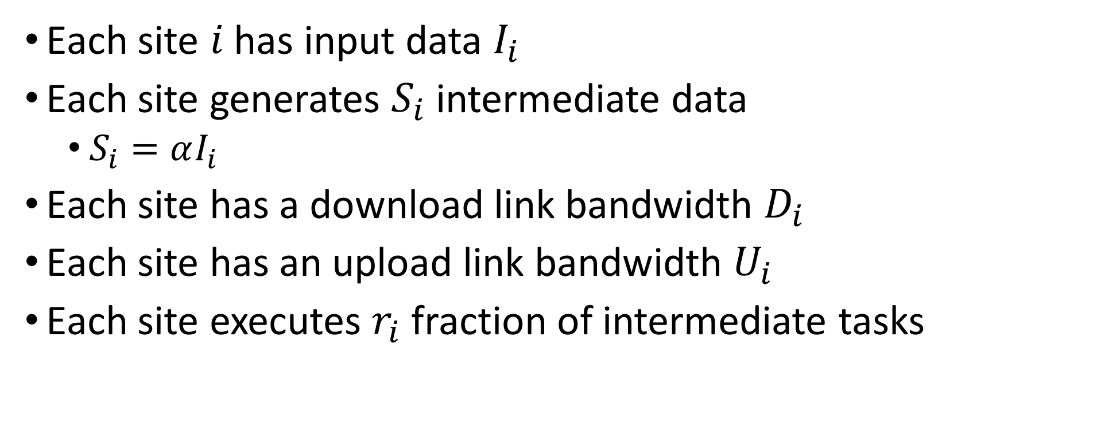
Formal Setup
Each site $i$ has input data $I_{i}$
Each site generates $S_{i}$ intermediate data
  $S_{i}=αI_{i}$
Each site has a download link bandwidth $D_{i}$
Each site has an upload link bandwidth $U_{i}$
Each site executes $r_{i}$ fraction of intermediate tasks

Slide 8
Putting Things in Context
1 MB/s
10 MB/s
WAN
London
10 MB/s
10 MB/s
Berkeley
10 MB/s
10 MB/s
10 MB/s
10 MB/s
Illinois
Beijing

Slide 9
Task Placement Comparison
Equal Distribution
(0.33, 0.33, 0.33)
Optimized Distribution
(0.05, 0.475, 0.475)

Slide 10
Data Placement Comparison
Data in place
(0.1, 0.45, 0.45)
Optimized data placement
(0, 0.85, 0.15)

Slide 11
Iridium
Ultimate goal is to reduce query response time
Solve optimal task placement to identify bottlenecks
  Minimize longest transfer of all links
Find amount of data to move to handle bottlenecks
  Joint task-data optimization is non-convex
Be mindful of WAN bandwidth constraints

Slide 12
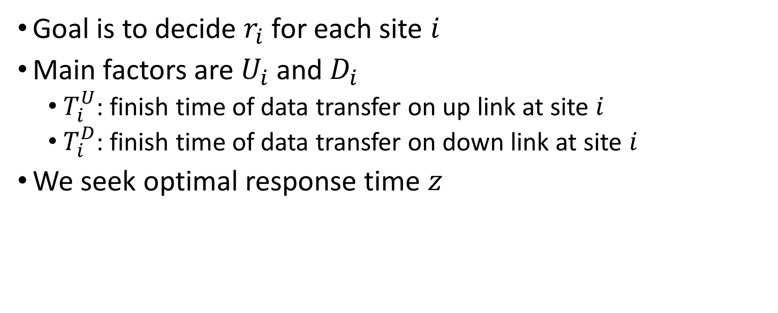
Task Placement Optimization
Goal is to decide $r_{i}$ for each site $i$
Main factors are $U_{i}$ and $D_{i}$
  $T_{i}^{U}$: finish time of data transfer on up link at site $i$
  $T_{i}^{D}$: finish time of data transfer on down link at site $i$
We seek optimal response time $z$

Slide 13

Optimization Problem
Linear Programming optimization problem
Identifies optimum response time $z$
Obtain bottleneck sites for free

Slide 14
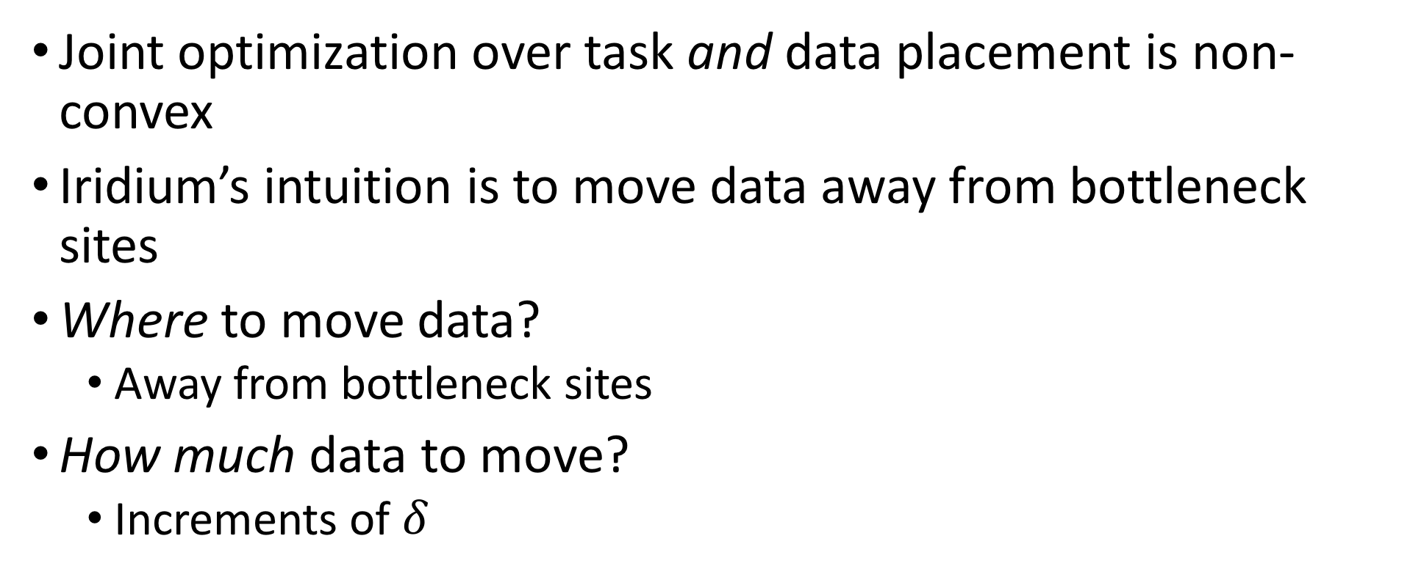
Data Placement Optimization
Joint optimization over task and data placement is non-convex
Iridium’s intuition is to move data away from bottleneck sites
Where to move data?
  Away from bottleneck sites
How much data to move?
  Increments of $δ$

Slide 15
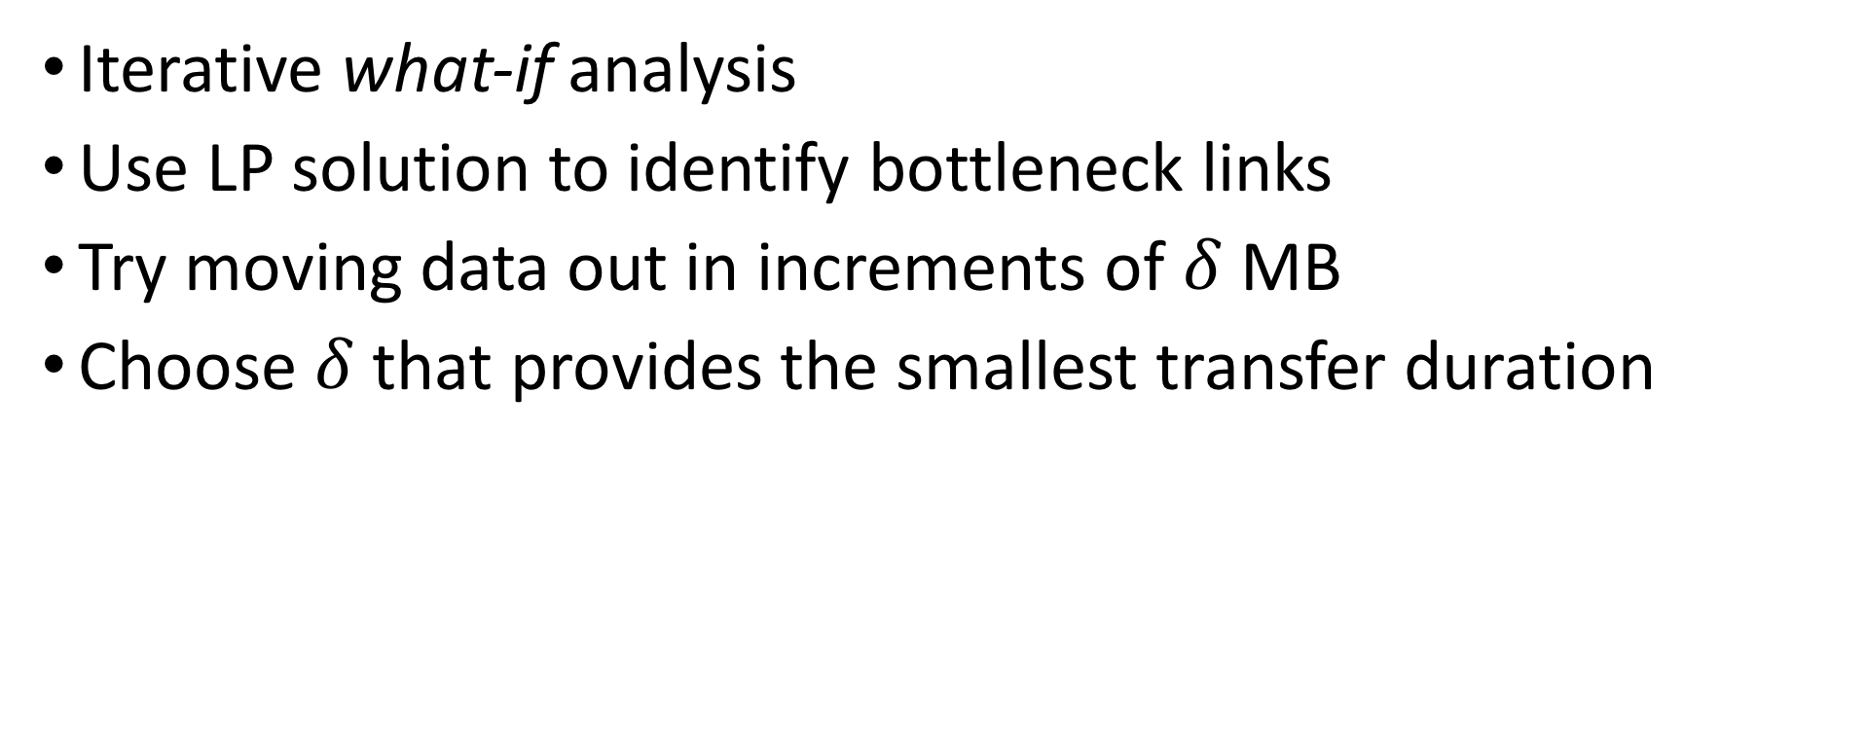
Data Placement Heuristic
Iterative what-if analysis
Use LP solution to identify bottleneck links
Try moving data out in increments of $δ$ MB
Choose $δ$ that provides the smallest transfer duration

Slide 16
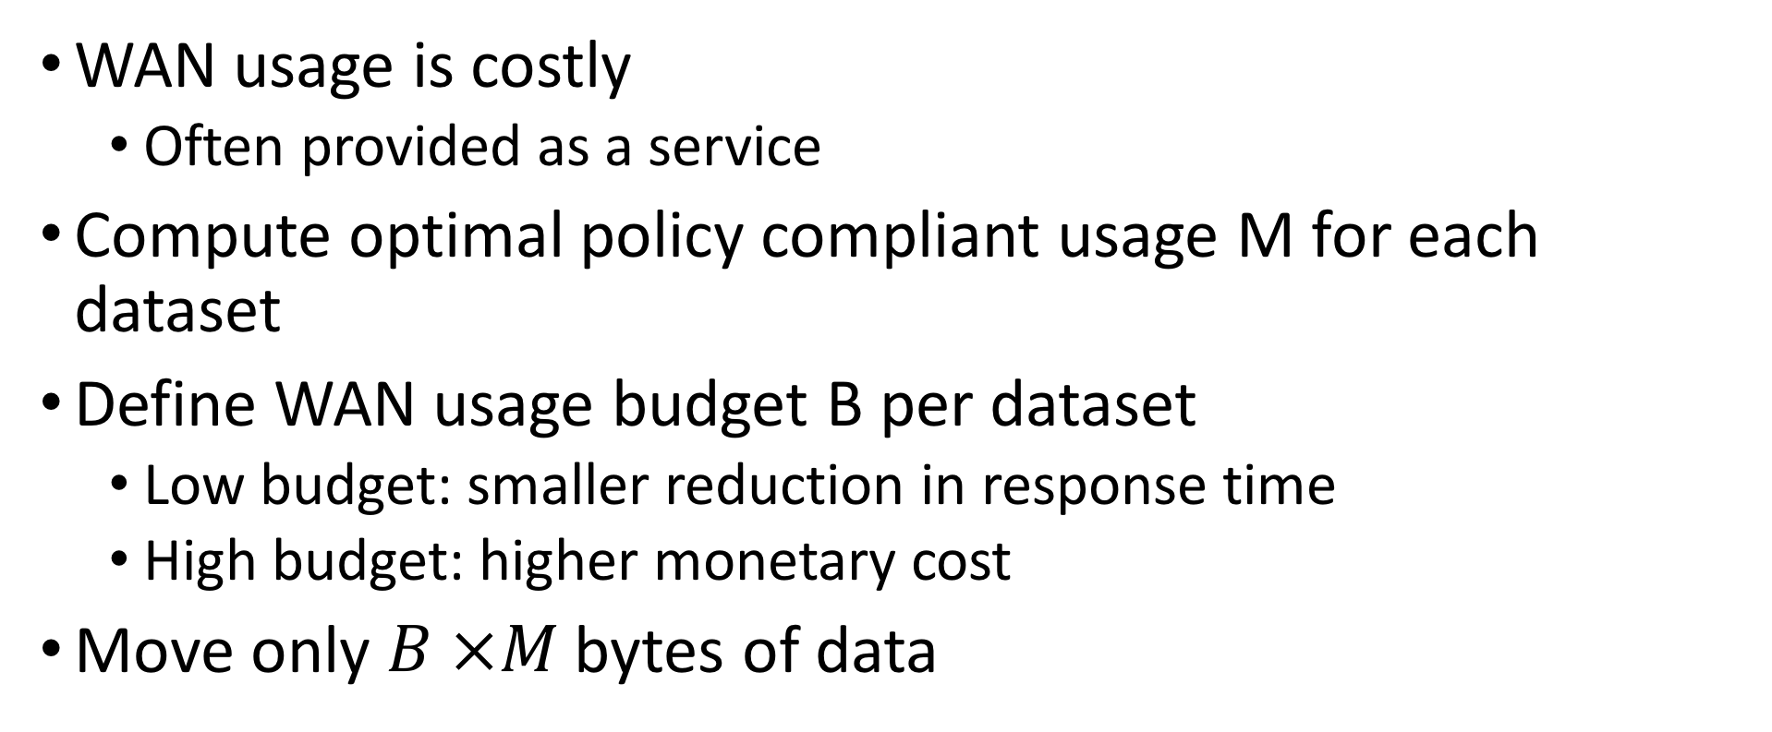
Bandwidth Constraints
WAN usage is costly
  Often provided as a service
Compute optimal policy compliant usage M for each dataset
Define WAN usage budget B per dataset
  Low budget: smaller reduction in response time
  High budget: higher monetary cost
Move only $B ×M$ bytes of data

Slide 17
Experimental Setup
Actual EC2 implementation on top of Apache Spark
  Eight regions across five continents
  Mimic larger setup with 30 sites within one region
Used four benchmarks (Conviva, Bing, etc.)
150 sites simulator setup
  Trace driven simulation from Facebook’s Hadoop cluster
Compare against “in-place” and “centralized” policies
Metric is % reduction in average response time

Slide 18
EC2 Results

Slide 19
Simulator Results

Slide 20
Bandwidth Allocation
Compare to MinBW that optimizes WAN usage
Not a very fair comparison.
MinBW has different goals

Slide 21
Conclusion
Iridium is a system that
  Optimizes task and data allocation for queries in geo-located data centers
  Optimization done with WAN bandwidth budget constraints
Iridium reduces query response time by 3x – 19x on the benchmarks

Slide 22
Discussion
Iridium assumes unlimited intra-datacenter bandwidth
Iridium assumes infinite compute and storage resources
  The proposed LP problem no longer holds
How do we handle heterogeneous tasks?
  Tasks with different or no intermediate data generation
Can we solve an approximate problem instead of using heuristics?
  In which cases are the heuristics non-optimal?

