Slide 1
NOVA: A Log-structured File System for Hybrid Volatile/Non-volatile Main Memories
J. Xu et al, FAST ‘16
Presenter: Rohit Sarathy
April 18, 2017

Slide 2
NVMM Challenges
Performance
Write reordering
Atomicity
Notes:
Intel’s NVMM new technologies promise to revolutionize I/O performance.
Performance = tradeoffs between software and hardware latency
Software costs can dominate memory latency
Power failures are a challenge for write reodering
Atomicity needed for posix compliance
Disks and processor have small atomicity guarantees

Slide 3
NOVA’s contributions
Extends existing log-structured file system techniques
Atomic-mmap
Adaptable across many NVMM systems

Slide 4
Why LFS?
Log-structuring provides cheaper atomicity than journaling and shadow paging
NVMM supports fast, highly concurrent random accesses
Notes:
https://www.usenix.org/sites/default/files/conference/protected-files/fast16_slides_xu.pdf

Slide 5
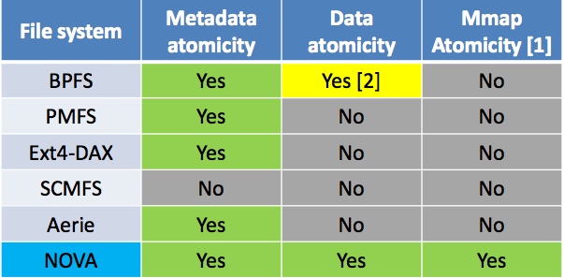
Comparison with other NVMMs
Notes:
https://www.usenix.org/sites/default/files/conference/protected-files/fast16_slides_xu.pdf

Slide 6
NOVA Design
Maintain logs in NVMM and indexes in DRAM
Each inode has its own log
Utilize logging and lightweight journaling for complex atomic updates
Implement the log as a singly linked list
No logging of file data
Notes:
Images and header bullet points from https://www.usenix.org/sites/default/files/conference/protected-files/fast16_slides_xu.pdf

Slide 7
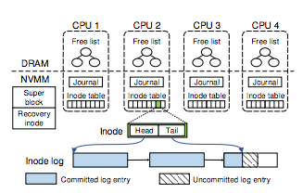
NVMM Data Structures
Divides the NVMM into 4 parts (superblock and recovery inode, inode tables, journals, log/data pages
Figure 1: NOVA data structure layout

Slide 8
Inode Table
2 MB block array of inodes
Aligned on 128-byte boundary
If inode table is full, build a linked list of 2 MB subtables
Inode contains valid bit, NOVA reuses invalid nodes for new files and directories
Log is linked list of 4KB pages
Each inode has pointers to head and tail of its corresponding log

Slide 9
Journal
4KB circular buffer
Managed with an <enqueue, dequeue> ptr pair
Only one open transaction allowed per core
Kernel VFS locks all affected inodes to protect concurrent transactions

Slide 10
Space Management
NOVA divides NVMM into pools (one per CPU)
If no pages free, allocate from largest pool
Use a red-black tree to maintain free list sorted by address
Allocator state not stored in NVMM
Allocates log space aggressively to avoid resizes
If full, allocate new pages for double the log space

Slide 11
Atomicity and write ordering
64-bit atomic updates
Logging
Lightweight journaling
Enforce write ordering
Commit data and log entries to NVMM
Commit journal entries to NVMM
Commit new versions of data pages to NVMM
new_tail = append_to_log(inode->tail, entry);
// writes back the log entry cachelines
clwb(inode->tail, entry->length);
sfence(); // orders subsequent PCOMMIT
PCOMMIT(); // commits entry to NVMM
sfence(); // orders subsequent store
inode->tail = new_tail;
Pseudocode for enforcing write ordering. If NOVA runs on a system that supports clfushopt(), clwb() and PCOMMIT operations, it will use the above code.

Slide 12
Directory Operations
Closely linked to application performance
NOVA directories = NVMM inode log + DRAM radix tree
Log has two entries: dentry and inode update entries
Use dentry timestamp to atomically update directory inode’s mtime and ctime

Slide 13
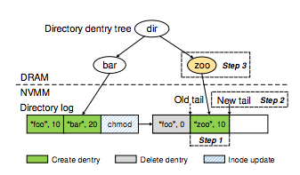
Directory Operations
Create
Append dentry to directory log
Update log tail (transaction)
Update radix tree
Delete (Linux)
Decrement link count of file inode
Remove file from directory
Delete (NOVA)
Append delete dentry log entry to directory
Append inode update entry
Use journaling to atomically update both log tails
Propagate changes in DRAM radix tree

Slide 14
Atomic File Operations
Inode log records metadata changes
Radix tree in DRAM to locate file data by file offset
Large writes are broken into multiple write requests, all appended in single update
Reads: update access time with atomic write, and copy data to user buffer

Slide 15
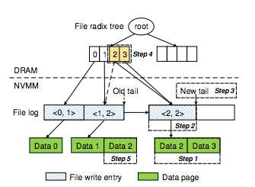
Atomic File Operations
8 KB (2-page) write
write copy of data to new pages
Append file write entry
Update log tail
Update radix tree
Return old version of data to allocator

Slide 16
Atomic mmap
Use NVMM to allocate replica pages
Copy file to replica pages, and map replicas to address space
Copy-on-write for file data, reclaim stale pages immediately
Higher overhead, but stronger consistency guarantee
Atomic mmap in DRAM?

Slide 17
Garbage Collection
Collect stale pages during write ops
Log entry is dead if it is not the last entry in the log OR
File write entry is dead if it does not refer to valid data pages
An inode update is dead if modifies the same piece of metadata
Dentry update is dead if marked invalid

Slide 18
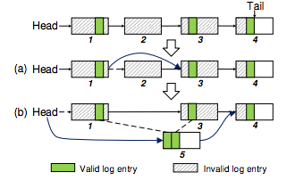
Fast GC vs. Thorough GC
Fast GC
No copying required
Reclaim invalid log pages by deleting them from linked list
Thorough GC
If live entries account for < 50% of log space, applied after fast GC
Copy live entries into new, compacted version of log
Update DRAM data structure pointer
Replace old w/new, reclaim old log
NOVA log cleaning: (a) Fast GC
(b) Thorough GC

Slide 19
Shutdown and Recovery
“Lazy rebuild”: postpone rebuilding radix tree and inode until first system access
Clean dismount
Store NVMM page allocator state in recovery inode log
No inode logs scanned = fast recovery (50 GB in 1.2 ms)

Slide 20
Shutdown and Recovery
Unclean dismount
Rebuild NVMM allocator info by scanning inode logs
Check each journal, rollback uncommitted transitions
Recovery thread on each CPU, scan inode tables in parallel
Build bitmap of occupied pages, use result to rebuild allocator

Slide 21
Experimental setup
NVMM | Read Latency | Write bandwidth | Clwb latency | PCOMMIT latency
STT-RAM | 100 ns | Full DRAM | 40 ns | 200 ns
PCM | 300 ns | 1/8 DRAM | 40 ns | 500 ns
Workload | Avg file size | I/O size (r/w) | Threads | R/W ratio | # of files Sm / lg
Fileserver | 128 KB | 16 KB / 16 KB | 50 | 1:2 | 100K / 400K
Webproxy | 32 KB | 1 MB / 16 KB | 50 | 5:1 | 100K / 1M
Webserver | 64 KB | 1 MB / 8 KB | 50 | 10:1 | 100K / 500K
Varmail | 32 KB | 1 MB / 16 KB | 50 | 1:1 | 100K / 1M

Slide 22
Filesystem Latencies
NOVA provides lowest latency for each operation
NOVA outperforms other filesystems between 35% to 17x
NOVA only accounts for 21-28% of total latency in create and append ops
NOVA delete latency increases by 76%

Slide 23
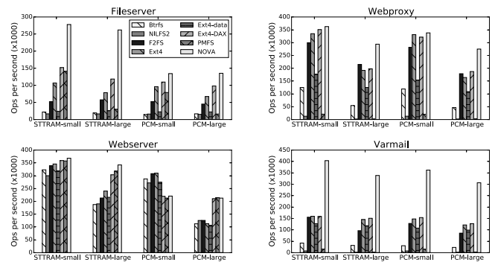
Filebench Throughput
Figure 7: Filebench throughput with different filesystem patterns and
dataset sizes on STT-RAM and PCM.

Slide 24
Full Filesystem Perfomance
Duration | 10s | 30s | 120s | 600s | 3600s
NILFS2 | FAIL | FAIL | FAIL | FAIL | FAIL
F2FS | 37,979 | 23,193 | 18,240 | FAIL | FAIL
NOVA | 222,337 | 222,229 | 220,158 | 209,454 | 205,347
GC pages
Fast | 0 | 255 | 17,385 | 159,406 | 1,170,611
Thorough | 102 | 2,120 | 9,633 | 27,292 | 72,727
30 GB fileserver workload under 95% NVMM utilization with different durations.

Slide 25
Recovery
Dataset | Filesize | # of files | Dataset size | I/O size
Videoserver | 128 MB | 400 | 50 GB | 1 MB
Fileserver | 1 MB | 50,000 | 50 GB | 64 KB
Mailserver | 128 KB | 400,000 | 50 GB | 16 KB
Dataset | Videoserver | Fileserver | Mailserver
STTRAM-normal | 156 µs | 313 µs | 918 µs
PCM-normal | 311 µs | 660 µs | 1197 µs
STTRAM-failure | 37 ms | 39 ms | 72 ms
PCM-failure | 43 ms | 50 ms | 116 ms

Slide 26
Conclusion
An extension of LFS to leverage NVMM
Fast GC, recovery from system failures
Provides stronger consistency and atomicity guarantees

Slide 27
References
J. Xu, S. Swanson. NOVA: A Log-structured File System for Hybrid Volatile/Non-volatile Main Memories. FAST ’16
https://www.usenix.org/sites/default/files/conference/protected-files/fast16_slides_xu.pdf. ONLINE Accessed 2017-04-12.
https://github.com/NVSL/NOVA. ONLINE Accessed 2017-04-12.

