Slide 1
(In)Consistency
Presented by Xin Wei, Guoqiao Li,
Scribed by: Shaoshi Ling

Slide 2
Disciplined Inconsistency with Consistency Types
Brandon Holt, James Bronholt, Irene Zhang, Mark Oskin and Luis Ceze
Presented by Xin Wei

Slide 3
Background: Consistency types
Strong Consistency
Weak Consistency
Eventual Consistency
Notes:
Strong Consistency: All accesses are seen by all parallel processes (or nodes, processors, etc.) in the same order (sequentially)
Weak Consistency: 1. All accesses to synchronization variables are seen by all processes (or nodes, processors) in the same order (sequentially) - these are synchronization operations. 2. Accesses to critical sections are seen sequentially.All other accesses may be seen in different order on different processes (or nodes, processors). 3. The set of both read and write operations in between different synchronization operations is the same in each process.
Eventual Consistency: guarantees that, if no new updates are made to a given data item, eventually all accesses to that item will return the last updated value.

Slide 4
Motivation
Modern applications make tradeoff between consistency and performance
Both double charging and keep the users waiting are bad
Network Environment change rapidly: a black and blue dress can change the performance in the blink of an eye.

Slide 5
Old approaches
Storage systems allow developers to adjust consistency level.
Unfortunately, using such system correctly is challenging.
Programmers can inadvertently update strongly consistent data in the storage system read from weakly consistent operations.

Slide 6
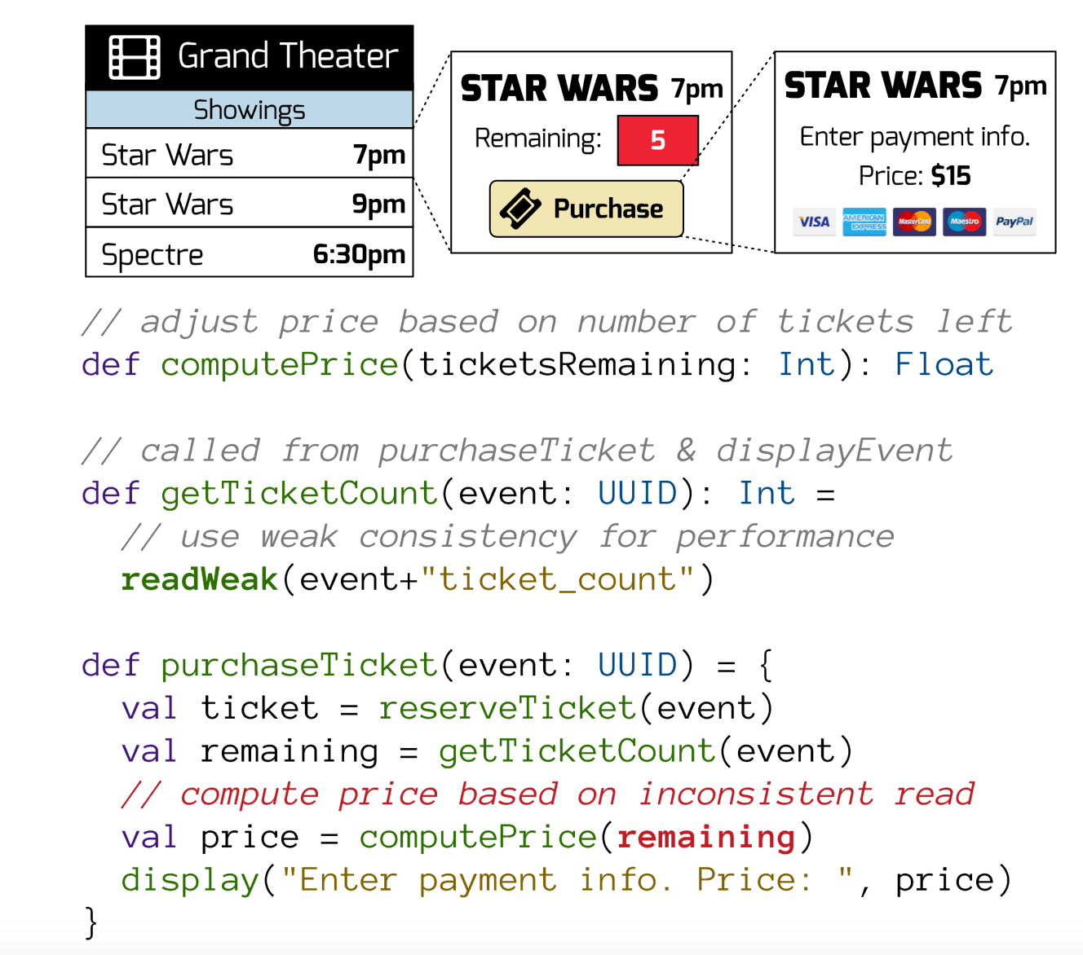
To meet a performance target in display event, developer switches to a week read for getTicketCount, not realizing that this inconsistent read will be used elsewhere to compute the ticket price.

Slide 7
Inconsistency Performance-bound Approximate
Concepts:
Consistency Safety
Consistency Types
Error-bounded Consistency
Notes:
More disciplined approach: IPA
Consistency Safety: Ensures values from weakly consistent operations don’t flow into stronger consistency operations without endorsement.
Consistency Types: Define the consistency and correctness of the returned value from every storage operations.
Error-bounded Consistency: This consistency can allow some numeric error within the bound on the returned value.

Slide 8
Programming Model
Abstract Data Types (ADTs) implement common data structures on distributed storage.
Consistency policies on ADTs specify the desired level for an object in application-specific terms (such as latency or accuracy bounds)
Consistency types track the consistency of operation results and enforce consistency safety by requiring developers to consider weak outcomes.
Notes:
Programmers annotate ADTs with consistency policies to choose their desired level of consistency. The consistency policy on the ADT operation determines the consistency type of the result.

Slide 10
Abstract Data Types
The base of IPA type system is a set of ADTs.
Notes:
It present a clear abstract model through a set of operations. It also allows users and systems alike to reason about their logical algebraic properties. ADTs are also ideal places to reason about consistency and system-level optimizations. The consistency of a read depends on the write that produces the value. Custom ADTs can express application-level correctness constraints.

Slide 11
Consistency Policies
Static Policies:
Consistent(Strong)
...
Dynamic Policies:
LatencyBound(x)
ErrorTolerance(x%)
Notes:
The IPA programming Model provides a set of consistency policies that can be placed on ADT instance to specify consistency properties for the lifetime of the object.
Static policies are fixed and static annotations provide the same direct control as previous approaches but simplified reasoning about correctness by applying them globally on the ADT.
Dynamic policies specify a consistent level in terms of application requirements.:
LatencyBound(x): Specify a target latency for some operations. The runtime can choose the consistency level and optimize the operation with the strongest level that is likely to satisfy the latency bound.
ErrorTolerance(x%): Specify the desired accuracy for read operations on the ADT. The runtime can optimize the consistency of write operations so that reads are guaranteed to meet the bound.

Slide 12
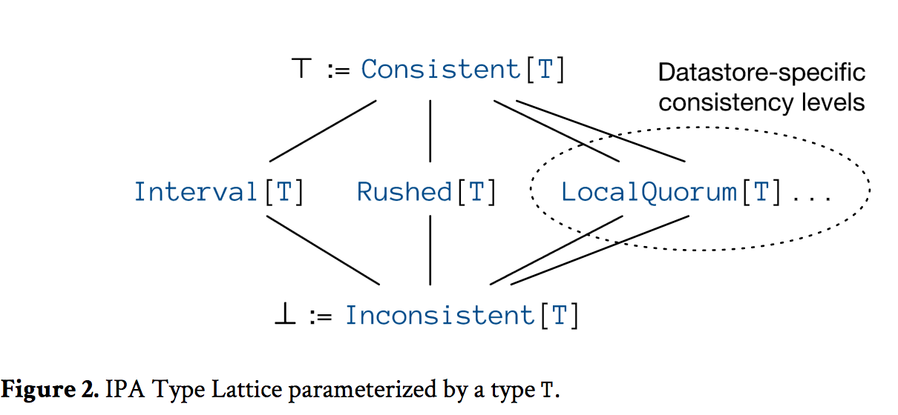
Consistency Types
Notes:
Read operations of ADTs returns an instance of consistency type. Consistent[T] behave as any other instance of T.
Inconsistent[T] needs to be endorsed. Endorsement is an upcast from Inconsistent[T] to Consistent[T]

Slide 13
Endorsement
It’s the same idea as type inferencing
in compilers.
What endorsement does is
an upcast from inconsistent type to consistent type.
For those who interested: https://courses.engr.illinois.edu/cs421/fa2014/lectures/14-unif.pdf
Notes:
Type inferencing, refer to CS421 elsa has really good slides.

Slide 14
Rushed Type
Rushed[T] is the result of read operations on ADT with policy LatencyBound(x). It is a sum type with one variant per consistency level available to the implementation of LatencyBound.

Slide 15
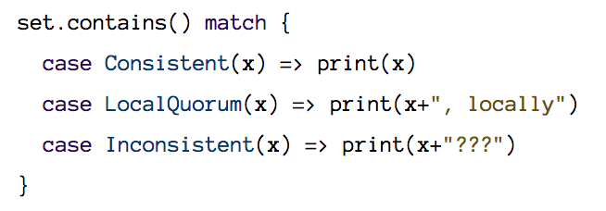
Example
Notes:
System with geo-distributed replicas may only be able satisfy a latency bound of 50 ms. In this case Rushed[T] can be destructured as following.

Slide 16
Interval Type
Result of read operation of ErrorTolerance(x%)
Can return any value within the error interval.

Slide 17
Enforcing Consistency Policies
Static consistent policies are enforced by the underlying storage systems.
Dynamic policies each require a new runtime mechanism to enforce them: parallel operations with latency monitoring for latency bound and reusable reservation for error tolerance.

Slide 18
Latency bound
Issues read request at different consistency levels in parallel
Composes the parallel operations and returns a result either when the strongest operations returns or with the strongest available at the specified time limit
If no response available at the time limit, it waits for the first to return.
Notes:
Main problem: it wastes time by issuing parallel requests and may cause longer waiting time due to sudden surge in traffic

Slide 19
Monitors
Introduce monitor to each client.
Systems monitor and predict the latency of different consistency level
System adjust request’s consistency level accordingly

Slide 20
Error Bounds
The idea is to set aside a pool of permissions to perform certain update operations (we call them reservations or tokens).
Tokens can be produced lazily if there are enough around already.
They can be distributed among replicas.
This means that replicas can perform updates without coordinating with other replicas
Notes:
Replicas need to prevent exceeding tokens and they need to locally know how many tokens it has without synchronizing.

Slide 21
Reservation Server
Client requests requesting tokens are routed to reservation servers.
The server forward request to datastore when permitted.
Reservation server only keep the transient state
Synchronize with other replicas when tokens are exhausted

Slide 23
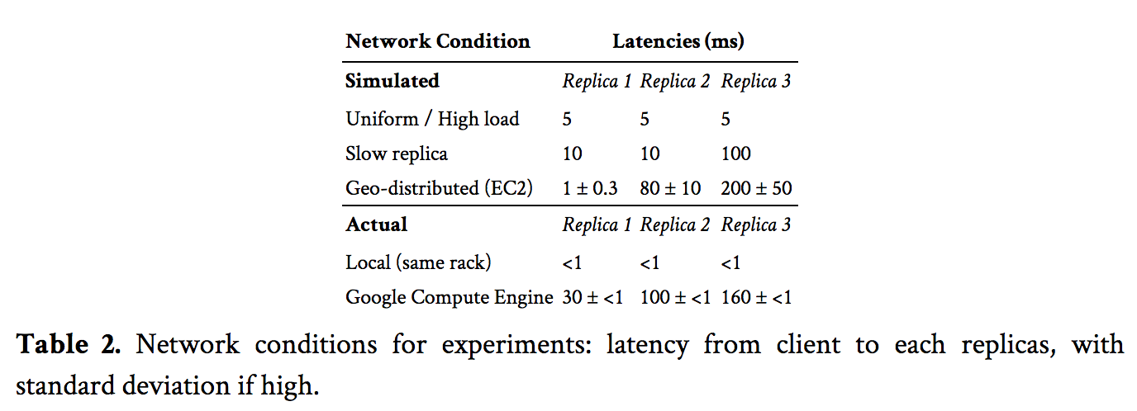
Experiments and Evaluation

Slide 24
Ticket Service

Slide 25
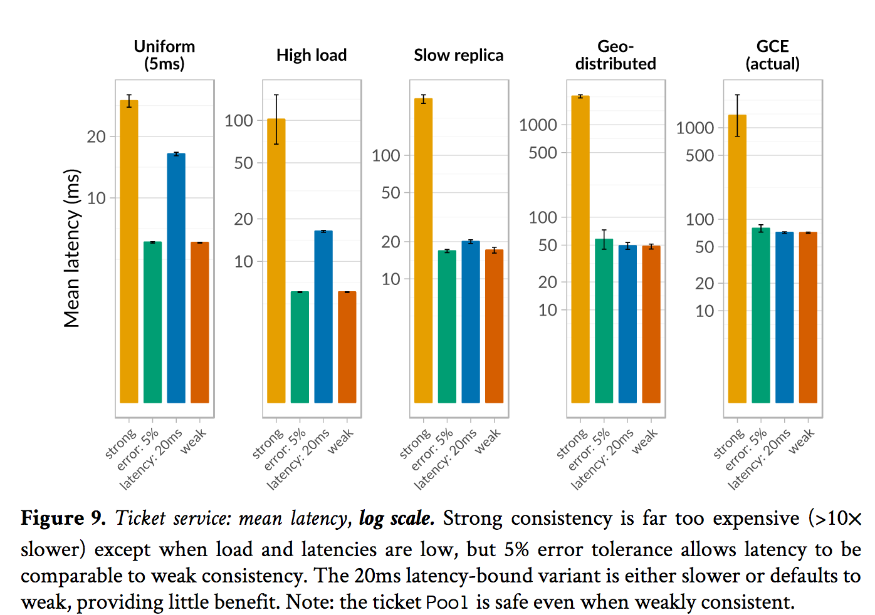

Slide 26
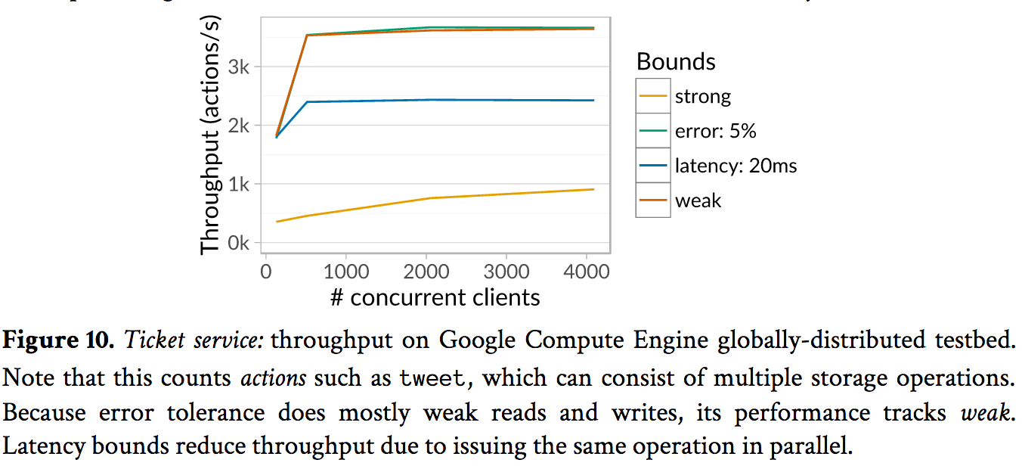

Slide 27
Take away
“All problems in computer science can be solved by another level of indirection. “
--David Wheeler
However, configuring monitors and reservation servers might be more challenging than old approaches.

Slide 28
Towards Weakly Consistent Local Storage Systems
By Guoqiao Li

Slide 29
Motivation
Data across many different social media
Different latency and throughput
Older version in Log-structured design
Tradeoff between performance and consistency
Notes:
Heterogeneity is a fact of life for modern storage servers. For example, a server may spread terabytes of data across many different storage media, ranging from magnetic disks, DRAM, NAND-based solid state drives (SSDs), as well as hybrid drives that package various combinations of these technologies.

Slide 30
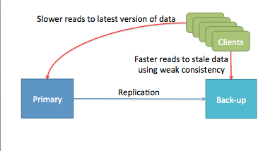
Some facts
Performance/Consistency Trade-off
Why faster read for stale data.

Slide 31
Why Stale Data is faster
Single-disk log-structured stores
SSD FTLs(Flash Translation layers)
Log Structured arrays
Durable write caches that are fast for write but slow for read
Deduplicated system with read caches

Slide 32
Single-disk log-structured stores
Extract sequential write bandwidth from hard disks by logging all updates
Result in the existence of stale versions
Faster if closer to the disk arm than the latest version
Notes:
The most common example of a system design that internally stores faster stale versions of data is a log-structured storage system

Slide 33
SSD FTLs
Act as collections of small log-structured stores
Erase block are erased or reset together during garbage collection
Faster to access if the erase block is undergoing compaction or GC
Notes:
SSDs based on NAND flash act as collections of small log-structured stores: each erase block consists of multiple 4KB physical pages that (for many devices) must be written in sequence and are erased or reset together during garbage collection. Logging results in stale versions, which can be faster to access if the latest version happens to be in an erase block that’s undergoing compaction or garbage collection.

Slide 34
Log structured Arrays
Storaged array with a chained log
Write in the tail drive of log
Read is faster when read from body of the log

Slide 35
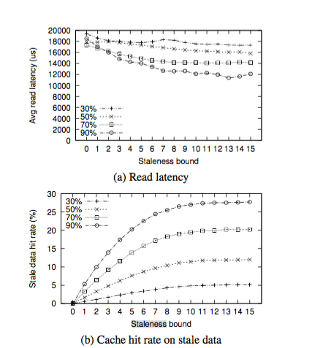
Deduplicate systems
Deduplicate Data:
Data deduplication is a specialized data compression technique for eliminating duplicate copies of repeating data
Notes:
Systems often deduplicate data to save space. In such systems, an older version of a data item may be identical to the latest, cached version of some other data item; in this case, fetching the older version can result in a cache hit

Slide 36
Goal
Speedup local storage systems using stale data

Slide 37
Example: Pileus
Distributed storage service support weaker consistency guarantee
A single primary server and multiple backup server
Primary server send updates to backup server
Notes:
For any cloud storage service, the software stack on a single server typically contains a top-most layer that runs as a user-space process and exposes some high-level abstraction – such as key-value pairs and files – over the network to applications running on remote clients. This process acts in concert with other processes to implement a distributed storage service;
If the distributed storage service supports weaker consistency guarantees, clients can mandate that reads satisfy some such guarantee (such as read-your-writes or monotonic reads); typically they do so by specifying some set of versions which are permissible.
A client writes a new key-value pair by sending it to the primary, which assigns a monotonically increasing timestamp to it before writing it to local storage. The primary then asynchronously sends the update to the backups, which apply updates in timestamp order. As a result, a global ordering exists across all updates.
each backup server contains a strict prefix of this global order corresponding to some timestamp. Clients can then obtain weaker consistency guarantees by specifying a timestamp for their reads, and contacting the closest server that is storing a prefix which extends beyond this timestamp

Slide 38
StaleStore
Single-node storage system
Maintain and serve multiple version
Split between application and store
Versions to timestamp
Notes:
Abstractly, a StaleStore is a single-node storage system that maintains and serves multiple versions.
the information required to support consistency and performance trade-offs is typically split between the application and the store.
The application (i.e., the server process implementing the distributed cloud store) understands consistency (i.e., timestamps), and the store understands performance characteristics (i.e., where data is placed and how fast it can be accessed).

Slide 39
API Characteristics
Timestamp writes
Snapshot reads
Snapshot is a consistent view of the data store from the viewpoint of the storage at a particular timestamp.
Cost estimation
Version Exploration
Notes:
• Timestamped writes: First, writes to the StaleStore are accompanied by a monotonically increasing timestamp. This version number is global across all writes to the StaleStore; for example, for a key-value store, each put operation must have a non-decreasing timestamp, regardless of which key-value pair it touches.
• Snapshot reads: Second, the application should be able to read from a consistent, potentially stale snapshot corresponding to a timestamp. Read APIs are augmented with a timestamp parameter. A read operation at a timestamp T reflects all writes with a lower or equal timestamp. For example, for a key-value store, if a particular key has been updated by three puts at timestamps T7, T33 and T56 respectively, a get operation at timestamp T100 will return the value inserted by the put at T56, which reflects the latest update at timestamp T100.
• Cost estimation: Third, the application should be able to query the cost of issuing a particular read operation at a snapshot. This cost is an arbitrary integer value that may not correspond to real-world metrics such as latency or throughput; all we require is that two cost estimates from the same StaleStore can be compared.
• Version exploration: Finally, the application should be able to determine – having read a particular version of an item – what range of timestamps that version is valid for. For example, if the application reads an item X at timestamp T7, and that item does not change next until timestamp T33, the application can optimize cost querying operations with this information, or read other items at any timestamp in between and still obtain a consistent snapshot across items.

Slide 40
StaleStore on Diff Layers
Application-level StaleStore
On top of many single-version storage subsystems
Filesystem/embedded key
Block-level
Notes:
the application is aware of the consistency guarantee required (or equivalently, of high-level constructs such as timestamps), and knows which versions will satisfy the read, the application is aware of the consistency guarantee required (or equivalently, of high-level constructs such as timestamps), and knows which versions will satisfy the read
d reusability: a filesystem StaleStore can be reused by multiple cloud storage systems. On the flip side, it itself operates over a logical address space – a block device – and has little visibility into where blocks are mapped, making it difficult to estimate the cost of reads to particular versions.
Block-level StaleStore: The third option is for a smart block layer to manage, maintain, and expose versions. The block layer has detailed information on where each block in its address space lives, and can provide accurate access latency estimates. Further, the block device shares the advantage of the filesystem: implementing tunable consistency within the block device allows new high-level storage systems – such as graph stores, new types of filesystems, table stores, databases, etc. – to easily support consistency/performance trade-offs without reimplementing the required mechanisms. We now describe the design and implementation of a block-level StaleStore called Yogurt.

Slide 41
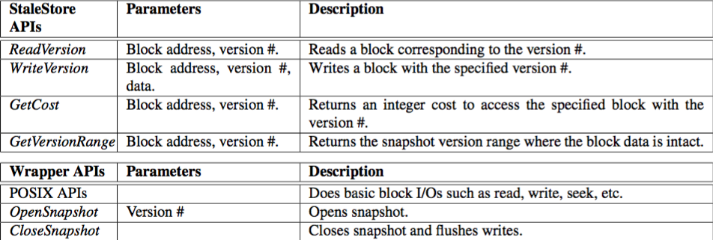
Yogurt: A block-level StaleStore
Notes:
If these multiple writes are sent to the StaleStore with different timestamps, the application could potentially access inconsistent snapshots reflecting one write but not the other

Slide 42
Yogurt: Wrapper API
Application will potentially access inconsistent snapshot
OpenSnapshot(version): all operations are on the samesnapshot
Notes:
If the snapshot accessed by the OpenSnapshot(version) call is from the past, one cannot directly write new data onto it. To write data, the application supplies a timestamp to OpenSnapshot() greater than any the StaleStore has seen before; this opens a writeable snapshot. The application can then write multiple blocks within the snapshot, and then call CloseSnapshot to flush the writes out to the store.

Slide 43
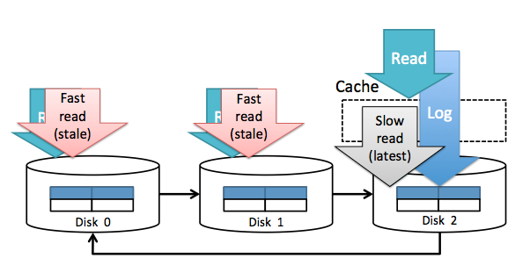
Yogurt: Version Storage Design
Chains a log across multiple device
Two layers
Maintains a multi-version index
Cache(LRU based)
Maintains multi-version index
data is logged using small segments to each block device in round robin
Notes:
Yogurt implements the block-level StaleStore API over a number of raw block devices, handling I/O requests to multiversioned data and offering cost estimates for reads.
new writes proceed to the tail drive while reads can be served by any drive in the chain. Yogurt maintains a multi-version index over this chained log that maps each logical block address and version number pair to a physical block address on a drive in the chain
Perfectly distributing different versions to different block devices is doable in the lower layer, but it can make the versioned block store design complicated and can cause data skew to certain block devices depending on the workload. Instead, the versioned block store uses a simpler approach: data is logged using small segments to each block device in round robin

Slide 44
Yogurt: Implementation
Device mapper(eg, Linux kernel)
Serve multiple snapshots to one or many applications
One thread per user
Notes:
Since modern applications are highly concurrent and serve multiple users, Yogurt should be able to service multiple snapshots to one or many applications. To do this, Yogurt identifies its users using pid, which is distinctively given to each thread.
Figure 8 shows a logical view of a multi-version index and how a snapshot is constituted.
if multiple blocks need to be accessed to read an object (e.g. a file that spans multiple data blocks), the blocks accessed after a block become dependent on the previously accessed block.

Slide 45
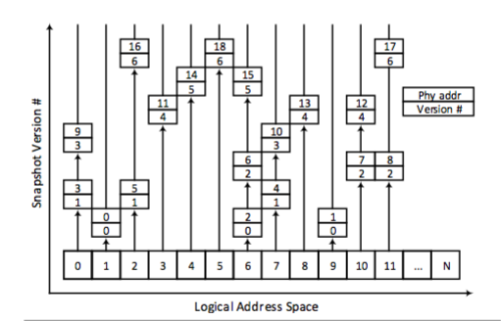
Yogurt: multiversion-index

Slide 46
Yogurt: Read Cost Estimation
First look up in cache
Not in cache?
Number of queued I/Os
SSD are preferred over disks
most of the time
Notes:
3) mixing reads and writes can penalize read operations in SSDs; and 4) random read latencies of SSDs are orders of magnitude faster than those of disks.

Slide 47
Evaluation
Distributed storage pattern on Pileus
Primary server and a secondary server
Block API & key-value service
Hardware
3 disks & 256MB cache(can be enable and disable)
Gecko chain logging
Notes:
To evaluate the benefit of Yogurt, we implemented a distributed storage service patterned on Pileus

Slide 48
Evaluation: Block store
Local latest version/global latest version
Uniform random and zipf workload
Read-my-write and monotonic reads consistency guarantee

Slide 49
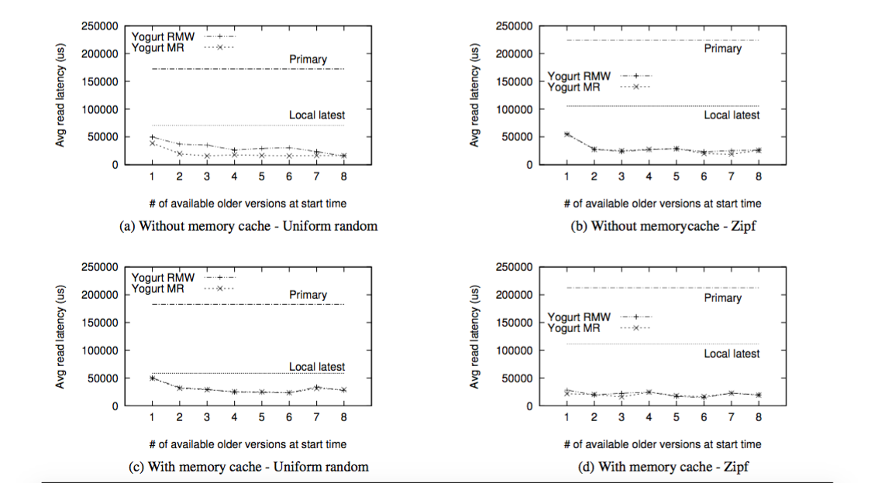

Slide 50
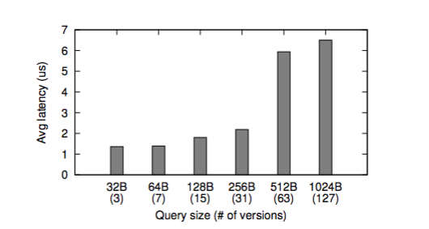
Evaluation: Overhead

Slide 51
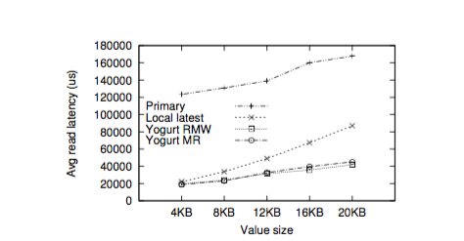
Evaluation: Key-value store

Slide 52
Take Away
Sacrifice consistency to performance
Yogurt is a block-level StaleStore
All operations should base on a same snapshot

Slide 53
Discussion Disciplined Inconsistency with Consistency Types
How to extend IPA’s consistency to more consistency models such as sequential consistency, linearizability and causal consistency?
It's not clear how consistency types in the middle of the lattice interact with each other- must different types always be "endorsed" to the strongly consistent type before affecting an operation on a type with different consistency bounds? Is this overly conservative?
What if rush type return two different value for weakly consistency?
Notes:
1.The key to consistency safety in IPA is the consistency types—enforcing type safety directly enforces consistency safety. The current implementation has two types: weak consistency type Rushed and Type interval which only gives the interval of its value. To extend the consistency models. We can just simply implement the types which enforce that model. 2. The consistency types track the consistency of the results and enforce a fundamental non-interference property: results from weakly consistent operations cannot flow into computations with stronger consistency without explicit endorsement. So, it’s not conservative, if programmers update strongly consistent data in the storage system using value read from weakly consistent operations, it will propagate inconsistency and corrupt the stored data. 3. We can just use majority vote policy to determine the value.

Slide 54
Discussion Towards Weakly Consistent Local Storage Systems
What applications that will benefit from weaker consistency?
What is the stale data? What if Stale data can also be incorrect data which the user does not want.
How is the cost estimation function work?
Notes:
1. Local storage systems are increasingly multi-versioned and older versions are often faster to access. The simplest and most common example of a system design that internally stores faster stale versions of data is a log-structured storage system, either in the form of a filesystem or block store. Such systems extract sequential write bandwidth from hard disks by logging all updates. This log-structured design results in the existence of stale versions; furthermore, these stale versions can be faster to access if they are closer to the disk arm than the latest version. 2. Stale data is old-version data. It’s not incorrect data and in some cases, it’s perfectly fine to give user these old data.
3. If the searching data block is inside the memory cache, it is always faster to read it from the memory than from either disk or SSD. For disks and SSDs, precise cost estimation is difficult because the internal states of the block devices are not exposed and they are most depend on I/O queued on SSD.

Slide 55
Would a StaleStore model be a good choice for a social network storage layer since some companies like Facebook already serve stale data if required in order to provide high availability?
Does the stalesotre handle concurrency control with their implementation?
Do existing applications have to be redesigned to properly leverage this local storage abstraction?
Notes:
1. If the older version data are faster to access, it would be a good choice. But for Facebook, I don’t think user want to have old-version data. 2.One approach to implementing the above API in a real system involves guarding all data with a single, coarse lock. In this case, it’s simple for application logic to ensure that writes are always in non-decreasing timestamp order, and that reads reflect writes with prior timestamps. In practice, however, the application can use fine-grained locking to issue requests in parallel, while providing the same semantics as a single lock. For example, in a key-value store, puts to different keys can proceed in parallel, while a get on a key has to be ordered after any puts to that key with a lower timestamp. We expect the application to implement concurrency control above the StaleStore API (in much the same way a filesystem implements locking above a block store API, or a key-value store implements locking above a filesystem API), while ensuring that the semantics of the system are as if a single lock guards all data. 3.If it’s block-level or file-system level, we don’t need to redesign the applications

Slide 56
Why the local storage system looks like they're modelling a geo-distributed system?
How would the authors' approach work in a system with active replication? (Say, a Paxos replicated state machine?)
Notes:
1.Current storage system designs typically use a mix of multi-device idioms – such as caching, tiering, striping, mirroring, etc. – to spread data across a range of devices, including hard disks, DRAM, NAND-based solid state drives (SSDs), and byte- addressable NVRAM or Phase Change Memory (PCM). Each such storage medium exhibits vastly different throughput and latency characteristics; access latencies to data can vary considerably depending on which media the data resides on. 2.The system only consists of a single primary server and multiple backup servers. So the current implementation may not support active replication.

