Slide 1
B2W2 N-Way Concurrent Communication for IoT Devices
Paper Presentation
Kai Huang

Slide 2
Key Idea
Enables BLE to WiFi transmission while concurrently support original WiFi to WiFi and BLE to BLE communication among multiple WiFi and BLE devices.

Slide 3
Introduction
Increasing number of IoT devices
The need for a Gateway between BLE and WiFi devices
This paper presets B2W2, a novel communication framework that enables N-way concurrent communication among WiFi and BLE devices.
Enables BLE to WiFi while concurrently support original WiFi to WiFi and BLE to BLE communication among multiple WiFi and BLE devices.

Slide 4
Abstract

Slide 5
Design Challenges 1
Send message from BLE to WiFi with concurrent transmission of BLE to BLE and WiFi to WiFi
Totally different physical layer and bandwidth
Different protocol
BLE-BLE communication has to follow FCC
Solution: novel modulation scheme.

Slide 6
Design Challenges 2
Demodulate message from BLE to WiFi under noisy environment accurately
Demodulate message from BLE-WiFi utilizes CSI (Channel state information)
CSI is designed to capture change of channel status

Slide 7
Design Challenges 3
Enable N-way concurrent communication among WiFi and BLE devices
Scalability issue
Solution: N-way concurrent communication design

Slide 8
Design Overview

Slide 9
Design Overview
BLE side
DAFSK converter (discrete amplitude and frequency-shift keying
Modulate M B2W message on top of original B2B messages
WiFi receiver side
CSI extractor and demodulator

Slide 10
Modulation @ BLE - DAFSK converter
WiFi device can detect M b2w message by monitoring change of BLE’s transmission power levels.
Packet length and packet interval are not feasible for use for modulation, leaving only the power level as the only variable we can use.
BLE devices generally have 8 to 32 levels of transmission power
Use Pulse-Amplitude Modulation or Amplitude-Shift Keying is not best option due to attenuation and interference
Use a technique similar to Frequency-Shift Keying

Slide 11
Modulation @ BLE - DAFSK converter

Slide 12
Modulation @ BLE - Symbol Mapper
Problem introduced by Frequency Hopping (for interference avoidance)
Create FIFO for each channel
Map transmission power levels to BLE packets

Slide 13
Modulation @ BLE - Symbol Mapper

Slide 14
Demodulation @ WiFi
Extract CSI
Matrix averaging
Reconstruct magnitude
Parallel to serial conversion

Slide 15
N-way concurrent communication
Extract CSI
Matrix averaging
Reconstruct magnitude
Parallel to serial conversion

Slide 16
Evaluation
The authors have implemented a N-way B2W2 prototype using a RF testbed and multiple BLE devices

Slide 17
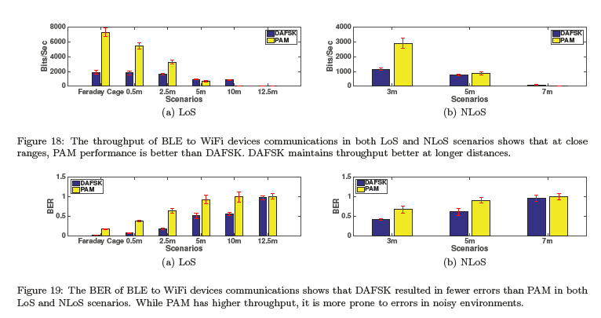
Evaluation

Slide 18
Evaluation

Slide 19
Equalization
The authors discovered that the bit error rate (BER) of W2W increases due to the presence of BLE transmission
The authors managed to reduce BER by multiplying an invers phased BLE signal and use the correlation between neighboring CSI value to compensate the change in vector distance.

Slide 20
Equalization
BLE transmission can increase the BER (bit error rate) of W2W transmission. To overcome this, the author multiply an inverse phased BLE signal and compensate the change in vector distance using the correlation between neighboring CSI value, therefore reducing the BER.

Slide 21
Conclusion
This paper introduced an N-way concurrent communication framework which can concurrently conduct WiFi to WiFi, BLE to WiFi and BLE to BLE

Slide 22
Thoughts
This paper presents a novel framework that enables BLE to WiFi transmission without affecting existing BLE and WiFi communication protocols.
What can we do differently if we were to re-design the BLE protocol with compatibility to WiFi receiver in mind, without sacrificing performance?

Slide 23
Thank you!

