Slide 1

Centiman: Elastic, High Performance Optimistic Concurrency Control by Watermarking
Scriber: Xiaoming Chen

Slide 2
Summary
A system for high performance , elastic transaction processing with full ACID guarantees in cloud.
Address loosely coupled design problems: spurious aborts and bypass validation (solution: WaterMark).
Contribution: utilizes watermarks to minimize system-wide synchronization, supports elastic scaling with watermark-based OCC validation and an experimental evaluation.

Slide 3
Discussion of system architecture
What’s wrong with the naive approach, writeSet grows and storage overhead at the validator/ garbage collection with the aggressive truncation cause abort. the age out time, need synch with the validator decision?
System required database particular get/put API support for time stamp, s.t. put(key, value, timestamp). get(key) returns (value, version)
Compare the different on naive approach and the watermark approach.
what’s wrong with the naive approach? storage overhead, garbage collection, aggressive truncation cause abort?
Why watermarks is better? no need for extra communication, eventually age out, abort due to the aggressive garbage collection
Read-Only transaction with by-pass logic(one trip)

Slide 4
Discussion on shared validation
How can the processors assign timestamps: physical system time(TrueTime API etc) vs monotonically increasing timestamp.
processor periodically recomputes its local watermark and caches info about other’s process’s watermarks. what’s the frequency? Trade-off?
Latency between process and validator arise the abort and overhead?
When should the switch happen after the new validator added.

Slide 5
Discussion on Experiments
execution speed of process need to be assumed as the same to avoid low and even no communication btw the process and validators
Abort rate btw naive and watermark approach with different buffer size/update frequencies.
Elastic scaling: sharp peak and mechanism to detect the switch time
optimization for read-heavy workload: 86% pass with 10% write-only, less than 40% pass with 30% more write-only
scalability: maintain 89% throughput for single validator. throughput and abort rate increase while new validator added. double to triple through put when turn on the local-check for read-only.

Slide 6
Questions on Piazza
During the transition period of scaling up or down the number of validators may cause bottleneck while the system is already overload
No comparison of Centiman with other ACID database
How do we know there is no watermark of i in-flight

Slide 7
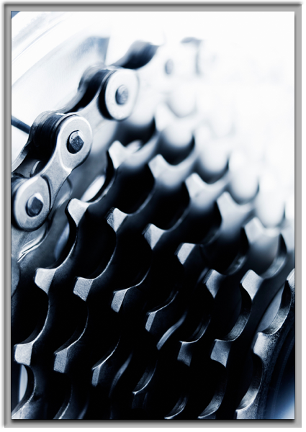
Thank you

