Slide 1
There is more Consensus in Egalitarian Parliaments
Presented by Shayan Saeed

Slide 2
Motivation
State Machine Replication
Optimal Commit latency for Wide Area
Optimal Load Balancing for high throughput
Graceful Performance Degradation for slow or failed nodes
Paxos and its variants widely used
Pre-ordered instances
Choose commands for each slots
2 rounds to commit a command
Elect a leader to get the slot
Propose the command to all the replicas
Even more rounds for dueling leaders

Slide 3
Ordering of Instances
Compete for slots – Paxos
Leader decides for slots - Multi-paxos
Vote
Vote
Vote
ACK
ACK
Me
Me
Me

Slide 4
Ordering of Instances cont.
Pre-distribute slots among replicas – Mencius
Drawbacks
2 RTT for Paxos – more for dueling leaders
Multi Paxos – Leader is bottleneck, leader re-election problem, leader can be far so high latency
Mencius – communicate to all the replicas, speed of the slowest replica, bad availability on failure

Slide 5
EPaxos Innovation
Every replica can commit concurrently
Notes dependencies before committing
Executes them in order
2 RTT only for concurrent and interferring commands – small chance
A
B
C
D
A
B
C
D

Slide 6
EPaxos Commit Protocol
Phase 1: Establish Ordering Constraints
A replica L receiving a command C from client:
Prepare a list dep of all instances whose commands interfere with C.
Calculate seq greater than that of all interfering commands in dep.
Send (C,dep,seq) to other replicas in a PreAccept message.
Any replica R on receiving PreAccept message:
Update dep and seq according to its own command log.
Record C and new attributes in command log and send it back.
If L receives enough replies and all attributes are the same, it will move to commit phase. Otherwise it goes to Paxos-Accept Phase

Slide 7
Phase 2: Paxos-Accept Phase
If the attributes in some replies are updated differently than in others:
Take union of all deps and choose highest seq and update attributes.
Tell the replicas to accept these attributes.
After hearing back from a majority, move on to the commit phase.
Phase 3: Commit Phase
Log the command as committed.
Reply back to client notifying the commit.
Send commit messages asynchronously to all the replicas.

Slide 8
EPaxos in Action
R1
R2
R3
R4
R5
C2: Update obj_A
ACK C2
Pre-Accept C2
Accept C2
C2 -> ϕ
C2 -> ϕ
Commit C2->C1
C2 -> C1
ACK
C2-> C1
ACK
C1 -> ϕ
C1 -> ϕ
Pre-Accept C1
Commit C1->ϕ
C1: Update obj_A
ACK C1

Slide 9
EPaxos Execution Algorithm
After the instance gets committed, following execution algorithm is run for a command C:
Build dependency graph for command C and recursively for all nodes in there
Find strongly connected components (where every component is reachable from other), sort them topologically
It will be a DAG now. In inverse topological order, for every strongly connected component
Sort all commands in the component by their sequence numbers
Execute all the commands in increasing sequence number order

Slide 10
Execution
A
E
1
C
B
D
2
E
D
C,A,B
3
Strongly Connected Components

Slide 11
Failure Recovery – Explicit Prepare
Replica Q, after timing out for instance L.i to commit for a failed replica L will:
Send Prepare to all replicas with ballot greater than L.i and wait for replies R.
If any reply says instance committed, run commit phase.
If any reply says instance accepted, run Paxos-Accept phase.
If more than half replicas have pre accepted, run Paxos-Accept phase.
If any reply has pre accepted then run phase 1.
Otherwise make that instance a no-op

Slide 12
Experimental Results

Slide 13
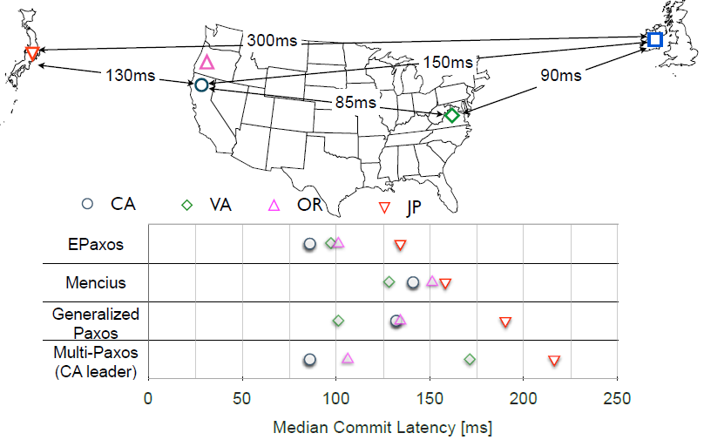
Wide Area Commit Latency

Slide 14
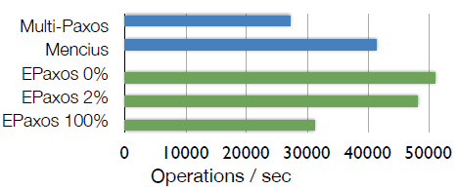
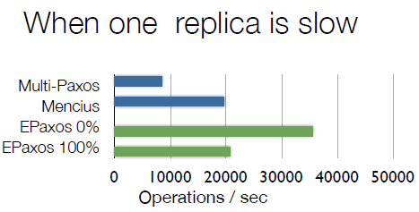
Throughput for 5 replicas

Slide 15
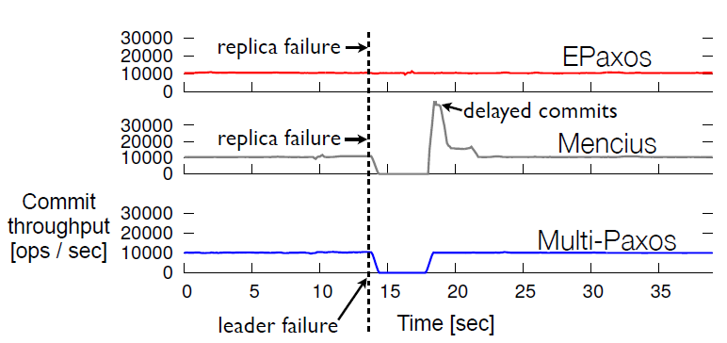
Availability

Slide 16
Discussion
Determining whether the commands interfere
Process might be expensive if log is huge
If you can’t, assume all the commands as interfering
Latency and throughput almost same as Mencius
Size of dependency list?
Only include commands that interfere directly
Process cumbersome for ordering dependencies and execution
Prioritize processing old commands over new ones
O(n) for highly connected components and O(log n) for sorting by sequence no.

Slide 17
Discussion
Read leases effect on writes?
All the writes routed to the node holding read lease
What would the effect be if leasing node is slow or far?
Results shown only for 3 and 5 replicas for which EPaxos optimal. How would it compare for more?

Slide 18
Replicated Commit
Nick Ciaglia

Slide 19
Review
Atomicity
Transaction is “all-or-nothing”
Consistency
Transactions will only bring the database from one valid state to another
Isolation
Concurrent execution gives the same answer that serial would have
Durability
Once a transaction has been committed, it will remain so. Even in the case of system failure.

Slide 20
Background
Traditional Relational Databases not good enough anymore?
Cassandra, Dynamo, Bigtable don’t guarantee isolation or atomicity
SQL Azure, NoSQL, Megastore only guarantee subsets of database
Spanner, Scatter
Two-Phase Commit, Two-Phase Locking, Replicated Paxos Log
Notes:
Well it looks like Spanner and Scatter have it down, right? Solves everything?

Slide 21
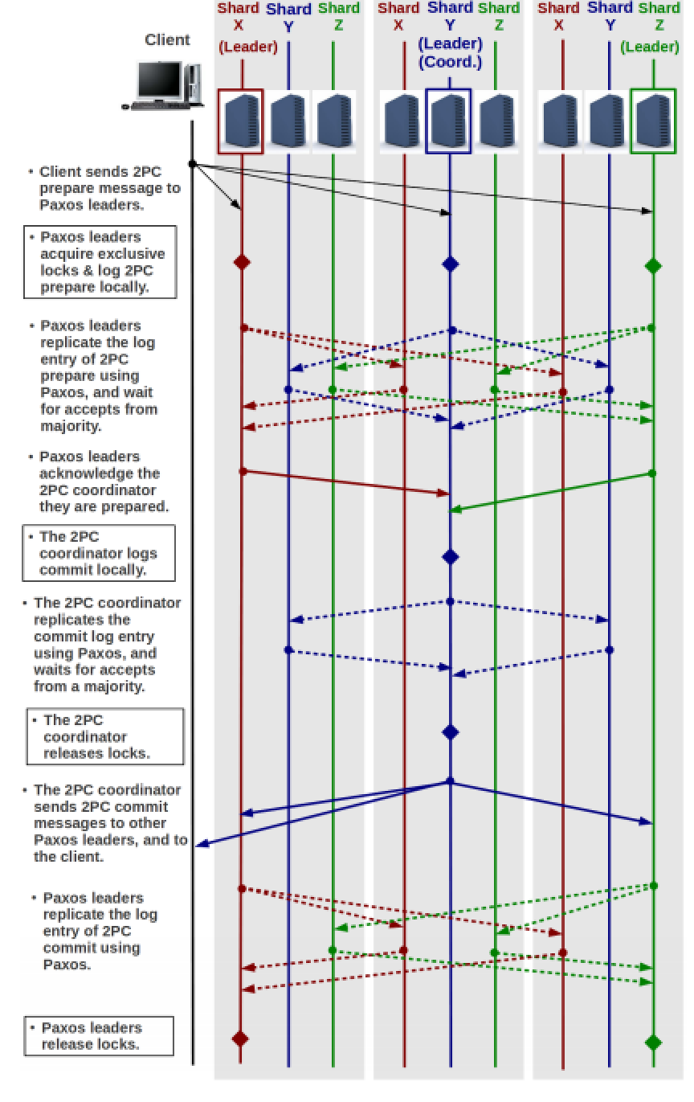
Replicated Log (Spanner, Scatter)
Between 7 and 8 cross-datacenter trips
While holding locks
Uses Multi-Paxos
Removes the need to elect leader every run
Notes:
Let’s take a closer look at these implementations
Dotted lines indicate Paxos communication
Solid lines indicate Two-Phase Commit
You’ll notice that a number of these messages are spit across different centers
- Client sends 2PC prepare message to Paxos leaders => “Hey, you guys ready to commit?”
- Paxos leaders acquire exclusive locks & log 2PC prepare locally => Getting ready in each datacenter
- Paxos leaders replicate the log entry of 2PC, prepare using Paxos, and wait for accepts from majority => Have to send the prepare message and get responses from the majority of datacenters before committing locally
- Paxos leaders acknowledge the 2PC coordinator they are prepared
- 2PC coordinator logs commit locally
- 2PC coordinator replicates the commit log entry using Paxos, and waits for accepts from a majority
- 2PC coordinator releases locks
- 2PC coordinator sends 2PC commit messages to other Paxos leaders, and to the client
- Paxos leaders replicate the log entry of 2PC commit using Paxos
- Paxos leaders release locks

Slide 22
Motivation
Cross-Datacenter communications costly
Google: 0.5 second increase in search page generation time causes traffic to drop 50%
Amazon: Every 100ms increase in latency results in 1% loss of sales
Who Cares?
Packet sent from East to West coast takes nearly 45ms
Notes:
Can we do better?

Slide 23
Replicated Commit
Reduce the number of cross-datacenter trips as much as possible
Replicate commit itself, rather than logs
Continue to ensure ACID
Remain agnostic to relational or key-value
High scalability
Notes:
Rather than replicating the logs, we’re going to replicated the commit itself

Slide 24
Basic Paxos Review
Players
Proposer - Entity that advocates a client request
Acceptor - Accepts proposals
Learner - Learn the value that majority of acceptors accepted
Phases
Phase 1 - Acceptors vote for leader <-- We can skip this!
Phase 2 - Acceptors accept value proposed by the leader
Phase 3 - Learners learn it

Slide 25
How We Use Paxos
Proposer: The Client
Acceptors/Learners: Each datacenter
No need for election phase since there’s only one Proposer
Value to agree on: whether or not to commit
Default is don’t commit

Slide 26
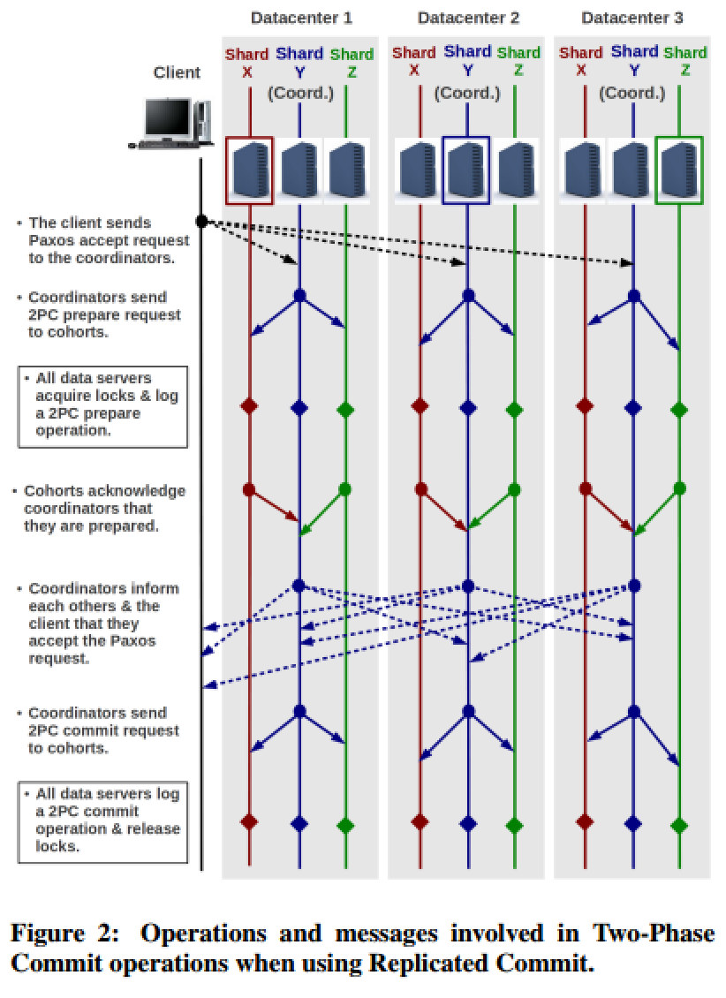
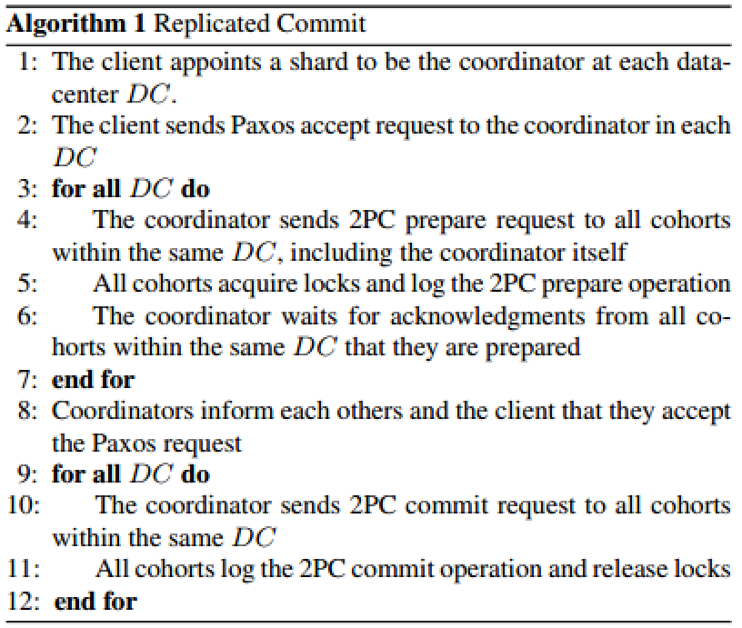
Algorithm
Notes:
Idea: run commit protocol at every datacenter and use Paxos to agree system-wide

Slide 27
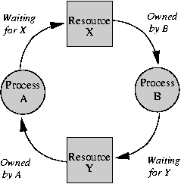
Avoiding Deadlocks
If lock cannot be granted, request is denied
No hold & wait
Write lock can take over existing read lock
Notes:
Wanted to point this out because it’s such a simple solution. Maybe there are better ones out there?
Responsibility on the user to ensure everything works!

Slide 29
Comparisons
Replicated Log
Requires reads from Paxos leader, which is arbitrarily far from client
Re-electing leader can take entire seconds(!)
7-8 Cross Datacenter Trips
Replicated Commit
Only requires majority of replicas at different datacenters up and running
Once majority respond, any further communication is done “behind the scenes”
2-4 Cross Datacenter Trips
6-7 fewer trips total while holding locks

Slide 30
Experiments
5 Datacenters
California (C)
Virginia (V)
Oregon (O)
Ireland (I)
Singapore (S)
Three different servers per center
Each responsible for independant shard of data
Three unique shards (X, Y, Z)

Slide 31
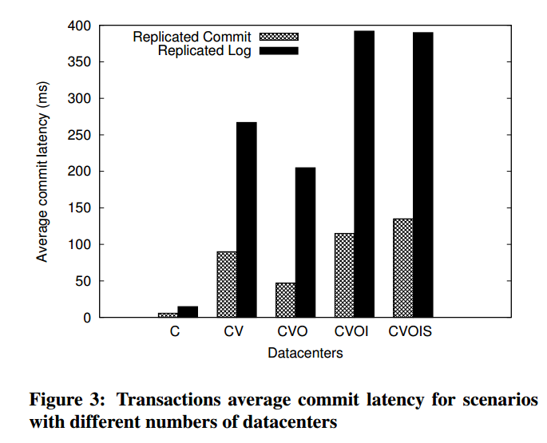
Experiments (Commit Latency)
Considerably faster
Especially when further apart
Notes:
Note the jump between CVO and CVOI, as well as the drop between CV and CVO

Slide 32
Latency Analysis
With N datacenters, Replicated Commit will perform better as long as there are < 2.5N reads per transaction
Trade-off between read and commit latency

Slide 33
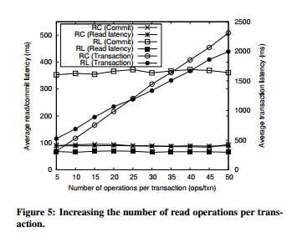
Experiments (# Ops)
Recall: 2.5N is the magic number
Replicated Log (RL) should overcome Replicated Commit (RC) at 12.5 Ops/txn
Half operations are write, so the crossover at 25 is perfect
Analysis works (go figure)!
Notes:
50000 read/write operations
Remember earlier there are 5 datacenters spread across the globe

Slide 34
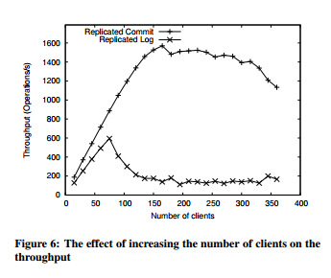
Experiments (Throughput)
Throughput = Number of successfully committed operations per second.
Avoids thrashing due to no contention among leaders (no leaders!)
Notes:
Declines as more and more clients are added (naturally)

Slide 35
Thoughts
Simple deadlock avoidance strategy
Leads to traffic asking for same resource multiple times or never getting it
Rests on developers shoulders
Degenerates with increasing read/transaction
Relational Databases are inherently high-read constructs
Could this be avoided?
Would like to see bigger tests
Notes:
Each transaction starts a new Paxos instance for its own Two-Phase Commit
Simple deadlock prevention
- In large DBs, conflicts will be rare
- Either abort if denied or re-request after a randomized backoff
Each read operation waits for replies from majority of replicas
- bounded by the slowest datacenter in the majority
- could optimize by grabbing the first response (optimistic)
- Would need more in-depth algorithm to update if something is wrong
Remove multi-paxos

Slide 36
Improvements
Bounded by the slowest datacenter in majority for reads
Could be optimistic: return the first you see
Requires more logic if something turns out incorrectly
More scalability tests

Slide 37
Source
http://www.vldb.org/pvldb/vol6/p661-mahmoud.pdf

