Slide 1
In Byzantium
Advanced Topics in Distributed Systems
Spring 2011
Imranul Hoque

Slide 2
Problem
Computer systems provide crucial services
Computer systems fail
  Crash-stop failure
  Crash-recovery failure
  Byzantine failure
Example: natural disaster, malicious attack, hardware failure, software bug, etc.
Why tolerate Byzantine fault?

Slide 3
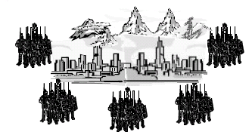
Byzantine Generals Problem
All loyal generals decide upon the same plan
A small number of traitors can’t cause the loyal generals to adopt a bad plan
Attack
Attack/Retreat
Attack
Retreat
Attack/Retreat
Solvable if more than two-third of the generals are loyal

Slide 4
Byzantine Generals Problem
1: All loyal lieutenants obey the same order
2: If the commanding general is loyal, then every loyal lieutenant obeys the order he sends.
General
Lieutenant
Lieutenant

Slide 5
Impossibility Results
Attack
Attack
General
Retreat
Lieutenant
Lieutenant

Slide 6
Impossibility Results (2)
Attack
Retreat
General
Retreat
Lieutenant
Lieutenant
No solution with fewer than 3m + 1 generals can cope with m traitors.

Slide 7
Lamport-Shostak-Pease Algorithm
Algorithm OM(0)
  The general sends his value to every lieutenant.
  Each lieutenant uses the value he receives from the general.
Algorithm OM(m), m>0
  The general sends his value to each lieutenant.
  For each i, let v_{i} be the value lieutenant i receives from the general. Lieutenant i acts as the general in OM(m-1) to send the value v_{i} to each of the n-2 other lieutenants.
  For each i, and each j≠i, let v_{i} be the value lieutenant i received from lieutenant j in step 2 (using OM(m-1)). Lieutenant i uses the value majority(v₁, v₂,...v_{n-1}).
Stage 1: Messaging/Broadcasting
Stage 2: Aggregation

Slide 8
Stage 1: Broadcast
Let, m = 2. Therefore, n = 3m + 1 = 7
Round 0:
  Generals sends order to all the lieutenants
P1
0
0
0
1
1
1
P2
P3
P4
P5
P6
P7
<0, 1>
<0, 1>
<0, 1>
<1, 1>
<1, 1>
<1, 1>

Slide 9
Stage 1: Round 1
P2
<0, 12>
<0, 13>
<0, 14>
<1, 15>
<1, 16>
<1, 17>
P3
P4
P5
P6
P7
<0, 12>
<0, 12>
<0, 12>
<0, 12>
<0, 12>
<0, 13>
<0, 13>
<0, 13>
<0, 13>
<0, 13>
<0, 14>
<0, 14>
<0, 14>
<0, 14>
<0, 14>
<1, 15>
<1, 15>
<1, 15>
<1, 15>
<1, 15>
<1, 16>
<1, 16>
<1, 16>
<1, 16>
<1, 16>
<1, 17>
<1, 17>
<1, 17>
<1, 17>
<1, 17>

Slide 10
Stage 1: Round 2
P4
<0, 12>
<0, 13>
<0, 14>
<1, 15>
<1, 16>
<1, 17>
P2
P3
P5
P6
P7
<0, 124>
<0, 134>
<0, 144>
<1, 154>
<1, 164>
<1, 174>
4 says: in round 1, 2 told me that it received a ‘0’ from 1 in round 0.

Slide 11
Stage 2: Voting
0, 1
0, 12
0, 123
0, 124
0, 125
X, 126
X, 127
0, 132
X, 157
0, 13
0, 134
0, 135
X, 136
X, 137
0, 14
0, 152
0, 153
0, 154
X, 156
0, 142
0, 143
0, 145
X, 146
X, 147
0, 15
X, 16
X, 162
X, 163
X, 164
X, 165
X, 167
X, 17
X, 172
X, 173
X, 174
X, 175
X, 176

Slide 12
Stage 2: Voting (contd.)
0, 1, ?
0, 12, ?
0, 123, ?
0, 124, ?
0, 125, ?
X, 126, ?
X, 127, ?
0, 132, ?
X, 157, ?
0, 13, ?
0, 134, ?
0, 135, ?
X, 136, ?
X, 137, ?
0, 14, ?
0, 152, ?
0, 153, ?
0, 154, ?
X, 156, ?
0, 142, ?
0, 143, ?
0, 145, ?
X, 146, ?
X, 147, ?
0, 15, ?
X, 16, ?
X, 162, ?
X, 163, ?
X, 164, ?
X, 165, ?
X, 167, ?
X, 17, ?
X, 172, ?
X, 173, ?
X, 174, ?
X, 175, ?
X, 176, ?

Slide 13
Stage 2: Voting (contd.)
0, 1, ?
0, 12, ?
0, 123, 0
0, 124, 0
0, 125, 0
X, 126, X
X, 127, X
0, 132, 0
X, 157, X
0, 13, ?
0, 134, 0
0, 135, 0
X, 136, X
X, 137, X
0, 14, ?
0, 152, 0
0, 153, 0
0, 154, 0
X, 156, X
0, 142, 0
0, 143, 0
0, 145, 0
X, 146, X
X, 147, X
0, 15, ?
X, 16, ?
X, 162, X
X, 163, X
X, 164, X
X, 165, X
X, 167, X
X, 17, ?
X, 172, X
X, 173, X
X, 174, X
X, 175, X
X, 176, X

Slide 14
Stage 2: Voting (contd.)
0, 1, 0
0, 12, 0
0, 123, 0
0, 124, 0
0, 125, 0
X, 126, X
X, 127, X
0, 132, 0
X, 157, X
0, 13, 0
0, 134, 0
0, 135, 0
X, 136, X
X, 137, X
0, 14, 0
0, 152, 0
0, 153, 0
0, 154, 0
X, 156, X
0, 142, 0
0, 143, 0
0, 145, 0
X, 146, X
X, 147, X
0, 15, 0
X, 16, X
X, 162, X
X, 163, X
X, 164, X
X, 165, X
X, 167, X
X, 17, X
X, 172, X
X, 173, X
X, 174, X
X, 175, X
X, 176, X

Slide 15
Practical Byzantine Fault Tolerance
M. Castro and B. Liskov, OSDI 1999.
Before PBFT: BFT was considered too impractical in practice
Practical replication algorithm
  Reasonable performance
Implementation
  BFT: A generic replication toolkit
  BFS: A replicated file system
Byzantine Fault Tolerance in Asynchronous Environment

Slide 16

Challenges
Request A
Request B
Client
Client

Slide 17
Challenges
Client
Client
1: Request A
2: Request B
Notes:
Operations are deterministic
Replicas start in the same state

Slide 18
State Machine Replication
Client
Client
How to assign sequence number to requests?
1: Request A
1: Request A
1: Request A
1: Request A
2: Request B
2: Request B
2: Request B
2: Request B

Slide 19
Primary Backup Mechanism
Client
Client
What if the primary is faulty?
Agreeing on sequence number
Agreeing on changing the primary (view change)
1: Request A
2: Request B
View 0

Slide 20
Practical Accountability for Distributed Systems
Andreas Haeberlen, Petr Kuznetsov, Peter Druschel
Acknowledgement: some slides are shamelessly borrowed from the author’s presentation.

Slide 21
Failure/Fault Detectors
So far: tolerating byzantine fault
This paper: detecting faulty nodes
Properties of distributed failure detectors:
  Completeness: each failure is detected
  Accuracy: there is no mistaken detection
Crash-stop failure detectors:
  Ping-ack
  Heartbeat

Slide 22





Dealing with general faults
Responsible
admin
Incorrect
message
How to detect faults?
How to identify the faulty nodes?
How to convince others that a node is (not) faulty?

Slide 23
Learning from the 'offline' world
Relies on accountability
Example: Banks
Can be used to detect, identify, and convince
But: Existing fault-tolerance work mostly focused on prevention
Goal: A general+practical system for accountability
Requirement | Solution
Commitment | Signed receipts
Tamper-evident record | Double-entry bookkeeping
Inspections | Audits

Slide 24
Implementation: PeerReview
Adds accountability to a given system:
  Implemented as a library
  Provides secure record, commitment, auditing, etc.
Assumptions:
  System can be modeled as a collection of deterministic state machines
  Nodes have reference implementation of state machines
  Correct nodes can eventually communicate
  Nodes can sign messages

Slide 25
PeerReview from 10,000 feet
All nodes keep a log of their inputs & outputs
  Including all messages
Each node has a set of witnesses, who audit its log periodically
If the witnesses detect misbehavior, they
  generate evidence
  make the evidence avai-lable to other nodes
Other nodes check evi-dence, report fault
A's witnesses
C
D
E
M
A
M
M
A's log
B
B's log

Slide 26

PeerReview detects tampering
Message
What if a node modifies its log entries?
Log entries form a hash chain
  Inspired by secure histories [Maniatis02]
Signed hash is included with every message
⇒ Node commits to its
current state
⇒ Changes are evident
Hash(log)
A
B
ACK
Hash(log)
B's log
H₄
H₃
Recv(M)
Hash chain
H₂
Send(Z)
H₁
Recv(Y)
H₀
Send(X)

Slide 27
PeerReview detects inconsistencies
What if a node
  keeps multiple logs?
  forks its log?
Check whether the signed hashes form a single hash chain
"View #2"
"View #1"
H₄'
H₄
Not found
H₃'
H₃
OK
Read X
H₂
Create X
H₁
OK
H₀
Read Z

Slide 28
PeerReview detects faults
How to recognize faults in a log?
Assumption:
  Node can be modeled as a deterministic state machine
To audit a node:
  Replay inputs to a trusted copy of the state machine
  Check outputs against the log
State machine
Module A
Module B
Network
Log
Module A
Module B
Input
=?
if ≠
Output

Slide 29
Provable Guarantees
Completeness: faults will be detected
  If node commits a fault + has a correct witness, then witness obtains:
    Proof of Misbehavior (PoM), or
    Challenge that the faulty node cannot answer
Accuracy: good nodes cannot be accused
  If node is correct:
    There can never be a PoM
    It can answer any challenge

Slide 30
PeerReview is widely applicable
App #1: NFS server in the Linux kernel
  Many small, latency-sensitive requests
    Tampering with files
    Lost updates
App #2: Overlay multicast
  Transfers large volume of data
    Freeloading
    Tampering with content
App #3: P2P email
  Complex, large, decentralized
    Denial of service
    Attacks on DHT routing

Slide 31
How much does PeerReview cost?
100
80
Checking logs
60
Avg traffic (Kbps/node)
Baseline traffic
40
Signatures
and ACKs
20
0
Baseline
1
2
3
4
5
Number of witnesses
W dedicated
witnesses
Dominant cost depends on
number of witnesses W
  O(W²) component

Slide 32
Mutual auditing
Small random
sample of peers
chosen as witnesses
Node
Small probability of error is inevitable
Can use this to optimize PeerReview
  Accept that an instance of a fault is found only with high probability
  Asymptotic complexity: O(N²) → O(log N)

Slide 33
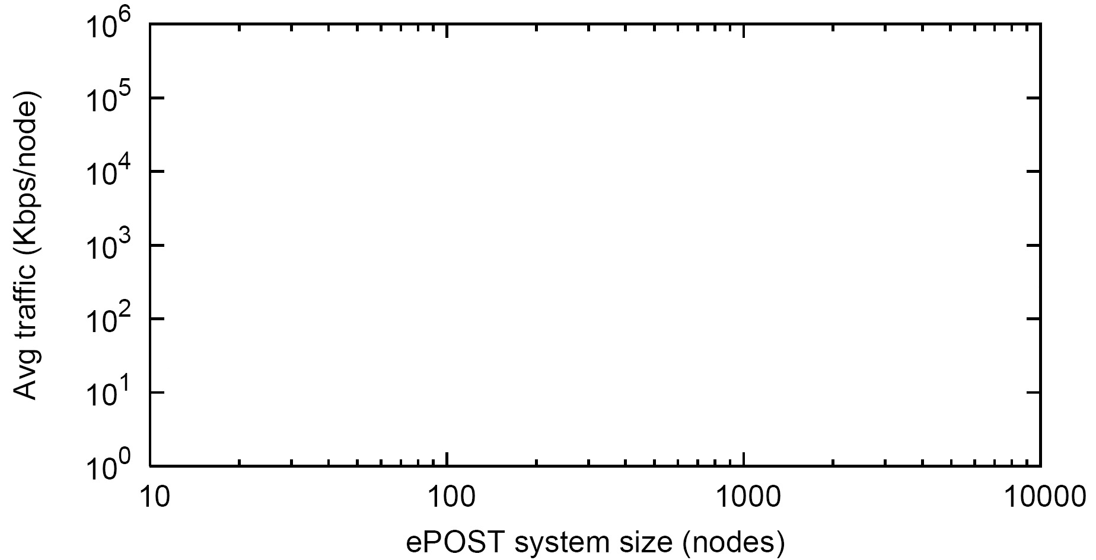
PeerReview is scalable
Email system + PeerReview
(P=1.0)
DSL/cable
upstream
Email system
+ PeerReview
(P=0.999999)
Avg traffic (Kbps/node)
Email system
w/o accountability
System size (nodes)
Assumption: Up to 10% of nodes can be faulty
Probabilistic guarantees enable scalability
  Example: Email system scales to over 10,000 nodes
  with P = 0.999999

Slide 34
Summary
Accountability is a new approach to handling
faults in distributed systems
  detects faults
  identifies the faulty nodes
  produces evidence
Practical definition of accountability:
Whenever a fault is observed by a correct node,
the system eventually generates verifiable evidence
against a faulty node
PeerReview: A system that enforces accountability
  Offers provable guarantees and is widely applicable

Slide 35
Airavat: Security and Privacy for MapReduce
Indrajit Roy, Srinath T.V. Setty, Ann Kilzer, Vitaly Shmatikov, Emmett Witchel
Acknowledgement: most slides are shamelessly borrowed from the author’s presentation.

Slide 36









Computing in the year 201X
Illusion of infinite resources
Pay only for resources used
Quickly scale up or scale down …
Data

Slide 37
Programming model in year 201X
Frameworks available to ease cloud programming
MapReduce: Parallel processing on clusters of machines
Output
Map
Reduce
Data mining
Genomic computation
Social networks
Data

Slide 38
Programming model in year 201X
Thousands of users upload their data
  Healthcare, shopping transactions, census, click stream
Multiple third parties mine the data for better service
Example: Healthcare data
Incentive to contribute: Cheaper insurance policies, new drug research, inventory control in drugstores…
Fear: What if someone targets my personal data?
  Insurance company can find my illness and increase premium

Slide 39


Privacy in the year 201X ?
Information leak?
Untrusted MapReduce program
Output
Data mining
Genomic computation
Social networks
Health Data

Slide 40
Use de-identification?
Achieves ‘privacy’ by syntactic transformations
  Scrubbing , k-anonymity …
Insecure against attackers with external information
  Privacy fiascoes: AOL search logs, Netflix dataset
Run untrusted code on the original data?
How do we ensure privacy of the users?

Slide 41
Airavat model
Airavat framework runs on the cloud infrastructure
  Cloud infrastructure: Hardware + VM
  Airavat: Modified MapReduce + DFS + JVM + SELinux
Airavat framework
1
Trusted
Cloud infrastructure

Slide 42
Airavat model
Data provider uploads her data on Airavat
  Sets up certain privacy parameters
2
Data provider
Airavat framework
1
Trusted
Cloud infrastructure

Slide 43
Airavat model
Computation provider writes data mining algorithm
  Untrusted, possibly malicious
Computation
provider
2
Data provider
Program
3
Output
Airavat framework
1
Trusted
Cloud infrastructure

Slide 44
Threat model
Airavat runs the computation, and still protects the privacy of the data providers
Threat
Computation
provider
2
Data provider
Program
3
Output
Airavat framework
1
Trusted
Cloud infrastructure

Slide 45

Programming model
Split MapReduce into untrusted mapper + trusted reducer
Limited set of stock reducers
Untrusted Mapper
MapReduce program for data mining
Trusted Reducer
No need to audit
Airavat
Data
Data

Slide 46
Challenge 1: Untrusted mapper
Untrusted mapper code copies data, sends it over the network
Peter
Peter
Chris
Map
Reduce
Meg
Leaks using system resources
Data

Slide 47
Challenge 2: Untrusted mapper
Output of the computation is also an information channel
Peter
Chris
Output 1 million if Peter bought Vi*gra
Map
Reduce
Meg
Data

Slide 48
Airavat mechanisms
Mandatory access control
Differential privacy
Prevent leaks through
storage channels like network connections, files…
Prevent leaks through the output of the computation
Output
Map
Reduce
Data

Slide 49
Enforcing differential privacy
Malicious mappers may output values outside the range
If a mapper produces a value outside the range, it is replaced by a value inside the range
  User not notified… otherwise possible information leak
Ensures that code is not more sensitive than declared
Range enforcer
Data 1
Data 2
Data 3
Data 4
Mapper
Reducer
Mapper
Range enforcer
Noise

Slide 50
Discussion
Can you trust the cloud provider?
What other covert channels you can exploit?
In what scenarios you might not know the range of the output?

