Slide 1
Cloud Computing Infrastructure Take a seat & prepare to fly
Anh M. Nguyen
CS525, UIUC, Spring 2009

Slide 2
Goals
Define
Cloud: public cloud, private cloud
Cloud Computing
Why cloud computing?
Obstacles & opportunities
Current state of cloud computing
Amazon EC2
Google AppEngine

Slide 3
What is cloud computing?
I don’t understand what we would do differently in the light of Cloud Computing other than change the wordings of some of our ads
Larry Ellision, Oracle’s CEO
I have not heard two people say the same thing about it [cloud]. There are multiple definitions out there of “the cloud”
Andy Isherwood, HP’s Vice President of European Software Sales
It’s stupidity. It’s worse than stupidity: it’s a marketing hype campaign.
Richard Stallman, Free Software Foundation founder

Slide 4
Software as a service (SaaS)
Application is used as an on demand service. Often provided via the Internet
Think on-demand TV programs
Example: Google App (online office)
Benefits to users
Reduce expenses: multiple computers, multiple users
Ease of usage: easy installation, access everywhere
Benefits to providers
Easier to maintain
Control usage (no illegal copies)

Slide 5
Utility Computing (UC)
Computing resources (cpu hour, memory, network) and platform to run software are provided as on demand service
Think electricity service
The same evolution happened
Hardware as a service (HaaS), Infrastructure as a service (IaaS), Platform as a Service (PaaS)
Examples of UC providers: Amazon EC2, Google AppEngine …
Who will use UC? Is UC the end of high-end PC?
People who otherwise has to build their own data center: SaaS providers, analytics & batch processing

Slide 6
Utility Computing - Benefit to users
Mitigate the risks of over-provisioning and under-provisioning
No up-front cost, invest on other aspects (marketing, technology…)
Less maintenance & operational cost
Save time, time = money
➔ In summary: Reduce cost

Slide 7
Utility Computing – Mitigate risks
Real world utilization 5%-20%
Animoto demand surge: from 50 servers to 3500 servers in 3 days
Black Friday sales
Capacity
Resources
Demand
Over-provisioning
t
Resources
Resources
Capacity
Capacity
Demand
Demand
On demand, scalable
t
1
2
3
t
Under-provisioning

Slide 8
Utility Computing – Benefit to providers
Make money
Economies of scale
Time diversity: different peeks for different services
Geographical diversity: choice of best location
Electric price in Idaho = 1/5 in Hawaii
Existing infrastructure & expertise
Google, Amazon: utilize off-peak capacity
Resource | Cost for medium scale | Cost for large scale | Ratio
Network | $95 / Mbps / month | $13 / Mbps / month | ~7x
Storage | $2.20 / GB / month | $0.40 / GB / month | ~6x
Administration | ≈140 servers/admin | >1000 servers/admin | ~7x

Slide 9
Utility Computing – Amazon EC2
Elastic Compute Cloud
Rent virtual machine instances to run your software. Monitor and increase / decrease the number of VMs as demand changes
How to use:
Create an Amazon Machine Image (AMI): applications, libraries, data and associated settings
Upload AMI to Amazon S3 (simple storage service)
Use Amazon EC2 web service to configure security and network access
Choose OS, start AMI instances
Monitor & control via web interface or APIs

Slide 10
Amazon EC2
Characteristics:
Elastic: increase or decrease capacity within minutes
Monitor and control via EC2 APIs
Completely controlled: root access to each instances
Flexible: choose your OS, software packages…
Redhat, Ubuntu, openSuse, Windows Sever 2003,…
Small, large, extra large instances
Reliable: Amazon datacenters, high availability and redundancies
Secure: web interface to configure firewall settings
Cost:
CPU: small instance, $0.10 per hour for Linux, $0.125 per hour for Windows (1.0-1.2 GHz 2007 Opteron or 2007 Xeon processor)
Bandwidth: in $0.10, out $0.17 per GB
Storage: $0.10 per GB-month, $0.10 per 1 million I/O requests

Slide 11
Utility Computing - Google AppEngine
Write your web program in Python and submit to Google. It will take care of the rest
How to use
Download AppEngine SDK
Develop your program locally
A set of python programs, input = requested url, output = return message
Debug locally
Register for an application id
Submit your application to Google

Slide 12
Google AppEngine – Hello world
Creating a Simple Request Handler
Create a file helloworld.py:
print 'Content-Type: text/plain' print '' print 'Hello, world!‘
Map url to handler
Edit configuration file app.yaml
application: helloworld
version: 1
handlers:
- url: /.*
script: helloworld.py
Data storage:
Distributed file system
Store using AppEngine API, retrieve using GQL
Debug: http://localhost:8080/

Slide 13
Google AppEngine
Register for an application ID
http://appengine.google.com
Verification code sent to your mobile
Uploading the Application
appcfg.py update helloworld/
Enter your Google username and password at the prompts
http://application-id.appspot.com
Manage using Administration Console
Set up domain name
Invite other people to be developers
View error logs, traffic logs
Switch between different versions

Slide 14
Google AppEngine
Characteristics
Easy to start, little administration
Scale automatically
Reliable
Integrate with Google user service: get user nickname, request login…
Cost:
Can set daily quota
CPU hour: 1.2 GHz Intel x86 processor
Free quotas going to be reduced soon
Resource | Unit | Unit cost | Free (daily)
Outgoing Bandwidth | gigabytes | $0.12 | 10GB
Incoming Bandwidth | gigabytes | $0.10 | 10GB
CPU Time | CPU hours | $0.10 | 46 hours
Stored Data | gigabytes per month | $0.15 | 1GB (all)

Slide 15
Spectrum of Abstractions
Different levels of abstraction
Instruction Set VM: Amazon EC2
Framework VM: Google AppEngine
Similar to languages
Higher level abstractions can be built on top of lower ones
Lower-level,
More flexibility,
More management
Not scalable by default
Higher-level,
Less flexibility,
Less management
Automatically scalable
EC2
Azure
AppEngine
Force.com
Notes:
3 ti

Slide 16
Detailed comparison
 | Amazon | Google AppEngine
Computation model | x86 Instruction Set Architecture Not scalable by default. Can use 3rd party service such as RightScale | Predefined 3-tiers Web app structure Fixed language: Python Automatic scaling up and down
Storage model | Scaling varies from none (EBS) to fully automatic (SimpleDB, S3) | Fixed API: BigTable Automatic scaling
Networking model | Define network access policies Choose availability zones, independent network failure Elastic IP addresses, persistently routable name Automatic scaling | Fixed topology to for 3-tier Web app structure Automatic scaling

Slide 17
What is a cloud?
Software and hardware to operate datacenters
Public cloud: cloud used to provide utility computing
Amazon EC2: Amazon datacenters, Xen, EC2 APIs and administrative interface
Google AppEngine: Google data center, GFS, AppEngine APIs, administrative interface…
Batch processing softwares: MapReduce, Hadoop, Pig, Dryad
Private cloud: datacenters, not available for rental
How about the academic clouds?
Protected clouds

Slide 18
Cloud Computing
A combination of existing concepts
SaaS Users
PaaS Users
SaaS
Utility Computing
SaaS Providers / PaaS Users
PaaS Providers
SaaS Providers

Slide 19
Cloud computing
Cloud Computing = SaaS + PaaS (utility computing)
Electricity On Demand
(PaaS)
Cloud TV
(Cloud Computing)
Video On Demand
(SaaS)

Slide 20
What is new in Cloud Computing
The illusion of infinite computing resources
The elimination of an up-front commitment by users
The ability to use and pay on demand
Cloud Computing vs P2P?
Both take advantage of remote resources
P2P: does not use clouds (datacenters), peers do not get paid, lower reliability
Cloud Computing vs Grid Computing?
Both use clouds
Grid Computing requires commitment, share based on common interests. Not public cloud

Slide 21
Cloud Killer Apps
Mobile and web applications
Mobile devices: low memory & computation power
Extensions of desktop software
Matlab, Mathematica
Batch processing / MapReduce
Peter Harkins at The Washington Post: 200 EC2 instances (1,407 server hours), convert 17,481 pages of Hillary Clinton’s travel documents within 9 hours
The New York Times used 100 Amazon EC2 instances + Hadoop application to recognize 4TB of raw TIFF image into 1.1 million PDFs in 24 hours ($240)

Slide 22
Should I move into a cloud
Does it really save money?
Cost_{cloud} > Cost_{datacenter} , balance by Utilization
UserHours_{cloud} > UserHours_{datacenter} (under-provisioning)
Other factors
Re-implement programs
Move data into cloud
What else?
Example:
Upload rate 20Mbits / s. 500GB takes 55 hours
If can process locally in less than 55 hours → moving into a cloud would not save time

Slide 23
Adoption Challenges
Challenge | Opportunity
Availability | Multiple providers
Data lock-in | Standardization
Data Conﬁdentiality and Auditability | Encryption, VLANs, Firewalls
Coghead, a cloud vendor closed its business a week ago
Customers need to rewrite their applications
Online storage service The Linkup closed July 10, 2008
20,000 paying subscribers lost their data
23

Slide 24
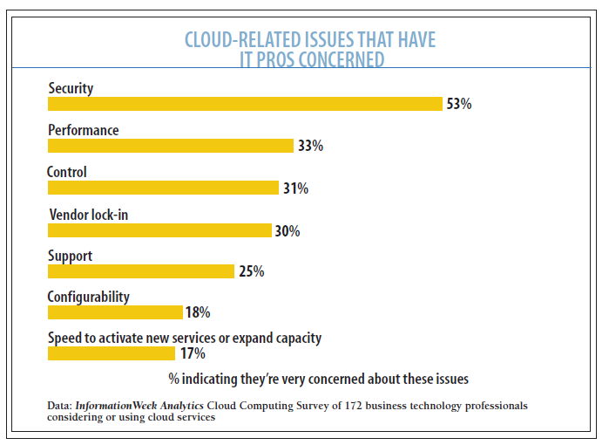
Adoption Challenges
Cloud Control, InformationWeek Reports, 2009

Slide 25
Growth Challenges
Challenge | Opportunity
Data transfer bottlenecks | FedEx-ing disks, reuse data multiple times
Performance unpredictability | Improved VM support, flash memory
Scalable storage | Invent scalable storage
Bugs in large distributed systems | Invent Debugger using Distributed VMs
Scaling quickly | Invent Auto-Scaler

Slide 26
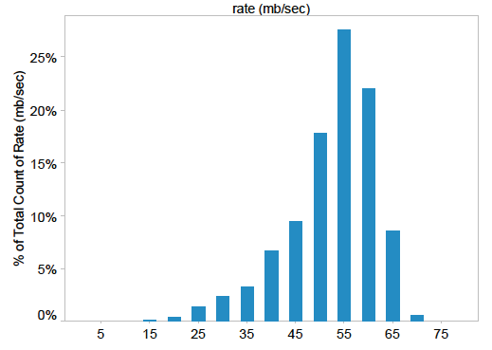
Growth Challenges
Data transfer bottle neck
WAN cost reduces slowest:
2003 → 2008: WAN 2.7x, CPU 16x, storage 10x
Fastest way to transfer large data: send the disks
Performance unpredictability
Large variation in I/O operations
Inefficiency in I/O virtualization

Slide 27
Policy and business challenge
Challenge | Opportunity
Reputation Fate Sharing | Offer reputation-guarding services like those for email
Software Licensing | Pay-for-use licenses; Bulk use sales
Reputation: Many blacklists use IP addresses and IP ranges
Software licensing:
Open source software readily applicable
Windows, IBM softwares offered per hour for EC2

Slide 28
The future?
Application software:
Cloud & client parts, disconnection tolerance
Infrastructure software:
Resource accounting, VM awareness
Hardware systems:
Containers, energy proportionality

Slide 29
Discussion
Is their definition correct?
What applications of cloud computing in your research area that you can think of?
Which service would you choose, EC2 or GoogApp?
Can you predict the future of cloud computing?

Slide 30
references
Above the Clouds: A Berkeley View of Cloud Computing, Michael Armbrust et al, Feb 2009 (white paper and presentation)
Google AppEngine: http://code.google.com/appengine/
Amazon EC2: http://aws.amazon.com/ec2/
Lessons From The Demise Of A Cloud Startup, John Foley, Feb 2009
Cloud Control, InformationWeek Reports, 2009

Slide 31
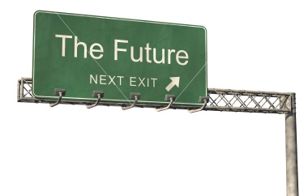
Are you ready for a ride?

Slide 32
Backup Slides

Slide 33
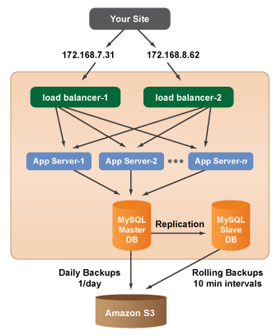
Rightscale
$2500 initial fee
$500 monthly

