Slide 1

VR Software
CS 498 VR
UNIVERSITY OF ILLINOIS AT URBANA-CHAMPAIGN

Slide 2
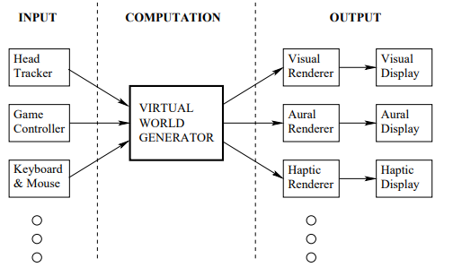
VR System: Software
Our conception of a VR software system will rely on Virtual World Generator (VWG) to generate an alternative reality
This alternative world can be totally synthetic or based on data captured from the real-world or a combination.
3D images from synthetic models are generated using computer graphics techniques
Real-world data can be capture using cameras (often specialized)
Combining both is often referred as augmented reality or mixed-reality.
  Augmented reality often has the connotation of being a real-time operation.
Notes:
Trackers → Configuration updates for tracking → Virtual World Generator controls the geometry and physics inside the virtual world → Rendering → Display

Slide 3
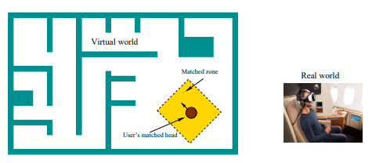
VWG Tasks
Matched Motion
A matched zone is a safe region in which a correspondence is maintained between the user motion in the real and virtual world. The safe region must be free from dangers in the real world.
The VWG must alter the virtual world in concert with user movements.
User Locomotion
Often, it is necessary to provide a mechanism for non-matched motion that allows the user to move through the virtual and explore it. Examples include navigating via mini-map or using a game controller to move through world. This type of motion can lead to motion-sickness.
Types of self motion:
________________________________________________________________
________________________________________________________________
Notes:
Types of self-motion
The user moves their physical self
The user moves their virtual self only

Slide 4
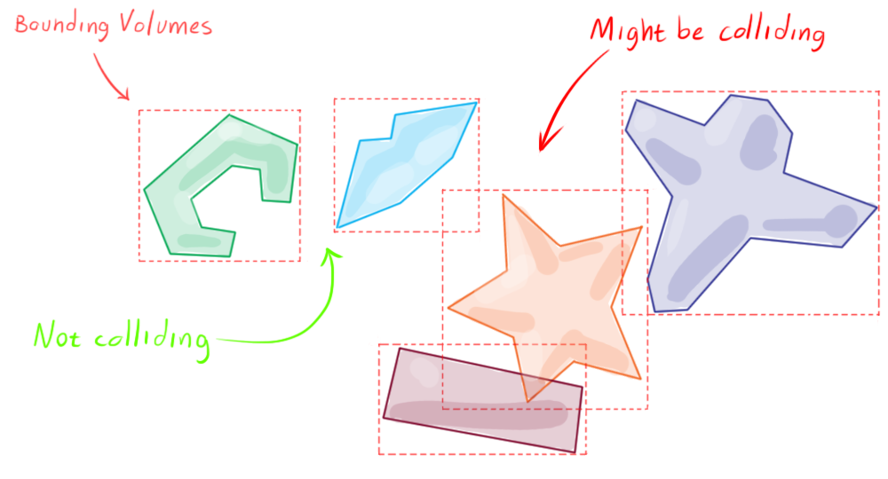
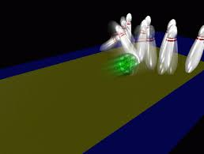
VWG Tasks
What makes collision detection hard? Can anyone suggest some reasons?
Physics
The VWG typically provides some approximation of real-world physics (e.g. collision detection and resolution). This is a surprisingly complicated task…
Networked Experiences
The VWG must maintain coherence in shared worlds. One user’s actions must be seen throughout the shared world and interactions must be handled in a realistic manner.
Types of self motion:
________________________________________________________________
________________________________________________________________
Notes:
Types of self-motion
The user moves their physical self
The user moves their virtual self only

Slide 5
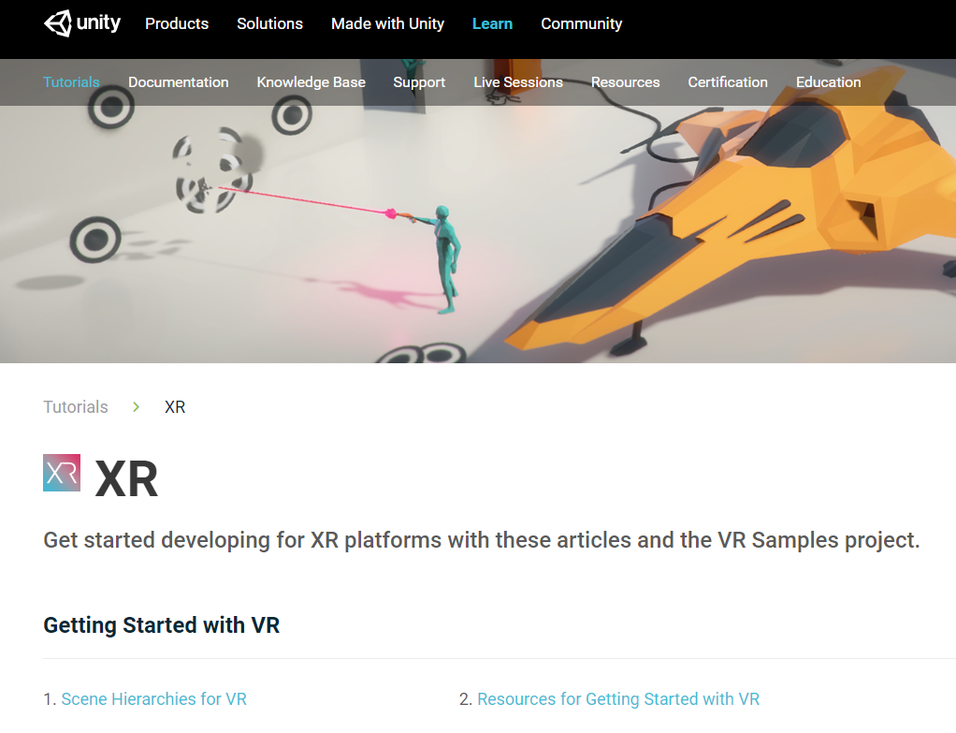
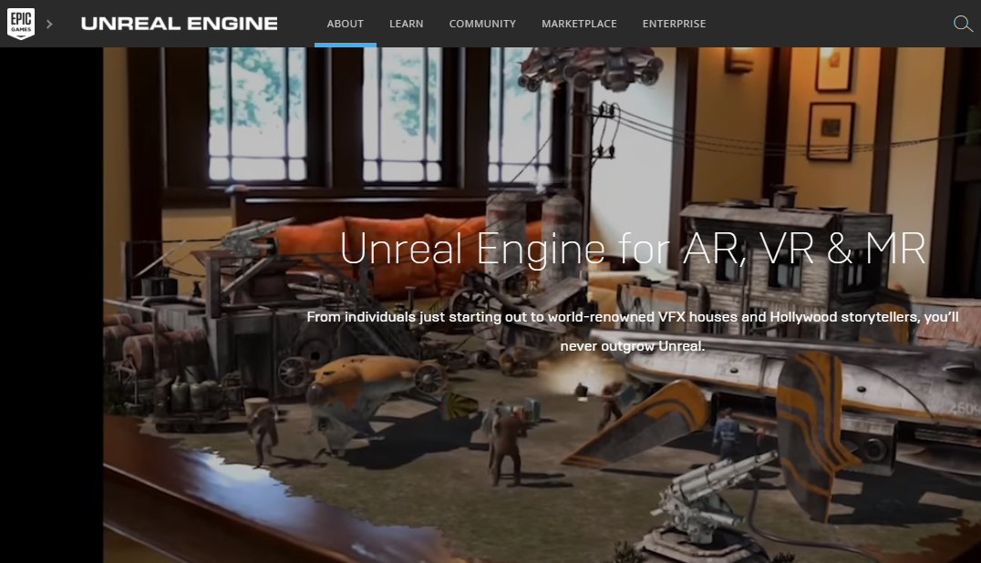

Developer Choices for VWGs
Unity (…using C#) ←recommended
  You will use it for the MPs & lots of support available on/off campus
Unreal (…using C++)
A-Frame/WebVR (uses JavaScript and HTML)
...I wouldn’t recommend trying to build an application from lower level tools like WebGL or DirectX
…someone tell me why…

Slide 6
Sensation and Perception
CS 498 VR
UNIVERSITY OF ILLINOIS AT URBANA-CHAMPAIGN

Slide 7
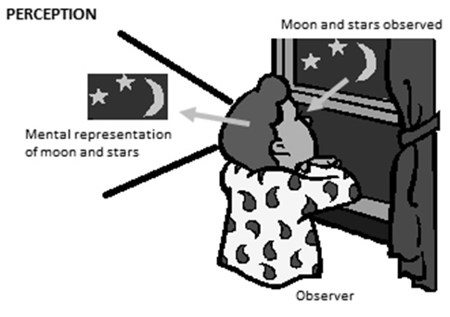
Perceptual Psychology
Perceptual psychology seeks to understand how the brain converts sensory stimulation into perceived phenomena.
Here are some typical questions that arise in VR and fall under this umbrella:
How far away does that object appear to be?
How much video resolution is needed to avoid seeing pixels?
How many frames per second are enough to perceive motion as continuous?
Is the user’s head appearing at the proper height in the virtual world?
Where is that virtual sound coming from?
Why am I feeling nauseated?
Why is one experience more tiring than another?
What is presence?

Slide 8
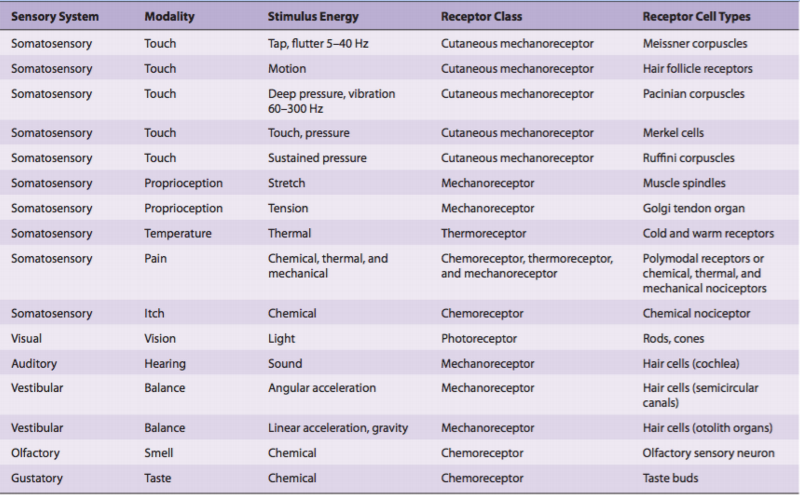
Human Senses
People often believe their senses produce very accurate data about reality
  This is not really true….

Slide 9
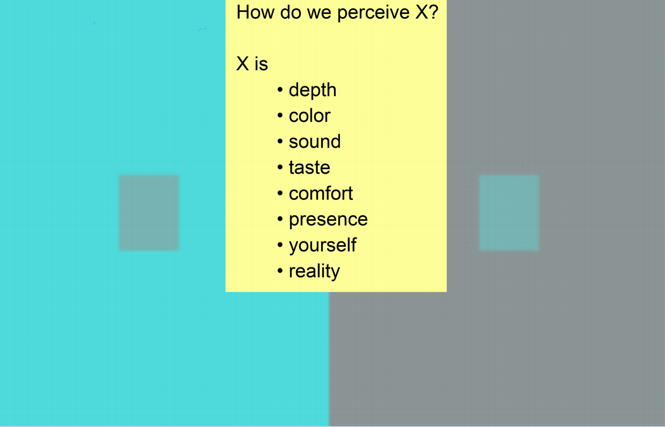
What is Reality? Sensation and Perception
Notes:
Perception to become aware of (to perceive) through processing of sensory information
Alt: (derived from http://www.businessdictionary.com/definition/perception.html):Perception is process translating sensory impressions into a coherent and unified view of the world around them.
Attention is a limited resource, so selective attention allows us to tune out unimportant details and focus on what really matters.
Source: https://i.stack.imgur.com/Of40B.jpg

Slide 10

Optical Illusions
Ponzo Illusion

Slide 11
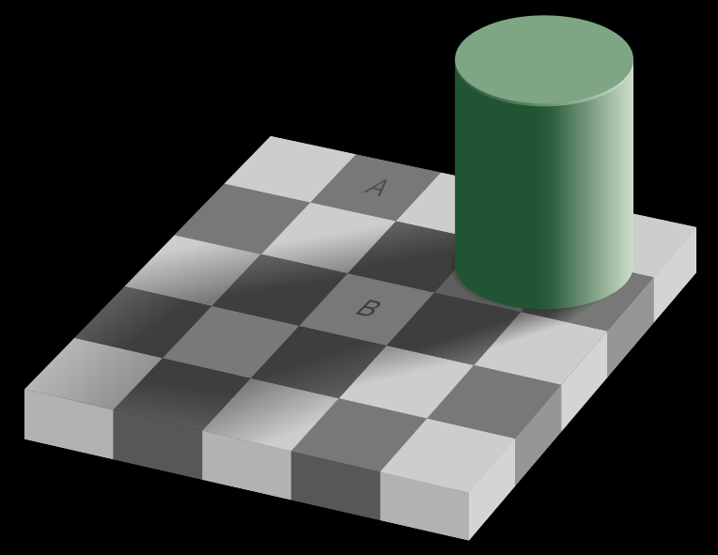
Optical Illusion…or Not?

Slide 12

Optical Illusion

Slide 13
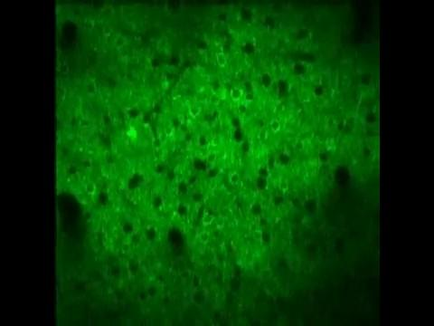
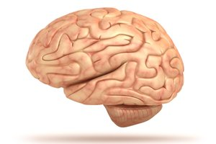

Neural Processing
Cerebral Cortex
Only found in mammals
Handle perception, memory, language…
Sheet of neurons
3mm thick, heavily folded
https://www.youtube.com/watch?v=kQxsTyNKtqg
Neurons firing
https://en.wikipedia.org/wiki/List_of_animals_by_number_of_neurons
Notes:
Videos 1 and 2- Both videos are of neurons firing in the brain
Wikipedia has a page with the number of neurons that each animal has - notice elephants have way more than us, fruit flies have more than lobsters for example; no direct correlation

Slide 14
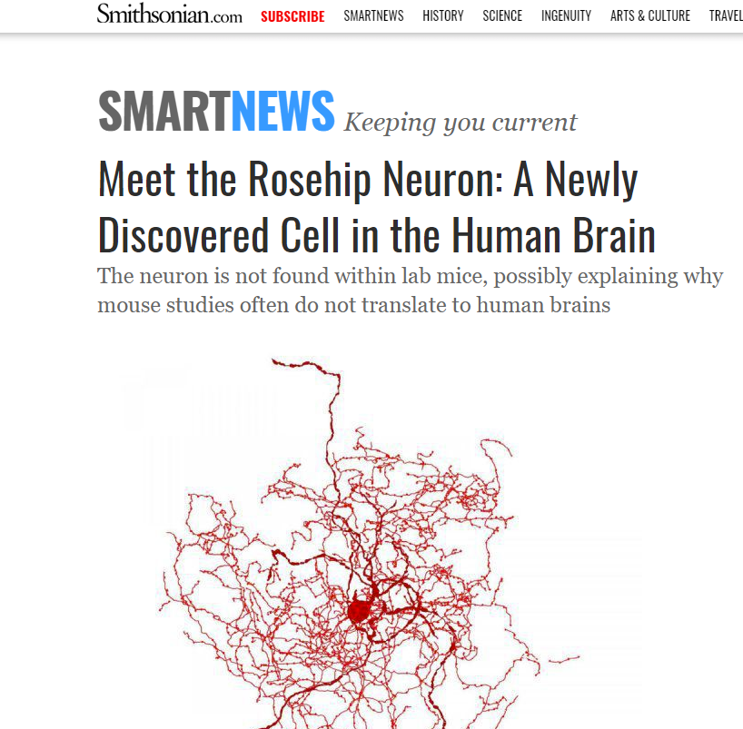
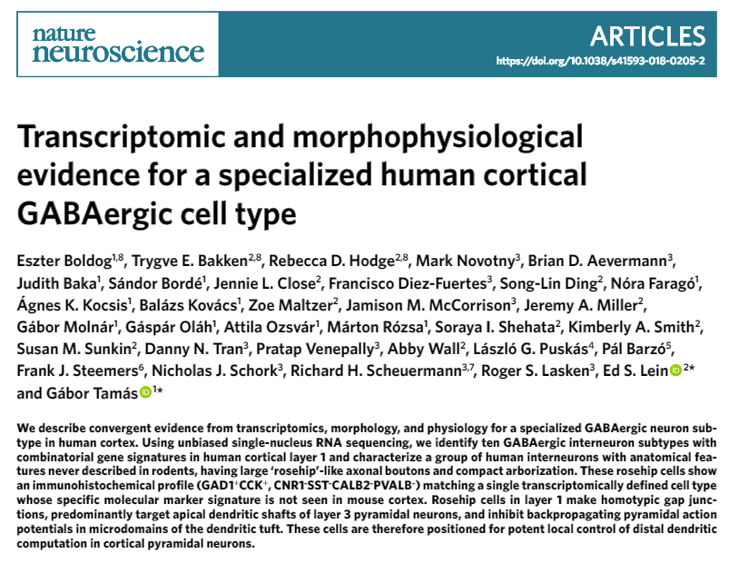
Neural Processing
September 2018….
→

Slide 15
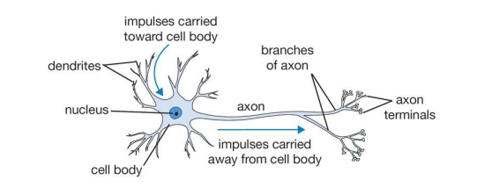
Neural Processing
Neuron count is not the only attribute that matters
It is an over-simplified model but you can consider neurons a directed graph
Dendrites are input edges
Axons are output edges
Lots of branching…very unconstrained structure
Synapse is the space between a dendrite-axon pair
About 7000 synaptic connections per neuron…10¹⁵ edges

Slide 16
Hierarchical Processing
Signals from multiple receptors are combined
And then combined with signals based on life experience

Slide 17
Proprioception
Proprioception is the ability to sense the relative positions of parts of our bodies
….and the amount of muscular eﬀort being involved in moving them.
Motor cortex sends efference copies to other parts of brain
Communicates what motions have happened.
…it why you can’t tickle yourself….

Slide 18
Fusion of Senses
So…perception typically involves multiple sensory inputs plus experience
Processing gets wacky* when an input is present without others usually present
Can cause
Fatigue
Headaches
Nausea
*wacky → technical term indicating that something is not typical or normal

Slide 19
Vection
Vection is the sensation of movement of the body in space produced purely by visual stimulation.
Notes:
Image source: https://commons.wikimedia.org/wiki/File:Guatemala_bus_front.jpg
In part, this perceptual response to sustained visual motion has probably evolved as an adaptation to the fact that signals from the vestibular apparatus in the inner ear decay quite quickly during constant rotation or linear movement of the head. The sensation of vection produced purely by visual stimulation tends to build up fairly slowly, in a way that complements the decay of the vestibular sensation of movement

Slide 20
Adaptation
Perceptually, adaptation means the perceived effect of stimuli changes over time
Perceived loudness of noises decreases in minutes
Our vision rapidly adapts to changes in light
Anecdotally, gaming with FPS games all the time leads to less nausea
Can be useful in debugging…you can train to perceive things such as
  A large amount of tracking latency has appeared
  The left and right eye views are swapped.
  Objects appear to one eye but not the other.
  One eye view has signiﬁcantly more latency than the other.
  Straight lines are slightly curved due to uncorrected warping in the optical system

Slide 21
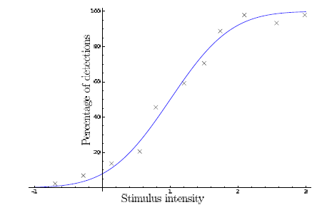
Psychophysics
Psychophysics is the scientiﬁc study of perceptual phenomena that are produced by physical stimuli.
Example:
Under what conditions is a light perceived as red?
Experiment:
Vary frequency of a mono-chromatic light until people call it red.

Slide 22
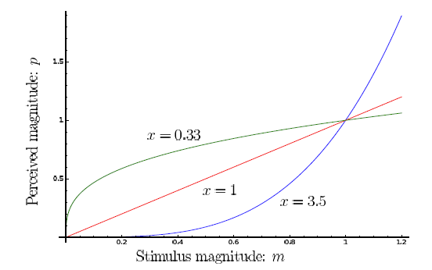
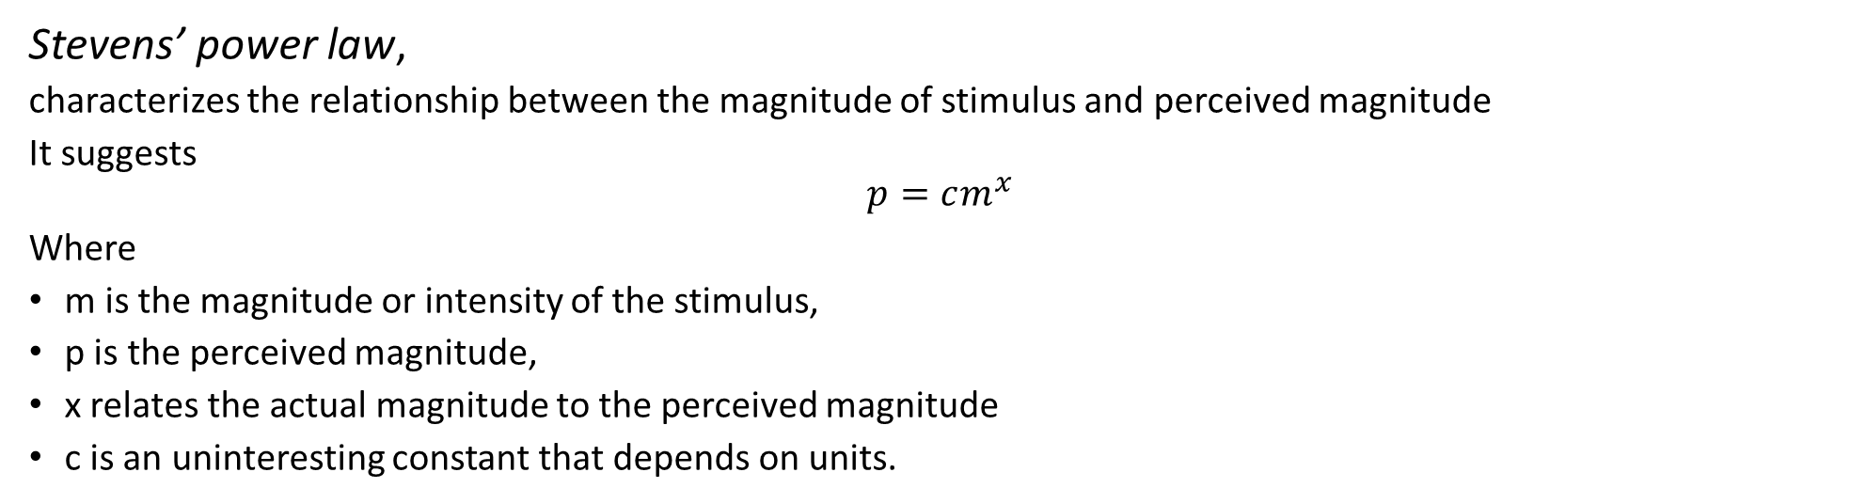
Stevens’ Power Law
Stevens’ power law,
characterizes the relationship between the magnitude of stimulus and perceived magnitude
It suggests
$$p=cm^{x}$$
Where
m is the magnitude or intensity of the stimulus,
p is the perceived magnitude,
x relates the actual magnitude to the perceived magnitude
c is an uninteresting constant that depends on units.

Slide 23
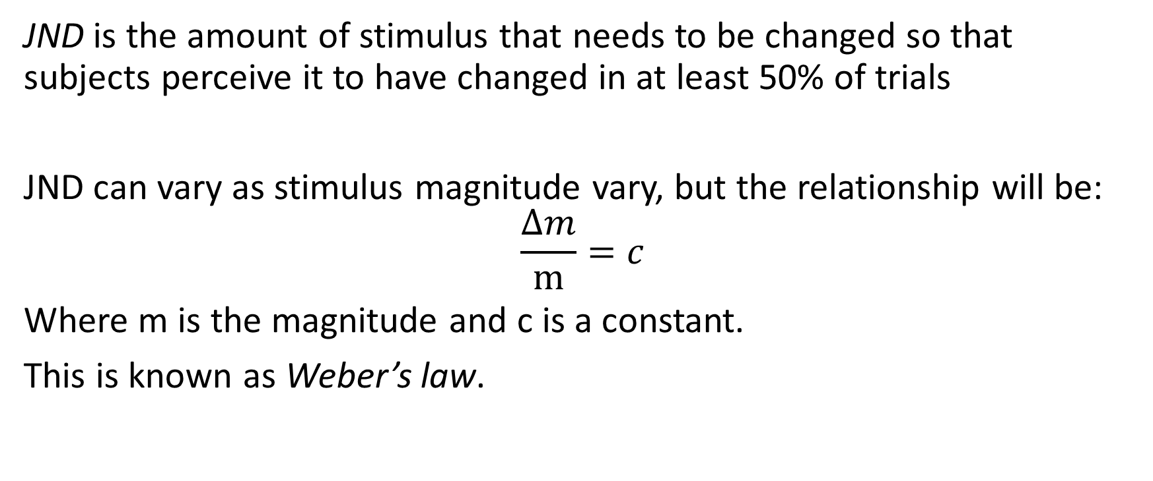
Just Noticeable Difference (JND)
JND is the amount of stimulus that needs to be changed so that subjects perceive it to have changed in at least 50% of trials
JND can vary as stimulus magnitude vary, but the relationship will be:
$$\frac{Δm}{m}=c$$
Where m is the magnitude and c is a constant.
This is known as Weber’s law.

Slide 24
Design of Experiments
…is very difficult
How many subjects are enough?
How do you measure adaptation to the experiment?
How do you control for prior experience?
What did the subjects eat for breakfast?
Is your data gathered via questionnaire? Will they answer honestly?
Can you make inferences about perception from other data?
…heart rate…etc….
This doesn’t mean it shouldn’t be done.
It means it should be done as carefully as possible…and with great effort.

Slide 25
Case Study: Depth Perception
How do we perceive how far away an object is?
Classic example of sensory fusion.
What are some of the multiple data we use to perceive depth?
Notes:
Depth perception: visual ability to perceive objects in 3D and distance to objects
Cues: binocular, monocular

Slide 26
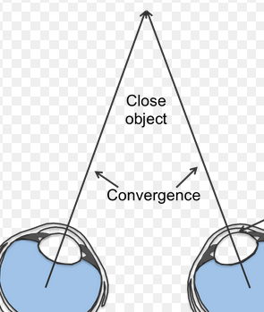
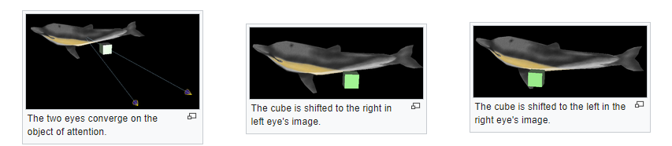
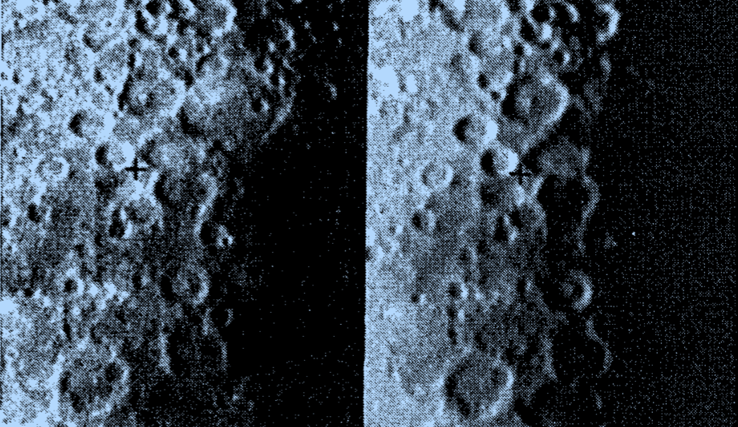
Binocular Cues
Convergence
Stereoscopic disparity / Binocular disparity
Shadow Stereopsis
Notes:
Moone Image from Puerta’s paper. Moon surface pictures 25 hours apart. Antonio Medina Puerta (JPL). The power of shadows: shadow stereopsis (Vol. 6, No. 2/February 1989/J. Opt. Soc. Am. A) “Shadows can create abrupt luminance changes in the scene but are neither edges nor boundaries, and their position varies with the position of the light sources. It is demonstrated that retinal images with no parallax disparity but with different shadows are fused stereoscopically, imparting depth perception to the imaged scene. Shadows are shown to be an important, hitherto undescribed stereoscopic cue for depth perception.”

Slide 27

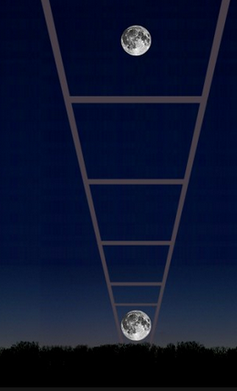
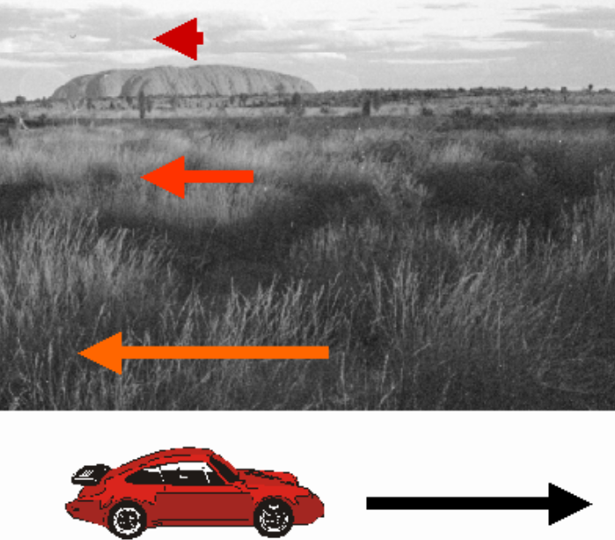
Monocular Cues
Relative Size
Absolute Size and Familiar Size
Elevation
Texture Gradient
Motion Parallax (demo)
Notes:
https://www.verywell.com/what-are-monocular-cues-2795829
Moon is ~ 240,000 miles away. Objects located closer to the horizon tend to be perceived as farther away,
https://usm.maine.edu/planet/moon-really-larger-when-it-horizon-i-heard-moons-distance-isnt-always-same-it-closer-when-it
https://www.tes.com/lessons/y2jlOT0AUujRVQ/gestalt-principles

Slide 28

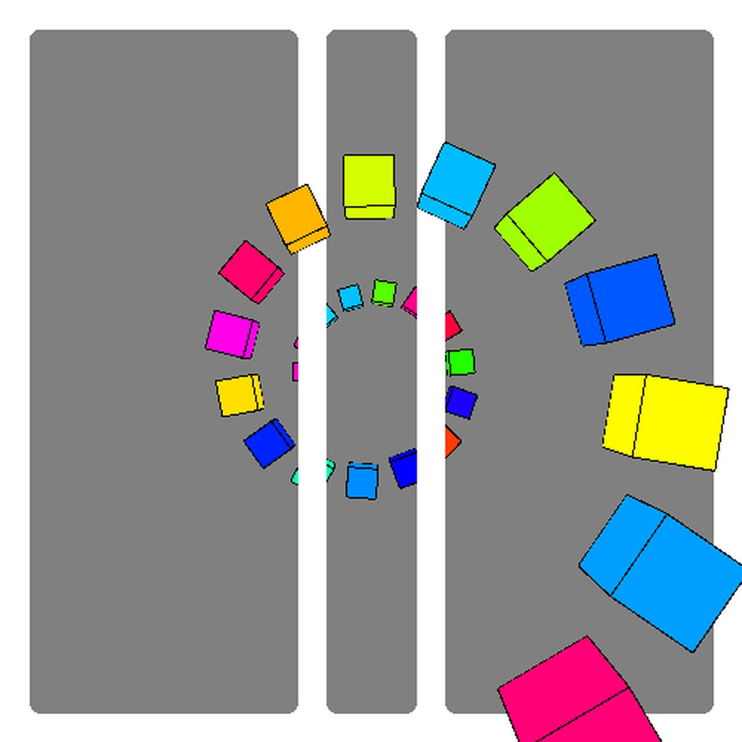
Monocular Cues
Aerial Perspective (distance fog)
Linear Perspective
Overlap (or Interposition) (demo)
Shading and Lighting
Accommodation
Notes:
https://www.verywell.com/what-are-monocular-cues-2795829
Aerial - Objects that are farther away seem to be blurred or slightly hazy due to the atmosphere.
Parallel lines appear to meet as they travel into the distance
Objects that are darkened and obscured MAY appear further away
Image overlap demo (example of “split depth”): https://giphy.com/gifs/3d-splitdepth-GGkqULbznGpLW

Slide 29

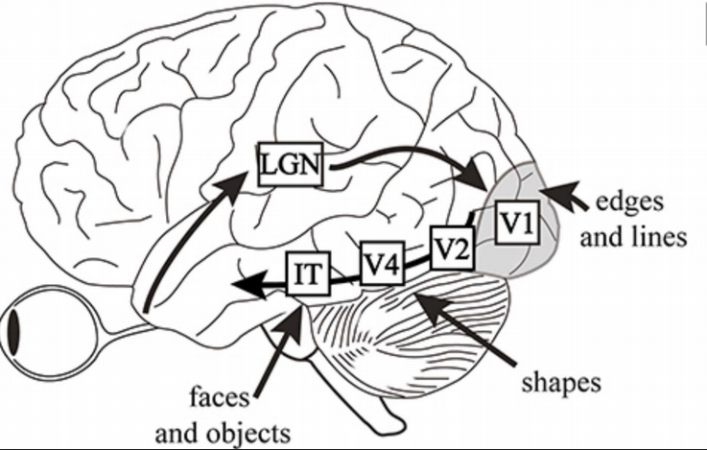
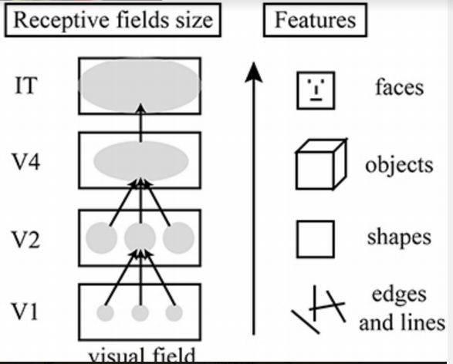
Stimuli Hierarchical Processing
https://youtu.be/A4QcyW-qTUg
Notes:
The average number of neurons in the adult human primary visual cortex in each hemisphere has been estimated at around 140 million. V1 has a very well-defined map of the spatial information in vision including blind spot. Cells are tuned to simple properties such as orientation, spatial frequency, and colour. The responses of many V2 neurons are also modulated by more complex properties. V4 is tuned for object features of intermediate complexity and modulated by attention. IT = inferotemporal cortex (Faces). The lateral geniculate nucleus (LGN; also called the lateral geniculate body or lateral geniculate complex) is a relay center in the thalamus for the visual pathway. It receives a major sensory input from the retina. The LGN is the main central connection for the optic nerve to the occipital lobe, particularly the primary visual cortex. In humans, each LGN has six layers of neurons (grey matter) alternating with optic fibers (white matter). [Source: Wikipedia]

Slide 30
Stimuli Fusion: Balance + Vision
Vection
Why is this important?
Vestibulo-ocular reflex (VOR)
Why is this important?
Perception of stationarity
https://youtu.be/RbOQFIo3g44
https://youtu.be/mlbyNq8KedQ
Notes:
The audio in the video for vection you don’t need to hear (mute it). The point is the background image is moving, and either you see the jitter as it moves in, or you get the sensation that the station is moving towards you. Vection is the illusion that you are moving when you aren’t actually moving (also commonly called the illusion of self-motion). A good example is when you are standing stationary on a platform and a train goes by, you feel like you are moving past the train instead of the reality that the train is moving and you are holding still.
The vestibulo-ocular reflex. A rotation of the head is detected, which triggers an inhibitory signal to the extraocular muscles on one side and an excitatory signal to the muscles on the other side. The result is a compensatory movement of the eyes.

Slide 31
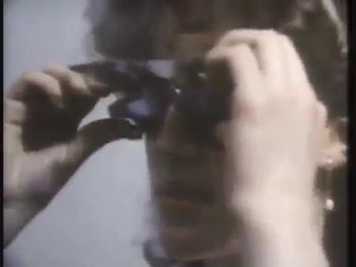
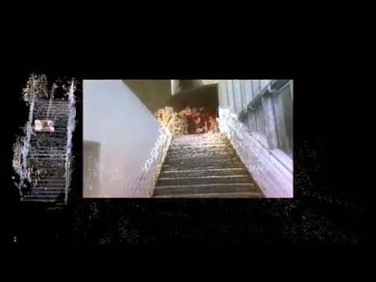

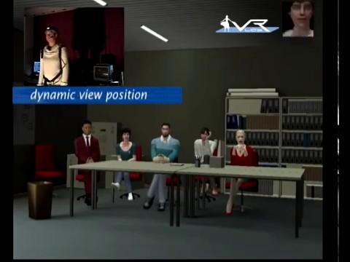
How Does Our Brain Piece Images Together?
https://youtu.be/MHMvEMy7B9k
https://youtu.be/2NcUkvIX6no
https://youtu.be/eR2j-fh18mk
https://youtu.be/3_dm7jSX4Cw
Notes:
Video 4- a video of an old experiment where a woman wore glasses that inverted her world, and how she adapted. Video 5- a video that tracked where Cristiano Ronaldo, a famous footballer, looked. Video 6- A 3D reconstruction of a staircase based on pupil tracking. Video 7- An experiment where participants were in VR, and had their eyes tracked.

Slide 32
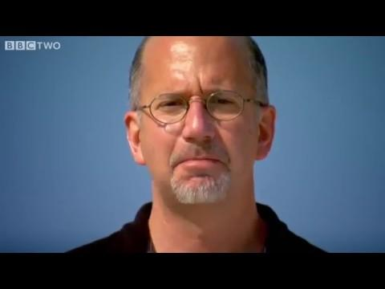
Stimuli Fusion: Speech Processing
https://www.youtube.com/watch?v=G-lN8vWm3m0 (0:32-2:30)
Notes:
Video 8- an illustration of the McGurk Effect

Slide 33
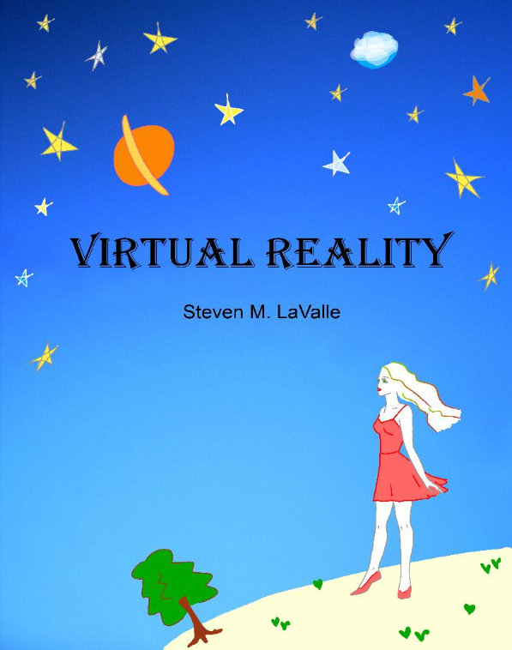
First Homework Assignment!
Machine Problem (MP) 1 is released!
See course website under Assignments tab.
You must work with a partner; find a buddy on Piazza
MP’s are submitted on Compass.
Only one of the partners should submit the zip file to us.
Be sure to name it with both NetID’s so we know who it’s for.
Other policies to know regarding assignments on course website
(late submissions, etc)
Lavalle, CH 2.3 & 3
Notes:
Problem with the lab computers - MP will be released later this week

