Slide 1
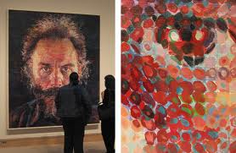
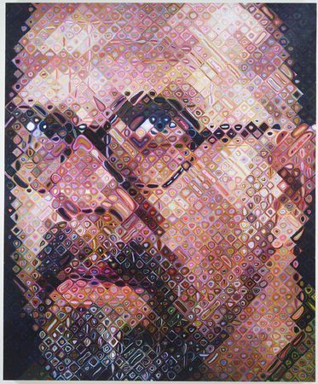
Face Detection and Recognition
10/28/10
Lucas by Chuck Close
Chuck Close, self portrait
Computational Photography
Derek Hoiem, University of Illinois
Some slides from Lana Lazebnik, Silvio Savarese, Fei-Fei Li

Slide 2
Administrative stuff
Previous class?
Project 4: vote for faves
Midterm (Nov 9)
  Closed book – can bring one loose-leaf page of notes
  Some review Nov 4
Project 5 (due Nov 15)

Slide 3

Face detection and recognition
Detection
Recognition
“Sally”

Slide 4
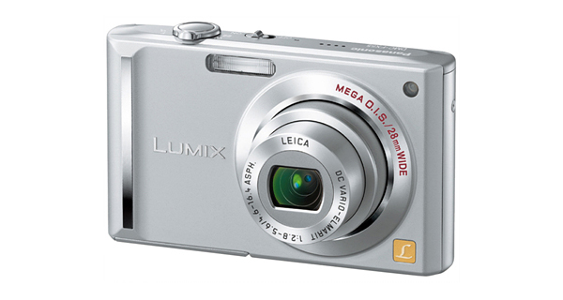
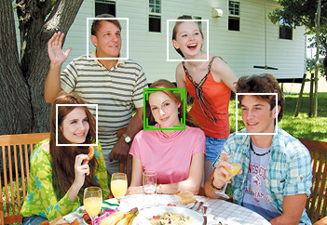
Applications of Face Recognition
Digital photography

Slide 5
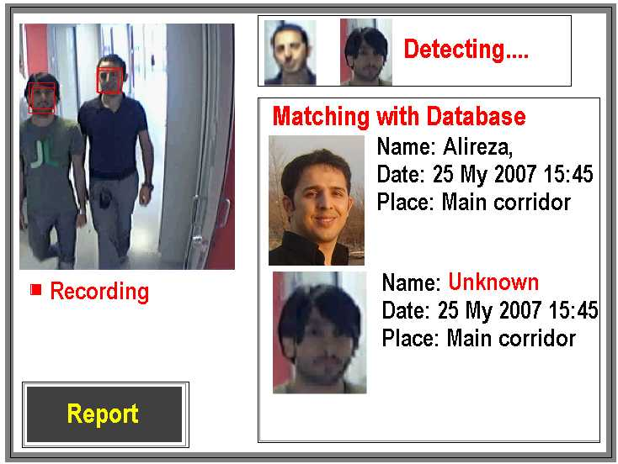
Applications of Face Recognition
Digital photography
Surveillance

Slide 6
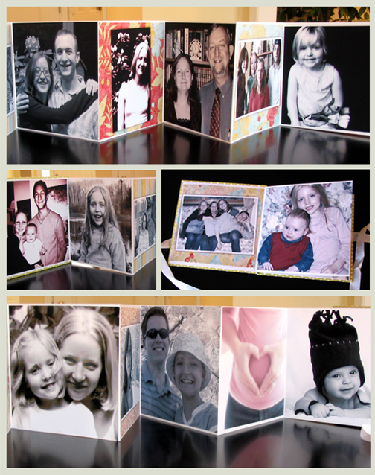
Applications of Face Recognition
Digital photography
Surveillance
Album organization

Slide 7
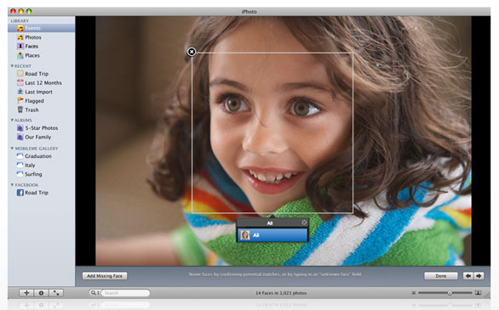
Consumer application: iPhoto 2009
http://www.apple.com/ilife/iphoto/

Slide 8
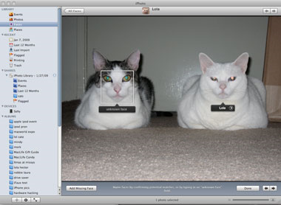
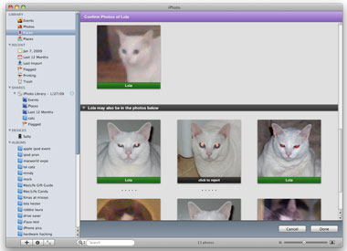
Consumer application: iPhoto 2009
Can be trained to recognize pets!
http://www.maclife.com/article/news/iphotos_faces_recognizes_cats

Slide 9
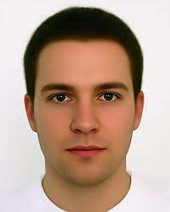
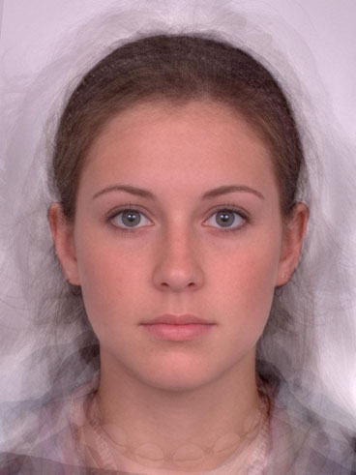
What does a face look like?

Slide 10
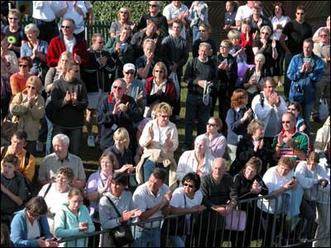
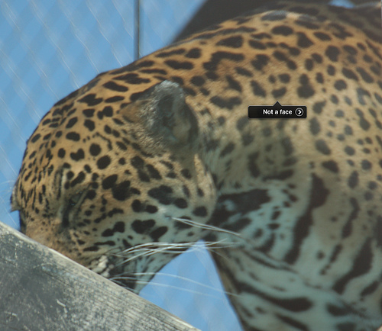
What does a face look like?

Slide 11
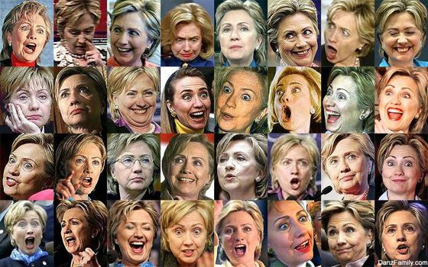
What makes face detection hard?
Expression

Slide 12
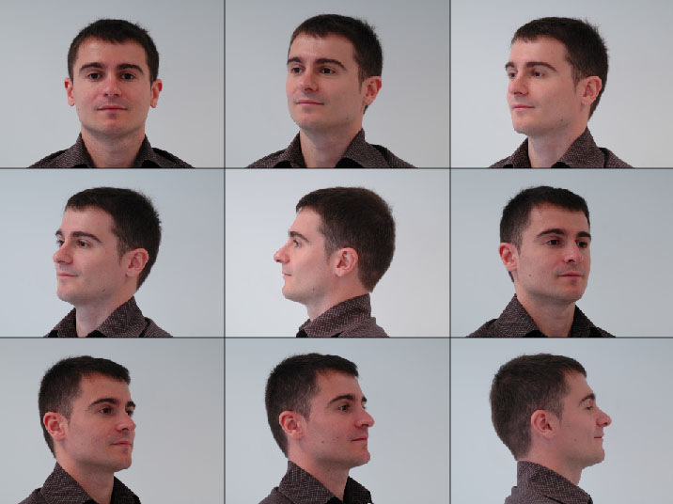
What makes face detection hard?
Viewpoint

Slide 13
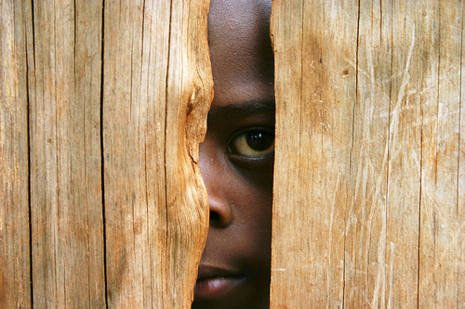
What makes face detection hard?
Occlusion

Slide 14
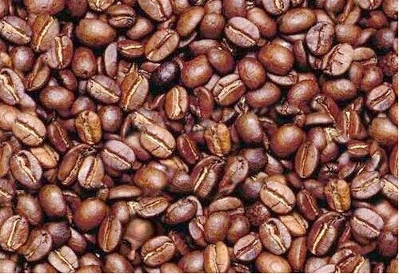
What makes face detection hard?
Distracting background

Slide 15
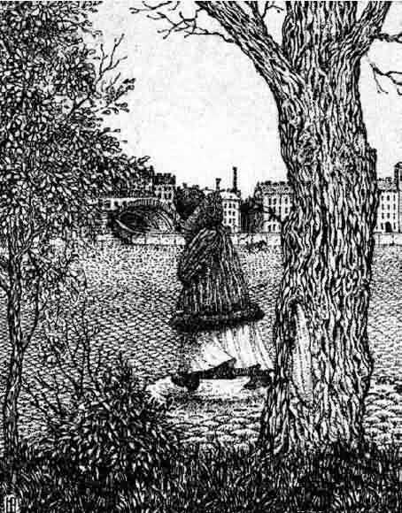
What makes face detection and recognition hard?
Coincidental textures

Slide 16
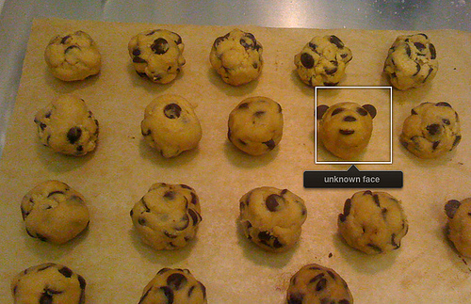
Consumer application: iPhoto 2009
Things iPhoto thinks are faces

Slide 17
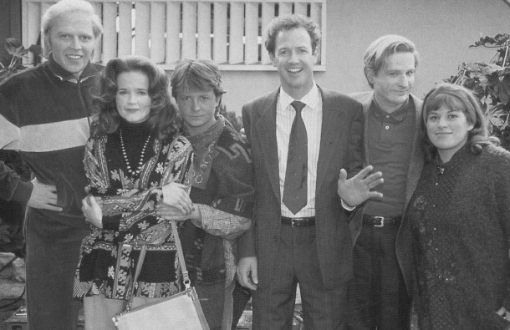
How to find faces anywhere in an image?

Slide 18

Face detection: sliding windows
Face or
Not Face
…
How to deal with multiple scales?

Slide 19
Face classifier
Training
Training Labels
Training Images
Image Features
Classifier Training
Trained Classifier
Testing
Image Features
Trained Classifier
Prediction
Face
Test Image

Slide 20
Face detection
Face or
Not Face
…
Face or
Not Face

Slide 21



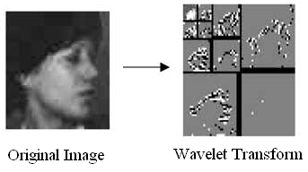
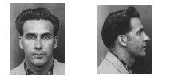
What features?
Exemplars
(Sung Poggio 1994)
Intensity Patterns (with NNs)
(Rowely Baluja Kanade1996)
Edge (Wavelet) Pyramids
(Schneiderman Kanade 1998)
Haar Filters
(Viola Jones 2000)

Slide 22
How to classify?
Many ways
  Neural networks
  Adaboost
  SVMs
  Nearest neighbor

Slide 23
Statistical Template
Object model = log linear model of parts at fixed positions
?
+3
+2
-2
-1
-2.5
= -0.5
> 7.5
Non-object
?
+4
+1
+0.5
+3
+0.5
= 10.5
> 7.5
Object

Slide 24
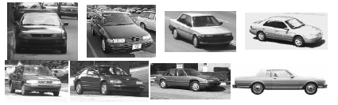
Training multiple viewpoints
Train new detector for each viewpoint.

Slide 25
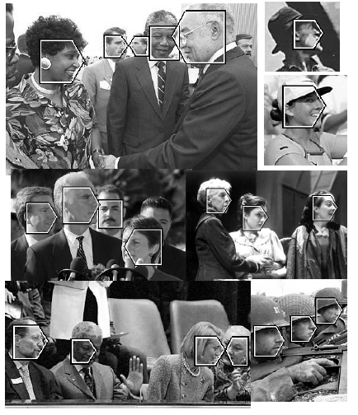
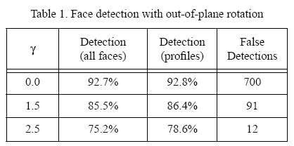
Results: faces
208 images with 441 faces, 347 in profile

Slide 26
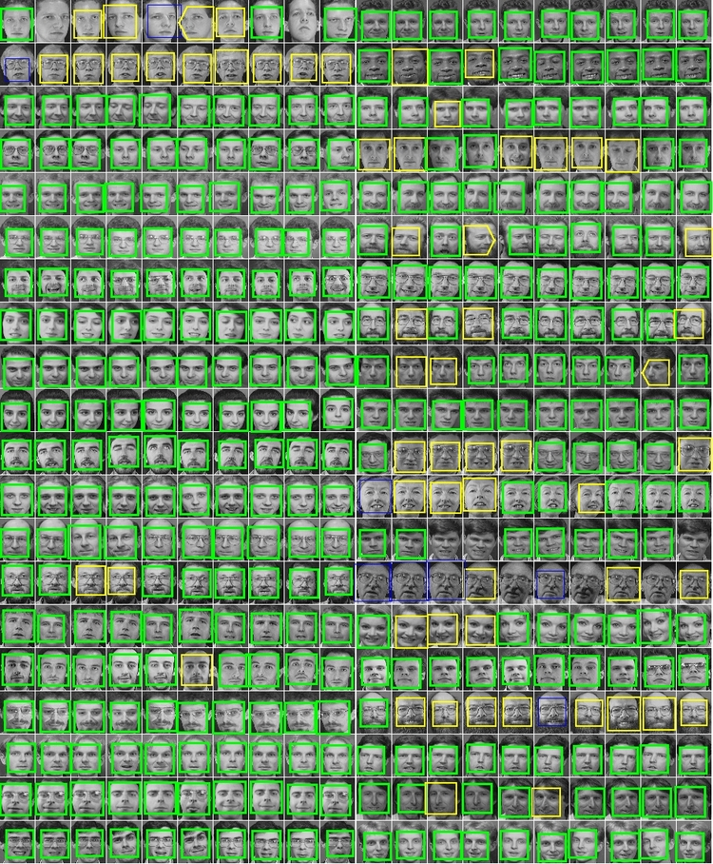
Results: faces today
http://demo.pittpatt.com/

Slide 27
Face recognition
Detection
Recognition
“Sally”

Slide 28
Face recognition
Typical scenario: few examples per face, identify or verify test example
What’s hard: changes in expression, lighting, age, occlusion, viewpoint
Basic approaches (all nearest neighbor)
  Project into a new subspace (or kernel space) (e.g., “Eigenfaces”=PCA)
  Measure face features
  Make 3d face model, compare shape+appearance (e.g., AAM)

Slide 29
What makes face recognition hard?
Some of the same stuff
  Change in expression
  Occlusion
  Viewpoint
Beards and glasses
Age
Lots of different faces

Slide 30

Simple idea
Treat pixels as a vector
Recognize face by nearest neighbor

Slide 31
The space of all face images
When viewed as vectors of pixel values, face images are extremely high-dimensional
  100x100 image = 10,000 dimensions
  Slow and lots of storage
But very few 10,000-dimensional vectors are valid face images
We want to effectively model the subspace of face images

Slide 32
The space of all face images
Eigenface idea: construct a low-dimensional linear subspace that best explains the variation in the set of face images

Slide 33
Principal Component Analysis (PCA)
Given: N data points x₁, … ,x_{N} in R^{d}
We want to find a new set of features that are linear combinations of original ones:
u(x_{i}) = u^{T}(x_{i} – µ)
(µ: mean of data points)
Choose unit vector u in R^{d} that captures the most data variance
Forsyth & Ponce, Sec. 22.3.1, 22.3.2

Slide 34
Principal Component Analysis
Direction that maximizes the variance of the projected data:
N
Maximize
subject to ||u||=1
Projection of data point
N
1/N
Covariance matrix of data
The direction that maximizes the variance is the eigenvector associated with the largest eigenvalue of Σ

Slide 35
Implementation issue
Covariance matrix is huge (N² for N pixels)
But typically # examples << N
Simple trick
  X is matrix of normalized training data
  Solve for eigenvectors u of XX^{T} instead of X^{T}X
  Then X^{T}u is eigenvector of covariance X^{T}X
  May need to normalize (to get unit length vector)

Slide 36
Eigenfaces (PCA on face images)
Compute covariance matrix of face images
Compute the principal components (“eigenfaces”)
  K eigenvectors with largest eigenvalues
Represent all face images in the dataset as linear combinations of eigenfaces
  Perform nearest neighbor on these coefficients
M. Turk and A. Pentland, Face Recognition using Eigenfaces, CVPR 1991

Slide 37
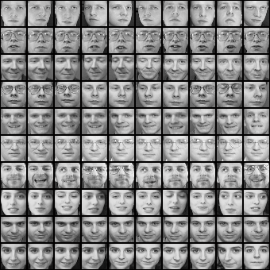
Eigenfaces example
Training images
x₁,…,x_{N}

Slide 38
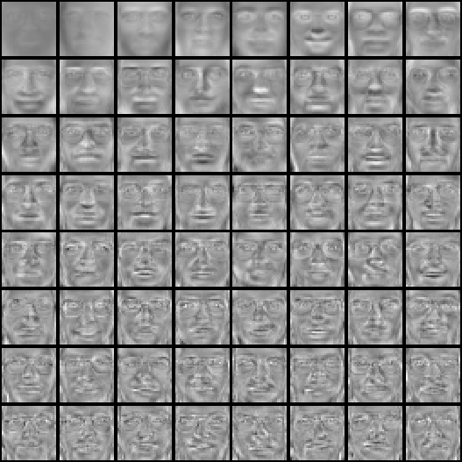
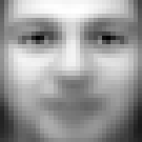
Eigenfaces example
Top eigenvectors: u₁,…u_{k}
Mean: μ

Slide 39

Visualization of eigenfaces
Principal component (eigenvector) u_{k}
μ + 3σ_{k}u_{k}
μ – 3σ_{k}u_{k}

Slide 40

Representation and reconstruction
Face x in “face space” coordinates:
=

Slide 41

Representation and reconstruction
Face x in “face space” coordinates:
Reconstruction:
=
=
+
^
x
=
µ + w₁u₁+w₂u₂+w₃u₃+w₄u₄+ …

Slide 42
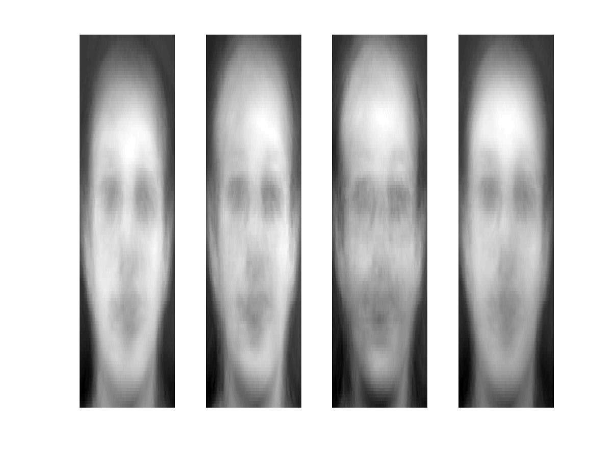
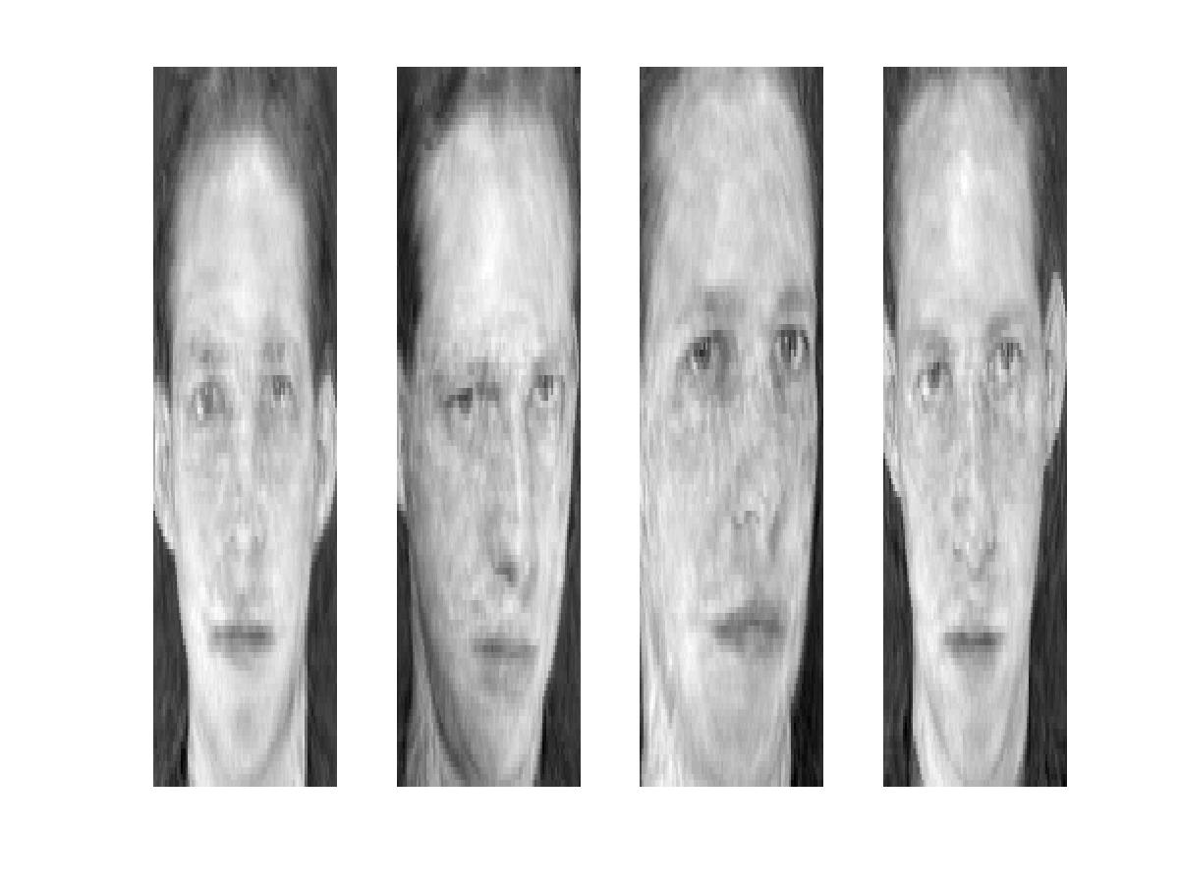
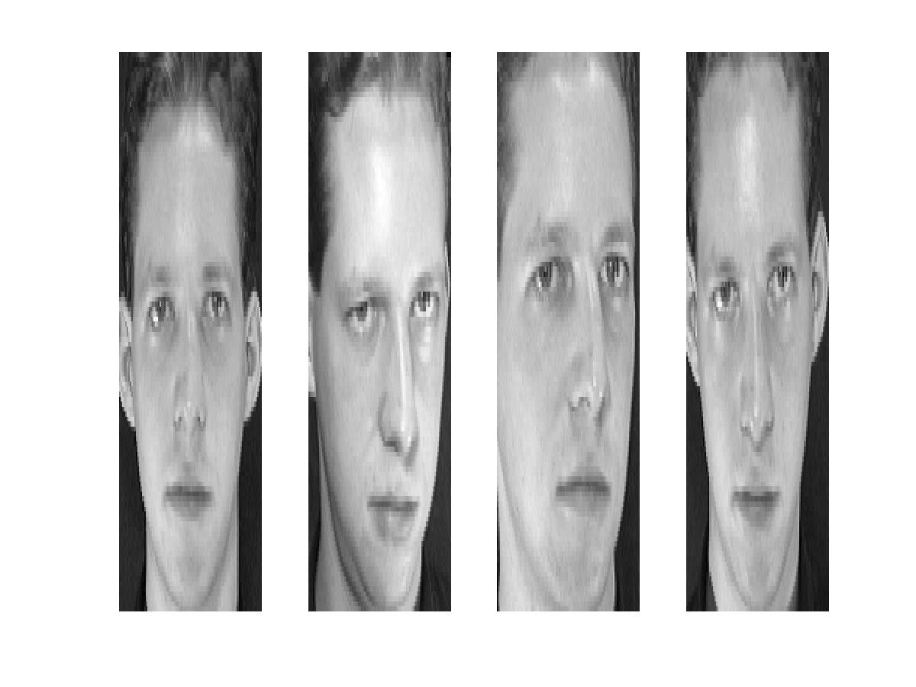
Reconstruction
P = 4
P = 200
P = 400
After computing eigenfaces using 400 face images from ORL face database

Slide 43
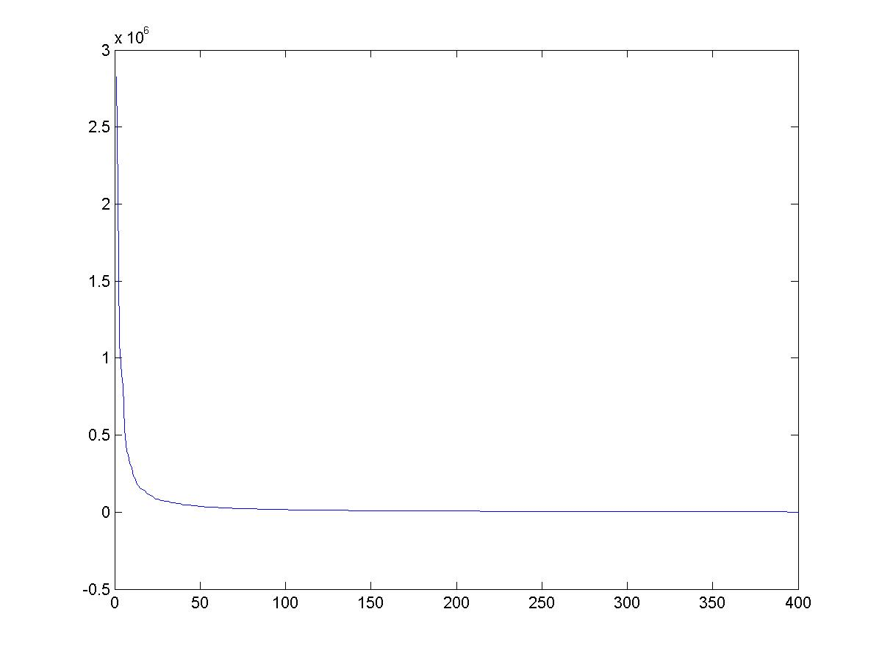
Eigenvalues (variance along eigenvectors)

Slide 44
Note
Preserving variance (minimizing MSE) does not necessarily lead to qualitatively good reconstruction.
P = 200

Slide 45
Recognition with eigenfaces
Process labeled training images
Find mean µ and covariance matrix Σ
Find k principal components (eigenvectors of Σ) u₁,…u_{k}
Project each training image x_{i} onto subspace spanned by principal components:
(w_{i1},…,w_{ik}) = (u₁^{T}(x_{i} – µ), … , u_{k}^{T}(x_{i} – µ))
Given novel image x
Project onto subspace:
(w₁,…,w_{k}) = (u₁^{T}(x – µ), … , u_{k}^{T}(x – µ))
Optional: check reconstruction error x – x to determine whether image is really a face
Classify as closest training face in k-dimensional subspace
^
M. Turk and A. Pentland, Face Recognition using Eigenfaces, CVPR 1991

Slide 46
PCA
General dimensionality reduction technique
Preserves most of variance with a much more compact representation
  Lower storage requirements (eigenvectors + a few numbers per face)
  Faster matching
What are the problems for face recognition?

Slide 47
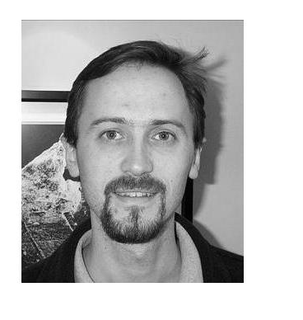
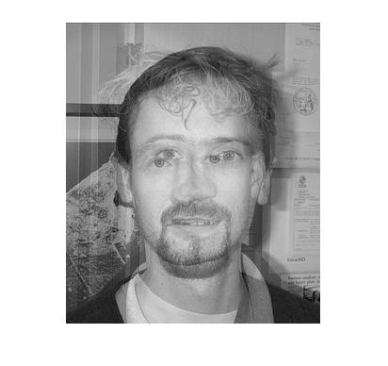
Limitations
Global appearance method: not robust to misalignment, background variation

Slide 48
Limitations
The direction of maximum variance is not always good for classification

Slide 49
A more discriminative subspace: FLD
Fisher Linear Discriminants → “Fisher Faces”
PCA preserves maximum variance
FLD preserves discrimination
  Find projection that maximizes scatter between classes and minimizes scatter within classes
Reference: Eigenfaces vs. Fisherfaces, Belheumer et al., PAMI 1997

Slide 50
Illustration
x2
Within class scatter
x1
Between class scatter
Objective:

Slide 51
Comparing with PCA

Slide 52
Recognition with FLD
Similar to “eigenfaces”
Compute within-class and between-class scatter matrices
Solve generalized eigenvector problem
Project to FLD subspace and classify by nearest neighbor

Slide 53
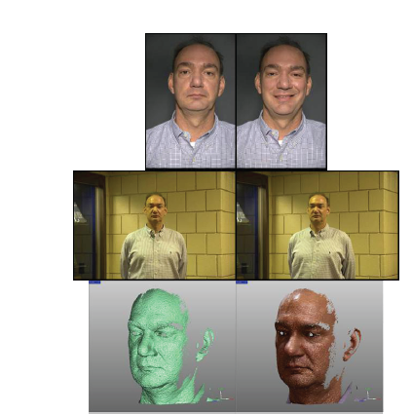
Large scale comparison of methods
FRVT 2006 Report
Not much (or any) information available about methods, but gives idea of what is doable

Slide 54
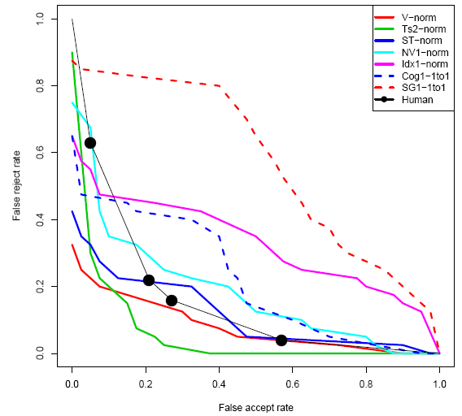
FVRT Challenge
Frontal faces
  FVRT2006 evaluation: computers win!

Slide 55
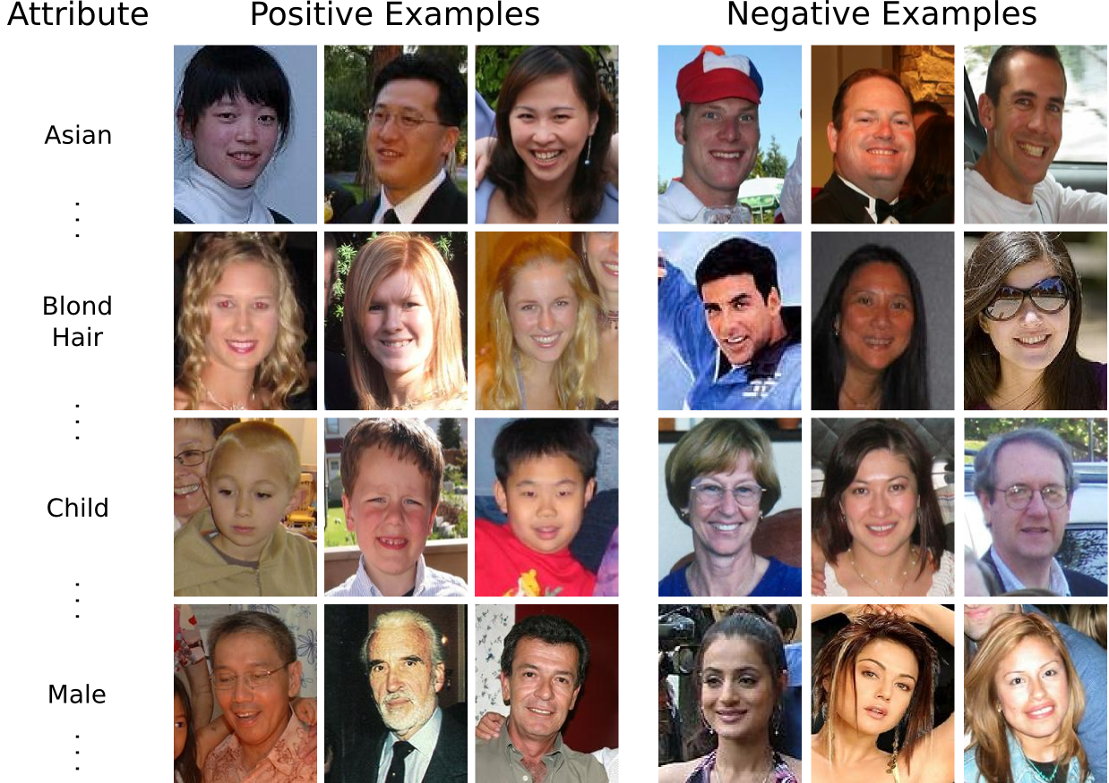
Another cool method: attributes for face verification
Kumar et al. 2009

Slide 56
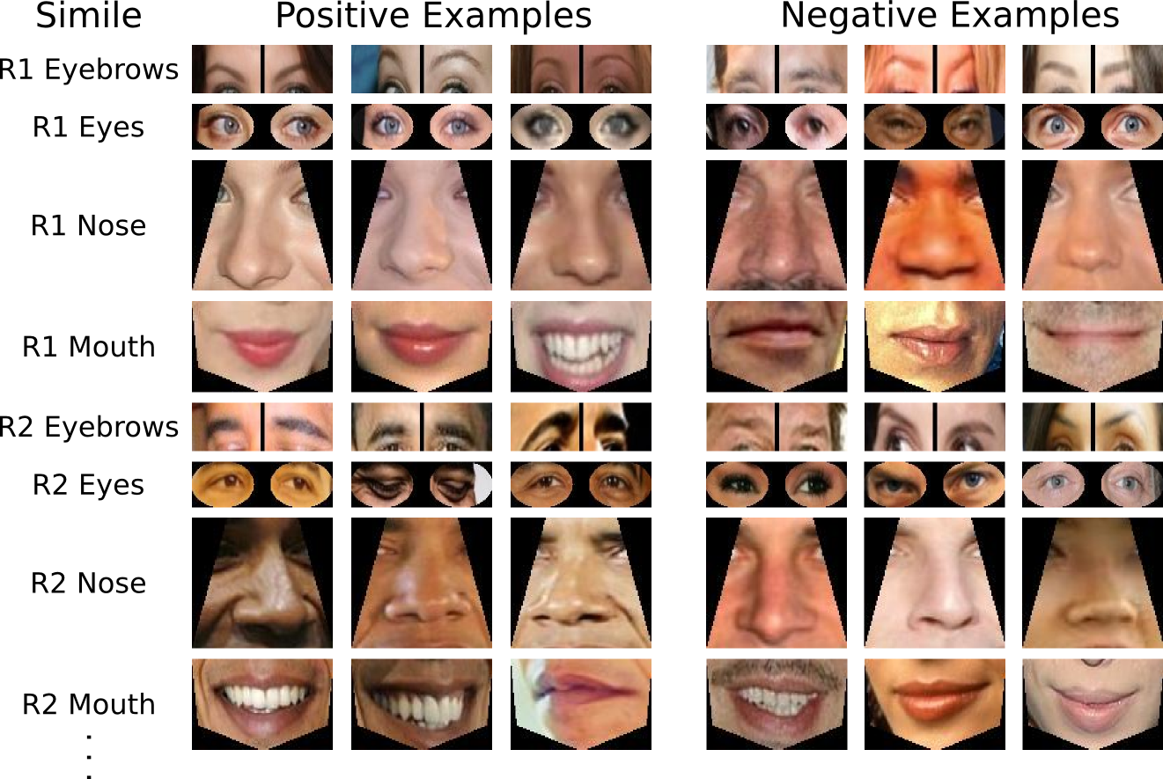
Attributes for face verification
Kumar et al. 2009

Slide 57
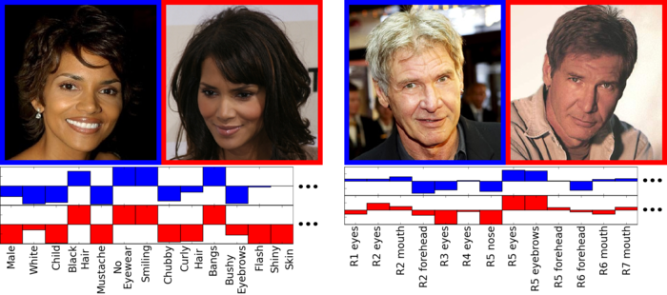
Attributes for face verification

Slide 58
Face recognition by humans
Face recognition by humans: 20 results (2005)
Slides by Jianchao Yang

Slide 59
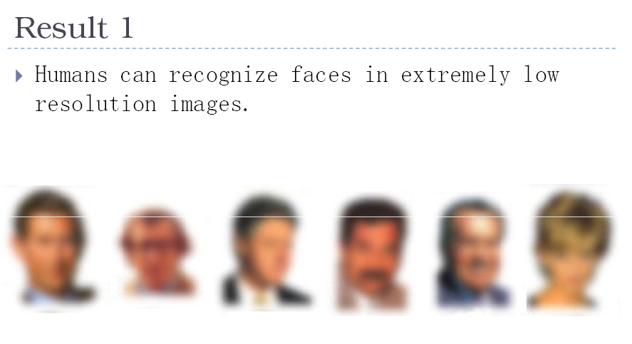

Slide 60
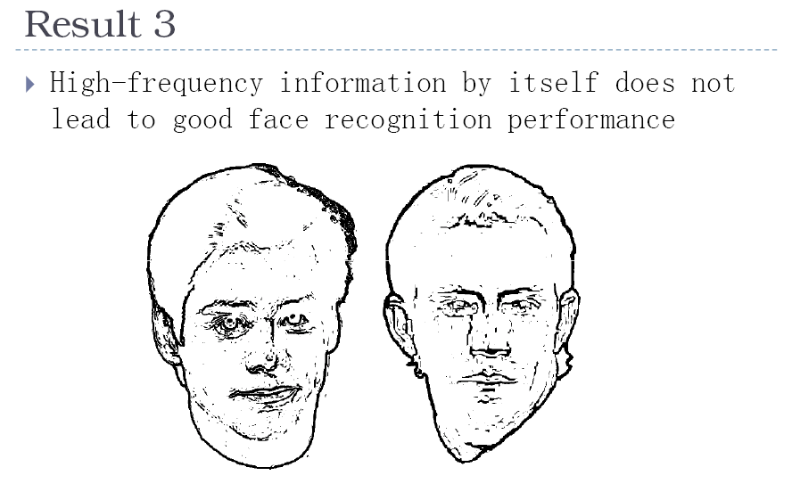

Slide 61
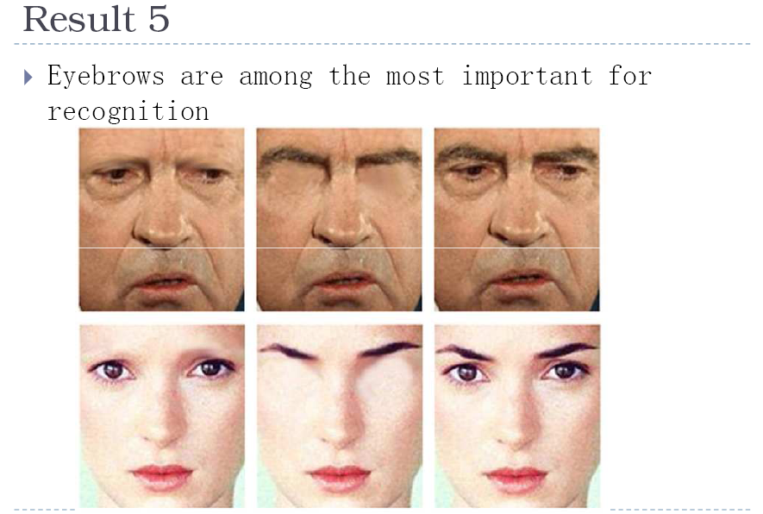

Slide 62
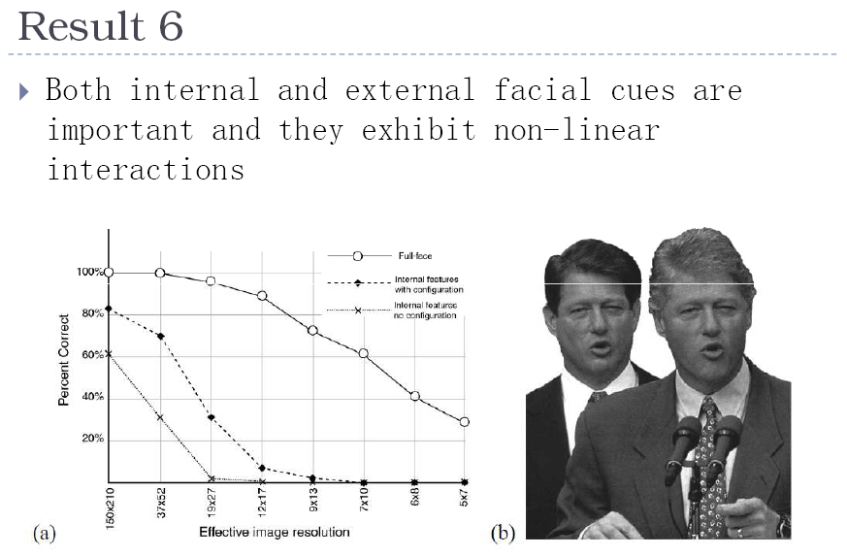

Slide 63
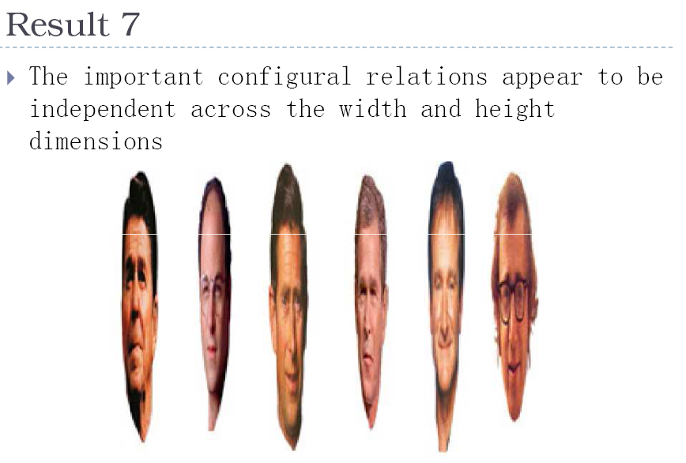

Slide 64
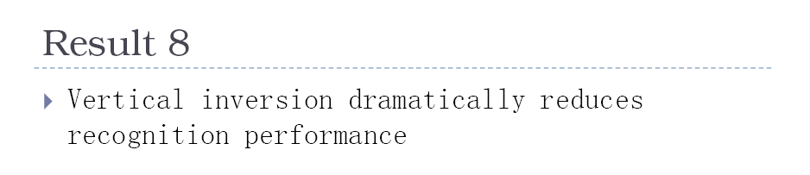
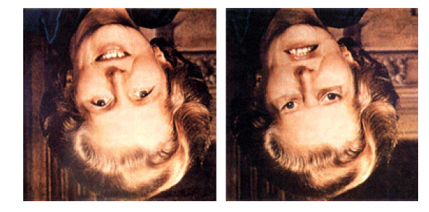
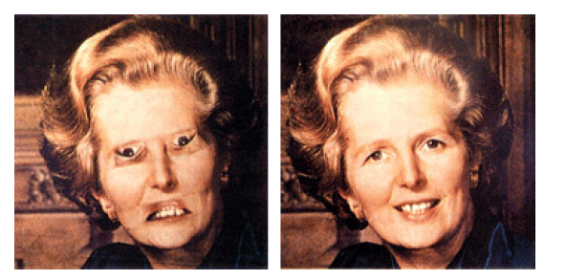

Slide 65
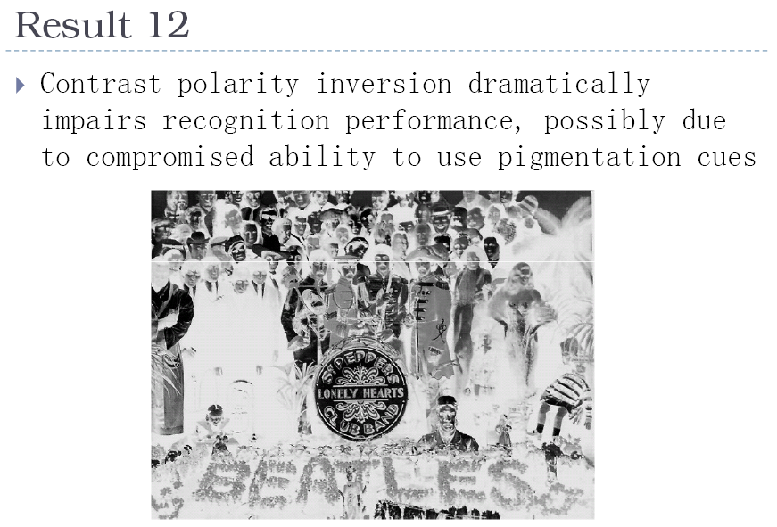
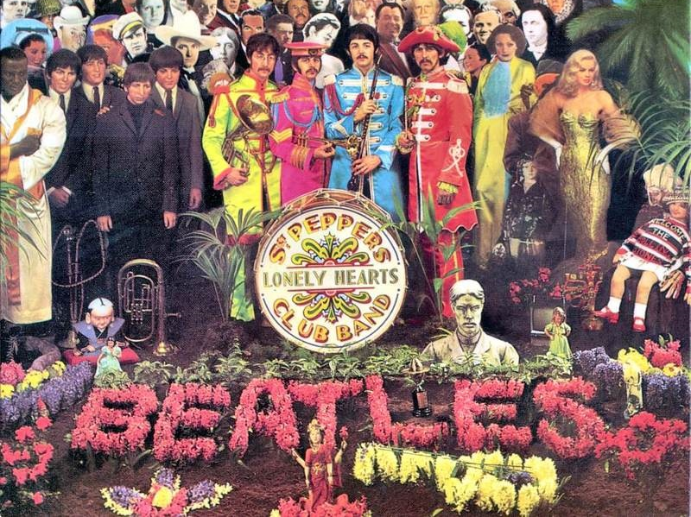

Slide 66


Slide 67

Result 17: Vision progresses from piecemeal to holistic

Slide 68


Slide 69
Things to remember
Face detection via sliding window search
  Features are important
PCA is a generally useful dimensionality reduction technique
  But not ideal for discrimination
FLD better for discrimination, though only ideal under Gaussian data assumptions
Computer face recognition works very well under controlled environments – still lots of room for improvement in general conditions

Slide 70
Next class
Things you can do with lots of data

