Slide 1
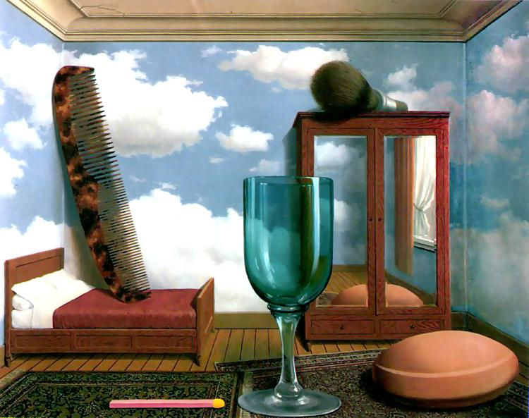
More with Pinhole + Single-view Metrology
10/07/10
Computational Photography
Derek Hoiem, University of Illinois

Slide 2
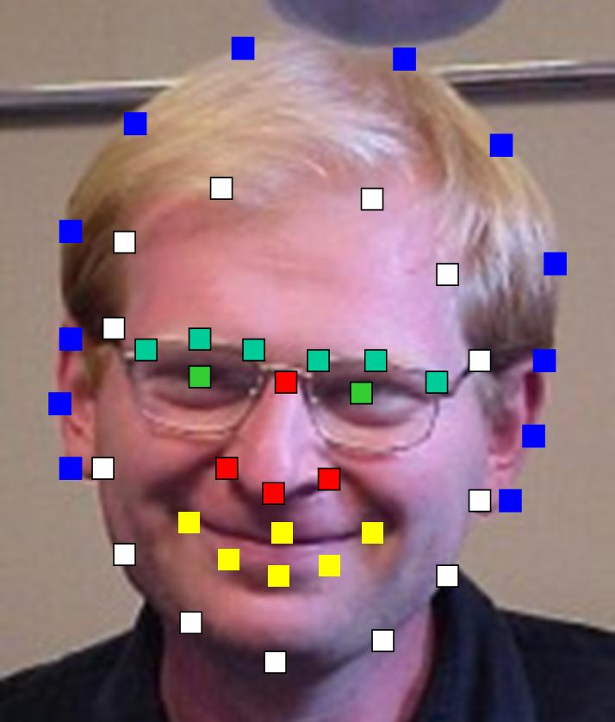
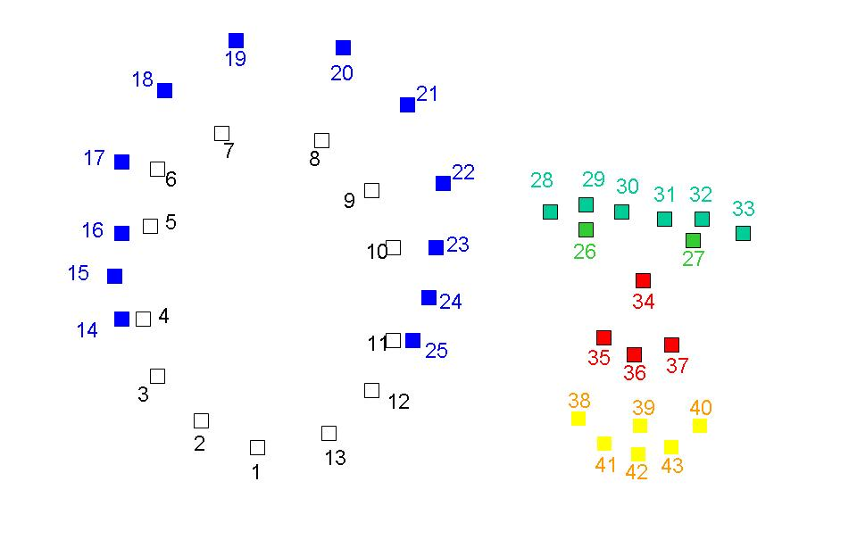
By next Tuesday…
Label your face

Slide 3
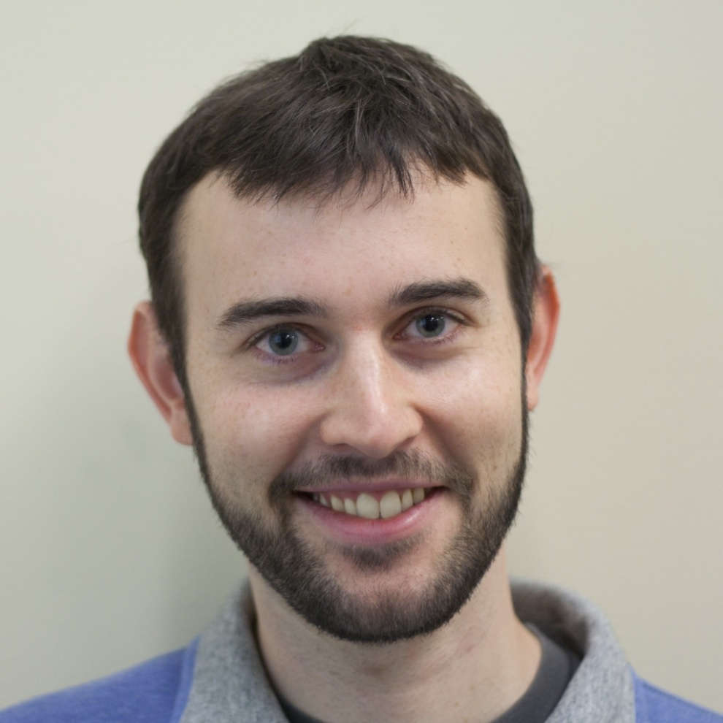
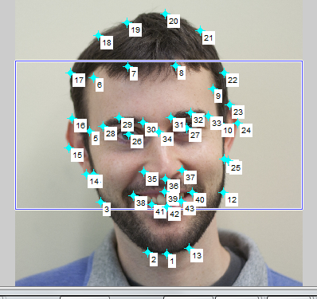

Slide 4
Last Class: Pinhole Camera
.
Optical Center (u₀, v₀)
.
.
f
Z
Y
.
v
Camera Center (t_{x}, t_{y}, t_{z})
u

Slide 5

Last Class: Projection Matrix
R
j_{w}
t
k_{w}
O_{w}
i_{w}

Slide 6
Last class: Vanishing Points
Vertical vanishing
point
(at infinity)
Vanishing
line
Vanishing
point
Vanishing
point
Slide from Efros, Photo from Criminisi

Slide 7
This class
How can we calibrate the camera?
How can we measure the size of objects in the world from an image?
What about other camera properties: focal length, field of view, depth of field, aperture, f-number?
How to do “focus stacking” to get a sharp picture of a nearby object
How the “vertigo effect” works

Slide 8
How to calibrate the camera?

Slide 9

Calibrating the Camera
Method 1: Use an object (calibration grid) with known geometry
  Correspond image points to 3d points
  Get least squares solution (or non-linear solution)

Slide 10
Calibrating the Camera
Method 2: Use vanishing points
  Find vanishing points corresponding to orthogonal directions
Vertical vanishing
point
(at infinity)
Vanishing
line
Vanishing
point
Vanishing
point

Slide 11
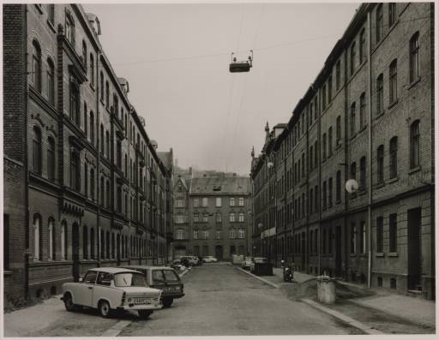
Take-home question
10/7/2010
Suppose you have estimated three vanishing points corresponding to orthogonal directions. How can you recover the rotation matrix that is aligned with the 3D axes defined by these points?
  Assume that intrinsic matrix K has three parameters
  Remember, in homogeneous coordinates, we can write a 3d point at infinity as (X, Y, Z, 0)
VP_{y}
.
VP_{x}
VP_{z}
Photo from online Tate collection

Slide 12
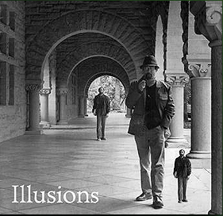
How can we measure the size of 3D objects from an image?
Slide by Steve Seitz

Slide 13
Perspective cues
Slide by Steve Seitz

Slide 14
Perspective cues
Slide by Steve Seitz

Slide 15
Perspective cues
Slide by Steve Seitz

Slide 16
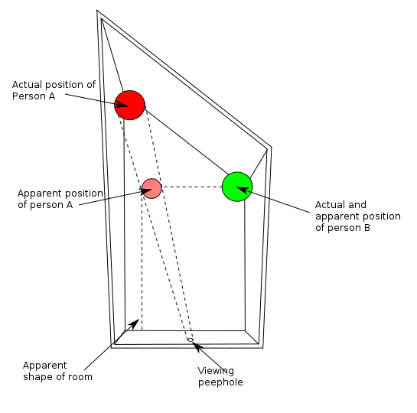
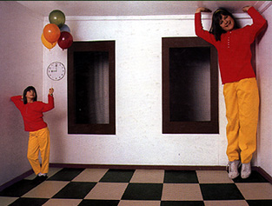
Ames Room

Slide 17
Comparing heights
Slide by Steve Seitz
Vanishing
Point

Slide 18
Measuring height
Slide by Steve Seitz
5.4
5
Camera height
4
3.3
3
2.8
2
1

Slide 19
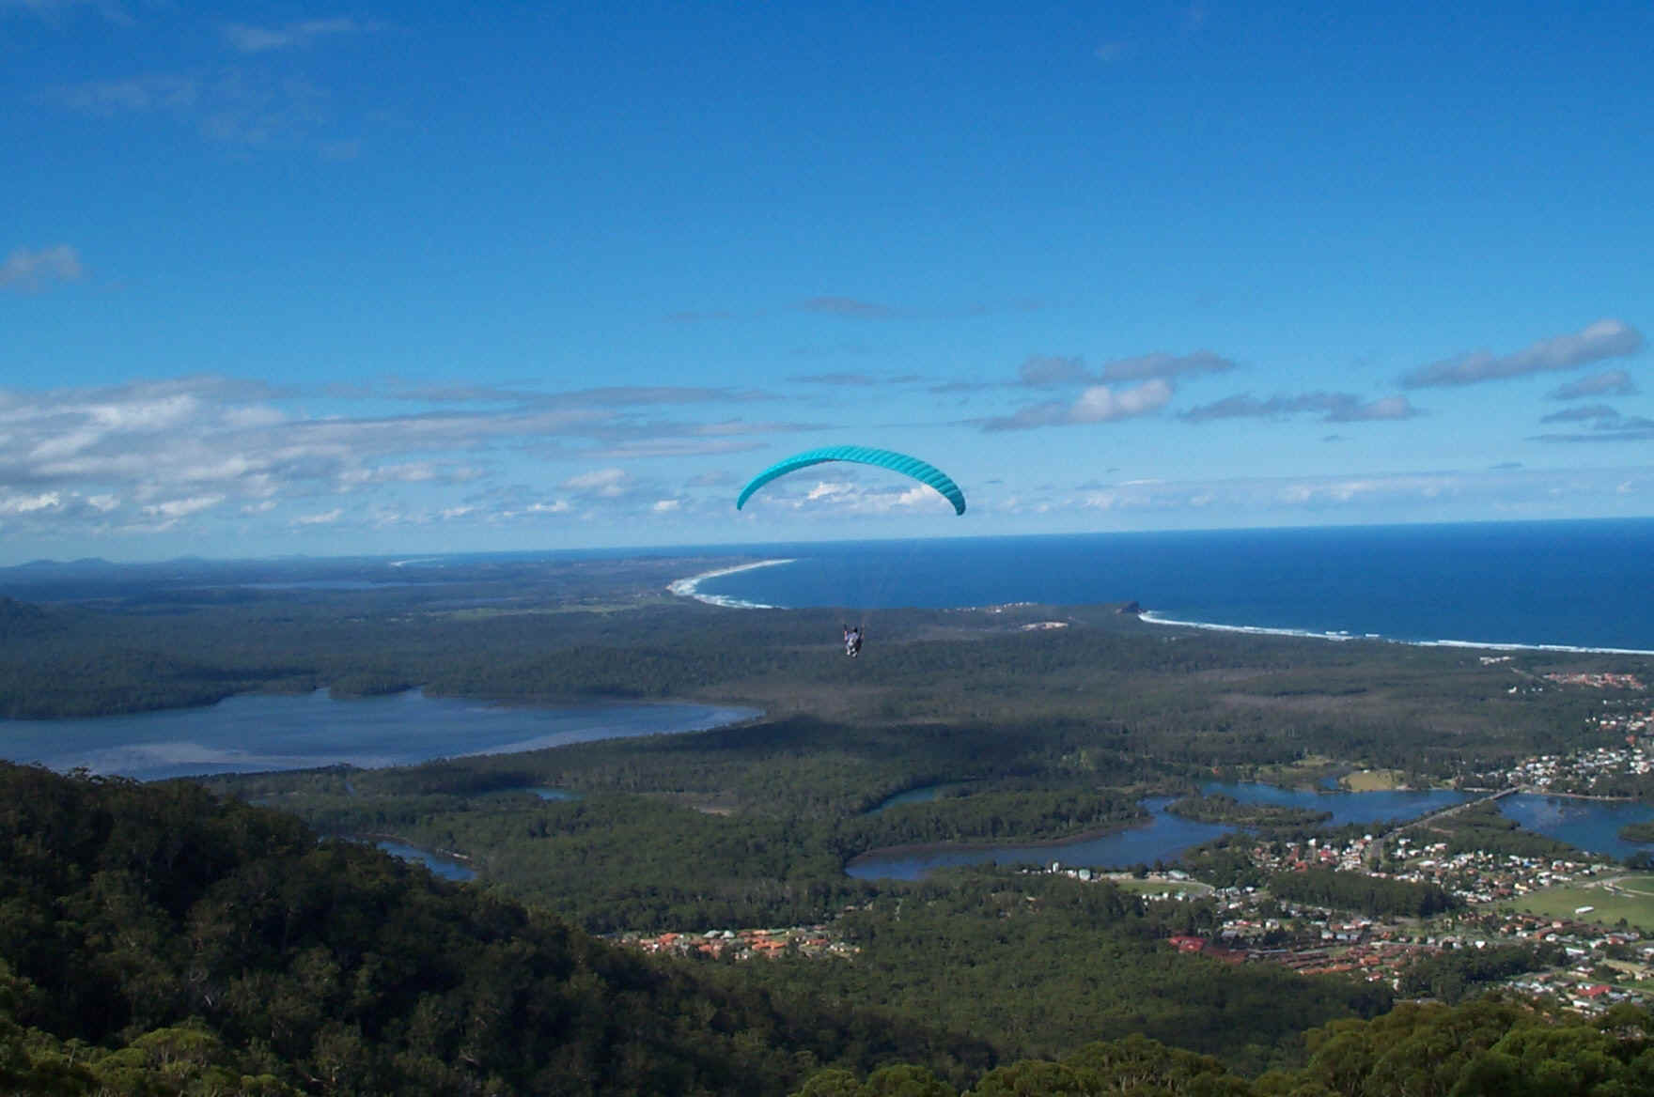
Which is higher – the camera or the parachute?

Slide 20
Computing vanishing points (from lines)
v
q₂
q₁
p₂
p₁
Intersect p₁q₁ with p₂q₂
Least squares version
  Better to use more than two lines and compute the “closest” point of intersection
  See notes by Bob Collins for one good way of doing this:
    http://www-2.cs.cmu.edu/~ph/869/www/notes/vanishing.txt

Slide 21
Measuring height without a ruler
Slide by Steve Seitz
C
Z
ground plane
Compute Z from image measurements
  Need more than vanishing points to do this

Slide 22
The cross ratio
Slide by Steve Seitz
A Projective Invariant
  Something that does not change under projective transformations (including perspective projection)
The cross-ratio of 4 collinear points
P₄
P₃
P₂
P₁
Can permute the point ordering
  4! = 24 different orders (but only 6 distinct values)
This is the fundamental invariant of projective geometry

Slide 23
Measuring height
Slide by Steve Seitz
∞
scene cross ratio
T (top of object)
t
r
R (reference point)
C
H
b
R
image cross ratio
v_{Z}
B (bottom of object)
ground plane
scene points represented as
image points as

Slide 24


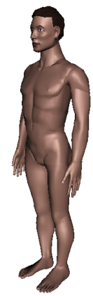
Measuring height
Slide by Steve Seitz
v_{z}
r
vanishing line (horizon)
t₀
t
v_{x}
v
v_{y}
H
R
H
b₀
b
image cross ratio

Slide 25
Measuring height
Slide by Steve Seitz
v_{z}
r
t₀
vanishing line (horizon)
t₀
v_{x}
v
v_{y}
m₀
t₁
b₀
b₁
b
What if the point on the ground plane b₀ is not known?
  Here the guy is standing on the box, height of box is known
  Use one side of the box to help find b₀ as shown above

Slide 26
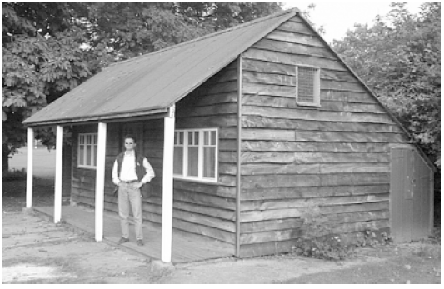
Take-home question
Assume that the camera height is 5 ft.
  What is the height of the man?
  What is the height of the building?
  How long is the left side of the building, compared to the right side?

Slide 27
What about focus, aperture, DOF, FOV, etc?

Slide 28
Adding a lens
“circle of
confusion”
A lens focuses light onto the film
  There is a specific distance at which objects are “in focus”
    other points project to a “circle of confusion” in the image
  Changing the shape of the lens changes this distance

Slide 29

Focal length, aperture, depth of field
F
focal point
optical center
(Center Of Projection)
A lens focuses parallel rays onto a single focal point
  focal point at a distance f beyond the plane of the lens
  Aperture of diameter D restricts the range of rays
Slide source: Seitz

Slide 30
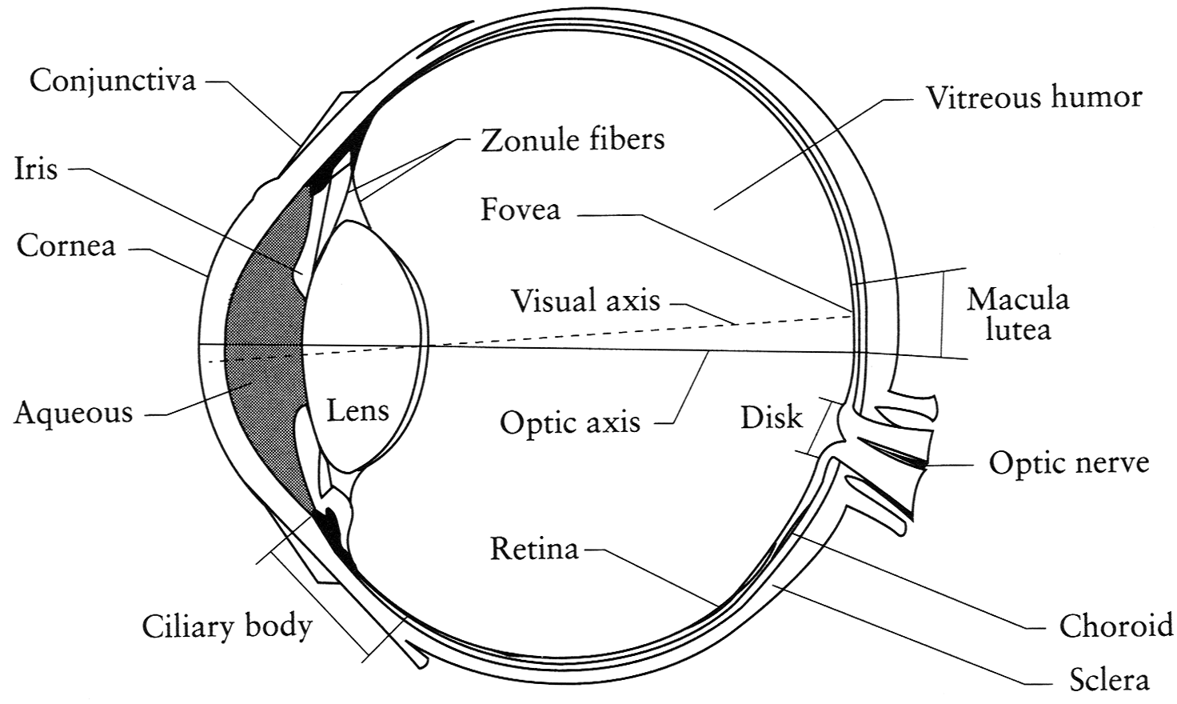
The eye
The human eye is a camera
  Iris - colored annulus with radial muscles
  Pupil - the hole (aperture) whose size is controlled by the iris
  What’s the “film”?
    photoreceptor cells (rods and cones) in the retina
Notes:
Note that the retina is curved

Slide 31
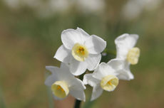
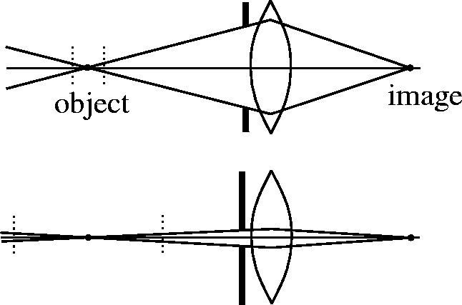
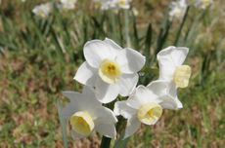
Depth of field
Slide source: Seitz
f / 5.6
f / 32
Changing the aperture size or focal length affects depth of field
  f-number (f/#) =focal_length / aperture_diameter (e.g., f/16 means that the focal length is 16 times the diameter)
Flower images from Wikipedia http://en.wikipedia.org/wiki/Depth_of_field

Slide 32
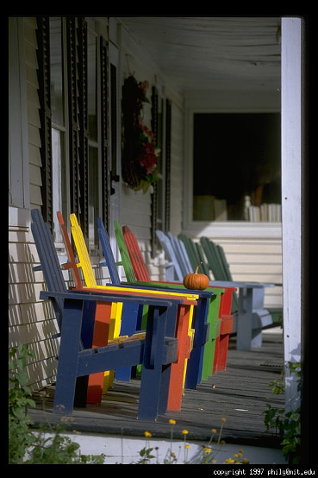
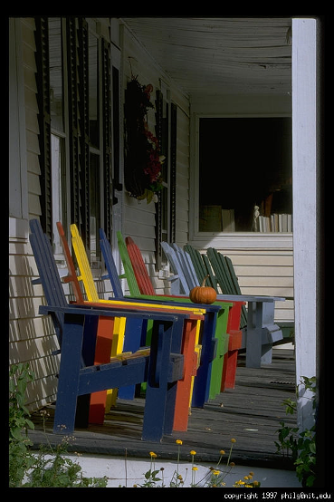
Varying the aperture
Slide from Efros
Large aperture = small DOF
Small aperture = large DOF

Slide 33
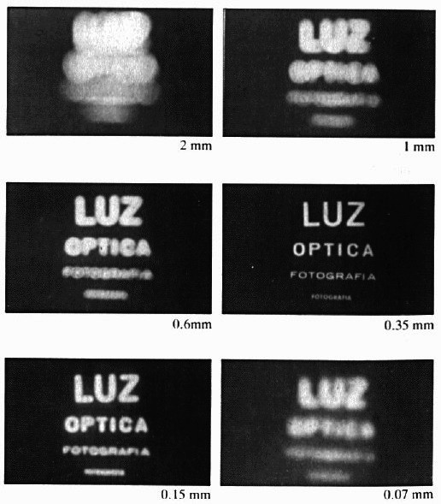
Shrinking the aperture
Why not make the aperture as small as possible?
  Less light gets through
  Diffraction effects
Slide by Steve Seitz

Slide 34
Shrinking the aperture
Slide by Steve Seitz

Slide 35
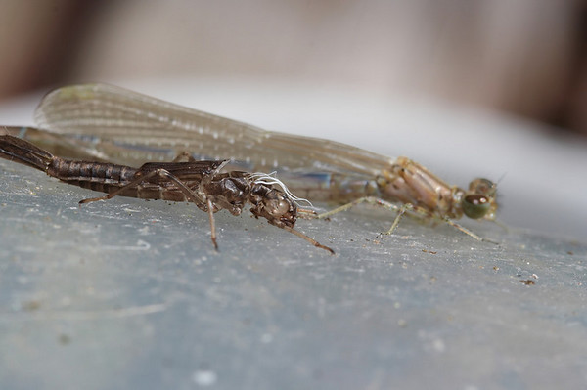
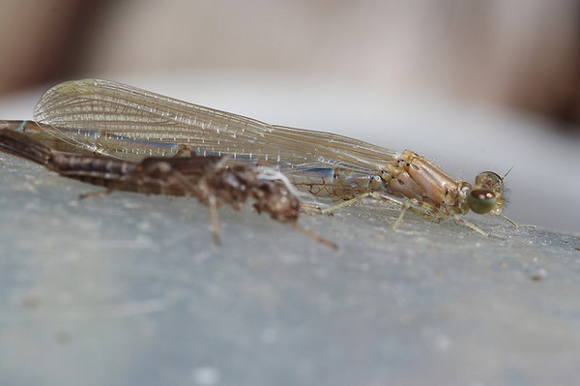
Difficulty in macro (close-up) photography
For close objects, we have a small relative DOF
Can only shrink aperture so far
How to get both bugs in focus?

Slide 36
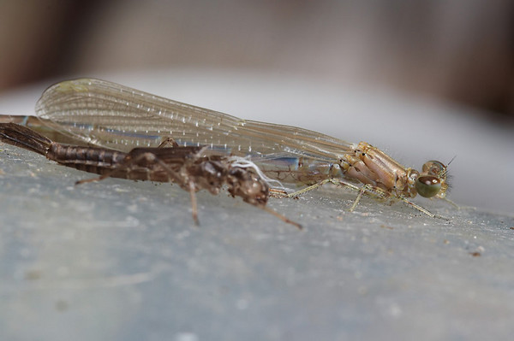
Solution: Focus stacking
Take pictures with varying focal length
Example from
http://www.wonderfulphotos.com/articles/macro/focus_stacking/

Slide 37
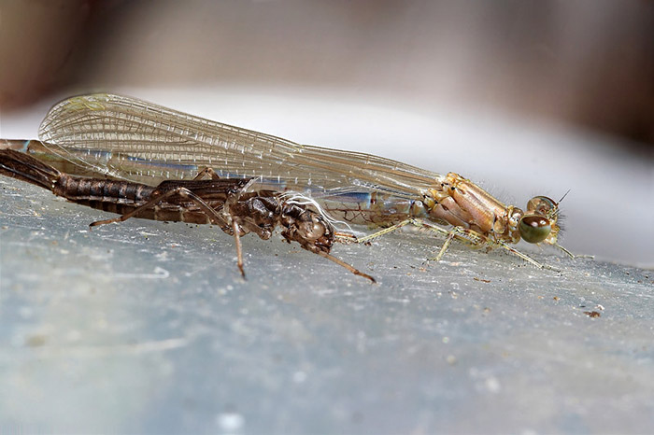
Solution: Focus stacking
Take pictures with varying focal length
Combine

Slide 38
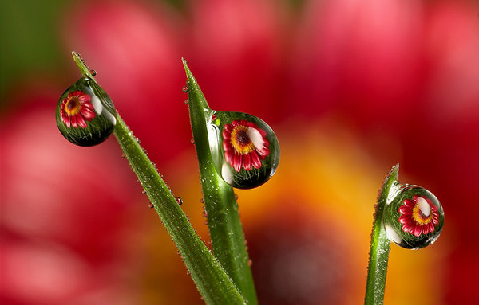
Focus stacking
http://www.wonderfulphotos.com/articles/macro/focus_stacking/

Slide 39
Focus stacking
How to combine?
Web answer: With software (Photoshop, CombineZM)
How to do it automatically?

Slide 40
Focus stacking
How to combine?
Align images (e.g., using corresponding points)
Two ideas
  Mask regions by hand and combine with pyramid blend
  Gradient domain fusion (mixed gradient) without masking
http://www.zen20934.zen.co.uk/photography/Workflow.htm#Focus%20Stacking

Slide 41
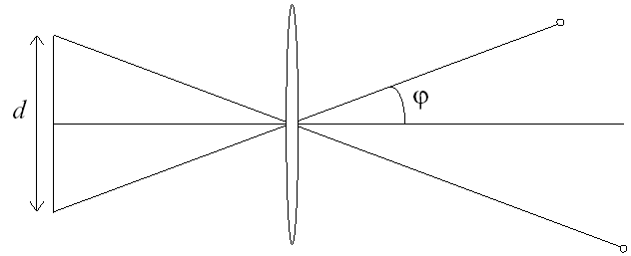
Relation between field of view and focal length
Field of view (angle width)
Film/Sensor Width
Focal length

Slide 42
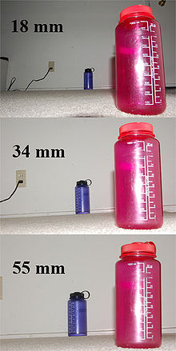
Dolly Zoom or “Vertigo Effect”
http://www.youtube.com/watch?v=Y48R6-iIYHs
How is this done?
Zoom in while moving away
http://en.wikipedia.org/wiki/Focal_length

Slide 43
Dolly zoom (or “Vertigo effect”)
http://www.youtube.com/watch?v=Y48R6-iIYHs
Field of view (angle width)
Film/Sensor Width
Focal length
width of object
Distance between object and camera

Slide 44
Things to remember
Can calibrate using grid or VP
Can measure relative sizes using VP
Effects of focal length, aperture + tricks
5
4
3
2
1

Slide 45
Next class
Go over take-home questions from today, Tuesday
Single-view 3D Reconstruction

