Slide 1
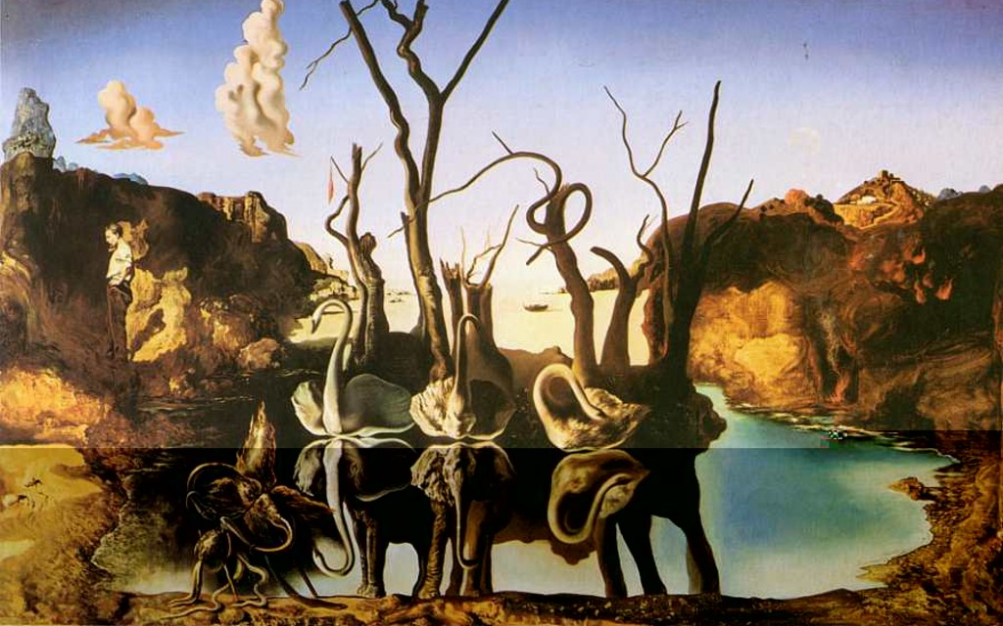
10/31/13
Object Recognition and Augmented Reality
Dali, Swans Reflecting Elephants
Computational Photography
Derek Hoiem, University of Illinois

Slide 2
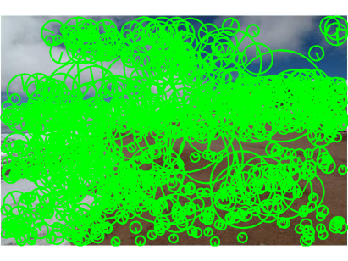
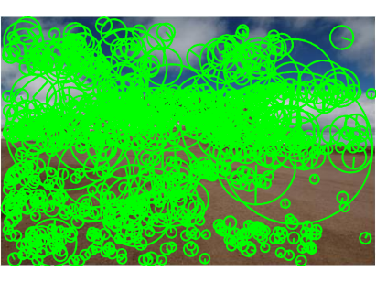
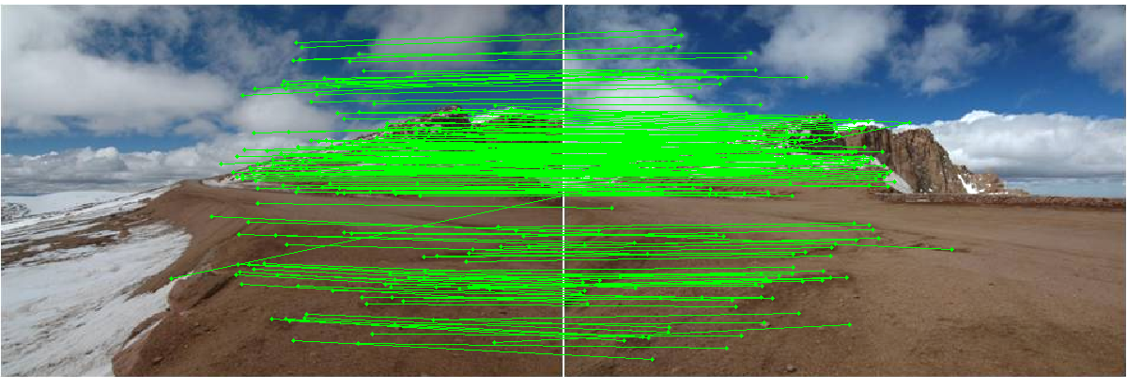
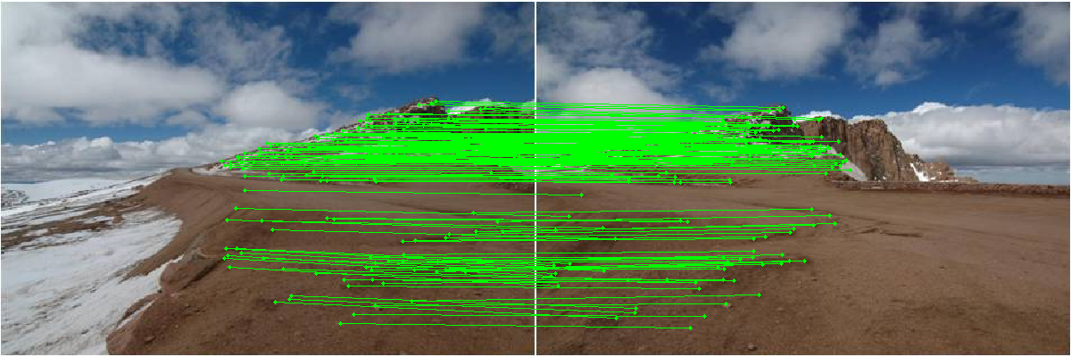
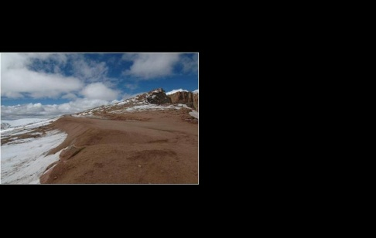
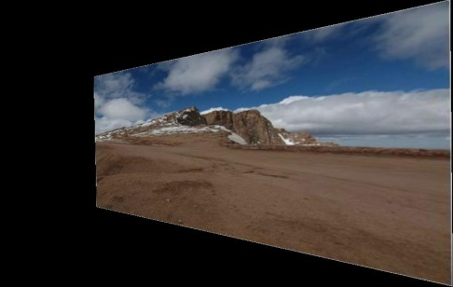
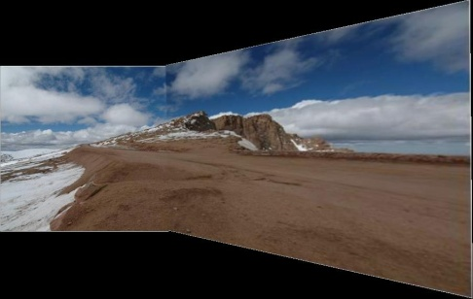
Last class: Image Stitching
Detect keypoints
Match keypoints
Use RANSAC to estimate homography
Project onto a surface and blend

Slide 3
Augmented reality
Insert and/or interact with object in scene
  Project by Karen Liu
  Responsive characters in AR
  KinectFusion
Overlay information on a display
  Tagging reality
  Layar
  Google goggles
  T2 video (13:23)

Slide 4
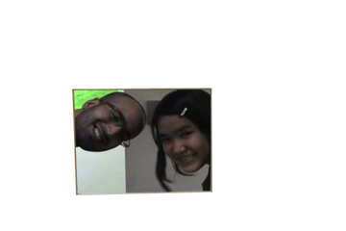
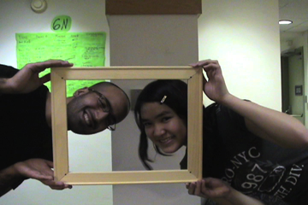
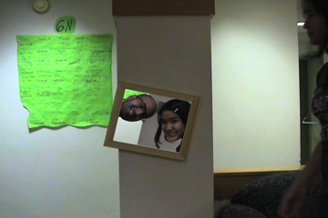
Adding fake objects to real video
Approach
Recognize and/or track points that give you a coordinate frame
Apply homography (flat texture) or perspective projection (3D model) to put object into scene
Main challenge: dealing with lighting, shadows, occlusion

Slide 5
Information overlay
Approach
Recognize object that you’ve seen before
Retrieve info and overlay
Main challenge: how to match reliably and efficiently?

Slide 6
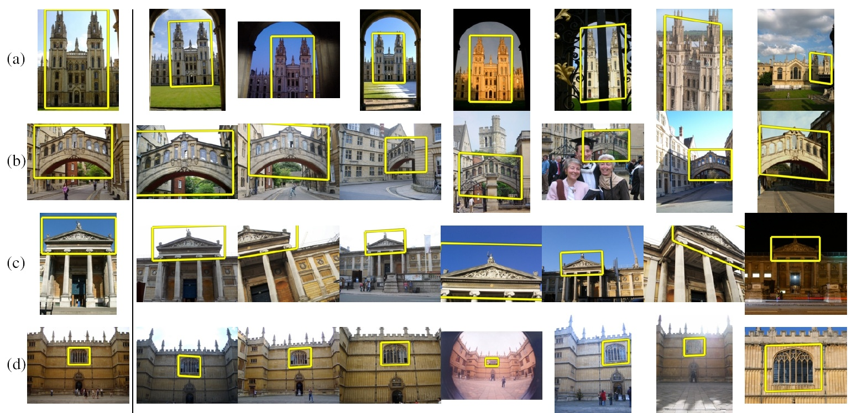
Today
How to quickly find images in a large database that match a given image region?

Slide 7
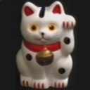
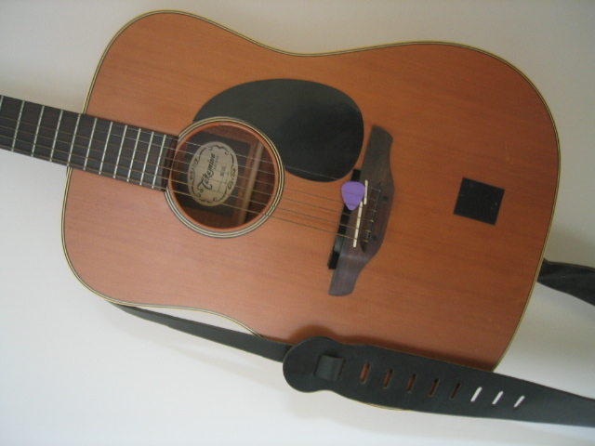
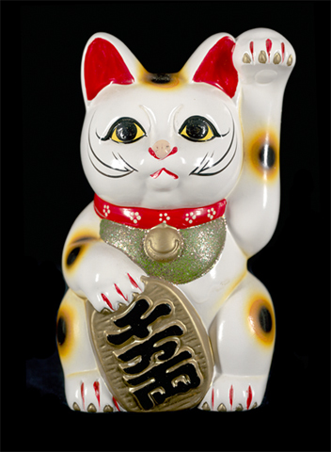
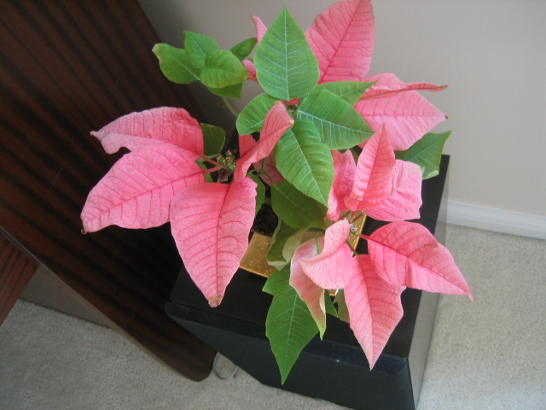
Let’s start with interest points
Database
Query
Compute interest points (or keypoints) for every image in the database and the query

Slide 8
Simple idea
See how many keypoints are close to keypoints in each other image
Lots of Matches
Few or No Matches
But this will be really, really slow!

Slide 9
Key idea 1: “Visual Words”
Cluster the keypoint descriptors

Slide 10
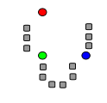
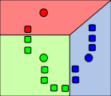
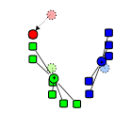
Key idea 1: “Visual Words”
K-means algorithm
1. Randomly select K centers
2. Assign each point to nearest center
3. Compute new center (mean) for each cluster
Illustration: http://en.wikipedia.org/wiki/K-means_clustering

Slide 11
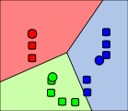
Key idea 1: “Visual Words”
K-means algorithm
1. Randomly select K centers
2. Assign each point to nearest center
Back to 2
3. Compute new center (mean) for each cluster
Illustration: http://en.wikipedia.org/wiki/K-means_clustering

Slide 12
Kmeans: Matlab code
function C = kmeans(X, K)
% Initialize cluster centers to be randomly sampled points
[N, d] = size(X);
rp = randperm(N);
C = X(rp(1:K), :);
lastAssignment = zeros(N, 1);
while true
% Assign each point to nearest cluster center
bestAssignment = zeros(N, 1);
mindist = Inf*ones(N, 1);
for k = 1:K
for n = 1:N
dist = sum((X(n, :)-C(k, :)).^2);
if dist < mindist(n)
mindist(n) = dist;
bestAssignment(n) = k;
end
end
end
% break if assignment is unchanged
if all(bestAssignment==lastAssignment), break; end;
lastAssignment = bestAssignmnet;
% Assign each cluster center to mean of points within it
for k = 1:K
C(k, :) = mean(X(bestAssignment==k, :));
end
end

Slide 13
K-means Demo
http://home.dei.polimi.it/matteucc/Clustering/tutorial_html/AppletKM.html

Slide 14
Key idea 1: “Visual Words”
Cluster the keypoint descriptors
Assign each descriptor to a cluster number
  What does this buy us?
  Each descriptor was 128 dimensional floating point, now is 1 integer (easy to match!)
  Is there a catch?
    Need a lot of clusters (e.g., 1 million) if we want points in the same cluster to be very similar
    Points that really are similar might end up in different clusters

Slide 15
Key idea 1: “Visual Words”
Cluster the keypoint descriptors
Assign each descriptor to a cluster number
Represent an image region with a count of these “visual words”

Slide 16
Key idea 1: “Visual Words”
Cluster the keypoint descriptors
Assign each descriptor to a cluster number
Represent an image region with a count of these “visual words”
An image is a good match if it has a lot of the same visual words as the query region

Slide 17
Naïve matching is still too slow
Imagine matching 1,000,000 images, each with 1,000 keypoints

Slide 18
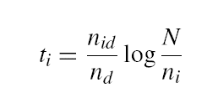
Key Idea 2: Inverse document file
Like a book index: keep a list of all the words (keypoints) and all the pages (images) that contain them.
Rank database images based on tf-idf measure.
tf-idf: Term Frequency – Inverse Document Frequency
# documents
# times word appears in document
# documents that contain the word
# words in document

Slide 19
Fast visual search
“Video Google”, Sivic and Zisserman, ICCV 2003
“Scalable Recognition with a Vocabulary Tree”, Nister and Stewenius, CVPR 2006.

Slide 20
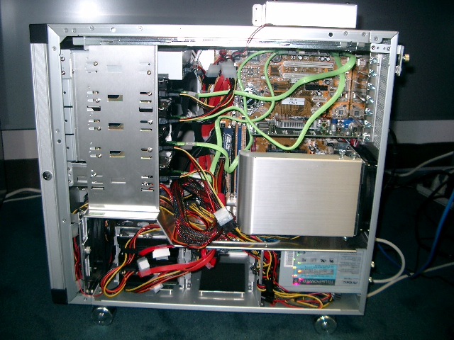
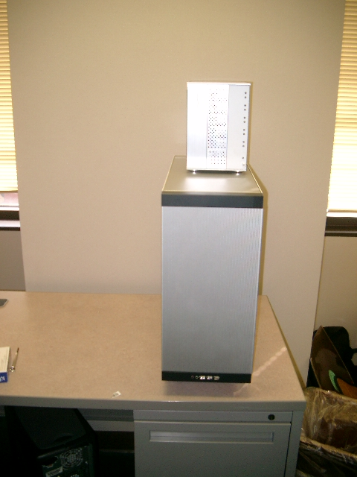
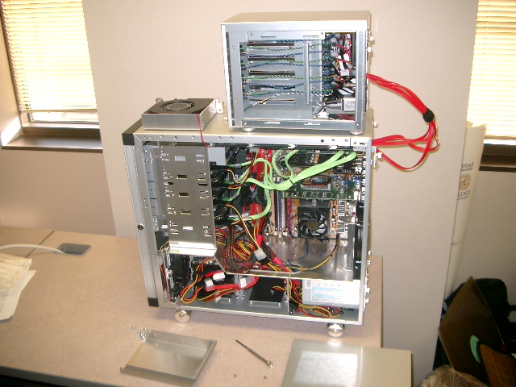
110,000,000 Images in 5.8 Seconds
Slide
Slide Credit: Nister
Notes:
Very recently, we have scaled the system even further.
The system we just demo’d searches a 50 thousand image index in the RAM of this laptop at real-time rates.
We have built and programmed a desktop system at home in which we currently have 12 hard drives. We bypass the operating system and
read and write the disk surfaces directly.
Last week this system clocked in on 110 Million images in 5.8 seconds, so roughly 20Million images per second and machine.
The images consist of around 10 days of four TV channels, so more than a month of TV.
Soon we don’t have to watch TV, because we’ll have machines doing it for us.

Slide 21
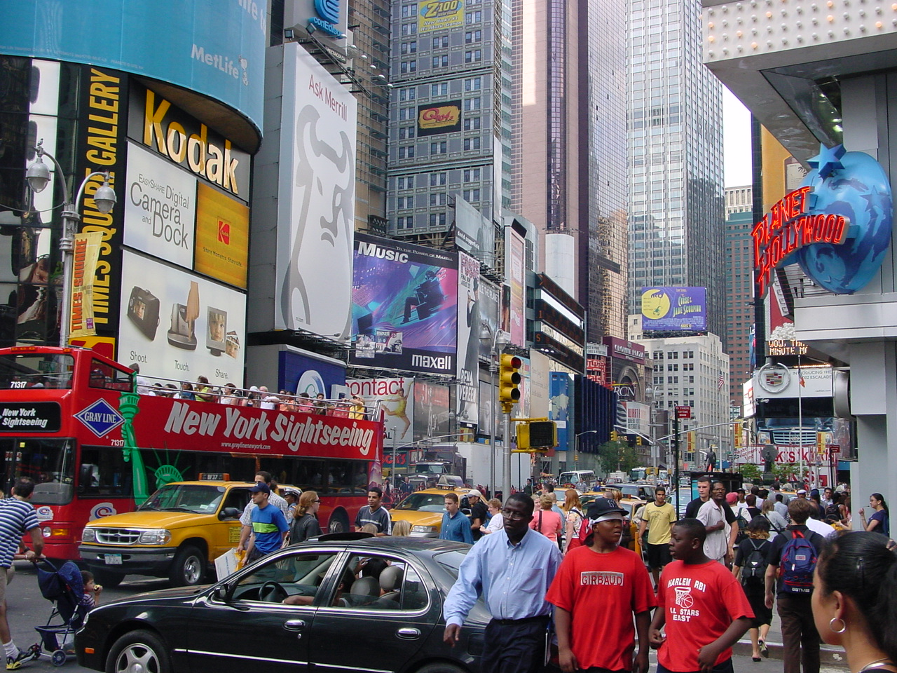


Slide
Slide Credit: Nister
Notes:
To continue the analogy, if we printed all these images on paper, and stacked them,

Slide 22
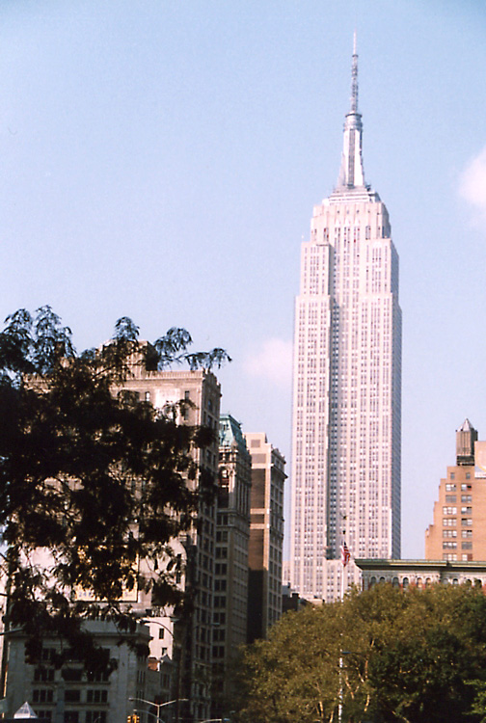
Slide
Slide Credit: Nister
Notes:
The pile would stack, as high as

Slide 23
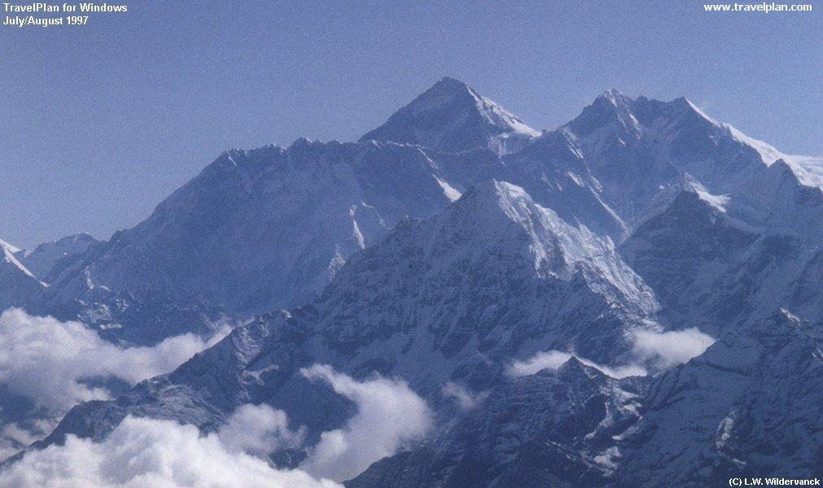
Slide
Slide Credit: Nister
Notes:
Mount Everest.
Another way to put perspective on this is, Google image search not too long ago claimed to index 2 billion images,
although based on meta-data, while we do it based on image content.
So, with about 20 desktop systems like the one I just showed, it seems that it may be possible to build a web-scale content-based image search engine,
and we are sort of hoping that this paper will fuel the race for the first such search engine.
So, that is some motivation.
Let me now move to the contribution of the paper.
As you can guess by now, it is about scalability of recognition and retrieval.

Slide 24
Key Ideas
Visual Words
  Cluster descriptors (e.g., K-means)
Inverse document file
  Quick lookup of files given keypoints
tf-idf: Term Frequency – Inverse Document Frequency
# documents
# times word appears in document
# documents that contain the word
# words in document

Slide 25
Recognition with K-tree
Following slides by David Nister (CVPR 2006)

Slide 26
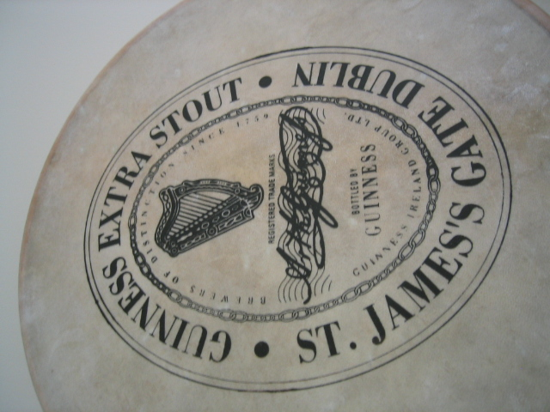
Notes:
I will now try to describe the approach with an animation.
The first, offline phase, is to train the vocabulary tree.
We use Maximally Stable Extremal Regions by Matas et al. and then we extract SIFT descriptors from the MSER regions.
Regarding the feature extraction, we are not really claiming anything other than down-in-the-trenches nose-to-the-grindstone hard work to get good implementations of the state-of-the-art, and since we are all obsessed with novelty I will not spend any time talking about the feature extraction.
We believe that the vocabulary tree approach will work well on any of your favorite descriptors.

Slide 27
Notes:
All the descriptor vectors are thrown into a common space.
This is done for many images, the goal being to acquire enough statistics on how natural images distribute points in the descriptor space.

Slide 30


Slide 31


Slide 33
Notes:
We then run k-means on the descriptor space. In this setting, k defines what we call the branch-factor of the tree, which indicates how fast the tree branches.
In this illustration, k is three. We then run k-means again, recursively on each of the resulting quantization cells.
This defines the vocabulary tree, which is essentially a hierarchical set of cluster centers and their corresponding Voronoi regions.
We typically use a branch-factor of 10 and six levels, resulting in a million leaf nodes. We lovingly call this the Mega-Voc.

Slide 43
Notes:
We now have the vocabulary tree, and the online phase can begin.
In order to add an image to the database, we perform feature extraction. Each descriptor vector is now dropped down from the root of the tree and quantized very efficiently into a path down the tree, encoded by a single integer.
Each node in the vocabulary tree has an associated inverted file index.
Indicies back to the new image are then added to the relevant inverted files.
This is a very efficient operation that is carried out whenever we want to add an image.

Slide 44
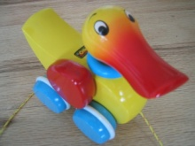


Slide 45
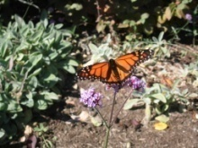


Slide 46



Slide 47



Slide 48
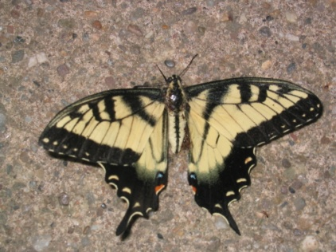
Notes:
When we then wish to query on an input image, we quantize the descriptor vectors of the input image in a similar way, and accumulate scores for the images in the database with so called term frequency inverse document frequency (tf-idf). This is effectively an entropy weighting of the information. The winner is the image in the database with the most common information with the input image.

Slide 49
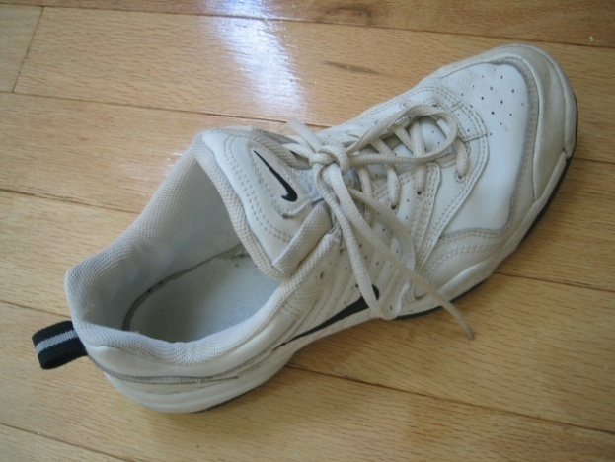
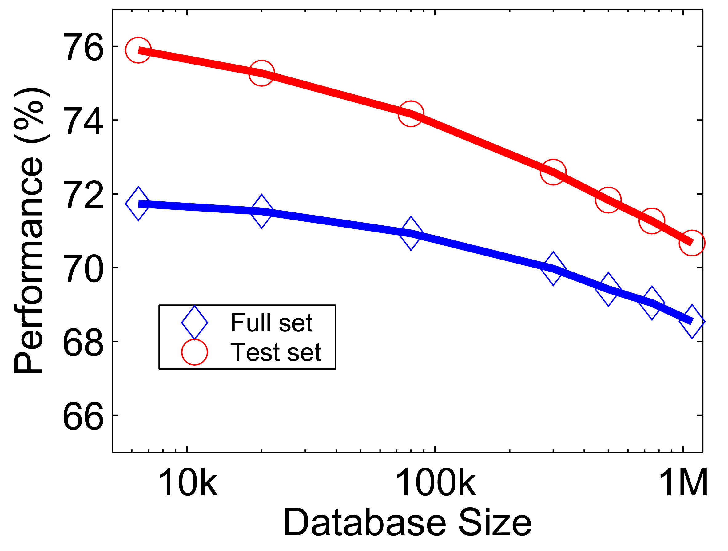





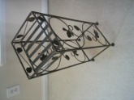




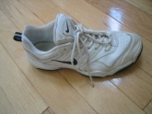
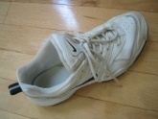
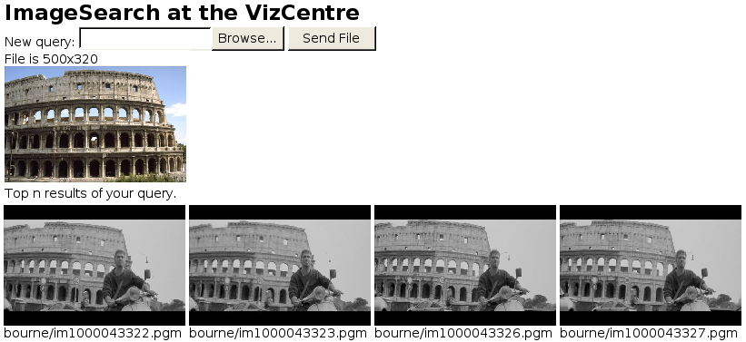





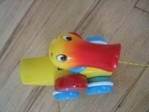

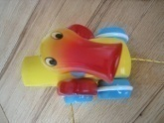




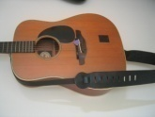

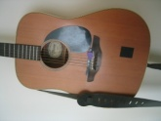
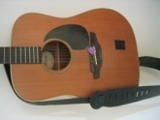
Performance
Notes:
One of the reasons we managed to take the system this far is that we have worked with rigorous performance testing against a database with ground truth.
We now have a benchmark database with over 10000 images grouped in sets of four images of the same object. We query on one of the images in the group and see how many of the other images in the group make it to the top of the query.
In the paper, we have tested this up to a million images, by embedding the ground truth database into a database encompassing all the frames of 10 feature length movies.

Slide 50
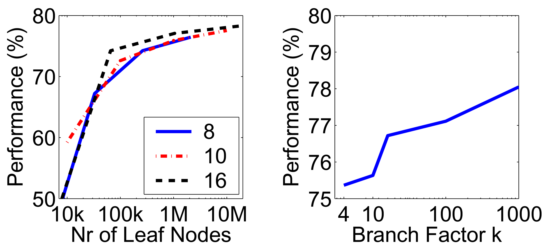
More words is better
Improves
Retrieval
Improves
Speed
Branch factor
Notes:
We have used the performance testing to explore various settings for the algorithm.
The most important finding is that the number of leaf nodes in the vocabulary tree is very important.
In principle, there is a trade-off, because we wish to have discriminative quantizations, which implies many leaf-nodes, while we also wish to have repeatable quantizations, which implies few leaf nodes.
However, it seems that in a large practical range, the bigger the better when it comes to the vocabulary. This probably depends on the descriptors used, but is not entirely surprising, since we are trying to divide up a 128-dimensional space in discriminative bins.
This is a very useful finding, because it means that we are in a win-win situation:
a larger vocabulary improves retrieval performance. It turns out that it also improves the retrieval speed, because our inverted file index becomes much sparser, so we exploit the true power of inverted files better with a larger vocabulary.
We also use a hierarchical scoring scheme, which has the nice property that the performance will only level out, not actually go down.

Slide 51
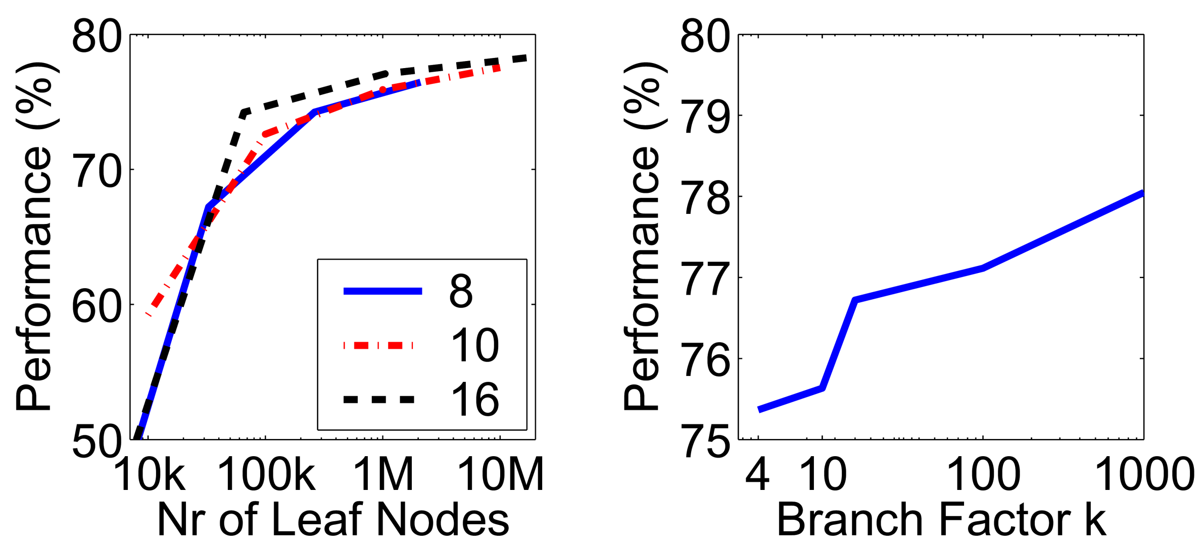
Higher branch factor works better (but slower)
Notes:
We also find that performance improves with the branch factor.
This improvement is not dramatic, but it is interesting to note that very low branch factors are somewhat weak, and a branch factor of two results in partitioning the space with planes.

Slide 52
Can we be more accurate?
So far, we treat each image as containing a “bag of words”, with no spatial information
Which matches better?
e
h
a
f
e
e
z
a
f
e
h
a
f
e
e

Slide 53
Can we be more accurate?
So far, we treat each image as containing a “bag of words”, with no spatial information
Real objects have consistent geometry

Slide 54
Final key idea: geometric verification
Goal: Given a set of possible keypoint matches, figure out which ones are geometrically consistent
How can we do this?

Slide 55
Final key idea: geometric verification
RANSAC for affine transform
Repeat N times:
e
z
e
z
a
a
Randomly choose 3 matching pairs
f
f
e
e
Estimate transformation
Affine Transform
e
z
e
Predict remaining points and count “inliers”
z
a
a
f
f
e
e

Slide 56
Application: Large-Scale Retrieval
Query
Results on 5K (demo available for 100K)
[Philbin CVPR’07]

Slide 57
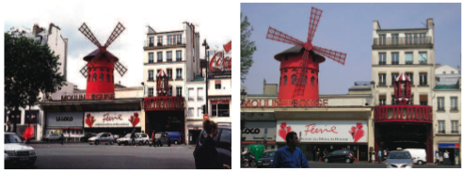
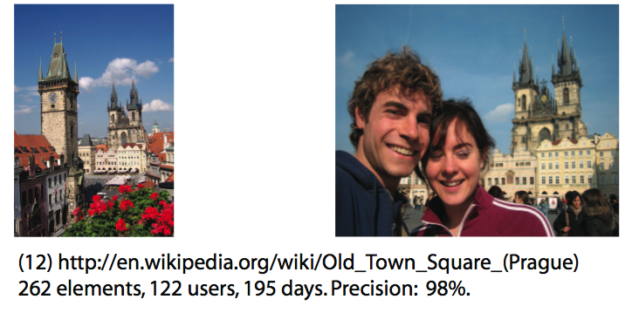
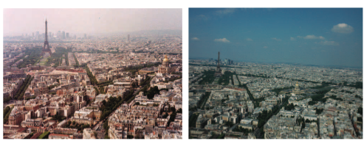
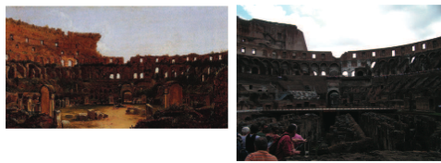
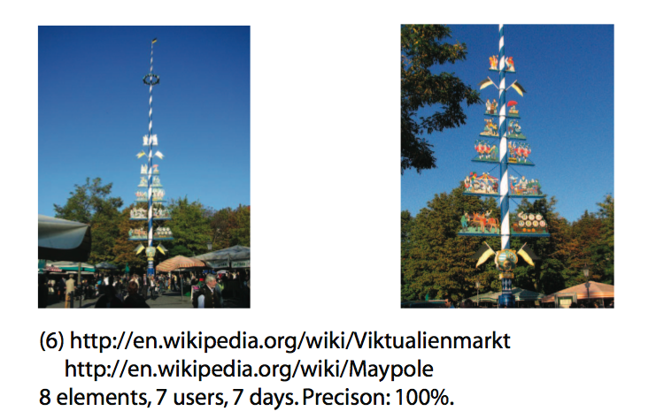
Application: Image Auto-Annotation
Moulin Rouge
Old Town Square (Prague)
Tour Montparnasse
Colosseum
Viktualienmarkt
Maypole
Left: Wikipedia image
Right: closest match from Flickr
[Quack CIVR’08]

Slide 58
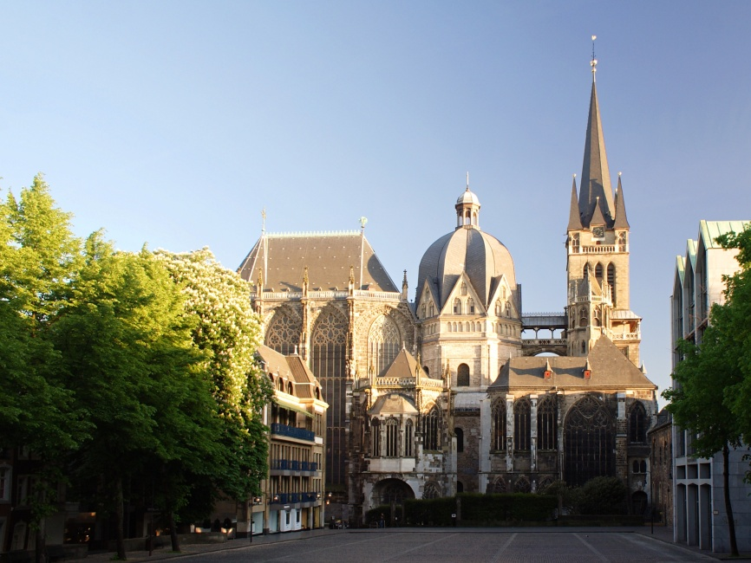

Example Applications
Aachen Cathedral
Mobile tourist guide
Self-localization
Object/building recognition
Photo/video augmentation
[Quack, Leibe, Van Gool, CIVR’08]

Slide 59














Video Google System
Query region
Collect all words within query region
Inverted file index to find relevant frames
Compare word counts
Spatial verification
Sivic & Zisserman, ICCV 2003
Demo online at : http://www.robots.ox.ac.uk/~vgg/research/vgoogle/index.html
Retrieved frames

Slide 60
Summary: Uses of Interest Points
Interest points can be detected reliably in different images at the same 3D location
  DOG interest points are localized in x, y, scale
SIFT is robust to rotation and small deformation
Interest points provide correspondence
  For image stitching
  For defining coordinate frames for object insertion
  For object recognition and retrieval

Slide 61
Next class
Opportunities of scale: stuff you can do with millions of images
  Texture synthesis of large regions
  Recover GPS coordinates
  Etc.

