Slide 1
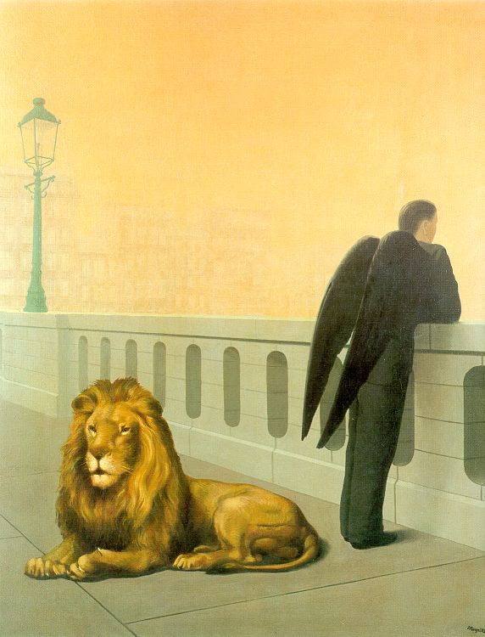
Midterm Review
11/06/12
Computational Photography
Derek Hoiem, University of Illinois
Magritte, Homesickness

Slide 2
Major Topics
Linear Filtering
  How it works
  Template and Frequency interpretations
  Image pyramids and their applications
  Sampling (Nyquist theorem, application of low-pass filtering)
Light and color
  Lambertian shading, shadows, specularities
  Color spaces (RGB, HSV, LAB)
Techniques
  Finding boundaries: intelligent scissors, graph cuts, where to cut and why
  Texture synthesis: idea of sampling patches to synthesize, filling order
  Compositing and blending: alpha compositing, Laplacian blending, Poisson editing
Warping
  Transformation matrices, homogeneous coordinates, solving for parameters via system of linear equations
Modeling shape
  Averaging and interpolating sets of points
  Compressing and finding dominant modes of variation using PCA

Slide 3
Major Topics
Camera models and Geometry
  Pinhole model: diagram, intrinsic/extrinsic matrices, camera center (or center of projection), image plane
  Focal length, depth of field, field of view, aperture size
  Vanishing points and vanishing lines (what they are, how to find them)
  Measuring relative lengths based on vanishing points and horizon
Interest points
  Trade-offs between repeatability and distinctiveness for detectors and descriptors
  Harris (corner) detectors and Difference of Gaussian (blob) detectors
  SIFT representation: what transformations is it robust to or not robust to
Image stitching
  Solving for homography
  RANSAC for robust detection of inliers
Object recognition and search
  Use of “visual words” to speed search
  Idea of geometric verification to check that points have consistent geometry

Slide 4
Studying for Midterm
Roughly 80% is related to topics in bold (linear filtering, warping, camera models and geometry)
No book, no notes, no computers/calculators allowed
Bring a pencil or pen

Slide 5
Today’s review
Light
Camera capture and geometry
Image filtering
Region selection and compositing
Solving for transformations
Purposes
Remind you of key concepts
Chance for you to ask questions

Slide 6
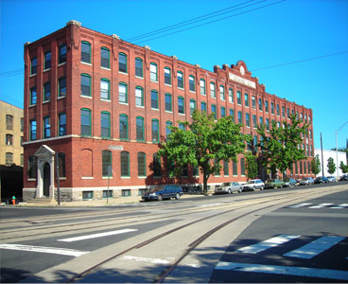
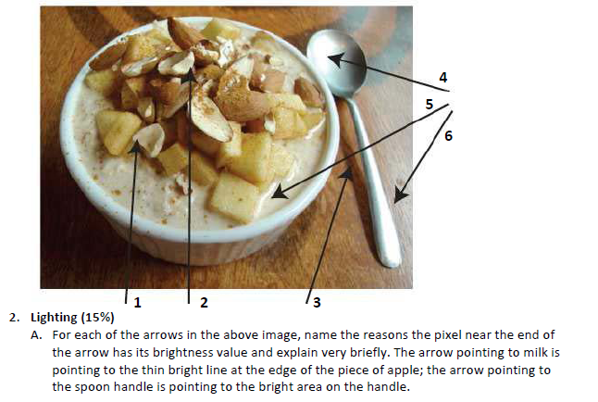
1. Light and color
Lighting
  Lambertian shading, shadows, specularities
  Color spaces (RGB, HSV, LAB)

Slide 7
How is light reflected from a surface?
Depends on
Illumination properties: wavelength, orientation, intensity
Surface properties: material, surface orientation, roughness, etc.
light source
λ
?

Slide 8
Lambertian surface
Some light is absorbed (function of albedo)
Remaining light is reflected equally in all directions (diffuse reflection)
Examples: soft cloth, concrete, matte paints
light source
light source
λ
λ
absorption
diffuse reflection

Slide 9
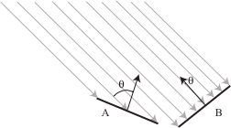
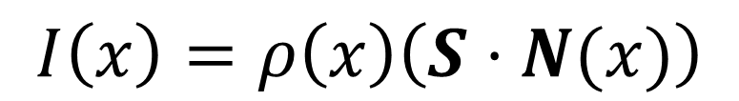

Diffuse reflection
Intensity does depend on illumination angle because less light comes in at oblique angles.
$ρ=$albedo
$S=$ directional source
$N=$ surface normal
$I=$ image intensity
$$I\left(x\right)=ρ\left(x\right)\left(S⋅N(x)\right)$$
Slide: Forsyth

Slide 10
1
2

Slide 11
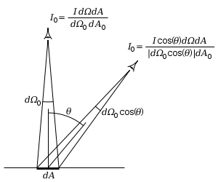
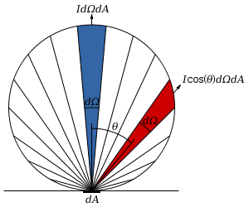
Diffuse reflection
Perceived intensity does not depend on viewer angle.
  Amount of reflected light proportional to cos(theta)
  Visible solid angle also proportional to cos(theta)
http://en.wikipedia.org/wiki/Lambert%27s_cosine_law

Slide 12
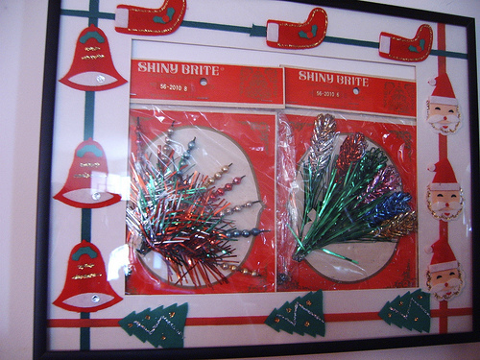
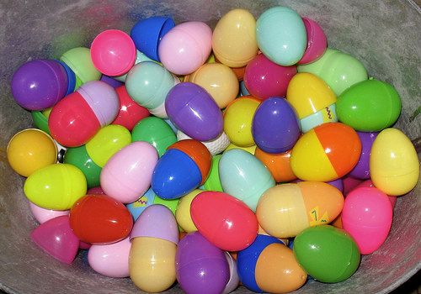


Specular Reflection
Reflected direction depends on light orientation and surface normal
E.g., mirrors are fully specular
Flickr, by suzysputnik
light source
λ
specular reflection
$$Θ$$
$$Θ$$
Flickr, by piratejohnny

Slide 13
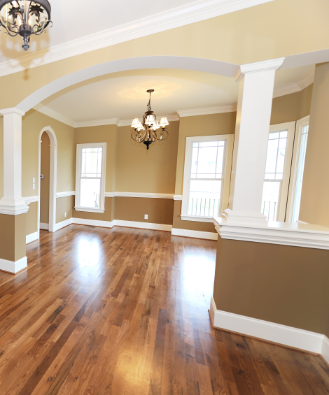
Many surfaces have both specular and diffuse components
Specularity = spot where specular reflection dominates (typically reflects light source)
Photo: northcountryhardwoodfloors.com

Slide 14
Questions
09/08/11
1.
Possible factors: albedo, shadows, texture, specularities, curvature, lighting direction

Slide 15
2. Camera Capture and Geometry

Slide 16
Pinhole Camera
.
Optical Center (u₀, v₀)
.
.
f
Z
Y
.
v
Camera Center (t_{x}, t_{y}, t_{z})
u
Useful figure to remember

Slide 17

Projection Matrix
R
j_{w}
t
k_{w}
O_{w}
i_{w}

Slide 18
Single-view metrology
5
4
3
2
1

Slide 19
Adding a lens
“circle of
confusion”
A lens focuses light onto the film
  There is a specific distance at which objects are “in focus”
    other points project to a “circle of confusion” in the image
  Changing the shape of the lens changes this distance

Slide 20

Focal length, aperture, depth of field
F
focal point
optical center
(Center Of Projection)
A lens focuses parallel rays onto a single focal point
  focal point at a distance f beyond the plane of the lens
  Aperture of diameter D restricts the range of rays
Slide source: Seitz

Slide 21
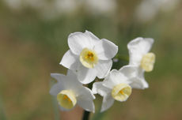
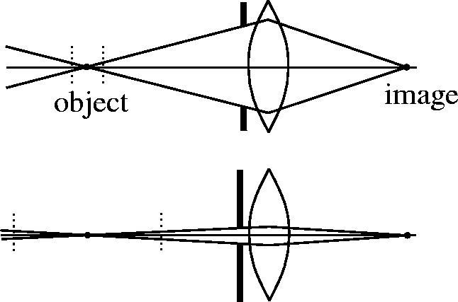
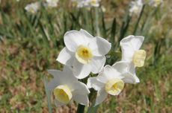
The aperture and depth of field
Slide source: Seitz
f / 5.6
f / 32
Two ways to increase depth of field:
  Decrease aperture size
  Increase focus distance (zoom)
F-number (f/#) =focal_length / aperture_diameter
- E.g., f/16 means that the focal length is 16 times the diameter
- When you set the f-number of a camera, you are setting the aperture
Flower images from Wikipedia http://en.wikipedia.org/wiki/Depth_of_field

Slide 22
The Photographer’s Great Compromise
What we want
More spatial resolution
Broader field of view
More depth of field
More temporal resolution
More light
How we get it
Cost
Increase focal length
Light, FOV
Decrease focal length
DOF
Decrease aperture
Light
Increase aperture
DOF
Shorten exposure
Light
Lengthen exposure
Temporal Res

Slide 23


Discretization
Because pixel grid is discrete, pixel intensities are determined by a range of scene points

Slide 24


Color Sensing: Bayer Grid
Estimate RGB at each cell from neighboring values
http://en.wikipedia.org/wiki/Bayer_filter
Slide by Steve Seitz

Slide 25
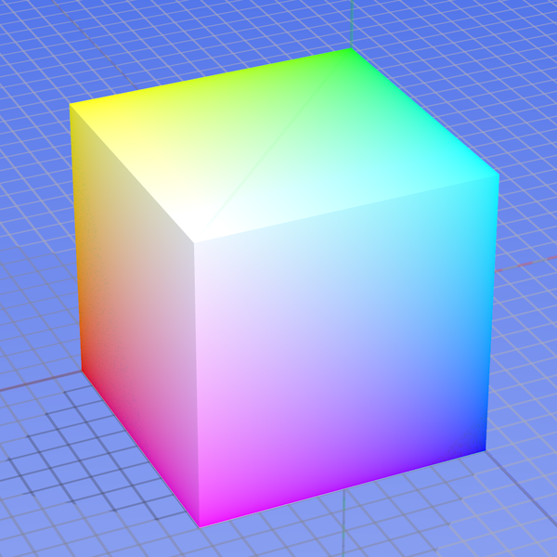
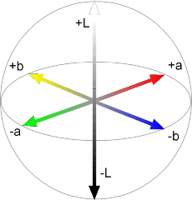
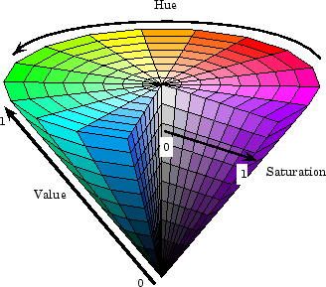



Color spaces
RGB
LAB
0,1,0
1,0,0
0,0,1
HSV
YCbCr
Y=0
Y=0.5
Y=1
Cr
Cb

Slide 26
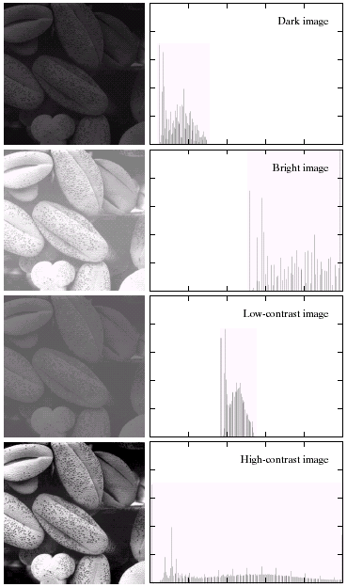

Image Histograms

Slide 27
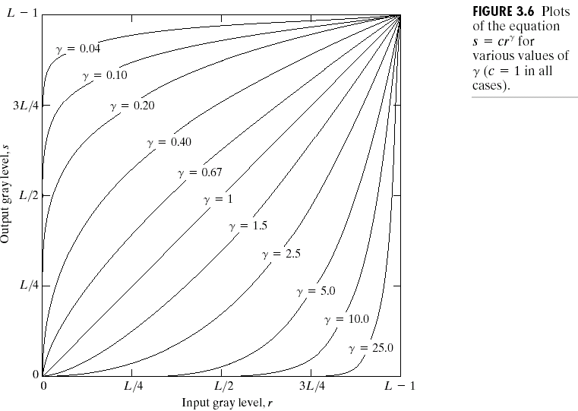
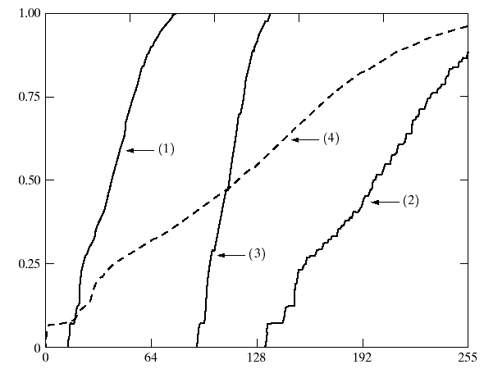
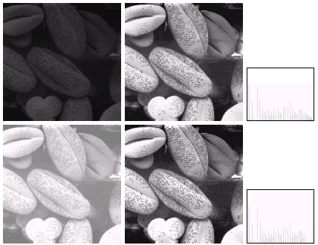
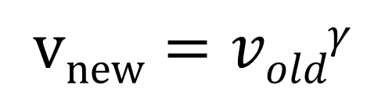
Contrast enhancement / balancing
Gamma correction
Histogram equalization
$$vnew=voldγ$$
Cumulative Histograms

Slide 28
3. Linear filtering
Can think of filtering as
  A function in the spatial domain (e.g., compute average of each 3x3 window)
  Template matching
  Modifying the frequency of the image

Slide 29

Filtering in spatial domain
Slide filter over image and take dot product at each position
1
1
1
1
1
1
1
1
1
0 | 0 | 0 | 0 | 0 | 0 | 0 | 0 | 0 | 0
0 | 0 | 0 | 0 | 0 | 0 | 0 | 0 | 0 | 0
0 | 0 | 0 | 90 | 90 | 90 | 90 | 90 | 0 | 0
0 | 0 | 0 | 90 | 90 | 90 | 90 | 90 | 0 | 0
0 | 0 | 0 | 90 | 90 | 90 | 90 | 90 | 0 | 0
0 | 0 | 0 | 90 | 0 | 90 | 90 | 90 | 0 | 0
0 | 0 | 0 | 90 | 90 | 90 | 90 | 90 | 0 | 0
0 | 0 | 0 | 0 | 0 | 0 | 0 | 0 | 0 | 0
0 | 0 | 90 | 0 | 0 | 0 | 0 | 0 | 0 | 0
0 | 0 | 0 | 0 | 0 | 0 | 0 | 0 | 0 | 0
 | 0 | 10 | 20 | 30 | 30
?

Slide 30
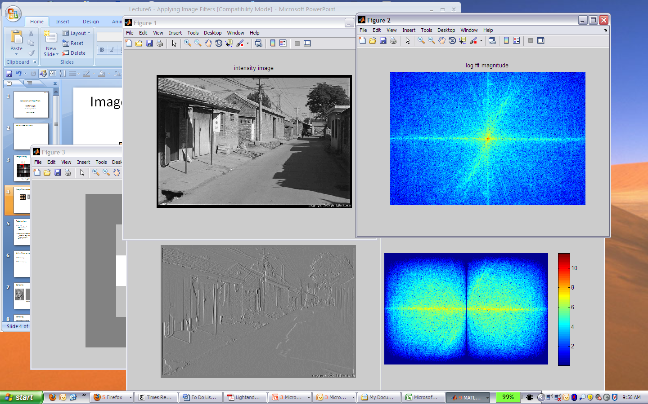
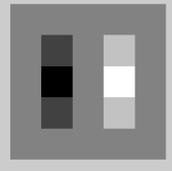
Filtering in spatial domain
1
0
-1
2
0
-2
1
0
-1
*
=

Slide 31
Filtering in frequency domain
Can be faster than filtering in spatial domain (for large filters)
Can help understand effect of filter
Algorithm:
  Convert image and filter to fft (fft2 in matlab)
  Pointwise-multiply ffts
  Convert result to spatial domain with ifft2

Slide 32
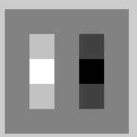

Filtering in frequency domain
FFT
FFT
=
Inverse FFT

Slide 33
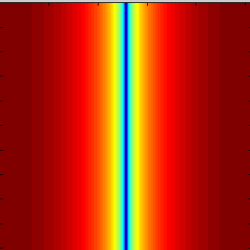
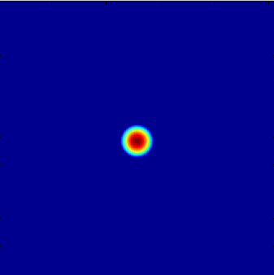

Filtering in frequency domain
Linear filters for basic processing
  Edge filter (high-pass)
  Gaussian filter (low-pass)
[-1 1]
Gaussian
FFT of Gradient Filter
FFT of Gaussian

Slide 34


Filtering
Why does the Gaussian give a nice smooth image, but the square filter give edgy artifacts?
Gaussian
Box filter
Notes:
Things we can’t understand without thinking in frequency

Slide 35
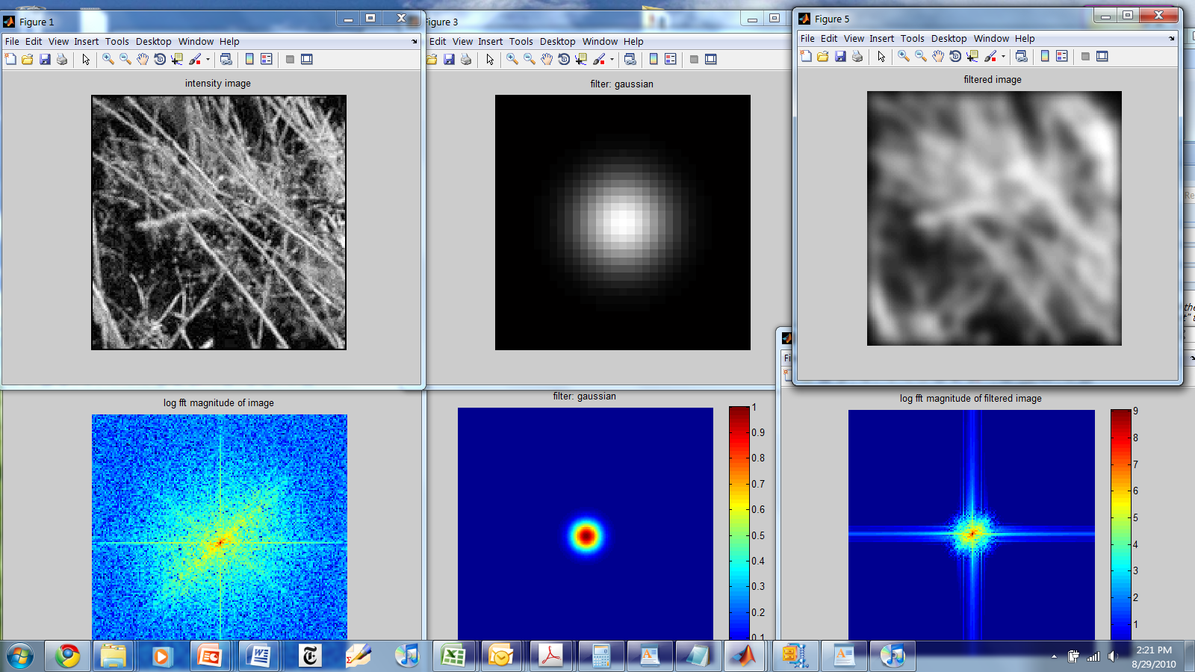
Gaussian

Slide 36
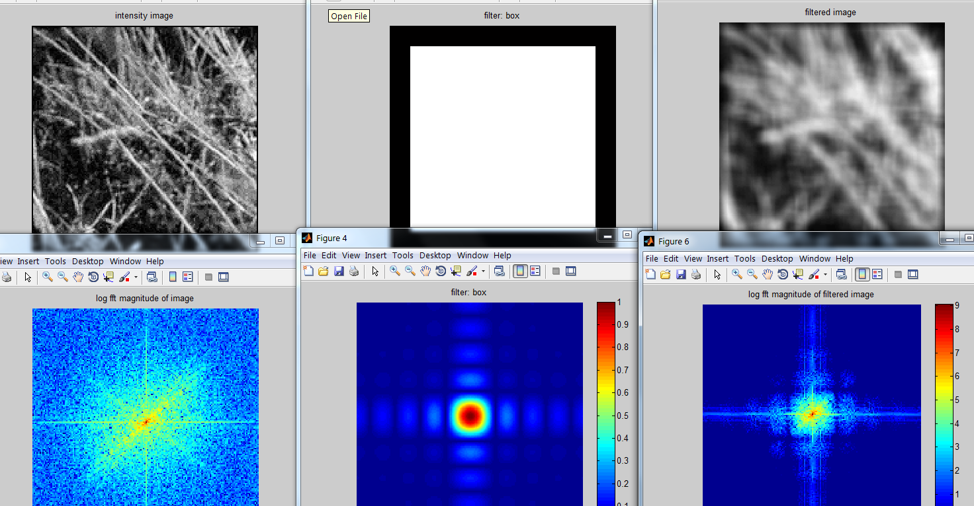
Box Filter

Slide 37
Question
Use filtering to find pixels that have at least three white pixels in among the 8 surrounding pixels
Write down a filter that will compute the gradient in the y-direction:
gradx(y,x) = im(y+1,x)-im(y,x) for each x, y

Slide 38
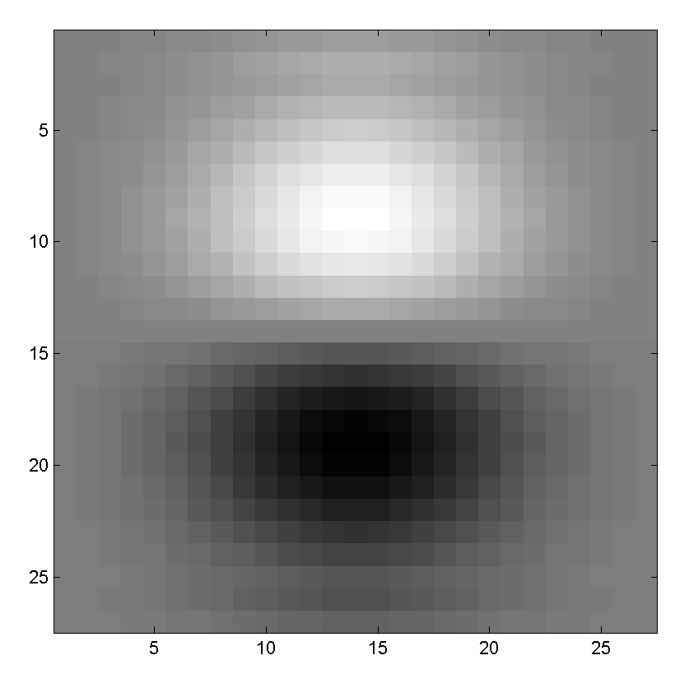
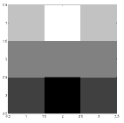
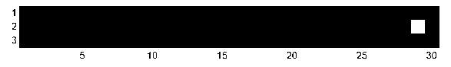
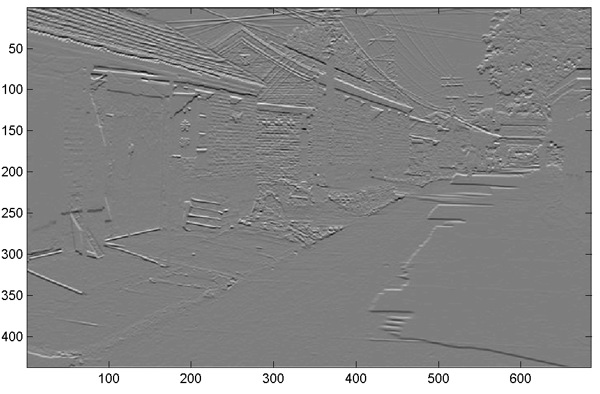
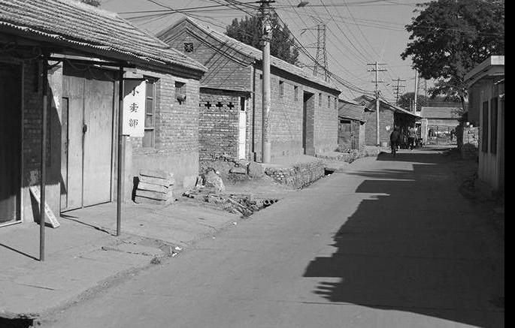
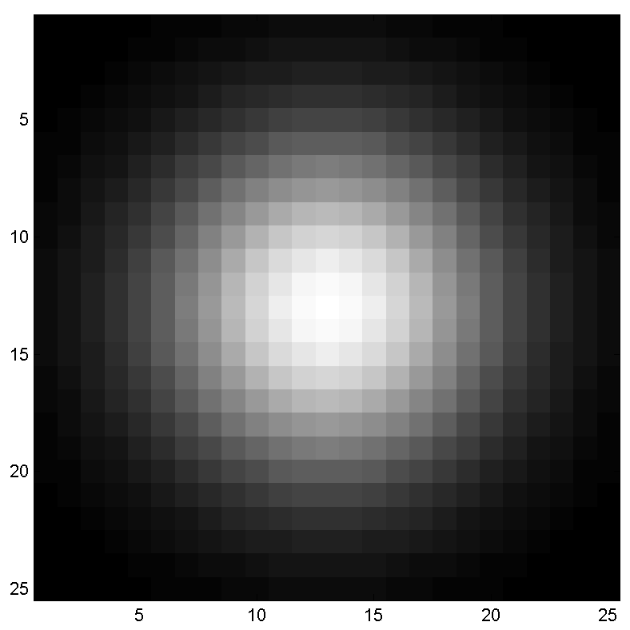
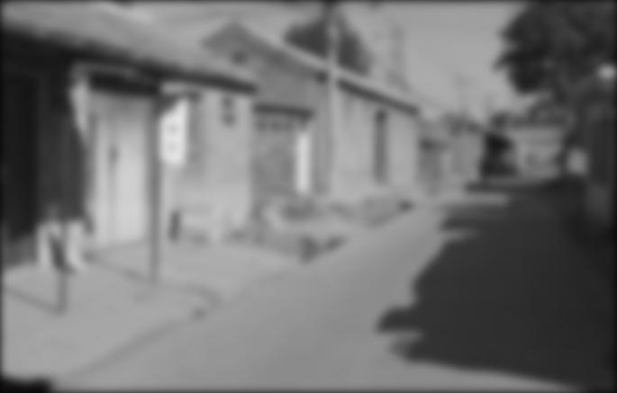
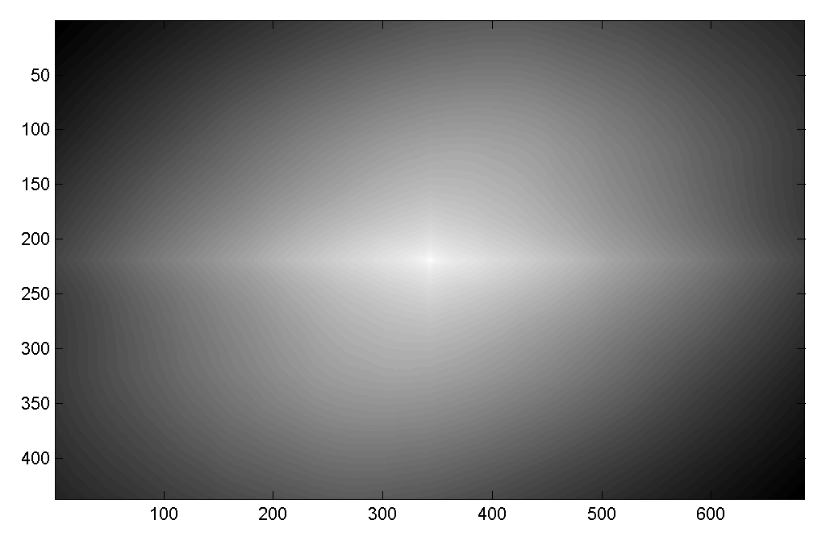

Question
Filtering Operator
a) _ = D * B
b) A = _ * _
c) F = D * _
d) _ = D * C
3. Fill in the blanks:
A
B
E
G
F
C
H
I
D

Slide 39
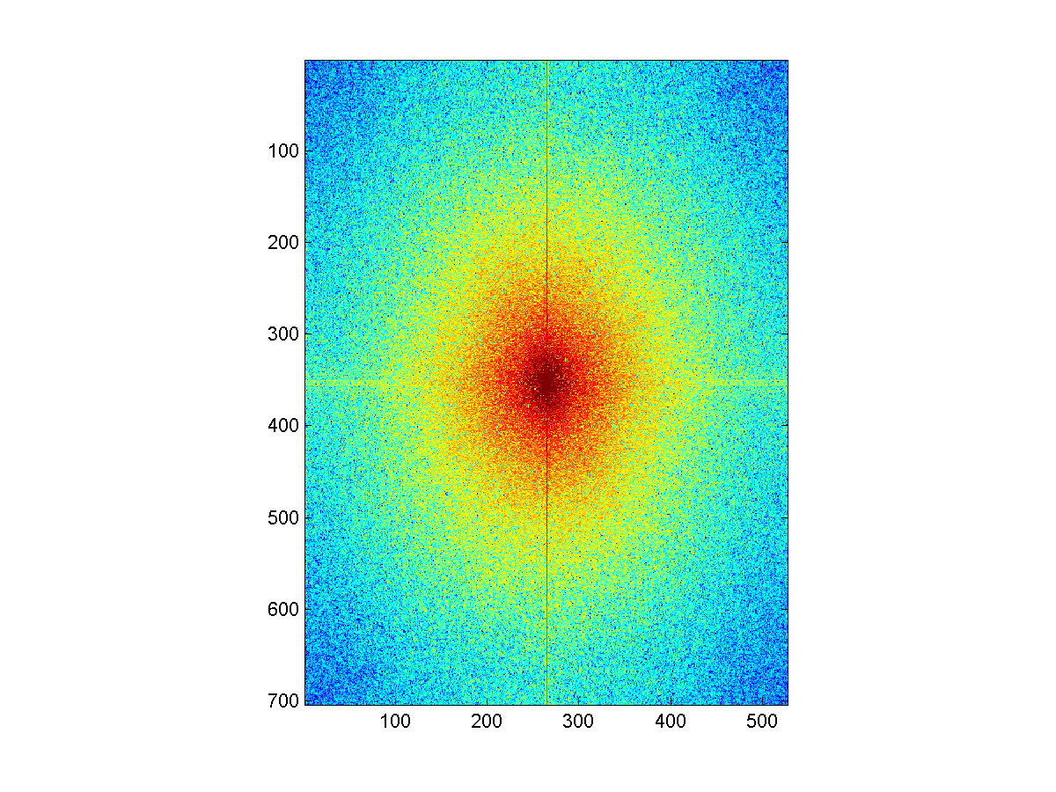
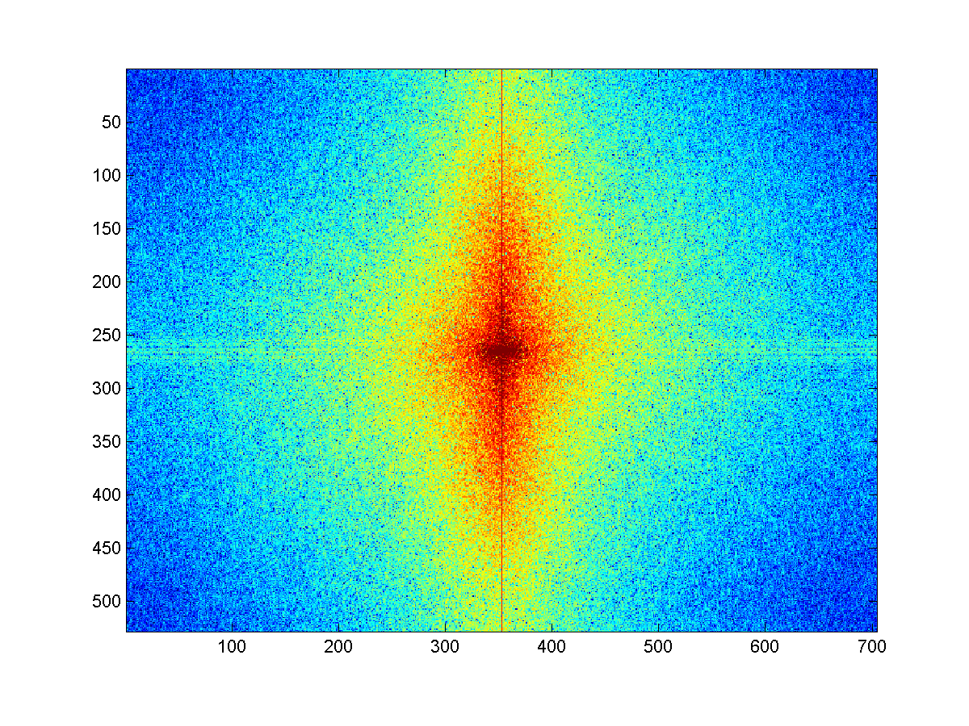
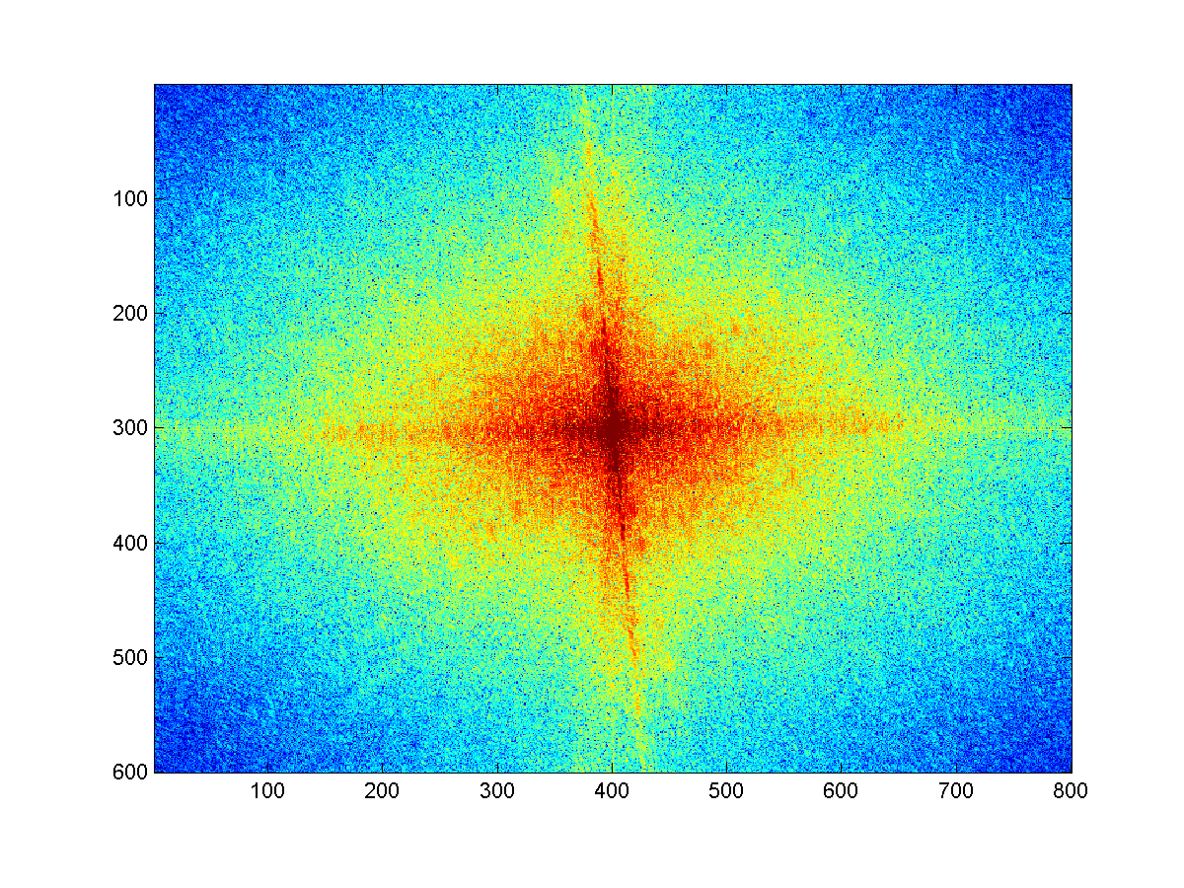
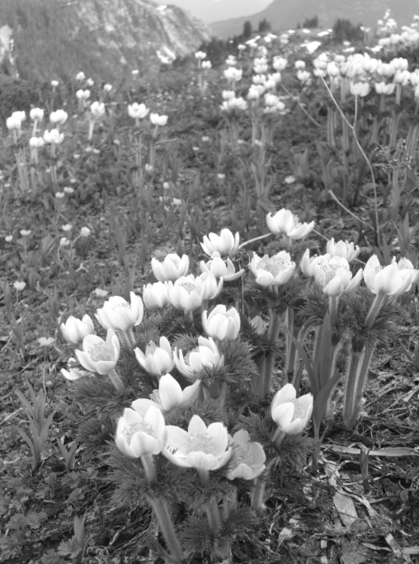
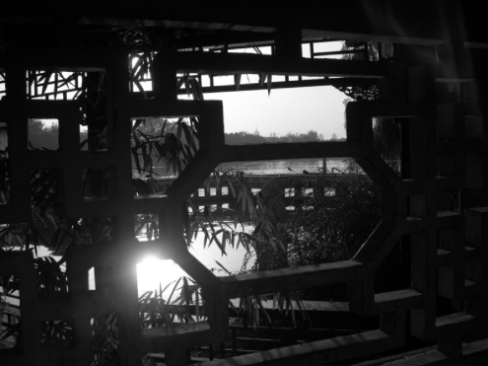
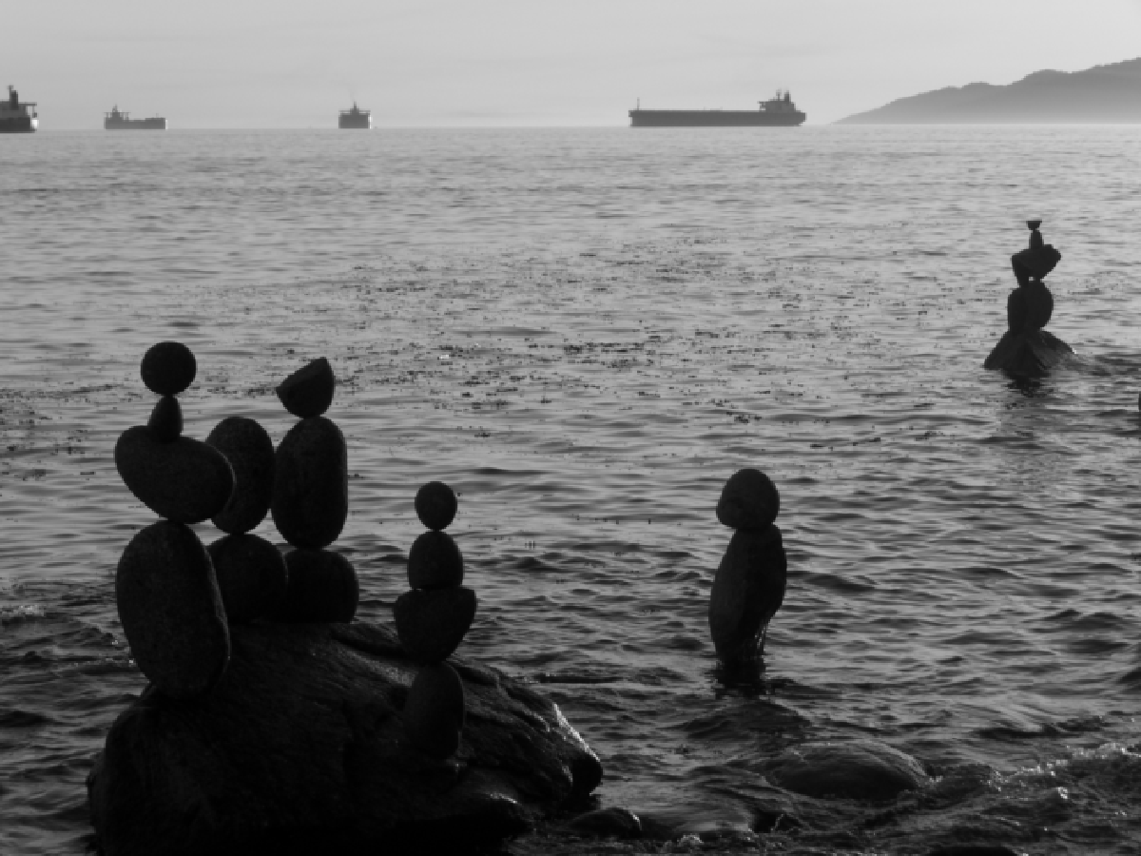

Question
Match the spatial domain image to the Fourier magnitude image
1
2
3
4
5
B
A
C
E
D

Slide 40
Applications of filters
Template matching (SSD or Normxcorr2)
  SSD can be done with linear filters, is sensitive to overall intensity
  Basis for object detection
Gaussian pyramid
  Coarse-to-fine search, multi-scale detection
Laplacian pyramid
  Can be used for blending
  More compact image representation

Slide 41

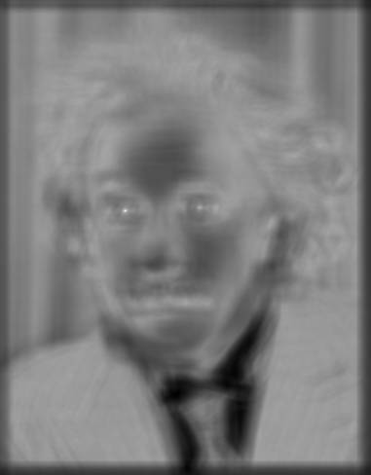

Matching with filters
Goal: find in image
Method 2: SSD
True detections
Input
1- sqrt(SSD)
Thresholded Image
Notes:
Problem: SSD sensitive to average intensity

Slide 42
Matching with filters
Goal: find in image
Method 3: Normalized cross-correlation
mean template
mean image patch
Matlab: normxcorr2(template, im)
Notes:
Invariant to mean and scale of intensity

Slide 43
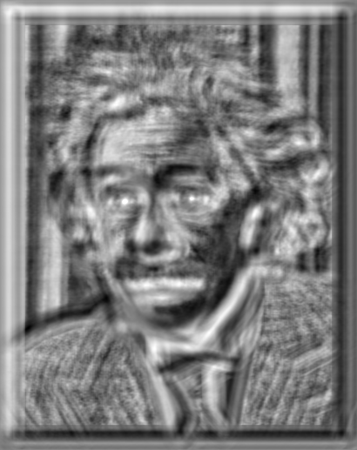

Matching with filters
Goal: find in image
Method 3: Normalized cross-correlation
True detections
Input
Normalized X-Correlation
Thresholded Image

Slide 44
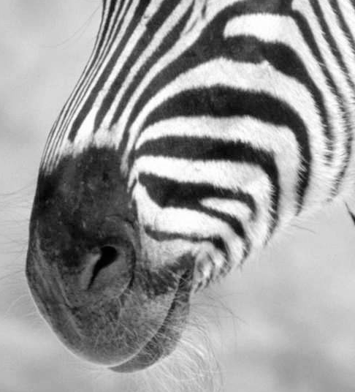
Subsampling by a factor of 2
Problem: This approach causes “aliasing”
Throw away every other row and column to create a 1/2 size image

Slide 45
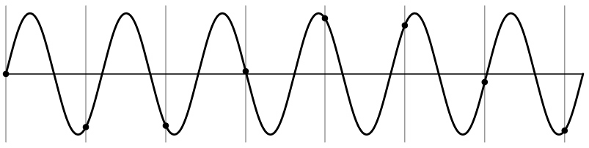
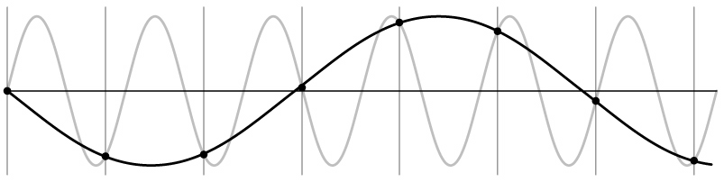
Nyquist-Shannon Sampling Theorem
When sampling a signal at discrete intervals, the sampling frequency must be ≥ 2 × f_{max}
f_{max} = max frequency of the input signal
This will allows to reconstruct the original perfectly from the sampled version
v
v
v
good
bad

Slide 46
Algorithm for downsampling by factor of 2
Start with image(h, w)
Apply low-pass filter
  im_blur = imfilter(image, fspecial(‘gaussian’, 7, 1))
Sample every other pixel
  im_small = im_blur(1:2:end, 1:2:end);

Slide 47



Subsampling without pre-filtering
1/2
1/4 (2x zoom)
1/8 (4x zoom)
Slide by Steve Seitz

Slide 48



Subsampling with Gaussian pre-filtering
Gaussian 1/2
G 1/4
G 1/8
Slide by Steve Seitz

Slide 49
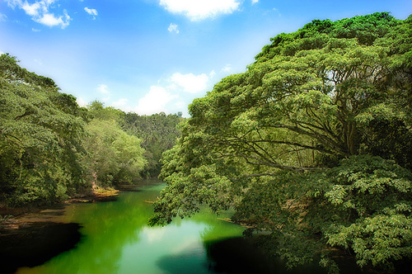
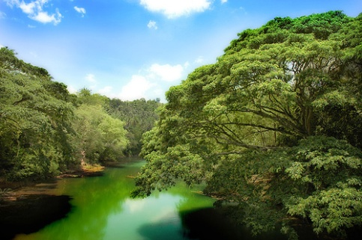
Sampling
Why does a lower resolution image still make sense to us? What do we lose?
Image: http://www.flickr.com/photos/igorms/136916757/

Slide 50

Gaussian pyramid
Useful for coarse-to-fine matching
Applications include multi-scale object detection, image alignment, optical flow, point tracking

Slide 51

Computing Gaussian/Laplacian Pyramid
Gaussian Pyramid
2-level Laplacian Pyramid
Useful figure to remember
http://sepwww.stanford.edu/~morgan/texturematch/paper_html/node3.html

Slide 52

Image reconstruction from Laplacian pyramid

Slide 53
4. Region selection and compositing
Selecting image regions
  Intelligent scissors
  Graph cuts
Compositing
  Alpha masks
  Feathering
  Laplacian pyramid blending
  Poisson blending

Slide 54


Intelligent Scissors
You can treat the image as a graph
  Nodes = pixels, edges connect neighboring pixels
Intelligent Scissors: Good boundaries are a short (high gradient) path through the graph

Slide 55

Graph Cuts
You can treat the image as a graph
  Nodes = pixels, edges connect neighboring pixels
Source (Label 0)
Cost to assign to 0
Cost to split nodes
Cost to assign to 1
Sink (Label 1)
Graph cut: Good boundaries are a cheap cut, where some pixels want to be foreground, and some to be background

Slide 56




Compositing and Blending
Feathering: blur mask around its edges
Laplacian blending: blend low-frequency slowly, high frequency quickly
  Blend with alpha mask values ranging from 0 to 1
laplacian
level
4
laplacian
level
2
laplacian
level
0

Slide 57



Question
1) I am trying to blend this bear into this pool. What problems will I have if I use:
  Alpha compositing with feathering
  Laplacian pyramid blending
  Poisson editing?
Lap. Pyramid
Poisson Editing

Slide 58




Keypoint Matching
1. Find a set of
distinctive key-
points
A₁
B₃
2. Define a region
around each
keypoint
A₂
A₃
B₁
B₂
3. Extract and
normalize the
region content
4. Compute a local
descriptor from the
normalized region
5. Match local
descriptors

Slide 59
Key trade-offs
A₁
B₃
A₂
A₃
B₂
B₁
Localization
More Points
More Repeatable
Robust to occlusion
Works with less texture
Robust detection
Precise localization
Description
More Robust
More Selective
Deal with expected variations
Maximize correct matches
Minimize wrong matches

Slide 60










Harris Detector [Harris88]
Second moment matrix
I_{x}
I_{y}
1. Image derivatives
I_{x}²
I_{y}²
I_{x}I_{y}
2. Square of derivatives
3. Gaussian
filter g(σ_{I})
g(I_{x}²)
g(I_{y}²)
g(I_{x}I_{y})
4. Cornerness function – both eigenvalues are strong
g(I_{x}I_{y})
5. Non-maxima suppression
har

Slide 61


Harris Detector – Responses [Harris88]
Effect: A very precise corner detector.

Slide 62
Applications
Image stitching
  Matching keypoints
  Solving for homography
  RANSAC
Object recognition
  Clustering keypoints and creating tf-idf tables for fast retrieval
  Geometric verification

Slide 63


5. Solving for transformations
Map between 2D coordinates using linear projection

Slide 64
Least-squares Solving
If all points (or correspondences) fit the model with some noise, better to use all for least squares estimate
x
x
x
x
x

Slide 65
Least-squares Solving
If some points are outliers, robust approach such as RANSAC is needed
Robust Fit
LSq Fit
x
x
x
x
x

Slide 66
Question
Suppose we have two triangles, ABC and DEF, related by a general affine transformation. Solve for the transformation.
B
E
D
C
A
F

Slide 67
Good luck!
Questions?

Slide 68
Take-home questions
9/21/2011
2) How would you make a sharpening filter using gradient domain processing? What are the constraints on the gradients and the intensities?

Slide 69

Take-home question
10/11/2011
Suppose you have estimated three vanishing points corresponding to orthogonal directions. How can you recover the rotation matrix that is aligned with the 3D axes defined by these points?
  Assume that intrinsic matrix K has three parameters
  Remember, in homogeneous coordinates, we can write a 3d point at infinity as (X, Y, Z, 0)
VP_{y}
.
VP_{x}
VP_{z}
Photo from online Tate collection

Slide 70

Take-home question
10/11/2011
Assume that the camera height is 5 ft.
  What is the height of the man?
  What is the height of the building?
  How long is the right side of the building compared to the small window on the right side of the building?

Slide 71

Growing: Texture synthesis and hole-filling
  Transfer based on simple matching is a powerful idea
  Hallucinate new pixels from their surroundings
Efros & Leung, Criminisi et al.: To fill in pixels, take the center pixel from a patch that matches known surrounding values. Work from the outside in, prioritizing pixels with strong gradients.

Slide 72


Fun with faces
Use corresponding points to average, manipulate, and extrapolate
PCA: compactly represent a large number of variables with a few coefficients by projecting onto directions of maximum variation
Average face
Make more feminine

