Slide 1
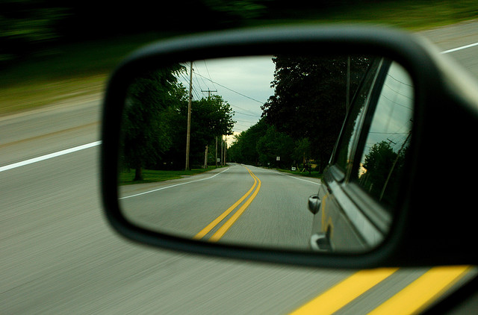
12/7/10
Looking Back, Moving Forward
Computational Photography
Derek Hoiem, University of Illinois
Photo Credit
Lee Cullivan

Slide 2
Anti-summary
Video
Motion
Exaggerating motion
Human motion transfer, animation, etc.
Tracking
Structure from motion
Activity recognition
Background subtraction and alpha matting
Projectors
Scene Understanding
Segmentation into “perceptually” salient regions
Automatic interpretation in terms of surfaces, materials, objects
From Image Parsing to Painterly Rendering
Contextual reasoning
Machine learning
Binocular and multi-view stereo
Animating photographs
Animating crowds

Slide 3
Today
Project 5 favorites
Adair Liu, Jia-bin Huang, Charles Park
Reminder: final project
Due next Monday night
Presentations on Tuesday during final exam period
What else is there?
ICES forms

Slide 4
This course has provided fundamentals
How photographs are captured from and relate to the 3D scene
How to think of an image as: a signal to be processed, a graph to be searched, an equation to be solved
How to manipulate photographs: cutting, growing, compositing, morphing, stitching
Basic principles of computer vision: filtering, detection, correspondence, alignment

Slide 5
What else is out there?
Video and motion
Scene understanding
Modeling humans

Slide 6
What else is out there?
Lots!
Videos and motion
Scene understanding
Interactive games
Modeling humans
…

Slide 7
Video and motion
Video = sequence of images
Track points → optical flow, tracked objects, 3D reconstruction
Look for changes → background subtraction
Find coherent space-time regions → segmentation
Examples:
Point tracking
2D3 / Boujou 1 / Boujou 2
“Motion Magnification” (Liu et al. 2005)

Slide 8
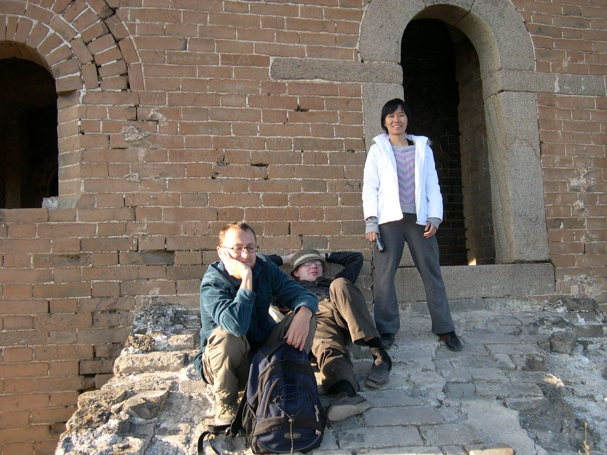
Scene understanding
Interpret image in terms of scene categories, objects, surfaces, interactions, goals, etc.
Remove the guy lying down (Alyosha)
Make the woman dance or the guy get up
Fill in the window with bricks
Find me images with only Alyosha and Piotro

Slide 9
Scene understanding
Mostly unsolved, but what we have is still useful (and quickly getting better)
Examples
“From Image Parsing to Painterly Rendering” (Zeng et al. 2010)
“Sketch2Photo: Internet Image Montage” (Chen et al. 2009)

Slide 10
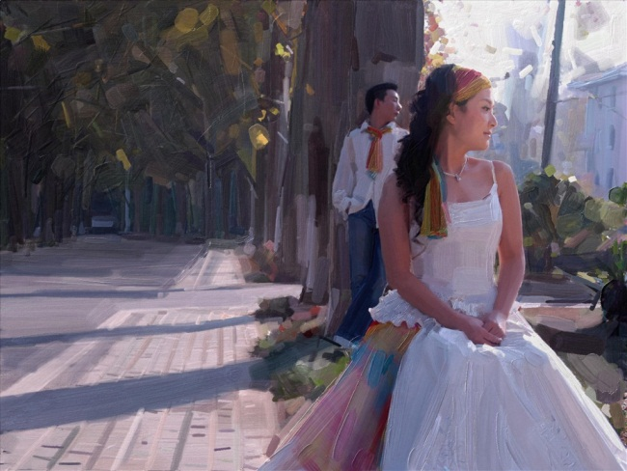
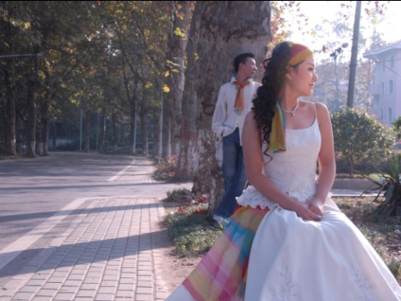
Image Parsing to Painterly Rendering
Zeng et al. SIGGRAPH 2010

Slide 11
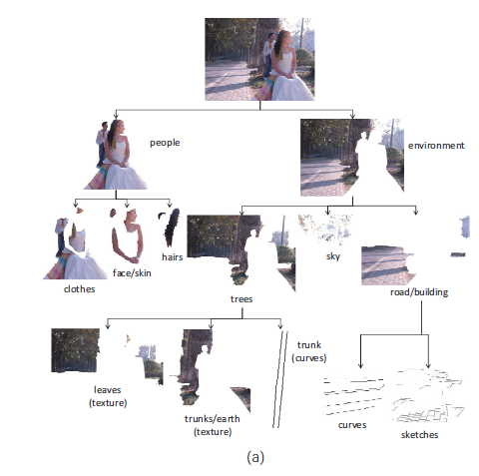
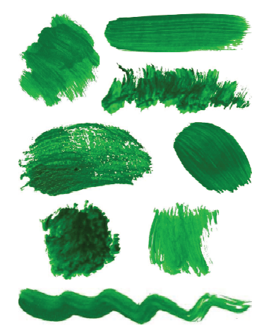
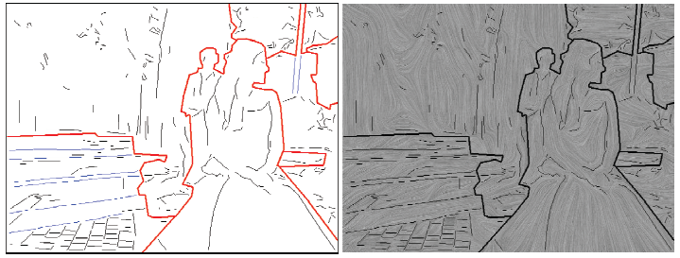
Image Parsing to Painterly Rendering
Parse
Brush Strokes
Sketch
Brush Orientations
Zeng et al. SIGGRAPH 2010

Slide 12
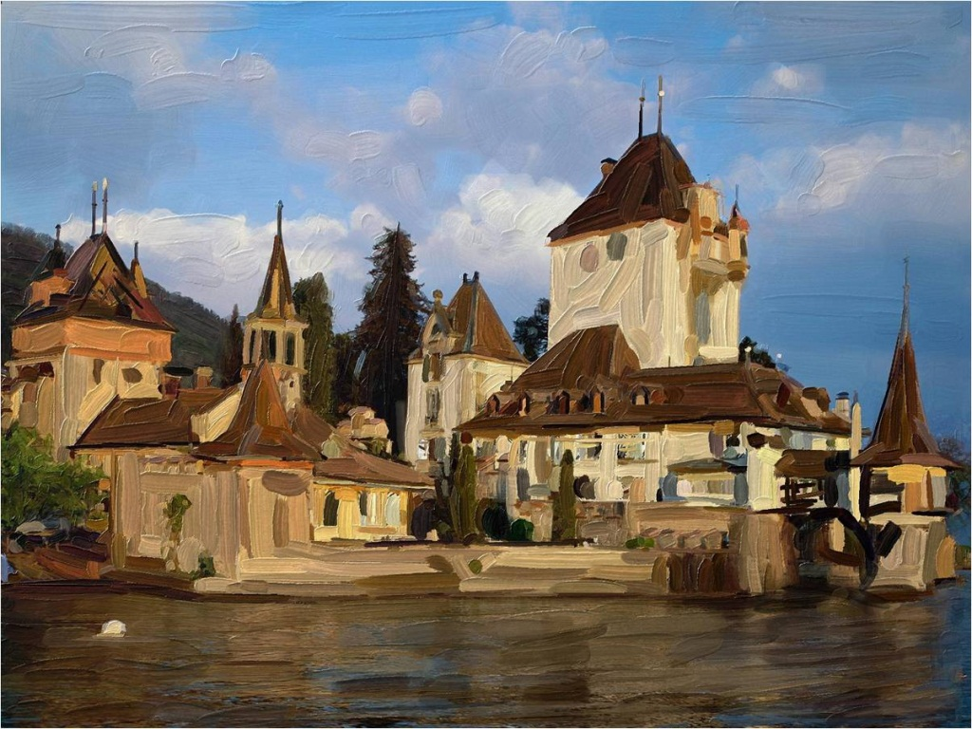
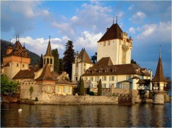
Image Parsing to Painterly Rendering
Zeng et al. SIGGRAPH 2010

Slide 13
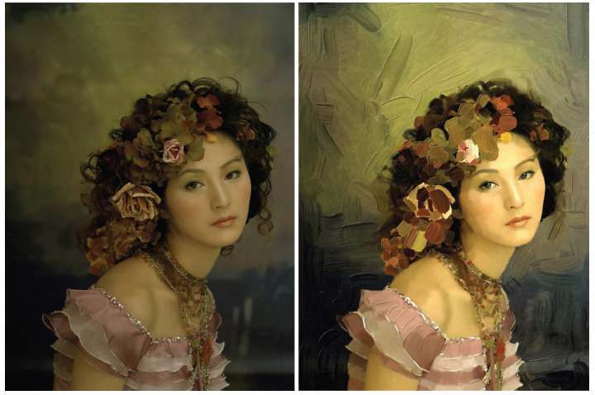
Image Parsing to Painterly Rendering

Slide 14
More examples
Sketch2photo: http://www.youtube.com/watch?v=dW1Epl2LdFM
Animating still photographs
Chen et al. 2009

Slide 15
Interactive games: Kinect
Object Recognition: http://www.youtube.com/watch?feature=iv&v=fQ59dXOo63o
Mario: http://www.youtube.com/watch?v=8CTJL5lUjHg
3D: http://www.youtube.com/watch?v=7QrnwoO1-8A

Slide 16
Modeling humans
Estimating pose and shape
Motion capture
Face transfer
Crowd simulation

Slide 17
Questions
How can we simplify editing of photos and videos?
How can we organize photographs and videos?
Can we just capture and store the whole visual world?

Slide 18
Questions, Looking Forward
How can we get computers to understand scenes (make predictions, describe them, etc.)?
How can we design programs where semi-smart computers and people collaborate?
What if we just capture and store the whole visual world (think StreetView)?
How will photography change if depth cameras or IR or stereo become standard?

Slide 19
How can you learn more?
Relevant courses
Production graphics (CS 419)
Machine learning (CS 446)
Computer vision (CS 543)
Optimization methods (w/ David Forsyth)
Parallel processing / GPU
HCI, data mining, NLP, robotics

Slide 20
Computer vision (w/ me Spring 2011)
Similar stuff to CP
Camera models, filtering, single-view geometry, light and capture
New stuff
Scene understanding
Object category recognition
Action/activity recognition
Edge detection, clustering, segmentation
Videos
Tracking
Structure from motion
Multi-view geometry
Notes:
Roughly 20-25% overlap

Slide 21
How do you learn more?
Explore!

Slide 22
Thank you!

