Slide 1
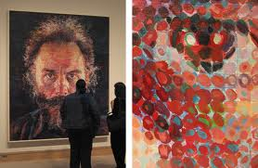
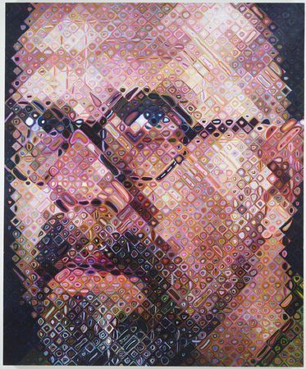
Understanding Faces
12/4/19
Detection, Recognition, and Transformation of Faces
Lucas by Chuck Close
Chuck Close, self portrait
Some slides from Amin Sadeghi, Lana Lazebnik, Silvio Savarese, Fei-Fei Li

Slide 2
Exams
Exams handed back after this class or in office hours
Go over common mistakes today
Better grade distribution than past years
 | 2015 | 2017 | 2019
90 - 100 | 12% | 20% | 32%
80 - 89 | 27% | 40% | 33%
70 - 79 | 42% | 24% | 21%
< 70 | 19% | 17% | 15%
Mean: 82%
Median: 84%
Max: 100%

Slide 3


Face detection and recognition
Detection
Recognition
“Sally”

Slide 4
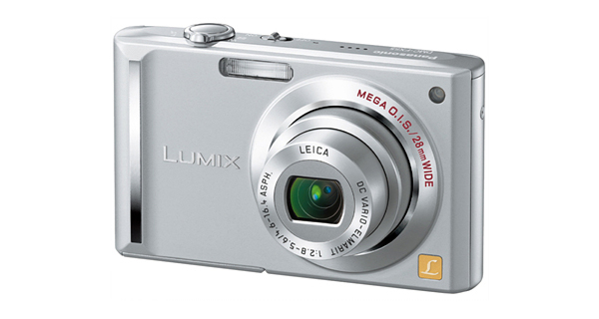
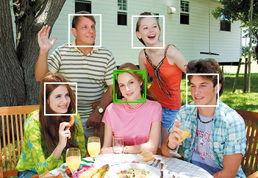
Applications of Face Recognition
Digital photography

Slide 5
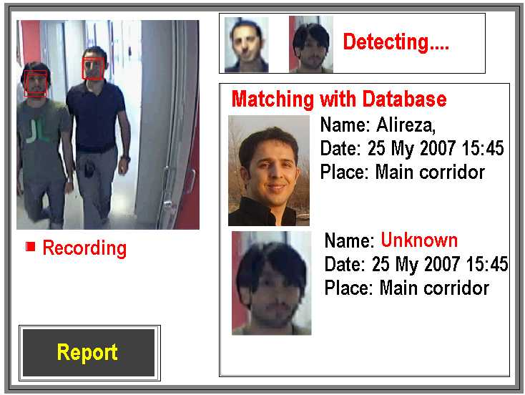
Applications of Face Recognition
Digital photography
Surveillance

Slide 6
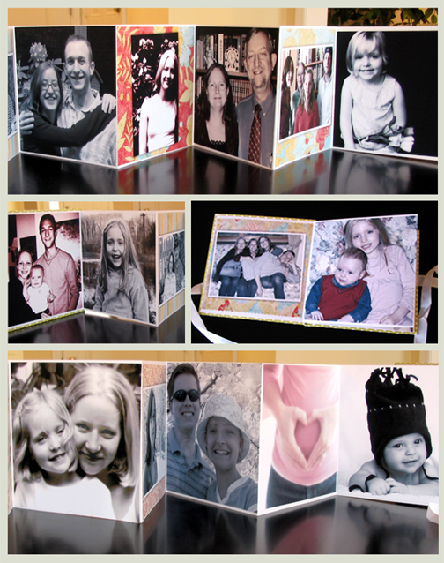
Applications of Face Recognition
Digital photography
Surveillance
Album organization

Slide 7
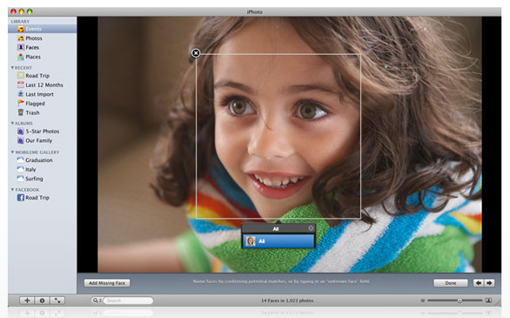
Consumer application: iPhoto 2009
http://www.apple.com/ilife/iphoto/

Slide 8
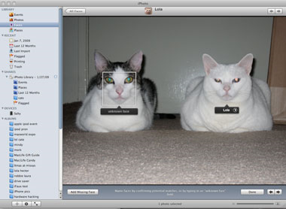
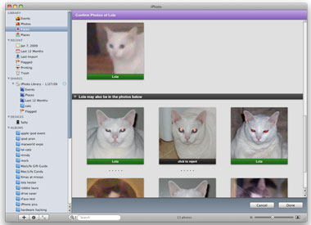
Consumer application: iPhoto 2009
Can be trained to recognize pets!
http://www.maclife.com/article/news/iphotos_faces_recognizes_cats

Slide 9
Face detection
Detection

Slide 10
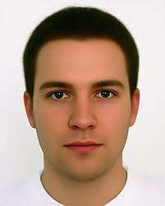
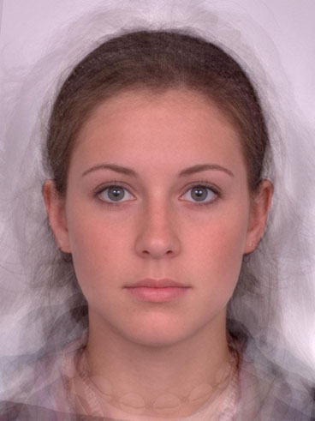
What does a face look like?

Slide 11
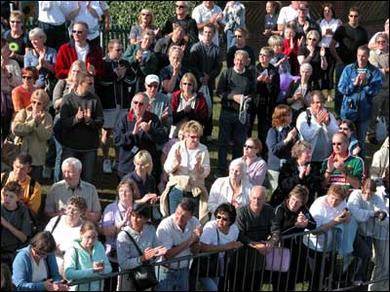
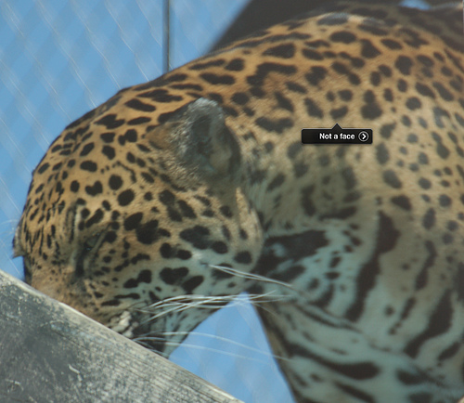
What does a face look like?

Slide 12
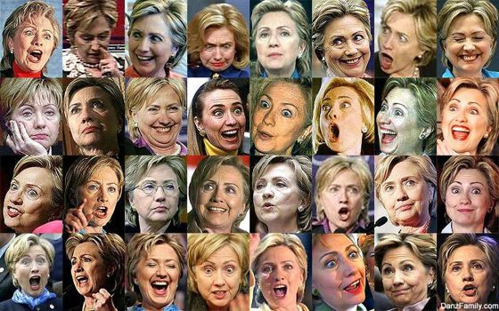
What makes face detection hard?
Expression

Slide 13
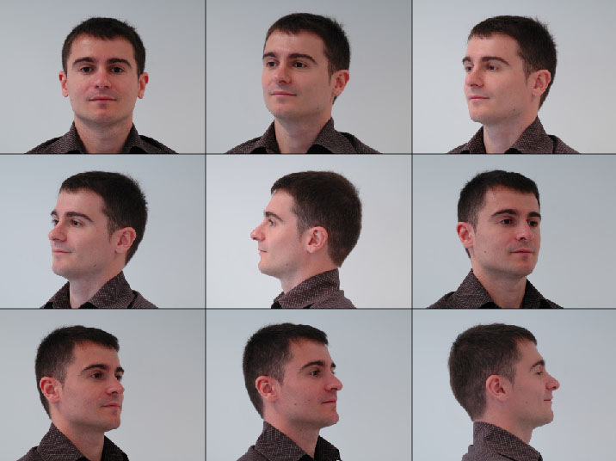
What makes face detection hard?
Viewpoint

Slide 14
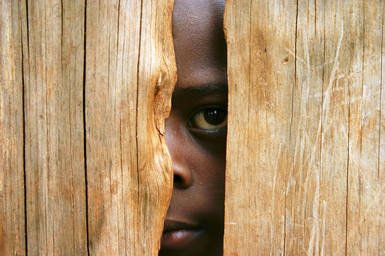
What makes face detection hard?
Occlusion

Slide 15
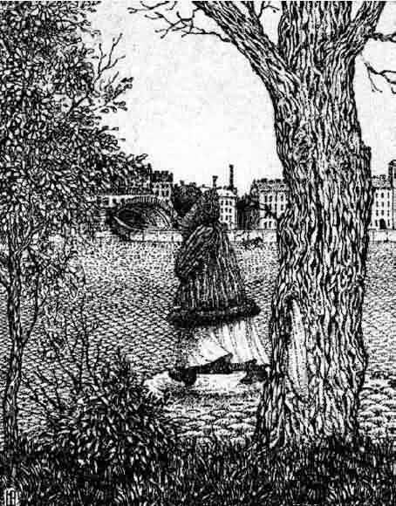
What makes face detection and recognition hard?
Coincidental textures

Slide 16
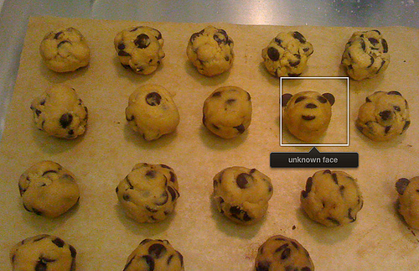
Consumer application: iPhoto 2009
Things iPhoto thinks are faces

Slide 17
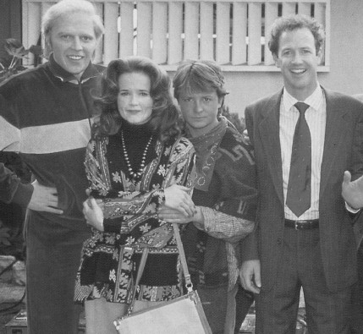

How to find faces anywhere in an image?
Filter Image with a face?

Slide 18
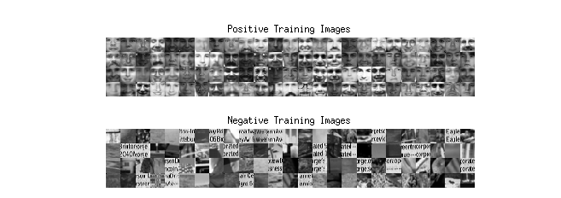
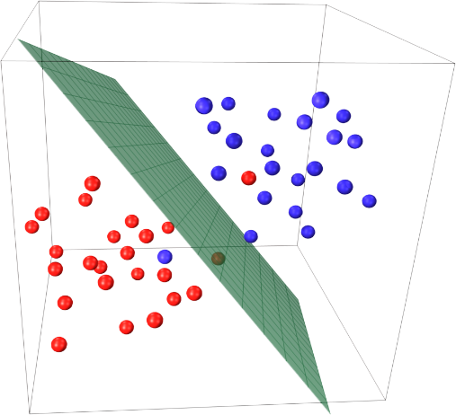
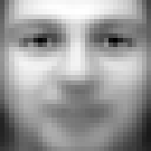
Train a Filter
SVM

Slide 19
Face detection: sliding windows
…
Filter/Template
Multiple scales

Slide 20



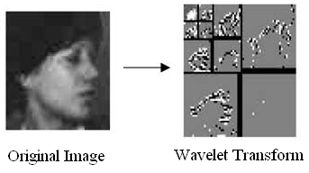
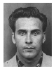
What features?
Exemplars
(Sung Poggio 1994)
Intensity Patterns (with NNs)
(Rowley Baluja Kanade 1996)
Edge (Wavelet) Pyramids
(Schneiderman Kanade 1998)
Haar Filters
(Viola Jones 2000)

Slide 21
How to classify?
Many ways
  Neural networks
  Adaboost
  SVMs
  Nearest neighbor

Slide 22
Face classifier
Training
Training Labels
Training Images
Image Features
Classifier Training
Trained Classifier
Testing
Image Features
Trained Classifier
Prediction
Face
Test Image

Slide 23
Face Detection: State of the Art
https://arxiv.org/pdf/1905.00641v2.pdf

Slide 24
Perfect

Slide 25
RetinaFace can find around 900 faces (threshold at 0.5) out of the reported 1151 people

Slide 26
Face recognition
Detection
Recognition
“Sally”

Slide 27
Face recognition
Typical scenario: few examples per face, identify or verify test example
What’s hard: changes in expression, lighting, age, occlusion, viewpoint
Basic approaches (all nearest neighbor)
  Project into a new subspace (or kernel space) (e.g., “Eigenfaces”=PCA)
  Measure face features
  Make 3d face model, compare shape+appearance (e.g., AAM)

Slide 28

Simple technique
Treat pixels as a vector
Recognize face by nearest neighbor

Slide 29
State-of-the-art Face Recognizers
Most recent research focuses on “faces in the wild”, recognizing faces in normal photos
  Classification: assign identity to face
  Verification: say whether two people are the same
Important steps
  Detect
  Align
  Represent
  Classify

Slide 30
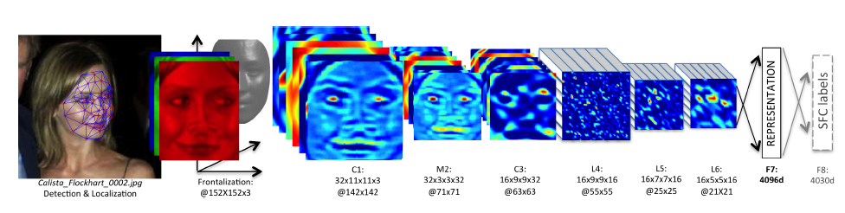
DeepFace: Closing the Gap to Human-Level Performance in Face Verification
Taigman, Yang, Ranzato, & Wolf (Facebook, Tel Aviv), CVPR 2014
Following slides adapted from Daphne Tsatsoulis

Slide 31
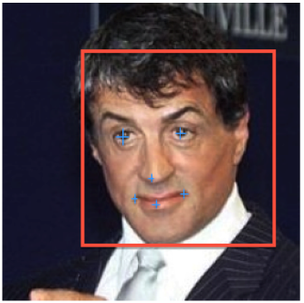
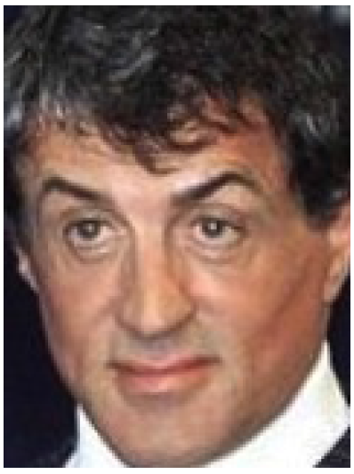
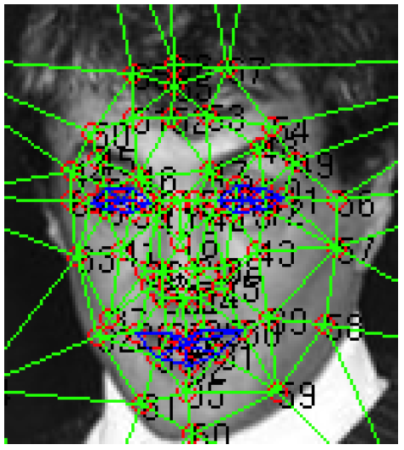
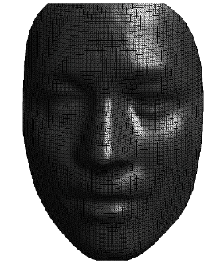
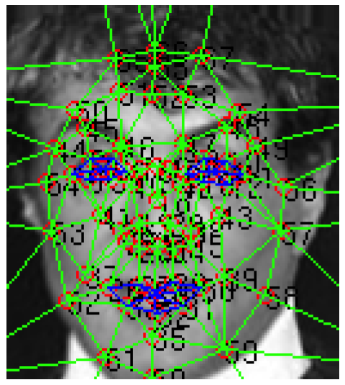
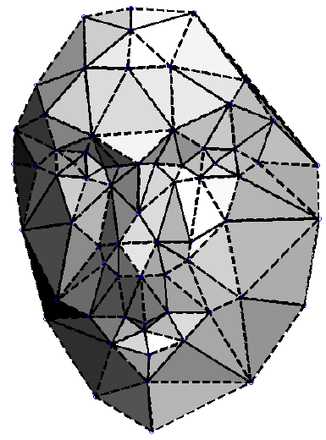
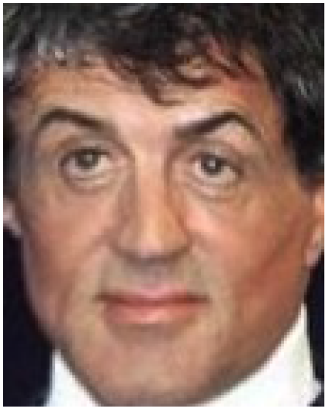
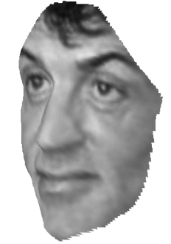
Face Alignment
1. Detect a face and 6 fiducial markers using a support vector regressor (SVR)
2. Iteratively scale, rotate, and translate image until it aligns with a target face
3. Localize 67 fiducial points in the 2D aligned crop
4. Create a generic 3D shape model by taking the average of 3D scans from the USF Human-ID database and manually annotate the 67 anchor points
5.Fit an affine 3D-to-2D projection and use it to frontally warp the face

Slide 32
Train DNN classifier on aligned faces
Architecture (deep neural network classifier)
Two convolutional layers (with one pooling layer)
3 locally connected and 2 fully connected layers
> 120 million parameters
Train on dataset with 4400 individuals, ~1000 images each
Train to identify face among set of possible people
Face matching (verification) is done by comparing features at last layer for two faces

Slide 33
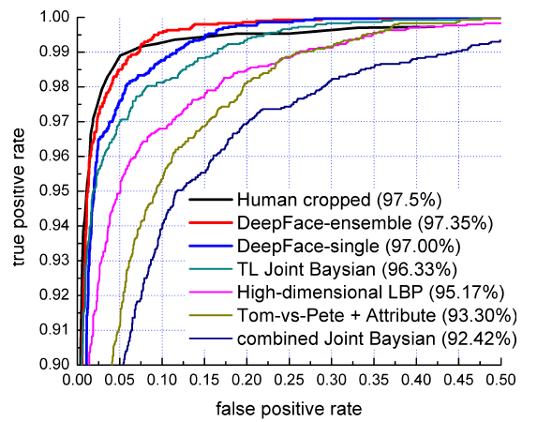
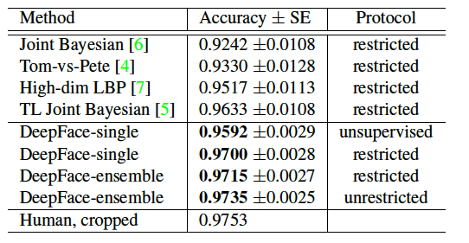
Results: Labeled Faces in the Wild Dataset
Performs similarly to humans!
(note: humans would do better with uncropped faces)
Experiments show that alignment is crucial (0.97 vs 0.88) and that deep features help (0.97 vs. 0.91)

Slide 34
Transforming faces

Slide 35
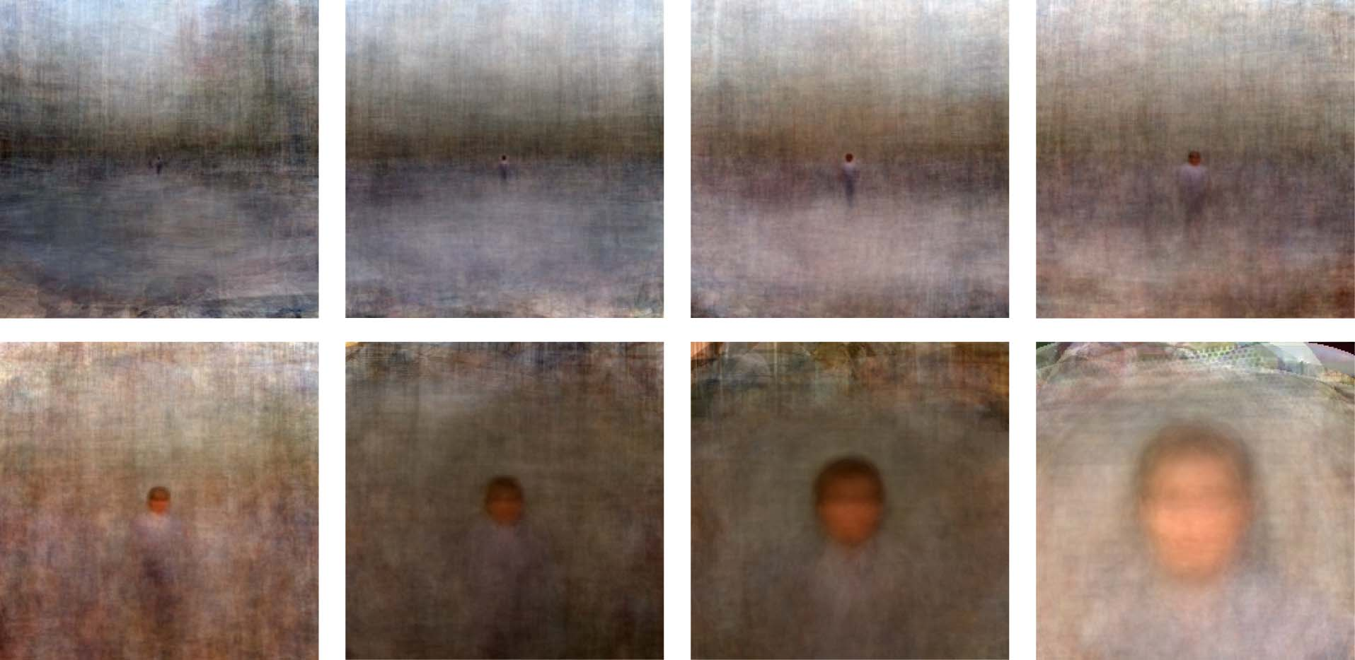
Figure-centric averages
Need to Align
  Position
  Scale
  Orientation
Antonio Torralba & Aude Oliva (2002)
Averages: Hundreds of images containing a person are averaged to reveal regularities
in the intensity patterns across all the images.
Notes:
Another usage is to show a significant trend.
----- Meeting Notes (10/4/11 17:12) -----
Aligned through translation and scale
average
35

Slide 36
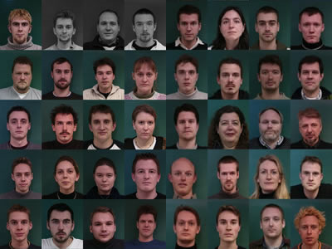
How do we average faces?
http://www2.imm.dtu.dk/~aam/datasets/datasets.html

Slide 37
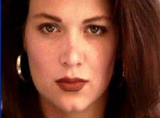

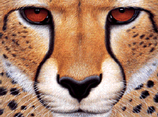
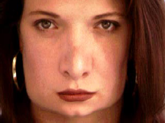
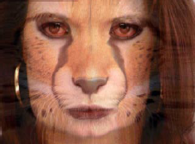
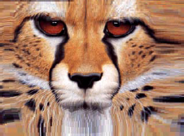
Morphing
image #1
image #2
warp
morphing
warp

Slide 38
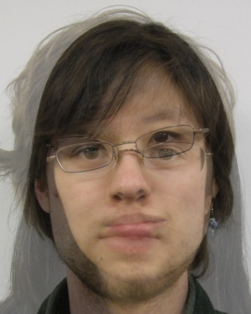
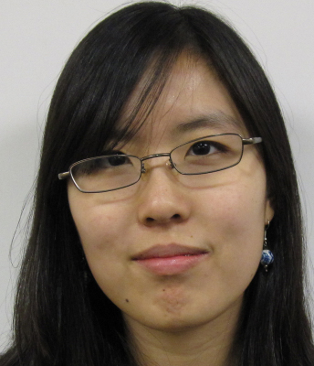
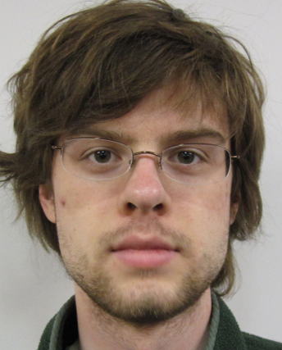
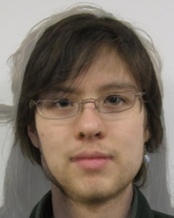
Cross-Dissolve vs. Morphing
Average of
Appearance Vectors
http://www.faceresearch.org/demos/vector
Average of
Shape Vectors
Images from James Hays
Notes:
----- Meeting Notes (10/4/11 17:12) -----
the demo

Slide 39
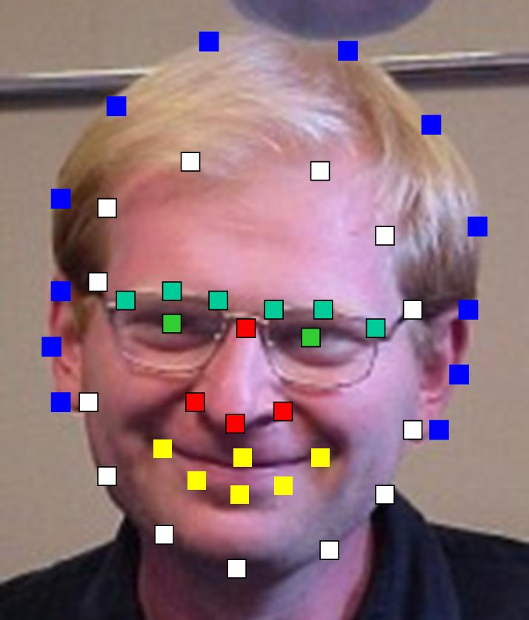
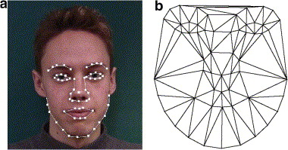
Aligning Faces
Need to Align
  Position
  Scale
  Orientation
  Key-points
The more key-points,
the finer alignment
Images from Alyosha Efros

Slide 40
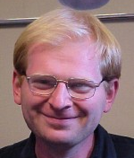
Appearance Vectors vs. Shape Vectors
Appearance
Vector
Vector of
200*150*3
Dimensions
200*150 pixels (RGB)
Shape
Vector
Vector of
43*2
Dimensions
43 coordinates (x,y)
Notes:
You can think about faces in different ways. You can represent this way or that way. These are complements.

Slide 41
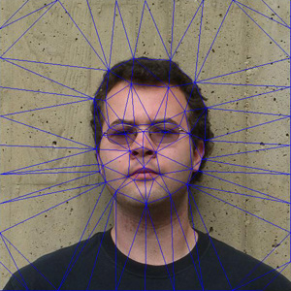


Average of two Faces
Input face keypoints
Pairwise average keypoint coordinates
Triangulate the faces
Warp: transform every face triangle
Average the pixels

Slide 42

Average of multiple faces
1. Warp to mean shape
2. Average pixels
http://graphics.cs.cmu.edu/courses/15-463/2004_fall/www/handins/brh/final/

Slide 43

Average Men of the world

Slide 44

Average Women of the world

Slide 45




Subpopulation means
Other Examples:
  Average Kids
  Happy Males
  Etc.
Average female
Average kid
Average happy male
Average male
Notes:
We might be curious what different populations of faces look like.

Slide 46

Manipulating faces
How can we make a face look more female/male, young/old, happy/sad, etc.?
With shape/texture analogies!
Current face
Prototype 1
Prototype 2
Notes:
----- Meeting Notes (10/4/11 17:24) -----
Add a matlab thing to show the differences. show how to use PCA in matlab.

Slide 47
Manipulating faces
We can imagine various meaningful directions
Sad
Masculine
Current face
Feminine
Happy

Slide 48
Averaging and transformation demos
http://www.faceresearch.org/demos

Slide 49
State-of-the-art in Face Fakery
CVPR 2019 (Best Paper Honorable Mention)

Slide 51
4x4 - 8x8
16x16 - 32x32
64x64 - 1024x1024
1024x1024

Slide 52
Making people say what you want
SIGGRAPH 2017

Slide 54
Human Perception

Slide 55

Notes:
Prince Charles, Woody Allen, Bill Clinton, Saddam Hussein, Richard Nixon and Princess Diana

Slide 56

Notes:
Jim Carrey (left) and Kevin Costner

Slide 57

Notes:
Nixon and Winona Ryder

Slide 58




Slide 59


Slide 60
Things to remember
Face Detection: train face vs. non-face model and scan over multi-scale image
Face Recognition: detect, align, compute features, and compute similarity
Represent faces with an appearance vector and a shape vector
Can transform faces by moving shape vector in a given direction and warping
Deep network methods enable more flexible mixing and generation

Slide 61
Next lectures
Motion magnification
Cutting edge and ICES forms

Slide 62
Old slides

Slide 63

How to represent variations?
Training images
x₁,…,x_{N}

Slide 64

The space of all face images
Eigenface idea: construct a low-dimensional linear subspace that best explains the variation in the set of face images

Slide 65
PCA
General dimensionality reduction technique
  Finds major directions of variation
Preserves most of variance with a much more compact representation
  Lower storage requirements (eigenvectors + a few numbers per face)
  Faster matching/retrieval

Slide 66



Principal Component Analysis
Given a point set , in an M-dim space, PCA finds a basis such that
  The most variation is in the first basis vector
  The second most, in the second vector that is orthogonal to the first vector
  The third…
2nd principal component
x₁
1st principal component
x₁
1st principal component
2nd principal component
x₀
x₀
Notes:
The goal of PCA is to find orthogonal vectors that the first r vectors have the highest variance of all.
----- Meeting Notes (10/4/11 17:12) -----
Write it more mathematically
say what PCA is solving

Slide 67
Principal Component Analysis (PCA)
Given: N data points x₁, … ,x_{N} in R^{d}
We want to find a new set of features that are linear combinations of original ones:
u(x_{i}) = u^{T}(x_{i} – µ)
(µ: mean of data points)
Choose unit vector u in R^{d} that captures the most data variance
Forsyth & Ponce, Sec. 22.3.1, 22.3.2

Slide 68
Principal Component Analysis
Direction that maximizes the variance of the projected data:
N
Maximize
subject to ||u||=1
Projection of data point
N
1/N
Covariance matrix of data
The direction that maximizes the variance is the eigenvector associated with the largest eigenvalue of Σ (can be derived using Raleigh’s quotient or Lagrange multiplier)

Slide 69
PCA in MATLAB
x=rand(3,10);%10 3D examples
mu=mean(x,2);
x_norm = x-repmat(mu,[1 n]);
x_covariance = x_norm*x_norm';
[U, E] = eig(x_covariance)
U =
0.74 0.07 -0.66
0.65 0.10 0.74
-0.12 0.99 -0.02
E =
0.27 0 0
0 0.63 0
0 0 0.94

Slide 70


Principal Component Analysis
  First r < M basis vectors provide an approximate basis that minimizes the mean-squared-error (MSE) of reconstructing the original points
Choosing subspace dimension r:
  look at decay of the eigenvalues as a function of r
  Larger r means lower expected error in the subspace data approximation
eigenvalues
1
r
M

Slide 71

Eigenfaces example (PCA of face images)
Top eigenvectors: u₁,…u_{k}
Mean: μ

Slide 72

Visualization of eigenfaces (appearance variation)
Principal component (eigenvector) u_{k}
μ + 3σ_{k}u_{k}
μ – 3σ_{k}u_{k}

Slide 73
Can represent face in appearance or shape space
Appearance
Vector
200*150 pixels (RGB)
Shape
Vector
43 coordinates (x,y)
Notes:
You can think about faces in different ways. You can represent this way or that way. These are complements.

Slide 74




First 3 Shape Bases with PCA
Mean appearance
http://graphics.cs.cmu.edu/courses/15-463/2004_fall/www/handins/brh/final/
Notes:
----- Meeting Notes (10/4/11 17:12) -----
show both extremes

