Slide 1
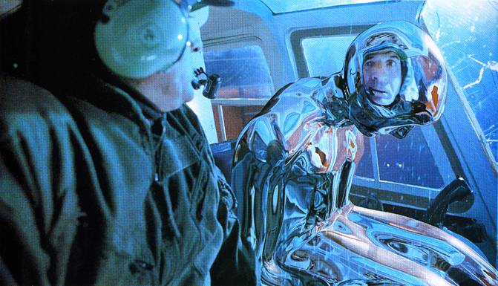
Image-based Lighting (Part 2)
10/19/17
T2
Computational Photography
Derek Hoiem, University of Illinois
Many slides from Debevec, some from Efros, Kevin Karsch

Slide 2
Today
Brief review of last class
Show how to get an HDR image from several LDR images, and how to display HDR
Show how to insert fake objects into real scenes using environment maps

Slide 3
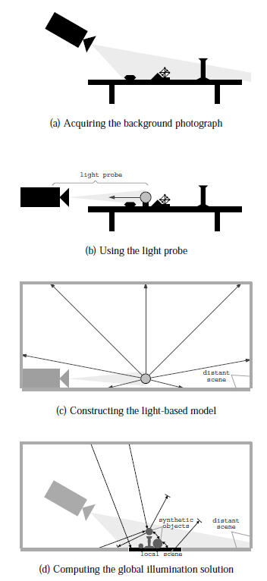
How to render an object inserted into an image?
Image-based lighting
Capture incoming light with a “light probe”
Model local scene
Ray trace, but replace distant scene with info from light probe
Debevec SIGGRAPH 1998

Slide 4

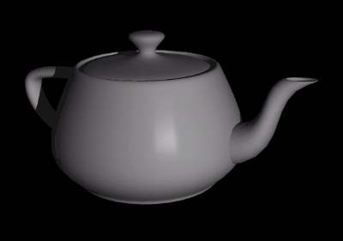
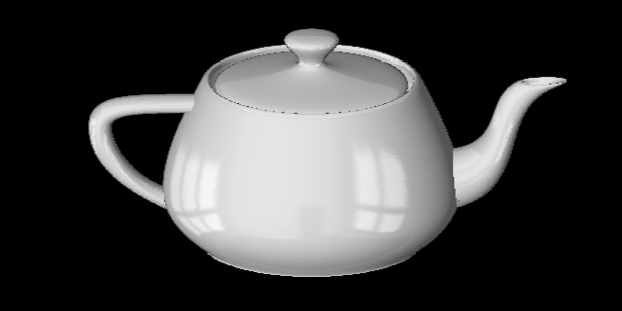
Key ideas for Image-based Lighting
Environment maps: tell what light is entering at each angle within some shell
+

Slide 5
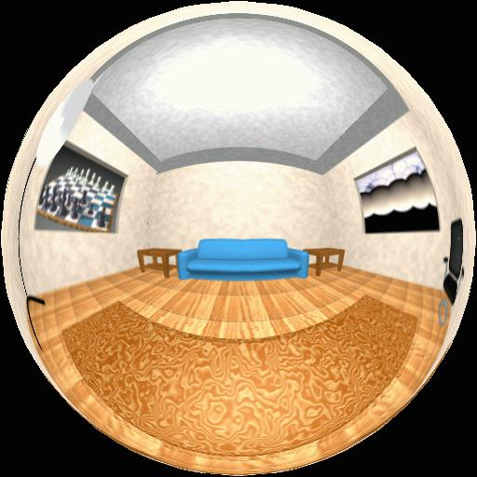
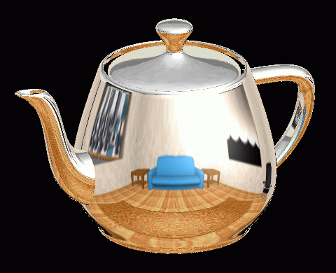
Spherical Map Example

Slide 6
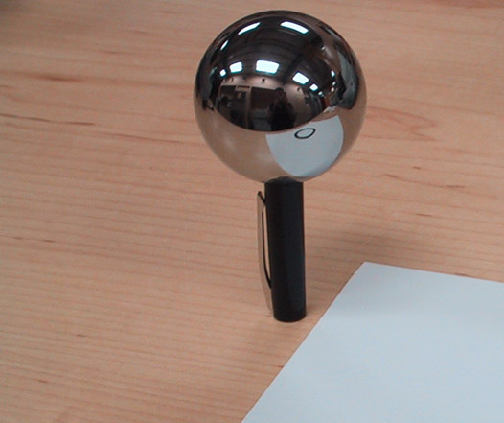
Key ideas for Image-based Lighting
Light probes: a way of capturing environment maps in real scenes

Slide 7
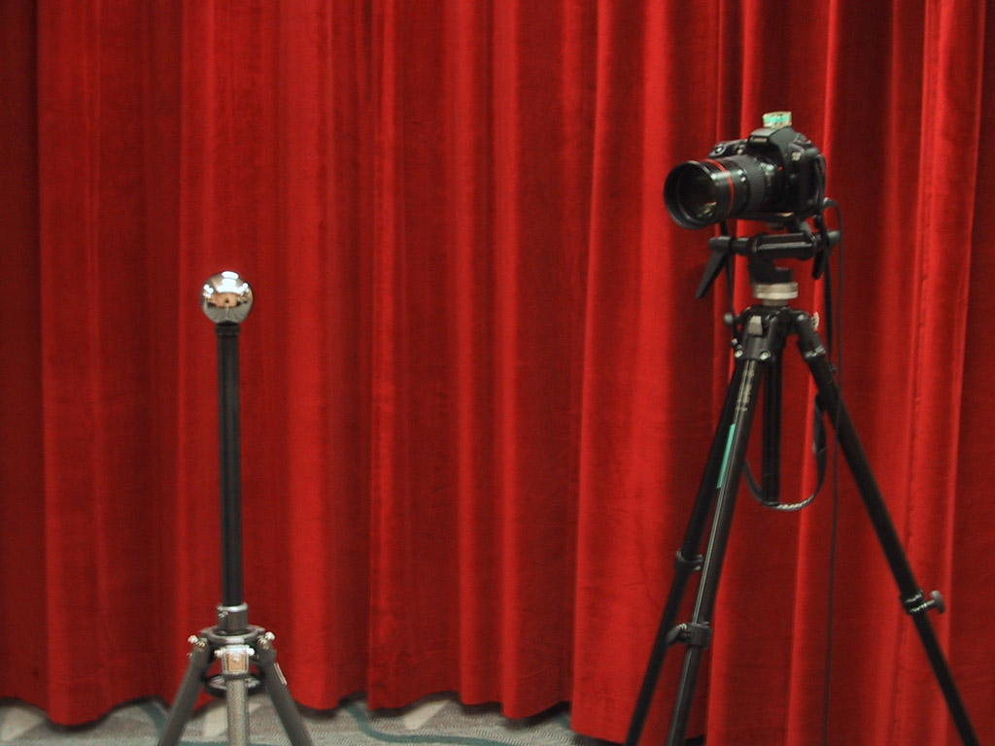
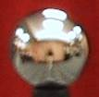
Mirrored Sphere

Slide 8
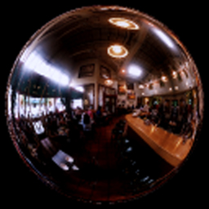
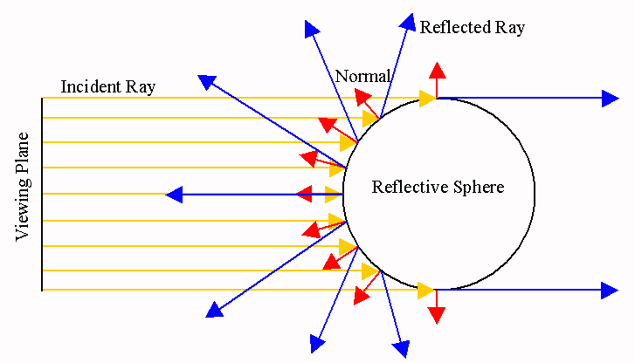
Compute normal of sphere from pixel position
Compute reflected ray direction from sphere normal
Convert to spherical coordinates (theta, phi)
Create equirectangular image

Slide 9
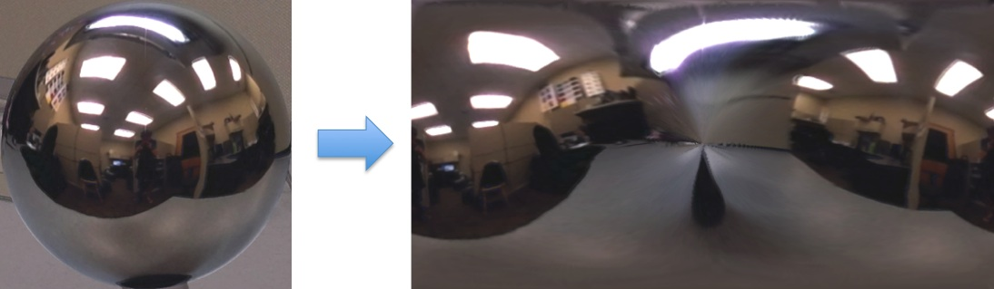
Mirror ball -> equirectangular

Slide 10
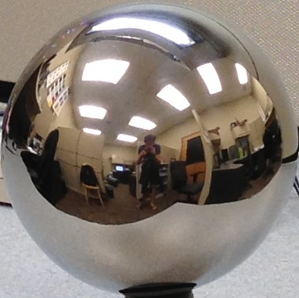


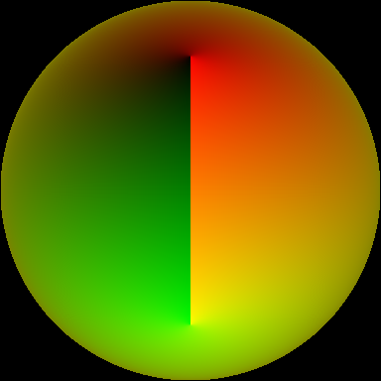
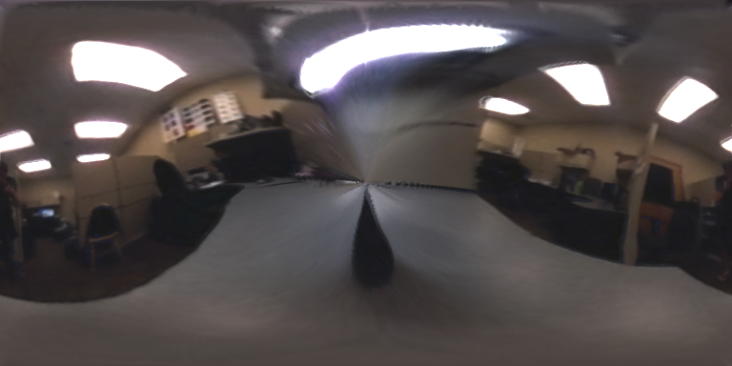

Mirror ball -> equirectangular
Mirror ball
Normals
Reflection
vectors
Phi/theta of reflection vecs
Equirectangular
Phi/theta equirectangular domain

Slide 11
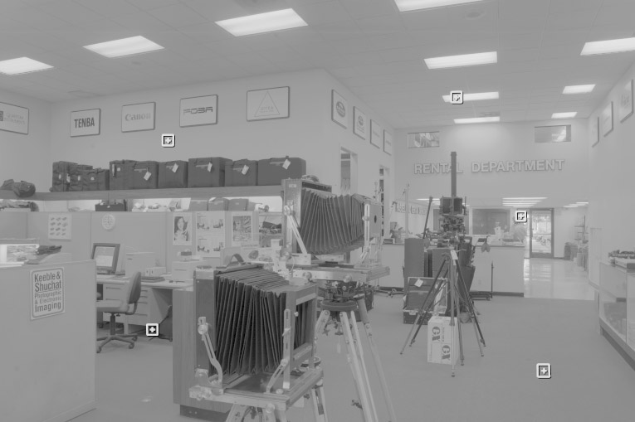
One small snag
How do we deal with light sources? Sun, lights, etc?
  They are much, much brighter than the rest of the environment
Use High Dynamic Range photography!
Relative Brightness
1907
.
46
.
.
15116
1
.
.
18

Slide 12
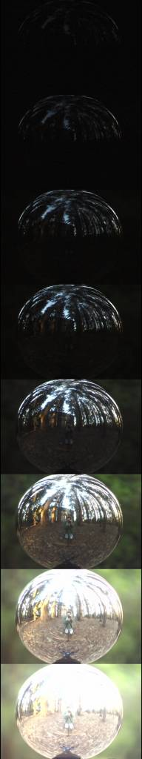
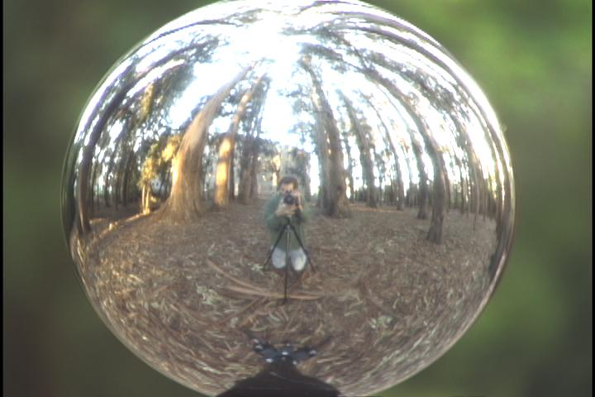
Key ideas for Image-based Lighting
Capturing HDR images: needed so that light probes capture full range of radiance

Slide 13
LDR->HDR by merging exposures
^{0 to 255}
Exposure 1
Exposure 2
…
Exposure n
10⁻⁶
10⁶
Real world
High dynamic range

Slide 14
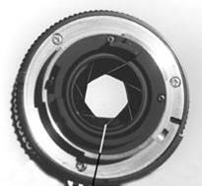
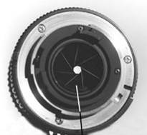
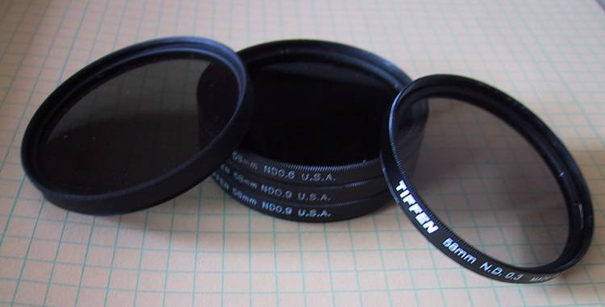
Ways to vary exposure
Shutter Speed (*)
F/stop (aperture, iris)
Neutral Density (ND) Filters

Slide 15
Recovering High Dynamic Range
Radiance Maps from Photographs
Paul Debevec
Jitendra Malik
Computer Science Division
University of California at Berkeley
August 1997
Notes:
1

Slide 16
The Approach
Get pixel values Z_{ij} for image with shutter time Δt_{j} (i^{th} pixel location, j^{th} image)
Exposure is irradiance integrated over time:
Pixel values are non-linearly mapped E_{ij}’s:
Rewrite to form a (not so obvious) linear system:

Slide 17
The objective
Solve for radiance R and mapping g for each of 256 pixel values to minimize:
give pixels near 0 or 255 less weight
known shutter time for image j
exposure should smoothly increase as pixel intensity increases
irradiance at particular pixel site is the same for each image
exposure, as a function of pixel value

Slide 18
The Math
Let g(z) be the discrete inverse response function
For each pixel site i in each image j, want:
Solve the overdetermined linear system:
fitting term
smoothness term
Notes:
g(z) maps the pixel intensity to an exposure

Slide 19
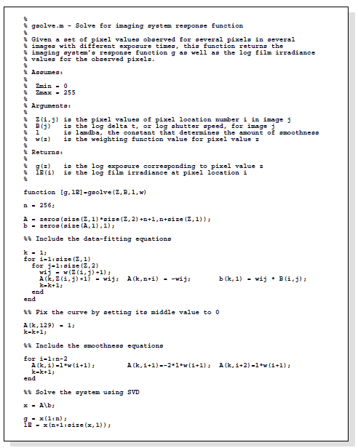
Matlab Code

Slide 20
Matlab Code
function [g,lE]=gsolve(Z,B,l,w)
n = 256;
A = zeros(size(Z,1)*size(Z,2)+n+1,n+size(Z,1));
b = zeros(size(A,1),1);
k = 1; %% Include the data-fitting equations
for i=1:size(Z,1)
for j=1:size(Z,2)
wij = w(Z(i,j)+1);
A(k,Z(i,j)+1) = wij; A(k,n+i) = -wij; b(k,1) = wij * B(j);
k=k+1;
end
end
A(k,129) = 1; %% Fix the curve by setting its middle value to 0
k=k+1;
for i=1:n-2 %% Include the smoothness equations
A(k,i)=l*w(i+1); A(k,i+1)=-2*l*w(i+1); A(k,i+2)=l*w(i+1);
k=k+1;
end
x = A\b; %% Solve the system using pseudoinverse
g = x(1:n);
lE = x(n+1:size(x,1));

Slide 21
Illustration
Image series
• 1
• 1
• 1
• 1
• 1
• 2
• 2
• 2
• 2
• 2
• 3
• 3
• 3
• 3
• 3
Δt =
1/64 sec
Δt =
1/16 sec
Δt =
1/4 sec
Δt =
1 sec
Δt =
4 sec
Pixel Value Z = f(Exposure)
Exposure = Radiance ∗ Δt
log Exposure = log Radiance + log Δt
Notes:
10

Slide 22
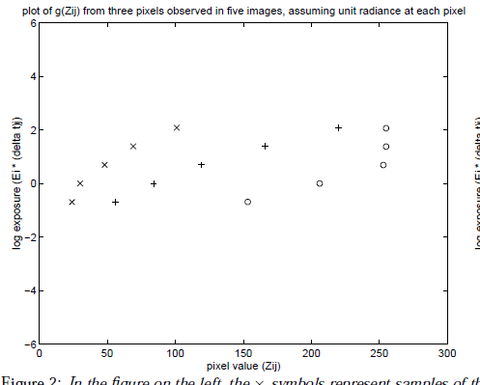
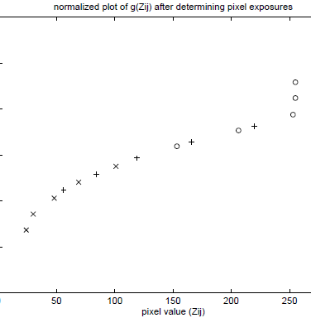
Illustration: Response Curve
ln(exposure)

Slide 23
Response Curve
Assuming unit radiance
for each pixel
After adjusting radiances to obtain a smooth response curve
3
2
Pixel value
Pixel value
1
ln Exposure
ln Exposure

Slide 24
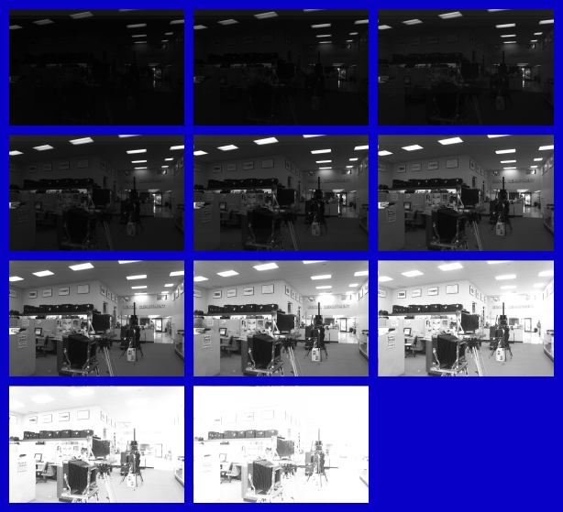
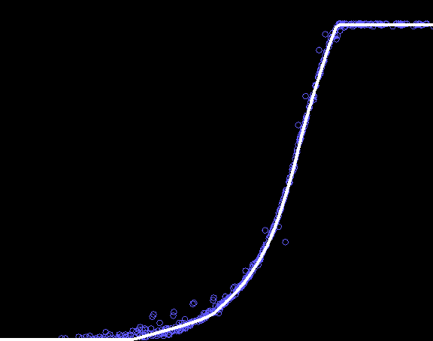
Results: Digital Camera
Kodak DCS460
1/30 to 30 sec
Recovered response curve
Pixel value
log Exposure
Notes:
13

Slide 25
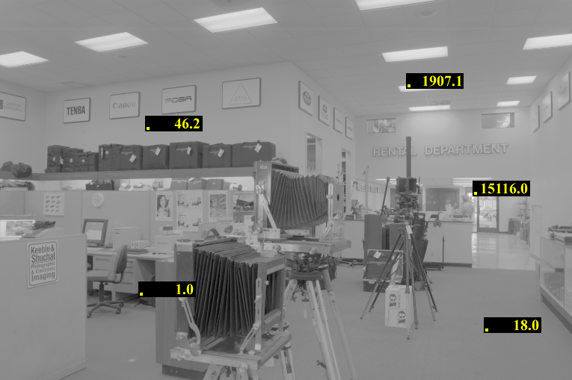
Reconstructed radiance map

Slide 26
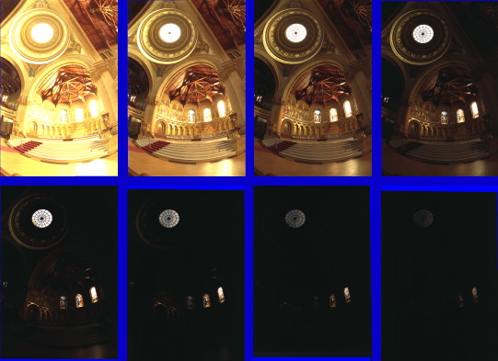
Results: Color Film
Kodak Gold ASA 100, PhotoCD
Notes:
14

Slide 27
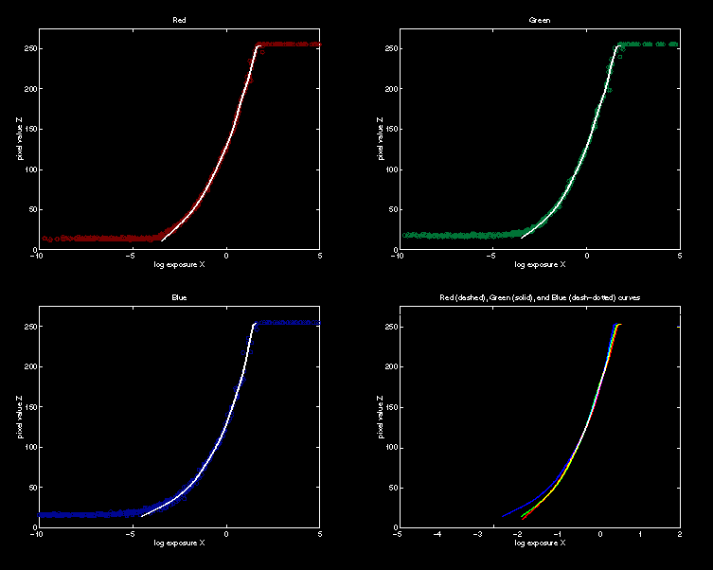
Recovered Response Curves
Red
Green
Blue
RGB
Notes:
15

Slide 28
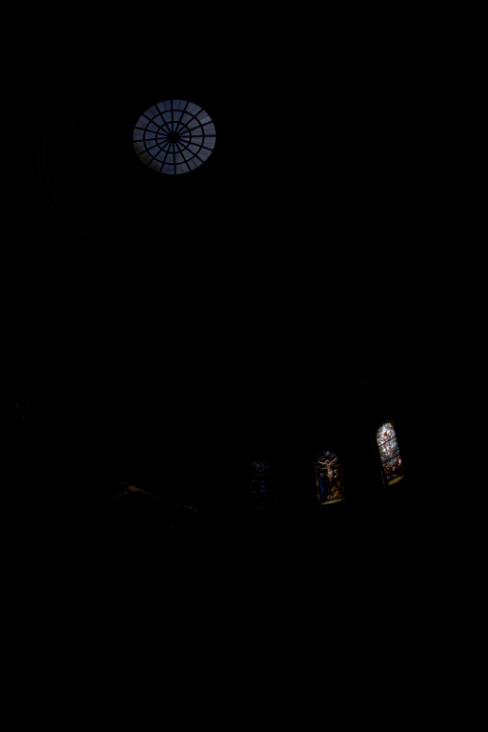
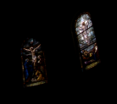
How to display HDR?
Linearly scaled to
display device

Slide 29
Simple Global Operator
Compression curve needs to
  Bring everything within range
  Leave dark areas alone
In other words
  Asymptote at 255
  Derivative of 1 at 0

Slide 30
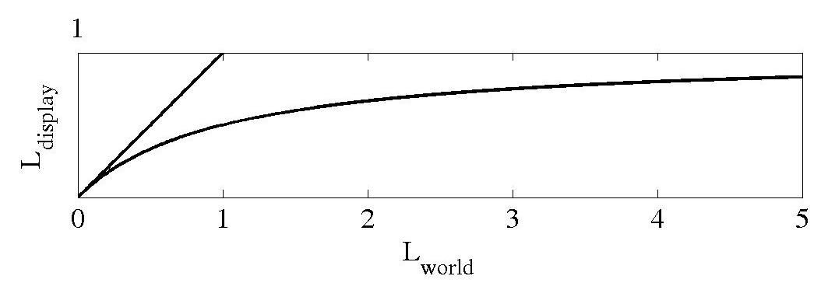
Global Operator (Reinhart et al)

Slide 31
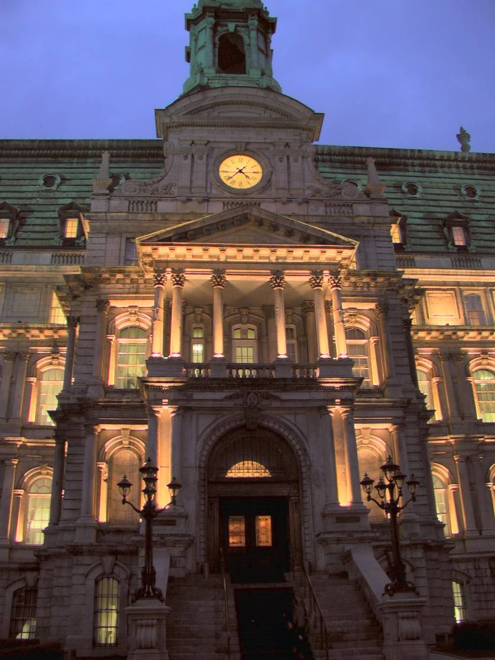
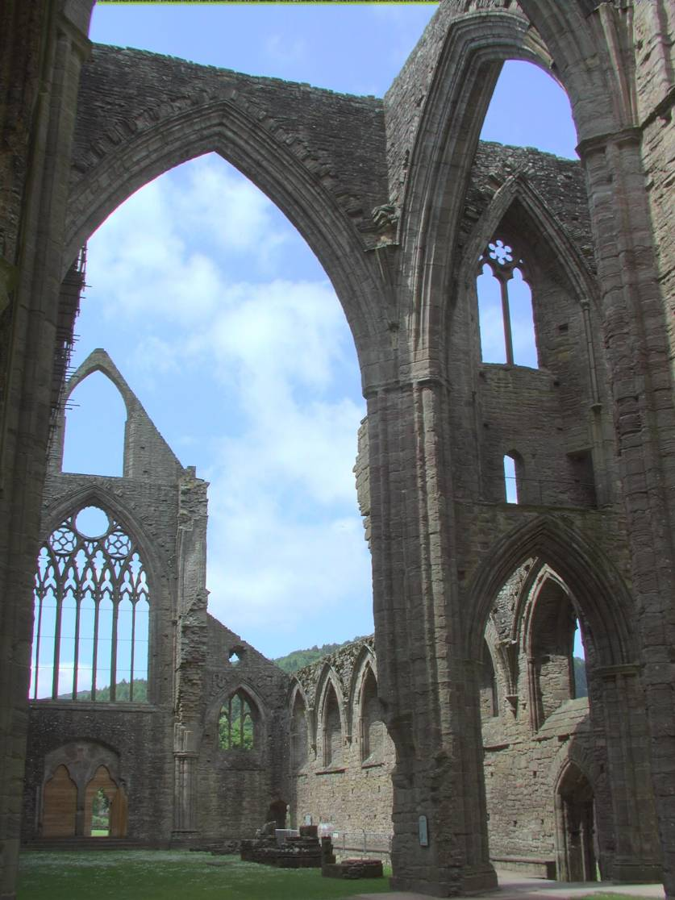
Global Operator Results

Slide 32
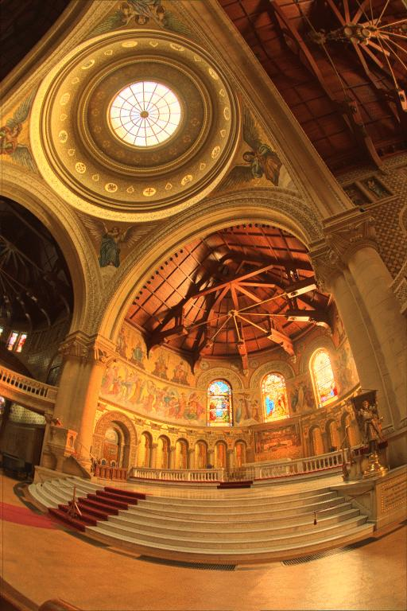
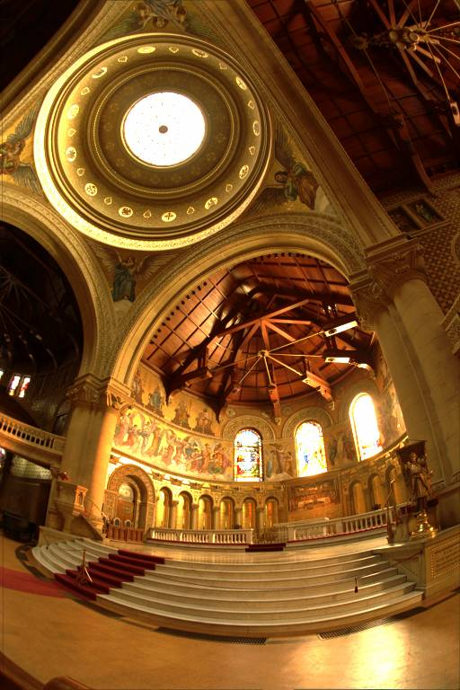
Reinhart Operator
Darkest 0.1% scaled
to display device

Slide 33
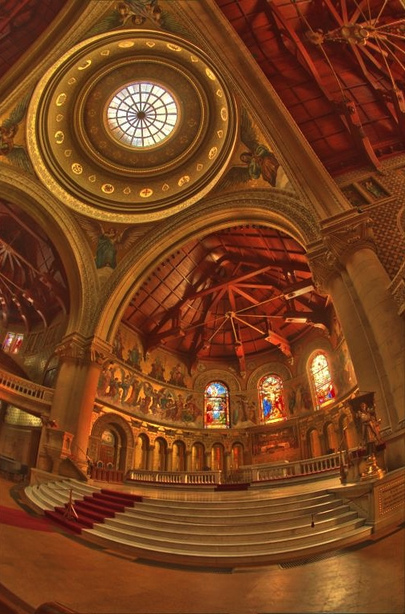
Local operator
http://people.csail.mit.edu/fredo/PUBLI/Siggraph2002/DurandBilateral.pdf

Slide 34
What do we see?
Vs.

Slide 35
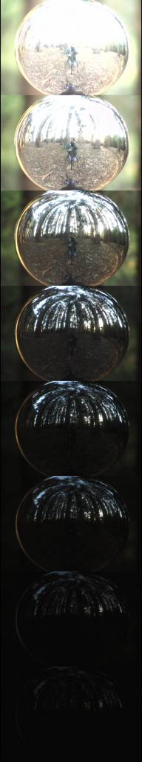
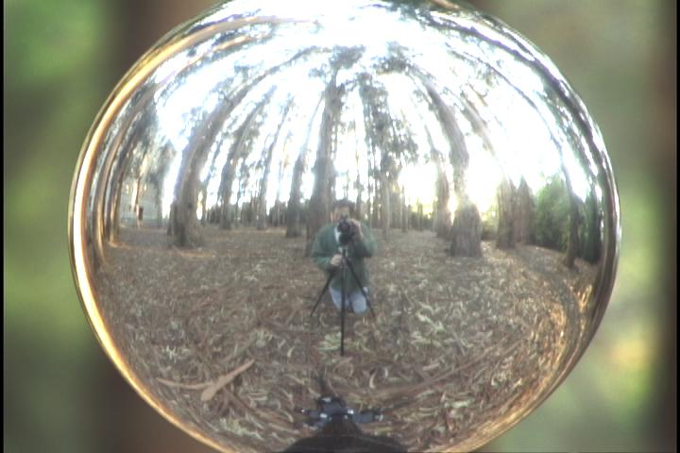
Acquiring the Light Probe

Slide 36
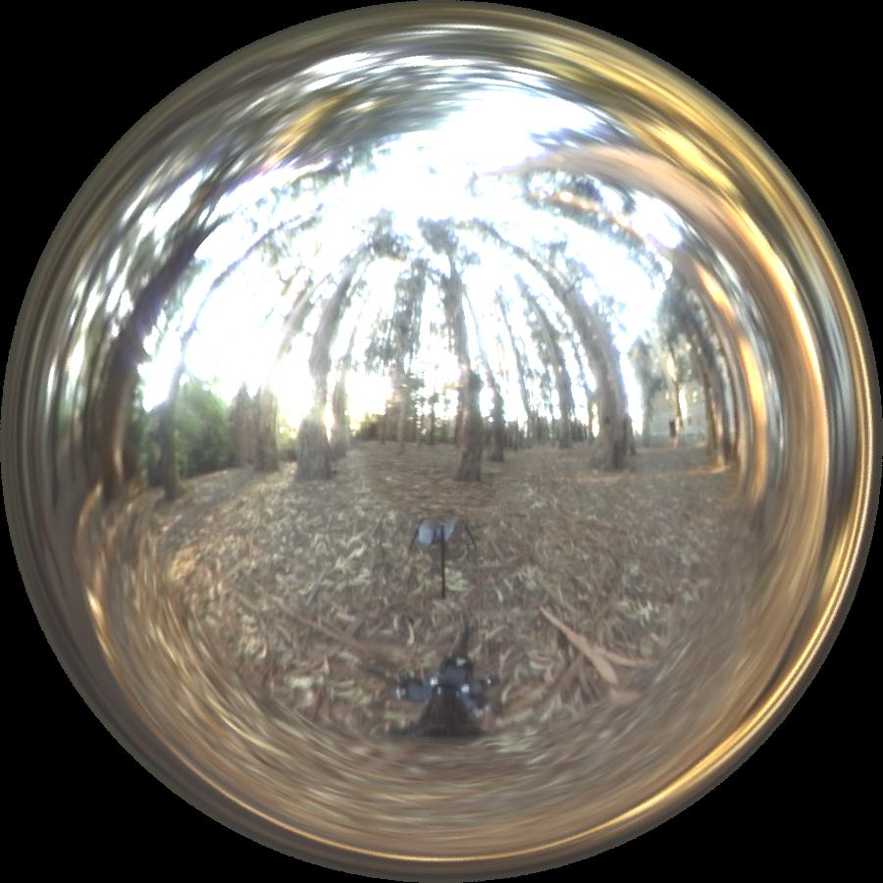
Assembling the Light Probe

Slide 37
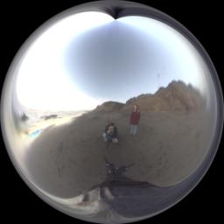
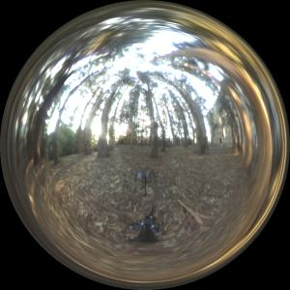
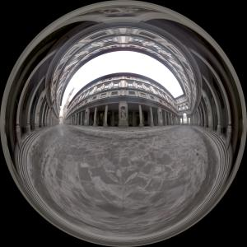
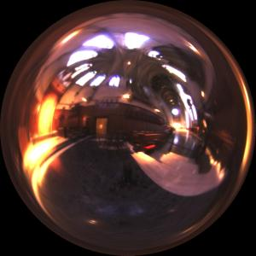
Real-World HDR Lighting Environments
Funston
Beach
Eucalyptus
Grove
Uffizi
Gallery
Grace
Cathedral
Lighting Environments from the Light Probe Image Gallery:
http://www.debevec.org/Probes/

Slide 38
Not just shiny…
We have captured a true radiance map
We can treat it as an extended (e.g spherical) light source
Can use Global Illumination to simulate light transport in the scene
  So, all objects (not just shiny) can be lighted
  What’s the limitation?

Slide 39
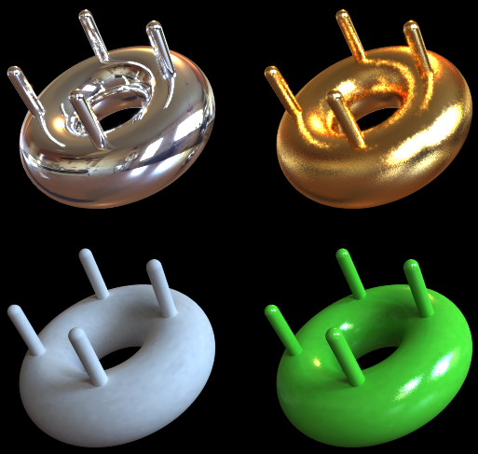
Illumination Results
Rendered with Greg Larson’s RADIANCE
synthetic imaging system
Notes:
HDR is revealed with rough specularities.

Slide 40
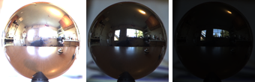
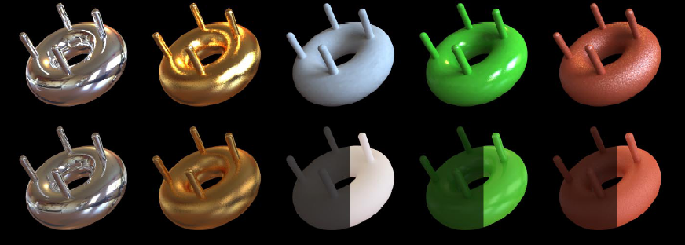
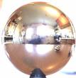
Comparison: Radiance map versus single image
HDR
LDR

Slide 41
Synthetic Objects
+
Real light!

Slide 42
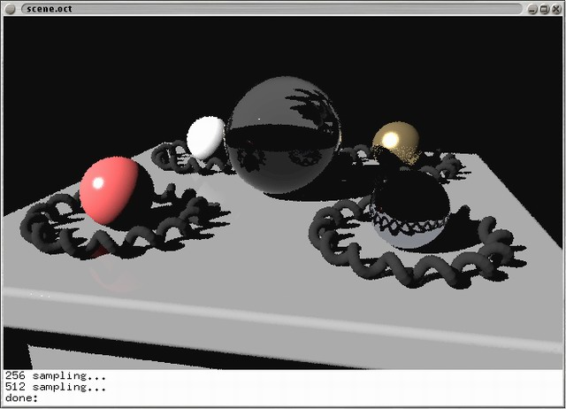
CG Objects Illuminated by a Traditional CG Light Source

Slide 43
Illuminating Objects using Measurements of Real Light
Light
Environment assigned “glow” material property in
Greg Ward’s RADIANCE system.
Object
http://radsite.lbl.gov/radiance/

Slide 44
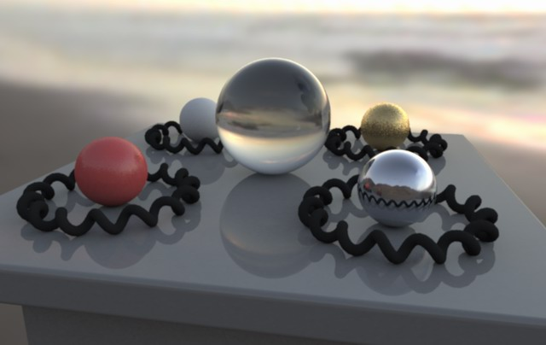



Paul Debevec. A Tutorial on Image-Based Lighting. IEEE Computer Graphics and Applications, Jan/Feb 2002.

Slide 45

Rendering with Natural Light
SIGGRAPH 98 Electronic Theater

Slide 46
Movie
http://www.youtube.com/watch?v=EHBgkeXH9lU

Slide 47

Illuminating a Small Scene

Slide 48


Slide 49
  We can now illuminate
  synthetic objects with real light.
  - Environment map
  - Light probe
  - HDR
  - Ray tracing
How do we add synthetic objects to a
real scene?

Slide 50

Real Scene Example
Goal: place synthetic objects on table

Slide 51
Modeling the Scene
light-based model
real scene

Slide 52
Light Probe / Calibration Grid

Slide 53

The Light-Based Room Model

Slide 54
Modeling the Scene
light-based model
local scene
synthetic objects
real scene

Slide 55
The Lighting Computation
distant scene (light-based, unknown BRDF)
synthetic objects
(known BRDF)
local scene
(estimated BRDF)

Slide 56
Rendering into the Scene
Background Image

Slide 57

Differential Rendering
Local scene w/o objects, illuminated by model

Slide 58

Rendering into the Scene
Objects and Local Scene matched to Scene

Slide 59

Differential Rendering
Difference in local scene
-
=

Slide 60

Differential Rendering
Final Result

Slide 61
How to render an object inserted into an image?
Image-based lighting
Capture incoming light with a “light probe”
Model local scene
Ray trace, but replace distant scene with info from light probe
Debevec SIGGRAPH 1998

Slide 62

IMAGE-BASED LIGHTING IN FIAT LUX
Paul Debevec, Tim Hawkins, Westley Sarokin, H. P. Duiker, Christine Cheng, Tal Garfinkel, Jenny Huang
SIGGRAPH 99 Electronic Theater

Slide 63
Fiat Lux
http://ict.debevec.org/~debevec/FiatLux/movie/
http://ict.debevec.org/~debevec/FiatLux/technology/

Slide 64


Slide 65






HDR Image Series
2 sec
1/4 sec
1/30 sec
1/250 sec
1/2000 sec
1/8000 sec

Slide 66











Slide 67

Assembled Panorama

Slide 68



Light Probe Images

Slide 69














Capturing a Spatially-Varying Lighting Environment

Slide 70



What if we don’t have a light probe?
Zoom in on eye
Insert Relit Face
Environment map from eye
http://www1.cs.columbia.edu/CAVE/projects/world_eye/ -- Nishino Nayar 2004

Slide 71


Slide 72

Environment Map from an Eye

Slide 73




Can Tell What You are Looking At
Eye Image:
Computed Retinal Image:

Slide 74





Slide 75
Video

Slide 76

Summary
Real scenes have complex geometries and materials that are difficult to model
We can use an environment map, captured with a light probe, as a replacement for distance lighting
We can get an HDR image by combining bracketed shots
We can relight objects at that position using the environment map

