Slide 1
Image Morphing
10/3/17
Computational Photography
Derek Hoiem, University of Illinois
Many slides from Alyosha Efros

Slide 2
Project 3: Gradient Domain Editing
Now posted!
General concept: Solve for pixels of new image that satisfy constraints on the gradient and the intensity
Constraints can be from one image (for filtering) or more (for blending)

Slide 3
2D image transformations
These transformations are a nested set of groups
Closed under composition and inverse is a member

Slide 4
Take-home Question
Suppose we have two triangles: ABC and A’B’C’. What transformation will map A to A’, B to B’, and C to C’? How can we get the parameters?
B
B’
?
T(x,y)
C’
A
C
A’
Source
Destination

Slide 5
Today: Morphing
Women in art
http://youtube.com/watch?v=nUDIoN-_Hxs
Aging
http://www.youtube.com/watch?v=L0GKp-uvjO0

Slide 6
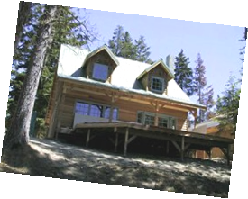
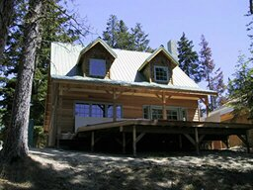
Image warping
T(x,y)
y
y’
x
x’
f(x,y)
g(x’,y’)
Given a coordinate transform (x’,y’) = T(x,y) and a source image f(x,y), how do we compute a transformed image g(x’,y’) = f(T(x,y))?

Slide 7
Forward warping
T(x,y)
y
y’
x
x’
f(x,y)
g(x’,y’)
Send each pixel f(x,y) to its corresponding location
(x’,y’) = T(x,y) in the second image

Slide 8
Forward warping
What is the problem with this approach?
T(x,y)
y
y’
x
x’
f(x,y)
g(x’,y’)
Send each pixel f(x,y) to its corresponding location
(x’,y’) = T(x,y) in the second image
Q: what if pixel lands “between” two pixels?
A: distribute color among neighboring pixels (x’,y’)
Known as “splatting”

Slide 9
Inverse warping
T⁻¹(x,y)
y
y’
x
x
x’
f(x,y)
g(x’,y’)
Get each pixel g(x’,y’) from its corresponding location
(x,y) = T⁻¹(x’,y’) in the first image
Q: what if pixel comes from “between” two pixels?

Slide 10
Inverse warping
T⁻¹(x,y)
y
y’
x
x
x’
f(x,y)
g(x’,y’)
Get each pixel g(x’,y’) from its corresponding location
(x,y) = T⁻¹(x’,y’) in the first image
Q: what if pixel comes from “between” two pixels?
A: Interpolate color value from neighbors
nearest neighbor, bilinear, Gaussian, bicubic
Check out interp2 in Matlab

Slide 11
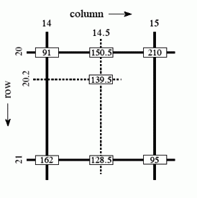
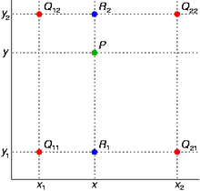
Bilinear Interpolation
http://en.wikipedia.org/wiki/Bilinear_interpolation

Slide 12
Forward vs. inverse warping
Q: which is better?
A: Usually inverse—eliminates holes
however, it requires an invertible warp function

Slide 13
Morphing = Object Averaging
The aim is to find “an average” between two objects
Not an average of two images of objects…
…but an image of the average object!
How can we make a smooth transition in time?
Do a “weighted average” over time t

Slide 14
Averaging Points
Q
What’s the average
of P and Q?
v = Q - P
P
Extrapolation: t<0 or t>1
P + 1.5v
= P + 1.5(Q – P)
= -0.5P + 1.5 Q (t=1.5)
P + 0.5v
= P + 0.5(Q – P)
= 0.5P + 0.5 Q
Linear Interpolation
New point: (1-t)P + tQ
0<t<1
P and Q can be anything:
points on a plane (2D) or in space (3D)
Colors in RGB (3D)
Whole images (m-by-n D)… etc.

Slide 15
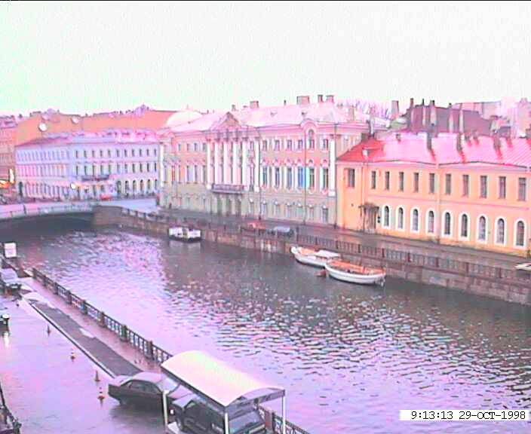
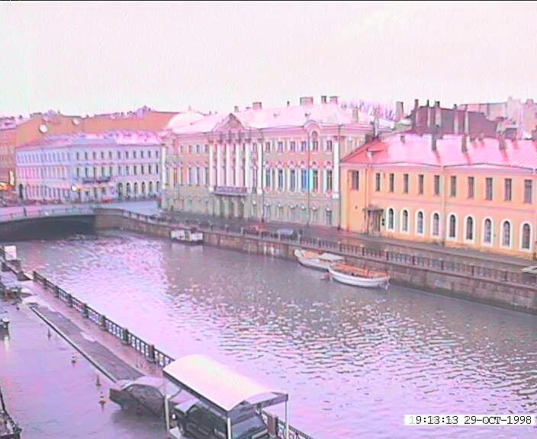
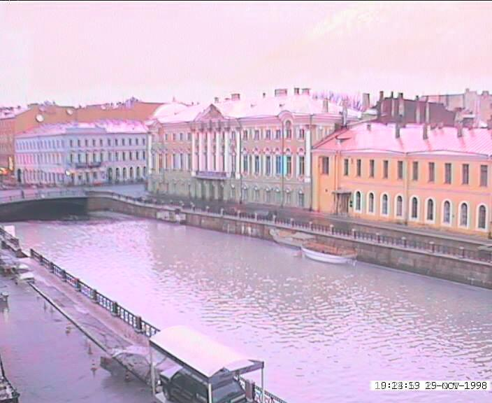
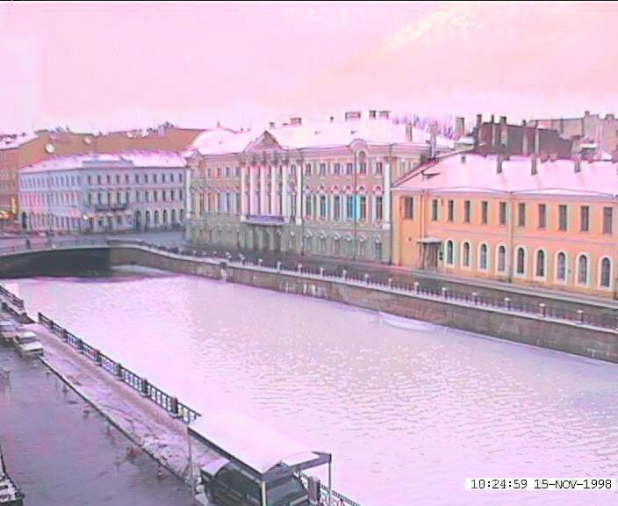
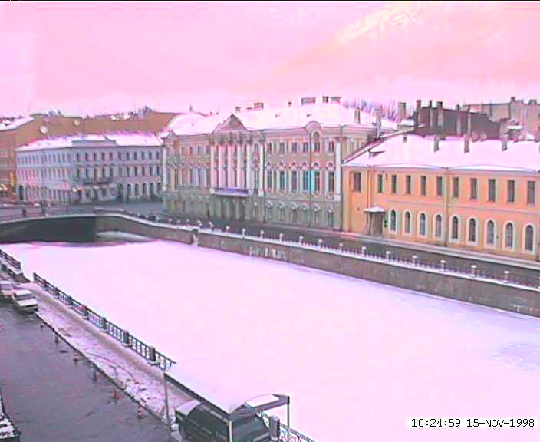
Idea #1: Cross-Dissolve
Interpolate whole images:
Image_{halfway} = (1-t)*Image₁ + t*image₂
This is called cross-dissolve in film industry
But what if the images are not aligned?

Slide 16
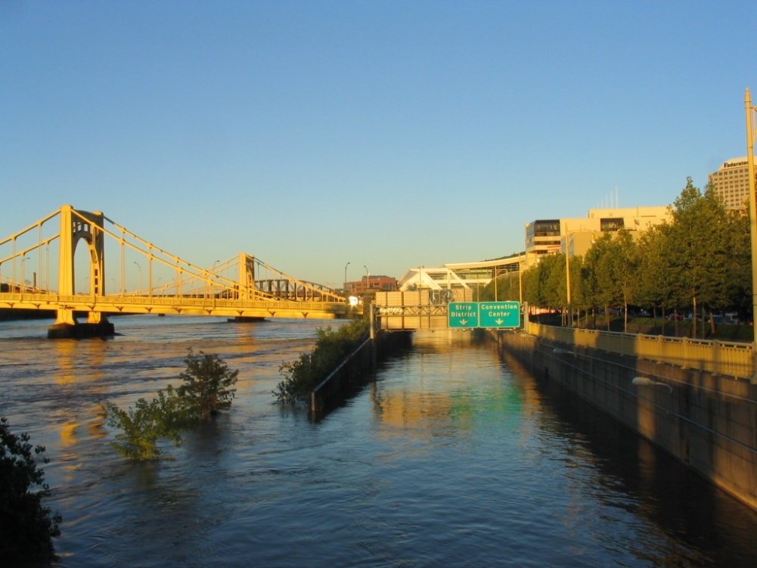
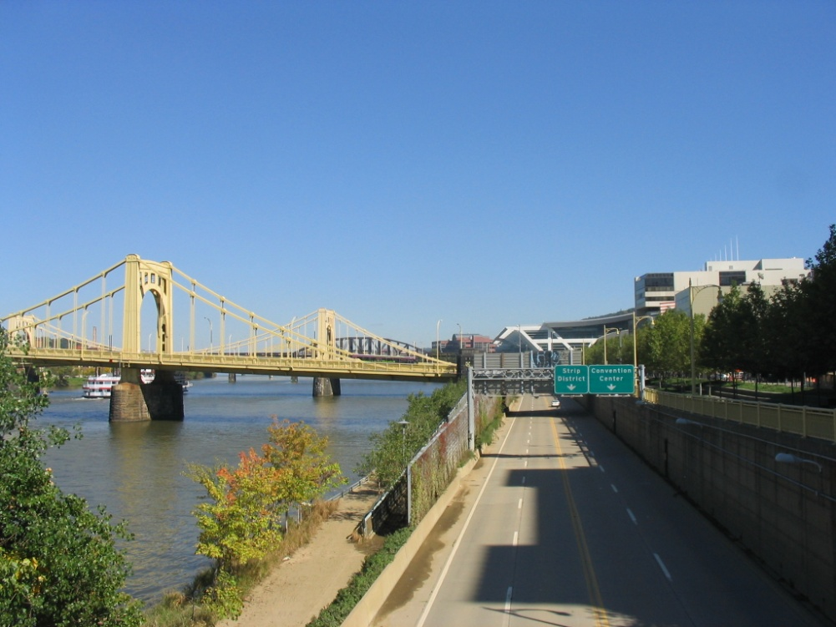
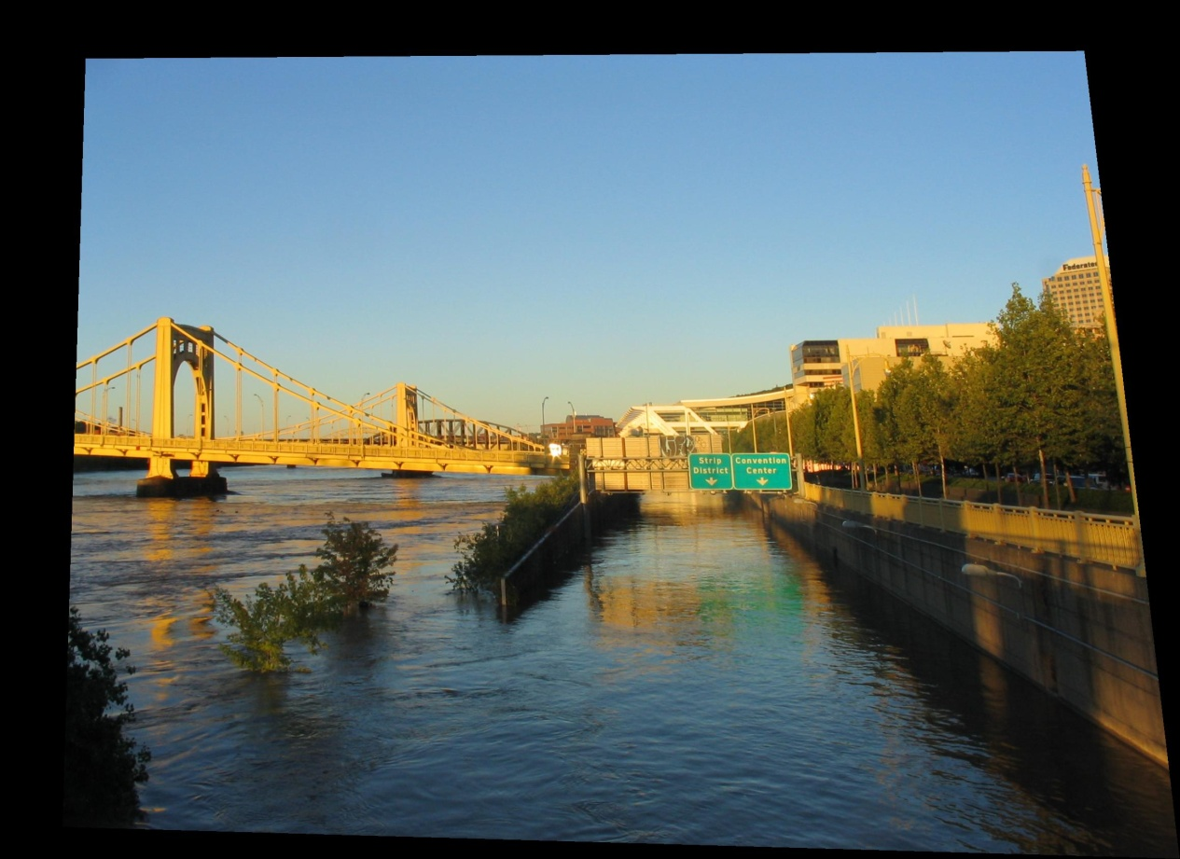
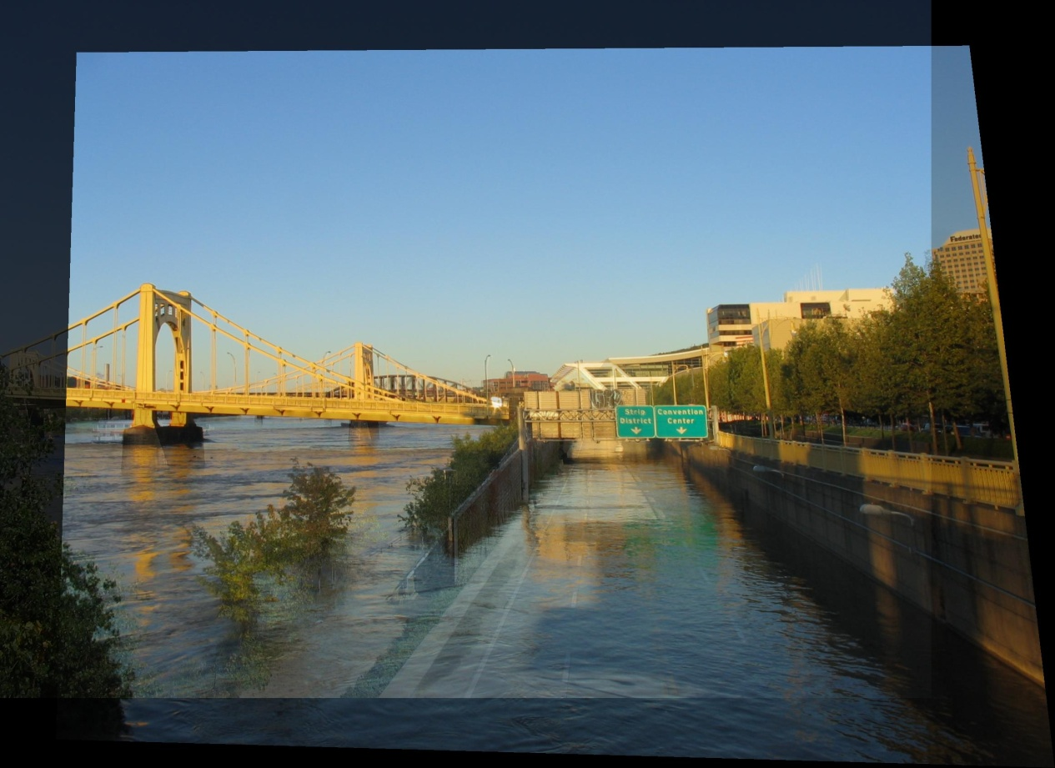
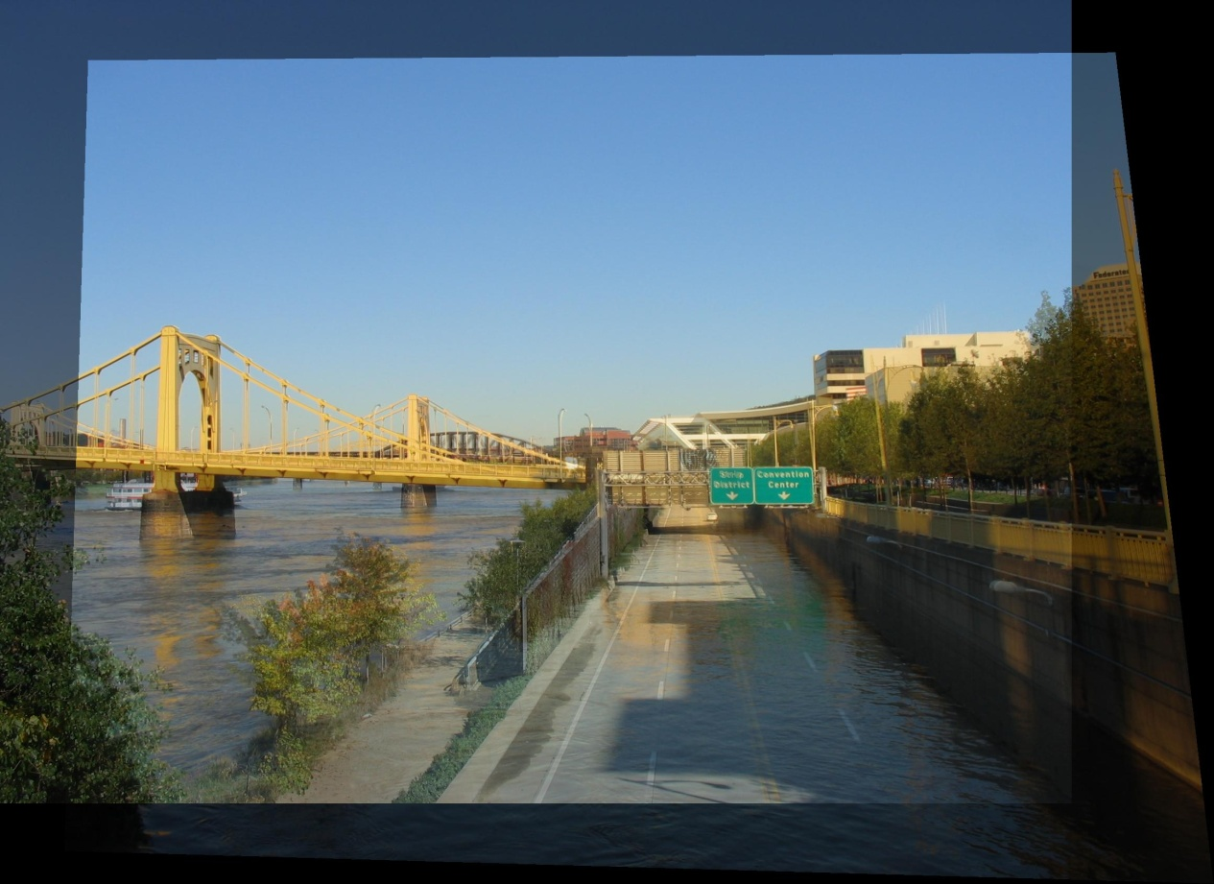
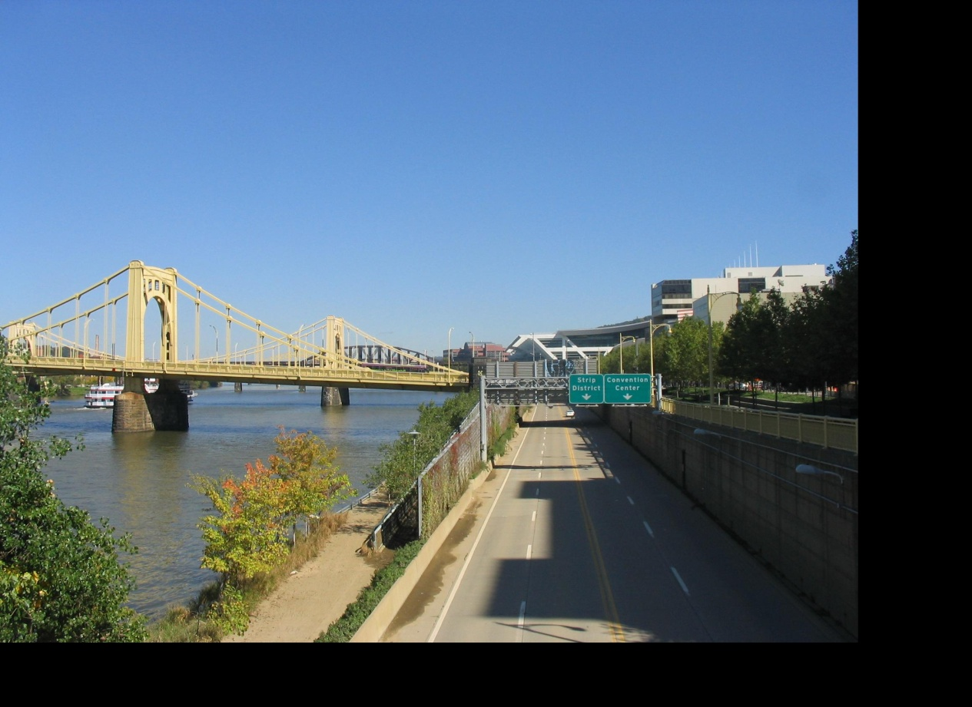
Idea #2: Align, then cross-disolve
Align first, then cross-dissolve
Alignment using global warp – picture still valid

Slide 17
Dog Averaging
What to do?
Cross-dissolve doesn’t work
Global alignment doesn’t work
Cannot be done with a global transformation (e.g. affine)
Any ideas?
Feature matching!
Nose to nose, tail to tail, etc.
This is a local (non-parametric) warp

Slide 18
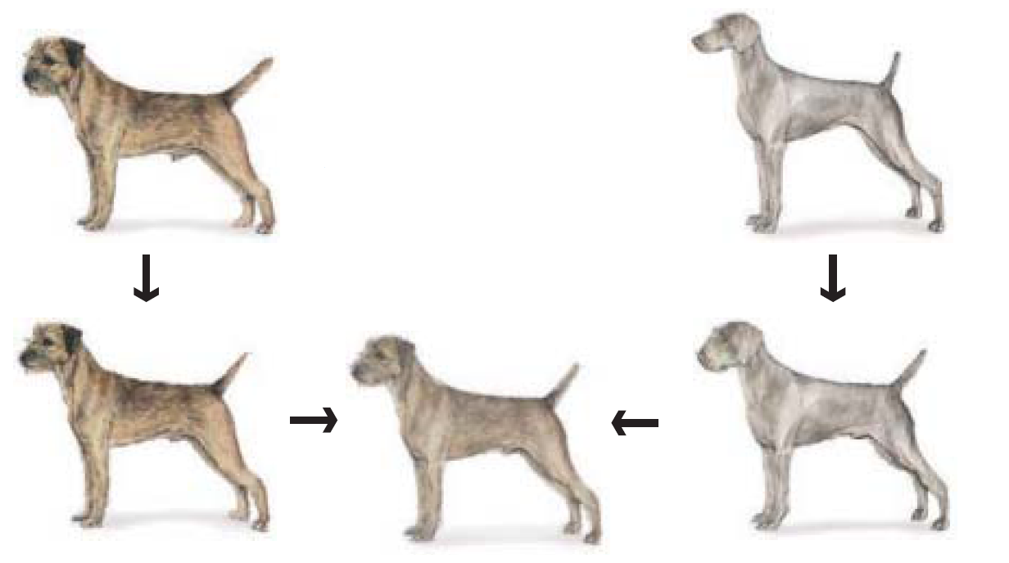
Idea #3: Local warp, then cross-dissolve
Morphing procedure
For every frame t,
Find the average shape (the “mean dog”☺)
local warping
Find the average color
Cross-dissolve the warped images

Slide 19
Local (non-parametric) Image Warping
Need to specify a more detailed warp function
Global warps were functions of a few (2,4,8) parameters
Non-parametric warps u(x,y) and v(x,y) can be defined independently for every single location x,y!
Once we know vector field u,v we can easily warp each pixel (use backward warping with interpolation)

Slide 20
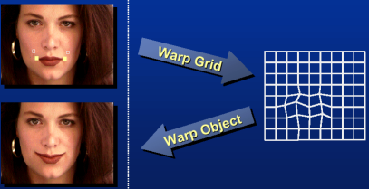
Image Warping – non-parametric
Move control points to specify a spline warp
Spline produces a smooth vector field

Slide 21
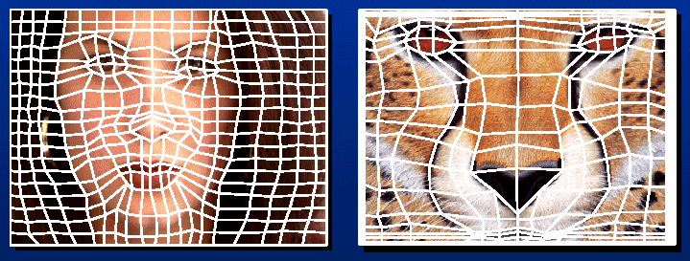
Warp specification - dense
How can we specify the warp?
Specify corresponding spline control points
interpolate to a complete warping function
But we want to specify only a few points, not a grid

Slide 22
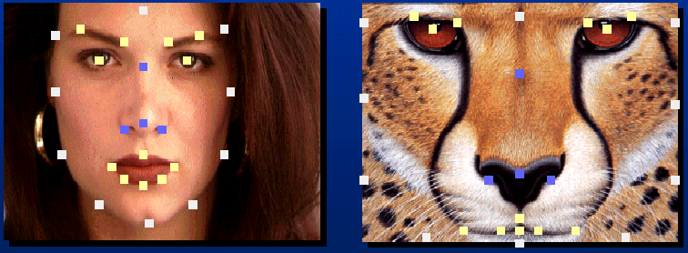
Warp specification - sparse
How can we specify the warp?
Specify corresponding points
interpolate to a complete warping function
How do we do it?
How do we go from feature points to pixels?

Slide 23
Triangular Mesh
Input correspondences at key feature points
Define a triangular mesh over the points
Same mesh (triangulation) in both images!
Now we have triangle-to-triangle correspondences
Warp each triangle separately from source to destination
Affine warp with three corresponding points (just like take-home question)

Slide 24
Triangulations
A triangulation of set of points in the plane is a partition of the convex hull to triangles whose vertices are the points, and do not contain other points.
There are an exponential number of triangulations of a point set.

Slide 25
An O(n³) Triangulation Algorithm
Repeat until impossible:
Select two sites.
If the edge connecting them does not intersect previous edges, keep it.

Slide 26
“Quality” Triangulations
Let α(T_{i}) = (α_{i1}, α_{i2} ,.., α_{i3}) be the vector of angles in the triangulation T in increasing order:
A triangulation T₁ is “better” than T₂ if the smallest angle of T₁ is larger than the smallest angle of T₂
Delaunay triangulation is the “best” (maximizes the smallest angles)
good
bad

Slide 27
Improving a Triangulation
In any convex quadrangle, an edge flip is possible. If this flip improves the triangulation locally, it also improves the global triangulation.
If an edge flip improves the triangulation, the first edge is called “illegal”.

Slide 28
Illegal Edges
An edge pq is “illegal” iff one of its opposite vertices is inside the circle defined by the other three vertices (see Thale’s theorem)
A triangle is Delaunay iff no other points are inside the circle through the triangle’s vertices
The Delaunay triangulation is not unique if more than three nearby points are co-circular
The Delaunay triangulation does not exist if three nearby points are colinear
p
q

Slide 29
Naïve Delaunay Algorithm
Start with an arbitrary triangulation. Flip any illegal edge until no more exist.
Could take a long time to terminate.

Slide 30
Delaunay Triangulation by Duality
Draw the dual to the Voronoi diagram by connecting each two neighboring sites in the Voronoi diagram.
The DT may be constructed in O(nlogn) time
This is what Matlab’s delaunay function uses
Demo: http://www.cs.cornell.edu/home/chew/Delaunay.html

Slide 31
Image Morphing
How do we create a morphing sequence?
Create an intermediate shape (by interpolation)
Warp both images towards it
Cross-dissolve the colors in the newly warped images

Slide 32
Warp interpolation
How do we create an intermediate shape at time t?
Assume t = [0,1]
Simple linear interpolation of each feature pair
(1-t)*p1+t*p0 for corresponding features p0 and p1

Slide 33
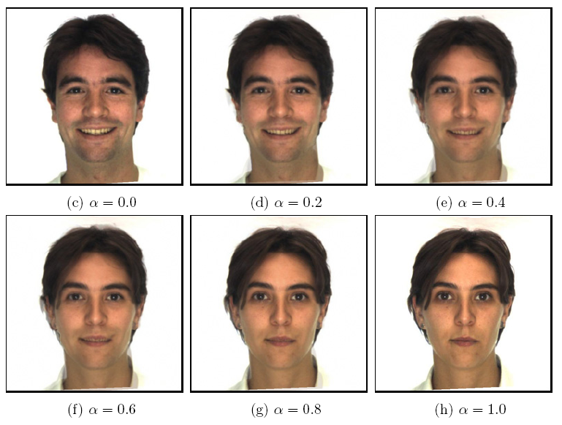
Morphing & matting
Extract foreground first to avoid artifacts in the background
Slide by Durand and Freeman

Slide 34
Dynamic Scene
Black or White (MJ):
http://www.youtube.com/watch?v=R4kLKv5gtxc
Willow morph: http://www.youtube.com/watch?v=uLUyuWo3pG0

Slide 35
Summary of morphing
Define corresponding points
Define triangulation on points
Use same triangulation for both images
For each t = 0:step:1
Compute the average shape (weighted average of points)
For each triangle in the average shape
Get the affine projection to the corresponding triangles in each image
For each pixel in the triangle, find the corresponding points in each image and set value to weighted average (optionally use interpolation)
Save the image as the next frame of the sequence

Slide 36
Next classes
Thursday
Pinhole camera: start of perspective geometry
Tuesday
Single-view metrology: measuring 3D distances from an image

