Slide 1
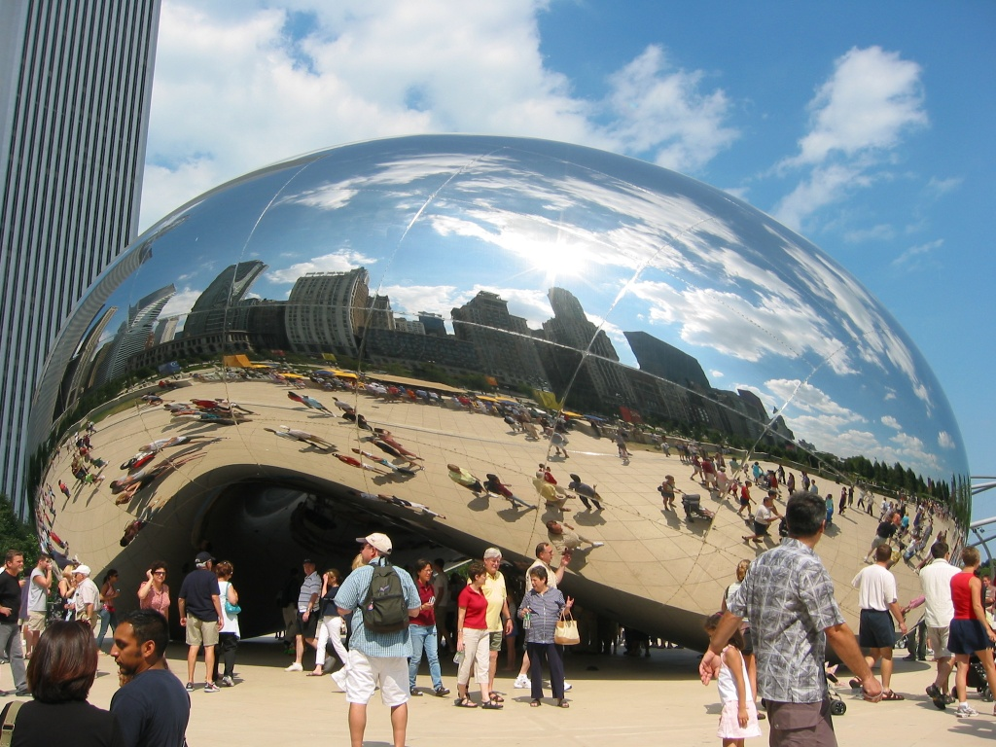
Image Warping
09/28/17
Computational Photography
Derek Hoiem, University of Illinois
Many slides from Alyosha Efros + Steve Seitz
Photo by Sean Carroll
Notes:
Show applications (alignment for hybrid image, face morphing, photo stitching) and example of transformation

Slide 2
Reminder: Proj 2 due monday
Much more difficult than project 1 – get started asap if not already
Must compute SSD cost for every pixel (slow but not horribly slow using filtering method; see tips at end of project page)
Learn how to debug visual algorithms: imshow, plot, dbstop if error, keyboard and break points are your friends
  Debugging suggestion: For “quilt_simple”, first set upper-left patch to be upper-left patch in source and iteratively find minimum cost patch and overlay --- should reproduce original source image, at least for part of the output

Slide 3
Review from last class: Gradient Domain Editing
General concept: Solve for pixels of new image that satisfy constraints on the gradient and the intensity
  Constraints can be from one image (for filtering) or more (for blending)

Slide 4

Project 3: Reconstruction from Gradients
Preserve x-y gradients
Preserve intensity of one pixel
Source pixels: s
Variable pixels: v
minimize (v(x+1,y)-v(x,y) - (s(x+1,y)-s(x,y))^2
minimize (v(x,y+1)-v(x,y) - (s(x,y+1)-s(x,y))^2
minimize (v(1,1)-s(1,1))^2

Slide 5
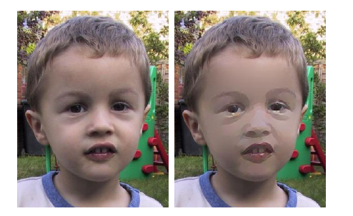
Project 3 (extra): NPR
Preserve gradients on edges
  e.g., get canny edges with edge(im, ‘canny’)
Reduce gradients not on edges
Preserve original intensity
Perez et al. 2003

Slide 6
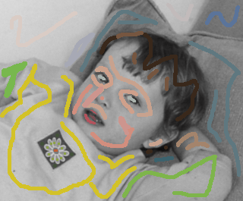

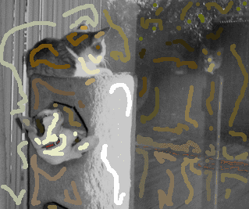
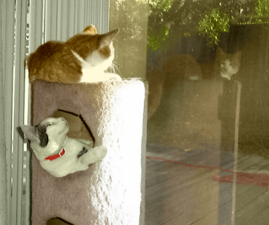
Colorization using optimization
Solve for uv channels (in Luv space) such that similar intensities have similar colors
Minimize squared color difference, weighted by intensity similarity
Solve with sparse linear system of equations
http://www.cs.huji.ac.il/~yweiss/Colorization/

Slide 7
Gradient-domain editing
Many image processing applications can be thought of as trying to manipulate gradients or intensities:
  Contrast enhancement
  Denoising
  Poisson blending
  HDR to RGB
  Color to Gray
  Recoloring
  Texture transfer
See Perez et al. 2003 for many examples

Slide 8
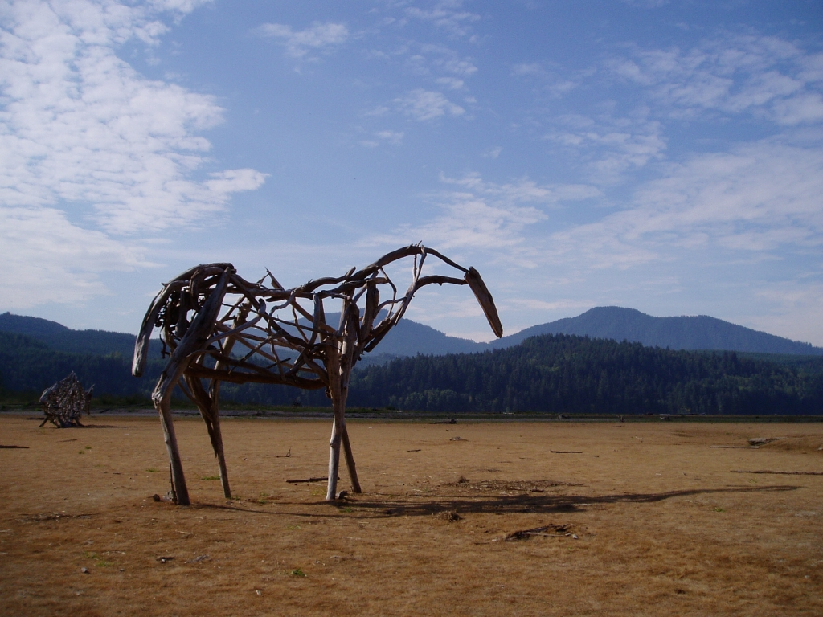
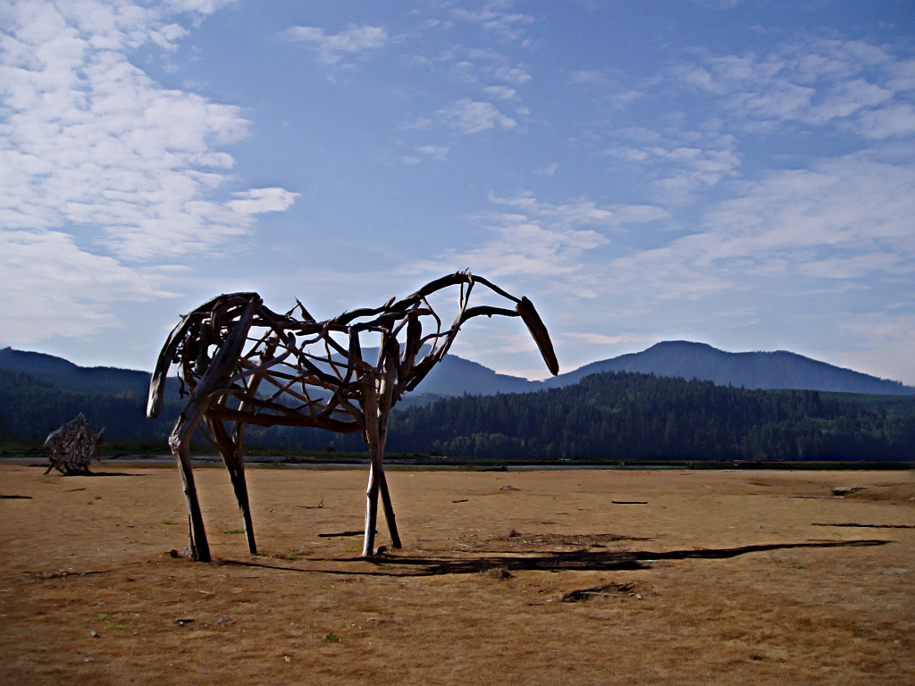
Gradient-domain processing
Saliency-based Sharpening

Slide 9


Gradient-domain processing
Non-photorealistic rendering

Slide 10
Project 3: Gradient Domain Editing
General concept: Solve for pixels of new image that satisfy constraints on the gradient and the intensity
  Constraints can be from one image (for filtering) or more (for blending)

Slide 11
Project 3: Reconstruction from Gradients
Preserve x-y gradients
Preserve intensity of one pixel
Source pixels: s
Variable pixels: v
minimize (v(x+1,y)-v(x,y) - (s(x+1,y)-s(x,y))^2
minimize (v(x,y+1)-v(x,y) - (s(x,y+1)-s(x,y))^2
minimize (v(1,1)-s(1,1))^2

Slide 12
Project 3 (extra): NPR
Preserve gradients on edges
  e.g., get canny edges with edge(im, ‘canny’)
Reduce gradients not on edges
Preserve original intensity
Perez et al. 2003

Slide 13
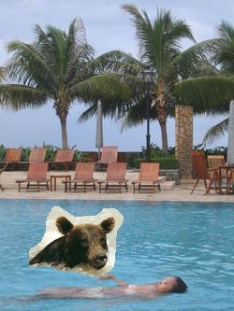


Take-home questions
1) I am trying to blend this bear into this pool. What problems will I have if I use:
  Alpha compositing with feathering
  Laplacian pyramid blending
  Poisson editing?
Lap. Pyramid
Poisson Editing

Slide 14
Take-home questions
2) How would you make a sharpening filter using gradient domain processing? What are the constraints on the gradients and the intensities?

Slide 15
Next two classes: warping and morphing
Today
  Global coordinate transformations
  Image alignment
Tuesday
  Interpolation and texture mapping
  Meshes and triangulation
  Shape morphing

Slide 16
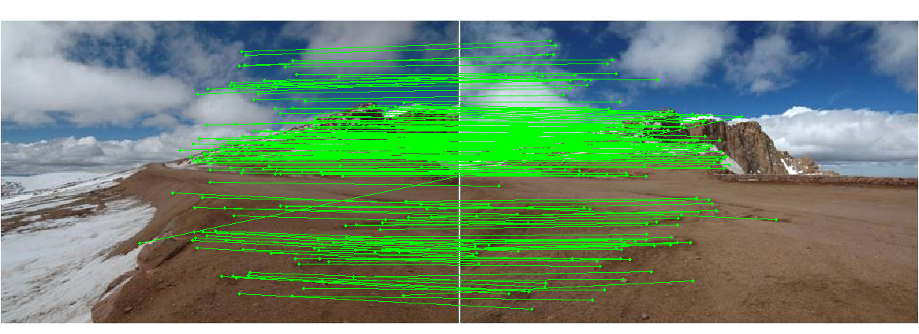
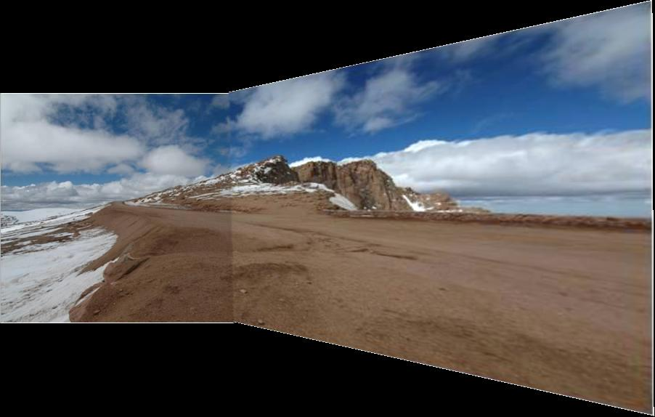
Photo stitching: projective alignment
Find corresponding points in two images
Solve for transformation that aligns the images

Slide 17

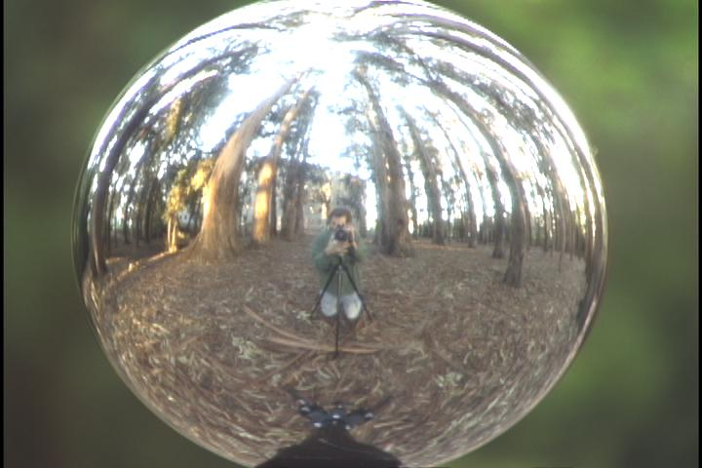
Capturing light fields
Estimate light via projection from spherical surface onto image

Slide 18
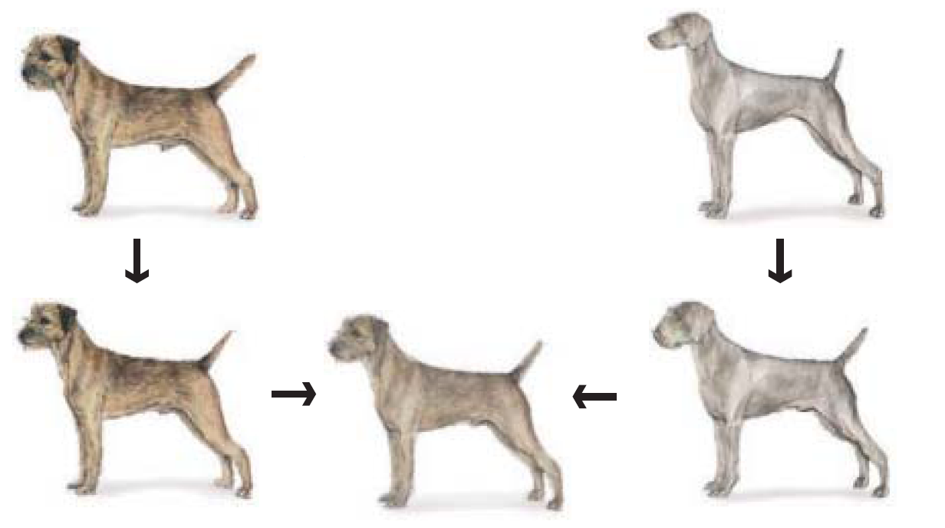
Morphing
Blend from one object to other with a series of local transformations

Slide 19
Image Transformations
image filtering: change range of image
g(x) = T(f(x))
f
f
T
x
x
image warping: change domain of image
g(x) = f(T(x))
f
f
T
x
x

Slide 20

Image Transformations
image filtering: change range of image
g(x) = T(f(x))
f
g
T
image warping: change domain of image
g(x) = f(T(x))
f
g
T

Slide 21
Parametric (global) warping
T
p = (x,y)
p’ = (x’,y’)
Transformation T is a coordinate-changing machine:
p’ = T(p)
What does it mean that T is global?
  Is the same for any point p
  can be described by just a few numbers (parameters)
For linear transformations, we can represent T as a matrix
p’ = Mp

Slide 22


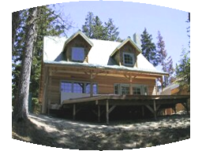

Parametric (global) warping
Examples of parametric warps:
translation
rotation
aspect
perspective
affine
cylindrical

Slide 23
Scaling
Scaling a coordinate means multiplying each of its components by a scalar
Uniform scaling means this scalar is the same for all components:
× 2

Slide 24
Scaling
Non-uniform scaling: different scalars per component:
X × 2,
Y × 0.5

Slide 25
Scaling
Scaling operation:
Or, in matrix form:
scaling matrix S
What is the transformation from (x’, y’) to (x, y)?

Slide 26
2-D Rotation
(x’, y’)
(x, y)
x’ = x cos(θ) - y sin(θ)
y’ = x sin(θ) + y cos(θ)
θ

Slide 27
2-D Rotation
Polar coordinates…
x = r cos (φ)
y = r sin (φ)
x’ = r cos (φ + θ)
y’ = r sin (φ + θ)
Trig Identity…
x’ = r cos(φ) cos(θ) – r sin(φ) sin(θ)
y’ = r sin(φ) cos(θ) + r cos(φ) sin(θ)
Substitute…
x’ = x cos(θ) - y sin(θ)
y’ = x sin(θ) + y cos(θ)
(x’, y’)
(x, y)
θ
φ

Slide 28
2-D Rotation
This is easy to capture in matrix form:
Even though sin(θ) and cos(θ) are nonlinear functions of θ,
  x’ is a linear combination of x and y
  y’ is a linear combination of x and y
What is the inverse transformation?
  Rotation by –θ
  For rotation matrices
R

Slide 29
2x2 Matrices
What types of transformations can be
represented with a 2x2 matrix?
2D Identity?
2D Scale around (0,0)?

Slide 30
2x2 Matrices
What types of transformations can be
represented with a 2x2 matrix?
2D Rotate around (0,0)?
2D Shear?

Slide 31
2x2 Matrices
What types of transformations can be
represented with a 2x2 matrix?
2D Mirror about Y axis?
2D Mirror over (0,0)?

Slide 32
2x2 Matrices
What types of transformations can be
represented with a 2x2 matrix?
2D Translation?
NO!

Slide 33
All 2D Linear Transformations
Linear transformations are combinations of …
  Scale,
  Rotation,
  Shear, and
  Mirror
Properties of linear transformations:
  Origin maps to origin
  Lines map to lines
  Parallel lines remain parallel
  Ratios are preserved
  Closed under composition

Slide 34
Homogeneous Coordinates
Q: How can we represent translation in matrix form?

Slide 35
Homogeneous Coordinates
Homogeneous coordinates
represent coordinates in 2 dimensions with a 3-vector

Slide 36
Homogeneous Coordinates
2D Points → Homogeneous Coordinates
Append 1 to every 2D point: (x y) → (x y 1)
Homogeneous coordinates → 2D Points
Divide by third coordinate (x y w) → (x/w y/w)
Special properties
Scale invariant: (x y w) = k * (x y w)
(x, y, 0) represents a point at infinity
(0, 0, 0) is not allowed
y
Scale Invariance
2
(2,1,1)
or (4,2,2)
or (6,3,3)
1
1
2
x

Slide 37
Homogeneous Coordinates
Q: How can we represent translation in matrix form?
A: Using the rightmost column:

Slide 38
Translation Example
t_{x} = 2
t_{y} = 1

Slide 39
Basic 2D transformations as 3x3 matrices
Translate
Scale
Rotate
Shear

Slide 40
Matrix Composition
Transformations can be combined by
matrix multiplication
p’ = T(t_{x},t_{y}) R(Θ) S(s_{x},s_{y}) p
Does the order of multiplication matter?

Slide 41
Affine Transformations
Affine transformations are combinations of
  Linear transformations, and
  Translations
Properties of affine transformations:
  Origin does not necessarily map to origin
  Lines map to lines
  Parallel lines remain parallel
  Ratios are preserved
  Closed under composition

Slide 42
Projective Transformations
Projective transformations are combos of
  Affine transformations, and
  Projective warps
Properties of projective transformations:
  Origin does not necessarily map to origin
  Lines map to lines
  Parallel lines do not necessarily remain parallel
  Ratios are not preserved
  Closed under composition
  Models change of basis
  Projective matrix is defined up to a scale (8 DOF)

Slide 43
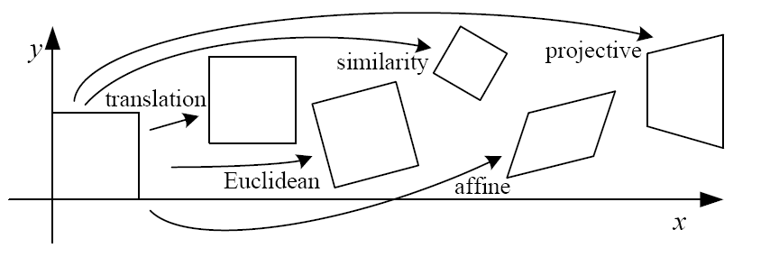
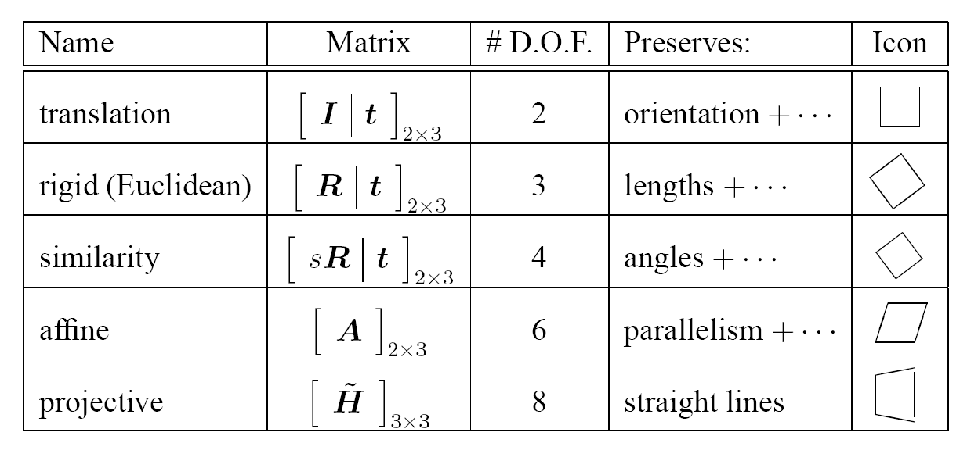
2D image transformations
These transformations are a nested set of groups
  Closed under composition and inverse is a member

Slide 44
Recovering Transformations
?
T(x,y)
y
y’
x
x’
f(x,y)
g(x’,y’)
What if we know f and g and want to recover the transform T?
  willing to let user provide correspondences
    How many do we need?

Slide 45
Translation: # correspondences?
?
T(x,y)
y
y’
x
x’
How many Degrees of Freedom?
How many correspondences needed for translation?
What is the transformation matrix?

Slide 46
Euclidean: # correspondences?
?
T(x,y)
y
y’
x
x’
How many DOF?
How many correspondences needed for translation+rotation?

Slide 47
Affine: # correspondences?
?
T(x,y)
y
y’
x
x’
How many DOF?
How many correspondences needed for affine?

Slide 48
Affine transformation estimation
Math
Matlab demo

Slide 49
Projective: # correspondences?
?
T(x,y)
y
y’
x
x’
How many DOF?
How many correspondences needed for projective?

Slide 50

Take-home Question
1) Suppose we have two triangles: ABC and A’B’C’. What transformation will map A to A’, B to B’, and C to C’? How can we get the parameters?
B
B’
?
T(x,y)
C’
A
C
A’
Source
Destination

Slide 51
Take-home Question
2) Show that distance ratios along a line are preserved under 2d linear transformations.
o
(x3,y3)
o
(x’3,y’3)
o
o
(x2,y2)
o
p1=(x1,y1)
o
(x’2,y’2)
p‘1=(x’1,y’1)
Hint: Write down x2 in terms of x1 and x3, given that the three points are co-linear

Slide 52
Next class: texture mapping and morphing

