Slide 1
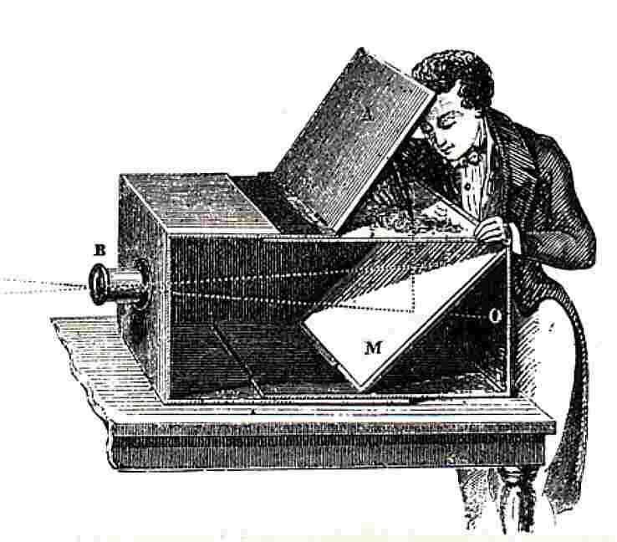
Pinhole Camera Model
10/01/15
Computational Photography
Derek Hoiem, University of Illinois

Slide 2
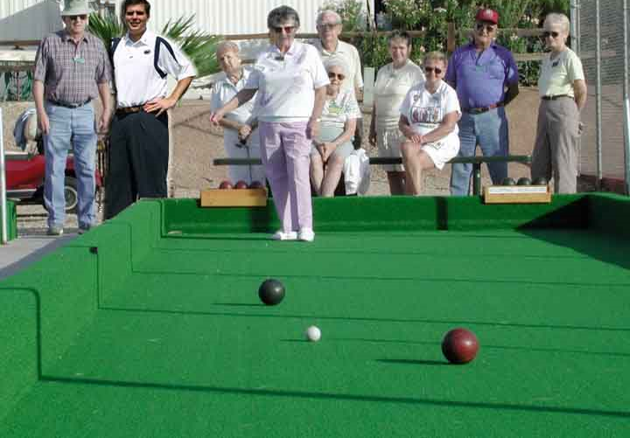
Next classes: Single-view Geometry
How tall is this woman?
How high is the camera?
What is the camera rotation?
What is the focal length of the camera?
Which ball is closer?

Slide 3
Today’s class
Mapping between image and world coordinates
  Pinhole camera model
  Projective geometry
    Vanishing points and lines
  Projection matrix

Slide 4
Image formation
Let’s design a camera
  Idea 1: put a piece of film in front of an object
  Do we get a reasonable image?
Slide source: Seitz

Slide 5
Pinhole camera
Idea 2: add a barrier to block off most of the rays
  This reduces blurring
  The opening known as the aperture
Slide source: Seitz
Notes:
Q: How does this transform the image? A: It gets inverted

Slide 6

Pinhole camera
f
c
f = focal length
c = center of the camera
Figure from Forsyth

Slide 7
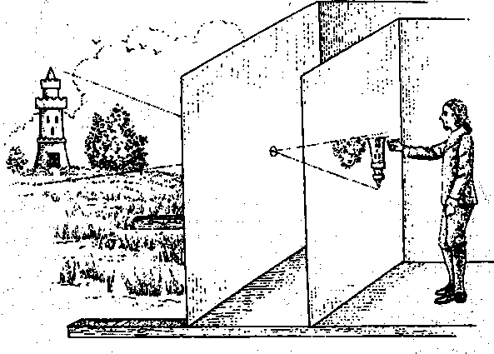
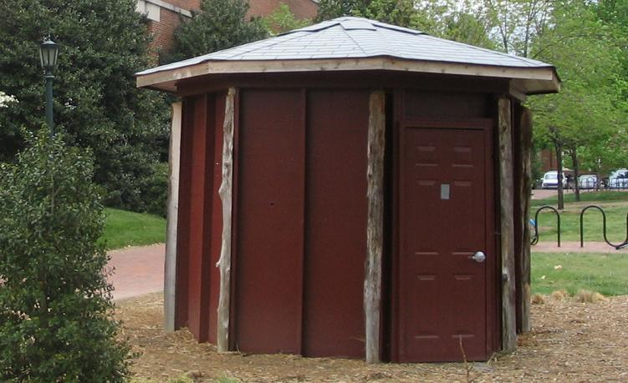
Camera obscura: the pre-camera
First idea: Mozi, China (470BC to 390BC)
First built: Alhacen, Iraq/Egypt (965 to 1039AD)
Illustration of Camera Obscura
Freestanding camera obscura at UNC Chapel Hill
Photo by Seth Ilys

Slide 8
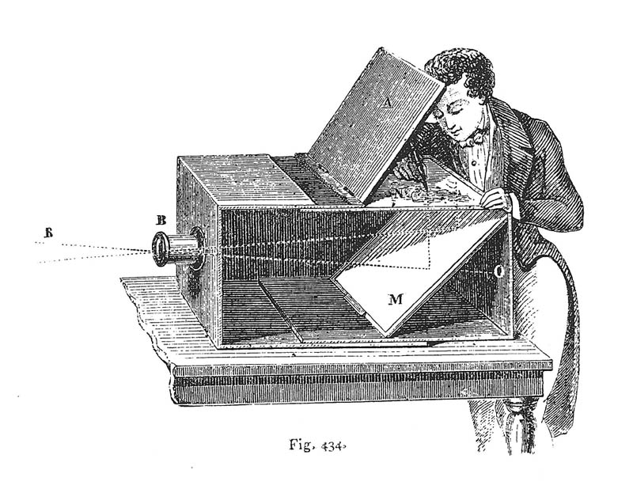
Camera Obscura used for Tracing
Lens Based Camera Obscura, 1568

Slide 9
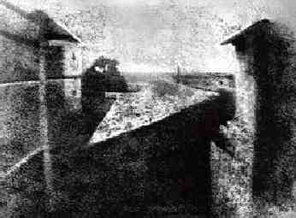
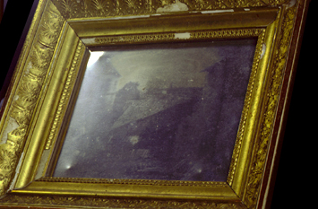
First Photograph
Oldest surviving photograph
  Took 8 hours on pewter plate
Photograph of the first photograph
Joseph Niepce, 1826
Stored at UT Austin
Niepce later teamed up with Daguerre, who eventually created Daguerrotypes

Slide 10
Pinhole camera
“circle of
confusion”
A lens focuses light onto the film
Slide source: Seitz

Slide 11
Dimensionality Reduction Machine (3D to 2D)
3D world
2D image
Figures © Stephen E. Palmer, 2002

Slide 12
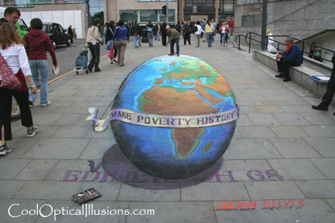
Projection can be tricky…
Slide source: Seitz

Slide 13
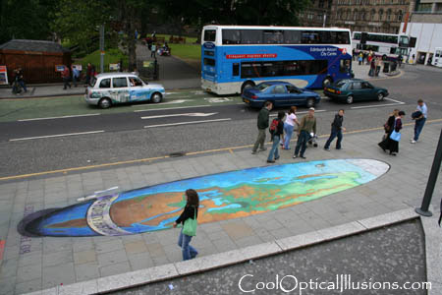
Projection can be tricky…
Slide source: Seitz

Slide 14
Projective Geometry
What is lost?
Length
Who is taller?
Which is closer?

Slide 15
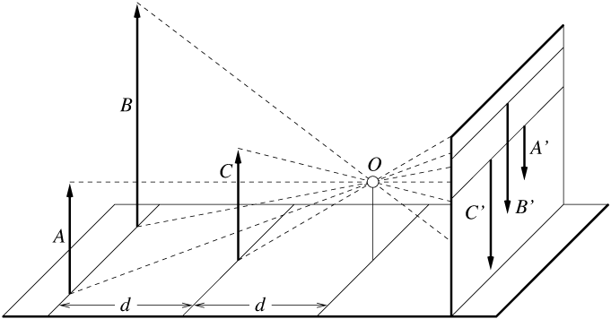
Length is not preserved
A’
C’
B’
Figure by David Forsyth

Slide 16
Projective Geometry
What is lost?
Length
Angles
Parallel?
Perpendicular?

Slide 17
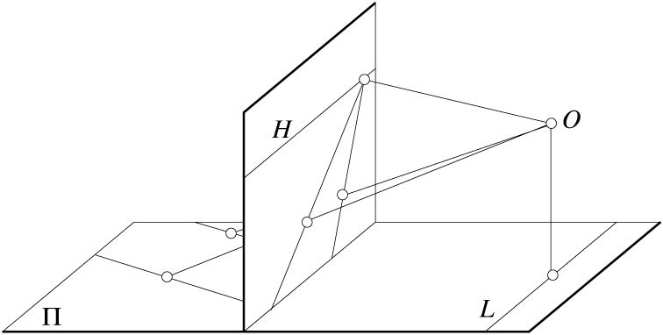
Parallel lines are not parallel in the image
Figure by David Forsyth

Slide 18
Projective Geometry
What is preserved?
Straight lines are still straight

Slide 19
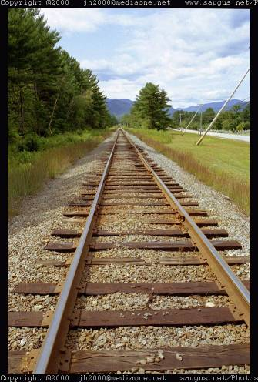
Vanishing points and lines
Parallel lines in the world intersect in the image at a “vanishing point”
Notes:
Go to board, sketch out various properties of vanishing points/lines

Slide 20
Vanishing points and lines
Vanishing Point
Vanishing Point
o
o
Vanishing Line
Notes:
Go to board, sketch out various properties of vanishing points/lines
Parallel lines intersect at a point
The intersection of red lines and blue lines form a parallelogram
Sets of parallel lines on the same plane form a vanishing line
Sets of parallel planes form a vanishing line
Not all lines that intersect are parallel

Slide 21

Vanishing points and lines
Vertical vanishing
point
(at infinity)
Vanishing
line
Vanishing
point
Vanishing
point
Credit: Criminisi

Slide 22
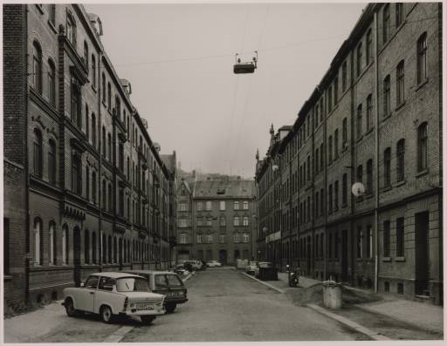
Vanishing points and lines
Photo from online Tate collection
Notes:
Where are the vanishing points? Do buildings on left and buildings on right have the same vanishing line? Which way is the camera tilted?

Slide 23
Note on estimating vanishing points
Use multiple lines for better accuracy
… but lines will not intersect at exactly the same point in practice
One solution: take mean of intersecting pairs
… bad idea!
Instead, minimize angular differences
Notes:
Go to board, sketch out various properties of vanishing points/lines

Slide 24
(more vanishing points on board)

Slide 25

Vanishing objects

Slide 26
Camera matrix
http://www.youtube.com/watch?v=6KlJzfsAzoY
Notes:
P = K [R t]

Slide 27
Projection: world coordinates→image coordinates
.
Optical Center (u₀, v₀)
.
.
f
Z
Y
.
v
Camera Center (t_{x}, t_{y}, t_{z})
u

Slide 28




Homogeneous coordinates
Conversion
Converting to homogeneous coordinates
homogeneous image
coordinates
homogeneous scene
coordinates
Converting from homogeneous coordinates
Notes:
Append coordinate with value 1; proportional coordinate system

Slide 29
Homogeneous coordinates
Invariant to scaling
Point in Cartesian is ray in Homogeneous
Homogeneous Coordinates
Cartesian Coordinates
Notes:
Q: Suppose we have a point in Cartesian coordinates. What is that in homogeneous coordinates? A: a ray

Slide 30
Basic geometry in homogeneous coordinates
Line equation: ax + by + c = 0
Append 1 to pixel coordinate to get homogeneous coordinate
Line given by cross product of two points
Intersection of two lines given by cross product of the lines

Slide 31
Another problem solved by homogeneous coordinates
Intersection of parallel lines
  Cartesian: (Inf, Inf)
  Homogeneous: (1, 1, 0)
  Cartesian: (Inf, Inf)
Homogeneous: (1, 2, 0)
Notes:
Parallel lines intersect at different infinities

Slide 32

Projection matrix
Slide Credit: Saverese
R,T
j_{w}
k_{w}
O_{w}
i_{w}
x: Image Coordinates: w(u,v,1)
K: Intrinsic Matrix (3x3)
R: Rotation (3x3)
t: Translation (3x1)
X: World Coordinates: (X,Y,Z,1)

Slide 33
Pinhole Camera Model
R
j_{w}
t
k_{w}
O_{w}
i_{w}
x: Image Coordinates: (u,v,1)
K: Intrinsic Matrix (3x3)
R: Rotation (3x3)
t: Translation (3x1)
X: World Coordinates: (X,Y,Z,1)

Slide 34
Interlude: when have I used this stuff?

Slide 35
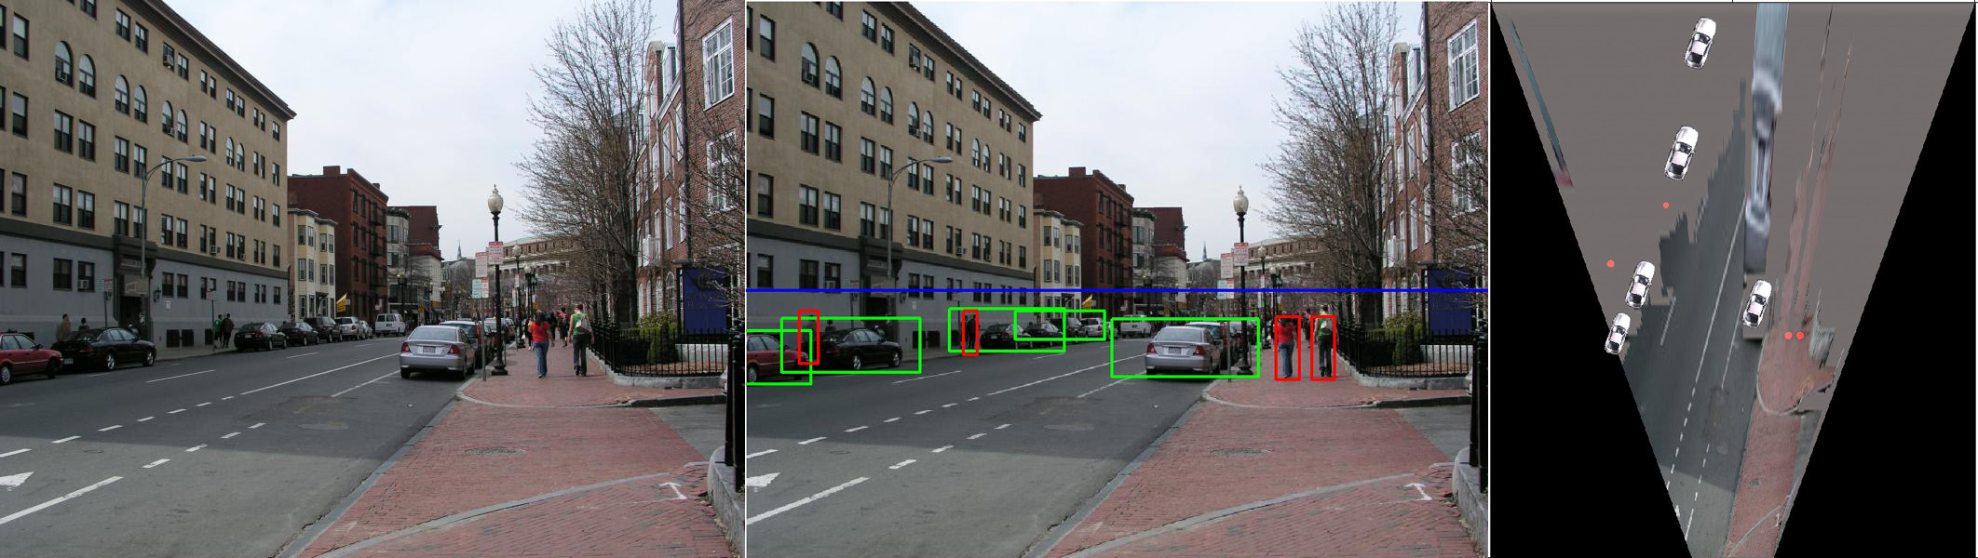
When have I used this stuff?
Object Recognition (CVPR 2006)

Slide 36
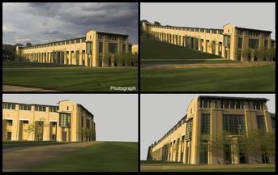
When have I used this stuff?
Single-view reconstruction (SIGGRAPH 2005)

Slide 37
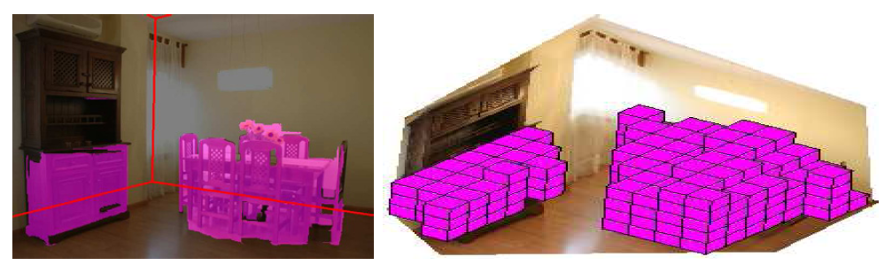
When have I used this stuff?
Getting spatial layout in indoor scenes (ICCV 2009)

Slide 38
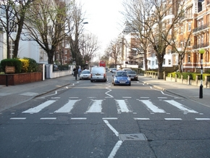
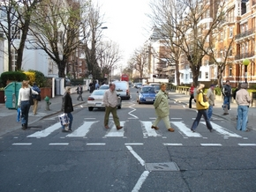
When have I used this stuff?
Inserting photographed objects into images (SIGGRAPH 2007)
Original
Created

Slide 39
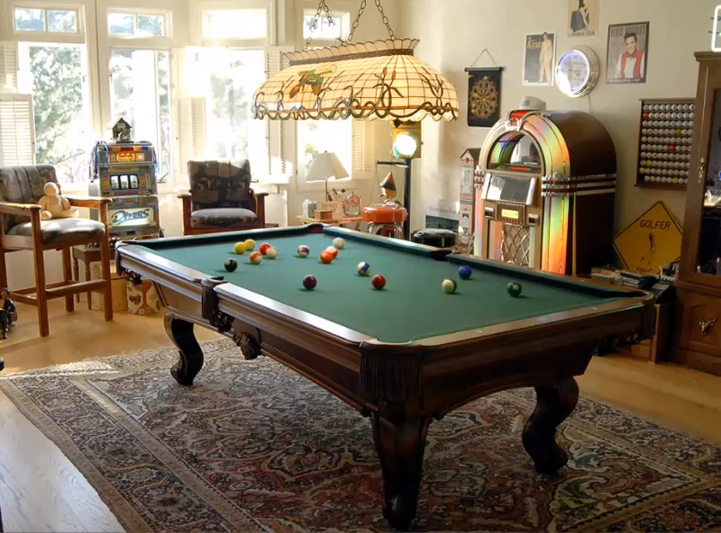
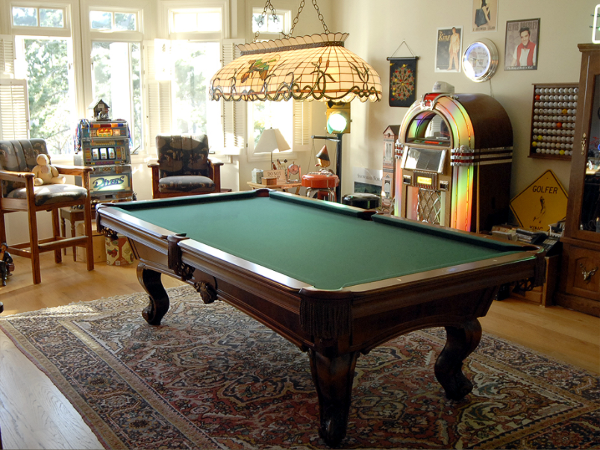
When have I used this stuff?
Inserting synthetic objects into images: http://vimeo.com/28962540

Slide 40
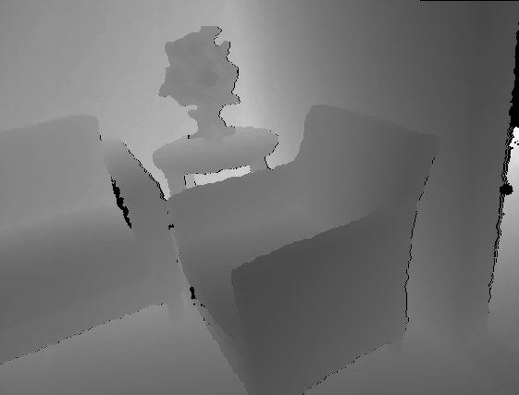
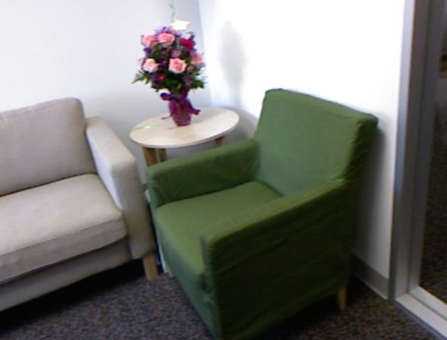
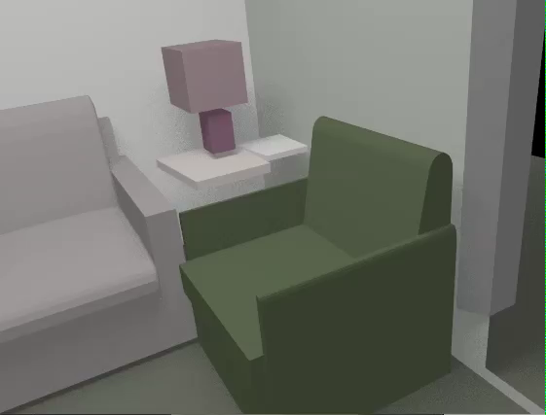
When have I used this stuff?
Creating detailed and complete 3D scene models from a single view (ongoing)

Slide 41
Projection matrix
Intrinsic Assumptions
Unit aspect ratio
Principal point at (0,0)
No skew
Extrinsic Assumptions
No rotation
Camera at (0,0,0)
K
Slide Credit: Saverese
Notes:
Work through equations for u and v on board

Slide 42
Remove assumption: known optical center
Intrinsic Assumptions
Unit aspect ratio
No skew
Extrinsic Assumptions
No rotation
Camera at (0,0,0)

Slide 43
Remove assumption: square pixels
Intrinsic Assumptions
No skew
Extrinsic Assumptions
No rotation
Camera at (0,0,0)

Slide 44
Remove assumption: non-skewed pixels
Intrinsic Assumptions
Extrinsic Assumptions
No rotation
Camera at (0,0,0)
Note: different books use different notation for parameters

Slide 45
Oriented and Translated Camera
R
j_{w}
t
k_{w}
O_{w}
i_{w}

Slide 46
Allow camera translation
Intrinsic Assumptions
Extrinsic Assumptions
No rotation

Slide 47
3D Rotation of Points
Slide Credit: Saverese
Rotation around the coordinate axes, counter-clockwise:
p’
γ
y
p
z

Slide 48
Allow camera rotation

Slide 49
Degrees of freedom
5
6
Notes:
How many known points are needed to estimate this?

Slide 50
Vanishing Point = Projection from Infinity

Slide 51
Orthographic Projection
Special case of perspective projection
  Distance from the COP to the image plane is infinite
  Also called “parallel projection”
  What’s the projection matrix?
Image
World
Slide by Steve Seitz

Slide 52
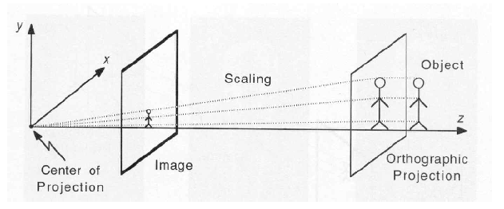
Scaled Orthographic Projection
Special case of perspective projection
  Object dimensions are small compared to distance to camera
  Also called “weak perspective”
  What’s the projection matrix?
Illustration from George Bebis
Slide by Steve Seitz

Slide 53
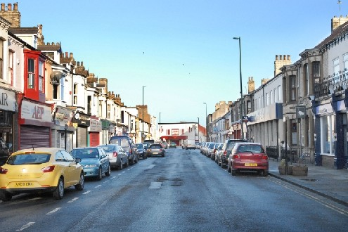
Take-home question
Suppose we have two 3D cubes on the ground facing the viewer, one near, one far.
What would they look like in perspective?
What would they look like in weak perspective?
Photo credit: GazetteLive.co.uk

Slide 54
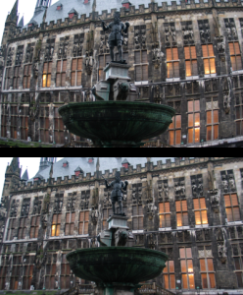
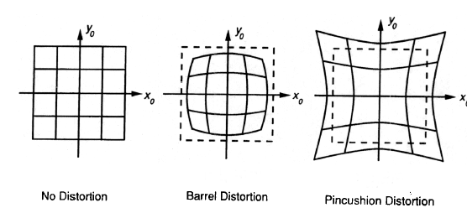
Beyond Pinholes: Radial Distortion
Corrected Barrel Distortion
Image from Martin Habbecke

Slide 55
Things to remember
Vertical vanishing
point
(at infinity)
Vanishing points and vanishing lines
Pinhole camera model and camera projection matrix
Vanishing
line
Vanishing
point
Vanishing
point

Slide 56
Next classes
Tues: single-view metrology
  Measuring 3D distances from the image
Thurs: single-view 3D reconstruction

