Slide 1
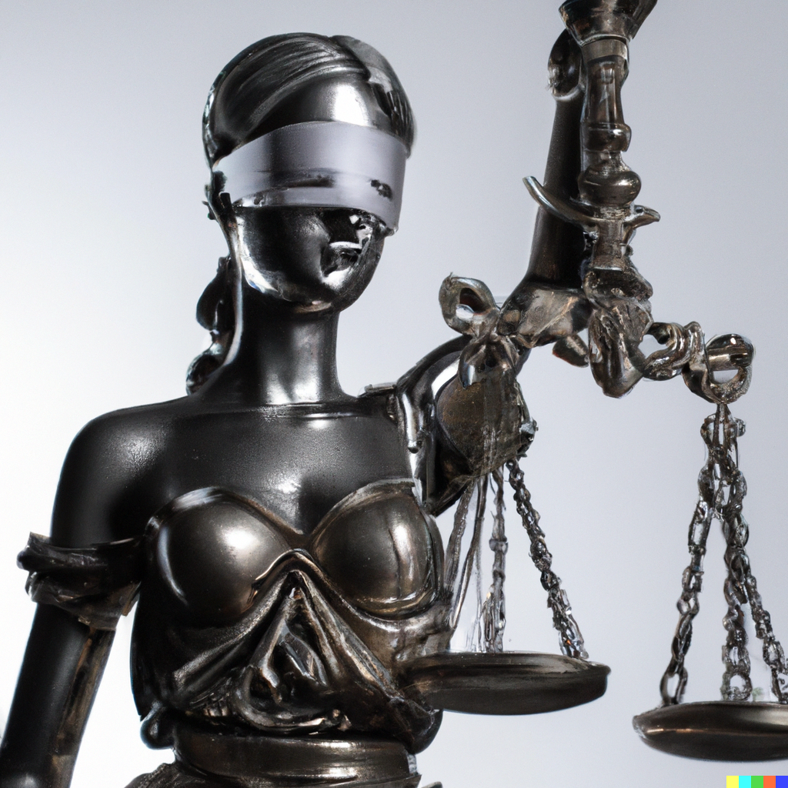
Data Bias and Fair ML
Applied Machine Learning Derek Hoiem
Dall-E

Slide 2
Today’s lecture
Algorithm and Data bias
Fair ML
Adopted from a 2019 guest lecture by Margaret Mitchell

Slide 3
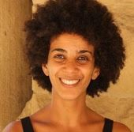
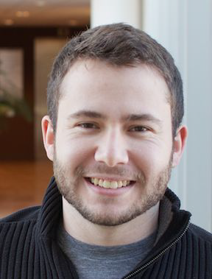
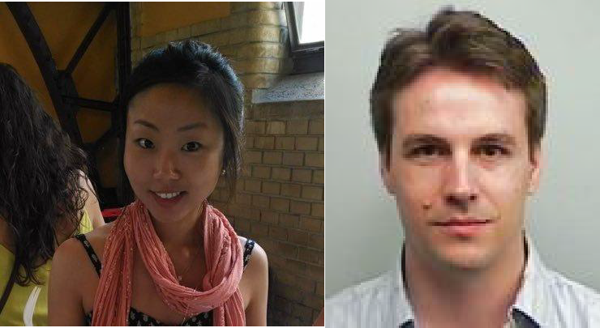
Bias in the Vision and Language of
Artificial Intelligence
Margaret Mitchell
Senior Research Scientist Google AI
Conversation AI
Andrew | Me | Simone | Parker | Lucy | Ben | Elena | Deb | Timnit Gebru
Zaldivar |  | Wu | Barnes | Vasserman | Hutchinson | Spitzer | Raji
Adrian Benton
Brian Zhang
Dirk Hovy
Josh Lovejoy
Alex Beutel
Blake Lemoine
Hee Jung Ryu
Hartwig Adam
Blaise Agüera y Arcas
CC BY / Margaret Mitchell / m-mitchell.com

Slide 4
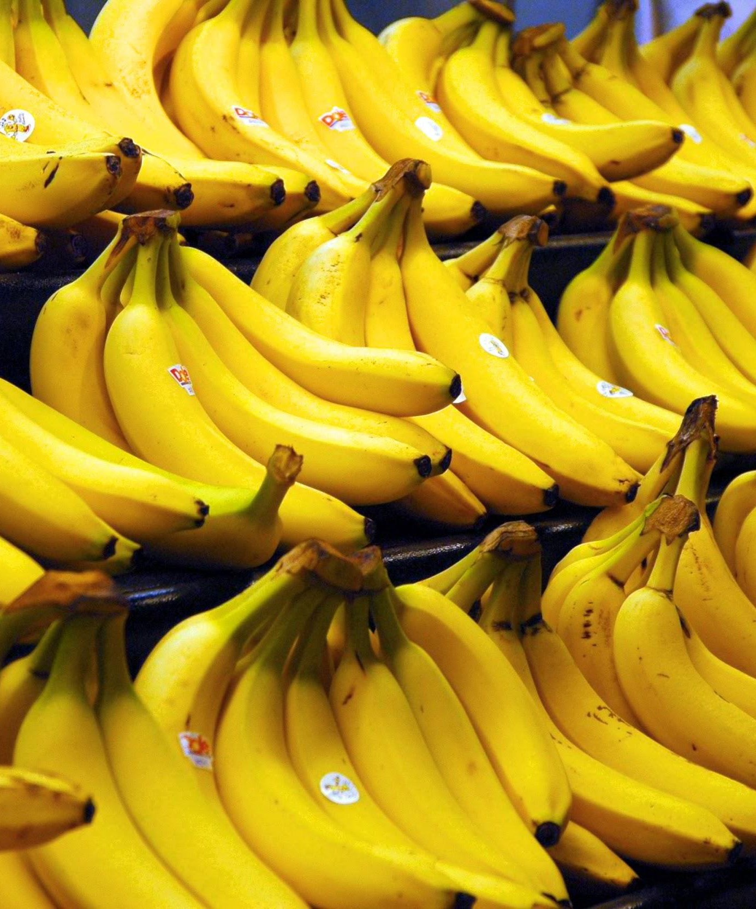
What do you see?
CC BY / Margaret Mitchell / m-mitchell.com

Slide 5
What do you see?
Bananas
CC BY / Margaret Mitchell / m-mitchell.com

Slide 6
What do you see?
Bananas
Stickers
CC BY / Margaret Mitchell / m-mitchell.com

Slide 7
What do you see?
Bananas
Stickers
Dole Bananas
CC BY / Margaret Mitchell / m-mitchell.com

Slide 8
What do you see?
Bananas
Stickers
Dole Bananas
Bananas at a store
CC BY / Margaret Mitchell / m-mitchell.com

Slide 9
What do you see?
Bananas
Stickers
Dole Bananas
Bananas at a store
Bananas on shelves
CC BY / Margaret Mitchell / m-mitchell.com

Slide 10
What do you see?
Bananas
Stickers
Dole Bananas
Bananas at a store
Bananas on shelves
Bunches of bananas
CC BY / Margaret Mitchell / m-mitchell.com

Slide 11
What do you see?
Bananas
Stickers
Dole Bananas
Bananas at a store
Bananas on shelves
Bunches of bananas
Bananas with stickers on them
CC BY / Margaret Mitchell / m-mitchell.com

Slide 12
What do you see?
Bananas
Stickers
Dole Bananas
Bananas at a store
Bananas on shelves
Bunches of bananas
Bananas with stickers on them
Bunches of bananas with stickers on them on shelves in a store
CC BY / Margaret Mitchell / m-mitchell.com

Slide 13
What do you see?
Bananas
Stickers
Dole Bananas
Bananas at a store
Bananas on shelves
Bunches of bananas
Bananas with stickers on them
Bunches of bananas with stickers on them on shelves in a store
...We don’t tend to say
Yellow Bananas
CC BY / Margaret Mitchell / m-mitchell.com

Slide 14
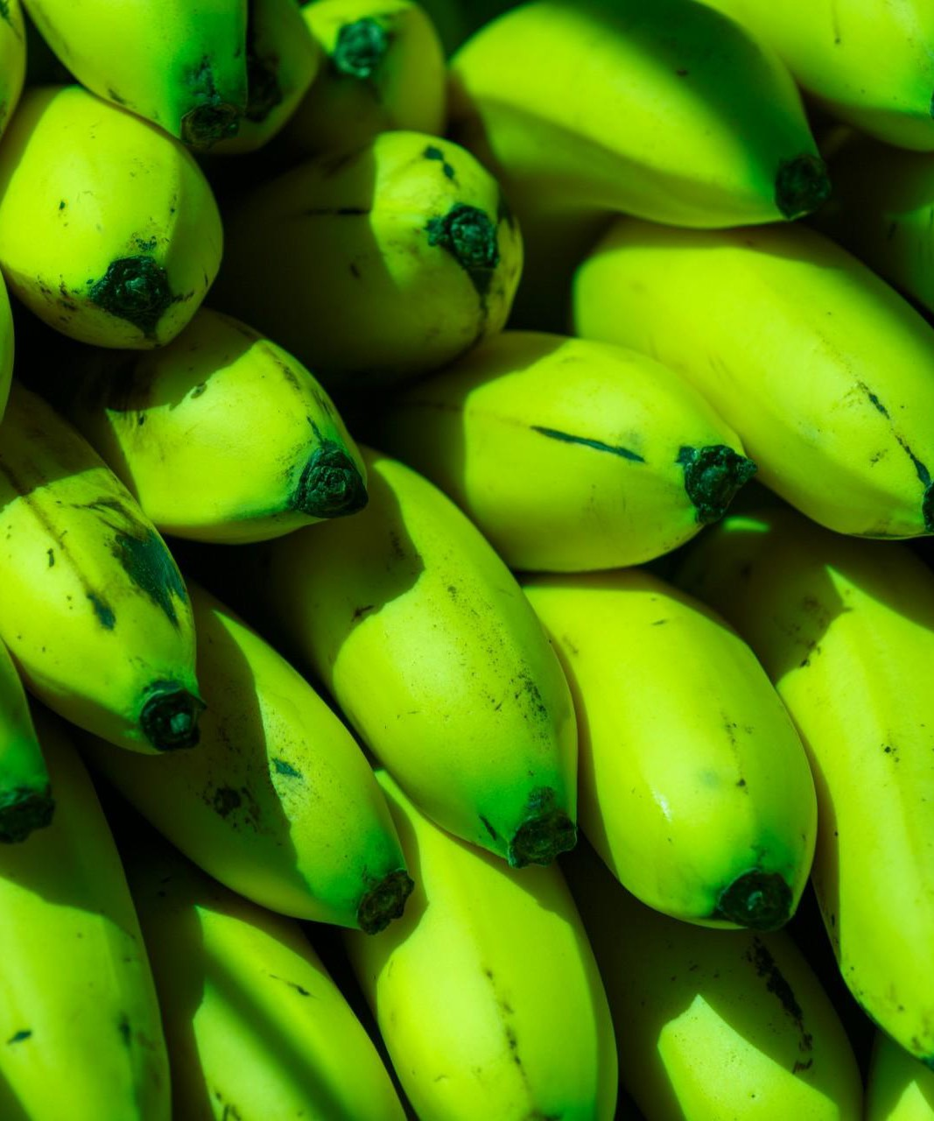
What do you see?
Green Bananas
Unripe Bananas
CC BY / Margaret Mitchell / m-mitchell.com

Slide 15
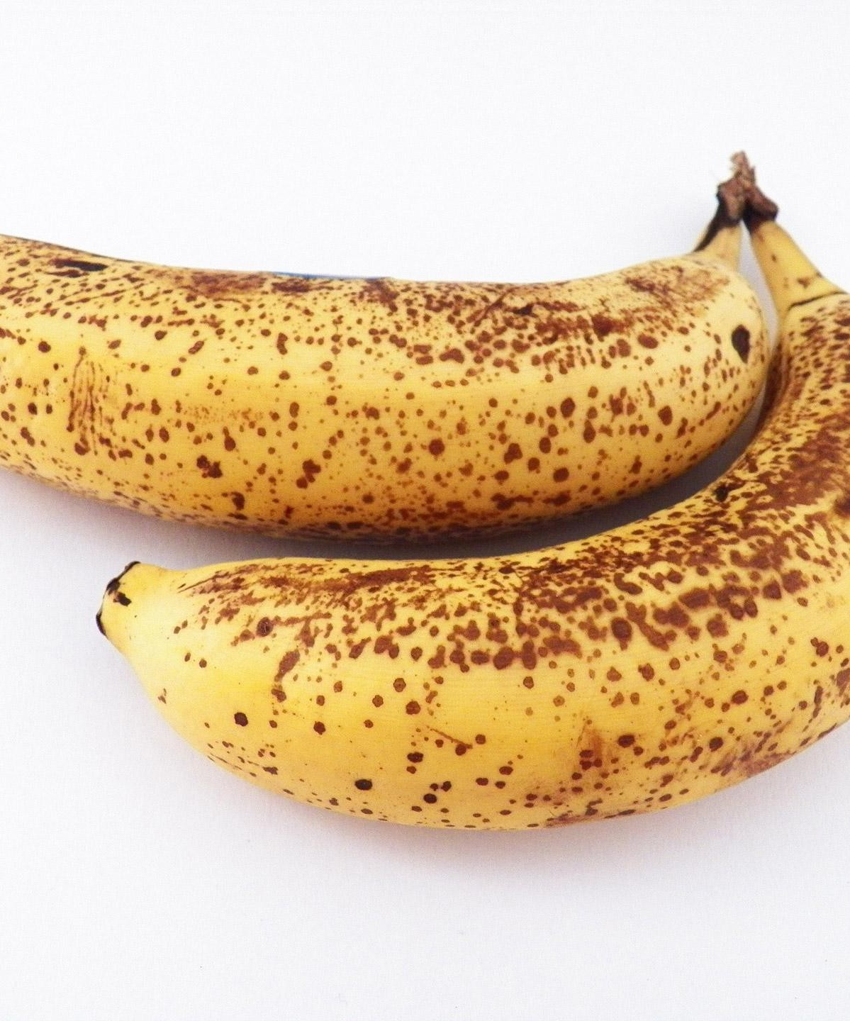
What do you see?
Ripe Bananas
Bananas with spots
CC BY / Margaret Mitchell / m-mitchell.com

Slide 16
What do you see?
Ripe Bananas
Bananas with spots
Bananas good for banana bread
CC BY / Margaret Mitchell / m-mitchell.com

Slide 17
What do you see?
Yellow Bananas
Yellow is prototypical for bananas
CC BY / Margaret Mitchell / m-mitchell.com

Slide 18
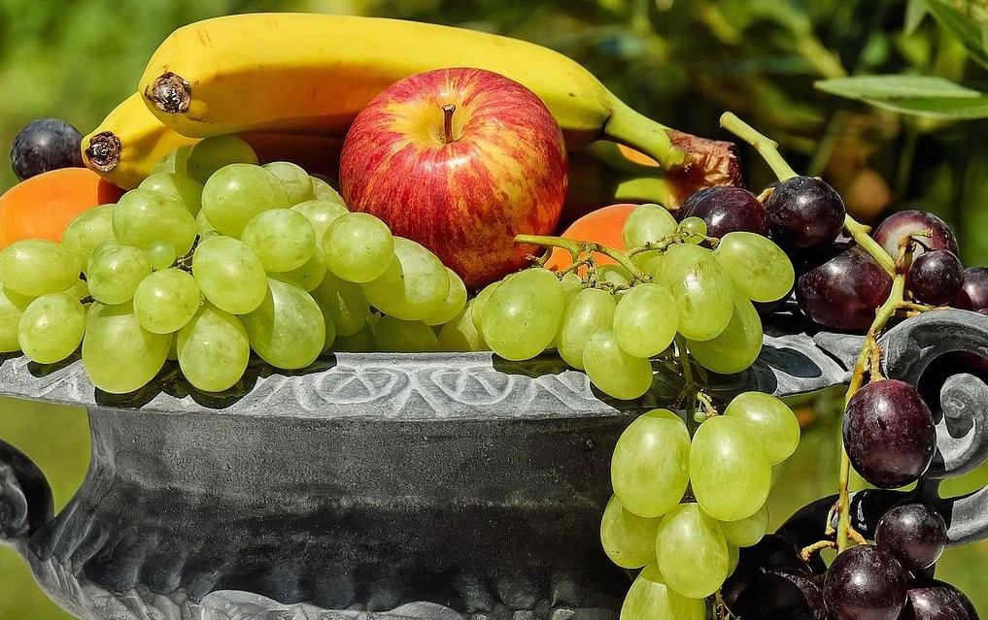
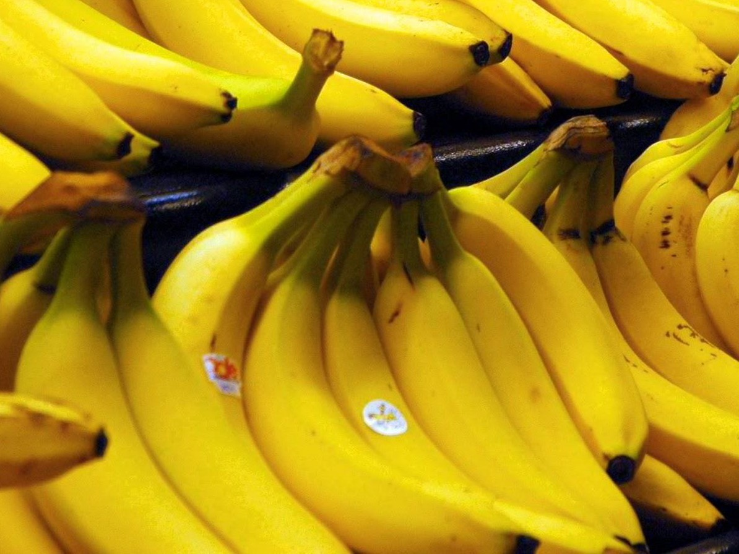
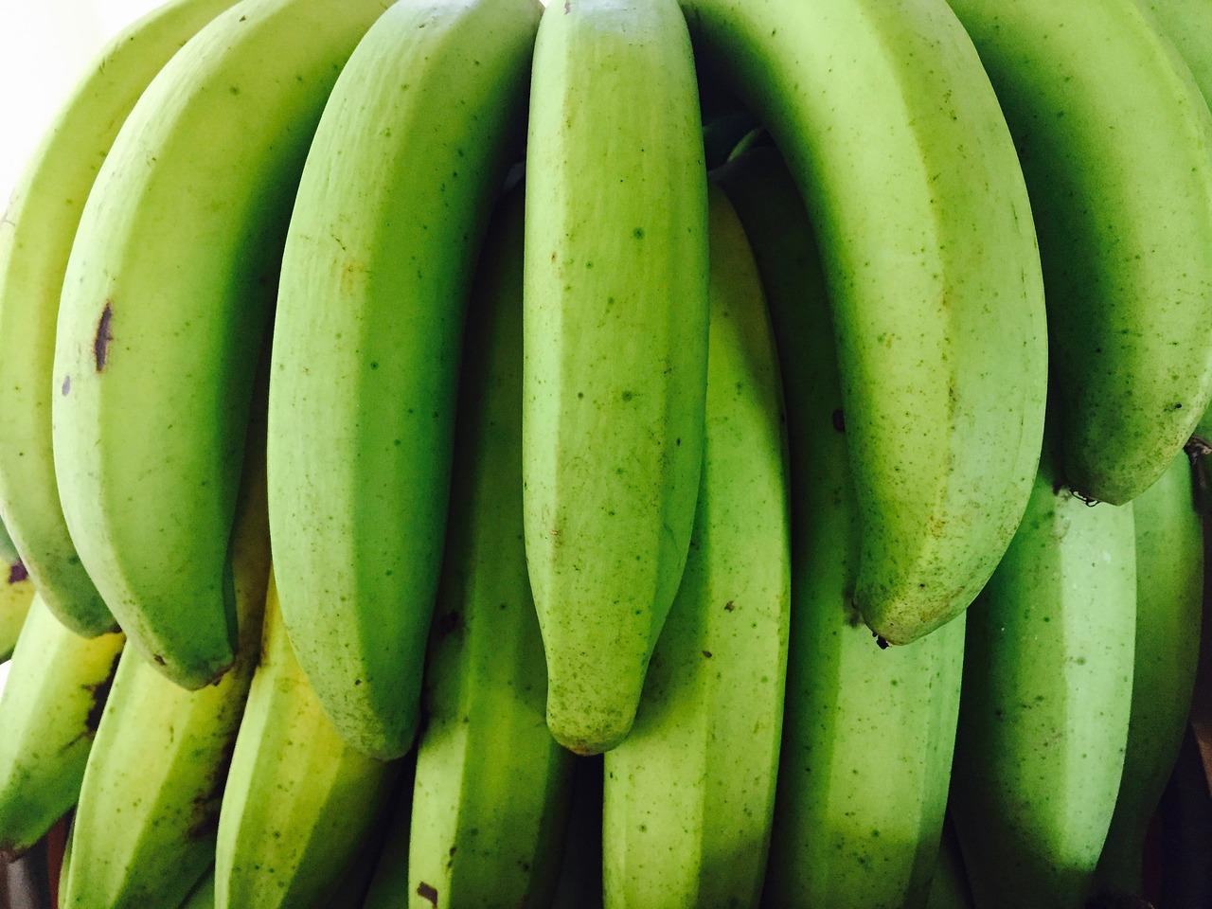
Prototype Theory
One purpose of categorization is to reduce the infinite differences among stimuli to behaviourally and cognitively usable proportions
There may be some central, prototypical notions of items that arise from stored typical properties for an object category (Rosch, 1975)
May also store exemplars (Wu & Barsalou, 2009)
Banana
Fruit
Bananas
“Basic Level”
Unripe Bananas, Cavendish Bananas

Slide 19
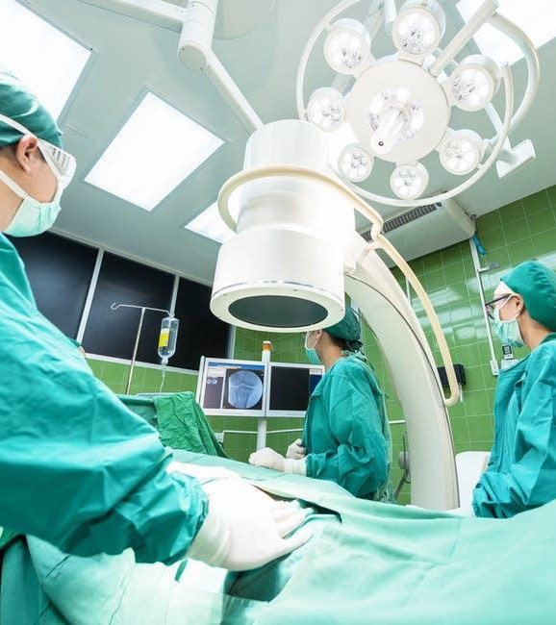
A man and his son are in a terrible accident and are rushed to the hospital in critical care.
The doctor looks at the boy and exclaims "I can't operate on this boy, he's my son!"
How could this be?
CC BY / Margaret Mitchell / m-mitchell.com

Slide 20
A man and his son are in a terrible accident and are rushed to the hospital in critical care.
The doctor looks at the boy and exclaims "I can't operate on this boy, he's my son!"
How could this be?

Slide 21
A man and his son are in a terrible accident and are rushed to the hospital in critical care.
The doctor looks at the boy and exclaims "I can't operate on this boy, he's my son!"
How could this be?
CC BY / Margaret Mitchell / m-mitchell.com

Slide 23
The majority of test subjects overlooked the possibility that the doctor is a she - including men, women, and self-described feminists.
Wapman & Belle, Boston University
CC BY / Margaret Mitchell / m-mitchell.com

Slide 24
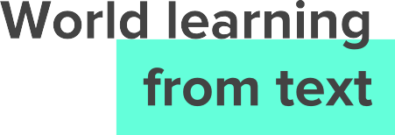
Word | Frequency in corpus
“spoke” | 11,577,917
“laughed” | 3,904,519
“murdered” | 2,834,529
“inhaled” | 984,613
“breathed” | 725,034
“hugged” | 610,040
“blinked” | 390,692
“exhale” | 168,985
Gordon and Van Durme, 2013
CC BY / Margaret Mitchell / m-mitchell.com

Slide 25
Word | Frequency in corpus
“spoke” | 11,577,917
“laughed” | 3,904,519
“murdered” | 2,834,529
“inhaled” | 984,613
“breathed” | 725,034
“hugged” | 610,040
“blinked” | 390,692
“exhale” | 168,985
Gordon and Van Durme, 2013
CC BY / Margaret Mitchell / m-mitchell.com

Slide 26
Human Reporting Bias
The frequency with which people write about actions, outcomes, or properties is not a reflection of real-world frequencies or the degree to which a property is characteristic of a class of individuals
CC BY / Margaret Mitchell / m-mitchell.com

Slide 27
CC BY / Margaret Mitchell / m-mitchell.com

Slide 28
CC BY / Margaret Mitchell / m-mitchell.com

Slide 29
CC BY / Margaret Mitchell / m-mitchell.com

Slide 30
CC BY / Margaret Mitchell / m-mitchell.com

Slide 31
CC BY / Margaret Mitchell / m-mitchell.com

Slide 32
CC BY / Margaret Mitchell / m-mitchell.com

Slide 33
Reporting bias: What people share is not a reflection of real-world frequencies
Data
Selection Bias: Selection does not reflect a random sample
Out-group homogeneity bias: People tend to see outgroup members as more alike than ingroup members when comparing attitudes, values, personality traits, and other characteristics
Confirmation bias: The tendency to search for, interpret, favor, and recall information in a way that confirms one's preexisting beliefs or hypotheses
Overgeneralization: Coming to conclusion based on information that is too general and/or not specific enough
Correlation fallacy: Confusing correlation with causation
Automation bias: Propensity for humans to favor suggestions from automated decision-making systems over contradictory information without automation
More at: https://developers.google.com/machine-learning/glossary/
Interpretation
CC BY / Margaret Mitchell / m-mitchell.com

Slide 34
Biases in Data

Slide 35
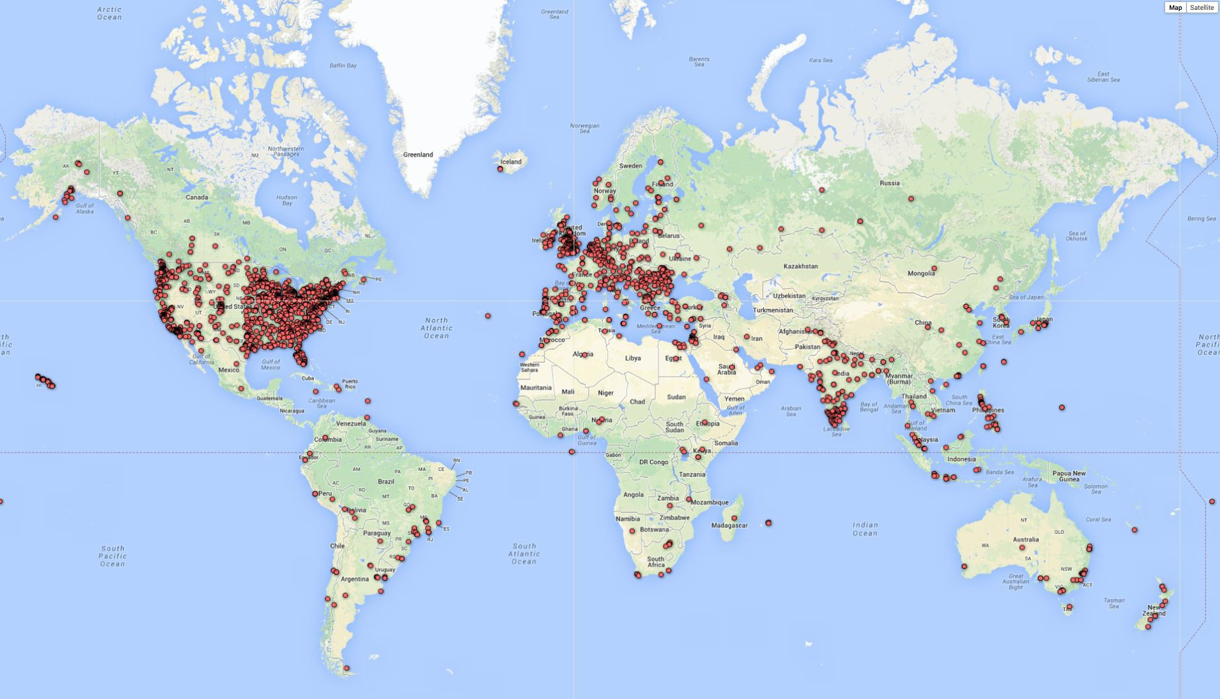
Biases in Data
Selection Bias: Selection does not reflect a random sample
CREDIT
© 2013–2016 Michael Yoshitaka Erlewine and Hadas Kotek
CC BY / Margaret Mitchell / m-mitchell.com

Slide 36
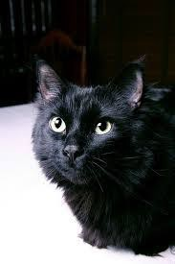
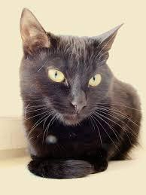
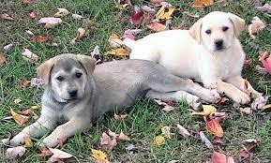
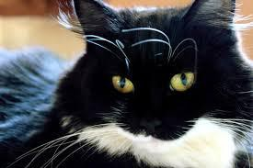
Biases in Data
Out-group homogeneity bias: Tendency to see outgroup members as more alike than ingroup members
CC BY / Margaret Mitchell / m-mitchell.com

Slide 37
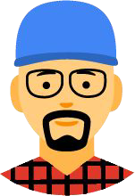
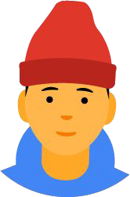
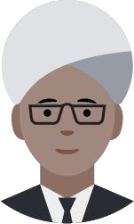
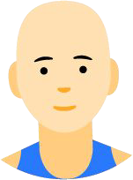
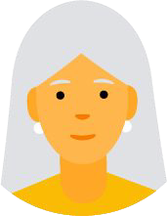
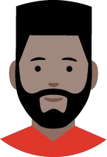
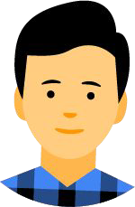
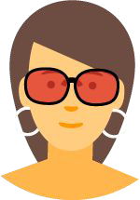
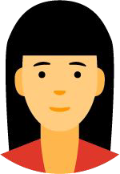
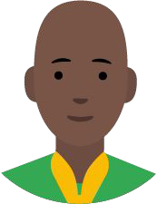
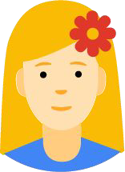
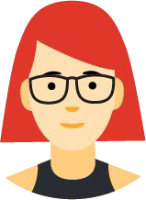
Biases in Data → Biased Data Representation
It's possible that you have an appropriate amount of data for every group you can think of but that some groups are represented less positively than others.
CC BY / Margaret Mitchell / m-mitchell.com

Slide 38
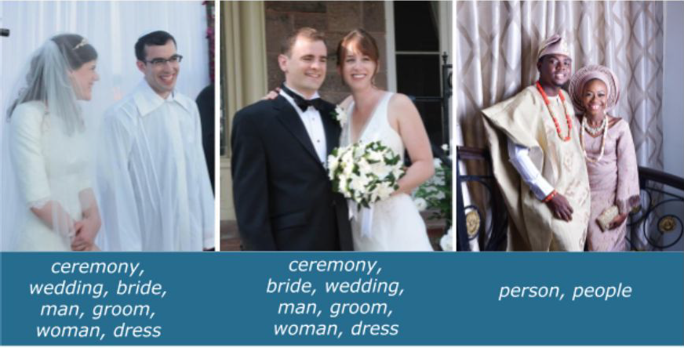
Biases in Data → Biased Labels
Annotations in your dataset will reflect the worldviews of your annotators.
https://ai.googleblog.com/2018/09/introducing-inclusive-images-competition.html

Slide 39
Biases in Interpretation

Slide 40
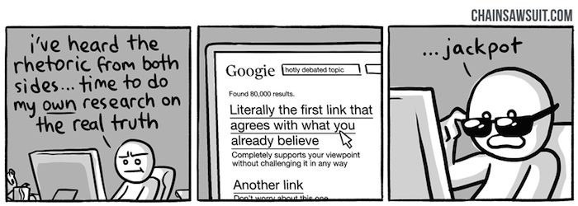
Biases in Interpretation
Confirmation bias: The tendency to search for, interpret, favor, recall information in a way that confirms preexisting beliefs
CREDIT
© kris straub - Chainsawsuit.com
CC BY / Margaret Mitchell / m-mitchell.com

Slide 41
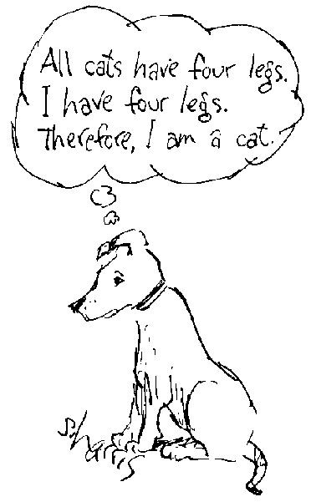
Biases in Interpretation
Overgeneralization: Coming to conclusion based on information that is too general and/or not specific enough (related: overfitting)
CREDIT
Sidney Harris
CC BY / Margaret Mitchell / m-mitchell.com

Slide 42
Biases in Interpretation
Correlation fallacy: Confusing correlation with causation
CREDIT
© mollysdad - Slideshare - Introduction to Logical Fallacies
CC BY / Margaret Mitchell / m-mitchell.com

Slide 43
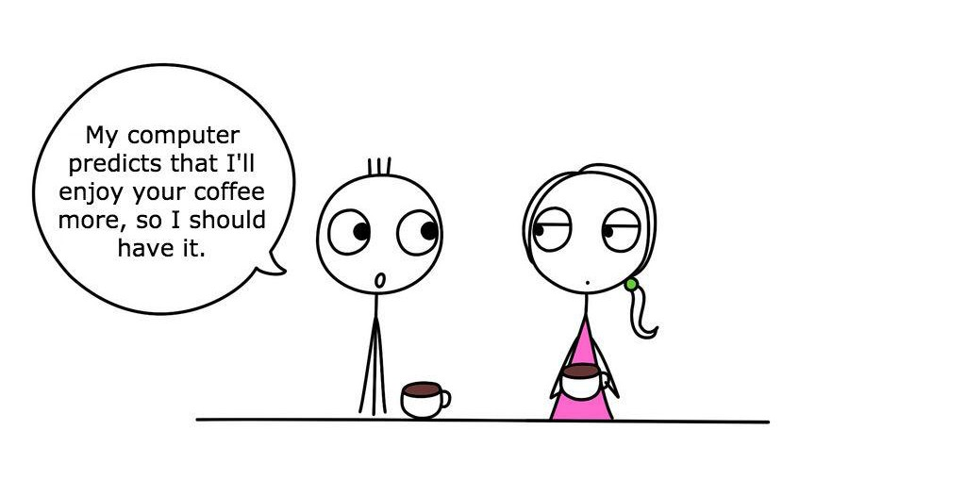
Biases in Interpretation
Automation bias: Propensity for humans to favor suggestions from automated decision-making systems over contradictory information without automation
CREDIT
thedailyenglishshow.com | CC BY 2.0
CC BY / Margaret Mitchell / m-mitchell.com

Slide 44
CC BY / Margaret Mitchell / m-mitchell.com

Slide 45
CC BY / Margaret Mitchell / m-mitchell.com

Slide 46
CC BY / Margaret Mitchell / m-mitchell.com

Slide 49
Human data perpetuates human biases.
As ML learns from human data, the result is a bias network effect.

Slide 50
BIAS = BAD ??

Slide 51
“Bias” can be Good, Bad, Neutral
Bias in statistics and ML
Bias of an estimator: Difference between the predictions and the correct values that we are trying to predict
The "bias" term b (e.g., y = mx + b)
Cognitive biases
Confirmation bias, Recency bias, Optimism bias
Algorithmic bias
Unjust, unfair, or prejudicial treatment of people related to race, income, sexual orientation, religion, gender, and other characteristics historically associated with discrimination and marginalization, when and where they manifest in algorithmic systems or algorithmically aided decision-making
CC BY / Margaret Mitchell / m-mitchell.com

Slide 52
“Bias” can be Good, Bad, Neutral
Bias in statistics and ML
Bias of an estimator: Difference between the predictions and the correct values that we are trying to predict
The "bias" term b (e.g., y = mx + b)
Cognitive biases
Confirmation bias, Recency bias, Optimism bias
Algorithmic bias
Unjust, unfair, or prejudicial treatment of people related to race, income, sexual orientation, religion, gender, and other characteristics historically associated with discrimination and marginalization, when and where they manifest in algorithmic systems or algorithmically aided decision-making
CC BY / Margaret Mitchell / m-mitchell.com

Slide 53
“Although neural networks might be said to write their own programs, they do so towards goals set by humans, using data collected for human purposes. If the data is skewed, even by accident, the computers will amplify injustice.”
— The Guardian
CREDIT
The Guardian view on machine learning: people must decide
CC BY / Margaret Mitchell / m-mitchell.com

Slide 54
Predicting Future Criminal Behavior

Slide 55
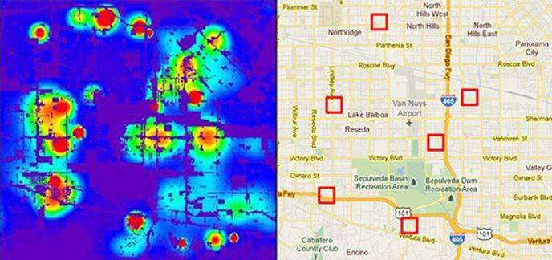
Predicting Policing
Algorithms identify potential crime hot-spots
Based on where crime is previously reported, not where it is known to have occurred
Predicts future events from past
CREDIT
Smithsonian. Artificial Intelligence Is Now Used to Predict Crime. But Is It Biased? 2018
CC BY / Margaret Mitchell / m-mitchell.com

Slide 56
Predicting Sentencing
Prater (who is white) rated low risk after shoplifting, despite two armed robberies; one attempted armed robbery.
Borden (who is black) rated high risk after she and a friend took (but returned before police arrived) a bike and scooter sitting outside.
Two years later, Borden has not been charged with any new crimes. Prater serving 8-year prison term for grand theft.
CREDIT
ProPublica. Northpointe: Risk in Criminal Sentencing. 2016.
CC BY / Margaret Mitchell / m-mitchell.com

Slide 57
Automation Bias in face of:
Overgeneralization
Feedback Loops
Correlation Fallacy
CC BY / Margaret Mitchell / m-mitchell.com

Slide 58
Predicting Criminality
Israeli startup, Faception
“Faception is first-to-technology and first-to-market with proprietary computer vision and machine learning technology for profiling people and revealing their personality based only on their facial image.”
Offering specialized engines for recognizing “High IQ”, “White-Collar Offender”, “Pedophile”, and “Terrorist” from a face image.
Main clients are in homeland security and public safety.
CC BY / Margaret Mitchell / m-mitchell.com

Slide 59
Predicting Criminality
“Automated Inference on Criminality using Face Images” Wu and Zhang, 2016. arXiv
1,856 closely cropped images of faces; Includes “wanted suspect” ID pictures from specific regions.
θ
θ
“[…] angle θ from nose tip to two mouth corners is on average 19.6% smaller for criminals than for
non-criminals ...”
See our longer piece on Medium, “Physiognomy’s New Clothes”
CC BY / Margaret Mitchell / m-mitchell.com

Slide 60
Selection Bias + Experimenter’s Bias + Confirmation Bias + Correlation Fallacy + Feedback Loops
CC BY / Margaret Mitchell / m-mitchell.com

Slide 61
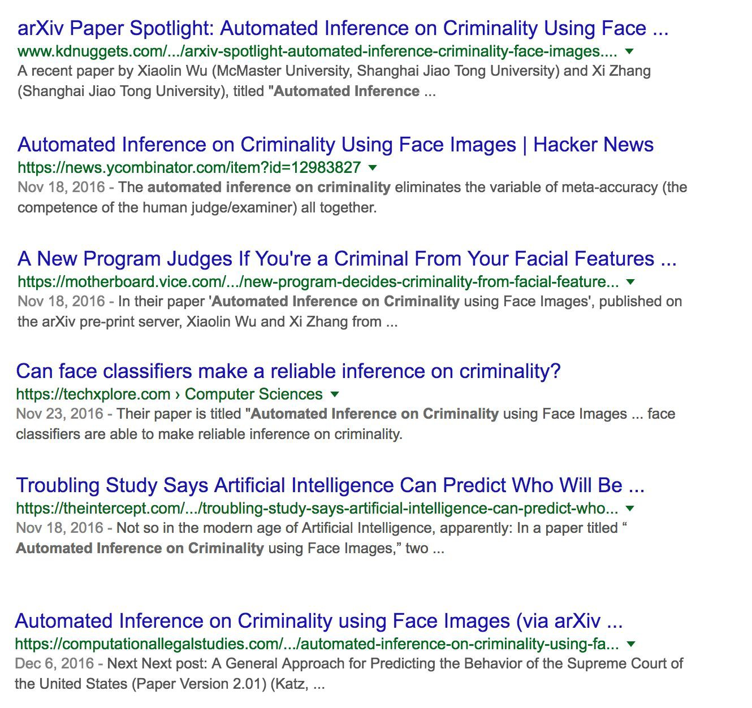
Predicting Criminality - The Media Blitz
CC BY / Margaret Mitchell / m-mitchell.com

Slide 62
(Claiming to) Predict Internal Qualities Subject To Discrimination
CC BY / Margaret Mitchell / m-mitchell.com

Slide 63
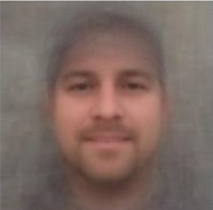
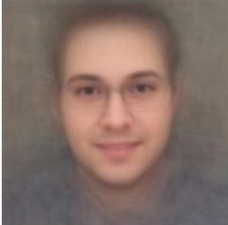
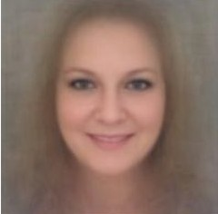
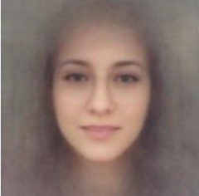
Predicting Homosexuality
Composite Straight Faces Composite Gay Faces
Wang and Kosinski, Deep neural networks are more accurate than humans at detecting sexual orientation from facial images, 2017.
“Sexual orientation detector” using 35,326 images from public profiles on a US dating website.
“Consistent with the prenatal hormone theory [PHT] of sexual orientation, gay men and women tended to have gender-atypical facial morphology.”
Male
Female
CC BY / Margaret Mitchell / m-mitchell.com

Slide 64
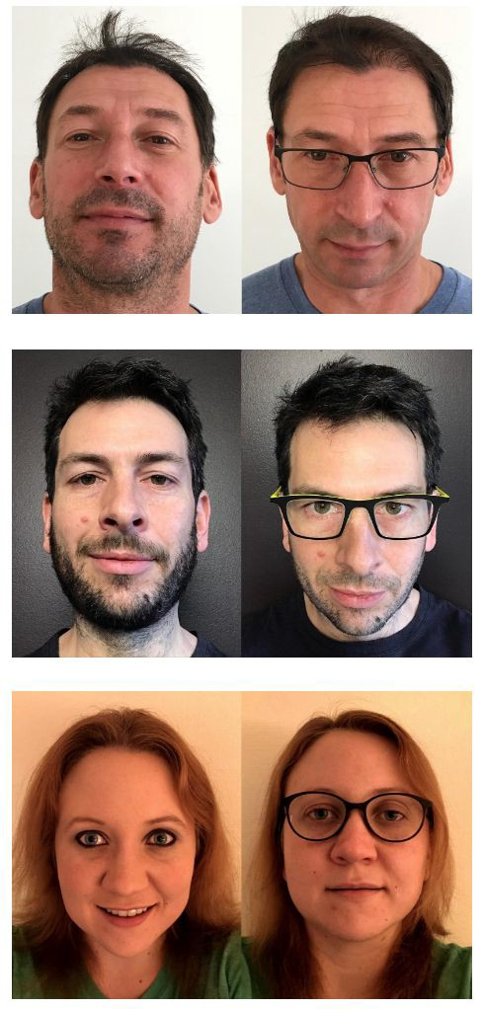
Predicting Homosexuality
Differences between lesbian or gay and straight faces in selfies relate to grooming, presentation, and lifestyle — that is, differences in culture, not in facial structure.
See our longer response on Medium, “Do Algorithms Reveal Sexual Orientation or Just Expose our Stereotypes?”
CC BY / Margaret Mitchell / m-mitchell.com

Slide 65
Selection Bias + Experimenter’s Bias +
Correlation Fallacy
CC BY / Margaret Mitchell / m-mitchell.com

Slide 66
Measuring Algorithmic Bias
CC BY / Margaret Mitchell / m-mitchell.com

Slide 67
Evaluate for Fairness & Inclusion
Disaggregated Evaluation
Create for each (subgroup, prediction) pair. Compare across subgroups.
CC BY / Margaret Mitchell / m-mitchell.com

Slide 68
Evaluate for Fairness & Inclusion
Disaggregated Evaluation
Create for each (subgroup, prediction) pair. Compare across subgroups.
Example: women, face detection
men, face detection
CC BY / Margaret Mitchell / m-mitchell.com

Slide 69
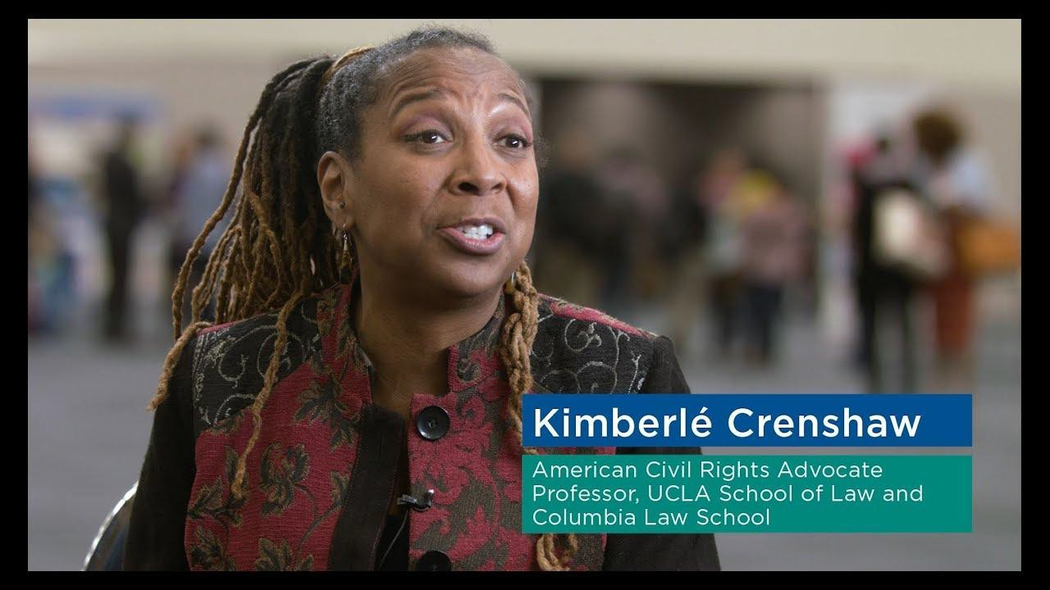
Evaluate for Fairness & Inclusion
Intersectional Evaluation
Create for each (subgroup1, subgroup2, prediction)
pair. Compare across subgroups.
Example: black women, face detection white men, face detection
CC BY / Margaret Mitchell / m-mitchell.com

Slide 70
Evaluate for Fairness & Inclusion: Confusion Matrix
Model Predictions
CC BY / Margaret Mitchell / m-mitchell.com

Slide 71
Evaluate for Fairness & Inclusion: Confusion Matrix
Model Predictions
Positive
Negative
CC BY / Margaret Mitchell / m-mitchell.com

Slide 72
Evaluate for Fairness & Inclusion: Confusion Matrix
Model Predictions
Positive
Negative
Exists
Predicted
True Positives
Doesn’t exist
Not predicted
True Negatives
CC BY / Margaret Mitchell / m-mitchell.com

Slide 73
Evaluate for Fairness & Inclusion: Confusion Matrix
Model Predictions
Positive
Negative
Exists
Predicted
True Positives
Exists
Not predicted
False Negatives
Doesn’t exist
Predicted
False Positives
Doesn’t exist
Not predicted
True Negatives
CC BY / Margaret Mitchell / m-mitchell.com

Slide 74
Evaluate for Fairness & Inclusion: Confusion Matrix
Model Predictions
Positive
Negative
Exists
Predicted
True Positives
Exists
Not predicted
False Negatives
Recall,
False Negative Rate
Doesn’t exist
Predicted
False Positives
Doesn’t exist
Not predicted
True Negatives
False Positive Rate, Specificity
Precision, False Discovery Rate
Negative Predictive Value, False Omission Rate
LR+, LR-
CC BY / Margaret Mitchell / m-mitchell.com

Slide 75
Evaluate for Fairness & Inclusion
Female Patient Results
Male Patient Results
True Positives (TP) = 10 | False Positives (FP) = 1
False Negatives (FN) = 1 | True Negatives (TN) = 488
True Positives (TP) = 6 | False Positives (FP) = 3
False Negatives (FN) = 5 | True Negatives (TN) = 48
Precision = ^{TP} = ¹⁰ = 0.909
TP + FP 10 + 1
Precision =
^{TP} = ⁶ = 0.667
TP + FP 6 + 3
Recall =
TP ₌
¹⁰ = 0.909
Recall =
^{TP} = ⁶ = 0.545
TP + FN 10 + 1
TP + FN 6 + 5
CC BY / Margaret Mitchell / m-mitchell.com

Slide 76
Evaluate for Fairness & Inclusion
Female Patient Results
Male Patient Results
True Positives (TP) = 10 | False Positives (FP) = 1
False Negatives (FN) = 1 | True Negatives (TN) = 488
True Positives (TP) = 6 | False Positives (FP) = 3
False Negatives (FN) = 5 | True Negatives (TN) = 48
Precision = ^{TP} = ¹⁰ = 0.909
TP + FP 10 + 1
Precision =
^{TP} = ⁶ = 0.667
TP + FP 6 + 3
Recall =
TP ₌
¹⁰ = 0.909
Recall =
^{TP} = ⁶ = 0.545
TP + FN 10 + 1
TP + FN 6 + 5
“Equality of Opportunity” fairness criterion: Recall is equal across subgroups
CC BY / Margaret Mitchell / m-mitchell.com

Slide 77
Evaluate for Fairness & Inclusion
Female Patient Results
Male Patient Results
True Positives (TP) = 10 | False Positives (FP) = 1
False Negatives (FN) = 1 | True Negatives (TN) = 488
True Positives (TP) = 6 | False Positives (FP) = 3
False Negatives (FN) = 5 | True Negatives (TN) = 48
Precision = ^{TP} = ¹⁰ = 0.909
TP + FP 10 + 1
Precision =
^{TP} = ⁶ = 0.667
TP + FP 6 + 3
Recall =
TP ₌
¹⁰ = 0.909
Recall =
^{TP} = ⁶ = 0.545
TP + FN 10 + 1
TP + FN 6 + 5
“Predictive Parity” fairness criterion: Precision is equal across subgroups
CC BY / Margaret Mitchell / m-mitchell.com

Slide 78
Choose your evaluation metrics in light of acceptable tradeoffs between
False Positives and False Negatives
CC BY / Margaret Mitchell / m-mitchell.com

Slide 79
False Positives Might be Better than False Negatives
Privacy in Images
False Positive: Something that doesn’t need to be blurred gets blurred.
Can be a bummer.
False Negative: Something that needs to be blurred is not blurred.
Identity theft.

Slide 80
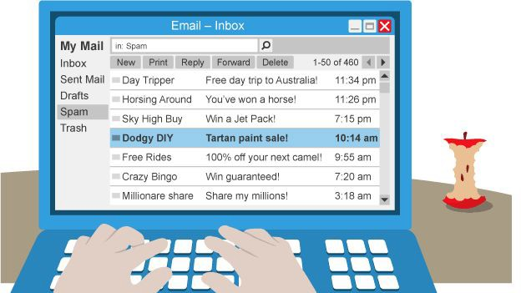
False Negatives Might Be Better than False Positives
Spam Filtering
False Negative: Email that is SPAM is not caught, so you see it in your inbox.
Usually just a bit annoying.
False Positive: Email flagged as SPAM is removed from your inbox.
If it’s from a friend or loved one, it’s a loss!
CC BY / Margaret Mitchell / m-mitchell.com

Slide 81
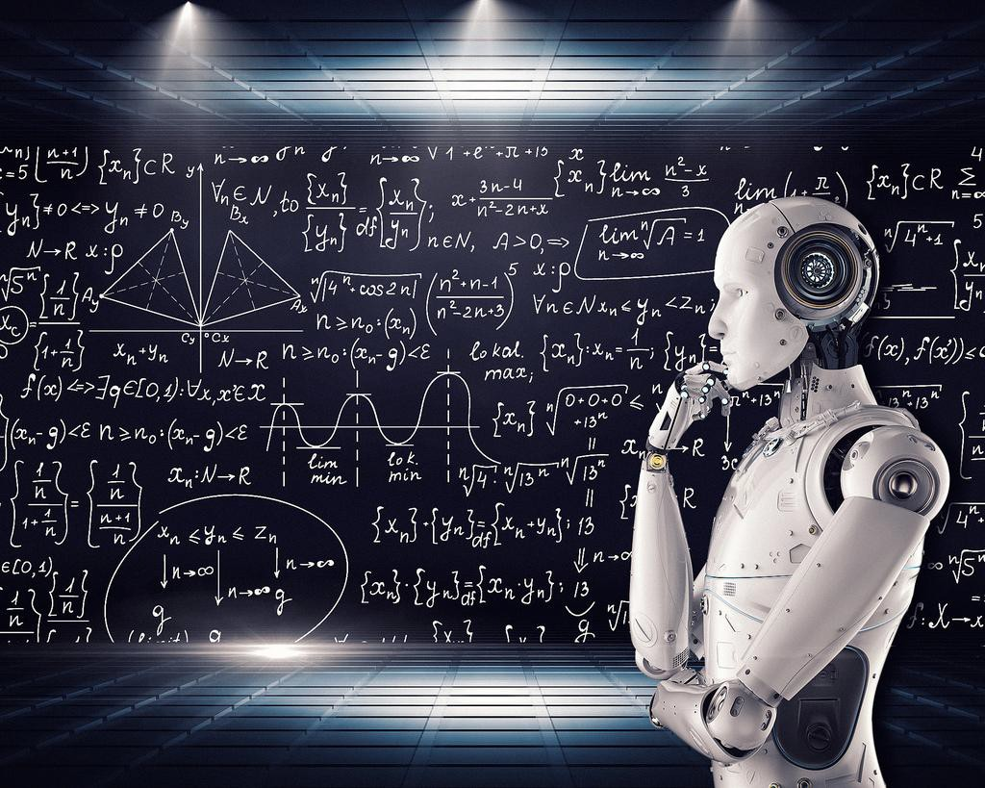
AI Can Unintentionally Lead to Unjust Outcomes
Lack of insight into sources of bias in the data and model
Lack of insight into the
feedback loops
Lack of careful, disaggregated evaluation
Human biases in interpreting and accepting results
CC BY / Margaret Mitchell / m-mitchell.com

Slide 82
It’s up to us to influence how AI evolves.
CC BY / Margaret Mitchell / m-mitchell.com

Slide 83
Global optimum
for humans, their environment, and Artificial Intelligence
Get paper award Get paper published
Today
Short-term
Longer-term
CC BY / Margaret Mitchell / m-mitchell.com

Slide 84
Global optimum
for humans, their environment, and Artificial Intelligence
Get paper award
Get paper published Find local optimum
given task, data, etc
Today
Short-term
Longer-term
CC BY / Margaret Mitchell / m-mitchell.com

Slide 85
Global optimum
for humans, their environment, and Artificial Intelligence
Get paper award
Get paper published, product launched
Find local optimum given task, data, etc
Today
Short-term
Longer-term
CC BY / Margaret Mitchell / m-mitchell.com

Slide 86
Global optimum
for humans, their environment, and Artificial Intelligence
Get paper award, 15 minutes of fame for thing
Get paper published, product launched
Find local optimum given task, data, etc
Today
Short-term
Longer-term
CC BY / Margaret Mitchell / m-mitchell.com

Slide 87
Positive outcomes for humans and their environment.
Get paper award, 15 minutes of fame for thing
Get paper published, product launched
Find local optimum given task, data, etc
Today
Short-term
Longer-term
CC BY / Margaret Mitchell / m-mitchell.com

Slide 88
Begin tracing out paths for the evolution of
ethical AI
Positive outcomes for
humans and their environment.
Get paper award, 15 minutes of fame for thing
Get paper published, product launched
Find local optimum given task, data, etc
How can the work I’m interested in now be best focused to help others?
Today
Short-term
Longer-term
CC BY / Margaret Mitchell / m-mitchell.com

Slide 89
It’s up to us to influence how AI evolves.
Here are some things we can do.
CC BY / Margaret Mitchell / m-mitchell.com

Slide 90
Data
CC BY / Margaret Mitchell / m-mitchell.com

Slide 91
Data Really, Really Matters
Understand your Data: skews, correlations
Abandon single training-set / testing-set from similar distribution
Combine inputs from multiple sources
Use held-out test set for hard use cases
Talk to experts about additional signals
CC BY / Margaret Mitchell / m-mitchell.com

Slide 92
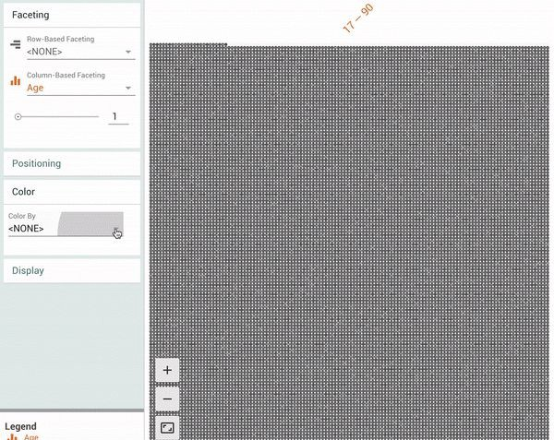
Understand Your Data Skews
Facets: pair-code.github.io
CC BY / Margaret Mitchell / m-mitchell.com

Slide 93
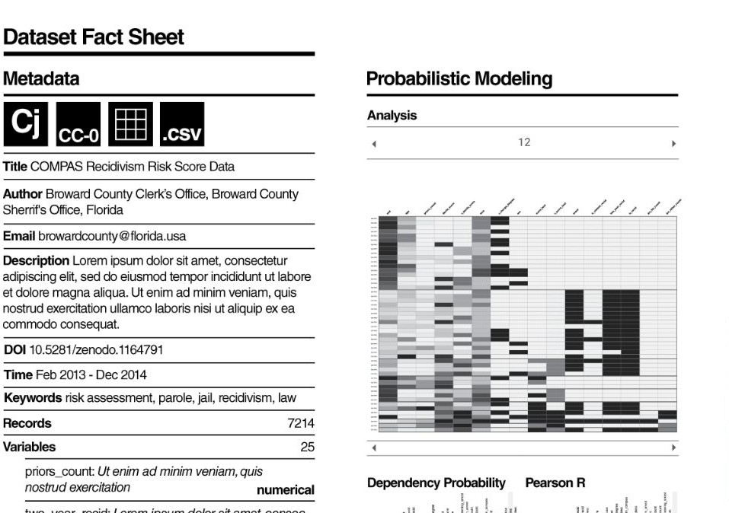
CC BY / Margaret Mitchell / m-mitchell.com

Slide 94
Machine Learning

Slide 95
Use ML Techniques for Bias Mitigation and Inclusion
Bias Mitigation
Removing the signal for problematic output
Stereotyping
Sexism, Racism, *-ism
“Debiasing”
CC BY / Margaret Mitchell / m-mitchell.com

Slide 96
Use ML Techniques for Bias Mitigation and Inclusion
Bias Mitigation
Removing the signal for problematic output
Stereotyping
Sexism, Racism, *-ism
“Debiasing”
Inclusion
Adding signal for desired variables
Increasing model performance
Attention to subgroups or data slices with worst performance
CC BY / Margaret Mitchell / m-mitchell.com

Slide 97
Multi-task Learning to Increase Inclusion

Slide 98
Multiple Tasks + Deep Learning for Inclusion: Multi-task Learning Example
Collaboration with UPenn WWP
Working directly with clinicians
Goals:
System that can alert clinicians if suicide attempt is imminent
Feasibility of diagnoses when few training instances are available
Benton, Mitchell, Hovy. Multi-task learning for Mental Health Conditions with Limited Social Media Data. EACL, 2017.

Slide 99
Multiple Tasks + Deep Learning for Inclusion: Multi-task Learning Example
Internal Data:
Electronic Health Records
Patient or patient family provided
Including mental health diagnoses, suicide attempts, and completions
Social Media data
Proxy Data:
Twitter media data
Proxy mental health diagnoses using self-declared diagnoses in tweets
“I’ve been diagnosed with X”
“I tried to commit suicide”
Benton, Mitchell, Hovy. Multi-task learning for Mental Health Conditions with Limited Social Media Data. EACL, 2017.
CC BY / Margaret Mitchell / m-mitchell.com

Slide 100
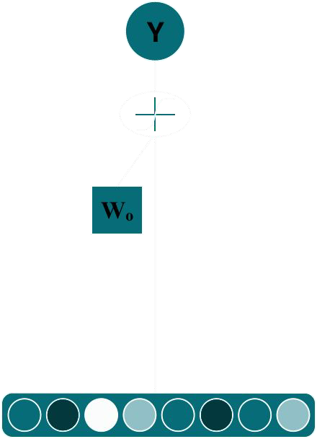
Single-Task: Logistic Regression
CC BY / Margaret Mitchell / m-mitchell.com

Slide 101
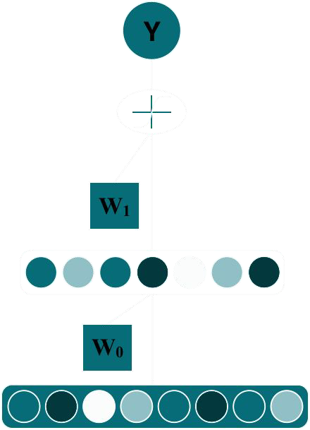
Single-Task: Deep Learning
CC BY / Margaret Mitchell / m-mitchell.com

Slide 102
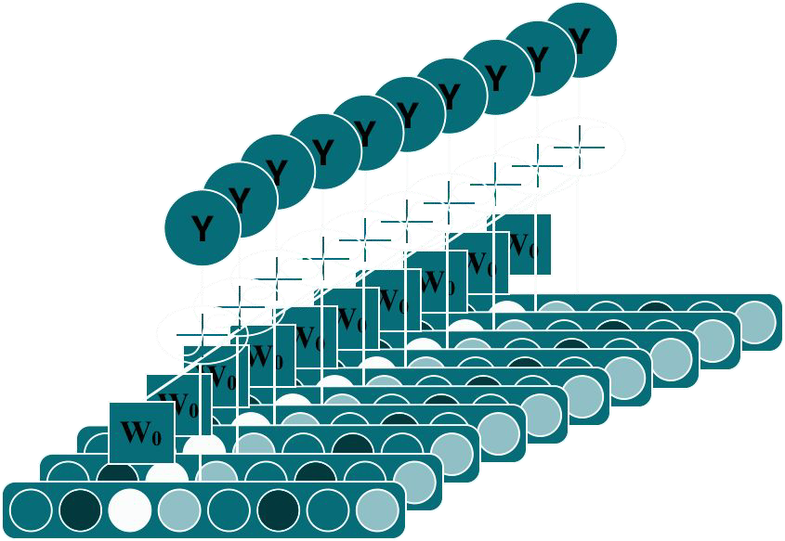
Multiple Tasks with Basic Logistic Regression
CC BY / Margaret Mitchell / m-mitchell.com

Slide 103
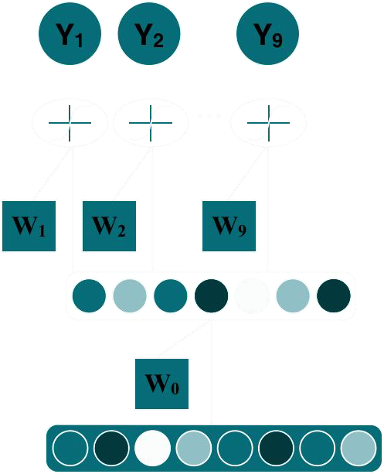
Multi-task Learning
Task 1
Task 2
Task 9
CC BY / Margaret Mitchell / m-mitchell.com

Slide 104
Multi-task Learning
Depression Anxiety
PTSD
Benton, Mitchell, Hovy.
Multi-task learning for Mental Health Conditions with Limited Social Media Data. EACL, 2017.
CC BY / Margaret Mitchell / m-mitchell.com

Slide 105
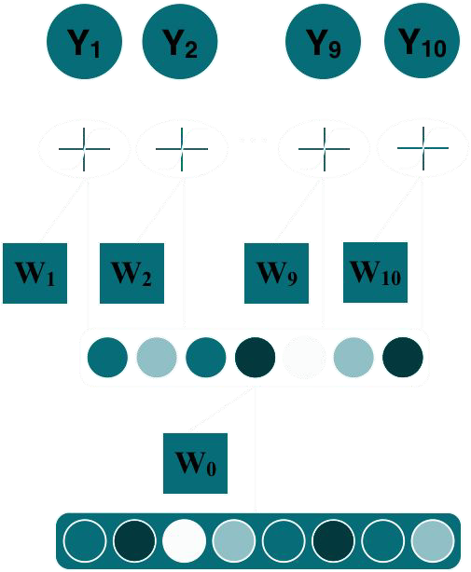
Multi-task Learning
Depression Anxiety
PTSD Gender
Benton, Mitchell, Hovy.
Multi-task learning for Mental Health Conditions with Limited Social Media Data. EACL, 2017.
CC BY / Margaret Mitchell / m-mitchell.com

Slide 106
Multi-task Learning
Multitask, given
cormorbidity
Depression Anxiety
PTSD Gender
Benton, Mitchell, Hovy.
Multi-task learning for Mental Health Conditions with Limited Social Media Data. EACL, 2017.
CC BY / Margaret Mitchell / m-mitchell.com

Slide 107
Improved Performance across Subgroups
0.6
True Positive Rate
@ False
Positive Rate = 0.1
~120 at-risk individuals
0.4
0.2
0.0
Benton, Mitchell, Hovy.
Multi-task learning for Mental Health Conditions with Limited Social Media Data. EACL, 2017.
CC BY / Margaret Mitchell / m-mitchell.com

Slide 108
We sometimes add “auxiliary” tasks to a network to help guide representation learning
Adds more data/labels to learn general representations
Encourages representations to encode information related to additional labels, e.g. adding a gender prediction task encourages final feature layer to more directly encode gender

Slide 109
Adversarial Multi-task Learning to Mitigate Bias

Slide 110
Multitask Adversarial Learning
Z⊥D | Y
Get promoted Gender
Basic idea: Jointly predict:
Output decision D
Attribute you’d like to remove from decision Z
Negate the effect of the undesired attribute
P(Ŷ = 1|Y = 1,Z = 1) = P(Ŷ = 1|Y = 1,Z = 0)
Beutel, Chen, Zhao, Chi. Data Decisions and Theoretical Implications when Adversarially Learning Fair Representations. FAT/ML, 2017.
Zhang, Lemoine, Mitchell. Mitigating Unwanted Biases with Adversarial Learning. AIES, 2018.
CC BY / Margaret Mitchell / m-mitchell.com

Slide 111
Equality of Opportunity in Supervised Learning
A classifier’s output decision should be the same across sensitive characteristics, given what the correct decision should be.
Hardt, Price, Srebro. Equality of Opportunity in Supervised Learning. NIPS, 2016.

Slide 112
Case Study: Conversation AI Toxicity

Slide 113
Measuring and Mitigating Unintended Bias in Text Classification
Lucas Dixon
ldixon@google.com
John Li
jetpack@google.com
Jeffrey Sorensen
sorenj@google.com
Nithum Thain
nthain@google.com
Lucy Vasserman
lucyvasserman@google.com
AIES, 2018 and FAT*, 2019
CC BY / Margaret Mitchell / m-mitchell.com

Slide 114
Conversation-AI
ML to improve online conversations at scale
Research Collaboration
Jigsaw, CAT, several Google-internal teams, and
external partners (NYTimes, Wikimedia, etc)

Slide 115
Perspective API
“You’re a dork!”
Data + ML
Toxicity, Severe Toxicity,
Threat, Off-topic,
+ dozens other models
API
Toxicity: 0.91
perspectiveapi.com
CC BY / Margaret Mitchell / m-mitchell.com

Slide 116
Unintended Bias
Model falsely associates frequently attacked identities with toxicity: False Positive Bias
Sentence
"i'm a proud tall person" "i'm a proud lesbian person" "i'm a proud gay person"
model score
0.18
0.51
0.69

Slide 117
Bias Source and Mitigation
Bias caused by dataset imbalance
Frequently attacked identities are overrepresented in toxic comments
Length matters
Add assumed non-toxic data from Wikipedia articles to fix the imbalance.
Original dataset had 127,820 examples
4,620 non-toxic examples added

Slide 118
Measuring Unintended Bias - Synthetic Datasets
Challenges with real data:
Existing datasets are small and/or have false correlations
Each example is completely unique: not easy to compare for bias
Approach: "bias madlibs": a synthetically generated 'templated' dataset for evaluation
Sentence | model score
"i'm a proud tall person" | 0.18
"i'm a proud lesbian person" | 0.51
"i'm a proud gay person" | 0.69
"audre is a brazilian computer programmer" | 0.02
"audre is a muslim computer programmer" | 0.08
"audre is a transgender computer programmer" | 0.56
CC BY / Margaret Mitchell / m-mitchell.com

Slide 119
Assumptions
Dataset is reliable:
Similar distribution as application
Ignores annotator bias
No causal analysis
CC BY / Margaret Mitchell / m-mitchell.com

Slide 120
Deep Learning Model
CNN architecture
Pretrained GloVe Embeddings
Keras Implementation
Source: Zhang, Y., & Wallace, B. (2015). A sensitivity analysis of (and practitioners' guide to) convolutional neural networks for sentence classification. arXiv preprint arXiv:1510.03820.
CC BY / Margaret Mitchell / m-mitchell.com

Slide 121
Measuring Model Performance
How good is the model at distinguishing good from bad examples? (ROC-AUC)
AUC (for a given test set) = Given two randomly chosen examples, one in-class (e.g. one is toxic and the other is not), AUC is the probability that the model will give the in-class example the higher score.
Toxic Comments
Non-toxic Comments
CC BY / Margaret Mitchell / m-mitchell.com

Slide 122
Measuring Model Performance
How good is the model at distinguishing good from bad examples? (ROC-AUC)
AUC (for a given test set) = Given two randomly chosen examples, one in-class (e.g. one is toxic and the other is not), AUC is the probability that the model will give the in-class example the higher score.
Toxic Comments
Non-toxic Comments
CC BY / Margaret Mitchell / m-mitchell.com

Slide 123
Types of Bias
background
Low Subgroup Performance
The model performs worse on subgroup comments than it does on comments overall.
Toxic Comments
Non-toxic Comments
subgroup
Metric: Subgroup AUC
CC BY / Margaret Mitchell / m-mitchell.com

Slide 124
Types of Bias
background
Subgroup Shift (Right)
The model systematically scores comments from the subgroup higher.
Toxic Comments
Non-toxic Comments
subgroup
Metric: BPSN AUC
(Background Positive Subgroup Negative)
CC BY / Margaret Mitchell / m-mitchell.com

Slide 125
Types of Bias
background
Subgroup Shift (Right)
The model systematically scores comments from the subgroup higher.
Toxic Comments
Non-toxic Comments
subgroup
Metric: BPSN AUC
(Background Positive Subgroup Negative)
CC BY / Margaret Mitchell / m-mitchell.com

Slide 126
Types of Bias
background
Subgroup Shift (Left)
The model systematically scores comments from the subgroup lower.
Toxic Comments
Non-toxic Comments
subgroup
Metric: BNSP AUC
(Background Negative Subgroup Positive)
CC BY / Margaret Mitchell / m-mitchell.com

Slide 127
Types of Bias
background
Subgroup Shift (Left)
The model systematically scores comments from the subgroup lower.
Toxic Comments
Non-toxic Comments
subgroup
Metric: BNSP AUC
(Background Negative Subgroup Positive)
CC BY / Margaret Mitchell / m-mitchell.com

Slide 128
Results
CC BY / Margaret Mitchell / m-mitchell.com

Slide 129
Release Responsibly

Slide 130
Model Cards for Model Reporting
Currently no common practice of reporting how well a model works when it is released
What It Does
How It Works
Why It Matters
A report that focuses on transparency in model performance to encourage responsible AI adoption and application.
It is an easily discoverable and usable artifact presented at important steps of a user journey for a diverse set of users and public stakeholders.
It keeps model developer accountable to release high quality and fair models.
Mitchell et al. Model Cards for Model Reporting. FAT*, 2019.

Slide 131
Intended Use, Factors and Subgroups
Example Model Card - Toxicity in Text
Model Details | Developed by Jigsaw in 2017 as a convolutional neural network trained to predict the likelihood that a comment will be perceived as toxic.
Intended Use | Supporting human moderation, providing feedback to comment authors, and allowing comment viewers to control their experience.
Factors | Identity terms referencing frequently attacked groups focusing on the categories of sexual orientation, gender identity and race.
Mitchell et al. Model Cards for Model Reporting. FAT*, 2019.

Slide 132
Metrics and Data
Metrics | Pinned AUC, which measures threshold-agnostic separability of toxic and non-toxic comments for each group, within the context of a background distribution of other groups.
Evaluation Data | A synthetic test set generated using a template-based approach, where identity terms are swapped into a variety of template sentences.
Training Data | Includes comments from a variety of online forums with crowdsourced labels of whether the comment is “toxic”. “Toxic” is defined as, “a rude, disrespectful, or unreasonable comment that is likely to make you leave a discussion”.
Mitchell et al. Model Cards for Model Reporting. FAT*, 2019.

Slide 133
Considerations, Recommendations
Ethical Considerations | A set of values around community, transparency, inclusivity, privacy and topic-neutrality to guide their work.
Caveats & Recommendations | Synthetic test data covers only a small set of very specific comments. While these are designed to be representative of common use cases and concerns, it is not comprehensive.
Mitchell et al. Model Cards for Model Reporting. FAT*, 2019.

Slide 134
Disaggregated Intersectional Evaluation
CC BY / Margaret Mitchell / m-mitchell.com

Slide 135
Things to remember
Unless actively countered, bias in algorithms is an expected (harmful) outcome, due to bias in the data and people involved in creation and use of the algorithms
Be wary of using algorithms to make decisions about people, e.g. criminality, admissions, hiring
Adding auxiliary tasks in multi-task learning can improve prediction in under-represented groups
Adversarial learning can be used to learn representations that are not predictive of sensitive attributes
Model cards, dataset cards, and intersectional evaluation are used to disclose potential biases and limitations

