Slide 1

Transformers in Vision and Language
Applied Machine Learning
Derek Hoiem
Dall-E

Slide 2
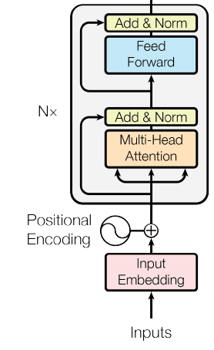
Remember from last class
Learned vector embeddings of these integers model the relationships between words
Stacked transformer blocks are a powerful network architecture that alternates attention and MLPs
Sub-word tokenization based on byte-pair encoding is an effective way to turn natural text into a sequence of integers
Attention is a general processing mechanism that regresses or clusters values
Chair is broken →
ch##, ##air, is, brok##, ##en
Paris – France + Italy = Rome
Input (k,q,v) | iter 1 | iter 2 | iter 3 | iter 4
1.000 | 1.497 | 1.818 | 1.988 | 2.147
9.000 | 8.503 | 8.182 | 8.012 | 7.853
8.000 | 8.128 | 8.141 | 8.010 | 7.853
2.000 | 1.872 | 1.859 | 1.990 | 2.147
Further reading: http://nlp.seas.harvard.edu/annotated-transformer/

Slide 3
Language Transformer: Complete Architecture
WordPiece tokens (integers) are mapped to learned 512-d vectors
Positional encoding added to each vector
N=6 transformer blocks applied to input
Until <EOS> is output:
  Process input + output so far
  Output most likely word (after more attention blocks and linear model)
Cross-Attention
Self-Attention
Self-Attention
Attention is all you need

Slide 4
Application to Translation
English-German
  4.5M sentence pairs
  37K tokens
English-French
  36M sentences
  32K tokens
Base models trained on 8 P100s for 12 hours
Big models (2x token dim, 3x training steps) trained for 3.5 days
Adam optimizer: learning rate ramps up for 4K iterations, then down
Regularization: drop-out, L2 weight, label smoothing
Cross-Attention
Self-Attention
Self-Attention
Attention is all you need

Slide 5
Results

Slide 8
Transformers: general data processors
Input tokens can represent anything: image patches, text tokens, audio, controls, etc.
Invariant to order of tokens: add positional embedding to distinguish pos/type of input
Transformer block:
  Apply multi-head attention
  Apply 2-layer MLP with ReLU to each token separately
  Residual and layer norm (over all tokens) after each
Can stack any number of transformer blocks
Attention is all you need

Slide 9
Today’s Lecture
BERT: Large Language Model
  Language model
ViT (Vision Transformer): Image classification
Unified-IO: Sequence-to-sequence vision-language

Slide 10
BERT (Devlin et al. 2019)
https://arxiv.org/abs/1810.04805

Slide 11
Why is BERT worth knowing about? (according to Chat GPT)
BERT (Bidirectional Encoder Representations from Transformers) is worth knowing about because it represents a significant breakthrough in natural language processing (NLP) technology.
Before BERT, NLP models typically processed text in a unidirectional manner, meaning they would only look at words to the left or right of the target word to try to understand its meaning. BERT, on the other hand, is a bidirectional model, which means it considers the entire context of a word, including the words that come before and after it. This allows BERT to better understand the meaning of a sentence and make more accurate predictions about what might come next.
BERT is also pre-trained on large amounts of text data, which allows it to generate high-quality, contextually relevant representations of words and phrases. These pre-trained models can then be fine-tuned on specific NLP tasks, such as sentiment analysis, question answering, or language translation, to achieve state-of-the-art results.
Overall, BERT has revolutionized the field of NLP and has led to significant improvements in language understanding and natural language generation tasks. As such, it is an important technology to be aware of for anyone working in NLP or interested in the development of artificial intelligence more broadly.

Slide 12
Overview of BERT
Uses standard transformer blocks
  Base: 12 layers, 768-dim, 12 heads; 110M parameters
  Large: 24 layers, 1024-dim, 16 heads; 340M parameters
WordPiece: 30K tokens
  Special [CLS] and [SEP] tokens
  Positional and sentence embeddings
Pre-trained with masked language modeling (MLM) and next sentence prediction
Fine-tuned for other tasks

Slide 13
BERT: Input representation
WordPiece: 30K tokens
  Special tokens
    [CLS] at start to encode sentence summary
    [SEP] to separate sentences or question and answer
  Positional and sentence embeddings

Slide 14
Pre-training with masked language modeling (MLM)
Randomly select 15% of text tokens to be “masked” and predicted by based on surrounding tokens
Masked tokens are replaced by
  [MASK] token (80% of the time)
  Random token (10%)
  Unchanged token (10%)
Only masked tokens are predicted
Masking example:
[cls] My dog is cute [sep] He likes play ##ing [sep]
[cls] [MASK] dog is grave [sep] He likes play ##ing [sep]

Slide 15
Pre-training with next sentence prediction
Input is two sentences A and B
Replace B with a random sentence 50% of the time
Predict whether B is the original sentence or not (via [CLS] token)

Slide 16
Pre-training and fine-tuning
Pre-train on MLM and NSP tasks
  BooksCorpus: 800M words
  English Wikipedia: 2.5B words
  Important to use full documents, not just shuffled sentences
  BERT_{BASE} trained on 16 TPU chips; BERT_{LARGE} on 64 chips; 4 days each
Fine-tune on each task, takes a few hours on a GPU
  Paraphrasing
  Entailment
  Question answering
  …

Slide 17
BERT results
SQuAD: question answering dataset
GLUE: General Language Understanding Evaluation – many tasks
MNLI: whether a sentence entails, contradicts, or is unrelated to another
QQP: whether two sentences are semantically equivalent
QNLI: question answering
SST-2: positive or negative sentiment
CoLA: whether sentence is grammatically correct
STS-B: sentence similarity score
MRPC: whether one sentence paraphrases another
RTE: whether a sentence entails a hypothesis

Slide 18
Key Take-aways from BERT
Bi-directional masked language modeling is highly effective pre-training
  Does not require supervision
  Learns general representations
Same idea has been adopted for vision, but with much higher masking ratio (~80% of patches masked)

Slide 19
ViT: Vision Transformers (Dosovitskiy et al. 2021)
https://arxiv.org/abs/2010.11929

Slide 20
Why is ViT worth knowing about?
(Chat GPT answer was mostly accurate but not very helpful)
Shows that the same exact Transformer blocks can be used for vision, paving the way for multimodal processing
Transformers work about as well as CNNs but are more computationally efficient

Slide 21
ViT Overview
Image is divided into patches (e.g., 16x16)
Each patch projects into a fixed length vector
Positional encoding added to each patch
Extra [class] token to encode image summary
Multiple layers of standard transformer (same as for language)
For classification, final prediction is linear layer applied to [class] token

Slide 22
Different size models, same pretraining
Same model, different pretraining dataset
Big convolutional networks
$30K
$120K

Slide 23
Information is integrated among distant patches

Slide 24
CNNs vs. Transformers
CNNs encode position as an index in the feature map. Transforms do not care about index order but encode positional embeddings
  Surprisingly, even when positional embeddings are not used, transformer models still work well
CNNs encode a bias that nearby pixels are most related
  Transformers enable combining information from distant patches, with positional embedding providing a weak prior to consider nearby patches
  CNNs can only use information in neighboring pixels/cells, but the receptive field (pixel area considered) grows larger as network gets deeper
In practice, CNNs and Transformers perform similarly for pure vision tasks, but Transformers are faster to train
  Hybrids are possible, e.g. apply shallow CNN before first patch embedding
Transformers operate on “tokens”, which is very general and can be applied to any modality

Slide 25
Unified-IO: <text, image> to <text, image> (Lu et al. 2022)
3B parameters
Pre-train on masked text and image completion for text, images, and image/caption pairs
Multitask training on 80 datasets
Unified-IO (June 2022)
https://unified-io.allenai.org/

Slide 26
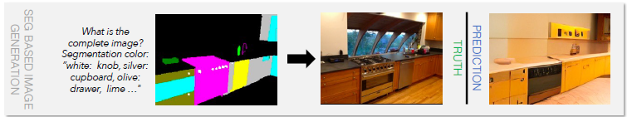
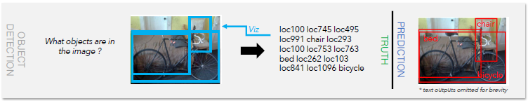
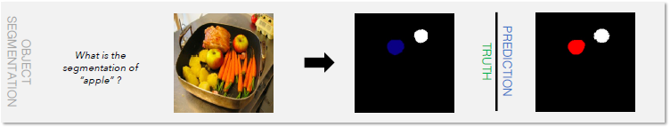
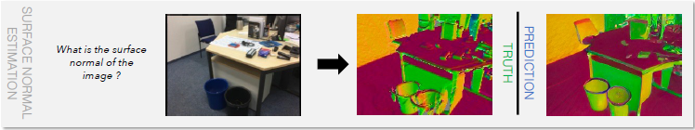
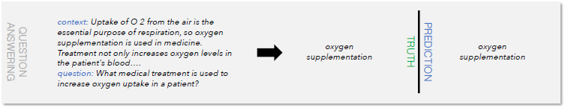
Vision tasks
Image synthesis from text / inpainting / segmentation
Image/object classification
Object detection, segmentation, keypoint estimation
Depth/normal estimation
Vision-language tasks
VQA, image/region captioning, referring expressions comprehension, relationship detection
NLP tasks
Question answering
Text classification

Slide 27
State-of-Art on GRIT

Slide 28
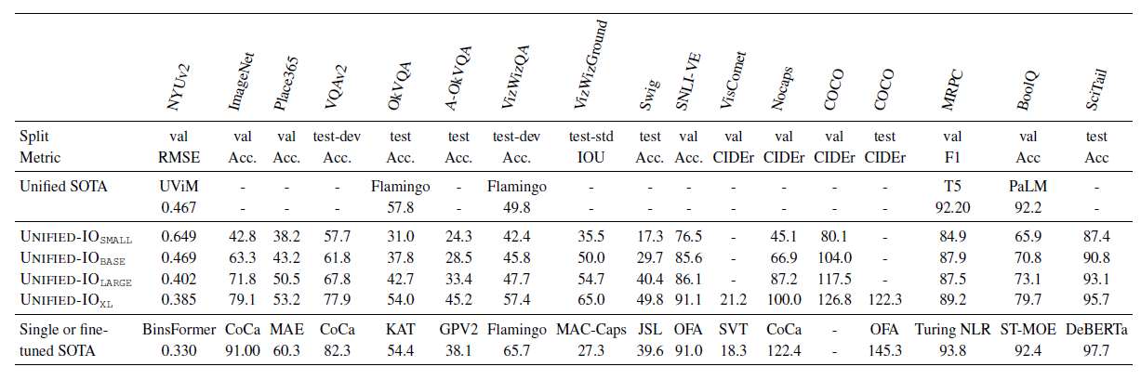
Often performs similarly or better than SotA single-task models

Slide 29
Explore demo
https://unified-io.allenai.org/

Slide 30
HW 3
https://docs.google.com/document/d/1f3O7RKvBKk1n15aISehYRxCHCh-ExPaDN6Ijqpgw0aY/edit?usp=sharing

Slide 31
Things to remember
Transformers are general data processors, applicable to text, vision, audio, control, and other domains
Pre-training to generate missing tokens in unsupervised text data learns a general model that can be fine-tuned
  Same idea is also applicable to other domains
Transformer architectures are state-of-art for vision and language individually
Arguably, the biggest benefit of transformers is ability to combine information from multiple domains

Slide 32
Next class: Foundation Models
GPT-3
CLIP

