Slide 1
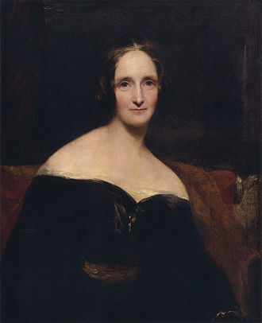
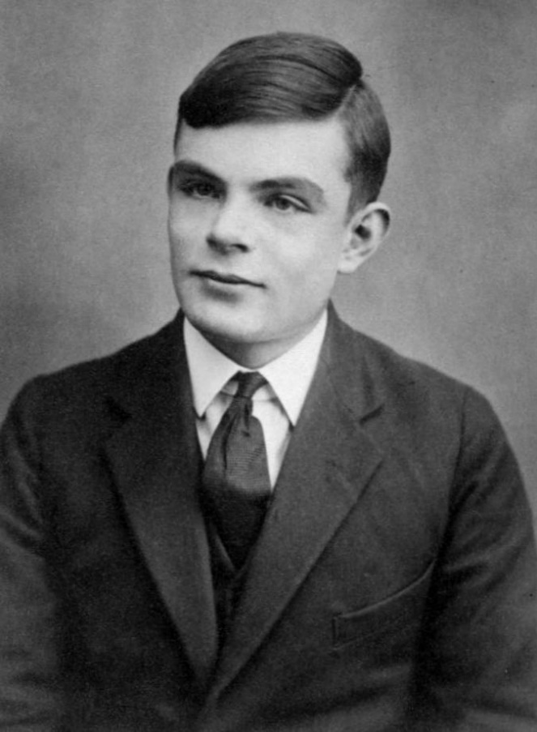
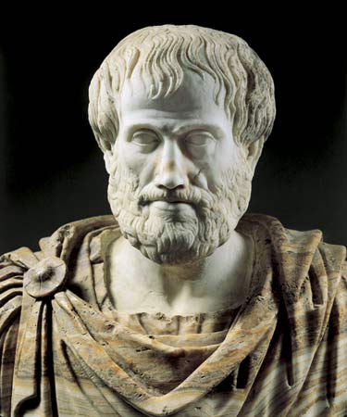
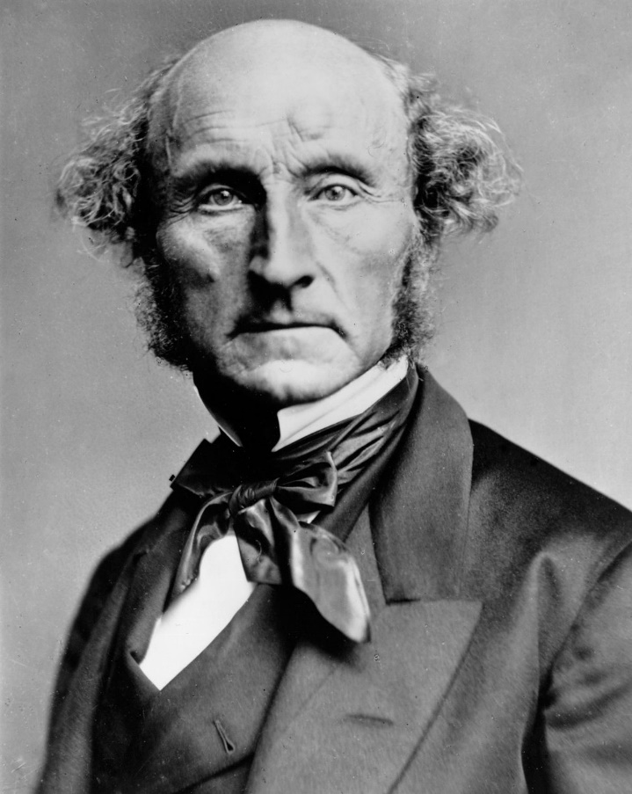
CS440/ECE448: Artificial Intelligence Lecture 1: What is AI?

Slide 2
CS440/ECE448 Lecture 1: What is AI?
Administration: Overview of the Syllabus
A two-bit summary of the philosophy of AI
Thinking like a Human
Acting like a Human
Thinking Rationally
Acting Rationally

Slide 3
1. Administrative Questions
Web page
How is this course graded?
Policies
How can I get help?

Slide 4
Web page
http://courses.engr.Illinois.edu/cs440/

Slide 5
How is this course graded?
40%: Exams
Mostly from the slides. The page http://courses.engr.Illinois.edu/cs440/lectures.html includes sample problems from the textbook.
60%: MPs (Mini-Projects)
Each MP is designed to require about 19 hours of work, including ~14 hours of thinking/ coding/ debugging and ~5 hours of waiting for your computer. Seriously. We really do target 19 hours.
You can work in teams of up to 3, only if it helps you. Software management exercise.

Slide 6
Policies
Late MPs:
Only if every member of your team has an emergency documented by the emergency dean.
If no emergency, penalty is 10% per day.
No homework accepted more than 7 days late.
DO THE HOMEWORK. Even partly, even 6 days late. If you miss ONE MP, you will probably not pass.
Plagiarism
Please DO search online to find good ideas.
Please LEARN THE IDEAS, don’t COPY THE CODE.
Graders will read on-line code repos before grading your MP.

Slide 7
How Can I Get Help?
Office Hours:
ECEB 5034. Times listed here: https://courses.engr.illinois.edu/ece448/sp2018/homework.html
Piazza:
https://piazza.com/class/jc8mft43dmb4gu
Teaching staff will check piazza at least once/day
Fellow students strongly encouraged to give good answers. Extra credit may be given for useful piazza answers.
DON’T post code on piazza, either for questions or for answers. You can post pseudo-code if you want.
Wikipedia etc: Often very useful. See previous slide.

Slide 8
2. A two-bit summary of the philosophy of AI

Slide 9
What is Artificial Intelligence?
Artificial (adj., Wiktionary): Man-made, i.e., constructed by means of skill or specialized art.
Intelligence (noun, Wiktionary): Capacity of mind to understand meaning, acquire knowledge, and apply it to practice.
Artificial Intelligence (implied by above): capacity of a man-made system to understand, acquire, and apply knowledge.

Slide 10
What is Artificial Intelligence?
Candidate definitions from the textbook:
1. Thinking humanly | 2. Acting humanly
3. Thinking rationally | 4. Acting rationally

Slide 11
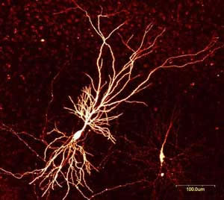
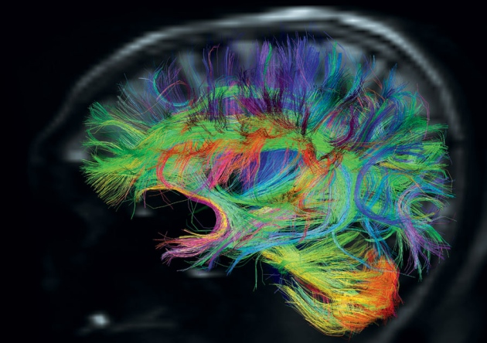
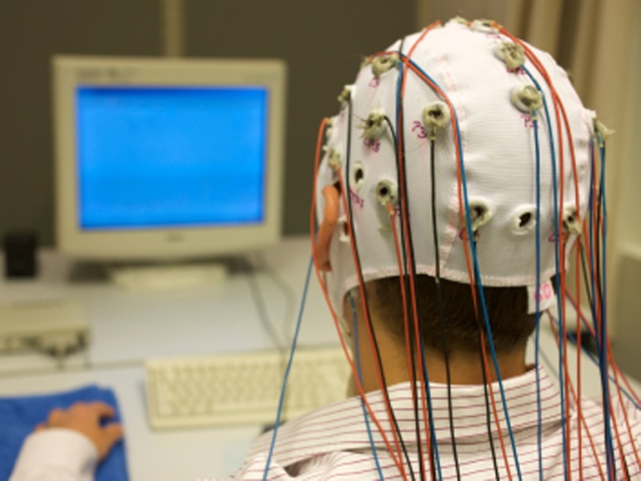
3. Thinking like a Human
Mary Shelley, author of Frankenstein: The Modern Prometheus; Neuron, showing branching of the dendrites; EEG cap; Cortical connectivity map, computed using diffusion tensor MRI

Slide 12
How many computations/second?
Hodgkin-Huxley neuron:
Neural computations are binary. Each neuron is either generating an action potential, or not.
Action potentials at rates between 1Hz and 1000Hz (1 to 1000 times/second)
Each neuron’s action potential is communicated to a set of other neurons --- usually 100-1000 other neurons.

Slide 13
Suppose the brain has 100 trillion neurons. How many binary computations per second can the brain perform?

Slide 14
Modern neuroimaging techniques
EEG (electro-encephalography)
Good temporal resolution: ~1000 samples/second
Poor spatial resolution: ~128 channels for the whole brain. “EEG activity therefore always reflects the summation of the synchronous activity of thousands or millions of neurons that have similar spatial orientation.”
fMRI (functional magnetic resonance imaginge)
Better spatial resolution: ~1mm/voxel, ~2000 voxels/brain (vs. 100 trillion neurons)
Poor temporal resolution: ~2 seconds/sample
ECOG (electrocorticography)
Spatial resolution of fMRI + temporal resolution of EEG
Only for the part of the brain that has been surgically revealed, for a living thinking human.

Slide 15
The best supercomputers perform far more computations/second than the human brain. If that’s true, why have we not yet duplicated a human brain?

Slide 16
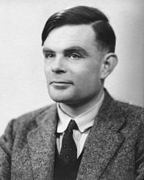
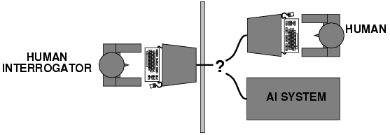
4. Acting like a Human
Schematic of the Turing test; Alan Turing

Slide 17
The Turing Test
Alan Turing, “Intelligent Machinery,” 1947:
It is not difficult to devise a paper machine which will play a not very bad game of chess. Now get three men as subjects for the experiment. A, B and C. A and C are to be rather poor chess players, B is the operator who works the paper machine. Two rooms are used with some arrangement for communicating moves, and a game is played between C and either A or the paper machine. C may find it quite difficult to tell which he is playing.
We now ask the question, “What will happen when a machine takes the part of A in this game?” Will the interrogator decide wrongly as often when the game is played like this as he does when the game is played between a man and a woman? These questions replace our original, “Can machines think?”

Slide 18
What capabilities would a computer need to have to pass the Turing Test?
Natural language processing
Knowledge representation
Automated reasoning
Machine learning
Turing predicted that by the year 2000, machines would be able to fool 30% of human judges for five minutes
A. Turing, Computing machinery and intelligence, Mind 59, pp. 433-460, 1950

Slide 19
What’s wrong with the Turing test?
Variability in protocols, judges
Success depends on deception!
Chatbots can do well using “cheap tricks”
First example: ELIZA (1966)
Javascript implementation of ELIZA

Slide 20
A better Turing test?
Winograd schema: Multiple choice questions that can be easily answered by people but cannot be answered by computers using “cheap tricks”
The trophy would not ﬁt in the brown suitcase because it was so small. What was so small?
The trophy
The brown suitcase
H. Levesque, On our best behaviour, IJCAI 2013
http://www.newyorker.com/online/blogs/elements/2013/08/why-cant-my-computer-understand-me.html

Slide 21
A better Turing test?
Winograd schema: Multiple choice questions that can be easily answered by people but cannot be answered by computers using “cheap tricks”
The trophy would not ﬁt in the brown suitcase because it was so large. What was so large?
The trophy
The brown suitcase
H. Levesque, On our best behaviour, IJCAI 2013
http://www.newyorker.com/online/blogs/elements/2013/08/why-cant-my-computer-understand-me.html

Slide 22
Winograd schema
Advantages over standard Turing test
Test can be administered and graded by machine
Scoring of the test does not depend on human subjectivity
Machine does not require ability to generate English sentences
Questions cannot be evaded using verbal “tricks”
Questions can be made “Google-proof” (at least for now…)
Winograd schema challenge
Held at IJCAI conference in July 2016
Six entries, best system got 58% of 60 questions correct (humans get 90% correct)

Slide 23
Sample questions
In what way can it be said that a machine that passes the Turing test is intelligent?
In what way can it be said that a machine that passes the Turing test is _not_ intelligent?
Give a few reasons why the Winograd schema is a better test of intelligence than the Turing test

Slide 24
AI definition 3: Thinking rationally
Aristotle, 384-322 BC

Slide 25
AI definition 3: Thinking rationally
Idealized or “right” way of thinking
Logic: patterns of argument that always yield correct conclusions when supplied with correct premises
“Socrates is a man; all men are mortal; therefore Socrates is mortal.”
Logicist approach to AI: describe problem in formal logical notation and apply general deduction procedures to solve it

Slide 26
Syllogism
Syllogism = a logical argument that applies deductive reasonining to arrive at a conclusion based on two or more propositions that are asserted to be true.
Example Problem (you should know this from binary logic classes):
Given: $p⇒q$
Given: $q⇒r$
Given: $q$ is false
Which of the following are true?
$p$ is true
$p$ is false
$r$ is true
$r$ is false

Slide 27
Successes of Logicist Approach: Expert Systems
Expert system = (knowledge base) + (logical rules)
Knowledge base = database of examples
Logical rules = easy to deduce from examples, and easy to verify by asking human judges
Combination of the two: able to analyze never-before-seen examples of complicated problems, and generate an answer that is often (but not always) correct
Expert systems = commercial success in the 1970s
Radiology, geology, materials science expert systems advised their human users
Dating services (match users based on hobbies, etc.)

Slide 28
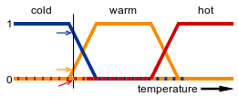
Successes of Logicist Approach: Fuzzy Logic
Logic operations
Category Labels
(cold, warm, hot)
Real numbers
(e.g.,room temperature)
If cold then
turn up the thermostat.
If hot then
turn down the thermostat.
By fullofstars - original (gif): Image:Warm fuzzy logic member function.gif, CC BY-SA 3.0, https://commons.wikimedia.org/w/index.php?curid=2870420
Real numbers (e.g., thermostat temperature)
Category Labels
(up, down)

Slide 29
Successes of Logicist Approach: Fuzzy Logic
Example: speed control system of the https://en.wikipedia.org/wiki/Sendai_Subway_Namboku_Line. “This system (developed by Hitachi) accounts for the relative smoothness of the starts and stops when compared to other trains, and is 10% more energy efficient than human-controlled acceleration.”

Slide 30
Failures of Logicist Approach: Fragility, and the “AI Winter”
Expert systems/fuzzy logic work if the number of rules you have to program is small and finite.
The law of the out-of-vocabulary word: No matter how many words are in your dictionary, there are words you missed.
Empirical proof: Hasegawa-Johnson, Elmahdy & Mustafawi, “Arabic Speech and Language Technology,” 2017
Implication: no matter how carefully you design the rules for your expert system, there will be real-world situations that it doesn’t know how to handle.
This is a well-known problem with expert systems, called “fragility”
Corporations and governments reacted to fragility by reducing funding of AI, from about 1966-2009. This was called the “AI Winter.”

Slide 31
Failures of Logicist Approach: Humans don’t think logically.
https://dilbert.com/strip/2019-01-08

Slide 32
AI definition 4: Acting rationally
John Stuart Mill, 1806-1873

Slide 33
AI definition 4: Acting rationally
A rational agent acts to optimally achieve its goals
Goals are application-dependent and are expressed in terms of the utility of outcomes
Being rational means maximizing your (expected) utility
This definition of rationality only concerns the decisions/actions that are made, not the cognitive process behind them
An unexpected step: rational agent theory was originally developed in the field of economics
Norvik and Russell: “most people think Economists study money. Economists think that what they study is the behavior of rational actors seeking to maximize their own happiness.”

Slide 34
Utility maximization formulation: Advantages
Generality: goes beyond explicit reasoning, and even human cognition altogether
Practicality: can be adapted to many real-world problems. Avoids philosophy and psychology.
Solvability: Amenable to good scientific and engineering methodology
For all of these reasons, this course will usually adopt this definition: An “artificial intelligence” is a machine that acts rationally (reasons out a plan of action) in order to maximize some measure of utility (a measure of how good is the resulting situation)
Notes:
Disadvantages: it may be hard to formulate utility functions, especially for complex open-ended tasks. Has limited applicability to humans.

Slide 35
Utility maximization formulation: Disadvantages
Practical disadvantages: can a machine act rationally in order to achieve a desirable outcome? Why or why not?
* Some problems only have vacuous solutions
Finite resources (compute time, memory)
Biased training data: real world is not what expected
Real world randomness/unpredictability
Programmer might not know how to calculate the answer
Theoretical disadvantages: should a machine act rationally in order to achieve a desirable outcome? Why or why not?
Not if it’s acting against human interests
Special circumstances, e.g., conflicting goals; subvert the usual rules to achieve an outcome that’s uniquely desirable right now
People are not rational; conversational agent might not be always rational either
Notes:
Disadvantages: it may be hard to formulate utility functions, especially for complex open-ended tasks. Has limited applicability to humans.

Slide 36
What is Artificial Intelligence?
1. Thinking humanly | 2. Acting humanly
3. Thinking rationally | 4. Acting rationally

