Slide 1
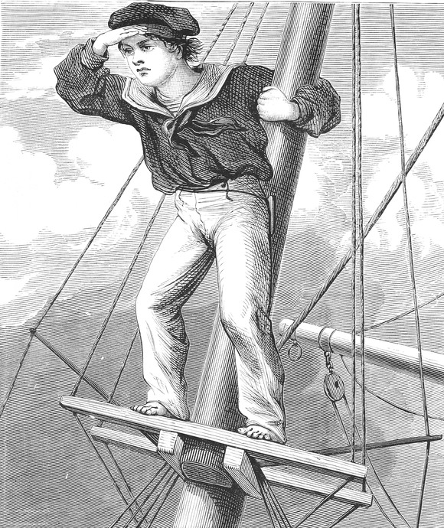
Lecture 5: Search informed by lookahead heuristics: Greedy, Admissible A*, Consistent A*
Mark Hasegawa-Johnson, January 2019
With some slides by Svetlana Lazebnik, 9/2016
Distributed under CC-BY 3.0
Title image: By Harrison Weir - From reuseableart.com, Public Domain, https://commons.wikimedia.org/w/index.php?curid=47879234

Slide 2
Outline of lecture
Search heuristics
Greedy best-first search: minimum h(n)
Nearly-A*: f(n)=h(n)+g(n)
A*: Optimal search
Bad interaction between A* and the explored set
Dijkstra = A* with h(n)=0
Designing heuristics: Relaxed problem, Sub-problem, Dominance

Slide 3
Review: DFS and BFS
Depth-first search
LIFO: expand the deepest node (farthest from START)
Pro: reach the end of the path as quickly as possible (space is $O\{bm\}$). Good if there are many paths to goal.
Con: not optimal, or even complete. Time is $O\{b^{m}\}$.
Breadth-first search
FIFO: expand the shallowest node (closest to START)
Pro: complete and optimal. Time is $O\{b^{d}\}$
Con: no path is found until the best path is found. Space is $O\{b^{d}\}$.

Slide 4
Why don’t we just measure…
Instead of FARTHEST FROM START (DFS):
why not choose the node that’s CLOSEST TO GOAL?

Slide 5
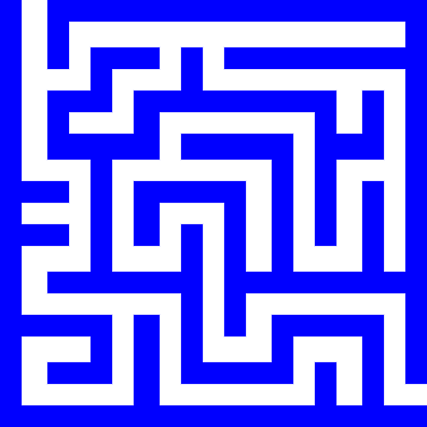
Why not choose the node CLOSEST TO GOAL?
Answer: because we don’t know which node that is!!
Example: which of these two is closest to goal?
Start state
Goal state

Slide 6
We don’t know which state is closest to goal
Finding the shortest path is the whole point of the search
If we already knew which state was closest to goal, there would be no reason to do the search
Figuring out which one is closest, in general, is a complexity $O\left\{b^{d}\right\}$ problem.
Start state
Goal state

Slide 7
Search heuristics: estimates of distance-to-goal
Often, even if we don’t know the distance to the goal, we can estimate it.
This estimate is called a heuristic.
A heuristic is useful if:
Accurate: $h(n) ≈d(n)$, where $h(n)$ is the heuristic estimate, and $d(n)$ is the true distance to the goal
Cheap: It can be computed in complexity less than $O\left\{b^{d}\right\}$
Start state
Goal state

Slide 8
Example heuristic: Manhattan distance
If there were no walls, this would be the path to goal: straight down, then straight right.
If there were no walls in the maze, then the number of steps from position $(x_{n},y_{n})$ to the goal position $(x_{G},y_{G})$ would be
$$h(n)=|x_{n}−x_{G}|+|y_{n}−y_{G}|$$
Start state
$$y_{n}$$
$$y_{G}$$
Goal state
$$x$$
$$x_{n}$$
$$x_{G}$$

Slide 9
Outline of lecture
Search heuristics
Greedy best-first search: minimum h(n)
Nearly-A*: f(n)=h(n)+g(n)
A*: Optimal search
Bad interaction between A* and the explored set
Dijkstra = A* with h(n)=0
Designing heuristics: Relaxed problem, Sub-problem, Dominance

Slide 10
Greedy Best-First Search
Instead of FARTHEST FROM START (DFS):
why not choose the node whose
HEURISTIC ESTIMATE
indicates that it might be
CLOSEST TO GOAL?

Slide 11
Greedy Search Example
According to the Manhattan distance heuristic, these two nodes are equally far from the goal, so we have to choose one at random.
Start state
Goal state

Slide 12
Greedy Search Example
If our random choice goes badly, we might end up very far from the goal.
= states in the explored set
= states on the frontier
Start state
Goal state

Slide 13
The problem with Greedy Search
Having gone down a bad path, it’s very hard to recover, because now, the frontier node closest to goal (according to the Manhattan distance heuristic) is this one:
Start state
Goal state

Slide 14
The problem with Greedy Search
That’s not a useful path…
Start state
Goal state

Slide 15
The problem with Greedy Search
Neither is that one…
Start state
Goal state

Slide 16
What went wrong?

Slide 17
Outline of lecture
Search heuristics
Greedy best-first search: minimum h(n)
Nearly-A*: f(n)=h(n)+g(n)
A*: Optimal search
Bad interaction between A* and the explored set
Dijkstra = A* with h(n)=0
Designing heuristics: Relaxed problem, Sub-problem, Dominance

Slide 18
The problem with Greedy Search
Among nodes on the frontier, this one seems closest to goal (smallest $h(n)$, where $h(n)≈d(n)$).
But it’s also farthest from the start. Let’s say $g(n)$ = total path cost so far.
So the total distance from start to goal, going through node $n$, is
$$c(n)=g\left(n\right)+d\left(n\right)≈g\left(n\right)+h(n)$$
Start state
Goal state

Slide 19
The problem with Greedy Search
Of these three nodes, this one has the smallest $g\left(n\right)+h(n)$.
So if we want to find the lowest-cost path, then it would be better to try that node, instead of this one.
Start state
Goal state

Slide 20
Smart Greedy Search
In fact, let’s back up. Already, at this point in the search, this node has the smallest $g\left(n\right)+h(n)$.
Start state
Goal state

Slide 21
Smart Greedy Search
So we move forward along THAT path instead, until we reach this point, where all three nodes have the same $g\left(n\right)+h(n)$.
Start state
Goal state

Slide 22
Smart Greedy Search
Moving forward on all three paths…
Start state
Goal state

Slide 23
Smart Greedy Search
All of the new star nodes here had EXACTLY THE SAME value of $g\left(n\right)+h\left(n\right)=34$.
Now these four circles, shown here, are the new frontier, the set of nodes with $g\left(n\right)+h\left(n\right)=35$
Start state
v
v
v
v
v
vv
vv
vv
vv
vv
vv
vv
vv
vv
v
vv
vv
vv
vv
vv
vv
vv
v
vv
vv
vv
vv
vv
vv
vv
vv
vv
vv
vv
vv
vv
vv
vv
vv
vv
vv
vv
v
v
vv
v
vv
Goal state

Slide 24
Smart Greedy Search
$$g\left(n\right)+h\left(n\right)=36$$
Start state
v
v
v
v
v
vv
vv
vv
vv
vv
vv
vv
vv
v
vv
v
vv
vv
vv
vv
vv
v
vv
vv
vv
vv
vv
vv
vv
vv
vv
vv
vv
vv
vv
vv
vv
vv
vv
vv
vv
v
v
vv
v
vv
Goal state

Slide 25
Smart Greedy Search
$$g\left(n\right)+h\left(n\right)=37$$
Start state
v
v
v
v
v
vv
vv
vv
vv
vv
vv
vv
vv
v
vv
v
vv
vv
vv
vv
vv
v
vv
vv
vv
vv
vv
vv
vv
vv
vv
vv
vv
vv
vv
vv
vv
vv
vv
vv
vv
vv
vv
vv
vv
vv
vv
vv
v
v
vv
v
vv
Goal state

Slide 26
Smart Greedy Search
$$g\left(n\right)+h\left(n\right)=41$$
Start state
v
v
v
v
v
vv
vv
vv
vv
vv
vv
vv
vv
v
vv
v
vv
vv
vv
vv
vv
v
vv
vv
vv
vv
vv
vv
vv
vv
vv
vv
vv
vv
vv
vv
vv
vv
vv
vv
vv
vv
vv
vv
vv
vv
vv
vv
vv
vv
vv
vv
vv
vv
v
v
vv
v
vv
Goal state

Slide 27
And so on…
I’m going to stop using this maze, at this point, because this maze was designed (by an author on Wikipedia) to be uniquely bad for A* search. A* search, on this maze, is just as bad as BFS.
Usually, A* search is much better than BFS. But not always.
Notes:
Dates back to 1968

Slide 28
“Almost-A* Search”
Idea: avoid expanding paths that are already expensive
The evaluation function f(n) is the estimated total cost of the path through node n to the goal:
f(n) = g(n) + h(n)
g(n): cost so far to reach n (path cost)
h(n): estimated cost from n to goal (heuristic)
This is called A* search if and only if the heuristic, h(n), is admissible. That’s a term I’ll define a few slides from now. But first, let’s look at an example where A* is much better than BFS.
Notes:
Dates back to 1968

Slide 29
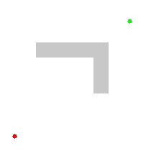
BFS vs. A* Search The heuristic h(n)=Manhattan distance favors nodes on the main diagonal. Those nodes all have the same g(n)+h(n), so A* evaluates them first.
Source: Wikipedia

Slide 30
Outline of lecture
Search heuristics
Greedy best-first search: minimum h(n)
Nearly-A*: f(n)=h(n)+g(n)
A*: Optimal search
Bad interaction between A* and the explored set
Dijkstra = A* with h(n)=0
Designing heuristics: Relaxed problem, Sub-problem, Dominance

Slide 31
Problems with “Almost-A*”
“Almost-A*” search looks pretty good! So are we done?
There’s one more problem. What, exactly, do we mean by the squiggly lines in these two equations:
Distance from n to Goal is “approximately” h(n):
$$d(n) ≈h(n)$$
Total cost of the path through n is “approximately” g(n)+h(n)
$$c(n)≈g\left(n\right)+h(n)$$

Slide 32
Problems with “Almost A*”
$$c\left(m\right)$$
m
S
G
n
$$g\left(n\right)$$
$$≈h\left(n\right)$$
Suppose we’ve found one path to $G$; the path goes through node $m$. Since we’ve calculated the whole path, we know its total path cost to be $c\left(m\right).$
Suppose that, for every other node on the frontier $\left(n\right)$, we have
$$h\left(n\right)+g\left(n\right)>c\left(m\right)$$
Does that mean that $c\left(m\right)$ is really the best path?
No!! Because all we know is that $c(n)≈g\left(n\right)+h(n)$.
“Approximately” allows the possibility that $c\left(n\right)<g\left(n\right)+h(n)$.
Therefore it’s possible that $c(n)<c\left(m\right)$.

Slide 33
Admissible heuristic
$$c\left(m\right)$$
m
S
G
n
$$g\left(n\right)$$
$$≥h\left(n\right)$$
We want to guarantee that
$$c\left(n\right)≥g\left(n\right)+h(n)$$
Then if we can find a best path, $m$, such that for every node $n$ left on the frontier,
$$h\left(n\right)+g\left(n\right)≥c(m)$$
Then we are guaranteed that there is no better node. We are guaranteed that for every node $n$ that is not on the path $m$,
$$c(n)≥h\left(n\right)+g\left(n\right)≥c(m)$$

Slide 34
Admissible heuristic
$$c\left(m\right)$$
m
S
G
n
$$g\left(n\right)$$
$$≥h\left(n\right)$$
Remember that the total path cost is $c\left(n\right)=g\left(n\right)+d(n)$. So in order to guarantee that
$$c\left(n\right)≥g\left(n\right)+h(n)$$
we just need
$$d(n)≥h\left(n\right)$$
Definition: A heuristic $h\left(n\right)$ is admissible if $d(n)≥h\left(n\right)$, i.e., if the heuristic is guaranteed to be less than or equal to the remaining path cost from node n to the goal state.

Slide 35
A* Search
$$c\left(m\right)$$
m
S
G
n
$$g\left(n\right)$$
$$≥h\left(n\right)$$
Definition: A* SEARCH
If $h\left(n\right)$ is admissible $(d(n)≥h\left(n\right))$, and
if the frontier is a priority queue sorted according to $g\left(n\right)+h(n)$, then
the FIRST path to goal uncovered by the tree search, path $m$, is guaranteed to be the SHORTEST path to goal
($h\left(n\right)+g\left(n\right)≥c(m)$ for every node $n$ that is not on path $m$)

Slide 36
Example A* Search: Manhattan Distance
Manhattan distance is guaranteed to be less than or equal to the true path to goal
Therefore, “smart greedy” search with Manhattan distance heuristic = A* Search

Slide 37
Outline of lecture
Search heuristics
Greedy best-first search: minimum h(n)
Smart greedy: f(n)=h(n)+g(n)
A*: Optimal search
Bad interaction between A* and the explored set
Dijkstra = A* with h(n)=0
Designing heuristics: Relaxed problem, Sub-problem, Dominance

Slide 38
Bad interaction between A* and the explored set
Frontier
S: g(n)+h(n)=2, parent=none
Explored Set
Select from the frontier: S

Slide 39
Bad interaction between A* and the explored set
Frontier
A: g(n)+h(n)=5, parent=S
B: g(n)+h(n)=2, parent=S
Explored Set
S
Select from the frontier: B

Slide 40
Bad interaction between A* and the explored set
Frontier
A: g(n)+h(n)=5, parent=S
C: g(n)+h(n)=4, parent=B
Explored Set
S, B
Select from the frontier: C

Slide 41
Bad interaction between A* and the explored set
Frontier
A: g(n)+h(n)=5, parent=S
G: g(n)+h(n)=6, parent=C
Explored Set
S, B, C
Select from the frontier: A

Slide 42
Bad interaction between A* and the explored set
Frontier
G: g(n)+h(n)=6, parent=C
Now we would place C in the frontier, with parent=A and h(n)+g(n)=3, except that C was already in the explored set!
Explored Set
S, B, C
Select from the frontier: Would be C, but instead it’s G

Slide 43
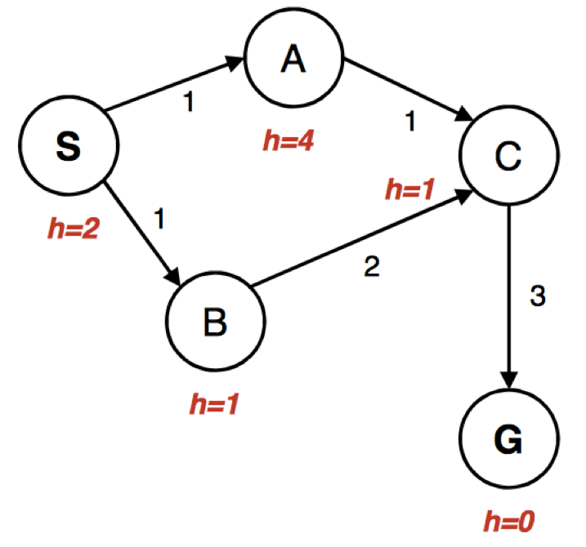
Bad interaction between A* and the explored set
Return the path S,B,C,G
Path cost = 6
OOPS

Slide 44
Bad interaction between A* and the explored set: Three possible solutions
Don’t use an explored set
This option is OK for any finite state space, as long as you check for loops.
Nodes on the explored set are tagged by their h(n)+g(n). If you find a node that’s already in the explored set, test to see if the new h(n)+g(n) is smaller than the old one.
If so, put the node back on the frontier
If not, leave the node off the frontier
Use a heuristic that’s not only admissible, but also consistent.

Slide 45
Consistent (monotonic) heuristic
g$\left(m\right)$
$$d\left(m\right)−d(p)$$
m
S
p
n
$$g\left(n\right)$$
$$d\left(n\right)−d(p)$$
$$≥h\left(n\right)−h(p)$$
Definition: A consistent heuristic is one for which, for every pair of nodes in the graph, $d\left(n\right)−d(p)≥h\left(n\right)−h\left(p\right)$.
In words: the distance between any pair of nodes is greater than or equal to the difference in their heuristics.

Slide 46
A* with an inconsistent heuristic
Frontier
A: g(n)+h(n)=5, parent=S
C: g(n)+h(n)=4, parent=B
Explored Set
S, B
Select from the frontier: C

Slide 47
A* with a consistent heuristic
Frontier
A: g(n)+h(n)=2, parent=S
C: g(n)+h(n)=4, parent=B
Explored Set
S, B
Select from the frontier: A
h=1

Slide 48
A* with a consistent heuristic
Frontier
.
C: g(n)+h(n)=2, parent=A
Explored Set
S, B, A
Select from the frontier: C
h=1

Slide 49
A* with a consistent heuristic
Frontier
.
G: g(n)+h(n)=5, parent=C
Explored Set
S, B, A, C
Select from the frontier: G
h=1

Slide 50
How consistency works
g$\left(m\right)$
$$d\left(m\right)−d(p)$$
m
S
p
n
$$g\left(n\right)$$
? $≥h\left(n\right)−h(p)$
Suppose that, on the best path from start to node $p$, node $m$ is $p$’s parent, and say that $d\left(m)−d(p\right)$ is the distance between them. Then the distance from start to node $p$ is
$$g\left(p\right)=g\left(m\right)+(d\left(m)−d(p)\right)≤g\left(n\right)+(d\left(n)−d(p\right))$$
Definition: A consistent heuristic is one for which, for every pair of nodes in the graph, $d\left(n)−d(p\right)≥h\left(n\right)−h\left(p\right)$.
Implication:
$$g\left(p\right)≥g\left(m\right)+\left(h\left(m)−h(p\right)\right)$$
$$g\left(p\right)+h(p)≥g\left(m\right)+h(m)$$
$g\left(p\right)+h\left(p\right)$ is monotonically non-decreasing along the path!! So it is guaranteed that node m is expanded before node p. (We have no such guarantees about node n).
By the time node p is popped from the frontier, it might have been inserted onto the frontier by many different paths. Each path uses the same h(p), but computes a different g(p). The shortest one (through node m) is guaranteed to already be on the frontier by that time, and is guaranteed to have inserted the best g(p).

Slide 51
Bad interaction between A* and the explored set: Three possible solutions
Don’t use an explored set.
This works for the MP!
If you find a node that’s already in the explored set, test to see if the new h(n)+g(n) is smaller than the old one.
Most students find that this is the most computationally efficient solution to the multi-dots problem.
Use a consistent heuristic.
This works for the single-dot problem, because Manhattan distance is a consistent heuristic.

Slide 52
Outline of lecture
Search heuristics
Greedy best-first search: minimum h(n)
Smart greedy: f(n)=h(n)+g(n)
A*: Optimal search
Bad interaction between A* and the explored set
Dijkstra = A* with h(n)=0
Designing heuristics: Relaxed problem, Sub-problem, Dominance

Slide 53
The trivial case: h(n)=0
A heuristic is admissible if and only if $d(n)≥h\left(n\right)$ for every $n$.
A heuristic is consistent if and only if $d\left(n,p\right)≥h\left(n\right)−h\left(p\right)$ for every $n$ and $p$.
Both criteria are satisfied by $h\left(n\right)=0.$

Slide 54
Dijkstra = A* with h(n)=0
Suppose we choose $h\left(n\right)=0$
Then the frontier is a priority queue sorted by
$$g\left(n\right)+h\left(n\right)=g(n)$$
In other words, the first node we pull from the queue is the one that’s closest to START!! (The one with minimum $g\left(n\right)$).
So this is just Dijkstra’s algorithm!

Slide 55
Outline of lecture
Search heuristics
Greedy best-first search: minimum h(n)
Smart greedy: f(n)=h(n)+g(n)
A*: Optimal search
Bad interaction between A* and the explored set
Dijkstra = A* with h(n)=0
Designing heuristics: Relaxed problem, Sub-problem, Dominance

Slide 56
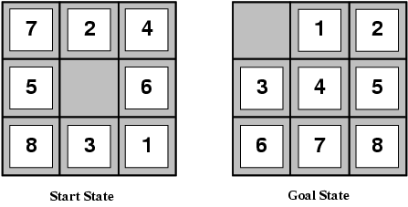
Designing heuristic functions Now we start to see things that actually resemble the multi-dot problem…
Heuristics for the 8-puzzle
h₁(n) = number of misplaced tiles
h₂(n) = total Manhattan distance (number of squares from desired location of each tile)
h₁(start) = 8
h₂(start) = 3+1+2+2+2+3+3+2 = 18
Are h₁ and h₂ admissible?

Slide 57
Heuristics from relaxed problems
A problem with fewer restrictions on the actions is called a relaxed problem
The cost of an optimal solution to a relaxed problem is an admissible heuristic for the original problem
If the rules of the 8-puzzle are relaxed so that a tile can move anywhere, then h₁(n) gives the shortest solution
If the rules are relaxed so that a tile can move to any adjacent square, then h₂(n) gives the shortest solution

Slide 58
Heuristics from subproblems This is also a trick that many students find useful for the multi-dot problem.
Let h₃(n) be the cost of getting a subset of tiles (say, 1,2,3,4) into their correct positions
Can precompute and save the exact solution cost for every possible subproblem instance – pattern database
If the subproblem is O{9^4}, and the full problem is O{9^9}, then you can solve as many as 9^5 subproblems without increasing the complexity of the problem!!

Slide 59
Dominance
If h₁ and h₂ are both admissible heuristics and h₂(n) ≥ h₁(n) for all n, (both admissible) then h₂ dominates h₁
Which one is better for search?
A* search expands every node with f(n) < C* or h(n) < C* – g(n)
Therefore, A* search with h₁ will expand more nodes = h₁ is more computationally expensive.

Slide 60
Dominance
Typical search costs for the 8-puzzle (average number of nodes expanded for different solution depths):
d=12 BFS expands 3,644,035 nodes A*(h₁) expands 227 nodes A*(h₂) expands 73 nodes
d=24 BFS expands 54,000,000,000 nodes A*(h₁) expands 39,135 nodes A*(h₂) expands 1,641 nodes

Slide 61
Combining heuristics
Suppose we have a collection of admissible heuristics h₁(n), h₂(n), …, h_{m}(n), but none of them dominates the others
How can we combine them?
h(n) = max{h₁(n), h₂(n), …, h_{m}(n)}

Slide 62
All search strategies. C*=cost of best path.
Algorithm | Complete? | Optimal? | Time complexity | Space complexity | Implement the Frontier as a…
BFS | Yes | If all step costs are equal | O(b^d) | O(b^d) | Queue
DFS | No | No | O(b^m) | O(bm) | Stack
IDS | Yes | If all step costs are equal | O(b^d) | O(bd) | Stack
UCS | Yes | Yes | Number of nodes w/ g(n) ≤ C* | Number of nodes w/ g(n) ≤ C* | Priority Queue sorted by g(n)
Greedy | No | No | Worst case: O(b^m) Best case: O(bd) | Worse case: O(b^m) Best case: O(bd) | Priority Queue sorted by h(n)
A* | Yes | Yes | Number of nodes w/ g(n)+h(n) ≤ C* | Number of nodes w/ g(n)+h(n) ≤ C* | Priority Queue sorted by h(n)+g(n)

