Slide 1
Physical Layer
CS 438: Spring 2014
Instructor: Matthew Caesar
http://courses.engr.illinois.edu/cs438/

Slide 2
Course Outline
~ Apr 16
L7
Application
~ Mar 21
Transport
L4
~ Feb 26
L3
Network
~ Feb 15
Data link
L2
Today
L1
Physical

Slide 3
Outline for Today
Today: The Physical Layer
How to encode data over a link
How to detect and correct errors

Slide 4
A Brief Overview of Physical Media

Slide 5
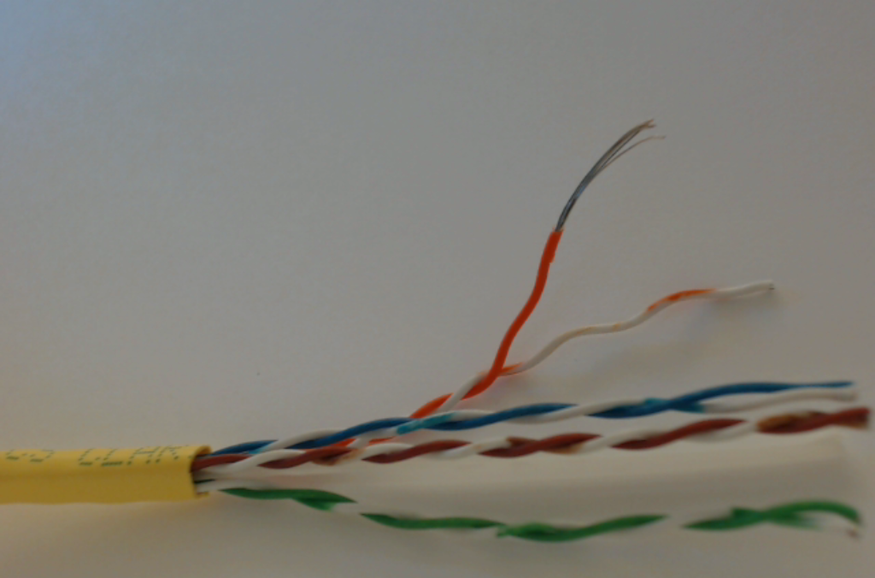
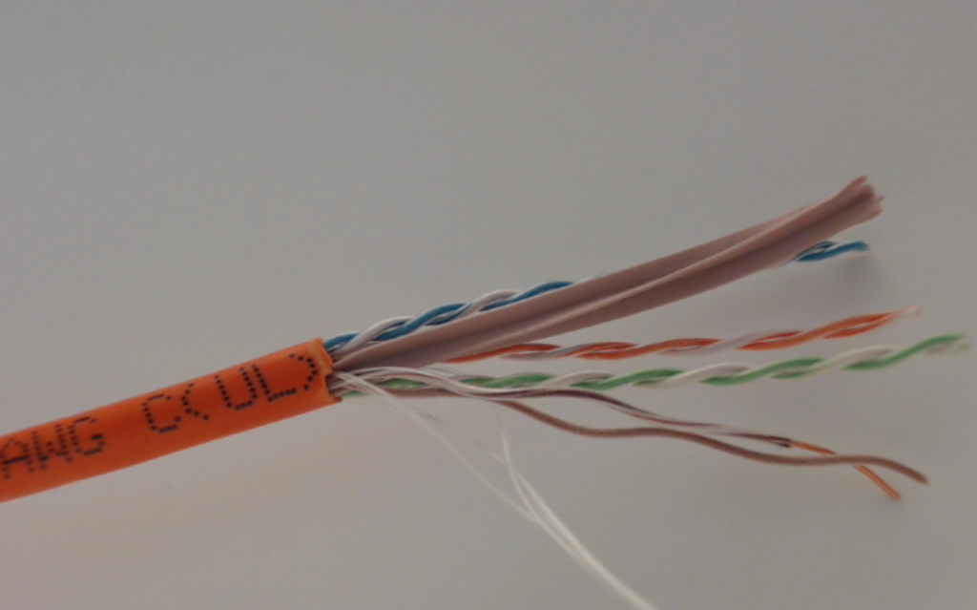
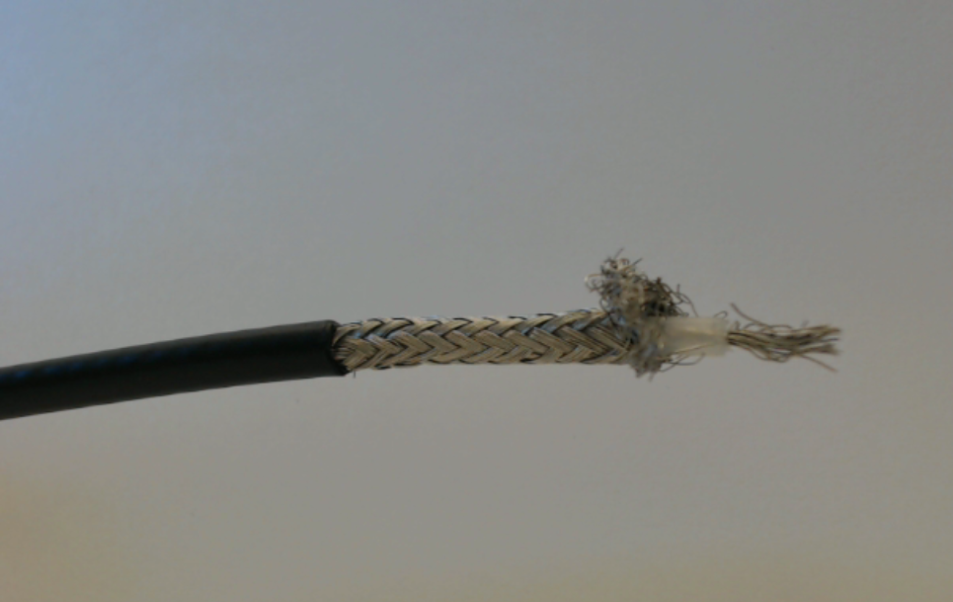
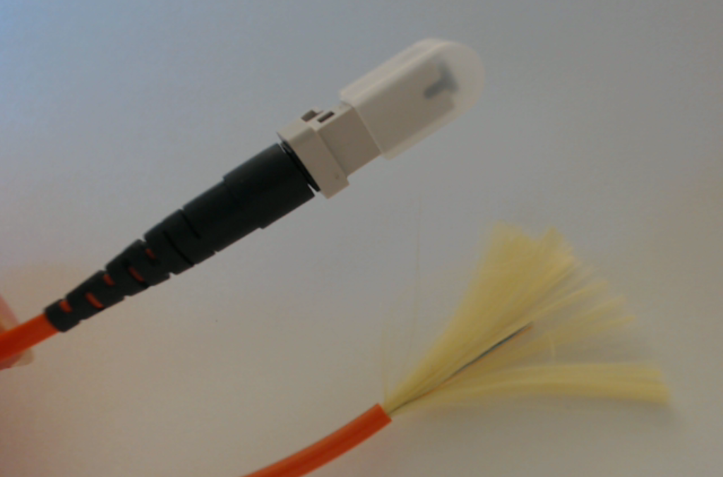

Slide 6
Links - Copper
Copper-based Media
  Category 3 Twisted Pair up to 100 Mbps
  Category 5 Twisted Pair 10-100Mbps 100m
  ThinNet Coaxial Cable 10-100Mbps 200m
  ThickNet Coaxial Cable 10-100Mbps 500m
more twists, less crosstalk, better signal over longer distances
twisted pair
copper core
insulation
braided outer conductor
outer insulation
coaxial
cable
(coax)
More expensive than twisted pair
High bandwidth and excellent noise immunity
CS/ECE 438
6

Slide 7
Links - Optical
Optical Media
  Multimode Fiber 100Mbps 2km
  Single Mode Fiber 100-2400Mbps 40km
glass core (the fiber)
glass cladding
plastic jacket
optical
fiber
CS/ECE 438
7

Slide 8
Links - Optical
Single mode fiber
  Expensive to drive (Lasers)
  Lower attenuation (longer distances) ≤ 0.5 dB/km
  Lower dispersion (higher data rates)
Multimode fiber
  Cheap to drive (LED’s)
  Higher attenuation
  Easier to terminate
core of single mode fiber
~1 wavelength thick = ~1 micron
core of multimode fiber (same frequency; colors for clarity)
O(100 microns) thick
CS/ECE 438
8

Slide 9
Encoding

Slide 10
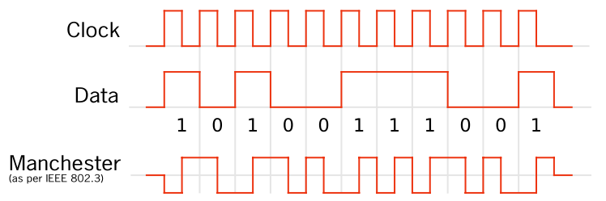
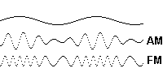
How can two hosts communicate?
Carrier signal
Carrier signal
0.7 Volts
-0.7 Volts
Encode data as variations in electrical/light/EM
  Phase, frequency, and signal strength modulation, and combinations thereof
  Simple scheme: voltage encoding
    Encode 1’s and 0’s as variations in voltage
    How to do that?
Notes:
Let’s start by considering the simplest case: we want to send some information between two hosts
Well, as we all know, computers store info as bits. So computers can communicate by transmitting bits as a series of electromagnetic pulses, over a wire connecting the two machines.
Variety of ways to do this: can vary
You could use silence interspersed with pusles, but then the problem is the two endpoints may get desync’d from one another.
Typical way to do this is to use some sort of “carrier signal”, which is a periodic waveform, and then that waveform is modulated in some way to carry information, for example by varying its amplitude/power, or its frequency/pitch, or its phase/timing.
And so by doing this, we can send information between two machines.
Many technologies can carry this signal, can be copper, optical, or wireless. Anything that can carry a signal. There’s even audio in the case of modems.
(aside: twisted pair, right hand rule… used to cancel out crosstalk.
--------
Twisting wires decreases interference because the loop area between the wires (which determines the magnetic coupling into the signal) is reduced. In balanced pair operation, the two wires typically carry equal and opposite signals (differential mode) which are combined by addition at the destination. The common-mode noise from the two wires (mostly) cancel each other in this addition because the two wires have similar amounts of EMI that are 180 degrees out of phase. This results in the same effect as subtraction. Differential mode also reduces electromagnetic radiation from the cable, along with the attenuation that it causes.
10

Slide 11
Non-Return to Zero (NRZ)
Signal to Data
  High ⇨ 1
  Low ⇨ 0
Comments
  Transitions maintain clock synchronization
  Long strings of 0s confused with no signal
  Long strings of 1s causes baseline wander
  Both inhibit clock recovery
Bits
0
0
1
0
1
1
1
1
0
1
0
0
0
0
1
0
NRZ
CS/ECE 438
11

Slide 12
Non-Return to Zero Inverted (NRZI)
Signal to Data
  Transition ⇨ 1
  Maintain ⇨ 0
Comments
  Solves series of 1s, but not 0s
Bits
0
0
1
0
1
1
1
1
0
1
0
0
0
0
1
0
NRZ
NRZI
CS/ECE 438
12

Slide 13
Manchester Encoding
Signal to Data
  XOR NRZ data with clock
  High to low transition ⇨ 1
  Low to high transition ⇨ 0
Comments
  Used by old 10Mbps Ethernet
  Solves clock recovery problem
  Only 50% efficient ( ½ bit per transition)
Bits
0
0
1
0
1
1
1
1
0
1
0
0
0
0
1
0
NRZ
Clock
Manchester
CS/ECE 438
13

Slide 14
4B/5B
Signal to Data
  Encode every 4 consecutive bits as a 5 bit symbol
Symbols
  At most 1 leading 0
  At most 2 trailing 0s
  Never more than 3 consecutive 0s
  Transmit with NRZI
Comments
  16 of 32 possible codes used for data
  At least two transitions for each code
  80% efficient
  Used by old 100Mbps Ethernet
  Variation (64B/66B) used by modern 10Gbps Ethernet

Slide 15
4B/5B – Data Symbols
  At most 1 leading 0
  At most 2 trailing 0s
0000 ⇒ 11110
0001 ⇒ 01001
0010 ⇒ 10100
0011 ⇒ 10101
0100 ⇒ 01010
0101 ⇒ 01011
0110 ⇒ 01110
0111 ⇒ 01111
1000 ⇒ 10010
1001 ⇒ 10011
1010 ⇒ 10110
1011 ⇒ 10111
1100 ⇒ 11010
1101 ⇒ 11011
1110 ⇒ 11100
1111 ⇒ 11101
CS/ECE 438
15
Notes:
If you put these back to back, you’ll never have 3 0s in a row

Slide 16
4B/5B – Control Symbols
CS/ECE 438
16
11111 ⇒ idle
11000 ⇒ start of stream 1
10001 ⇒ start of stream 2
01101 ⇒ end of stream 1
00111 ⇒ end of stream 2
00100 ⇒ transmit error
Other ⇒ invalid
Notes:
A nice thing about this approach is it also gives you some extra codes that you can use for control
You can have an idle code/star of stream code
Idle code of 1 is nice, bc it gives you transitions you need for sync

Slide 17
Binary Voltage Encodings
CS/ECE 438
17
Problem with binary voltage (square wave) encodings
  Wide frequency range required, implying
    Significant dispersion
    Uneven attenuation
  Prefer to use narrow frequency band (carrier frequency)
Types of modulation
  Amplitude (AM)
  Frequency (FM)
  Phase/phase shift
  Combinations of these
  Used in wireless Ethernet, optical communications
Notes:
Problem with binary encodings is tha tyou need pretty wide frequencies
Takes some time to get to +15
Quite a bit of dispersion, and there’s attenuation too
What I mean by this is
if I have a carrier signal, I can check amplitude to tell diff

Slide 18
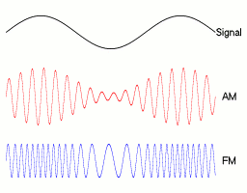
Example:
AM/FM for continuous signal
Original signal
Amplitude modulation
Frequency modulation

Slide 19
Amplitude Modulation
idle
1
0
CS/ECE 438
19

Slide 20
Frequency Modulation
idle
1
0
CS/ECE 438
20

Slide 21
Phase Modulation
idle
1
0
CS/ECE 438
21

Slide 22
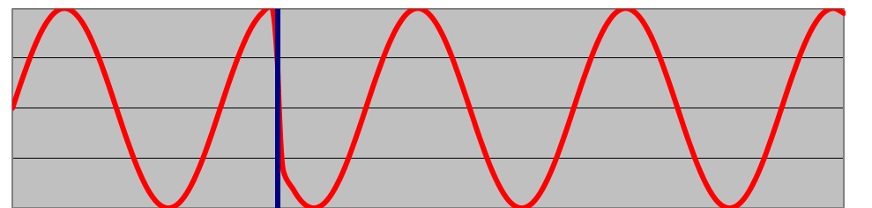
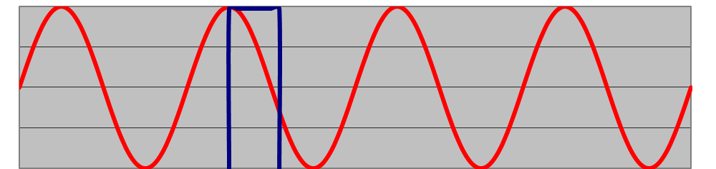
Phase Modulation
phase shift
in carrier
frequency
180º difference in phase
collapse for 180º shift
CS/ECE 438
22

Slide 23
Phase Modulation Algorithm
Send carrier frequency for one period
  Perform phase shift
  Shift value encodes symbol
    Value in range [0, 360º)
    Multiple values for multiple symbols
    Represent as circle
8-symbol
example
90º
135º
45º
180º
0º
225º
315º
270º
CS/ECE 438
23
Notes:
How do we use these shifts to create symbols and bits?
what’s nice about 8 symbols?
I can xfer 3 bits per symbol

Slide 24
You can combine modulation schemes
Example: QAM (Quadrature Amplitude Modulation)
For a given symbol:
Perform phase shift and change to new amplitude
2-dimensional representation:
  Angle is phase shift
  Radial distance is new amplitude
45º
15º
24
Notes:
TODO: can we get a pic of a real constellation from oscilloscope, to see noise around it?

Slide 25
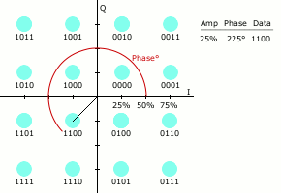
QAM: Example transmission

Slide 26
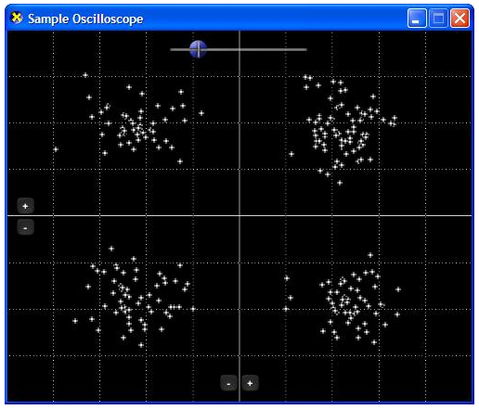
Real constellation with noise

Slide 27
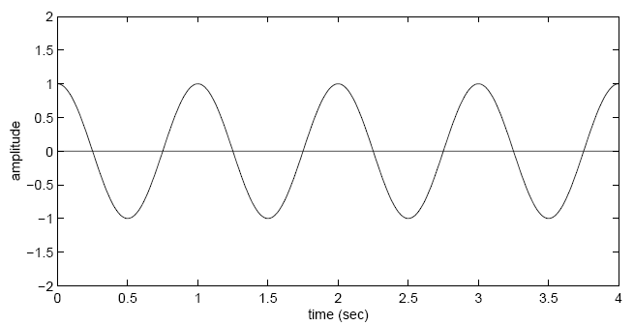
Sampling
Suppose you have the following 1Hz signal being received
How fast to sample, to capture the signal?

Slide 28
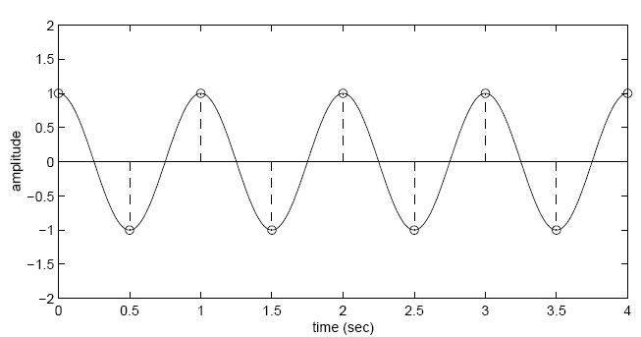
Sampling
Sampling a 1 Hz signal at 2 Hz is enough
  Captures every peak and trough

Slide 29
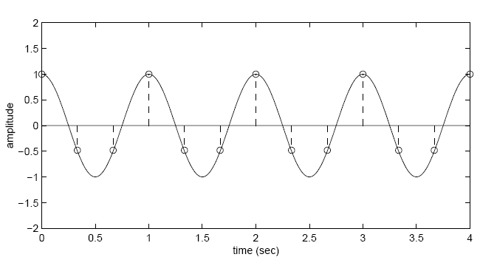
Sampling
Sampling a 1 Hz signal at 3 Hz is also enough
  In fact, more than enough samples to capture variation in signal

Slide 30
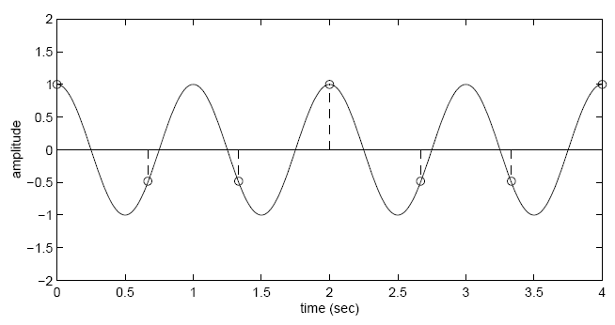
Sampling
Sampling a 1 Hz signal at 1.5 Hz is not enough
  Why?

Slide 31
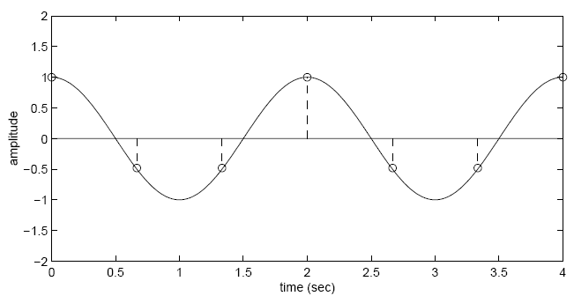
Sampling
Sampling a 1 Hz signal at 1.5 Hz is not enough
  Not enough samples, can’t distinguish between multiple possible signals

Slide 32
In general
Sampling a 1 Hz signal at 2 Hz is both necessary and sufficient
In general: sampling twice rate of signal is enough

Slide 33
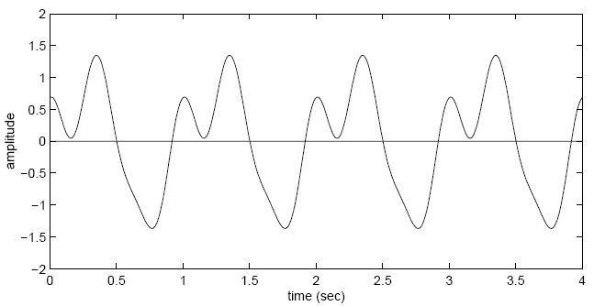
What about more complex signals?
Fourier’s theorem: any continuous signal can be decomposed into a sum of sines and cosines at different frequencies
Example: Sum of 1 Hz, 2 Hz, and 3 Hz sines
  How fast to sample?

Slide 34
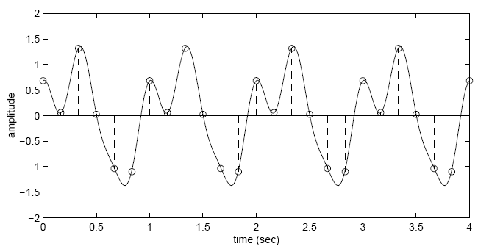
What about more complex signals?
Fourier’s theorem: any continuous signal can be decomposed into a sum of sines and cosines at different frequencies
Example: Sum of 1 Hz, 2 Hz, and 3 Hz sines
  How fast to sample?
  Answer: Twice rate of fastest signal (bandwidth): 6 Hz

Slide 35
Nyquist–Shannon sampling theorem
If a function x(t) contains no frequencies higher than B hertz, it is completely determined by giving its ordinates at a series of points spaced 1/(2B) seconds apart
In other words:
  If the bandwidth of your channel is B
  Your sampling rate should be 2B
  Higher sampling rates are pointless
  Lower sampling rates lead to aliasing/distortion/error

Slide 36
Related Question: How much data can you pack into a channel?
If I sample at a rate of 2B, I can precisely determine the signal of bandwidth B
If I have data coming in at rate 2B, I can encode it in a channel of rate B
  Similar argument to above, but in reverse
  Instead of “reading” a sample, we “write” a sample
More generally:
  Transmitting N distinct signals over a noiseless channel with bandwidth B, we can achieve at most a data rate of
  2B log2 N

Slide 37
Noiseless Capacity
CS/ECE 438
37
Nyquist’s theorem: 2B log₂ N
Example 1: sampling rate of a phone line
  B = 4000 Hz
  2B = 8000 samples/sec.
    sample every 125 microseconds
Example 2: noiseless capacity
  B = 1200 Hz
  N = each pulse encodes 16 levels
  C = 2B log₂ (N) = D x log₂ (N)
  = 2400 x 4 = 9600 bps.

Slide 38
What can Limit Maximum Data Rate?
CS/ECE 438
38
Noise
  E.g., thermal noise (in-band noise) can blur symbols
Transitions between symbols
  Introduce high-frequency components into the transmitted signal
  Such components cannot be recovered (by Nyquist’s Theorem), and some information is lost
Examples
  Phase modulation
    Single frequency (with different phases) for each symbol
    Transitions can require very high frequencies

Slide 39
How does Noise affect these Bounds?
CS/ECE 438
39
In-band (thermal, not high-frequency) noise
  Blurs the symbols, reducing the number of symbols that can be reliably distinguished.
Claude Shannon (1948)
  Extended Nyquist’s work to channels with additive white Gaussian noise (a good model for thermal noise)
channel capacity C = B log₂ (1 + S/N)
B is the channel bandwidth
S/N is the ratio between
the average signal power and
the average in-band noise power
Notes:
TODO: “thermal” noise?

Slide 40

Noisy Capacity
CS/ECE 438
40
Telephone channel
  3400 Hz at 40 dB SNR
  C = B log₂ (1+S/N) bits/s
  SNR = 40 dB
  40 =10 log₁₀ (S/N)
  S/N =10,000
  C = 3400 log₂ (10001) = 44.8 kbps
Notes:
What is a decibel? The decibel (dB) is a logarithmic unit of measurement that expresses the magnitude of a physical quantity (usually power or intensity) relative to a specified or implied reference level.
What happens if we increase noise

Slide 41
Summary of Encoding
CS/ECE 438
41
Problems
  Attenuation, dispersion, noise
Digital transmission allows periodic regeneration
Variety of binary voltage encodings
  High frequency components limit to short range
  More voltage levels provide higher data rate
Carrier frequency and modulation
  Amplitude, frequency, phase, and combinations
  Quadrature amplitude modulation: amplitude and phase, many signals
Nyquist (noiseless) and Shannon (noisy) limits on data rates

Slide 42
Error Detection/Correction

Slide 43
Error Detection
digital data
(a string of
symbols)
digital data
(a string of
symbols)
modulator
demodulator
a string
of signals
Encoding translates symbols to signals
Framing demarcates units of transfer
Error detection validates correctness of each frame
CS/ECE 438
43

Slide 44
Error Detection
44
Key idea: Add redundant information that can be used to determine if errors have been introduced, and potentially fix them
Errors checked at many levels
  Demodulation of signals into symbols (analog)
  Bit error detection/correction (digital)—our main focus
    Within network adapter (CRC check)
    Within IP layer (IP checksum)
    Possibly within application as well

Slide 45
Error Detection
CS/ECE 438
45
Analog Errors
  Example of signal distortion
Hamming distance
  Parity and voting
  Hamming codes
Error bits or error bursts?
Digital error detection
  Two-dimensional parity
  Checksums
  Cyclic Redundancy Check (CRC)

Slide 46
Analog Errors
CS/ECE 438
46
Consider RS-232 encoding of character ‘Q’
  ASCII Q = 1100001
Assume idle wire (-15V) before and after signal

Slide 47
RS-232 Encoding of 'Q'
start
1
1
0
0
0
0
1
stop
CS/ECE 438
47
Notes:
It’s not really going to look like this…

Slide 48
Limited-Frequency Signal Response
(bandwidth = baud rate)
start
1
1
0
0
0
0
1
stop
CS/ECE 438
48
Notes:
it’ll probably look like this. Most of the time I can detect reasonably well

Slide 49
Limited-Frequency Signal Response
(bandwidth = baud rate/2)
start
1
1
0
0
0
0
1
stop
CS/ECE 438
49
Notes:
If I have lower bandwidth, my signal gets more and more distroted

Slide 50
Symbols
+15
0
voltage
? (erasure)
0
1
-15
possible binary voltage encoding symbol neighborhoods and erasure region
possible QAM symbol
neighborhoods in green; all
other space results in erasure
CS/ECE 438
50

Slide 51
Symbols
CS/ECE 438
51
Inputs to digital level
  valid symbols
  erasures
Hamming distance
  Definition
  1-bit error-detection with parity
  1-bit error-correction with voting
  2-bit erasure-correction with voting
  Hamming codes (1-bit error correction)

Slide 52
Hamming Distance
CS/ECE 438
52
The Hamming distance between two code words is the minimum number of bit flips to move from one to the other
  Example:
  00101 and 00010
  Hamming distance of 3

Slide 53
Detecting bit flips with Parity
011
111
Valid code words
01
11
Parity Encoding:
White – invalid (error)
010
110
00
10
000
100
001
101
CS/ECE 438
53
1-bit error detection with parity
  Add an extra bit to a code to ensure an even (odd) number of 1s
  Every code word has an even (odd) number of 1s

Slide 54
Correcting bit flips with Voting
011
111
Voting:
White – correct to 1
Blue - correct to 0
010
110
Valid code words
0
1
000
100
001
101
CS/ECE 438
54
1-bit error correction with voting
  Every codeword is transmitted n times

Slide 55
2-bit Erasure Correction with Voting
011
111
2-erasure planes in green
remaining bit not ambiguous
cannot correct 1-error and 1-erasure
010
110
0??
??0
000
100
001
101
?0?
55
Every code word is copied 3 times

Slide 56
Minimum Hamming Distance
CS/ECE 438
56
The minimum Hamming distance of a code is the minimum distance over all pairs of codewords
  Minimum Hamming Distance for parity
    2
  Minimum Hamming Distance for voting
    3

Slide 57
Coverage
CS/ECE 438
57
N-bit error detection
  No code word changed into another code word
  Requires Hamming distance of N+1
N-bit error correction
  N-bit neighborhood: all codewords within N bit flips
  No overlap between N-bit neighborhoods
  Requires hamming distance of 2N+1

Slide 58
Hamming Codes
1
2
3
4
5
6
7
8
C
C
D
C
D
D
D
C
…
CS/ECE 438
58
Linear error-correcting code, Named after Richard Hamming
  Simple, commonly used in RAM (e.g., ECC-RAM)
Can detect up to 2 simultaneous bit errors
Can correct single-bit errors
Construction
  number bits from 1 upward
  powers of 2 are check bits
  all others are data bits
  Check bit j is XOR of all bits k such that
  (j AND k) = j
Example: 4 bits of data, 3 check bits

Slide 59
Hamming Codes
1
2
3
4
5
6
7
C₁
C₂
D₃
C₄
D₅
D₆
D₇
C1 = D3 XOR D5 XOR D7
C2 = D3 XOR D6 XOR D7
C4 = D5 XOR D6 XOR D7
CS/ECE 438
59

Slide 60
Hamming Codes
D₃
C₁
C₂
D₇
D₅
D₆
C₄
CS/ECE 438
60
Notes:
(note this handles check bit flips too! Try it and see! Eg if c1 is wrong then )
Example:
D3 1
D5 0
D7 1
D6 1
C1 0
C2 0
C4 1
Then if D5 gets flipped to 1, then C1 is incorrect, and C4 is incorrect

Slide 61
Error Bits or Bursts?
CS/ECE 438
61
Common model of errors
  Probability of error per bit
  Error in each bit independent of others
  Value of incorrect bit independent of others
Burst model
  Probability of back-to-back bit errors
  Error probability dependent on adjacent bits
  Value of errors may have structure
Why assume bursts?
  Appropriate for some media (e.g., radio)
  Faster signaling rate enhances such phenomena

Slide 62
Digital Error Detection Techniques
CS/ECE 438
62
Two-dimensional parity
  Detects up to 3-bit errors
  Good for burst errors
IP checksum
  Simple addition
  Simple in software
  Used as backup to CRC
Cyclic Redundancy Check (CRC)
  Powerful mathematics
  Tricky in software, simple in hardware
  Used in network adapter

Slide 63
Two-Dimensional Parity
Use 1-dimensional parity
  Add one bit to a 7-bit code to ensure an even/odd number of 1s
Add 2nd dimension
  Add an extra byte to frame
    Bits are set to ensure even/odd number of 1s in that position across all bytes in frame
Comments
  Can detect and correct any 1-bit error
  Can detect any 1-, 2- and 3-bit, and most 4-bit errors
Parity Bits
0101001
1
1101001
0
Data
1011110
1
0001110
1
0110100
1
1011111
0
Parity Byte
1111011
0
CS/ECE 438
63

Slide 64
Two-Dimensional Parity
0
1
0
0
0
1
1
1
0
0
1
1
0
1
1
1
1
0
0
1
1
0
1
1
1
1
0
0
1
1
0
0
1
0
0
1
0
0
1
0
0
0
1
1
1
CS/ECE 438
64
Notes:
Q: how is that bit in the lowermost rightmost corner computed? Is it computed so that the number of 1’s across both the vertical and horizantal make one?

Slide 65
What happens if…
Can detect exactly which bit flipped
Can also correct it!
0
1
1
0
0
0
1
1
1
0
0
1
1
0
1
1
1
1
0
0
1
1
0
1
1
1
1
0
0
1
1
0
0
1
0
0
1
0
0
1
0
0
0
1
1
1
CS/ECE 438
65

Slide 66
What happens if…
Can detect the two-bit error,
But can’t tell which bits are flipped,
so can’t correct
No longer a problem here
1
0
0
1
0
0
0
1
1
1
0
0
1
1
0
1
1
1
1
0
0
1
1
0
1
1
1
1
0
0
1
1
0
0
1
0
0
1
0
0
1
0
0
0
1
1
1
CS/ECE 438
66

Slide 67
What happens if…
Suppose these four parity bits don’t match
Which bits could be in error?
Could be the blue pair, OR, could be the orange pair. So, can’t correct.
0
1
0
0
0
1
1
1
0
0
1
1
0
1
1
1
1
0
0
1
1
0
1
1
1
1
0
0
1
1
0
0
1
0
0
1
0
0
1
0
0
0
1
1
1
CS/ECE 438
67

Slide 68
What about 3-bit errors?
Can detect exactly which bit flipped
You can correct in this case
0
1
1
0
0
0
0
0
1
1
1
0
0
1
1
0
1
1
1
1
0
0
1
1
0
1
1
1
1
0
0
1
1
0
0
1
0
0
1
0
0
1
0
0
0
1
1
1
CS/ECE 438
68

Slide 69
What about 3-bit errors?
Can detect exactly which bit flipped
But you can’t correct (eg if orange bits got
flipped instead of the blue ones)
1
0
0
0
1
0
0
0
1
1
1
0
0
1
1
0
1
1
1
1
0
0
1
1
0
1
1
1
1
0
0
1
1
0
0
1
0
0
1
0
0
1
0
0
0
1
1
1
CS/ECE 438
69

Slide 70
What about 4-bit errors?
Are there any 4-bit errors
this scheme *can* detect?
Can you think of a 4-bit error
this scheme can’t detect?
1
1
0
1
0
0
0
1
1
1
0
0
1
1
0
1
1
1
1
0
1
0
0
1
1
0
1
1
1
1
0
0
1
1
0
0
1
0
0
1
0
0
1
0
0
0
1
1
1
CS/ECE 438
70

Slide 71
Internet Checksum
CS/ECE 438
71
Idea: Add up all the words, transmit the sum
Internet Checksum
  Use 1’s complement addition on 16bit codewords
  Example
    Codewords: -5 -3
    1’s complement binary: 1010 1100
    1’s complement sum 1000
Comments
  Small number of redundant bits
  Easy to implement
  Not very robust
Notes:
Why does it use one’s complemnet, in particular?

Slide 72
IP Checksum
CS/ECE 438
72
u_short cksum(u_short *buf, int count) {
register u_long sum = 0;
while (count--) {
sum += *buf++;
if (sum & 0xFFFF0000) {
/* carry occurred, so wrap around */
sum &= 0xFFFF;
sum++;
}
}
return ~(sum & 0xFFFF);
}

Slide 73
Cyclic Redundancy Check (CRC)
CS/ECE 438
73
Non-secure hash function based on cyclic codes
Idea
  Add k bits of redundant data to an n-bit message
  N-bit message is represented as a n-degree polynomial with each bit in the message being the corresponding coefficient in the polynomial
  Example
    Message = 10011010
    Polynomial
        = 1 ∗x⁷ + 0 ∗x⁶ + 0 ∗x⁵ + 1 ∗x⁴ + 1 ∗x³ + 0 ∗x² + 1 ∗x + 0
        = x⁷ + x⁴ + x³ + x
Notes:
Hopefully k is much less than n so ew don’t need so much overhead

Slide 74
Overly simplified CRC-like protocol, using regular numbers
Both endpoints agree in advance on a divisor value C=3
Sender wants to send a message M=10
Sender computes a value P=M+X=10+2=12 that is evenly divisible by C
Sender sends P and M to receiver
Receiver checks to make sure P=12 is evenly divisible by C=3
  If it is not, then there’s error(s)
  If it is, then there are probably no errors
CRC is vaguely like this, but uses polynomials instead of numbers
  CRC can reconstruct M from P and C, so just needs to send P

Slide 75
CRC Approach
How can we determine these k bits?
CS/ECE 438
75
Given
  Message M(x) 10011010
  Represented as x⁷ + x⁴ + x³ + x
Select a divisor polynomial C(x) with degree k
  Example with k = 3:
    C(x) = x³ + x² + 1
    Represented as 1101
Transmit a polynomial P(x) that is evenly divisible by C(x)
  P(x) = M(x) + k bits

Slide 76
Properties of Polynomial Arithmetic
?
CS/ECE 438
76
Divisor
  Any polynomial B(x) can be divided by a polynomial C(x) if B(x) is of the same or higher degree than C(x)
Remainder
  The remainder obtained when B(x) is divided by C(x) is obtained by subtracting C(x) from B(x)
Subtraction
  To subtract C(x) from B(x), simply perform an XOR on each pair of matching coefficients
For example: (x³+1)/(x³+x²+1) = x²

Slide 77
CRC - Sender
Given
  M(x) = 10011010 = x⁷ + x⁴ + x³ + x
  C(x) = 1101 = x³ + x² + 1
Steps
  T(x) = M(x) * x^{k} (add zeros to increase degree of M(x) by k)
  Find remainder, R(x), from T(x)/C(x)
  P(x) = T(x) – R(x) ⇒ M(x) followed by R(x)
Example
  T(x) = 10011010000
  R(x) = 101
  P(x) = 10011010101
CS/ECE 438
77

Slide 78
CRC - Receiver
CS/ECE 438
78
Receive Polynomial P(x) + E(x)
  E(x) represents errors
  (if no errors then E(x) = 0)
Divide (P(x) + E(x)) by C(x)
  If result = 0, either
    No errors (E(x) = 0, and P(x) is evenly divisible by C(x))
    (P(x) + E(x)) is exactly divisible by C(x), error will not be detected

Slide 79
CRC – Example Encoding
C(x) = x³ + x² + 1 = 1101 Generator
M(x) = x⁷ + x⁴ + x³ + x = 10011010 Message
1101
10011010000
Message plus k zeros
1101
k + 1 bit check sequence c, equivalent to a degree-k polynomial
1001
1101
1000
Result:
Transmit message followed by remainder:
10011010101
1101
1011
1101
1100
1101
1000
Remainder
m mod c
1101
101
CS/ECE 438
79

Slide 80
CRC – Example Decoding – No Errors
C(x) = x³ + x² + 1 = 1101 Generator
P(x) = x¹⁰ + x⁷ + x⁶ + x⁴ + x² + 1 = 10011010101 Received Message
1101
10011010101
Received message, no errors
1101
k + 1 bit check sequence c, equivalent to a degree-k polynomial
1001
1101
1000
Result:
CRC test is passed
1101
1011
1101
1100
1101
1101
Remainder
m mod c
1101
0
CS/ECE 438
80

Slide 81
CRC – Example Decoding – with Errors
C(x) = x³ + x² + 1 = 1101 Generator
P(x) = x¹⁰ + x⁷ + x⁵ + x⁴ + x² + 1 = 10010110101 Received Message
1101
10010110101
Received message
1101
k + 1 bit check sequence c, equivalent to a degree-k polynomial
1000
Two bit errors
1101
1011
Result:
CRC test failed
1101
1101
1101
0101
Remainder
m mod c
CS/ECE 438
81

Slide 82
CRC Error Detection
CS/ECE 438
82
Properties
  Characterize error as E(x)
  Error detected unless C(x) divides E(x)
    (i.e., E(x) is a multiple of C(x))

Slide 83
Example of Polynomial Multiplication
1011
10110
This is a multiple of c, so that if errors occur according to this sequence, the CRC test would be passed
1101
1101
1101
00011111110
CS/ECE 438
83
Multiply
  1101 by 10110
  x³ + x² + 1 by x⁴ + x² + x

Slide 84
On Polynomial Arithmetic
CS/ECE 438
84
Polynomial arithmetic
  A fancy way to think about addition with no carries.
  Helps in the determination of a good choice of C(x)
  A non-zero vector is not detected if and only if the error polynomial E(x) is a multiple of C(x)
Implication
  Suppose C(x) has the property that C(1) = 0 (i.e. (x + 1) is a factor of C(x))
  If E(x) corresponds to an undetected error pattern, then it must be that E(1) = 0
  Therefore, any error pattern with an odd number of error bits is detected

Slide 85
CRC Error Detection
CS/ECE 438
85
What errors can we detect?
  All single-bit errors, if x^{k} and x⁰ have non-zero coefficients
  All double-bit errors, if C(x) has at least three terms
  All odd bit errors, if C(x) contains the factor (x + 1)
  Any bursts of length < k, if C(x) includes a constant term
  Most bursts of length ≥ k

Slide 86
Common Polynomials for C(x)
CRC | C(x)
CRC-8 | x⁸ + x² + x¹ + 1
CRC-10 | x¹⁰ + x⁹ + x⁵ + x⁴ + x¹ + 1
CRC-12 | x¹² + x¹¹ + x³ + x² + x¹ + 1
CRC-16 | x¹⁶ + x¹⁵ + x² + 1
CRC-CCITT | x¹⁶ + x¹² + x⁵ + 1
CRC-32 | x³² + x²⁶ + x²³ + x²² + x¹⁶ + x¹² + x¹¹ + x¹⁰ + x⁸ + x⁷ + x⁵ + x⁴ + x² + x¹ + 1
CS/ECE 438
86

