Slide 1
Basic Concepts
CS 438: Spring 2014
Matthew Caesar
http://courses.engr.illinois.edu/cs438/

Slide 2
Today
10,000 foot view of the Internet
Basic concepts
  links
  packet delays
  circuit switching
  packet (datagram) switching
Layering

Slide 3
A 10,000 foot view of the Internet

Slide 4
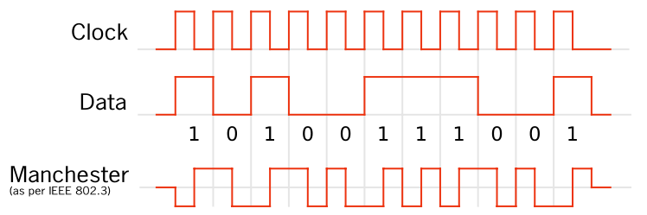
How can Two Hosts Communicate?
0.7 Volts
-0.7 Volts
Encode information on modulated “Carrier signal”
  Phase, frequency, and amplitude modulation, and combinations thereof
  Ethernet: self-clocking Manchester coding ensures one transition per clock
  Technologies: copper, optical, wireless

Slide 5
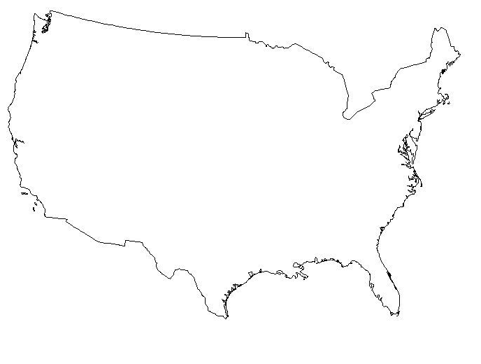
How can many hosts communicate?
Naïve approach: full mesh
Problem:
  Obviously doesn’t scale to the 570,937,778+ hosts in the Internet

Slide 6

How can many hosts communicate?
Better approach: Multiplex traffic with routers
Goals: make network robust to failures and attack, maintain spare capacity, reduce operational costs
  Introduces new challenges: What topology to use? How to find and look up paths? How to identify destinations?

Slide 7
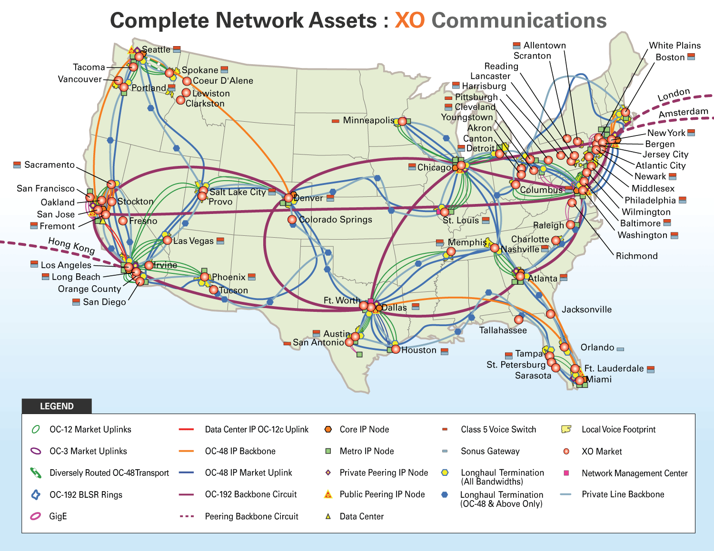

Slide 8
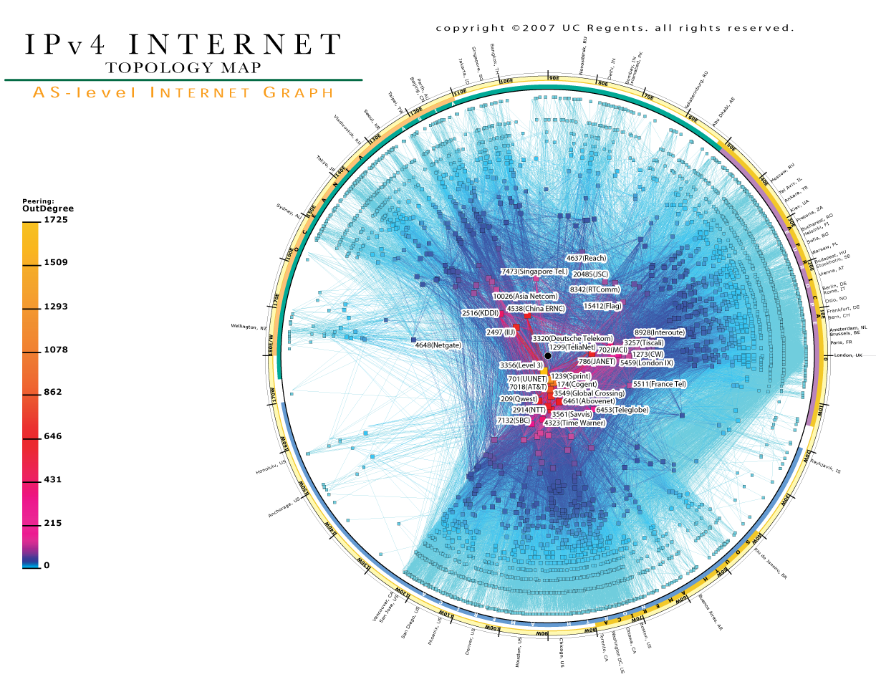

Slide 9
The Internet is a federated system
The Internet ties together different networks
  >20,000 ISP networks
Internet
user
ISP A
ISP B
ISP C
user
Tied together by IP -- the “Internet Protocol” : a single common interface between users and the network and between networks

Slide 10
The Internet is a federated system
The Internet ties together different networks
  >20,000 ISP networks
A single, common interface is great for interoperability…
…but tricky for business
Why does this matter?
  ease of interoperability is the Internet’s most important goal
  practical realities of incentives, economics and real-world trust
  drive topology, route selection and service evolution

Slide 11

How can routers find paths?
Robert’s local
DNS server
.com authoritative
DNS sever
Robert
Routing Table at B
Prefix
IF
Hops
10.1.8.7
4.0.0.0/8
D
1
23.2.0.1
IP address
A
10.1.0.0/16
B
4.9.0.1
23.2.0.0/24
4.18.5.1
Prefix
C
D
10.1.0.1
81.2.0.0/24
4.0.0.0/8
Routing Table at A
pinterest.com
Prefix
IF
Hops
81.2.0.1
4.5.16.2
4.0.0.0/8
B
2
Routing Table at C
Prefix
IF
Hops
4.0.0.0/8
D
1
Pinterest’s authoritative
DNS server
Hosts assigned topology-dependent addresses
Routers advertise address blocks (“prefixes”)
Routers compute “shortest” paths to prefixes
Map IP addresses to names with DNS

Slide 12
Basic Concepts

Slide 13

Nodes and Links
A
B

Slide 14
Properties of Links
bandwidth
delay x bandwidth
Latency
Bandwidth (capacity): “width” of the link
  number of bits sent (or received) per unit time (bits/sec or bps)
Latency (delay): “length” of the link
  propagation time for data to travel along the link (seconds)
Bandwidth-Delay Product (BDP): “volume” of the link
  amount of data that can be “in flight” at any time
  propagation delay × bits/time = total bits in link

Slide 15
Examples of Bandwidth-Delay
Same city over a slow link:
  BW ~100Mbps
  Latency ~0.1msec
  BDP ~10,000bits (~1.25KBytes)
Cross-country over fast link:
  BW ~10Gbps
  Latency~10msec
  BDP ~10⁸bits (~12.5GBytes)

Slide 16
Packet Delay
Sending a 100B packet from A to B?
A
B
1Mbps, 1ms
100 Byte packet
time=0
Time to transmit
one bit = 1/10⁶s
Time when that
bit reaches B
= 1/10⁶+1/10³s
Time to transmit
800 bits=800x1/10⁶s
The last bit
reaches B at
(800x1/10⁶)+1/10³s
= 1.8ms
Packet Delay = Transmission Delay + Propagation Delay
Packet Delay =
(Packet Size ÷ Link Bandwidth) + Link Latency
Time

Slide 17
Packet Delay
Sending a 100B packet from A to B?
1GB file in 100B packets
1Gbps, 1ms?
A
B
1Mbps, 1ms
100Byte packet
10⁷ x 100B packets
The last bit in the file
reaches B at
(10⁷x800x1/10⁹)+1/10³s
= 8001ms
The last bit
reaches B at
(800x1/10⁹)+1/10³s
= 1.0008ms
The last bit
reaches B at
(800x1/10⁶)+1/10³s
= 1.8ms
Time

Slide 18
Packet Delay: The “pipe” view
Sending 100B packets from A to B?
A
B
100Byte packet
1Mbps, 10ms
pkt tx
time
100Byte packet
100Byte packet
BW →
time →
Time

Slide 19
Packet Delay: The “pipe” view
Sending 100B packets from A to B?
1Mbps, 10ms (BDP=10,000)
BW →
time →
1Mbps, 5ms (BDP=5,000)
10Mbps, 1ms (BDP=10,000)
BW →
BW →
time →
time →

Slide 20
Packet Delay: The “pipe” view
Sending 100B packets from A to B?
200B?
1Mbps, 10ms (BDP=10,000)
BW →
time →
1Mbps, 10ms (BDP=10,000)
BW →
time →

Slide 21
Any questions?

Slide 22
Nodes and Links
A
B

Slide 23
What if we have more nodes?
One link for every node?
Need a scalable way to interconnect nodes

Slide 24
What if I have more nodes?
One link for all nodes?
This is a broadcast network

Slide 25
Solution: A switched network
Nodes share network link resources
How is this sharing implemented?
Notes:
multiple conversations in parallel
resources are shared

Slide 26
Two forms of switched networks
Circuit switching (used in the telephone network)
Packet switching (used in the Internet)
Notes:
borrow mckeown’s slides (of network with image); add Berkeley and MIT.
box -- links (incoming and outgoing)
packet -- data + header.
header has an address.

Slide 27
Circuit Switching
Idea: source reserves network capacity along a path
10Mb/s?
B
A
10Mb/s?
10Mb/s?
(1) Node A sends a reservation request
(2) Interior switches establish a connection -- i.e., “circuit”
(3) A starts sending data
(4) A sends a “teardown circuit” message
Notes:
multiple conversations in parallel
resources are shared

Slide 28
Circuit Switching: sharing a link
Time-division
  Each circuit allocated
  certain time slots
Frequency-division
  Each circuit allocated certain frequencies
frequency
time
time

Slide 29
Time Division Multiplexing
Frames
Slots =
0
1
2
3
4
5
0
1
2
3
4
5
Time divided into frames; frames into slots
Relative slot position inside a frame determines to which conversation data belongs
  e.g., slot 0 belongs to orange conversation
Slots are reserved (released) during circuit setup (teardown)
If a conversation does not use its circuit capacity is lost!

Slide 30
Timing in Circuit Switching
time

Slide 31
Timing in Circuit Switching
time

Slide 32
Timing in Circuit Switching
time

Slide 33
Timing in Circuit Switching
time

Slide 34
Timing in Circuit Switching
Circuit
Establishment
time

Slide 35
Timing in Circuit Switching
Information
Circuit
Establishment
Transfer
time

Slide 36
Timing in Circuit Switching
Information
Circuit
Establishment
Transfer
time
Circuit
Teardown
Notes:
Why the delays in the first pass of the establishment, but not in subsequent passes (or in teardown)?

Slide 37
Circuit switching: pros and cons
Pros
  guaranteed performance
  fast transfer (once circuit is established)
Cons

Slide 38
Timing in Circuit Switching
Information
Circuit
Establishment
Transfer
time
Circuit
Teardown
Notes:
Why the delays in the first pass of the establishment, but not in subsequent passes (or in teardown)?

Slide 39
Circuit switching: pros and cons
Pros
  guaranteed performance
  fast transfer (once circuit is established)
Cons
  wastes bandwidth if traffic is “bursty”

Slide 40
Timing in Circuit Switching
Information
Circuit
Establishment
Transfer
time
Circuit
Teardown
Notes:
Why the delays in the first pass of the establishment, but not in subsequent passes (or in teardown)?

Slide 41
Timing in Circuit Switching
Information
Circuit
Establishment
Data transfer
Circuit
Teardown
time
Notes:
Why the delays in the first pass of the establishment, but not in subsequent passes (or in teardown)?

Slide 42
Circuit switching: pros and cons
Pros
  guaranteed performance
  fast transfers (once circuit is established)
Cons
  wastes bandwidth if traffic is “bursty”
  connection setup time is overhead

Slide 43
Circuit switching
A
B
Circuit switching doesn’t “route around trouble”
Notes:
multiple conversations in parallel
resources are shared

Slide 44
Circuit switching: pros and cons
Pros
  guaranteed performance
  fast transfers (once circuit is established)
Cons
  wastes bandwidth if traffic is “bursty”
  connection setup time is overhead
  recovery from failure is slow

Slide 45
Two forms of switched networks
Circuit switching (e.g., telephone network)
Packet switching (e.g., Internet)

Slide 46


Packet Switching
Data is sent as chunks of formatted bits (Packets)
Packets consist of a “header” and “payload”*
Internet Address
Age
Checksum to protect header
Header
Data
payload
header
01000111100010101001110100011001

Slide 47
Packet Switching
Data is sent as chunks of formatted bits (Packets)
Packets consist of a “header” and “payload”*
  payload is the data being carried
  header holds instructions to the network for how to
  handle packet (think of the header as an interface!)

Slide 48
Packet Switching
Data is sent as chunks of formatted bits (Packets)
Packets consist of a “header” and “payload”
Switches “forward” packets based on their headers

Slide 49

Switches forward packets
UIUC
to MIT
switch#4
switch#2
Forwarding Table
111010010
MIT
Destination | Next Hop
UIUC | 4
UW | 5
MIT | 2
NYU | 3
switch#5
to UW
to NYU
switch#3

Slide 50
Timing in Packet Switching
payload
hdr
time
What about the time to process the packet at the switch?
We’ll assume it’s relatively negligible (mostly true)
Notes:
Why the delays in the first pass of the establishment, but not in subsequent passes (or in teardown)?

Slide 51
Timing in Packet Switching
payload
hdr
Could the switch start transmitting as
soon as it has processed the header?
time
Yes! This would be called
a “cut through” switch
Notes:
Why the delays in the first pass of the establishment, but not in subsequent passes (or in teardown)?

Slide 52
Timing in Packet Switching
payload
hdr
We will always assume a switch processes/forwards
a packet after it has received it entirely.
This is called “store and forward” switching
time
Notes:
Why the delays in the first pass of the establishment, but not in subsequent passes (or in teardown)?

Slide 53
Packet Switching
Data is sent as chunks of formatted bits (Packets)
Packets consist of a “header” and “payload”
Switches “forward” packets based on their headers

Slide 54
Packet Switching
Data is sent as chunks of formatted bits (Packets)
Packets consist of a “header” and “payload”
Switches “forward” packets based on their headers
Each packet travels independently
  no notion of packets belonging to a “circuit”

Slide 55
Packet Switching
Data is sent as chunks of formatted bits (Packets)
Packets consist of a “header” and “payload”
Switches “forward” packets based on their headers
Each packet travels independently
No link resources are reserved in advance. Instead packet switching leverages statistical multiplexing

Slide 56
Statistical Multiplexing

Slide 57
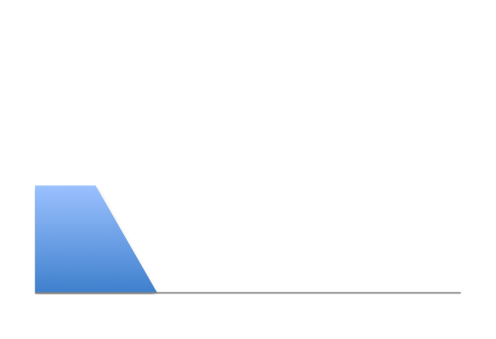
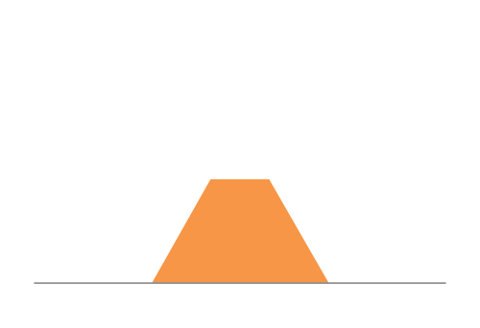

Three Flows with Bursty Traffic
Data Rate 1
Time
Data Rate 2
Capacity
Time
Data Rate 3
Time

Slide 58
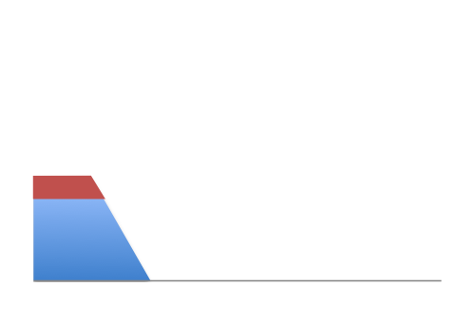
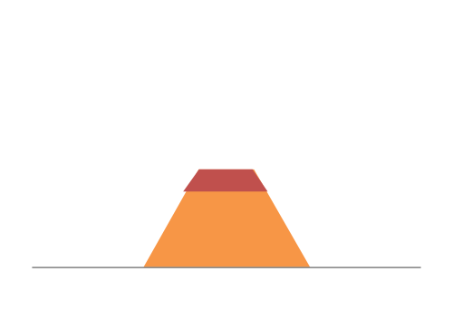
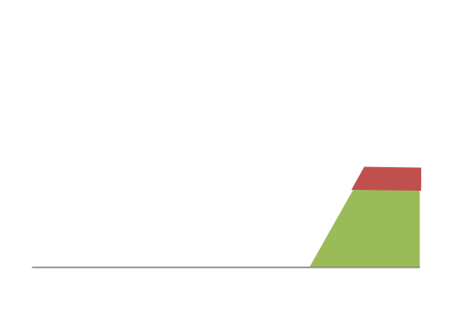
When Each Flow Gets 1/3rd of Capacity
Frequent Overloading
Data Rate 1
Time
Data Rate 2
Time
Data Rate 3
Time

Slide 59
When flows share total capacity
Time
No Overloading
Time
Statistical multiplexing relies on the assumption
that not all flows burst at the same time.
Very similar to insurance, and has same failure case
Time

Slide 60
Three Flows with Bursty Traffic
Data Rate 1
Time
Data Rate 2
Capacity
Time
Data Rate 3
Time

Slide 61
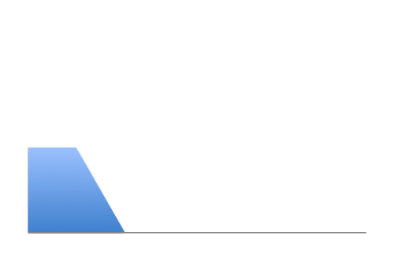

Three Flows with Bursty Traffic
Data Rate 1
Time
Data Rate 2
Capacity
Time
Data Rate 3
Time

Slide 62


Three Flows with Bursty Traffic
Data Rate 1+2+3 >> Capacity
Time
Capacity
Time
What do we do under overload?

Slide 63

Statistical multiplexing: pipe view
pkt tx
time
BW →
time →

Slide 64
Statistical multiplexing: pipe view

Slide 65
Statistical multiplexing: pipe view
No Overload!

Slide 66
Statistical multiplexing: pipe view
Queue
Transient Overload
Not a rare event!

Slide 67
Statistical multiplexing: pipe view
Queue
Transient Overload
Not a rare event!

Slide 68
Statistical multiplexing: pipe view
Queue
Transient Overload
Not a rare event!

Slide 69
Statistical multiplexing: pipe view
Queue
Transient Overload
Not a rare event!

Slide 70
Statistical multiplexing: pipe view
Queue
Transient Overload
Not a rare event!

Slide 71
Statistical multiplexing: pipe view
Queue
Transient Overload
Queues absorb transient bursts!
Not a rare event!

Slide 72
Statistical multiplexing: pipe view
What about persistent overload?
Will eventually drop packets

Slide 73
Queues introduce queuing delays
Recall, packet delay = tx delay + prop delay
With queues (stat. muxing)
  packet delay = tx delay + prop delay + queuing delay
Queuing delay caused by “packet interference”
Made worse at high load
  less “idle time” to absorb bursts
  think about traffic jams at rush hour

Slide 74
Basic Queuing Theory Terminology
Arrival process: how packets arrive
  Average rate A
  Peak rate P
Service process: transmission times
  Average transmission time (function of packet size)
W: average time packets wait in the queue
  W for “waiting time”
L: average number of packets waiting in the queue
  L for “length of queue”
Two different quantities

Slide 75
Little’s Law (1961)
L = A x W
Average queue size (L) is average packet arrival rate (A) times average wait time (W)
  Surprisingly, not influenced by arrival process distribution, service distribution, service order, etc.
Used for router queue, circuit dimensioning
More complex computation: Xth percentile queue size
  Realm of queuing theory
  Depends on arrival/service processes

Slide 76
Statistical Multiplexing is a recurrent theme in computer science
Phone network rather than dedicated lines
  Ancient history
Packet switching rather than circuits
  Today’s lecture
Cloud computing
  Shared datacenters, rather than single PCs

Slide 77
Packet Switching
Data is sent as chunks of formatted bits (Packets)
Packets consist of a “header” and “payload”
Switches “forward” packets based on their headers
Each packet travels independently
No link resources are reserved in advance. Instead packet switching leverages statistical multiplexing
  allows efficient use of resources
  but introduces queues and queuing delays

Slide 78
Circuit switching: pros and cons
Pros
  guaranteed performance
  fast transfers (once circuit is established)
Cons
  wastes bandwidth if traffic is “bursty”
  connection setup adds delay
  recovery from failure is slow

Slide 79
Packet switching: pros and cons
Cons
  no guaranteed performance
  header overhead per packet
  queues and queuing delays
Pros
  efficient use of bandwidth (stat. muxing)
  no overhead due to connection setup
  resilient -- can `route around trouble’

Slide 80
Recap: you should leave this lecture with…
A sense of how the basic `plumbing’ works
  links and switches
  packet delays (tx, propagation, queuing)
  statistical multiplexing and queues
  circuit vs. packet switching
Next: back to lofty principles
  protocols and layering

