Slide 1
Approximate Consensus
N processes, f crash faults (N > 2f)
Asynchronous systems
Properties:
Termination: eventually, each fault-free process
has an output
Agreement:
Validity:

Slide 2
Approximate Consensus
N processes, f crash faults (N > 2f)
Asynchronous systems
Properties:
Termination: eventually, each fault-free process
has an output
Agreement: each fault-free process has
“roughly” the same output
Validity:
difference bounded by a constant

Slide 3
Approximate Consensus
N processes, f crash faults (N > 2f)
Asynchronous systems
Properties:
Termination: eventually, each fault-free process
has an output
Agreement: each fault-free process has
“roughly” the same output
Validity: output inside convex hull

Slide 4
Approximate Consensus
input
output
real number line

Slide 5
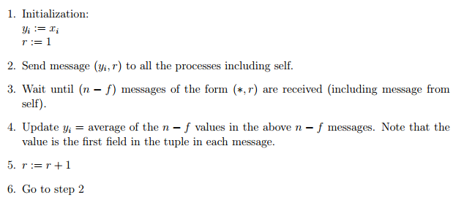
Approximate Consensus Algorithm
Process i proceeds in asynchronous rounds

Slide 6
Example Run of the Algorithm
f = 1
Round 1 (from perspective of A)
A’s new state = (0+1)/2 = 0.5
(1,1)
(0,1)
1
B
0
(0,1)
A
(0,1)
C
1

Slide 7
Example Run of the Algorithm
f = 1
End of Round 1
(suppose B and C did not wait for A’s message)
1
B
0.5
A
range shrinks
[0,1] ➔ [0.5, 1]
C
1

Slide 8
Correctness
Termination is obvious
fixed number of asynchronous rounds
Validity is also obvious
validity: output inside convex hull ➔ due to “average”

Slide 9
Agreement
Tow processes i, j
Ri[t] = values received at i in iteration t
Rj[t] = values received at j in iteration t
yi[t] = state at i in the end of iteration t
yj[t] = state at i in the end of iteration t
Key observation: Ri[t] ∩ Rj[t] is not empty
Exercise: show agreement
|yi[t]-yj[t]| approaches 0 as t increases
N > 2f and |Ri[t]| = |Rj[t]| = N-f

Slide 10
Broadcast
Reach agreement on what the source S has said

Slide 11
Broadcast
Reach agreement on what the source S has said

Slide 12
Byzantine Broadcast
Any process may be Byzantine faulty,
…including the source S
Look at textbook and slides 34~60 at
http://www.crhc.illinois.edu/wireless/talks/stonybrook-february-2012.pdf

Slide 13
Lower Bounds for Byzantine Broadcast in a Synchronous System
Number of rounds must be at least f+1
Number of processes must be more than 3f

Slide 14
Number of Processes
N = 3 f = 1
Scenario 1: C is faulty
S
x
x
y
C
B
x
B should output x

Slide 15
Number of Processes
N = 3 f = 1
Scenario 2: S is faulty
S
y
x
y
C
B
x
Indistinguishable from Scenario 1 for B ➔ B should output x, so as C

Slide 16
Number of Processes
N = 3 f = 1
Scenario 3: B is faulty
S
y
y
y
C
B
x
Indistinguishable from Scenario 2 for C ➔ C should output x
violating agreement

