Slide 1
CS 425/ECE 428 Distributed Systems
Nitin Vaidya

Slide 2
T.A.s
Persia Aziz
Frederick Douglas
Su Du
Yixiao Lin

Slide 3
Course handout … textbook … office hours … Piazza … grading policy … late submission policy

Slide 4
Course website … mid-term exam schedule … lectures page … homework
… programming assignments (for 4 credit hours only)

Slide 5
What’s this course about ?

Slide 6
What this course is not about …

Slide 7
As you can see, I have memorized this utterly useless piece of information long enough to pass a test question. I now intend to forget it forever. You’ve taught me nothing except how to cynically manipulate the system.
- ??????

Slide 8
Calvin and Hobbes
As you can see, I have memorized this utterly useless piece of information long enough to pass a test question. I now intend to forget it forever. You’ve taught me nothing except how to cynically manipulate the system.
- Calvin

Slide 9
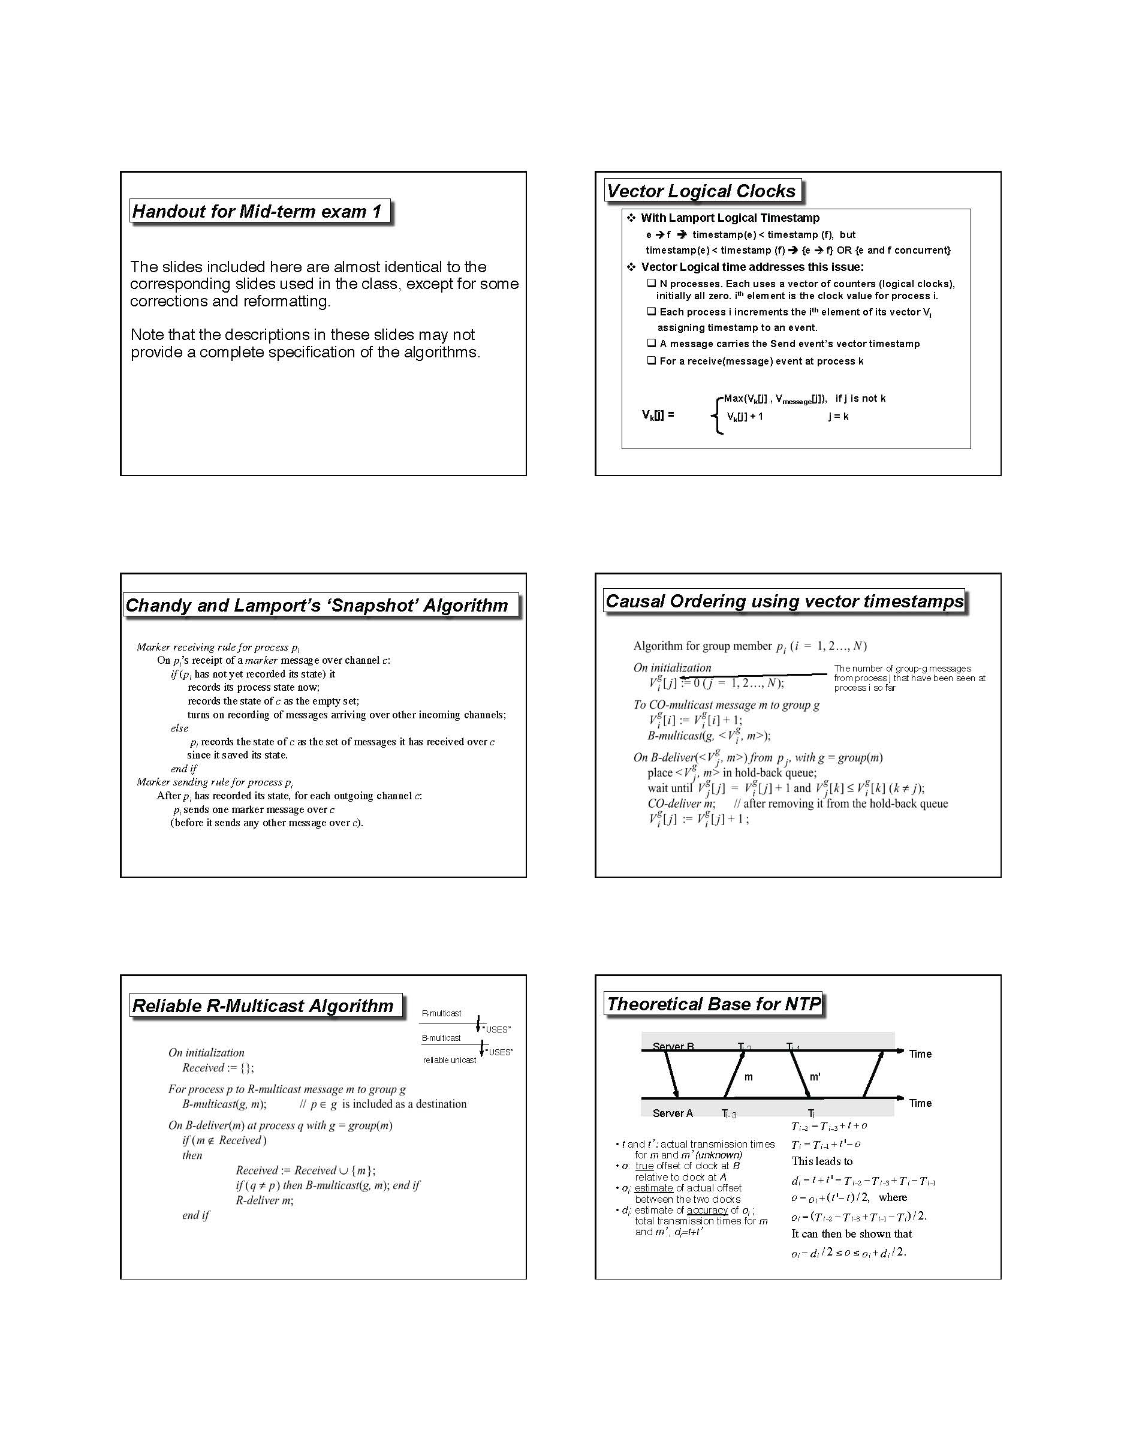
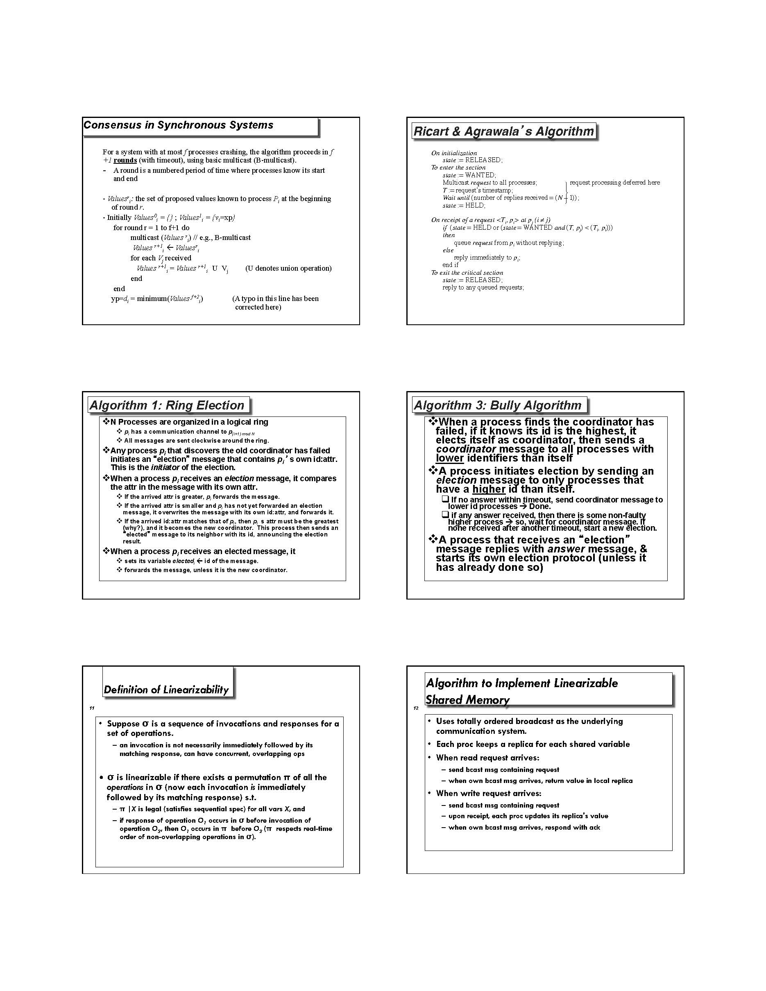
Handout provided for 1st mid-term in Spring 2014 … something similar this semester too

Slide 10
What is distributed computing?
Notes:
Provide examples of potential definitions

Slide 11
What is distributed computing?
Parallel computing versus distributed computing
Example: To add N numbers where N very large use 4 processors, each adding up N/4, then add the 4 partial sums
Parallel or distributed ?

Slide 12
What is distributed computing?
Parallel computing versus distributed computing
Role of uncertainty in distributed systems
Clock drift
Network delays
Network losses
Asynchrony
Failures

Slide 13
A distributed system is one in which the failure of a computer you didn't even know existed can render your own computer unusable.
-- Leslie Lamport

Slide 14
What is distributed computing?
Parallel computing versus distributed computing
Role of uncertainty in distributed systems
Clock drift
Network delays
Network losses
Asynchrony
Failures

Slide 15
Clocks
Notion of time very useful in real life, and so it is in distributed systems
Example … Submit programming assignment by e-mail by 11:59 pm Monday
By which clock ?

Slide 16
How to synchronize clocks?
Notes:
What if delays are fixed & KNOWN? Can we perfectly synchronize clocks?

Slide 17
How to synchronize clocks?
Role of delay uncertainty
Notes:
What if delays are variable & unpredictable? Can we perfectly synchronize clocks?

Slide 18
Ordering of Events
If we can’t have “perfectly” synchronized clocks, can we still determine what happened first?
Notes:
Role of causality

Slide 19
What is distributed computing?
Parallel computing versus distributed computing
Role of uncertainty in distributed systems
Clock drift
Network delays
Network losses
Asynchrony
Failures

Slide 20
Mutual Exclusion
We want only one person to speak
Only the person holding the microphone may speak
Must acquire microphone before speaking

Slide 21
Mutual Exclusion
How to implement in a message-passing system?
Notes:
Token-passing. Works well if communication is guaranteed to be reliable.

Slide 22
Mutual Exclusion
What if messages may be lost?
Notes:
Sender cannot know if the token is delivered. So need some sort of acknowledgment from the receiver. But the Ack can be lost too. Can we ensure that EXACTLY one node will have the taken (i.e., no more & no less than 1)?

Slide 23
What is distributed computing?
Parallel computing versus distributed computing
Role of uncertainty in distributed systems
Clock drift
Network delays
Network losses
Asynchrony
Failures

Slide 24
Agreement
Where to meet for dinner?
Notes:
In a synchronous system without failures, this problem is easy to solve.

Slide 25
Agreement with Failure
Non-faulty nodes must agree
Notes:
Consider synchronous system, but one in which nodes can still crash. The solution is still not too difficult. But requires more “work”.

Slide 26
Agreement with Crash Failure & Asynchrony
Notes:
Asynchrony makes the problem difficult (impossible, in fact, to solve exactly).

Slide 27
What if nodes misbehave?
Crash failures are benign
Other extreme … Byzantine failures

Slide 28
Agreement with Byzantine failures (synchronous system)
Notes:
Byzantine failures need more redundancy to be able to solve the problem, in a synchronous system.

Slide 29
How to improve system availability?
Potentially large network delays … network partition
Failures

Slide 30
Replication is a common approach
Consider a storage system
If data stored only in one place, far away user will incur significant access delay
➔ Store data in multiple replicas, Clients prefer to access “closest” replica

Slide 31
Replicated Storage
How to keep replicas “consistent” ?
What does “consistent” really mean?

Slide 32
What’s this course about?

Slide 33
Learn to “reason” about distributed systems
… not just facts, but principles
Learn important canonical problems, and some solutions
Programming experience

Slide 34
In class: we will focus on principles
Supplemental readings: read about practical aspects, recent industry deployments

Slide 35
Distributed Computing … our scope
Communication models:
message passing
shared memory
Timing models:
synchronous
Asynchronous
Fault models
Crash
Byzantine

Slide 36
Shared Memory
Different processes (or threads of execution) can communicate by writing to/reading from (physically) shared memory

Slide 37
Shared Memory

Slide 38
Distributed Shared Memory
The “shared memory” may be simulated by using local memory of different processors

Slide 39
Distributed Shared Memory

Slide 40
Key-Value Stores

Slide 41
Consistency Model
Since shared memory may be accessed by different processes concurrently, we need to define how the updates are observed by the processes
Consistency model captures these requirements

Slide 42
Consistency #1
Alice: My cat was hit by a car.
Alice: But luckily she is fine.
Bob: That’s great!
What should Calvin observe?
Notes:
Calvin may observe: A1, A2, B … this is what is intuitively expected. But he may also observe A1, B, A2, which will be confusing to him. What Calvin may observe depends on which model of consistency is implemented.

Slide 43
Consistency #1
Alice: My cat was hit by a car.
Alice: But luckily she is fine.
Bob: That’s great!
What should Calvin observe?
Notes:
Calvin may observe: A1, A2, B … this is what is intuitively expected. But he may also observe A1, B, A2, which will be confusing to him. What Calvin may observe depends on which model of consistency is implemented.

Slide 44
Consistency #2
Alice: My cat was hit by a car.
Alice: But luckily she is fine. Bob: That’s terrible!
What should Calvin observe?
Notes:
A2 and B are performed “simultaneously”. Calvin may observe A1, B, A2 or A1, A2, B.

Slide 45
Consistency #2
Alice: My cat was hit by a car.
Alice: But luckily she is fine. Bob: That’s terrible!
What should Calvin observe?
Notes:
A2 and B are performed “simultaneously”. Calvin may observe A1, B, A2 or A1, A2, B.

