Slide 1
Begin Android Journey
In HourS
CS425 / CSE 424 / ECE 428 [Fall 2009]
Sept. 14, 2009
Ying Huang

Slide 2
Reference
Online development guide
  http://developer.android.com/guide/index.html
Book resource
  “Professional Android Application Development”, by Reto Meier, (Wrox, amazon link)
  “Android A programmers guide”, by J.F. DiMarzio, (McGraw Hill, amazon link)
  “Beginning.Android”, by Mark L. Murphy, (Apress, amazon link)
  “Pro Android”, by Sayed Y. Hashimi, Satya Komatineni, (Apress, amazon link)

Slide 3

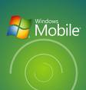
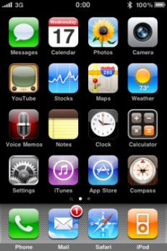

Mobile OS
Symbian
iPhone
RIM's BlackBerry
Window mobile
Linux
Palm webOS
Android
….

Slide 4
What is Android?
Google → OHA (Open Handset Alliance)
  The first truly open and comprehensive platform for mobile devices, all of the software to run a mobile phone but without the proprietary obstacles that have hindered mobile innovation.
  Linux OS kernel
  Java programming
  Open source libraries: SQLite, WebKit, OpenGL

Slide 5

Why Android
A simple and powerful SDK
No licensing, distribution, or development fees
Development over many platform
  Linux, Mac OS, windows
Excellent documentation
Thriving developer community
For us
  Java-based, easy to import 3rd party Java library
  Funding (40+ G1 phones)
  Prize (amazon’s kindle)
  Job opportunity

Slide 6
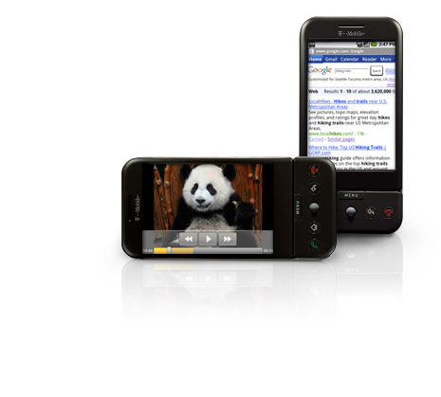
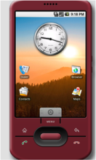
Android SDK Feature
GSM, EDGE, and 3G networks, WiFi, Bluetooth
  API Support for Bluetoothe, WiFi Ad hoc mode
Libraries
  Media, SQLite, WebKit, SSL
Hardware control:
  Accelerometer, compass, microphone, camera, GPS
  touch screen, power
Location-based service, map (Google API)
MP3
MP3

Slide 7


Tools
The Android Emulator
  Implementation of the Android virtual machine
  Test and debug your android applications.
Dalvik Debug Monitoring Service (DDMS)
  Monitor and Control the Dalvik virtual machines
  Logcat (see logged msgs)
Android Debug Bridge (ADB)
  Manage the state of an emulator instance or Android-powered device
  Copy files, install compiled application packages, and run shell commands.
Traceview
  Graphical analysis tool for viewing the trace logs from your Android application
  Debug your application and profile its performance
MkSDCard
  Creates an SDCard disk image
MP2

Slide 8
run two networking emulators in a computer (Updated) - ADB
Q: run two networking emulators in a computer A using the public IP address of A, during debugging and demo?
A1: telnet + redir (MP1 doc)
A2: adb forward
  1) Port forward to connect Android from localhost
    abd –s emulator-5554 forward tcp:15216 tcp:15216
  2) Use a proxy server which can listen on my_public_ip:15216 and forward the data to localhost:15216
    stcppipe localhost 15216 15216
E1
E2
M1

Slide 9


MP1
G1 Phone (Peer)
Peer Registration
Server
Underlying
Infrastructure-based
WiFi /TCP/IP Network
Peer
Peer

Slide 10
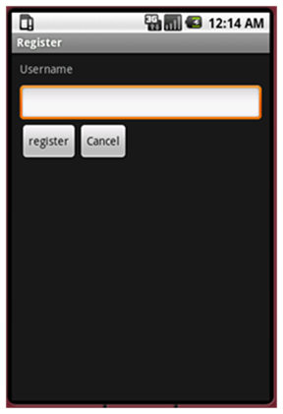
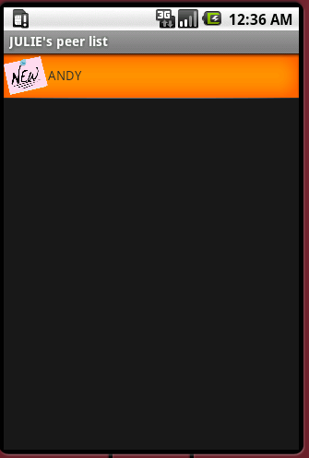
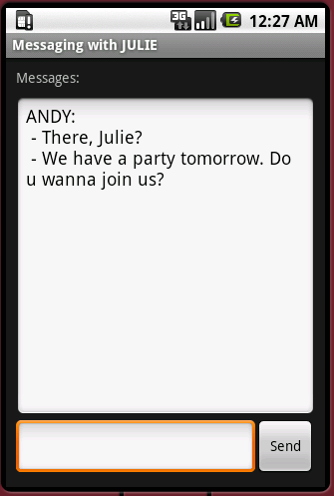
MP1 Project Structure
Registration
PeerList
Messaging

Slide 11
Android Application Architecture
View
Activity
Intent
Thread
Resource
Service
Views:
  Building block for user interface components.
Activities
  A single, focused thing that the user can do.
  Interaction with users: creating a window to place UI
  full-screen windows, floating windows, embedded inside of another activity
  Ex: Registration, Peerlist, Messaging GUI

Slide 12
Android Application Architecture
View
Activity
Intent
Thread
Resource
Service
Activity
Activity
Services (Background)
  Ex: Network Operation
Intent
  Inter-communication among activities or services
Resource
  Externalization of strings and graphics
Notification
  signaling users: Light, sound, icon, dialog, notification
  Ex: new message arrives
Content Providers
  share data between applications
Intent

Slide 13

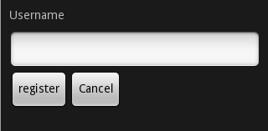
View
View
Activity
Intent
Thread
Resource
Service
screen.xml
Layout of visual interface
Java Code
  Initialize
  Access
  TextView myTextView = (TextView)findViewById(R.id.myTextView);
<?xml version=”1.0” encoding=”utf-8”?>
<LinearLayout xmlns:android=”http://schemas.android.com/apk/res/android”
android:orientation=”vertical”
android:layout_width=”fill_parent”
android:layout_height=”fill_parent”>
<TextView
android:id=”@+id/myTextView”
android:layout_width=”fill_parent”
android:layout_height=”wrap_content”
android:text=”Hello World, HelloWorld”
/>
</LinearLayout>
@Override
public void onCreate(Bundle icicle) {
super.onCreate(icicle);
setContentView(R.layout.screen);
}

Slide 14
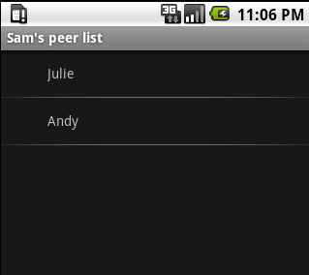
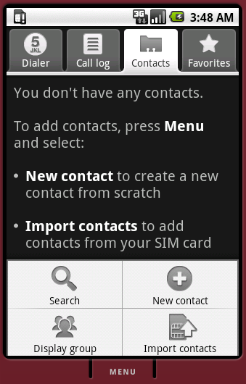
View Component
View
Activity
Intent
Thread
Resource
Service
Widget Toolbox
  TextView, EditText,Button, Form, TimePicker…
  ListView (PeerList)
    Update list by arrays
      ArrayAdapter
      myListView.setAdapter
  Layout
    Positions of controls
    LinearLayout, Relativelayout
  http://developer.android.com/guide/tutorials/views/index.html
Menu
  Exit app

Slide 15
Activity
View
Activity
Intent
Thread
Resource
Service
Foreground Activity: suspended when invisible
  Visual, interactive
  Ex: Game, Map
Background Service: Little interaction
  Ex: Hardware, power management
Intermittent Activity
  Notification, service
  Expects some interactivity but does most of its work in the background.
Registration
Peer List
Messaging
Network
Operation Management

Slide 16
User Interaction Event
View
Activity
Intent
Thread
Resource
Service
onKeyDown. onKeyUp
onTrackBallEvent
onTouchEvent
registerButton.setOnClickListener(new OnClickListener() {
public void onClick(View arg0) {….}}
myEditText.setOnKeyListener(new OnKeyListener() {
public boolean onKey(View v, int keyCode, KeyEvent event) {
if (event.getAction() == KeyEvent.ACTION_DOWN)
if (keyCode == KeyEvent.KEYCODE_DPAD_CENTER)
{
…
return true;
}
return false;
}});}

Slide 17
Application and Component Glues
View
Activity
Intent
Thread
Resource
Service
An intent is an abstract description of an operation to be performed.
  Launch an activity
    Explicit
    Implicit: Android selects the best
    startActivity();
  Subactivity: feedback
    Child: use intent as feedback, setResult
    Parent: onActivityResult
    startActivityForResult
  Action, data, extra parameter
    intent.putExtra(name, property);
Ex: Intent intent = new
Intent(MyActivity.this, MyOtherActivity.class);
Im: Intent intent = new Intent(Intent.ACTION_DIAL,
Uri.parse(“tel:555-2368”));

Slide 18
Intent (Cntd.)
View
Activity
Intent
Thread
Resource
Service
Manifest.xml
Broadcast
  announce application events system-wide
  sendBroadcast
  MyBroadcastReceiver extends BroadcastReceiver
  registerReceiver (in java / in xml)
Intent Filter
  Register Activities, Services, and Broadcast Receivers as being capable of performing an action on a particular kind of data.
<activity …>
<intent-filter>
<action
android:name=”com.paad.earthquake.intent.action.SHOW_DAMAGE”>
</action>
<category android:name=”android.intent.category.DEFAULT”/>
<category
android:name=”android.intent.category.ALTERNATIVE_SELECTED”/>
<data android:mimeType=”vnd.earthquake.cursor.item/*”/>
</intent-filter>
</activity>

Slide 19
Intent from Peerlist to Messaging
View
Activity
Intent
Thread
Resource
Service
Select a peer
Send Intent
PeerList
Messaging

Slide 20
Working in Background
View
Activity
Intent
Thread
Resource
Service
Services
  NO GUI, higher priority than inactive Activities
  Usage:
    responding to events, polling for data, updating Content Providers.
  However, all in the main thread
Background threads

Slide 21
Service
View
Activity
Intent
Thread
Resource
Service
Service class
  public class MyService extends Service
  public void onStart() {…}
Manifest.xml
  <service android:enabled=”true” android:name=”.MyService”></service>
Control
  startService
  stopService
Communication
  Bind service with activity: use public method and properties
  Intent

Slide 22
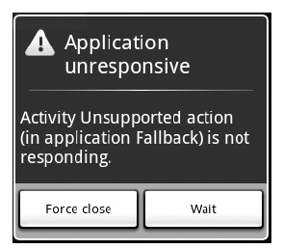
Threading
Being Responsive (1sec)
  Respond to any user action within 5 seconds.
  A Broadcast Receiver must return within 10 seconds.
What to thread?
  Network, file IO, Complex processing
How?
  New Thread
  Synchronize threads
    Handler.post()

Slide 23
MP1 Threading Structure
Is it enough?
GUI
Acitivty
Network
Service
Server Socket
Server Socket
Server Socket
Spawn
Thread

Slide 24
Periodical Register with Server
Every 15 seconds
How to update PeerList on PeerList GUI?
  Intent
Timer

Slide 25
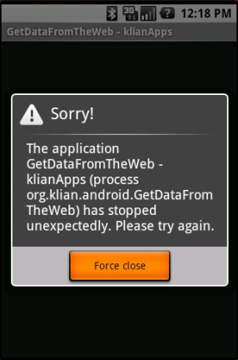
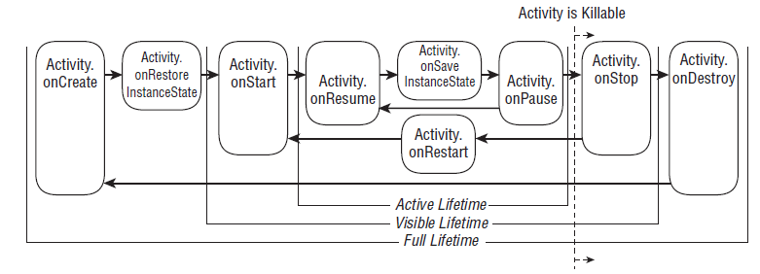
Activity Lifetime
Android apps do not control their lifetime.
Active (Foreground) - Paused (FG, lose focus) - Stopped (invisible) – Inactive (kill, exit)
create Services and threads
threads, processes, or Broadcast Receivers
Broadcast Receivers exclusively used to update UI

Slide 26
Declaration of App – Manifest.xml
Service
Activity (intent-filter)
Permission
  Don’t forget. Otherwise, your socket programming won’t run
<?xml version="1.0" encoding="utf-8" ?>
<manifest xmlns:android="http://schemas.android.com/apk/res/android"
android:versionCode="1“ android:versionName="1.0“ package="com.uiuc.cs425">
<application android:icon="@drawable/icon" android:label="@string/app_name" android:debuggable="true">
<service android:name=".services.IMService" />
<activity android:name=".Register">
<intent-filter>
<action android:name="android.intent.action.MAIN" />
<category android:name="android.intent.category.LAUNCHER" />
</intent-filter>
</activity>
<activity android:name=".PeerList">
<intent-filter>
<action android:name="android.intent.action.MAIN" />
<category android:name="android.intent.category.NORMAL" />
</intent-filter>
</activity>
<activity android:name=".Messaging">
…
</activity>
</application>
…
<uses-permission android:name="android.permission.INTERNET" />
<uses-permission android:name="android.permission.ACCESS_NETWORK_STATE" />
</manifest>

Slide 27
External Resources
View
Activity
Intent
Thread
Resource
Service
values/
  String, color, array, dimension, style theme
drawables/
  Image
layout/
  screen.xml

Slide 28
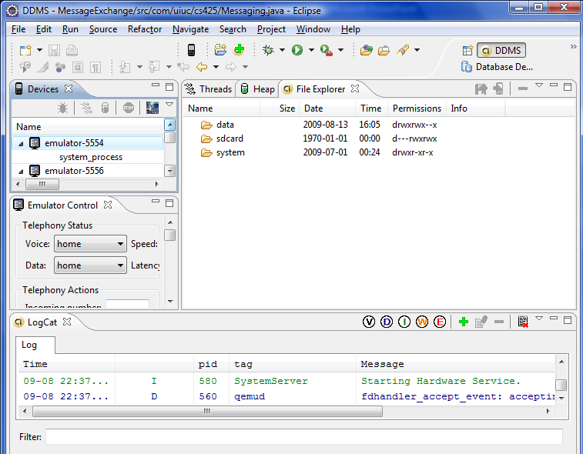
Debug
System.err.println()
Package - android.util.Log
View results
  Logcat
  Eclipse IDE

Slide 29
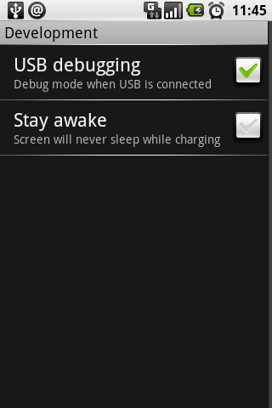
Debug on Device
On device
  Debug mode
On desktop
  Connect your G1 with your PC
  When it asks for driver location choose
    For windows, android-sdk-windows-1.5_r3\usb_driver\x86\
  You'll see sth like "HTC Dream Composite ADB Interface" on success
  (Re)Start Eclipse
  Your G1 should now be listed in the DDMS-Perspective under Device
Reference: [http://www.anddev.org/debugging-installing_apps_on_the_g1_windows_driver-t3236.html]

Slide 30
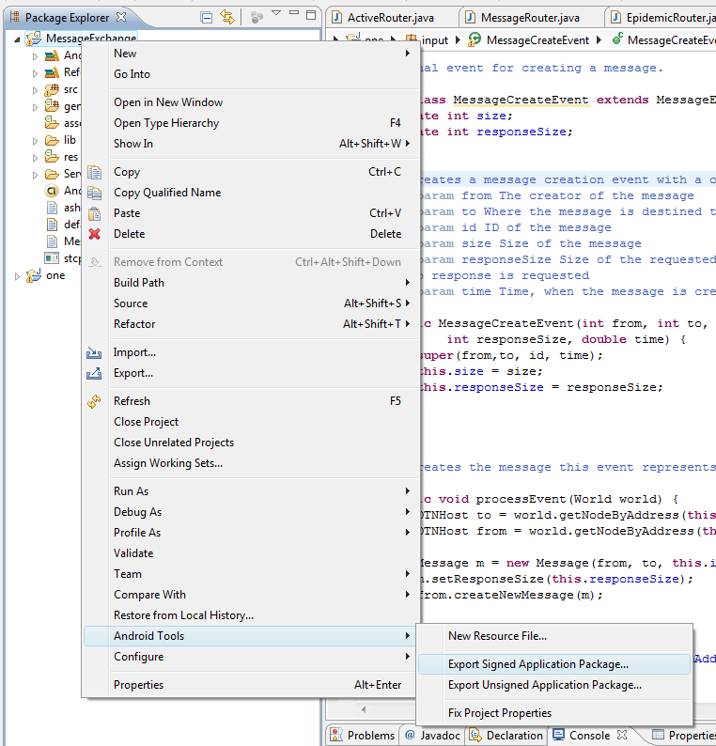
Install package to Android Phones
Compile the apk packages in Eclipse
  Export signed application package
adb install …apk
  Error: uninstall

Slide 31
Other Tips
Automatic imports of packages
In Eclipse, cmd-shift-o or ctrl-shift-o
Start as early as possible
  Possible task partition for a group
    P1: GUI, activity, intent
    P2: network service
    P3: integration

Slide 32

Demo

Slide 33

Dalvik Debug Monitoring Service

Slide 34
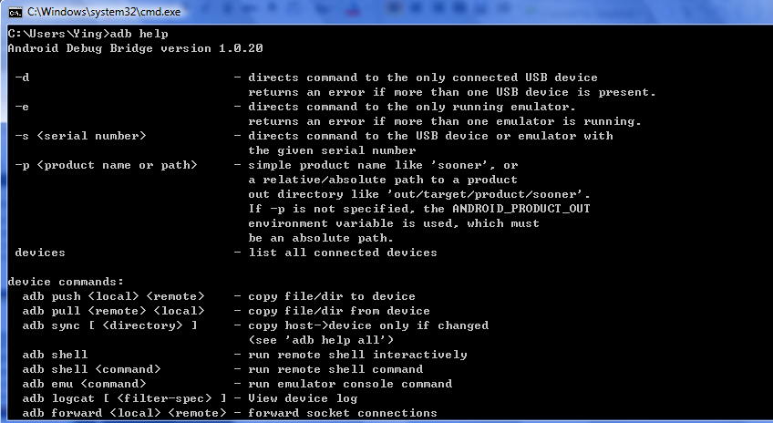
Android Debug Bridge (ADB)

