Slide 1
Programming Languages and Compilers (CS 421) #2: Ocaml, environments, closures
Madhusudan Parthasarathy (madhu)
3112 Siebel Center madhu@illinois.edu
https://courses.engr.illinois.edu/cs421/fa2017/CS421D
Based on slides by Elsa Gunter, who made these slides mostly, in part borrowing from slides by Mattox Beckman, as updated by Vikram Adve and Gul Agha

Slide 2
Features of OCAML
Higher order applicative language
Call-by-value parameter passing
Modern syntax
Parametric polymorphism
Aka structural polymorphism
Automatic garbage collection
User-defined algebraic data types
It’s fast - winners of the 1999 and 2000 ICFP Programming Contests used OCAML

Slide 3
Why learn OCAML?
Many features not clearly in languages you have already learned
Assumed basis for much research in programming language research
OCAML is particularly efficient for programming tasks involving languages (eg parsing, compilers, user interfaces)
Industrially Relevant: Jane Street trades billions of dollars per day using OCaml programs
Similar languages: Microsoft F#, SML, Haskell, Scala

Slide 4
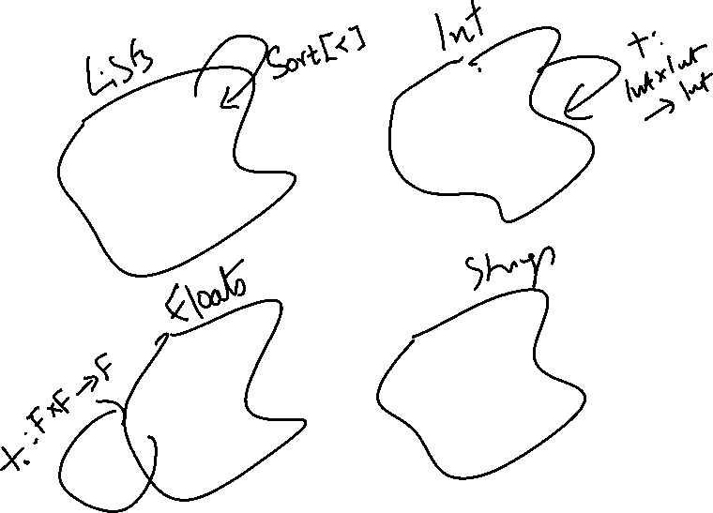

Slide 5
What are values of function expressions ?
Continuations
Expressions
Values
Types

Slide 6
Session in OCAML
% ocaml
Objective Caml version 4.01
# (* Read-eval-print loop; expressions and declarations *)
2 + 3;; (* Expression *)
: int = 5
# 3 < 2;;
- : bool = false

Slide 7
No Overloading for Basic Arithmetic Operations
# 15 * 2;;
- : int = 30
# 1.35 + 0.23;; (* Wrong type of addition *)
Characters 0-4:
1.35 + 0.23;; (* Wrong type of addition *)
^^^^
Error: This expression has type float but an expression was expected of type
int
# 1.35 +. 0.23;;
- : float = 1.58

Slide 8
No Implicit Coercion
# 1.0 * 2;; (* No Implicit Coercion *)
Characters 0-3:
1.0 * 2;; (* No Implicit Coercion *)
^^^
Error: This expression has type float but an expression was expected of type
int

Slide 9
Sequencing Expressions
# "Hi there";; (* has type string *)
- : string = "Hi there"
# print_string "Hello world\n";; (* has type unit *)
Hello world
- : unit = ()
# (print_string "Bye\n"; 25);; (* Sequence of exp *)
Bye
- : int = 25

Slide 10
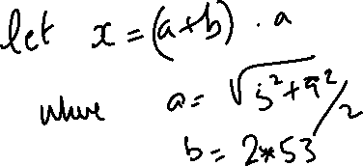
Declarations; Sequencing of Declarations
# let x = 2 + 3;; (* declaration *)
val x : int = 5
# let test = 3 < 2;;
val test : bool = false
# let a = 1 let b = a + 4;; (* Sequence of dec *)
val a : int = 1
val b : int = 5

Slide 11
Environments
Environments record what value is associated with a given identifier
Central to the semantics and implementation of a language
Notation
ρ = {name₁ → value₁, name₂→ value₂, …}
Using set notation, but describes a partial function
Often stored as list, or stack
To find value start from left and take first match

Slide 12
Environments
X ➔ 3
name ➔ “Steve”
. . .
region ➔ (5.4, 3.7)
y ➔ 17
id ➔ {Name = “Paul”,
Age = 23,
SSN = 999888777}
b ➔ true

Slide 13
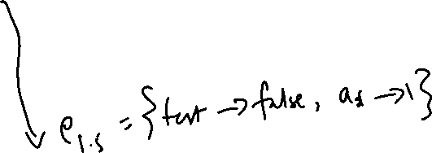
Global Variable Creation
# 2 + 3;; (* Expression *)
// doesn’t affect the environment
# let test = 3 < 2;; (* Declaration *)
val test : bool = false
// ρ₁ = {test → false}
# let a = 1 let b = a + 4;; (* Seq of dec *)
// ρ₂ = {b → 5, a → 1, test → false}

Slide 14
Environments
test ➔ true
a ➔ 1
b ➔ 5

Slide 15
New Bindings Hide Old
// ρ₂ = {b → 5, a → 1, test → false}
let test = 3.7;;
What is the environment after this declaration?

Slide 16
New Bindings Hide Old
// ρ₂ = {b → 5, a → 1, test → false}
let test = 3.7;;
What is the environment after this declaration?
// ρ₃ = {test → 3.7, a → 1, b → 5}

Slide 17
Environments
test ➔ 3.7
a ➔ 1
b ➔ 5

Slide 18
Now it’s your turn
You should be able to do WA1 Problem 1 , parts (* 1 *) and (* 2 *)

Slide 19
Local Variable Creation
test ➔ 3.7
// ρ₃ = {test → 3.7, a → 1, b → 5}
# let b = 5 * 4
// ρ₄ = {b → 20, test → 3.7, a → 1}
in 2 * b;;
- : int = 40
// ρ₅ = ρ₃= {test → 3.7, a → 1, b → 5}
# b;;
- : int = 5
a ➔ 1
b ➔ 5
test ➔ 3.7
a ➔ 1
b ➔ 20
b ➔ 5
test ➔ 3.7
a ➔ 1
b ➔ 5

Slide 20
Local let binding
a ➔ 1
test ➔ 3.7
// ρ₅ = {test → 3.7, a → 1, b → 5}
# let c =
let b = a + a
// ρ₆ = {b → 2} + ρ₃
// ={b → 2, test → 3.7, a → 1}
in b * b;;
val c : int = 4
// ρ₇ = {c → 4, test → 3.7, a → 1, b → 5}
# b;;
- : int = 5
b ➔ 5

Slide 21
Local let binding
a ➔ 1
test ➔ 3.7
// ρ₅ = {test → 3.7, a → 1, b → 5}
# let c =
let b = a + a
// ρ₆ = {b → 2} + ρ₃
// ={b → 2, test → 3.7, a → 1}
in b * b;;
val c : int = 4
// ρ₇ = {c → 4, test → 3.7, a → 1, b → 5}
# b;;
- : int = 5
b ➔ 5
a ➔ 1
test ➔ 3.7
b ➔ 2
b ➔ 5

Slide 22
Local let binding
a ➔ 1
test ➔ 3.7
// ρ₅ = {test → 3.7, a → 1, b → 5}
# let c =
let b = a + a
// ρ₆ = {b → 2} + ρ₃
// ={b → 2, test → 3.7, a → 1}
in b * b;;
val c : int = 4
// ρ₇ = {c → 4, test → 3.7, a → 1, b → 5}
# b;;
- : int = 5
b ➔ 5
a ➔ 1
test ➔ 3.7
b ➔ 2
b ➔ 5
a ➔ 1
test ➔ 3.7
c ➔ 4
b ➔ 5

Slide 23
Now it’s your turn
You should be able to do WA1 Problem 1 , parts (* 3 *) and (* 4 *)

Slide 24
Booleans (aka Truth Values)
# true;;
- : bool = true
# false;;
- : bool = false
// ρ₇ = {c → 4, test → 3.7, a → 1, b → 5}
# if b > a then 25 else 0;;
- : int = 25

Slide 25
Booleans and Short-Circuit Evaluation
# 3 > 1 && 4 > 6;;
- : bool = false
# 3 > 1 || 4 > 6;;
- : bool = true
# (print_string "Hi\n"; 3 > 1) || 4 > 6;;
Hi
- : bool = true
# 3 > 1 || (print_string "Bye\n"; 4 > 6);;
- : bool = true
# not (4 > 6);;
- : bool = true

Slide 26
Now it’s your turn
You should be able to do WA1 Problem 1 , part (* 5 *)

Slide 27
Tuples as Values
// ρ₇ = {c → 4, test → 3.7,
a → 1, b → 5}
# let s = (5,"hi",3.2);;
val s : int * string * float = (5, "hi", 3.2)
// ρ₈ = {s → (5, "hi", 3.2),
c → 4, test → 3.7,
a → 1, b → 5}
a ➔ 1
b ➔ 5
test ➔ 3.7
c ➔ 4
a ➔ 1
b ➔ 5
test ➔ 3.7
c ➔ 4
s ➔ (5, ”hi”, 3.2)

Slide 28
Pattern Matching with Tuples
/ ρ₈ = {s → (5, "hi", 3.2),
c → 4, test → 3.7,
a → 1, b → 5}
# let (a,b,c) = s;; (* (a,b,c) is a pattern *)
val a : int = 5
val b : string = "hi"
val c : float = 3.2
# let x = 2, 9.3;; (* tuples don't require parens in Ocaml *)
val x : int * float = (2, 9.3)
a ➔ 1
b ➔ 5
test ➔ 3.7
c ➔ 4
s ➔ (5, ”hi”, 3.2)
b ➔ “hi”
a ➔ 5
test ➔ 3.7
s ➔ (5, ”hi”, 3.2)
c ➔ 3.2
a ➔ 5
b ➔ “hi”
test ➔ 3.7
s ➔ (5, ”hi”, 3.2)
c ➔ 3.2
x ➔ (2, 9.3)

Slide 29
Nested Tuples
# (*Tuples can be nested *)
let d = ((1,4,62),("bye",15),73.95);;
val d : (int * int * int) * (string * int) * float =
((1, 4, 62), ("bye", 15), 73.95)
# (*Patterns can be nested *)
let (p,(st,_),_) = d;; (* _ matches all, binds nothing *)
val p : int * int * int = (1, 4, 62)
val st : string = "bye"

Slide 30
Now it’s your turn
You should be able to do WA1 Problem 1 , part (* 6 *)

Slide 31
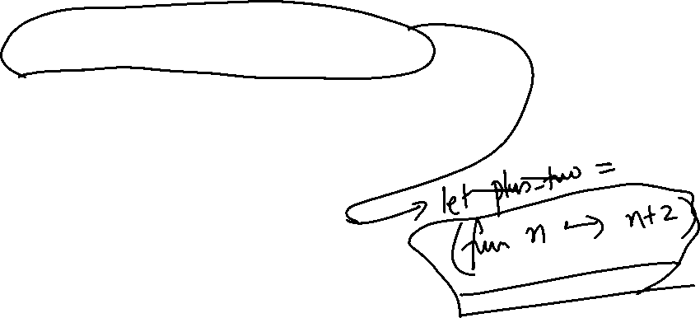
Functions
# let plus_two n = n + 2;;
val plus_two : int -> int = <fun>
# plus_two 17;;
- : int = 19

Slide 32
Functions
let plus_two n = n + 2;;
plus_two 17;;
- : int = 19

Slide 33
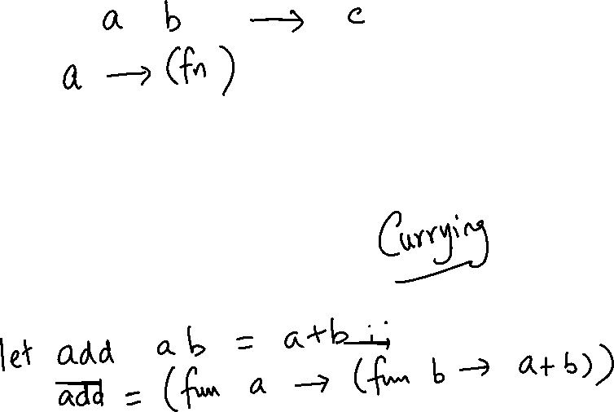
Nameless Functions (aka Lambda Terms)
fun n -> n + 2;;
(fun n -> n + 2) 17;;
- : int = 19

Slide 34
Functions
# let plus_two n = n + 2;;
val plus_two : int -> int = <fun>
# plus_two 17;;
- : int = 19
# let plus_two = fun n -> n + 2;;
val plus_two : int -> int = <fun>
# plus_two 14;;
- : int = 16
First definition syntactic sugar for second

Slide 35
Using a nameless function
# (fun x -> x * 3) 5;; (* An application *)
- : int = 15
# ((fun y -> y +. 2.0), (fun z -> z * 3));; (* As data *)
- : (float -> float) * (int -> int) = (<fun>, <fun>)
Note: in fun v -> exp(v), scope of variable is only the body exp(v)

Slide 36
Values fixed at declaration time
X ➔ 12
…
# let x = 12;;
val x : int = 12
# let plus_x y = y + x;;
val plus_x : int -> int = <fun>
# plus_x 3;;
What is the result?

Slide 37
Values fixed at declaration time
# let x = 12;;
val x : int = 12
# let plus_x y = y + x;;
val plus_x : int -> int = <fun>
# plus_x 3;;
- : int = 15

Slide 38
Values fixed at declaration time
# let x = 7;; (* New declaration, not an update *)
val x : int = 7
# plus_x 3;;
What is the result this time?

Slide 39
Values fixed at declaration time
# let x = 7;; (* New declaration, not an update *)
val x : int = 7
# plus_x 3;;
What is the result this time?
X ➔ 7
…
X ➔ 12
…

Slide 40
Values fixed at declaration time
# let x = 7;; (* New declaration, not an update *)
val x : int = 7
# plus_x 3;;
- : int = 15

Slide 41
Question
Observation: Functions are first-class values in this language
Question: What value does the environment record for a function variable?
Answer: a closure

Slide 42
Save the Environment!
A closure is a pair of an environment and an association of a sequence of variables (the input variables) with an expression (the function body), written:
f → < (v1,…,vn) → exp, ρ_{f} >
Where ρ_{f} is the environment in effect when f is defined (if f is a simple function)

Slide 43
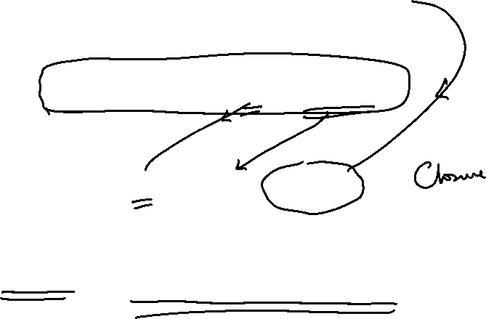
Closure for plus_x
When plus_x was defined, had environment:
ρ_{plus_x =} {…, x → 12, …}
Recall: let plus_x y = y + x
is really let plus_x = fun y -> y + x
Closure for fun y -> y + x:
<y → y + x, ρ_{plus_x} >
Environment just after plus_x defined:
{plus_x → <y → y + x, ρ_{plus_x} >} + ρ_{plus_x}

Slide 44
Now it’s your turn
You should be able to do WA1 Problem 1 , parts (* 7 *) and (* 8 *)

Slide 45
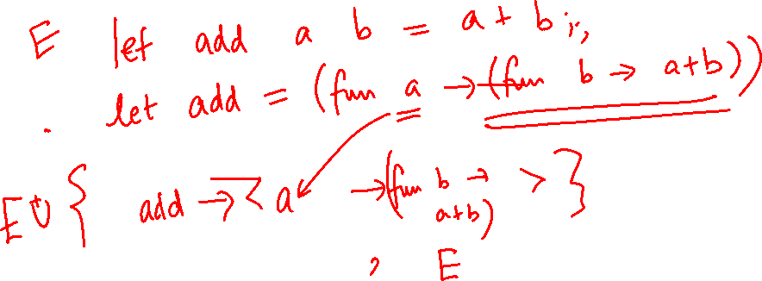

Slide 46
Evaluation of Application of plus_x;;
Have environment:
ρ = {plus_x → <y → y + x, ρ_{plus_x} >, … ,
y → 3, …}
where ρ_{plus_x} = {x → 12, … , y → 24, …}
Eval (plus_x y, ρ) rewrites to
App (Eval(plus_x, ρ) , Eval(y, ρ)) rewrites to
App (<y → y + x, ρ_{plus_x} >, 3) rewrites to
Eval (y + x, {y → 3} +ρ_{plus_x} ) rewrites to
Eval (3 + 12 , ρ_{plus_x} ) = 15

Slide 47
Functions with more than one argument
# let add_three x y z = x + y + z;;
val add_three : int -> int -> int -> int = <fun>
# let t = add_three 6 3 2;;
val t : int = 11
# let add_three =
fun x -> (fun y -> (fun z -> x + y + z));;
val add_three : int -> int -> int -> int = <fun>
Again, first syntactic sugar for second

Slide 48
Partial application of functions
let add_three x y z = x + y + z;;
# let h = add_three 5 4;;
val h : int -> int = <fun>
# h 3;;
- : int = 12
# h 7;;
- : int = 16

Slide 49
Functions as arguments
# let thrice f x = f (f (f x));;
val thrice : ('a -> 'a) -> 'a -> 'a = <fun>
# let g = thrice plus_two;;
val g : int -> int = <fun>
# g 4;;
- : int = 10
# thrice (fun s -> "Hi! " ^ s) "Good-bye!";;
- : string = "Hi! Hi! Hi! Good-bye!"

Slide 50
Functions on tuples
# let plus_pair (n,m) = n + m;;
val plus_pair : int * int -> int = <fun>
# plus_pair (3,4);;
- : int = 7
# let double x = (x,x);;
val double : 'a -> 'a * 'a = <fun>
# double 3;;
- : int * int = (3, 3)
# double "hi";;
- : string * string = ("hi", "hi")

Slide 51
Match Expressions
# let triple_to_pair triple =
match triple
with (0, x, y) -> (x, y)
| (x, 0, y) -> (x, y)
| (x, y, _) -> (x, y);;
val triple_to_pair : int * int * int -> int * int = <fun>
Each clause: pattern on left, expression on right
Each x, y has scope of only its clause
Use first matching clause

Slide 52
Closure for plus_pair
Assume ρ_{plus_pair} was the environment just before plus_pair defined
Closure for plus_pair:
<(n,m) → n + m, ρ_{plus_pair}>
Environment just after plus_pair defined:
{plus_pair → <(n,m) → n + m, ρ_{plus_pair} >} + ρ_{plus_pair}

