Slide 1
Lab 2
CS 418: Interactive Computer Graphics
UNIVERSITY OF ILLINOIS AT URBANA-CHAMPAIGN
Slides by Eric Shaffer

Slide 2
Agenda for Today
MP1 Exercise – Changing coordinates in the vertex buffer
Any MP1 Questions?

Slide 3
Drawing Triangle Fans
WebGL offers as special drawing mode to render triangle fans
A triangle fan is a triangulated polygon with a central vertex
This central vertex forms one corner of every triangle

Slide 4
Drawing Triangle Fans
vertexPositionBuffer = gl.createBuffer();
gl.bindBuffer(gl.ARRAY_BUFFER, vertexPositionBuffer);
var triangleVertices = [
0.5, -0.5, 0.0,
1.0, 0.5, 0.0,
0.0, 0.5, 0.0,
-0.5, -0.5, 0.0,
];
gl.bufferData(gl.ARRAY_BUFFER, new Float32Array(triangleVertices), gl.DYNAMIC_DRAW);
vertexPositionBuffer.itemSize = 3;
vertexPositionBuffer.numberOfItems = 4;
….
gl.drawArrays(gl.TRIANGLE_FAN, 0, vertexPositionBuffer.numberOfItems);
First vertex is the fan center
Next two vertices specify the first triangle
Each succeeding vertex forms a triangle with the center and previous vertex
Which vertices correspond to which coordinates in the code?

Slide 5
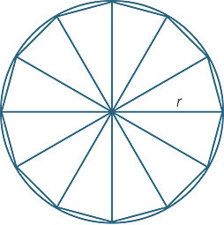
Drawing a Circle
We can procedurally generate the geometry for a circle
Easy to approximate the shape using a triangle fan

Slide 6
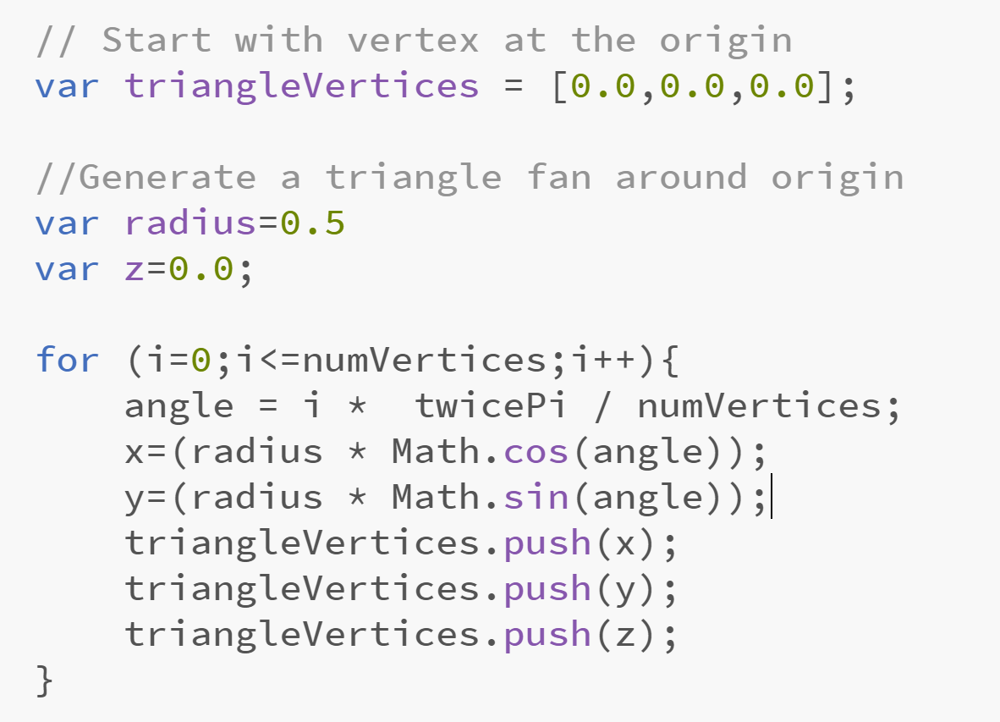
Generating the Circle Vertices
What would we draw if the loop were for(i=0;i<numVertices;i++) ?
Where in the array does the JavaScript push function place the new coordinate?

Slide 7
Exercise: Deforming a Mesh
Let’s try deforming the circle by explicitly changing the vertex buffer.
We’ll add offsets based on a sine curve to the circle boundary vertices
Grab the demo code and take a look….it should draw a circle

Slide 8
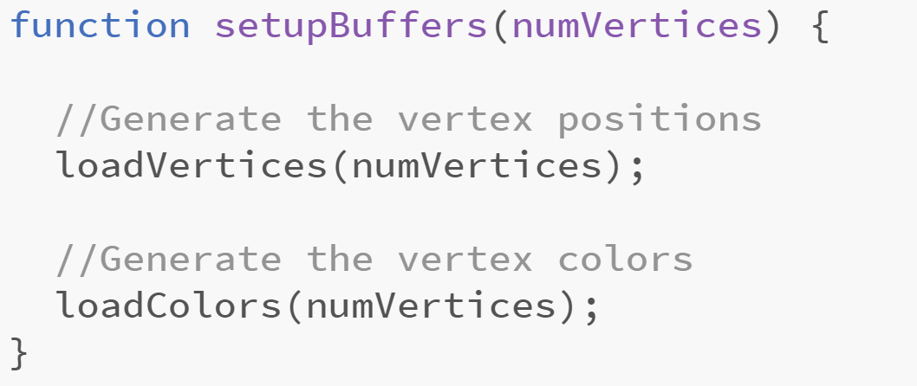
Deforming a Circle
Some things to notice about the code
gl.bufferData(gl.ARRAY_BUFFER, new Float32Array(triangleVertices), gl.DYNAMIC_DRAW);
This is a hint to WebGL that we’ll be changing the values in the buffer….
We keep a global defAngle that is incremented once per frame We’ll use this to move the deformation around the boundary boundary….
The setupBuffers function has been refactored There are now separate functions for setting up the vertex and color buffers. Why?

Slide 9
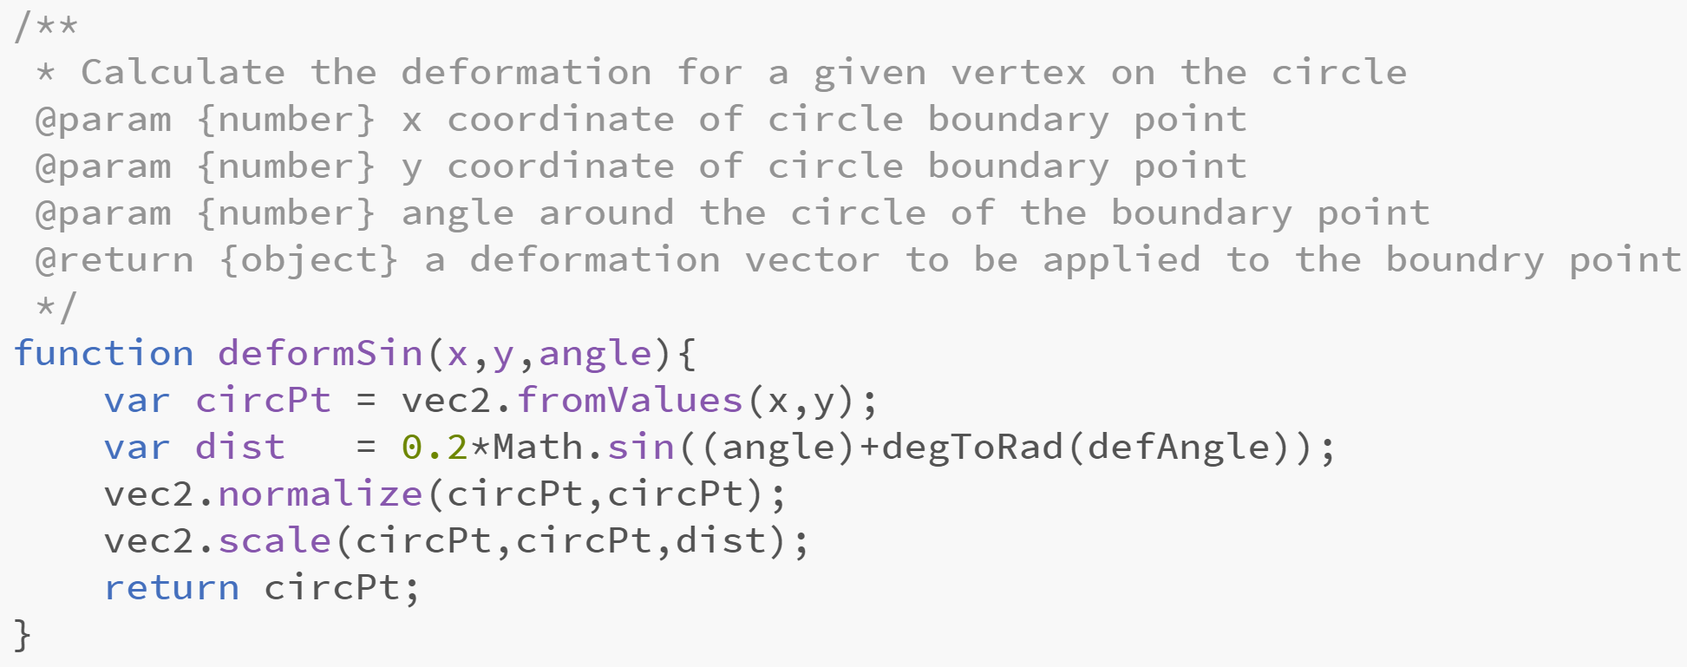
Deforming a Circle
Here’s some code you could use to calculate the deformation…
Can you explain what it is doing?

Slide 10
Deforming a Circle
Your Tasks
Add code for the deformSin function
In loadVertices, call deformSin Use it to adjust the positions of the boundary vertices
What needs to be added to the animate function? Just a single line…but it needs to happen to see the geometry change

