Slide 1

Lab 1
CS 418: Interactive Computer Graphics
UNIVERSITY OF ILLINOIS AT URBANA-CHAMPAIGN

Slide 2
Course Staff
Apollo Ellis
Ashwin Vijay
Sid Oderberg

Slide 3
Agenda for today
Some course information
Intro to Chrome Dev Tools
Machine Problem 1 specification
Some WebGL programming tips
  The WebGL view volume
  The glmatrix library
  Uniform variables
Programming demo

Slide 4
WebGL Resources
Mozzilla WebGL API reference
https://developer.mozilla.org/en-US/docs/Web/API/WebGL_API
Tutorials
  Learning WebGL
  http://learningwebgl.com
  WebGL Fundamentals
  https://webglfundamentals.org/
Stack Overflow
https://stackoverflow.com/

Slide 5
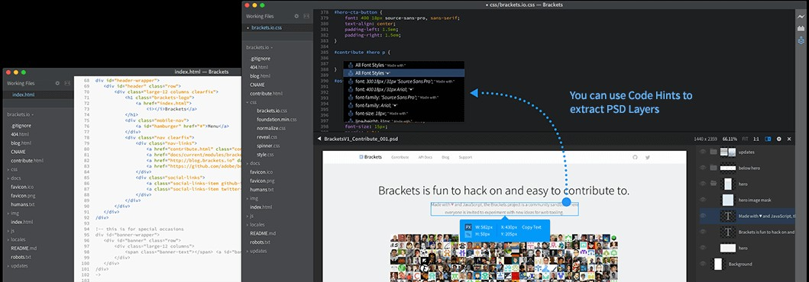
You Need a Text Editor
Brackets is a good choice…but whatever works for you is fine
http://brackets.io/

Slide 6
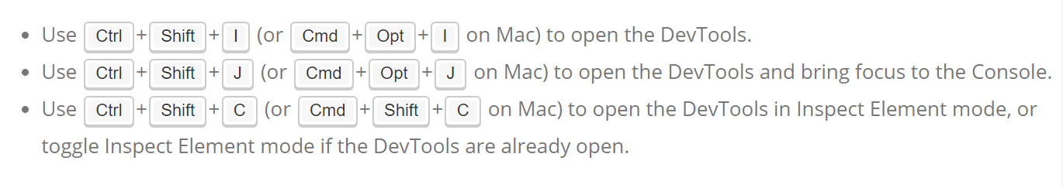
Chrome Development Tools
Recommended Development Environment
  http://www.google.com/chrome
Built-in debugging environment within Google Chrome browser
Use this to set breakpoints, examine variables, etc.
Check out the chrome devtools overview
https://developer.chrome.com/devtools
I

Slide 7
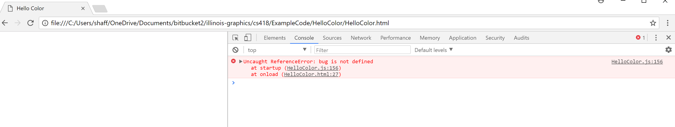
Dev Tools: How to Look at the Console…

Slide 8
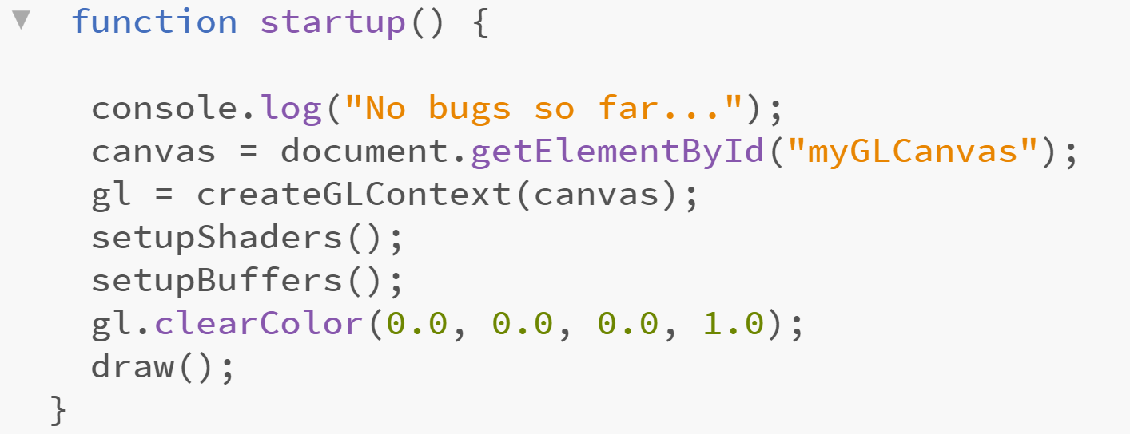
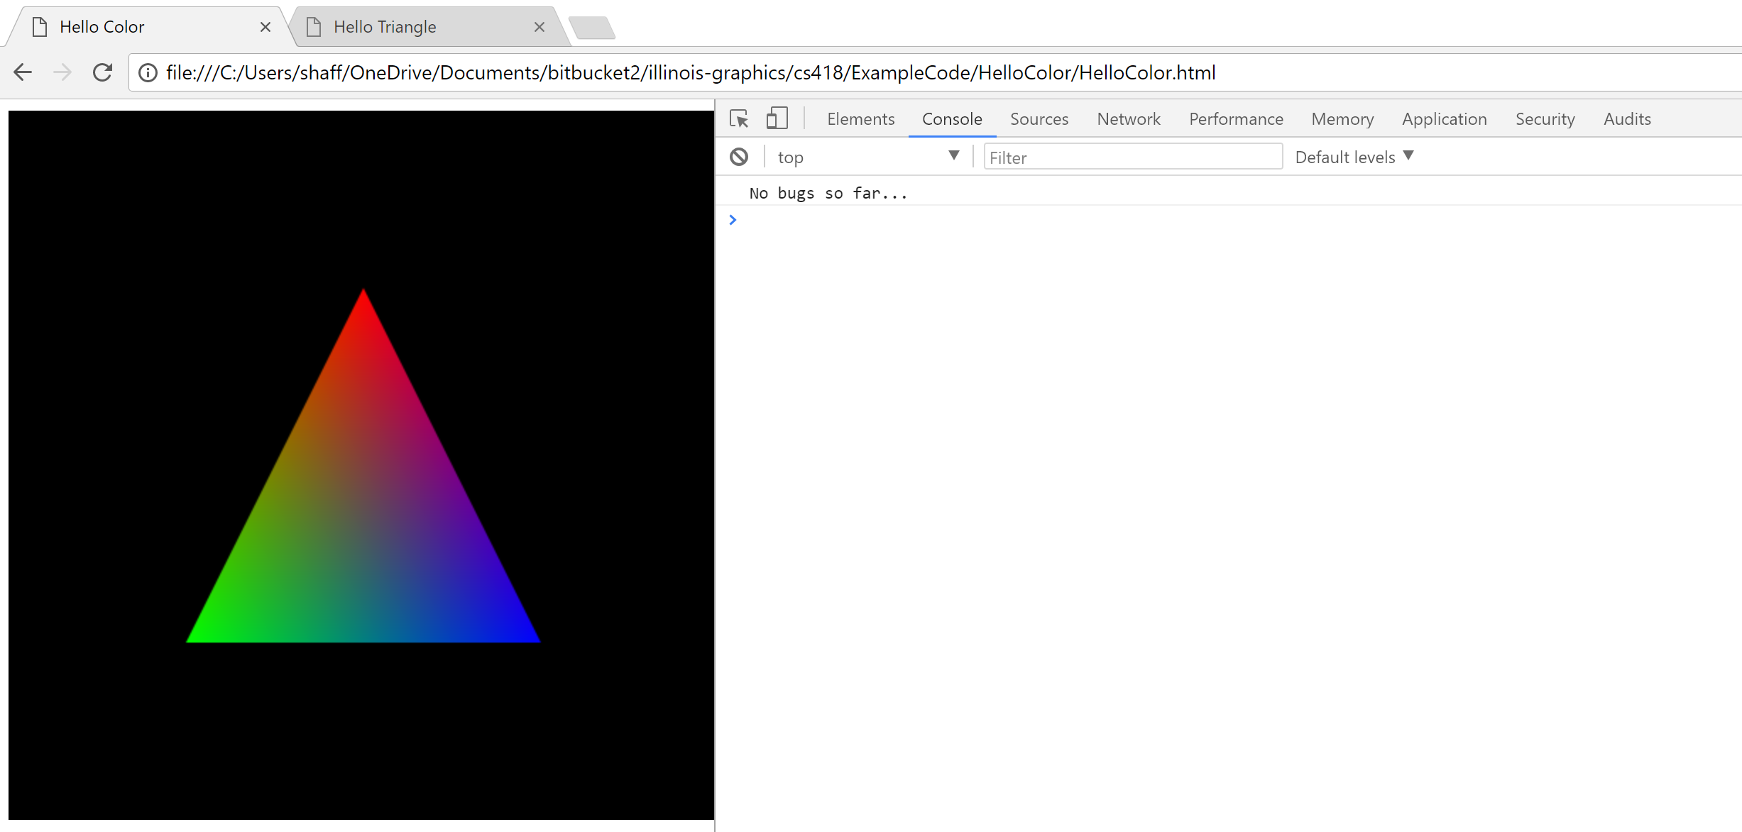
Dev Tools: How to Print to the Console

Slide 9
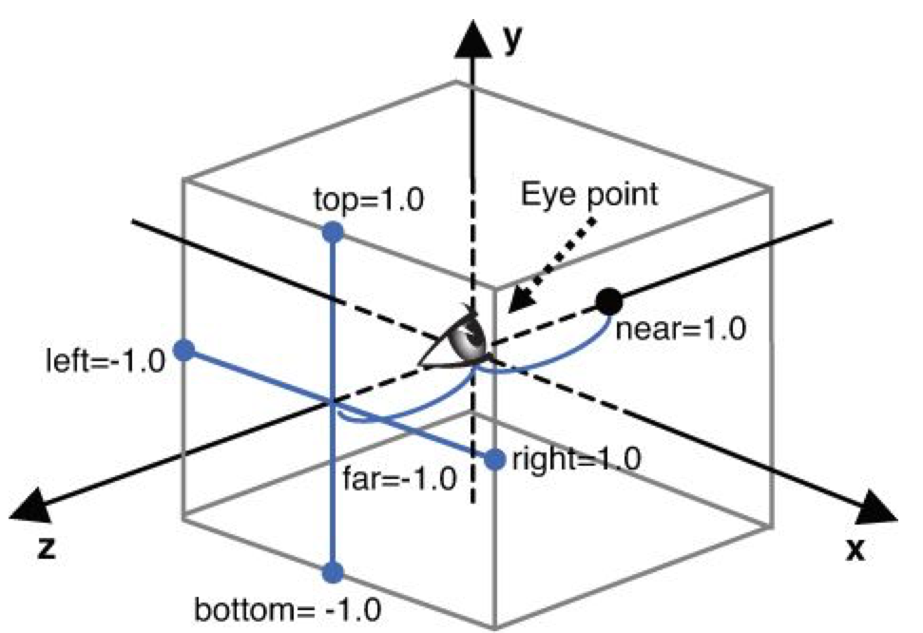
WebGL View Volume
View volume is a box running between [-1,1] in x, y, and z
Geometry outside volume will not be rendered
WebGL default eyepoint is on the z axis…

Slide 10
WebGL View Volume
How can you work with more convenient coordinates (e.g. [-100, 100])?
  Let’s call those world coordinates….
  View volume coordinates are often called clip coordinates
You can change coordinate systems pretty easily…
Specify your geometry in whatever world coordinates you want
Transform the coordinates into clip coordinates
  In other words…scale down all your geometry to fit in the view volume
  To do so we will use something called an affine transformation

Slide 11
Affine Transformations
Quick Overview
You can transform the coordinates of a vertex using a matrix
Just multiply the matrix M times the vertex p
  Convention is to use right multiplication of vertex Mp=q
You can easily perform
  Translation
  Scaling
  Rotation
We will work with 4D vertex coordinates <x, y, z, w> where w=1
  These are called homogeneous coordinates
  You will learn more in about them and transformations in lecture this week

Slide 12
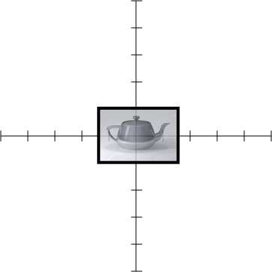
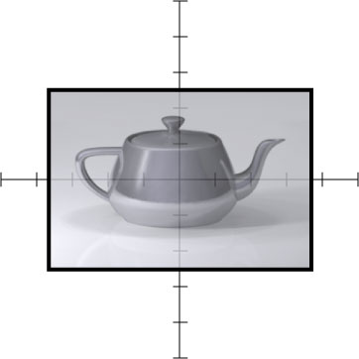
Scaling

Slide 13
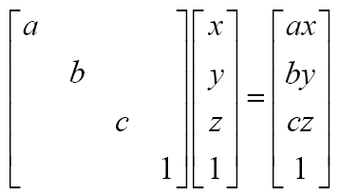
Scaling

Slide 14
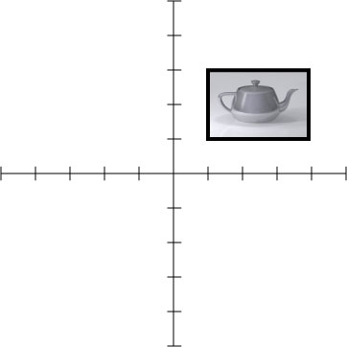
Translation

Slide 15
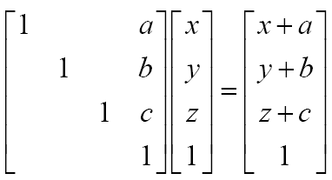
Translation

Slide 16
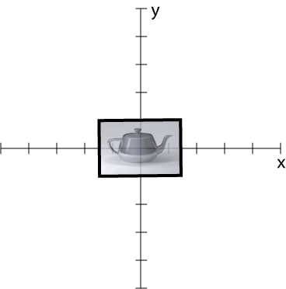
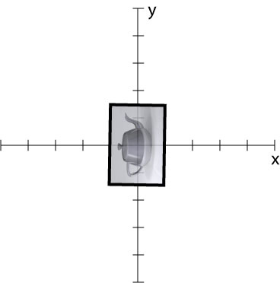
Rotation

Slide 17
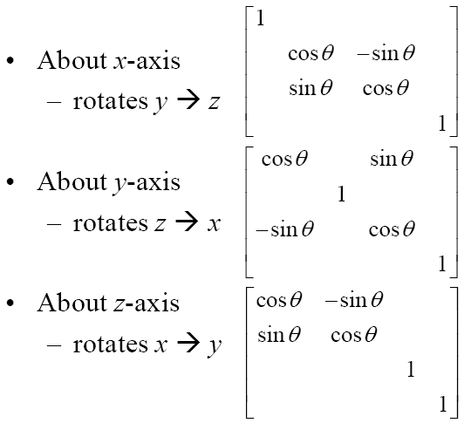
Rotation
You may also specify rotation
about an arbitrary axis…

Slide 18
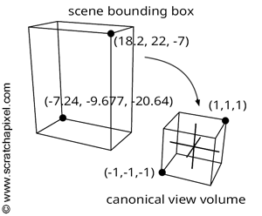
The ortho Transformation
The ortho transformation maps any rectangular axis-aligned viewing volume to the WebGL view volume
It’s basically just a translation and scale

Slide 19
Programming Transformations
One way to move geometry is to apply an affine transformation to it.
We can encode that transformation using a matrix multiplication
The transformation can be implemented in the vertex shader
    In the JavaScript we create a matrix using the glMatrix library
    That matrix is then passed to the vertex shader as a Uniform variable
    Let’s look at the code……

Slide 20
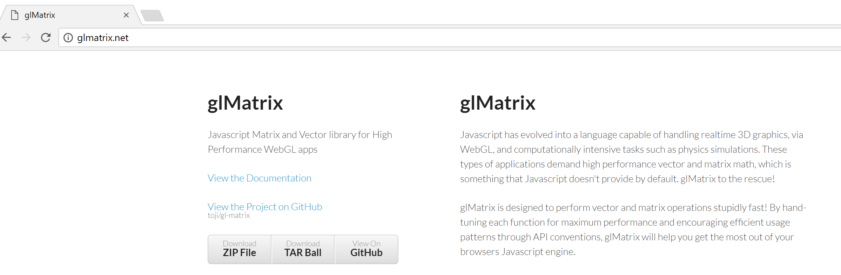
The glmatrix Library
A javascript library that supports 3D matrix and vector operations
To use it grab a copy from glmatrix.net

Slide 21
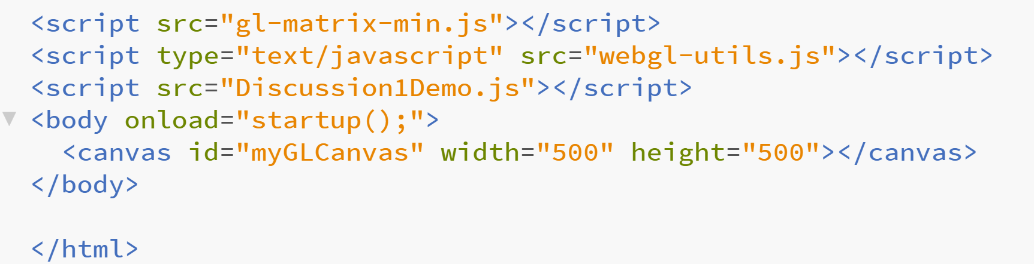
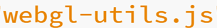
The glmatrix Library
Add a line to your html file with the location of the glmatrix library
In this example, library is in the same folder/directory as html file
  Also, a set of utility JavaScript code is being used as well

Slide 22
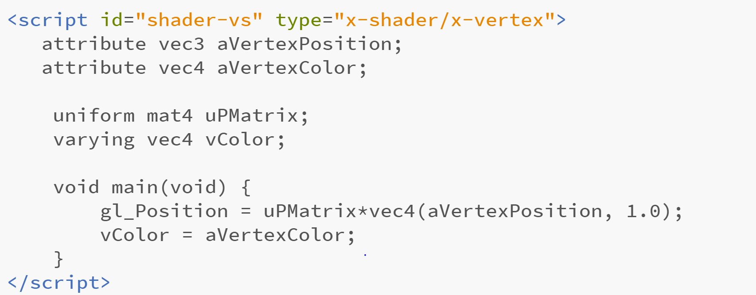
Transforming a Vertex in a Shader
This vertex shader code expects a matrix to be loaded from the application
The matrix is provided as a uniform variable

Slide 23
Transforming a Vertex in a Shader
In GLSL a uniform is a variable that is
the same for all executions of a shader program in a given draw call
In GLSL an attribute is a variable that may be
different for all executions of a shader program in a given draw call

Slide 24
Creating an ortho Matrix in JavaScript
First, when you create the shader program, get the uniform location
shaderProgram.pMatrixUniform = gl.getUniformLocation(shaderProgram, "uPMatrix");
Create the matrix
var pMatrix = mat4.create();
mat4.ortho(pMatrix, left, right , bottom , top , near, far);
Send the matrix to the GPU before you issue a draw call
gl.uniformMatrix4fv(shaderProgram.pMatrixUniform, false, pMatrix);

Slide 25
The ortho Matrix
The parameters left and right are the x coordinates of the planes forming those sides of the view volume
The parameters top and bottom are the y coordinates of the planes forming those sides of the view volume
The parameters near and far are distances down the negative z axis measured from the origin
For our 2D work we can just keep near=-1 and far=1

Slide 26
Programming Exercise
Download Brackets if you need an editor
Download the demo code and unzip it
Modify the code to display a capital block I instead of an L
Use a convenient coordinate system
Apply an ortho transformation to the block I
Test for correctness and debug
Make it multi-colored (e.g. display a gradient from orange to blue)
Test for correctness and debug
Pro-tip:
Implement and test each new feature separately

