Slide 1
I/O and Filesystems
Based on slides by Matt Welsh, Harvard

Slide 2
Announcements
Finals approaching, make sure you know when yours are
Ours: May 11, 1:30 – 4:30 pm
Honors projects due soon
By April 30: contact us to schedule demo
Before final exam: complete demo
All members must contribute substantially and understand the entire project

Slide 3
But first, review

Slide 4
Threads in your web server
Why are multiple threads useful in your web server – as opposed to serving all clients with a single thread in a single process? (Check all that apply)
Multiple threads can spread work across multiple cores / CPUs to decrease processing time.
Multiple threads have greater memory space to read files and write them to the network.
A single thread would have to switch back and forth between each connection, which is slow and annoying to program.
One thread can be reading/writing from the network while another is waiting to read a file off disk.

Slide 5
DNS caching
Why does the DNS system use caching? (Check all that apply)
Returns more up-to-date results
Improves speed of response
Decreases workload on root and authoritative DNS servers
Improves security
Improves robustness (things still work even if some DNS servers fail)

Slide 6
Part 1: Disks

Slide 7
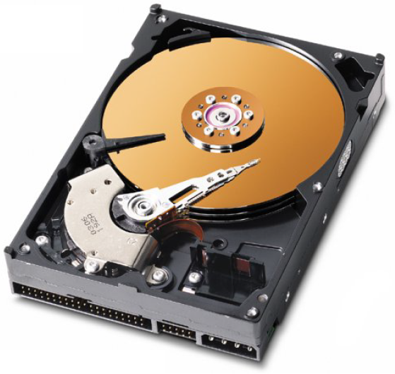
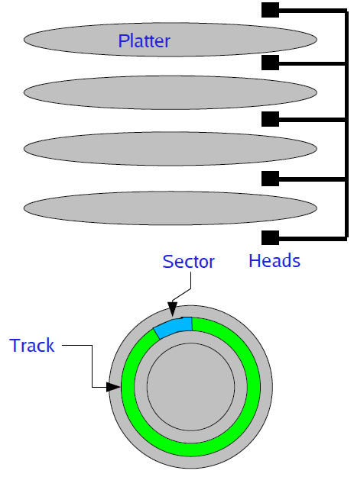
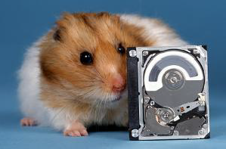
A Disk Primer
Disks consist of one or more platters divided into tracks
Each platter may have one or two heads that perform read/write operations
Each track consists of multiple sectors
The set of sectors across all platters is a cylinder
Notes:
http://www.youtube.com/watch?v=9eMWG3fwiEU

Slide 8
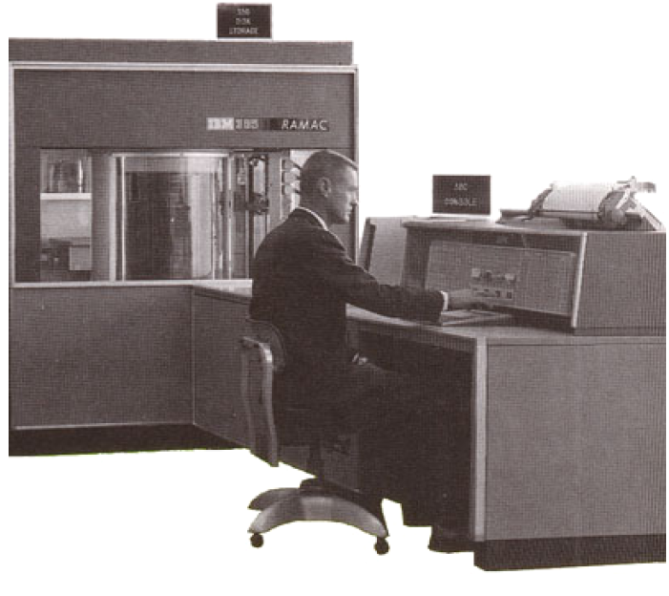
Hard Disk Evolution
IBM 305 RAMAC (1956)
First commercially produced hard drive
5 Mbyte capacity, 50 platters each 24” in diameter

Slide 9
Cost of recording your life
How much does the disk storage to record the audio of your entire life cost?
The whole thing ... even when you’re asleep and even the part you haven’t lived yet
Assume pretty good quality audio

Slide 10
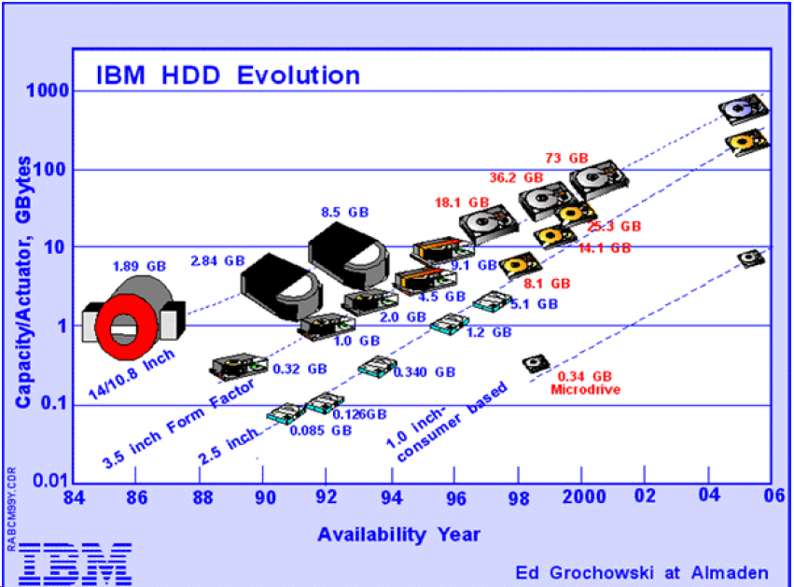
Hard Drive Evolution

Slide 11
Disk access time
Command overhead:
Time to issue I/O, get the HDD to start responding, select appropriate head
Seek time:
Time to move disk arm to the appropriate track
Depends on how fast you can physically move the disk arm
These times are not improving rapidly!
Settle time:
Time for head position to stabilize on the selected track
Rotational latency:
Time for the appropriate sector to move under the disk arm
Depends on the rotation speed of the disk (e.g., 7200 RPM)
Transfer time
Time to transfer a sector to/from the disk controller
Depends on density of bits on disk and RPM of disk rotation

Slide 12
Disks are messy and slow
Low-level interface for reading and writing sectors
Generally allow OS to read/write an entire sector at a time
No notion of “files” or “directories” – just raw sectors
So, what do you do if you need to write a single byte to a file?
Disk may have numerous bad blocks – OS may need to mask this from filesystem
Access times are still very slow
Disk seek times are around 10 ms
Although raw throughput has increased dramatically
Compare to several nanosec to access main memory
Requires careful scheduling of I/O requests

Slide 13
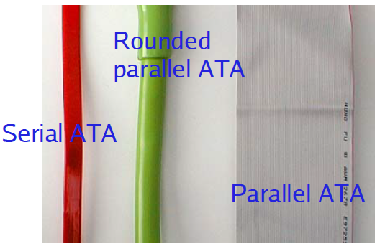
ATA Interfaces
Serial ATA (SATA): Today’s standard for connecting hard drives to the motherboard
Using a serial (not parallel) interface
Earlier versions used a parallel interface (PATA)
Speeds starting at 1.5 Gbit/sec (SATA 1.0)
SATA 2.0 (3.0 Gbit/sec), SATA 3.0 (6.0 Gbit/sec)
Can drive longer cables at much higher clock speeds than parallel cable

Slide 14
Disk I/O Scheduling
Given multiple outstanding I/O requests, what order to issue them?
Why does it matter?
Major goals of disk scheduling:
1) Minimize latency for small transfers
Primarily: Avoid long seeks by ordering accesses according to disk head locality
2) Maximize throughput for large transfers
Large databases and scientific workloads often involve enormous files and datasets
Note that disk block layout also has a large impact on performance
Where we place file blocks, directories, file system metadata, etc.
This will be covered in future lectures

Slide 15
Disk I/O Scheduling
Given multiple outstanding I/O requests, what order to issue them?
FIFO: Just schedule each I/O in the order it arrives
What's wrong with this? Potentially lots of seek time!
SSTF: Shortest seek time first
Issue I/O with the nearest cylinder to the current one
Favors middle tracks: Head rarely moves to edges of disk
SCAN (or Elevator) Algorithm:
Head has a current direction and current cylinder
Sort I/Os according to the track # in the current direction of the head
If no more I/Os in the current direction, reverse direction
CSCAN Algorithm:
Always move in one direction, “wrap around” to beginning of disk when moving off the end
Idea: Reduce variance in seek times, avoid discriminating against the highest and lowest tracks

Slide 16
SCAN example
Current track
Direction

Slide 17
SCAN example
Current track
Direction

Slide 18
SCAN example
Current track
Direction

Slide 19
SCAN example
Current track
Direction

Slide 20
SCAN example
Current track
Direction

Slide 21
SCAN example
Current track
Direction

Slide 22
SCAN example
Current track
Direction

Slide 23
SCAN example
Current track
Direction

Slide 24
SCAN example
Current track
Direction

Slide 25
SCAN example
Current track
Direction

Slide 26
SCAN example
Current track
Direction
What is the overhead of the SCAN algorithm?
Count the total amount of seek time to service all I/O requests
I.e., count total number of track changes
In this case, 12 tracks in --> direction
15 tracks for long seek back
5 tracks in <-- direction
Total: 12+15+5 = 32 tracks

Slide 27
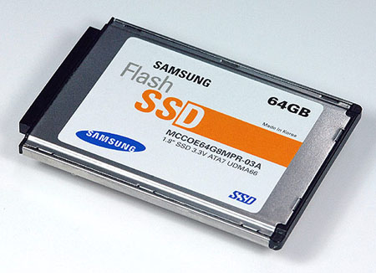
What about flash?
Non-volatile, solid state storage
No moving parts!
Fast access times (about 0.1 msec)
Can read and write individual bytes at a time
Limitations
Block erasure: However, must erase a whole “block” before writing to it
Read disturb: Reads can cause cells near the read cell to change
Solution: Periodically re-write blocks
Limited number of erase/write cycles
Most flash on the market today can withstand up to 1 million erase/write cycles
Flash Translation Layer (FTL): writes to a different cell each time to wear-level device, cache to avoid excessive writes
How does this affect how we design filesystems???
Notes:
Todo: more slides on flash

Slide 28
Part 2: I/O

Slide 29
Input and Output
A computer’s job is to process data
Computation (CPU, cache, and memory)
Move data into and out of a system (between I/O devices and memory)
Challenges with I/O devices
Different categories: storage, networking, displays, etc.
Large number of device drivers to support
Device drivers run in kernel mode and can crash systems
Goals of the OS
Provide a generic, consistent, convenient and reliable way to
access I/O devices
As device-independent as possible
Don’t hurt the performance capability of the I/O system too much

Slide 30
How does the CPU talk to devices?
Device controller: Circuit that enables devices to talk to the peripheral bus
Host adapter: Circuit that enables the computer to talk to the peripheral bus
Bus: Wires that transfer data between components inside computer
Device controller allows OS to specify simpler instructions to access data
Example: a disk controller
Translates “access sector 23” to “move head reader 1.672725272 cm from edge of platter”
Disk controller “advertises” disk parameters to OS, hides internal disk geometry
Most modern hard drives have disk controller embedded as a chip on the physical device

Slide 31
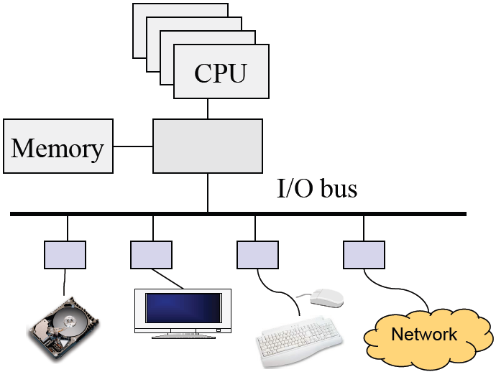
Review: Computer Architecture
Compute hardware
CPU and caches
Chipset
Memory
I/O Hardware
I/O bus or interconnect
I/O controller or adaptor
I/O device
Two types of I/O
Programmed I/O (PIO)
CPU does the work of moving data
Direct Memory Access (DMA)
CPU offloads the work of moving data to DMA controller

Slide 32
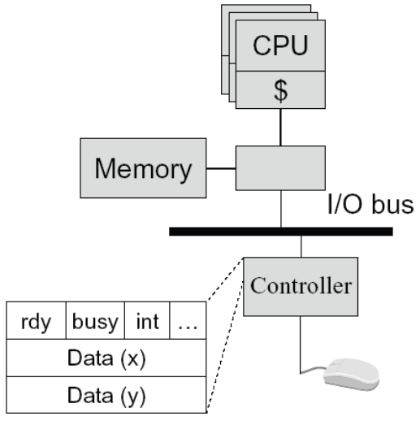
Programmed Input Device
Device controller
Status register
ready: tells if the host is done
busy: tells if the controller is done
int: interrupt
…
Data registers
A simple mouse design
When moved, put (X, Y) in mouse’s device controller’s data registers
Interrupt CPU
Input on an interrupt
CPU saves state of currently-executing program
Reads values in X, Y registers
Sets ready bit
Wakes up a process/thread or execute a piece of code to handle interrupt

Slide 33
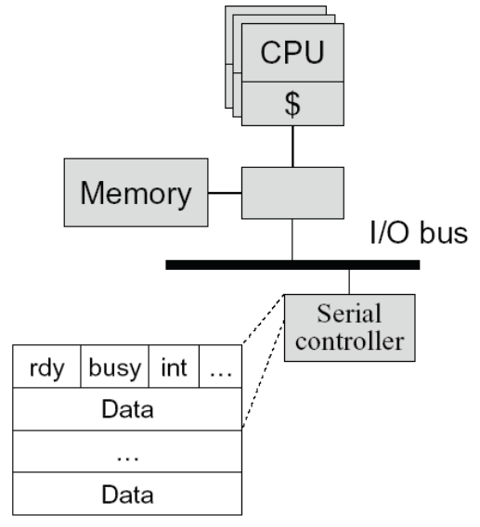
Programmed Output Device
Device
Status registers (ready, busy, … )
Data registers
Example
A serial output device
Perform an output
CPU: Poll the busy bit
Writes the data to data register(s)
Set ready bit
Controller sets busy bit and transfers data
Controller clears the busy bit
Notes:
Wait until ready bit is clear

Slide 34
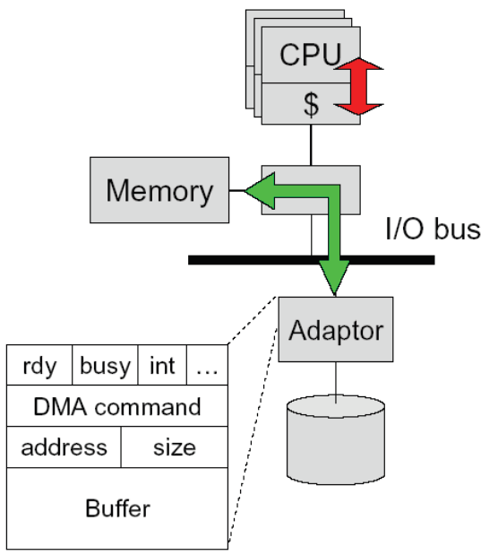
Direct Memory Access (DMA)
DMA controller or adaptor
Status register (ready, busy, interrupt, …)
DMA command register
DMA register (address, size)
DMA buffer
Host CPU initiates DMA
Device driver call (kernel mode)
Wait until DMA device is free
Initiate a DMA transaction
(command, memory address, size)
Block
Controller performs DMA
DMA data to device (size--; address++)
Interrupt on completion (size == 0)
Interrupt handler (on completion)
Wakeup the blocked process

Slide 35
Memory-mapped I/O
Use the same address bus to address both memory and I/O devices
The memory and registers of I/O devices are mapped to address values
Allows same CPU instructions to be used with regular memory and devices
I/O devices, memory controller, monitor address bus
Each responds to addresses they own
Orthogonal to DMA
May be used with, or without, DMA

Slide 36
Polling- vs. Interrupt-driven I/O
Polling
CPU issues I/O command
CPU directly writes instructions into device’s registers
CPU busy waits for completion
Interrupt-driven I/O
CPU issues I/O command
CPU directly writes instructions into device’s registers
CPU continues operation until interrupt
Direct Memory Access (DMA)
Typically done with Interrupt-driven I/O
CPU asks DMA controller to perform device-to-memory transfer
DMA issues I/O command and transfers new item into memory
CPU module is interrupted after completion
Which is better, polling or interrupt-driven I/O?

Slide 37
Polling- vs. Interrupt-driven I/O
Polling
Expensive for large transfers
Better for small, dedicated systems with infrequent I/O
Interrupt-driven
Overcomes CPU busy waiting
I/O module interrupts when ready: event driven

Slide 38
How Interrupts are implemented
CPU hardware has an interrupt report line that the CPU tests after executing every instruction
If a(ny) device raises an interrupt by setting interrupt report line
CPU catches the interrupt and saves the state of current running process into PCB
CPU dispatches/starts the interrupt handler
Interrupt handler determines cause, services the device and clears the interrupt report line
Other uses of interrupts: exceptions
Division by zero, wrong address
System calls (software interrupts/signals, trap)
Virtual memory paging

Slide 39
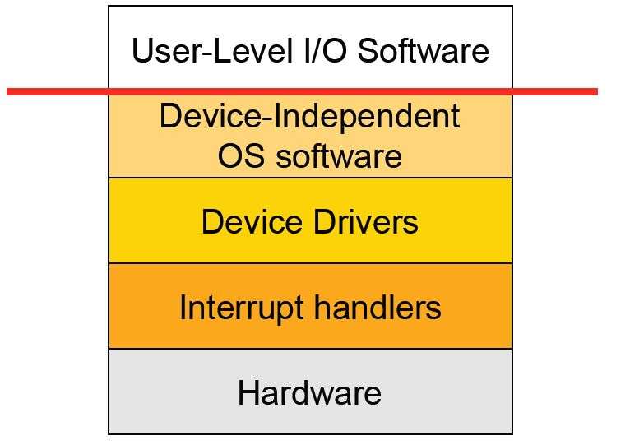
I/O Software Stack

Slide 40
Interrupt Handling
Save context (registers that hw hasn’t saved, PSW etc)
Mask interrupts if needed
Set up a context for interrupt service
Set up a stack for interrupt service
Acknowledge interrupt controller, perhaps enable it
Save entire context to PCB
Run the interrupt service
Unmask interrupts if needed
Possibly change the priority of the process
Run the scheduler
Then OS will set up context for next process, load registers and PSW, start running process …

Slide 41
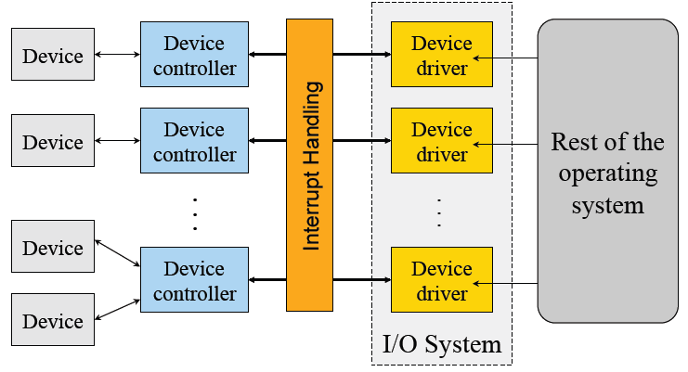
Device Drivers
Manage the complexity and differences among specific types of devices (disk vs. mouse, different types of disks …)
Each handles one type of device or small class of them (eg SCSI)

Slide 42
Typical Device Driver Design
Operating system and driver communication
Commands and data between OS and device drivers
Driver and hardware communication
Commands and data between driver and hardware
Driver responsibilities
Initialize devices
Interpreting commands from OS
Schedule multiple outstanding requests
Manage data transfers
Accept and process interrupts
Maintain the integrity of driver and kernel data structures

Slide 43
Device Driver Behavior
Check input parameters for validity, and translate them to device specific language
Check if device is free (wait or block if not)
Issue commands to control device
Write them into device controller’s registers
Check after each if device is ready for next (wait or block if not)
Block or wait for controller to finish work
Check for errors, and pass data to device-independent software
Return status information
Process next queued request, or block waiting for next
Challenges:
Must be reentrant (can be called by an interrupt while running)
Handle hot-pluggable devices and device removal while running
Complex and many of them; bugs in them can crash system

Slide 44
Types of I/O Devices
Block devices
Organize data in fixed-size blocks
Transfers are in units of blocks
Blocks have addresses and data are therefore addressable
E.g. hard disks, USB disks, CD-ROMs
Character devices
Delivers or accepts a stream of characters, no block structure
Not addressable, no seeks
Can read from stream or write to stream
Printers, network interfaces, terminals
Like everything, not a perfect classification
E.g. tape drives have blocks but not randomly accessed
Clocks are I/O devices that just generate interrupts

Slide 45
Char/Block Device Interfaces
Character device interface
read( deviceNumber, bufferAddr, size )
Reads “size” bytes from a byte stream device to “bufferAddr”
write( deviceNumber, bufferAddr, size )
Write “size” bytes from “bufferAddr” to a byte stream device
Block device interface
read( deviceNumber, deviceAddr, bufferAddr )
Transfer a block of data from “deviceAddr” to “bufferAddr”
write( deviceNumber, deviceAddr, bufferAddr )
Transfer a block of data from “bufferAddr” to “deviceAddr”
seek( deviceNumber, deviceAddress )
Move the head to the correct position
Usually not necessary

Slide 46
Sync vs Asynchronous I/O
Synchronous I/O
read() or write() will block a user process until its completion
OS overlaps synchronous I/O with another process
Asynchronous I/O
read() or write() will not block a user process
user process can do other things before I/O completion
I/O completion will notify the user process

Slide 47
Example: Blocked Read
A process issues a read call which executes a system call
System call code checks for correctness
If it needs to perform I/O, it will issues a device driver call
Device driver allocates a buffer for read and schedules I/O
Controller performs DMA data transfer
Block the current process and schedule a ready process
Device generates an interrupt on completion
Interrupt handler stores any data and notifies completion
Move data from kernel buffer to user buffer
Wakeup blocked process (make it ready)
User process continues when it is scheduled to run

