Slide 1
Internet and Distributed Computing

Slide 2
Visualizing the Internet

Slide 3
https://www.submarinecablemap.com/

Slide 5
XKCD Version
https://xkcd.com/195/

Slide 6
ARPA Net September 1973

Slide 7
TCP/IP – Foundations of the Internet
https://beej.us/guide/bgnet/

Slide 8
Distributed Systems Not Parallel?

Slide 9
Why Distributed
Economics -
Inherent Distribution -
Reliability -
Incremental Growth -
Existing Systems -
Accessibility -

Slide 10
Challenges?
Software
Network
Security

Slide 11
Client Server

Slide 12
Multiple Client

Slide 13
Napster – Birth of Peer to Peer

Slide 14
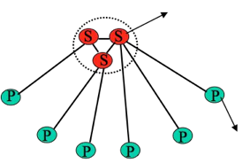
Napster Model
Filename | Info
TakeFive.mp3 | @128.174.5.126:1006
…
Metedata stored in "servers"
Peers of "clients" store files
Filename
TakeFive.mp3

Slide 15
Problems for Napster
Centralized Servers
No Security
Legal Problems

Slide 16
An Explosion of Versions

Slide 17
Cloud Computing

Slide 18
Current Work
Work on Project
Code Reviews to Present Progress - No Tuesday Deadlines
Final Deadline May 1st
Final Presentation Details Pending
Work with your moderator

