Slide 1
ECE 530 – Analysis Techniques for Large-Scale Electrical Systems
Lecture 22: Singular Value Decomposition
Prof. Hao Zhu
Dept. of Electrical and Computer Engineering
University of Illinois at Urbana-Champaign
haozhu@illinois.edu
11/18/2015

Slide 2
Announcements
HW 6 posted, due Tuesday, December 1
Final exam on Monday Dec 14 from 1:30 to 4:30pm in this room (ECEB-3081)
  Closed book, closed notes; you can bring in two note sheets (one new note sheet and midterm exam note sheet), along with simple calculators

Slide 3
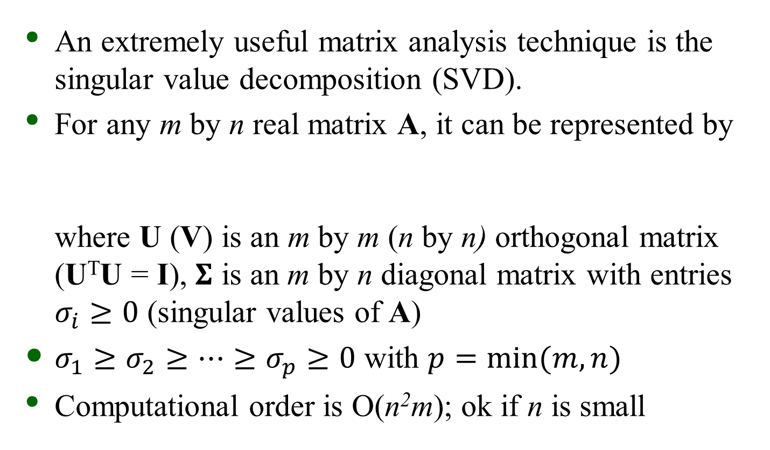
Singular Value Decomposition
An extremely useful matrix analysis technique is the singular value decomposition (SVD).
For any m by n real matrix A, it can be represented by
where U (V) is an m by m (n by n) orthogonal matrix (U^{T}U = I), $Σ$ is an m by n diagonal matrix with entries $σ_{i}≥0$ (singular values of A)
$σ_{1}≥σ_{2}≥…≥σ_{p}≥0$ with $p=\min{(m,n)}$
Computational order is O(n²m); ok if n is small
Source: Y. Saad, Lecture notes for CSCI 5304 at UMN
http://www-users.cs.umn.edu/~saad/csci5304/

Slide 4
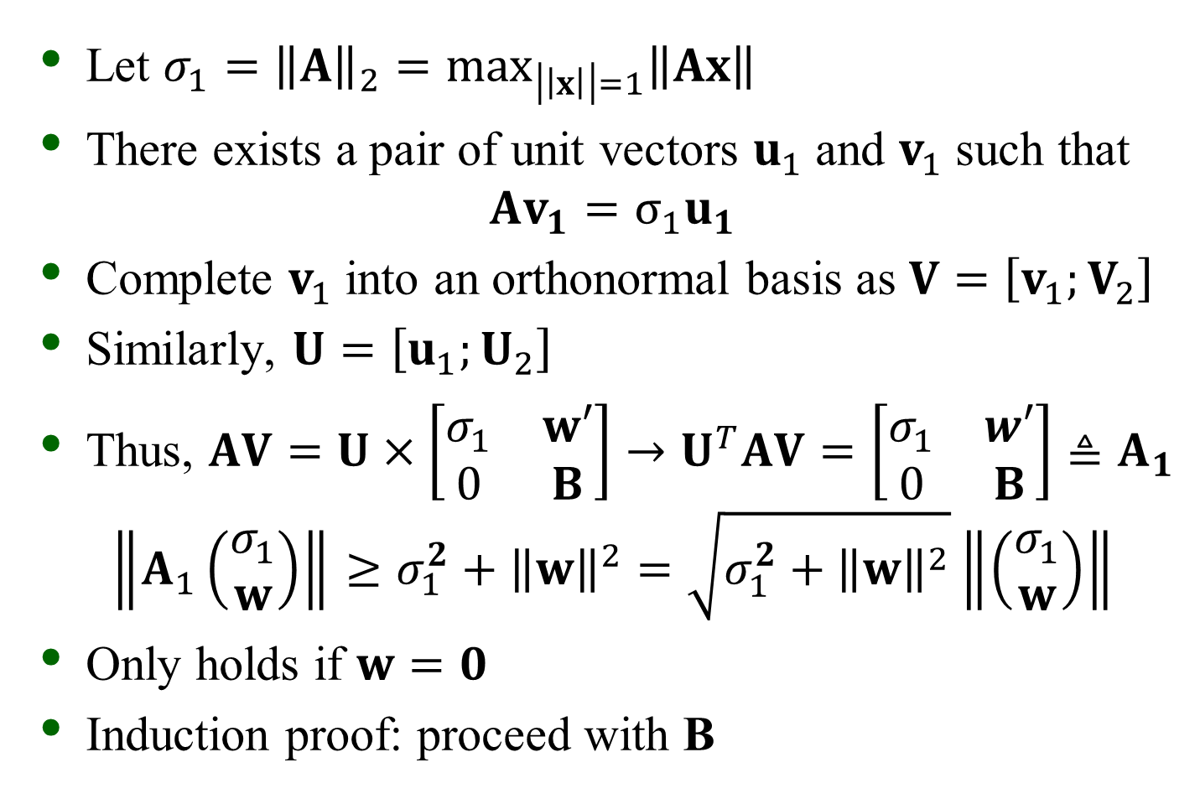
SVD Existence and Uniqueness
Let $σ_{1}={\left\|A\right\|}_{2}=\max_{\left|\left|x\right|\right|=1}\left\|Ax\right\|$
There exists a pair of unit vectors $u_{1}$ and $v_{1}$ such that
$$Av_{1}=σ_{1}u_{1}$$
Complete $v_{1}$ into an orthonormal basis as $V=\left[v_{1};V_{2}\right]$
Similarly, $U=\left[u_{1};U_{2}\right]$
Thus, $AV=U×\left[\begin{matrix}σ_{1} & w′ \\ 0 & B\end{matrix}\right]→U^{T}AV=\left[\begin{matrix}σ_{1} & w′ \\ 0 & B\end{matrix}\right]≜A_{1}$
$$\left\|A_{1}\left(\begin{matrix}σ_{1} \\ w\end{matrix}\right)\right\|≥σ_{1}^{2}+{\left\|w\right\|}^{2}=\sqrt{σ_{1}^{2}+{\left\|w\right\|}^{2}}\left\|\left(\begin{matrix}σ_{1} \\ w\end{matrix}\right)\right\|$$
Only holds if $w=0$
Induction proof: proceed with B

Slide 5
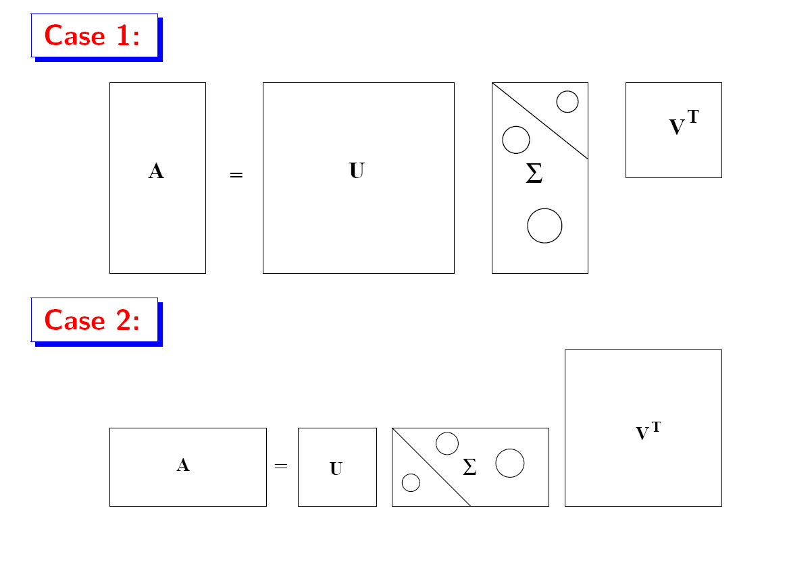
Two SVD Cases

Slide 6
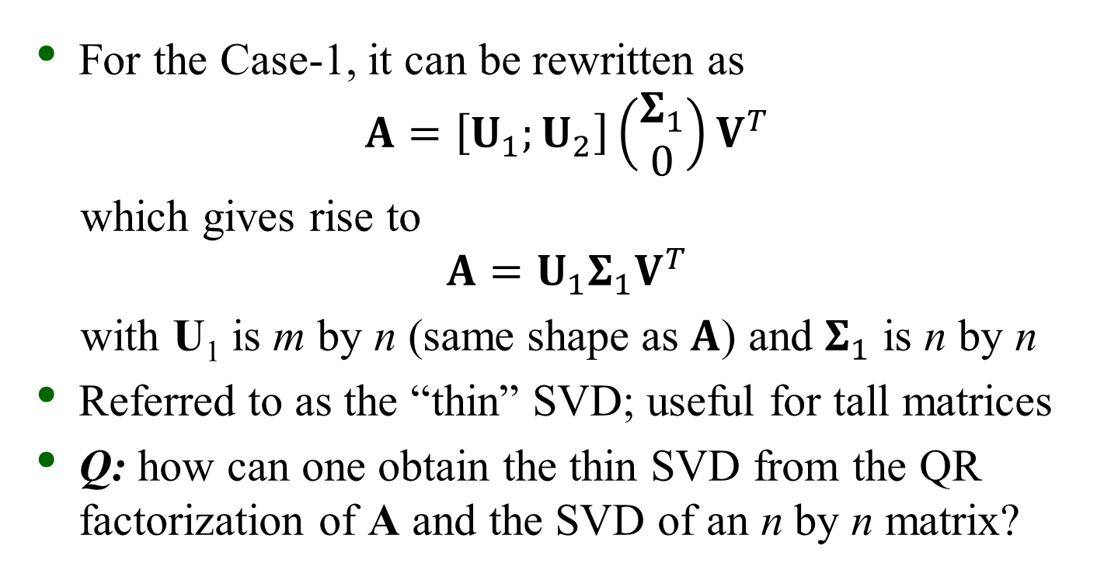
The “Thin” SVD
For the Case-1, it can be rewritten as
$$A=\left[U_{1};U_{2}\right]\left(\begin{matrix}Σ_{1} \\ 0\end{matrix}\right)V^{T}$$
which gives rise to
$$A=U_{1}Σ_{1}V^{T}$$
with U₁ is m by n (same shape as $A$) and $Σ_{1}$ is n by n
Referred to as the “thin” SVD; useful for tall matrices
Q: how can one obtain the thin SVD from the QR factorization of A and the SVD of an n by n matrix?

Slide 7
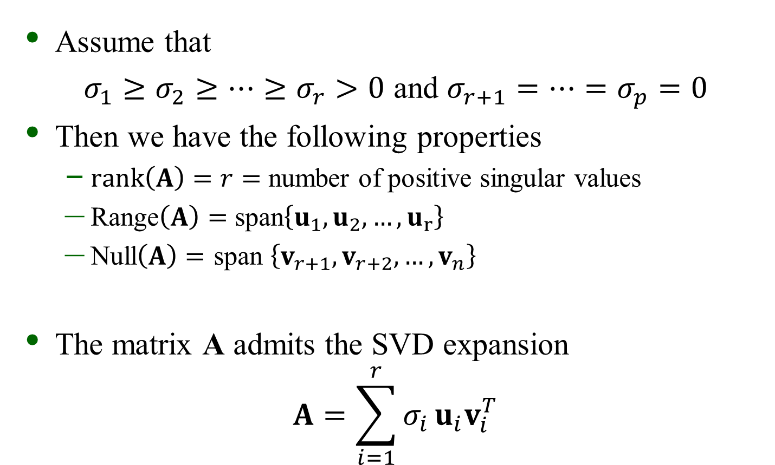
SVD Properties
Assume that
$σ_{1}≥σ_{2}≥…≥σ_{r}>0$ and $σ_{r+1}=…=σ_{p}=0$
Then we have the following properties
  $rank\left(A\right)=r=$ number of positive singular values
  Range$\left(A\right)=$ span$\left\{u_{1},u_{2},…,u_{r}\right\}$
  Null$\left(A\right)=$ span $\left\{v_{r+1},v_{r+2},…,v_{n}\right\}$
The matrix A admits the SVD expansion
$$A=\sum_{i=1}^{r}{σ_{i}}u_{i}v_{i}^{T}$$

Slide 8
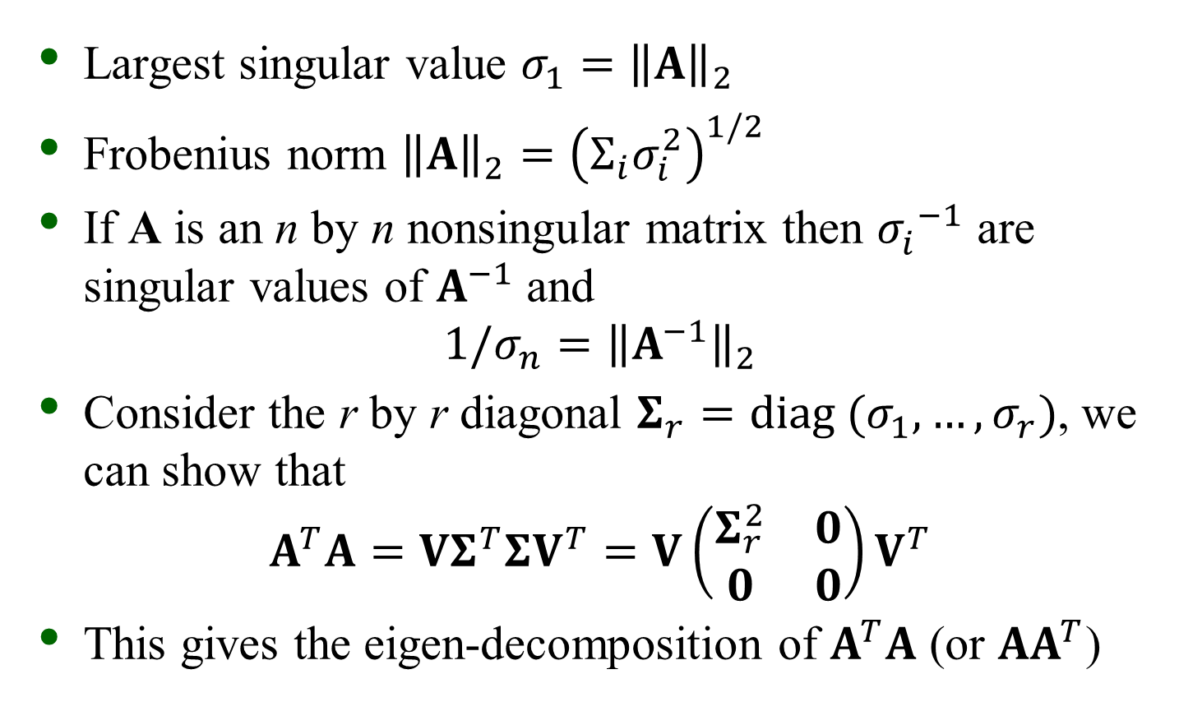
SVD Properties
Largest singular value $σ_{1}={\left\|A\right\|}_{2}$
Frobenius norm ${\left\|A\right\|}_{2}={\left(Σ_{i}σ_{i}^{2}\right)}^{1/2}$
If A is an n by n nonsingular matrix then ${σ_{i}^{}}^{−1}$ are singular values of $A^{−1}$ and
$${1/σ}_{n}={\left\|A^{−1}\right\|}_{2}$$
Consider the r by r diagonal $Σ_{r}=diag (σ_{1},…,σ_{r})$, we can show that
$$A^{T}A=VΣ_{}^{T}ΣV^{T}=V\left(\begin{matrix}Σ_{r}^{2} & 0 \\ 0 & 0\end{matrix}\right)V^{T}$$
This gives the eigen-decomposition of $A^{T}A$ (or ${AA}^{T}$)

Slide 9
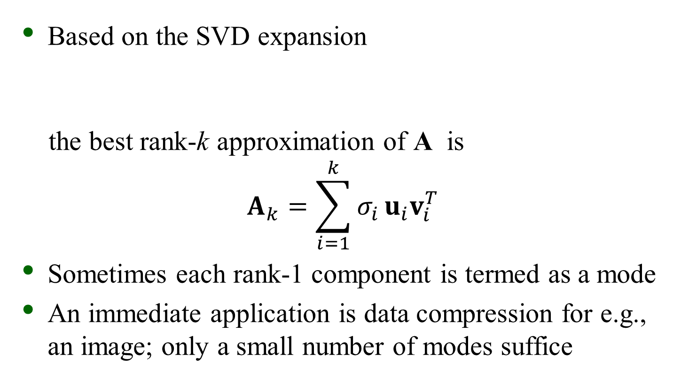
SVD Applications
Based on the SVD expansion
the best rank-k approximation of A is
$$A_{k}=\sum_{i=1}^{k}{σ_{i}}u_{i}v_{i}^{T}$$
Sometimes each rank-1 component is termed as a mode
An immediate application is data compression for e.g., an image; only a small number of modes suffice

Slide 10
SVD Image Compression Example
Image source http://fourier.eng.hmc.edu/e161/lectures/svdcompression.html

Slide 11
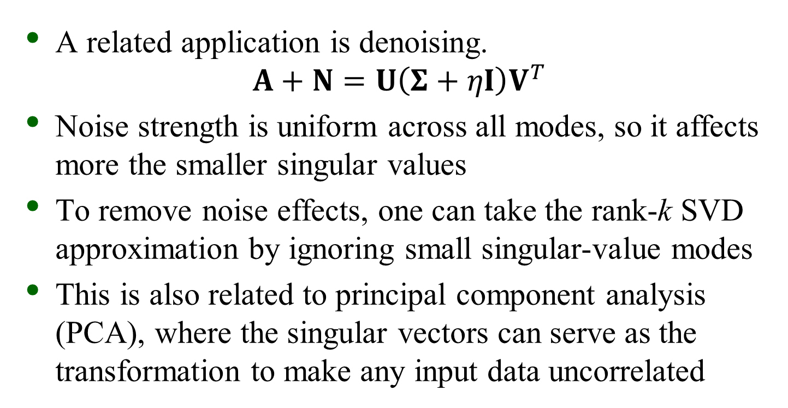
SVD Applications
A related application is denoising.
$$A+N=U\left(Σ+ηI\right)V^{T}$$
Noise strength is uniform across all modes, so it affects more the smaller singular values
To remove noise effects, one can take the rank-k SVD approximation by ignoring small singular-value modes
This is also related to principal component analysis (PCA), where the singular vectors can serve as the transformation to make any input data uncorrelated

Slide 12
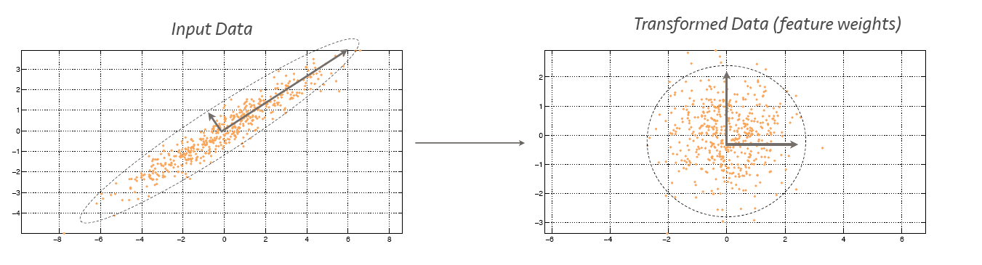
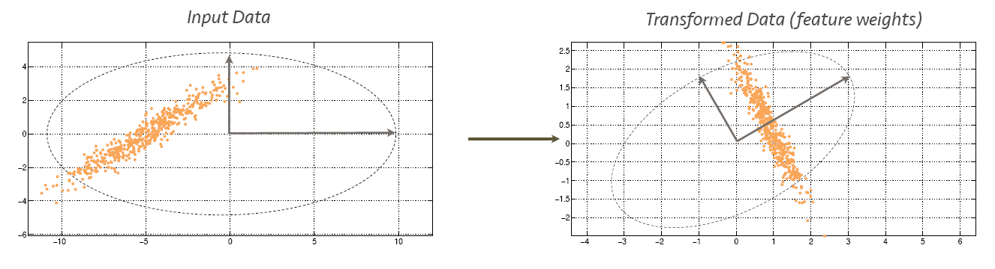
PCA Example
Inexplicitly assuming input to be zero-mean Gaussian

Slide 13

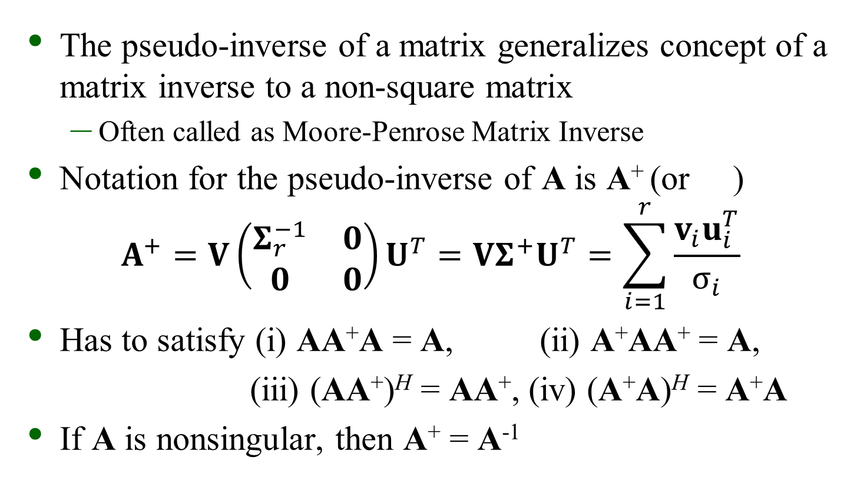
Pseudo-inverse of a Matrix
The pseudo-inverse of a matrix generalizes concept of a matrix inverse to a non-square matrix
  Often called as Moore-Penrose Matrix Inverse
Notation for the pseudo-inverse of A is A⁺ (or )
$$A^{+}=V\left(\begin{matrix}Σ_{r}^{−1} & 0 \\ 0 & 0\end{matrix}\right)U^{T}=VΣ^{+}U^{T}=\sum_{i=1}^{r}{\frac{v_{i}u_{i}^{T}}{σ_{i}}}$$
Has to satisfy (i) AA⁺A = A, (ii) A⁺AA⁺ = A,
(iii) (AA⁺)^{H} = AA⁺, (iv) (A⁺A)^{H} = A⁺A
If A is nonsingular, then A⁺ = A⁻¹

Slide 14
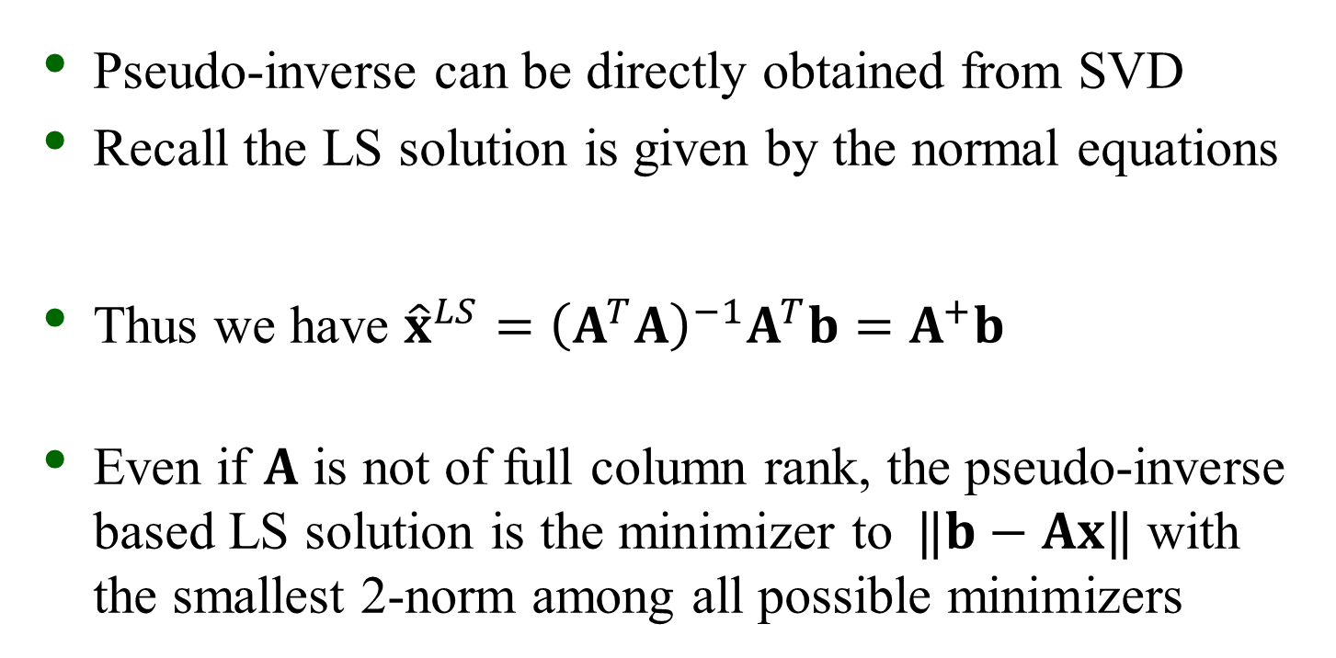
Pseudo-inverse and LS
Pseudo-inverse can be directly obtained from SVD
Recall the LS solution is given by the normal equations
Thus we have ${\hat{x}}^{LS}={\left(A^{T}A\right)}^{−1}A^{T}b=$ $A^{+}b$
Even if $A$ is not of full column rank, the pseudo-inverse based LS solution is the minimizer to $⁡‖b−Ax‖$ with the smallest 2-norm among all possible minimizers

Slide 15
Simple Least Squares Example
Assume we which to fix a line (mx + b = y) to three data points: (1,1), (2,4), (6,4)
Two unknowns, m and b; hence x = [m b]^{T}
Setup in form of Ax = b

Slide 16
Simple Least Squares Example
Doing the SVD
Computing the pseudo-inverse

Slide 17
Simple Least Squares Example
Computing x = [m b]^{T} gives
With the pseudo-inverse approach we immediately see the sensitivity of the elements of x to the elements of b

Slide 18
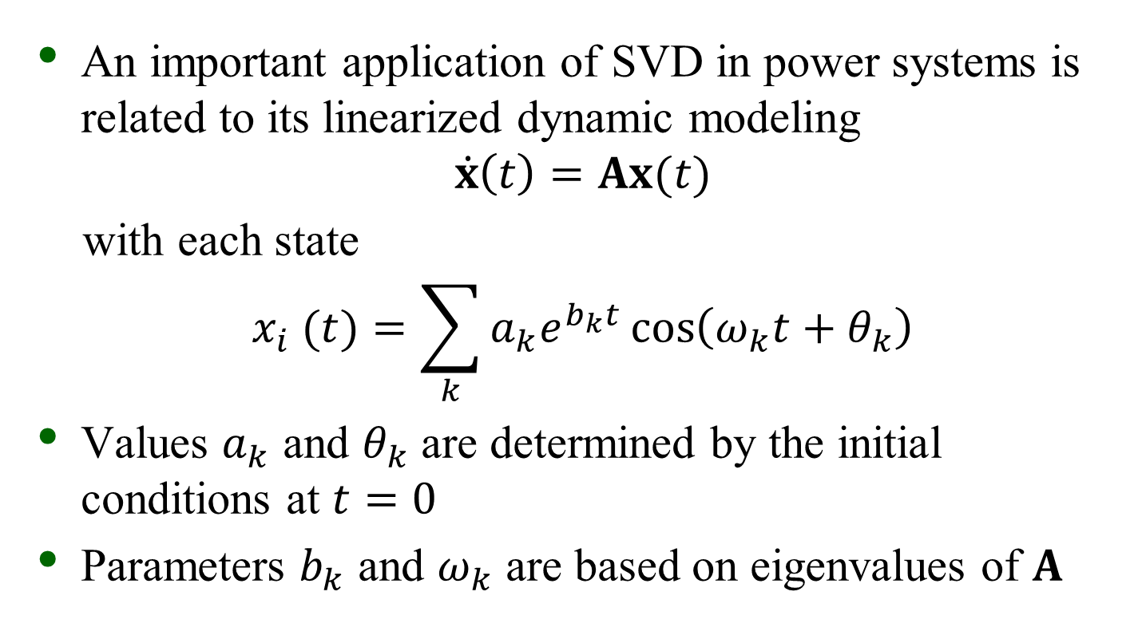
Modal Identification
An important application of SVD in power systems is related to its linearized dynamic modeling
$$\dot{x}\left(t\right)=Ax(t)$$
with each state
$$x_{i} (t)=\sum_{k}{a_{k}e^{b_{k}t}\cos\left(ω_{k}t+θ_{k}\right)}$$
Values $a_{k}$ and $θ_{k}$ are determined by the initial conditions at $t=0$
Parameters $b_{k}$ and $ω_{k}$ are based on eigenvalues of $A$

Slide 19

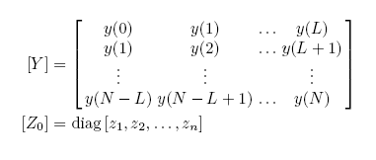
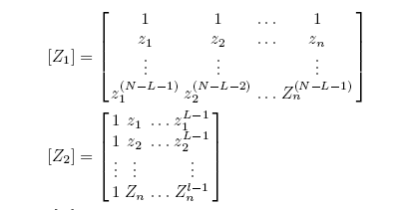

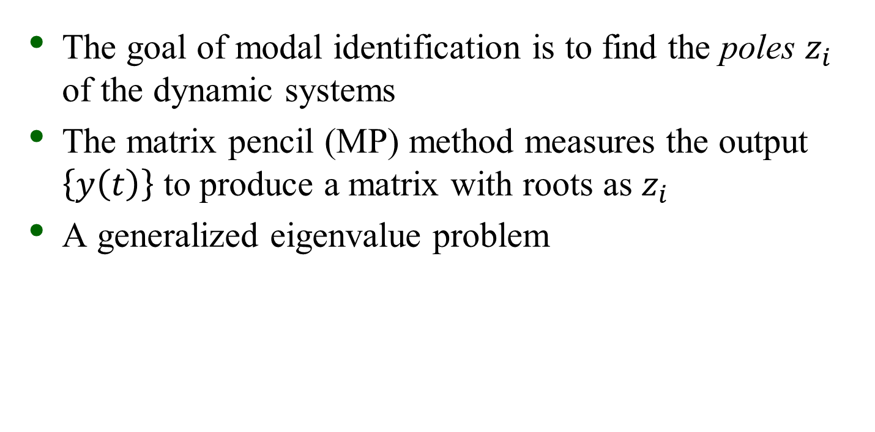
Matrix Pencil Method
The goal of modal identification is to find the poles $z_{i}$ of the dynamic systems
The matrix pencil (MP) method measures the output $\left\{y\left(t\right)\right\}$ to produce a matrix with roots as $z_{i}$
A generalized eigenvalue problem

Slide 20
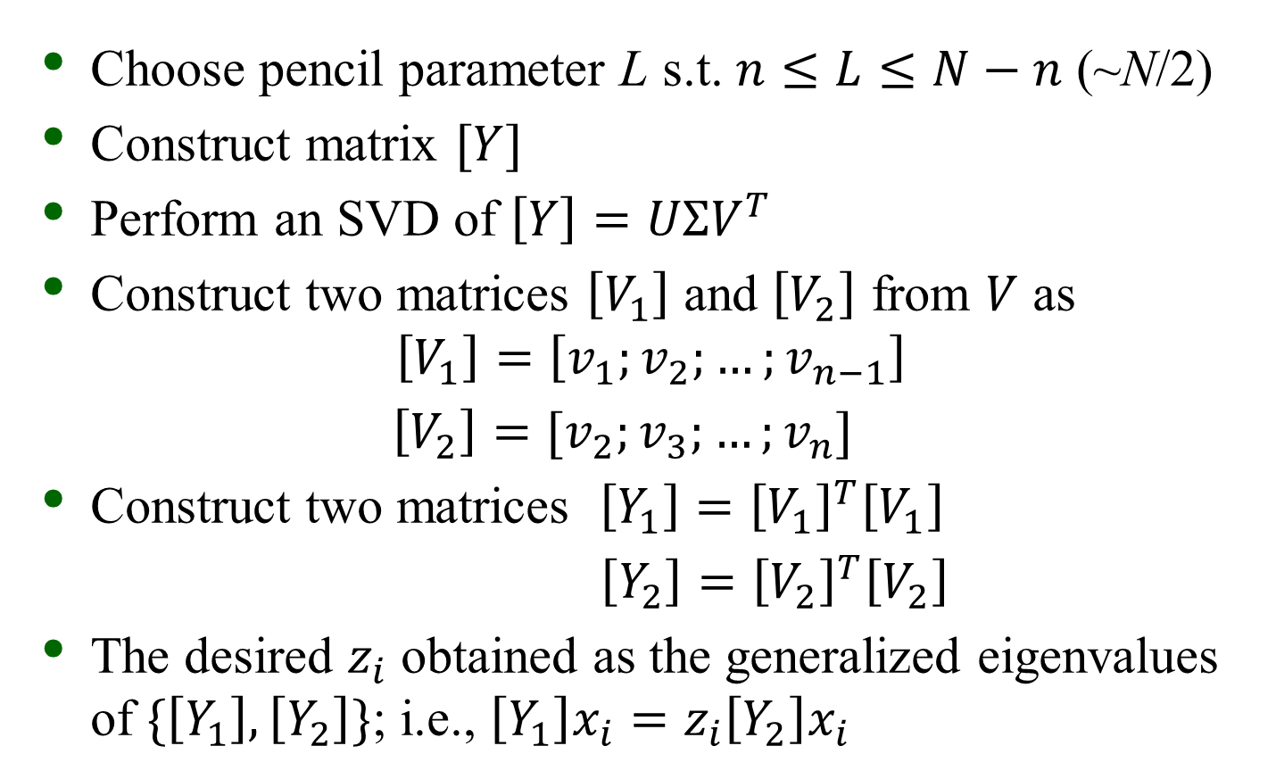
MP Procedure
Choose pencil parameter L s.t. $n≤L≤N−n$ (~N/2)
Construct matrix $[Y]$
Perform an SVD of $\left[Y\right]=UΣV^{T}$
Construct two matrices $\left[V_{1}\right]$ and $\left[V_{2}\right]$ from $V$ as
$$\left[V_{1}\right]=\left[v_{1};v_{2};…;v_{n−1}\right]$$
$\left[V_{2}\right]=[v_{2};v_{3};…;v_{n}]$
Construct two matrices $\left[Y_{1}\right]={\left[V_{1}\right]}^{T}\left[V_{1}\right]$
$\left[Y_{2}\right]={\left[V_{2}\right]}^{T}\left[V_{2}\right]$
The desired $z_{i}$ obtained as the generalized eigenvalues of $\{\left[Y_{1}\right],\left[Y_{2}\right]\}$; i.e., $\left[Y_{1}\right]x_{i}=z_{i}\left[Y_{2}\right]x_{i}$

Slide 21
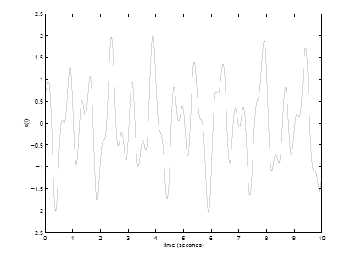

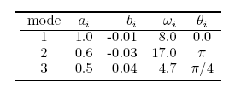
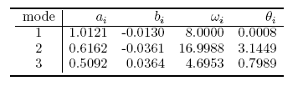
Toy Example
Three-mode waveform
MP solution

Slide 22
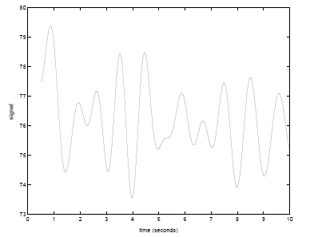
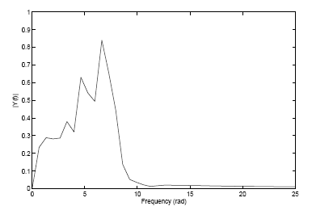
Power System Example
Dynamic PSS/E simulation of a large Midwest utility system
Number of modes unknown
FFT results

Slide 23
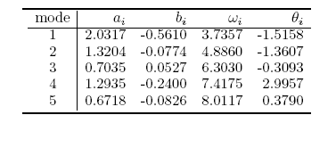
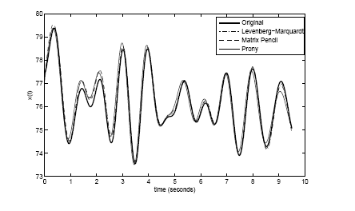
Power System Example
Use MP to extract five modes
Reconstruction results (MP + two other methods)

