Slide 1
IEEE Workshop Series:
EAGLE Workshop

Slide 2
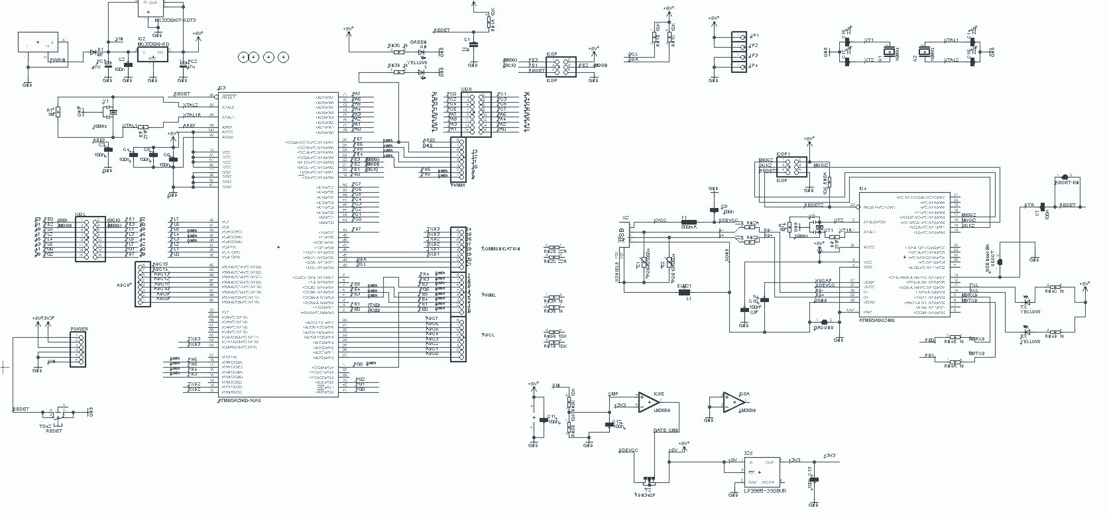
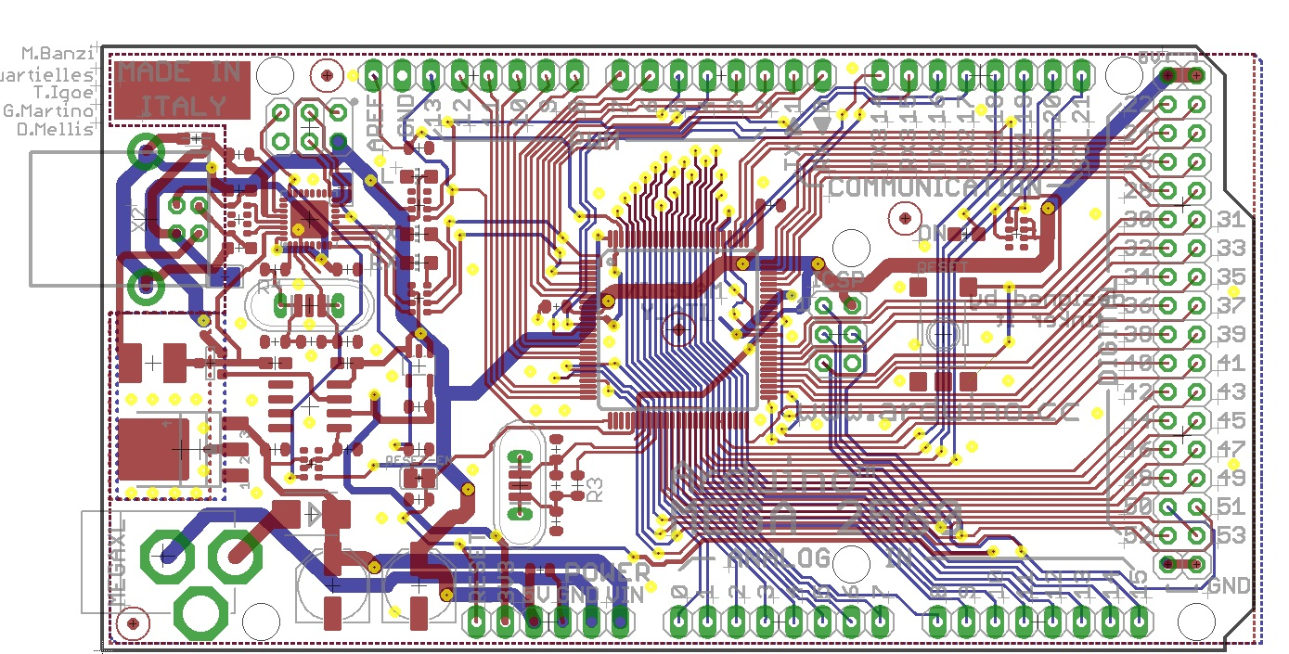
Why EAGLE?
FREE for students :)
Most seamless transition from Design->Schematic->Layout->Board
Integrates easily with Autodesk software

Slide 3
Presentation Outline
Main Presentation:
Schematic Editor
Basic tools
PCB Layout
Design considerations
Ordering the PCB
What’s a Gerber file?
Additional info
Adding custom part footprints to EAGLE

Slide 4
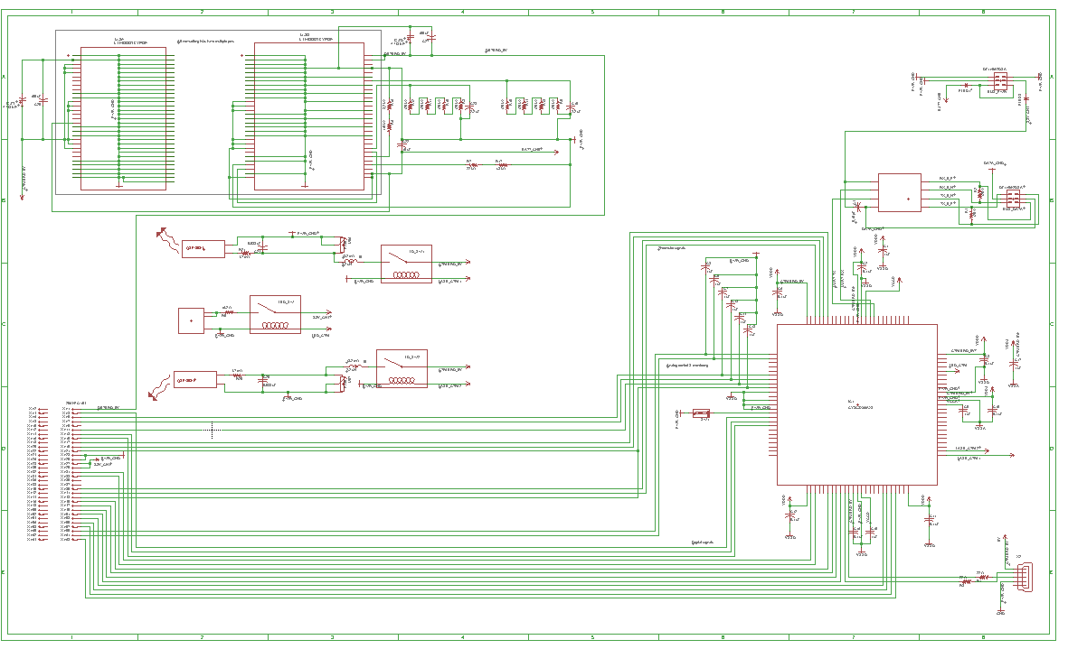
Schematic
Editor

Slide 5
Schematic Editor Tools – Basic Overview
Select, Move, Flip, and Rotate
Copy, Paste, Delete, Edit, and Add
Name, Value, and Smash
Adding shapes and text
Connecting parts

Slide 6
Some Tool Tips
Name vs. value
Show tool vs. moving

Slide 7
Some General Tips
Inputs on left, outputs on right.
Modularize
Keep them clean and legible!
- Avoid crossed wires at all costs
- Label nets, parts, and sections
- Make “tunnels” if you have to
- Order/connect things consistently

Slide 8
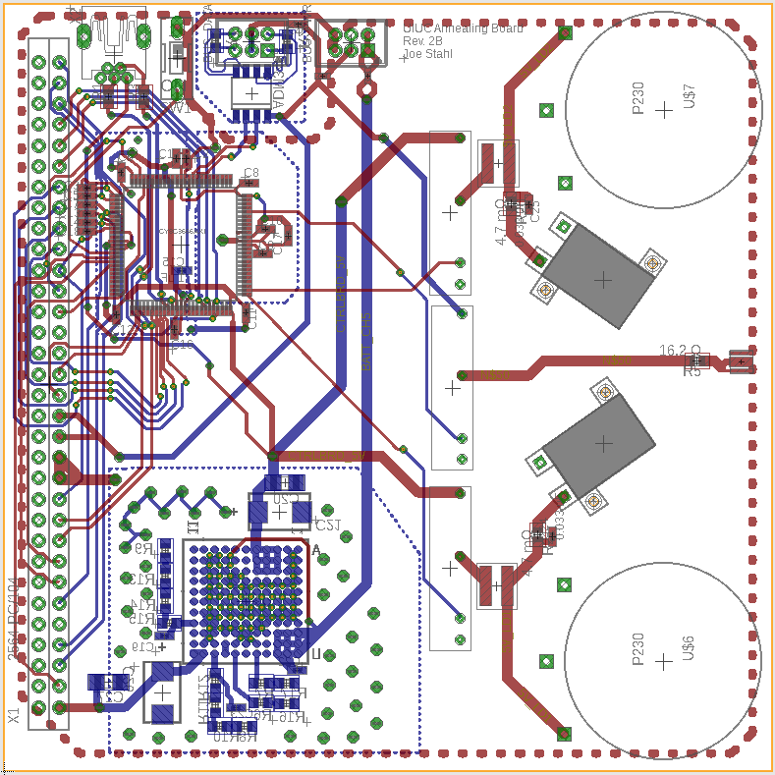
Board
Layout

Slide 9
First Step: Set Your Design Rules!
Know what your fabricator can do
- Minimum drill size, trace width, tolerances on sizes
- Set minimum distance rule accordingly
Know how much current each signal will carry
- This can vary based on your maximum temperature rise
- Set minimum trace width accordingly

Slide 10
Board Layout Tools – Basic Overview
Mirror
Route and un-route
Add vias
Ratsnest

Slide 11
General Design Guides
Tolerances! (again)
- Always design around the maximum tolerances if you can
Avoid right angles
- Mutual inductance and signal coupling are board killers
Consider how the parts will solder
- Trying to solder a small part surrounded by big parts is not fun
Add planes for ground and power, if space permits

Slide 12
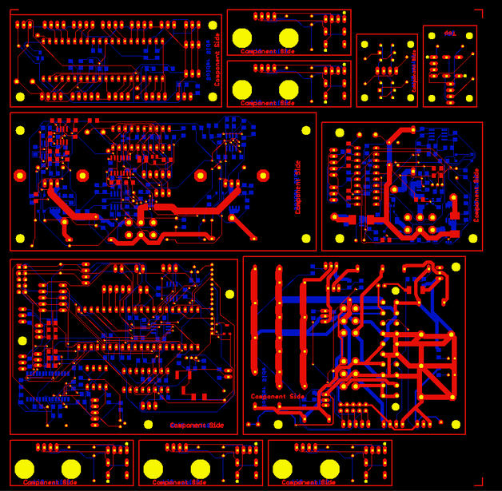
Ordering the PCB

Slide 13
Generate Gerber Files
Common Gerber files (RS-274X)
Each one is a vector file that serves as instructions for the manufacturer
Make sure to include those drill files!
CAM Processor -> Open Job -> gerb274x.cam AND excellon.cam
Extension | Function
.gbr | Generic file
.gtl/.gbl | Top/bottom copper layers
.gto/.gbo | Top/bottom silkscreen layers
.gts/.gbs | Top/bottom soldermask layers
.drl/.txt | Drill file(s)
.oln | Board outline

Slide 14
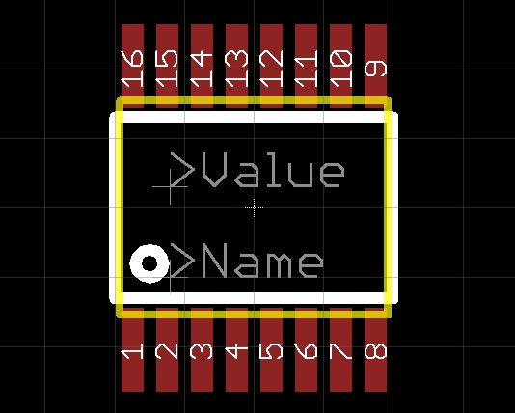
Custom Parts

Slide 15
Steps of Creation
Read those datasheets!
Draw a schematic and add pins
Draw a layout and add pads
Connect the pins and pads
For step-by-step tutorial, look at learn.sparkfun.com/tutorials

Slide 16
Questions?

