Slide 1
On The Versatility of Beverage Coasters
Benjamin C. Eng
RSSS
January 23, 2018

Slide 2
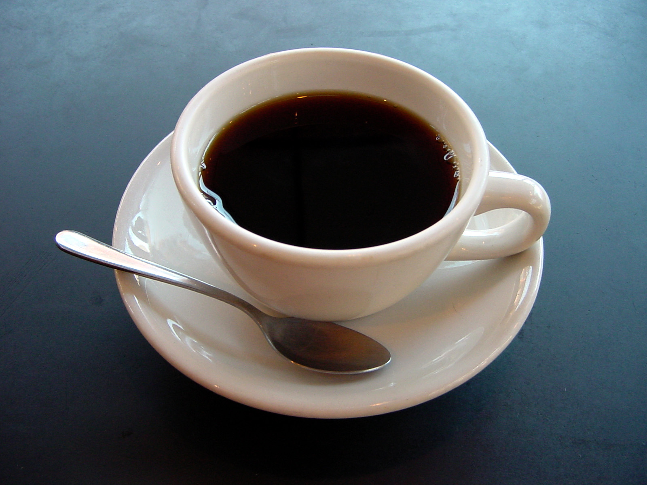
Question:
Does Drinking More Caffeine Lead to Increased Work Productivity?
First principles suggest that the answer is “yes”
Similar studies done in 90s with Cigarettes and Factory Workers showed this to be true [1].
How can we measure productivity in an office setting?

Slide 3
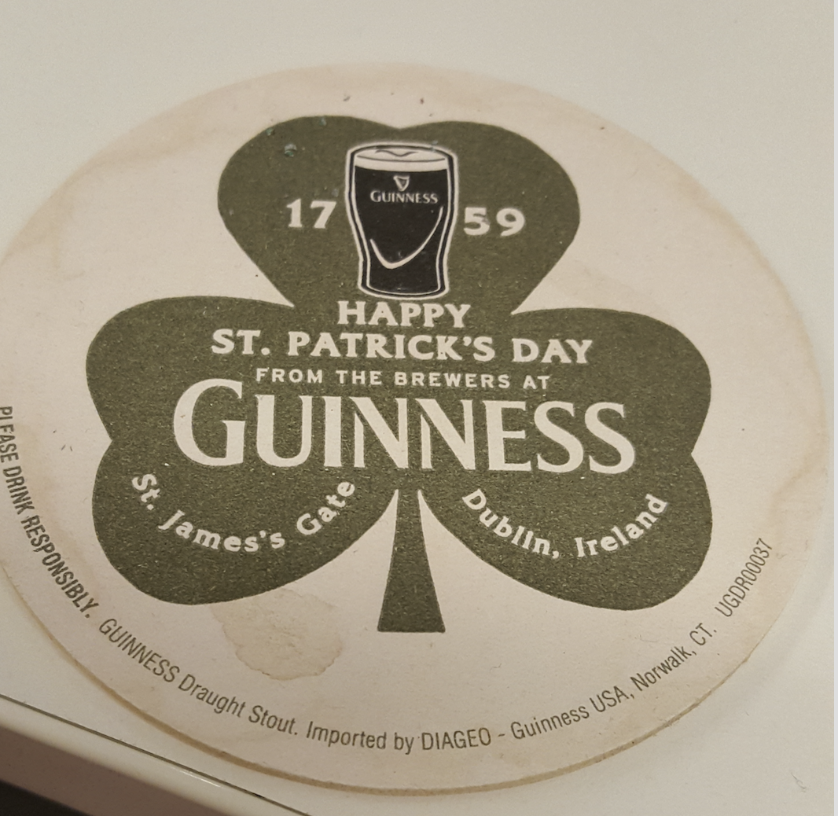
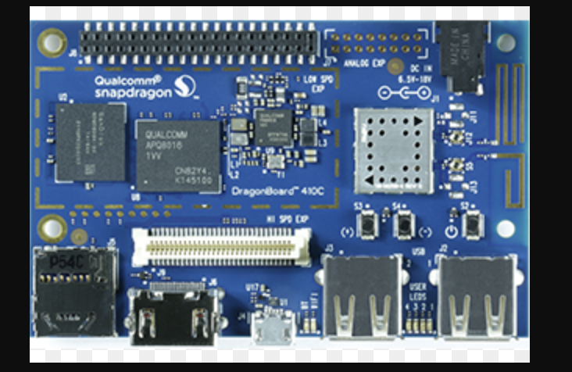
A Proposed Solution Space
Assumption 1 : Suppose productivity is a strong function of keyboard strokes and mouse clicks
Assumption 2 : Assume worker is stationary at desk for several hours at a time
Repurpose the coaster:
Current usage : Prevent a ring from forming on the surface of table
Proposed usage: Add sensing capability to track quantity of liquid over time
Disclaimer: Proposed solution does not involve the use of development board

Slide 4
Other Applications of Beverage Coasters
Restaurant Industry
Provide “Analytics” for rates of consumptions of beverages
Coaster could potentially have a signaling capability for a waiter’s/waitress’s attention
Really any venue which involve food or beverage may have enhanced success with a coaster that has a sensing capability

Slide 5
For Interested Senior Design Students
Identify a problem in {Restaurants, Offices, etc.} where beverage coasters can aid in solving
Identify an “on-napkin” system
Teams interested should discuss with Ben (bceng2@illinois.edu). Potentially funding up to $100.

Slide 6
Citations (Improper)
[1] Untoro “The association between BMI and haemoglobin and work productivity among Indonesian female factory workers”. 1998

