Slide 1
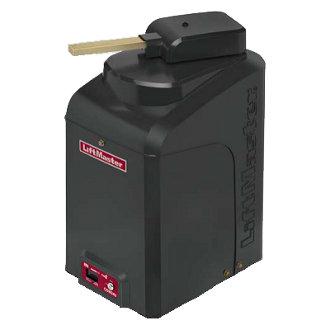
Design of an improved pad mounted swing gate operator
The Chamberlain Group would like the students to design, build a proof of concept prototype and test an improved pad mounted swing gate operator. The students will reverse engineer a competitor’s gate operator that utilizes a brushless DC motor and estimate the production cost. They will then perform value analysis/value engineering (VA/VE) to determine which features to incorporate in an improved Chamberlain gate operator. Next, they will design, build, and test a proof of concept prototype of the improved gate operator. An existing Chamberlain gait operator will be utilized/modified for the proof of concept prototype. The improved pad mounted gate operator design must be:
Robust & reliable: will potentially be exposed to a dirty environment (dust, sea salt , and elements) and should operate 2 million times before failure
Cost competitive over Chamberlain’s and competitor’s designs (use a-Priori software to predict cost)
Readily manufactured
Safe
Environmentally friendly
Energy efficient
In conformance with applicable standards and regulations
Developed to avoid patent infringement
The student will sign over intellectual property developed in this project to the sponsor.
The ECE team would work with the mechanical engineering team on this project and focus on the electrical/controls/circuitry related design/build aspects.

Slide 2
Design of an improved gate position sensing system
The Chamberlain Group would like to investigate new position sensing systems for its pad mounted gate operators. A robust gate position sensing system is needed to ensure proper gate operation. The current system is proven, but Chamberlain feels there are opportunities to reduce complexity and cost. In this project the students will design, build and test a pad mounted gate operator that is:
Accurate and repeatable measures the gate position
Robust& reliable: will potentially be exposed to a dirty environment (dust, sea salt , and elements) and should operate 2 million times before failure
Cost effective (use a-Priori software to predict cost)
Is integrated with existing chamberlain gate operators (CSW12U, CSL12U, CSW24U,CSL24U, CSW200, SL3000, SL585, SL595, and if possible, the HCTDCU).
Readily manufactured
Safe
Environmentally friendly
In conformance with applicable standards and regulations
Developed to avoid patent infringement
The students will research potential positioning sensing methods and evaluate utilizing a decision matrix. They will then build proof of concept prototype(s) and test the most promising solutions.
The student will sign over intellectual property developed in this project to the sponsor.
The ECE team would work with the mechanical engineering team on this project and focus on the electrical/controls/circuitry related design/build aspects.

Slide 3
Design of a small sports timing device
In this project the students will design, build, and test a small timing device operating as a stopwatch to be worn on the index finger, clipped on cloths, or slid into a pocket on a watch band. The size and weight of the device, as well as the method of attachment to the finger and other locations are all important considerations. The device should display accurate results to the hundredth of a second on a readable screen, and ideally it should include some other timing features common in digital stopwatches. The device should be easily operated by the thumb, and alarms or tones should indicate when buttons are pressed. Ideally, a central device such as a smartphone should be able to collect and display data from multiple sport timers. A track coach, for example, should be able to have up to 20 athletes each use such a device to time their own workouts and automatically send their results via bluetooth to the smartphone. Additional modes of operation such as a heart rate monitor, count up count down timer, should be considered, provided the size of the device and the cost are not prohibitive.
For a variety of applications a stand-alone device is being considered with no strap or attachments. The device could then slide into a sleeve or receptacle made of a one piece rubber poly that can be worn on the index finger. Additional user options would include: a clip attachment the device slides into and could be clipped to a shirtsleeve or collar for instance, device could slide into a pocket on a watch band. The designs should be waterproof and minimize wind and water drag forces. Some similar products that may help to view are the following:
-Swimmers lap counter by SportCount.com for the way it is attached to the finger
-The gym boss interval timer gymboss.com for the multiple interval timing that rolls from one timed segment into the next.
-Toprime Fitness Tracker wearable on Amazon. Interchangeable wristbands
-Garmin Vivofit Fitness Tracker garmin.com interchangeable wristbands
In all, the design must be compact, lightweight, robust, safe, cost-effective (use aPriori software to estimate manufacturing costs), readily-manufactured, and comply with applicable standards and regulations.
Students on this project will be required to sign over intellectual property developed to the sponsor.
The ECE team would work with the mechanical engineering team on this project and focus on the electrical/controls/circuitry related design/build aspects.

