Slide 1
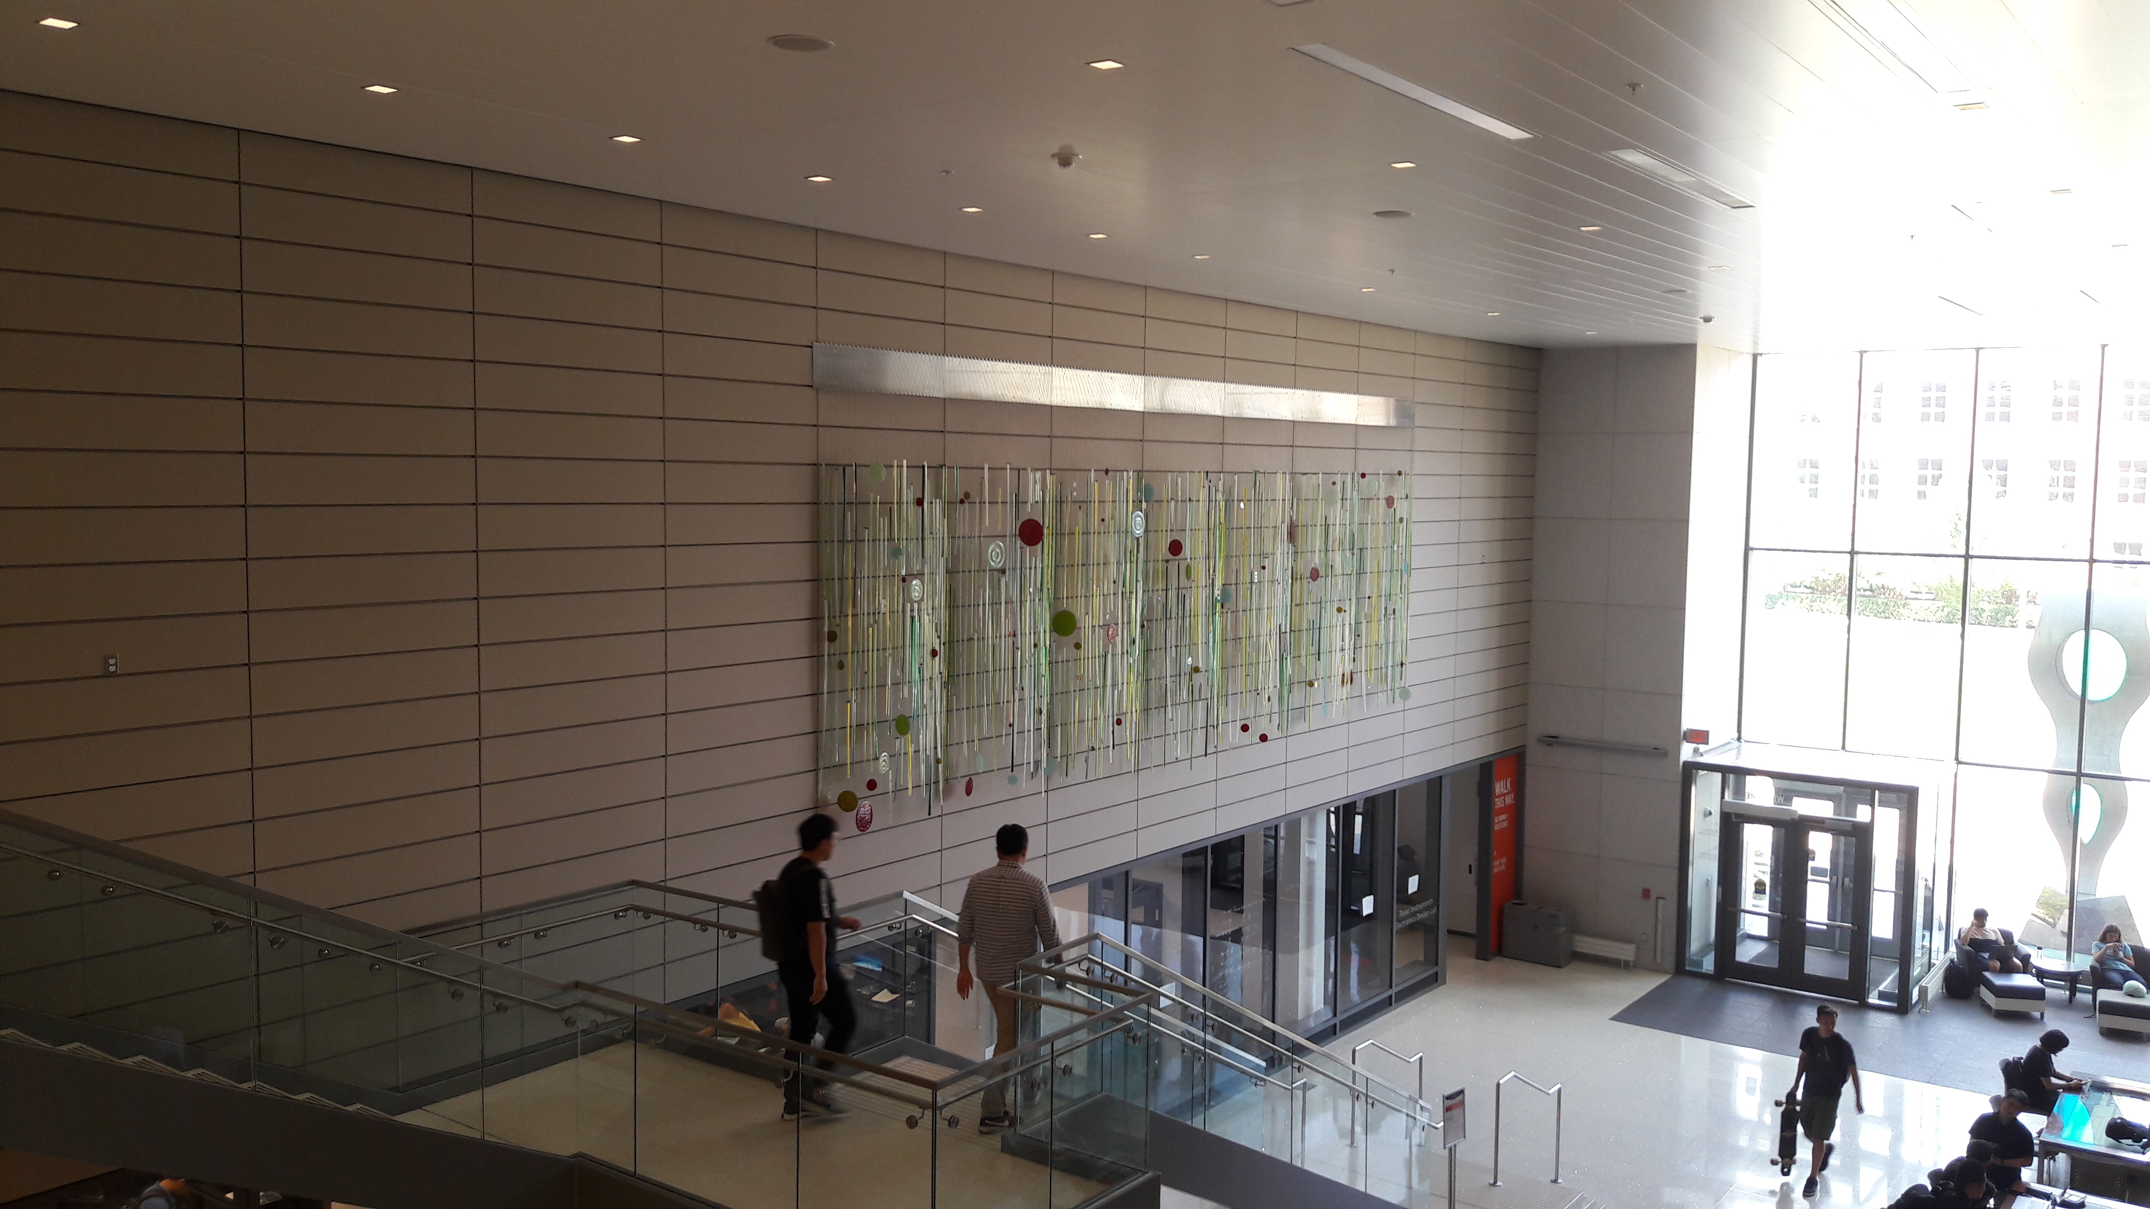
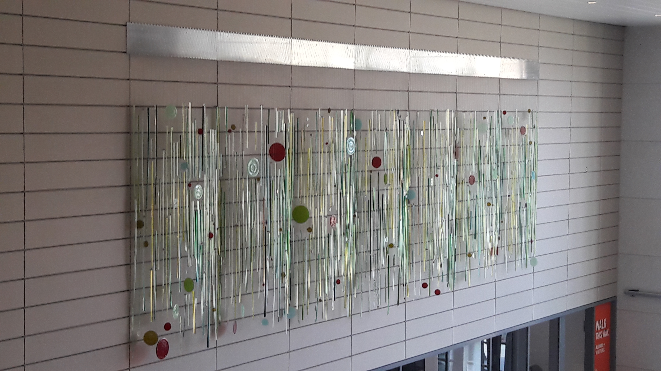
Senior Design: Topic 1: Illuminate ECEB Lobby
Objective: Design a distributed LED-lighting system to illuminate the art work in the ECEB lobby.
Input: Wall supply, 110 V, 60 Hz.
Design Criteria: Come up with at least three approaches to illuminate the art work to make it a aesthetically pleasant. Emphasize the art work and its detailed forms with effective use of lighting.
At least one design has to be built and tested.
Timeline: 15th December

Slide 2
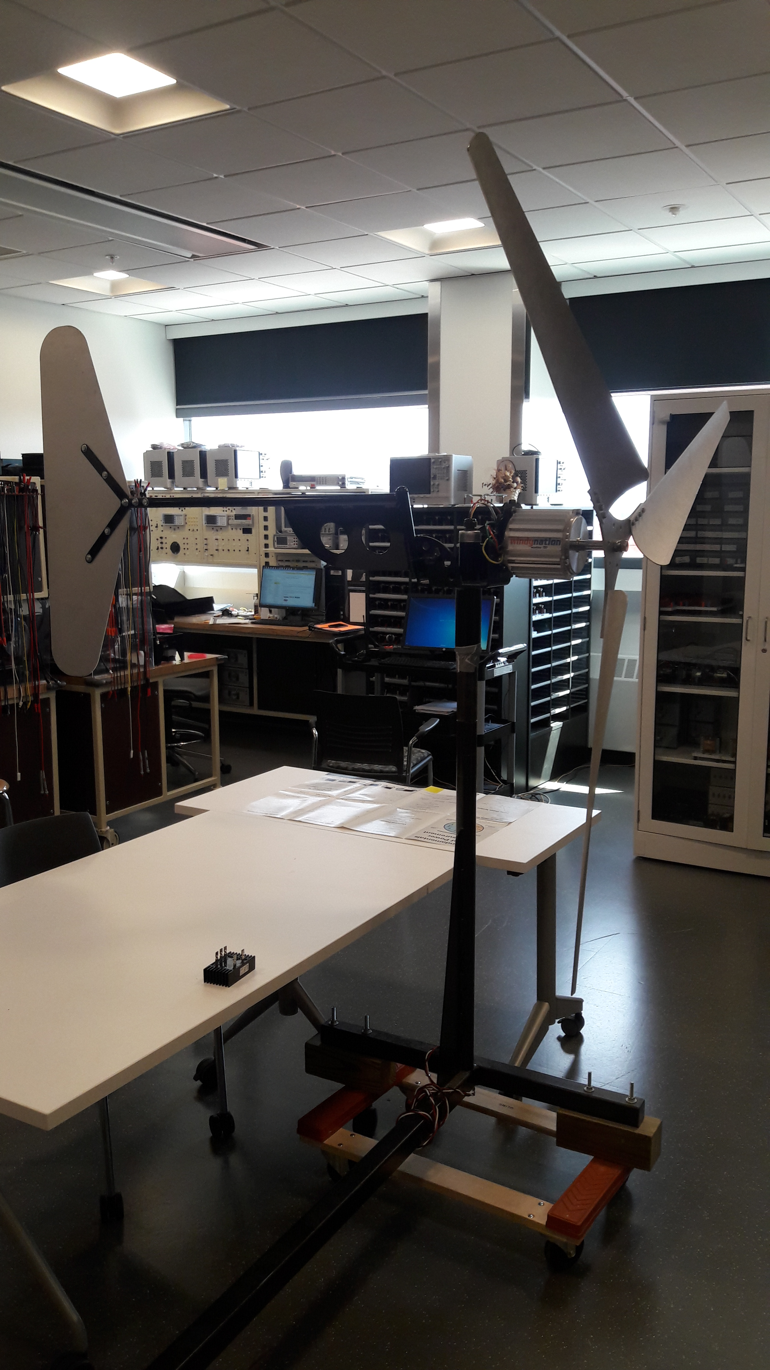
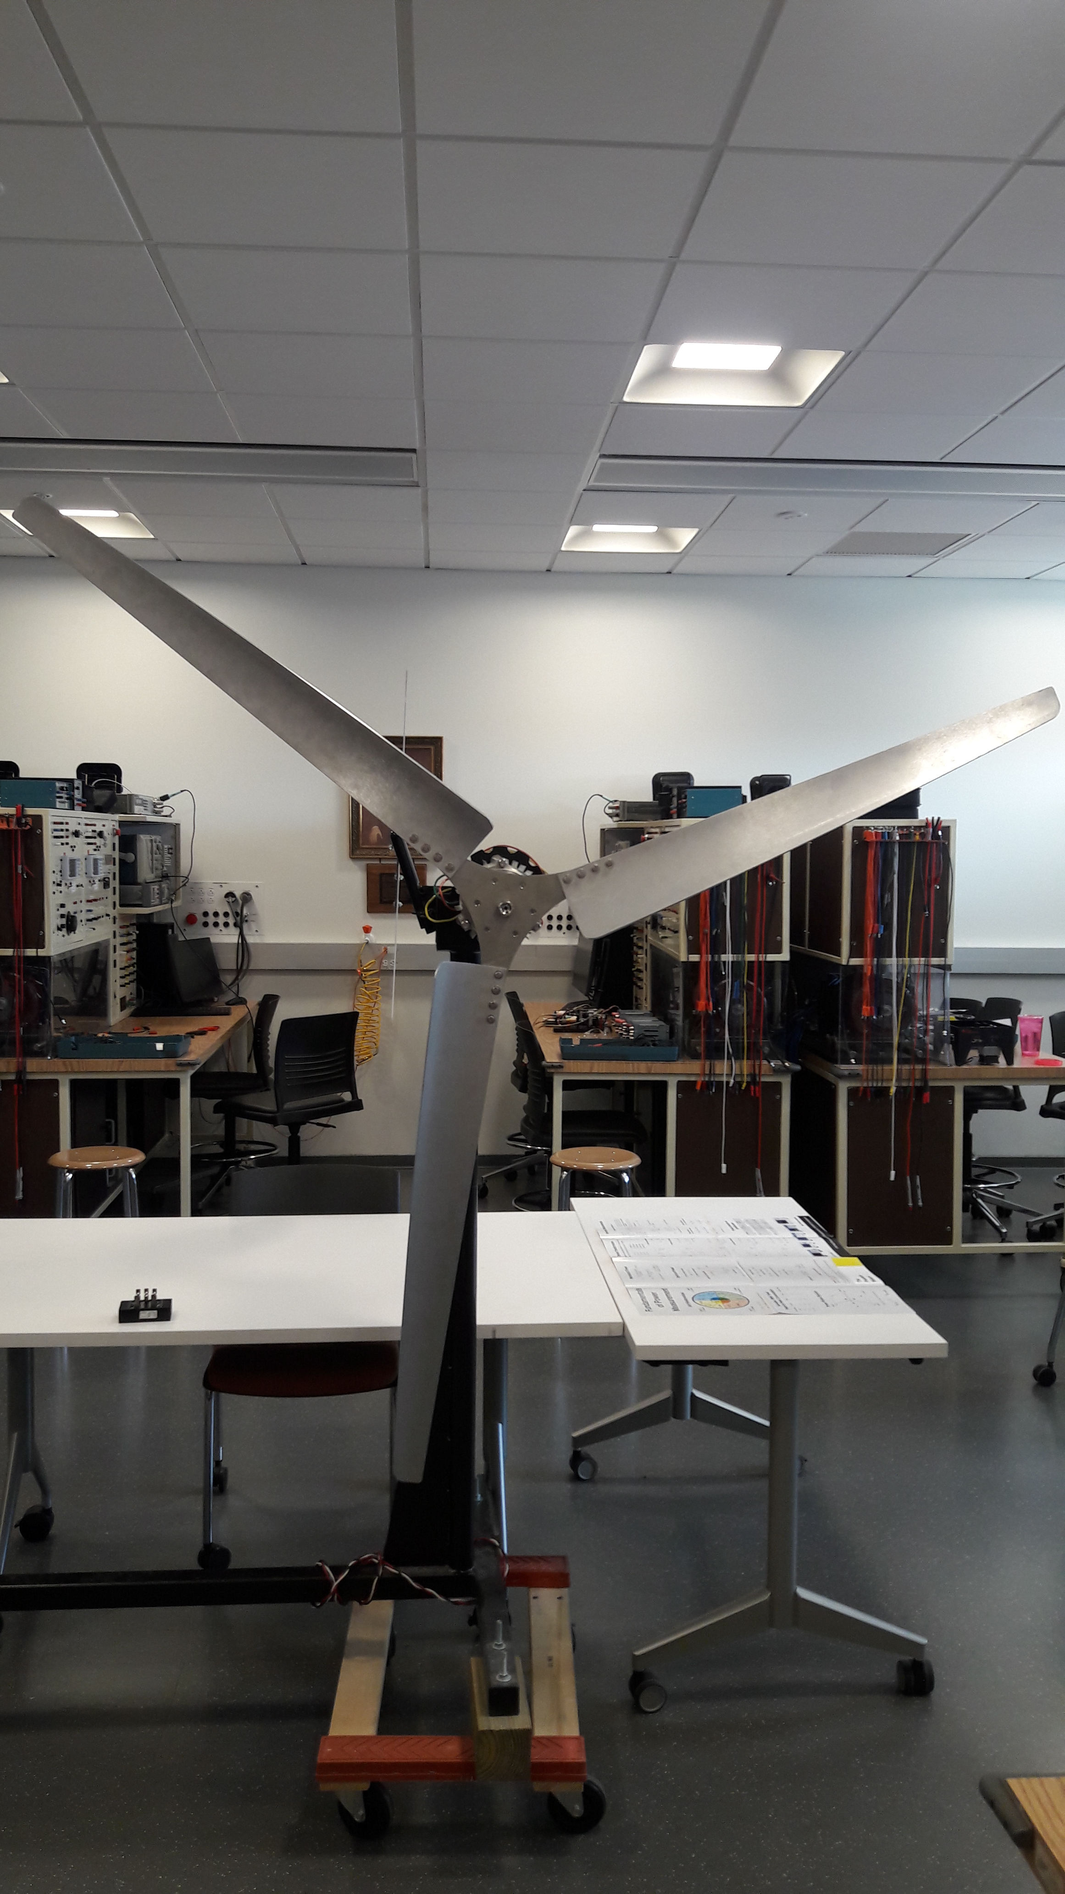
Senior Design: Topic 2: Maximum power extraction from wind
Objective: Build an active AC-to-DC converter that extracts maximum power from the wind turbine and dump it onto a resistor.
Input: Variable voltage variable frequency
Design Criteria: Generator maximum power 750 W.

