Slide 1
How to RFA(Request For Approval) Successfully
Zipeng Wang
Sep 5, 2017

Slide 2
RFA is the start of your senior design journey

Slide 3
RFA Process Block Diagram

Slide 4
Step 1: Have an Idea
But How?
Brainstorm with friends and classmates
Use a project idea that was pitched in class
Draw inspiration from past semesters
Some Tips:
Your idea must involve some hardware design
Don’t use the word “smart” in the project title – be descriptive (Smart Shovel vs. Dirt Detecting Shovel)
Be wary of hobbyist components (Raspberry Pi, Arduino, etc.)

Slide 5
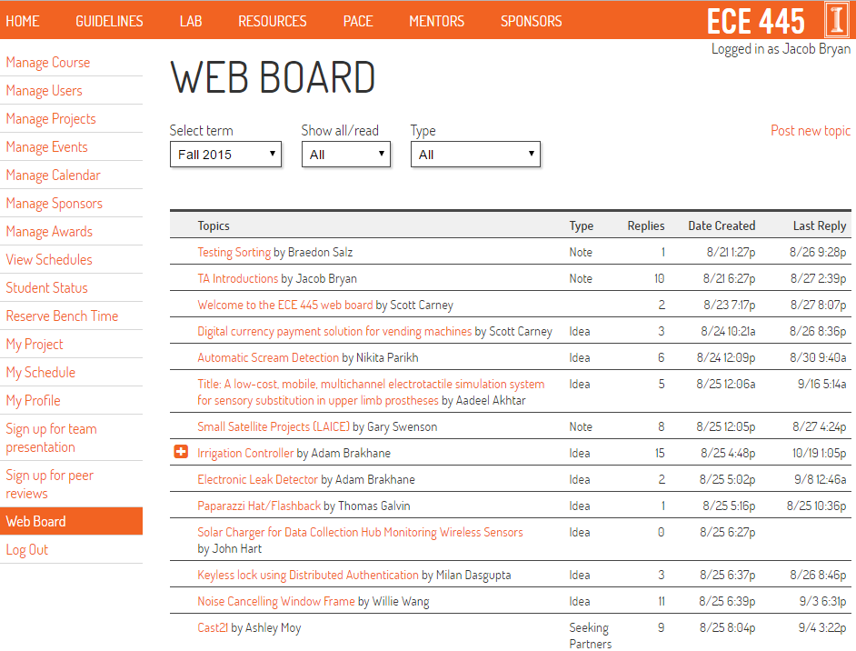
Step 2: Post to the Web Board

Slide 6
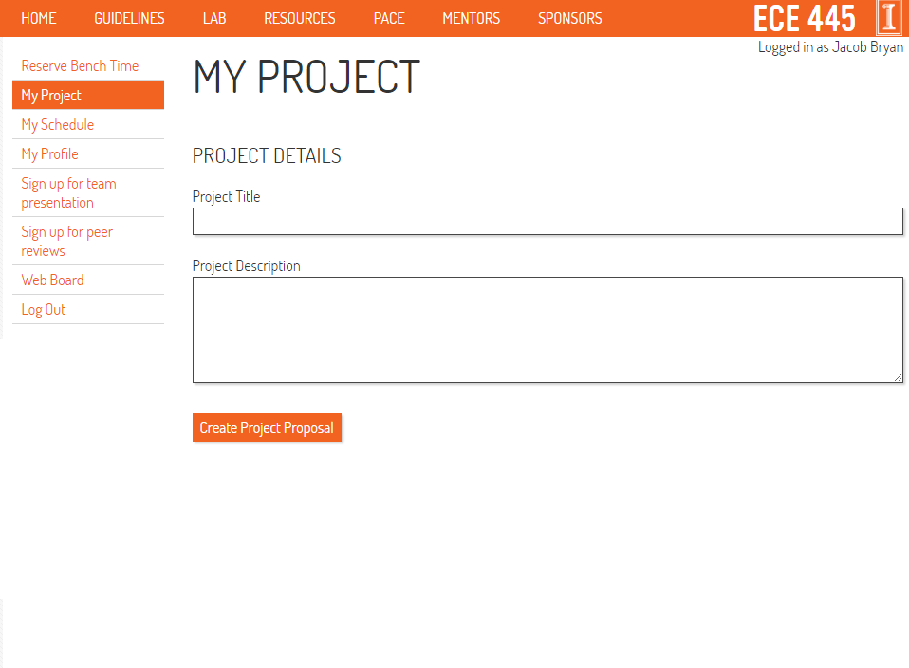
Step 3: Submit the RFA

Slide 7
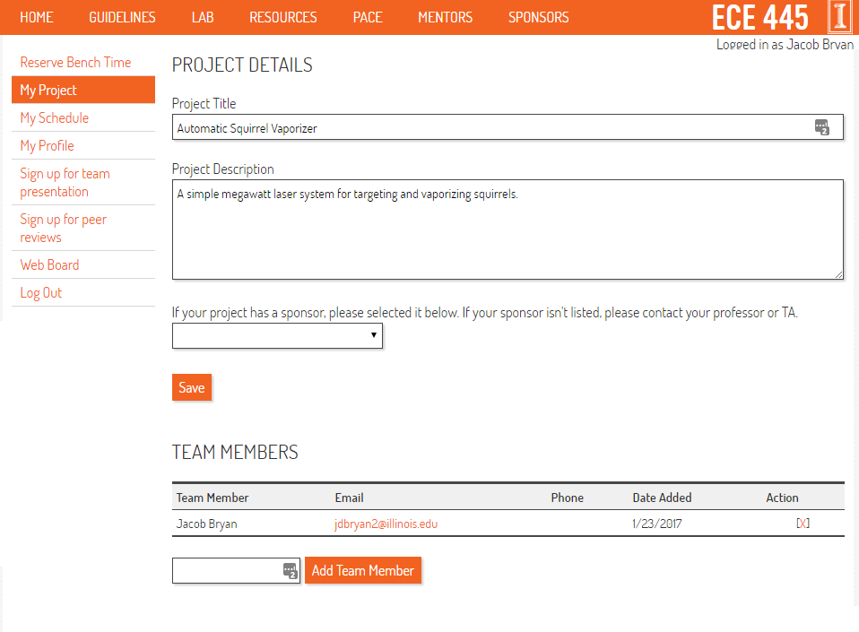
Step 3: Submit the RFA

Slide 8
Step 4: Incorporate Feedback
Your proposal is automatically cloned to the Web Board
The staff may give you feedback
Update your RFA from the My Project page
Project Rejected
Try, try again…
Project Approved
Start working on your Proposal

