Slide 1
OCCUPANCY COUNTER
Team 73: Tanmay Kant, Aryan Mathur, Ashwin Provine

Slide 2
60%
30%
Is the average total energy consumption by HVAC in most buildings.
Is the average total energy consumption by HVAC in laboratory buildings.

Slide 3
Why does occupancy count matter?
Notes:
In large building environments, managing energy consumption efficiently, particularly for heating, ventilation, and air conditioning (HVAC) systems, presents a significant challenge. HVAC systems often operate on a fixed schedule, with little regard for the actual occupancy of a space, leading to unnecessary energy use and increased operational costs. This inefficiency is especially pronounced in spaces like offices or small meeting rooms due to constant movement. The motivation for the occupancy counter project is to enable more intelligent and adaptive HVAC control by accurately tracking the number of people in a given space. Our experience in the ECE391 Lab (ECEB3026) was a perfect example of HVAC not recognizing the amount of students working late in the lab, with temperature fluctuating constantly.

Slide 4
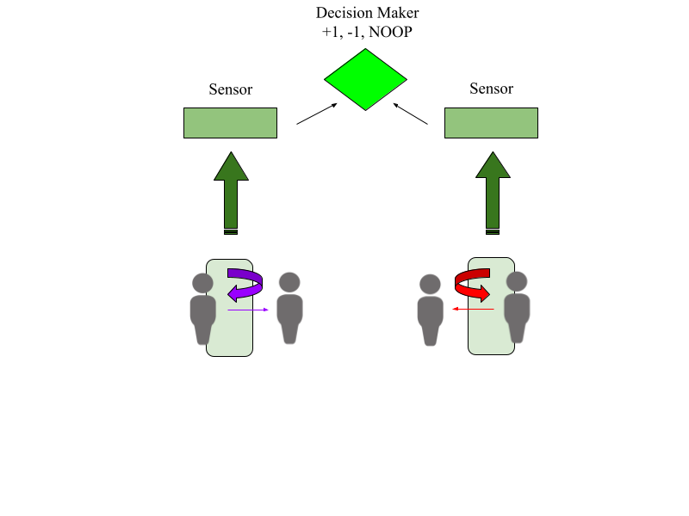
The Objective

Slide 5
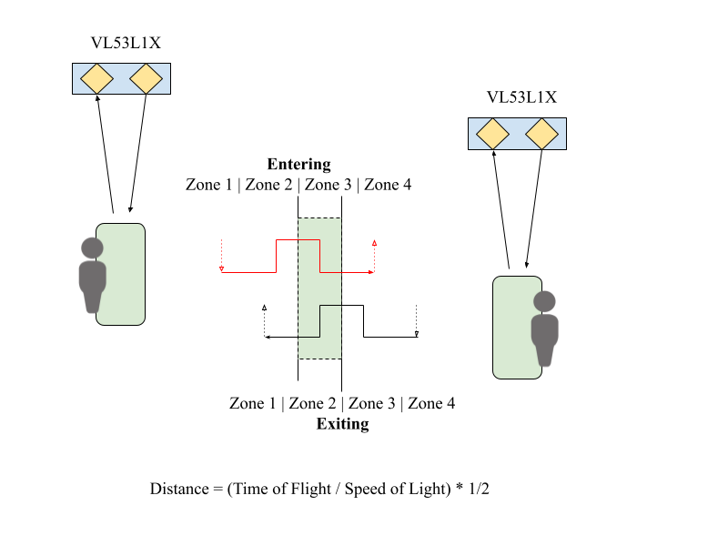
The Solution

Slide 6
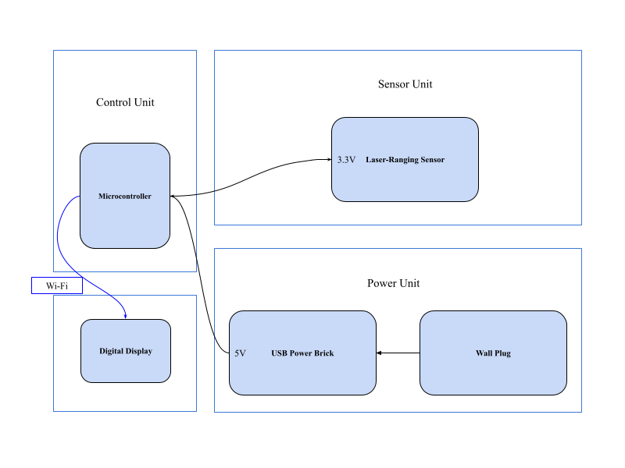
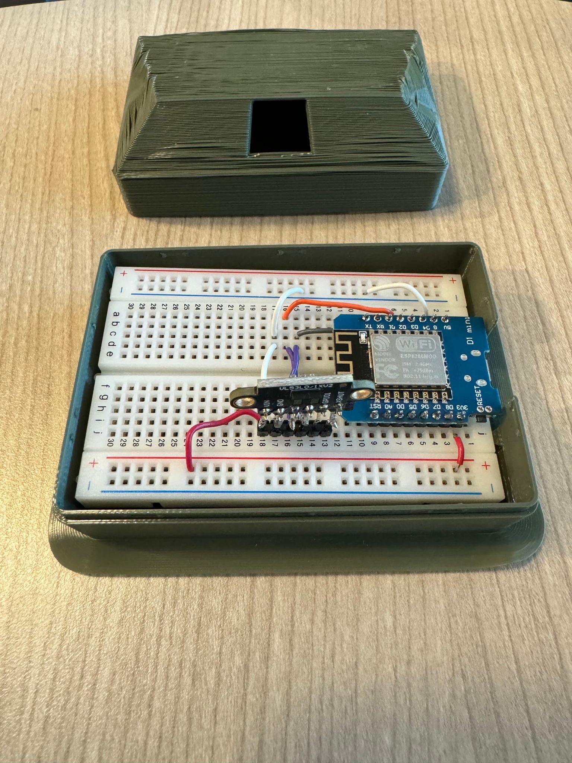
Design Choices

Slide 7
High Level Requirements
Accuracy/precision of count
The count must be exact for up to six occupants, and correct within plus/minus of one person for up to twelve. Since this project is being used as a dependency for a much bigger system, precision and accuracy are important.
Update Frequency
The actual display should update between two to ten times per minute. This is to ensure that our count is considered live and makes an impact on the energy-saving and HVAC procedures that will ensue.
Universal Compatibility
Output data will be transferred via a wireless (WiFi) connection to a display. The microcontroller we are using has a built-in web interface that we will use for universal access for users of the project.

Slide 8
Control Unit Subsystem
Requirements | Verification
The ESP8266 should maintain an accurate count of how many people are in the room. The count must be exact for up to six occupants, and correct within plus/minus of one person for up to twelve. | Simulate movements between Zone 1 and 2 and verify that the room count adjusts accordingly Test edge cases such as rapid movements or simultaneous movements from multiple targets
Data summaries must be transmitted over WiFi to a digital display device. The actual display should update between two to ten times per minute. | Ensure reliable and secure data transmission Test the stability and speed of WiFi transmission under various network conditions Conduct stress tests to ensure system can handle a high volume of data transmissions

Slide 9
Sensor Subsystem
Requirements | Verification
The VL53L1X sensor must accurately detect individuals within a range of up to 4 meters, catering to small to medium-sized rooms. The detection error has to be minimal to ensure precision | We will conduct field tests to test out the sensor's detection range and accuracy, by having individuals moving at different speeds and distances up to 4 meters to verify the sensor's performance.
The sensor needs to be able to accurately capture a fast ranging frequency of up to 50 Hz. | We will simulate scenarios where individuals cross the detection zone rapidly, and measure sensor response time to see if it satisfies the 50 Hz requirement

Slide 10
Power Subsystem
Requirements | Verification
The sensor carrier board must regulate the voltage supplied to the VL53L1X sensor within the specified range (2.8V to 5.5V). | Measure the voltage output of the sensor carrier board to ensure it falls within the specified range for the VL53L1X sensor. Verify that the ESP8266 module receives an average of around 3.3V input voltage. Test the voltage regulation circuit under different load conditions to ensure stability and reliability.
Ensure the USB cable provides reliable power transmission without any significant voltage drops/interruptions. | Inspect the USB cable for any physical damage or defects before permanent installation. Test the cable for continuity and proper power transmission. Perform stress tests by bending and flexing the cable to see if it has the proper durability and longevity.

Slide 11
0.6Microcontroller + 0.132VL53L1X = 0.732 W
Our system’s peak power consumption. With this, we succeeded in making a small, efficient, modular, and highly scalable solution.
From here, the next steps would be to order another PCB to make the module even more sleek, to upgrade the software so that it maintains history of data which could be used for analysis, and add another VL53L1X sensor for the highly unlikely, but possible entry of running persons.

Slide 12
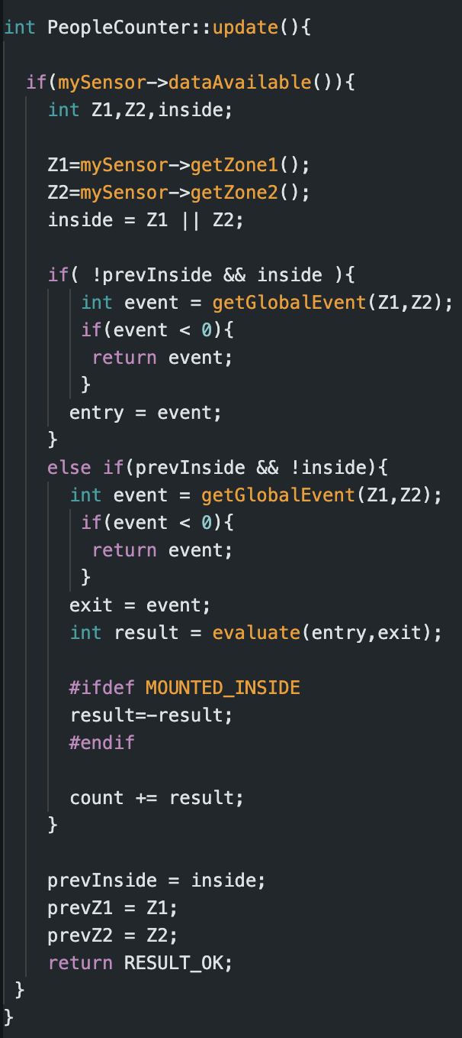

Slide 13
Thank you, any questions?

