Slide 1
ECEB Submetering
Electrical & Computer Engineering
Team 75
Aleksai Herrera, Mike Lee, Jonathan Izurieta
04/30/2024

Slide 2
Project Purpose
Power Quality important to homes and commercial
Allows for energy optimization
Important in clean energy movement
ELECTRICAL & COMPUTER ENGINEERING
GRAINGER ENGINEERING

Slide 3
High Level Requirements
Be able to measure current and voltage for single phase systems within +/- 1% for loads of 200-400A
Be able to accurately measure the phase angle within +/- 1% and using the phase angle calculate the Power Factor within +/- 2%.
Be able to display calculated data to an LCD screen and the TVs in ECEB.
ELECTRICAL & COMPUTER ENGINEERING
GRAINGER ENGINEERING

Slide 4
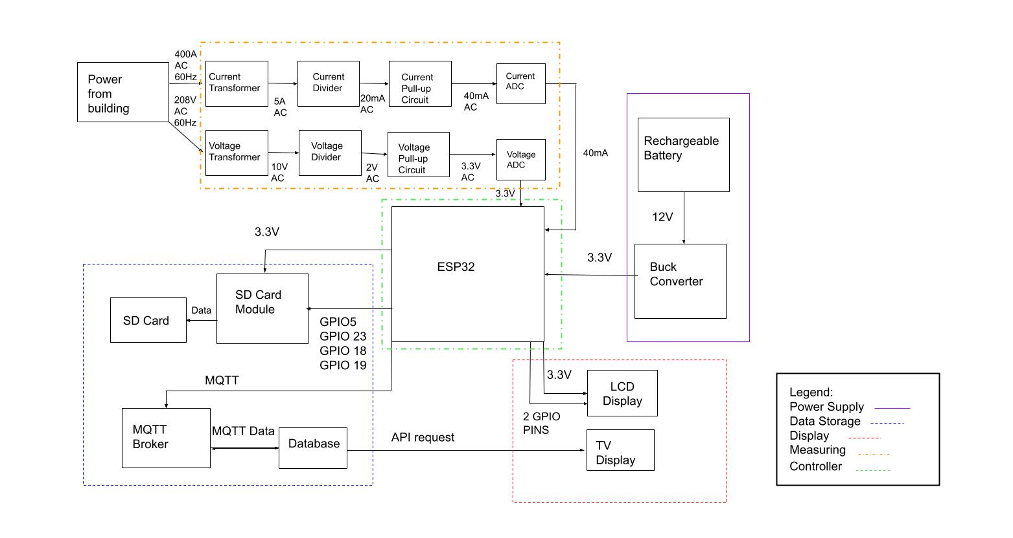
Block Diagram
ELECTRICAL & COMPUTER ENGINEERING
GRAINGER ENGINEERING

Slide 5
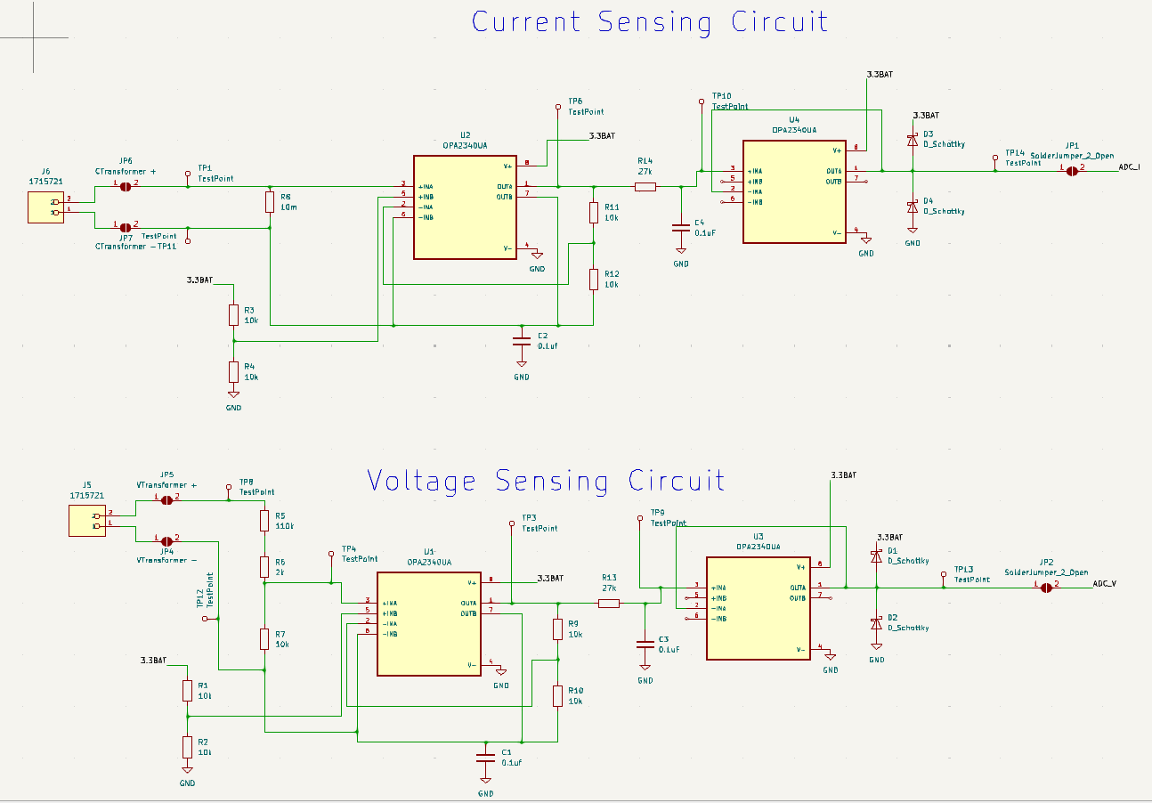
Subsystem Descriptions
Metering Subsystem
Brings current and voltage to acceptable levels for ESP32
Keeps signal integrity to achieve good margins of error when doing calculations.
ELECTRICAL & COMPUTER ENGINEERING
GRAINGER ENGINEERING

Slide 6
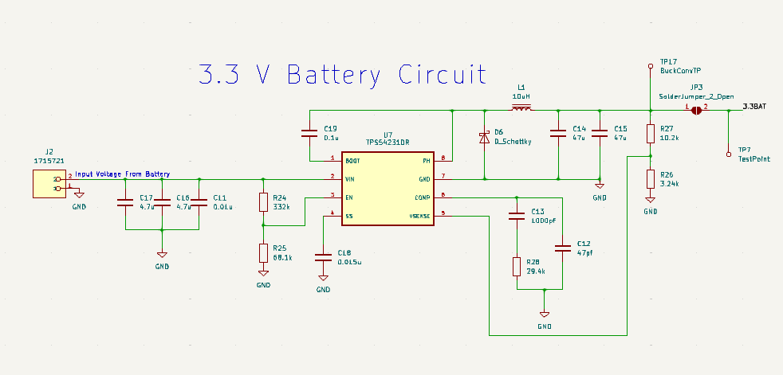
Subsystem Descriptions
Board Power Subsystem
Steps down 12V to 3.3V +/-0.3V to power multiple devices on the board.
ELECTRICAL & COMPUTER ENGINEERING
GRAINGER ENGINEERING

Slide 7
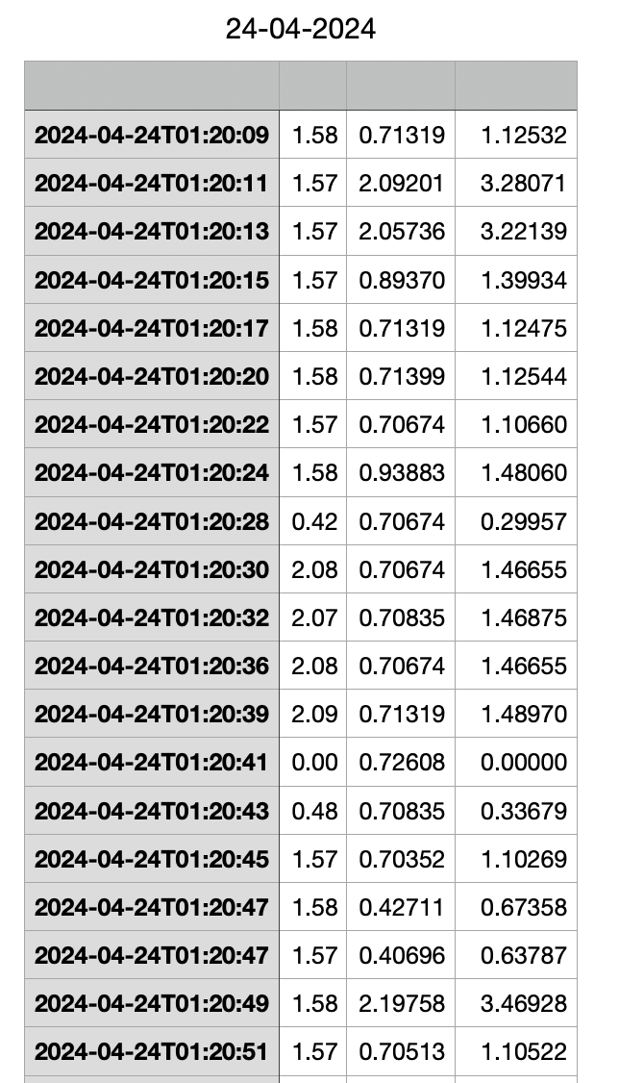
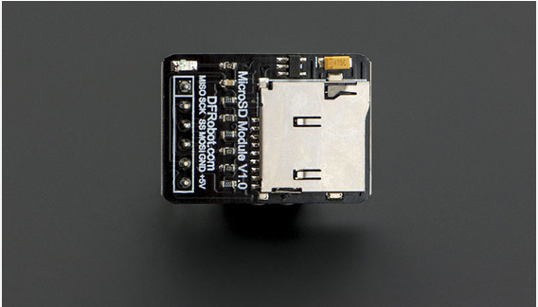
Subsystem Descriptions
SD Card Module
Able to locally store rms current and voltage measurements with date and timestamp
Stores 10 times every second.
Data is offloaded to database for website display
ELECTRICAL & COMPUTER ENGINEERING
GRAINGER ENGINEERING

Slide 8
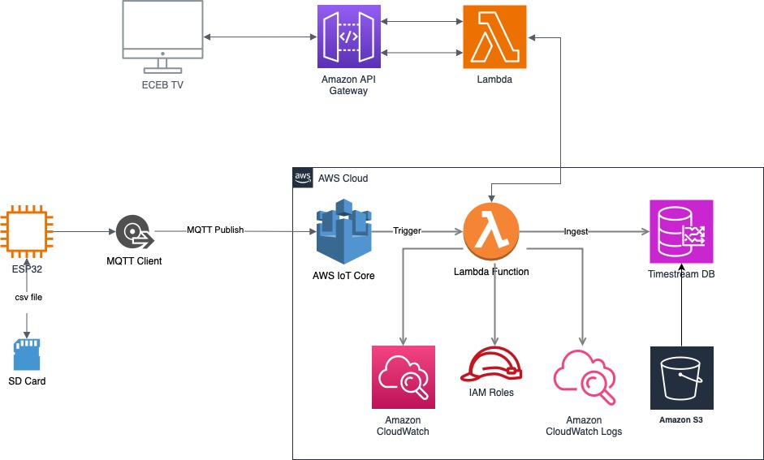
Subsystem Descriptions
Cloud Infrastructure
Ingested MQTT messages, stored as Time Series Database
Endpoint that queries database and outputs data on the web
ELECTRICAL & COMPUTER ENGINEERING
GRAINGER ENGINEERING

Slide 9
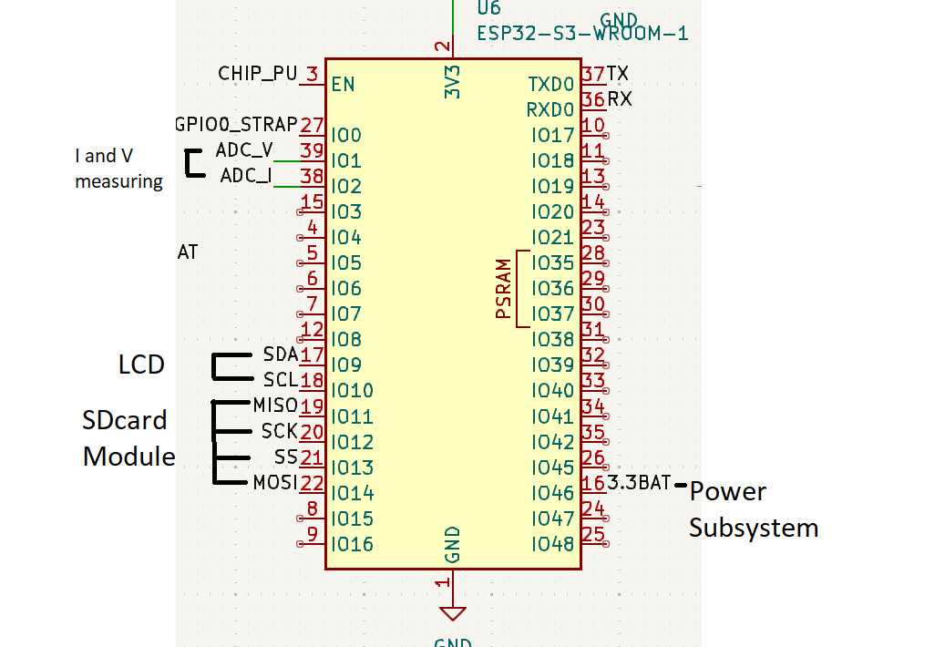
Subsystem Descriptions
Microcontroller Subsystem
Interfaces with all the other subsystems
Measures Current & Voltage and does data calculations
ELECTRICAL & COMPUTER ENGINEERING
GRAINGER ENGINEERING

Slide 10
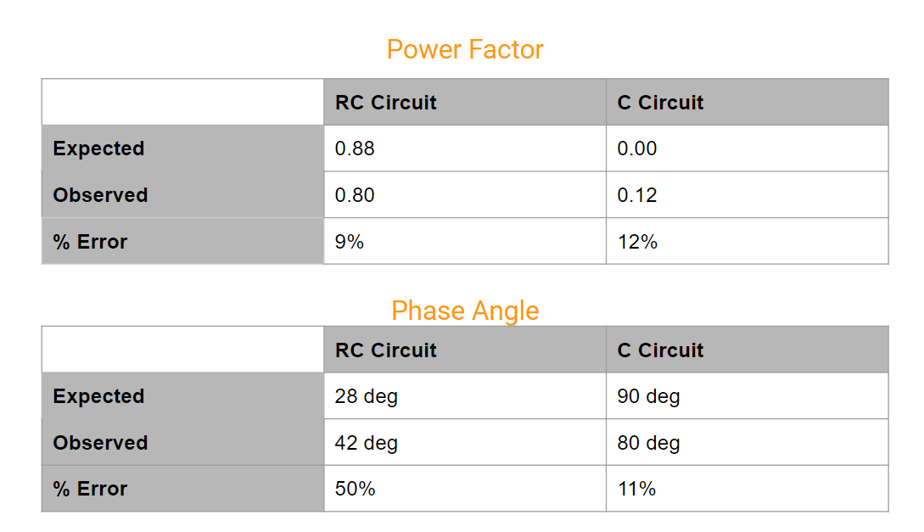
Testing Results
Results of testing a purely capacitive load and an RC load versus theoretical computation
ELECTRICAL & COMPUTER ENGINEERING
GRAINGER ENGINEERING

Slide 11
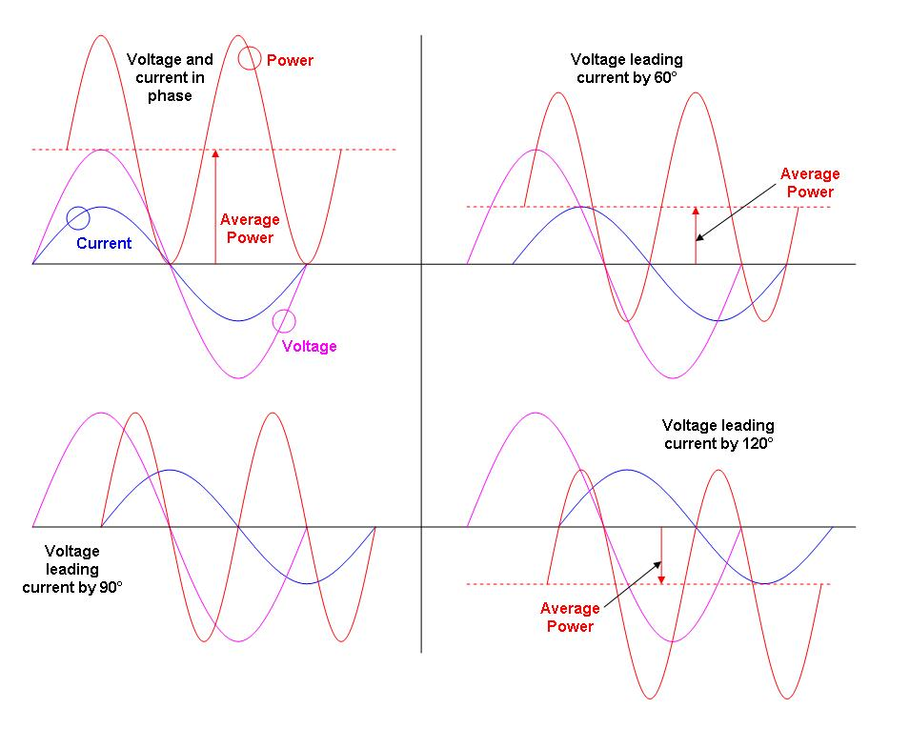
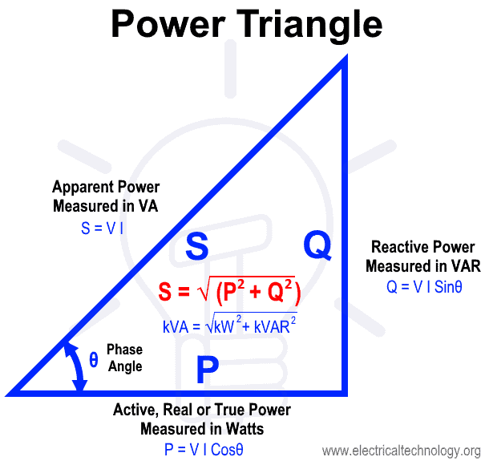
Calculation Theory
Phase Angle & Power Factor
Real Power from average of instantaneous power
Apparent Power from Vrms and Irms
PF = Real/Apparent
ELECTRICAL & COMPUTER ENGINEERING
GRAINGER ENGINEERING

Slide 12
Challenges and Failures
Design Challenges
Linear Regulator or Buck Converter for stepping down Voltage to 3.3V
What cut off frequency to use for Low Pass RC filter
Making sure voltage was in safe range for ESP32
Failures
Buck Converter failed to provide 3.3V despite following datasheet (11.7 V->11.2 V)
Programming circuit could not pull GPIO0 Low resulting in never entering download boot mode
ELECTRICAL & COMPUTER ENGINEERING
GRAINGER ENGINEERING

Slide 13
Future Improvements
ELECTRICAL & COMPUTER ENGINEERING
GRAINGER ENGINEERING

Slide 14
Thank You!
Any Questions?
ELECTRICAL & COMPUTER ENGINEERING
GRAINGER ENGINEERING

