Slide 1
Team 3: DigiDough
ECE 445 Final Presentation
Alec Thompson, Jake Hayes, Abhitya Krishnaraj
4-29-2024

Slide 2
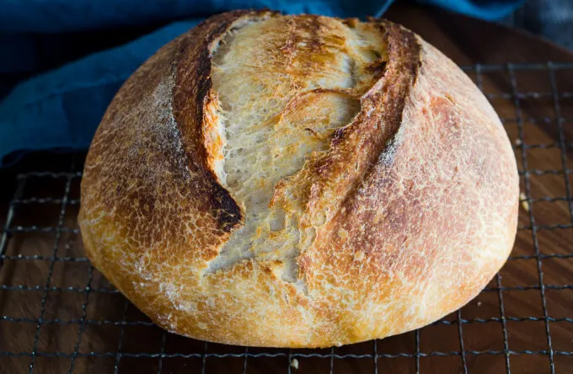
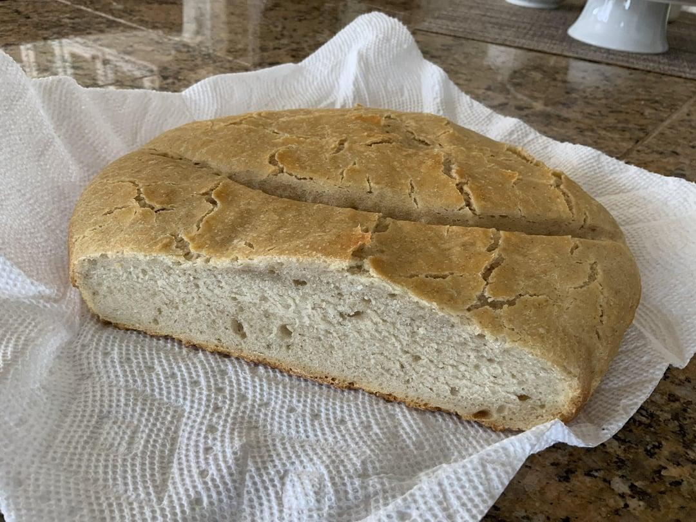
A tale of two sourdoughs
ECE 445
GRAINGER ENGINEERING

Slide 3
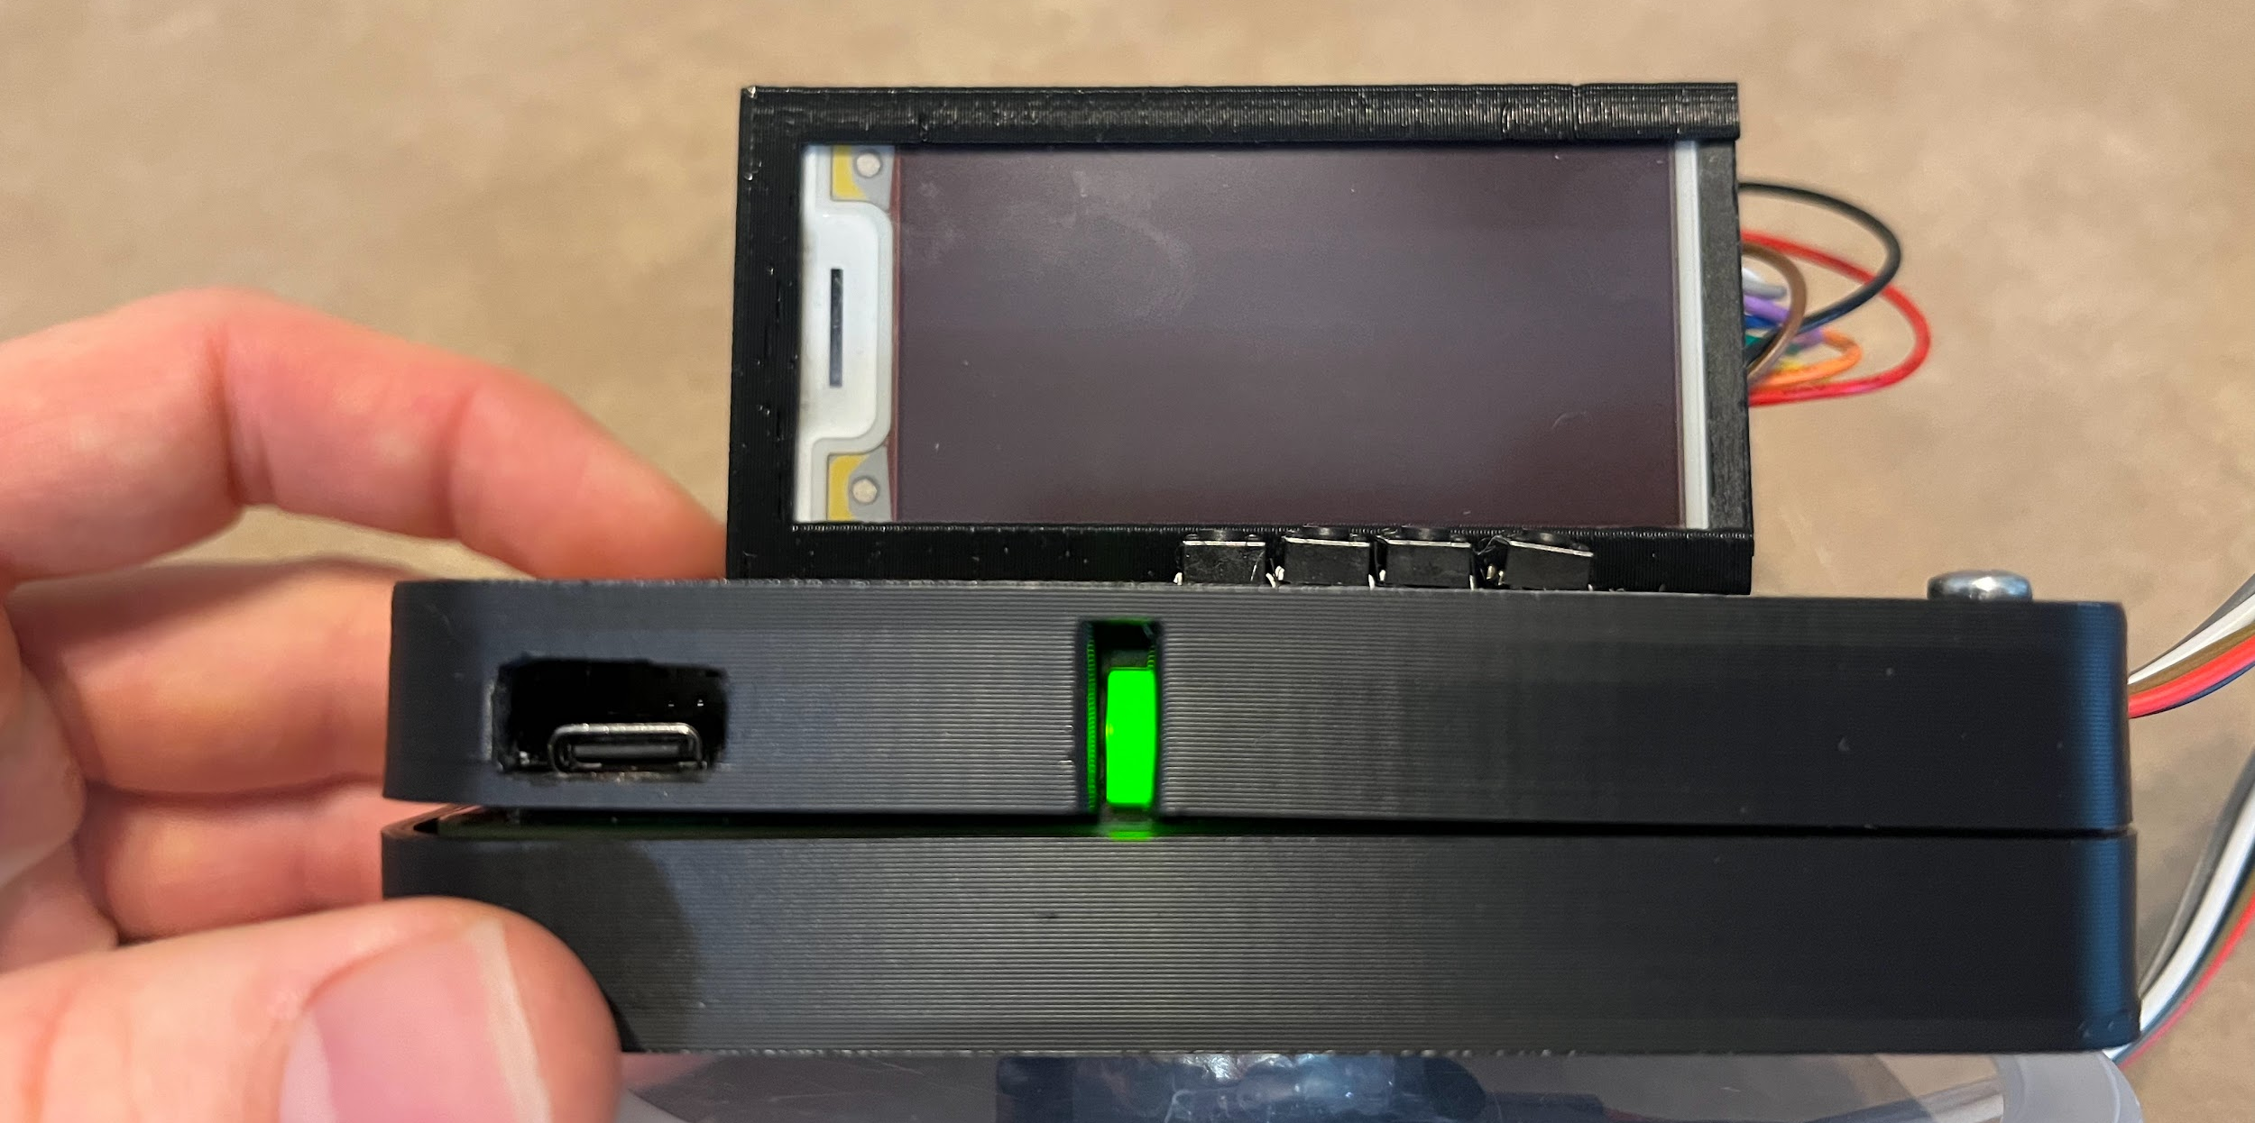
Objective and Design Overview
Problem
Dough/starter is tricky!
Variable time
Temperature
Repeated rise/fall
Physical Design
Solution
Create a device to see the temperature and dough growth at a glance
ECE 445
GRAINGER ENGINEERING

Slide 4
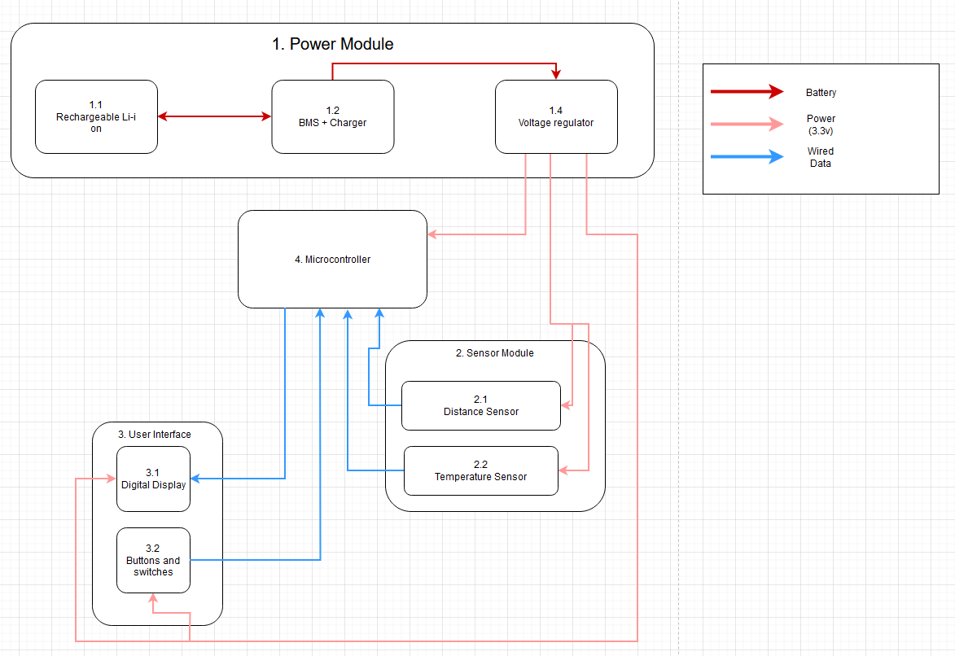
Block Diagram + High Level Requirements
High Level Requirements
Supply power to each subsystem using a rechargeable battery that lasts for at least 10 hours
Accurately read and store distance values (with an accuracy of ±1 cm below 10 cm and ±10% between 10-20 cm) and temperature values (±3°C)
Display the start, peak, and current heights, and current temperature on a display that updates at least once every five minutes
ECE 445
GRAINGER ENGINEERING

Slide 5
Subsystems
ECE 445
GRAINGER ENGINEERING

Slide 6
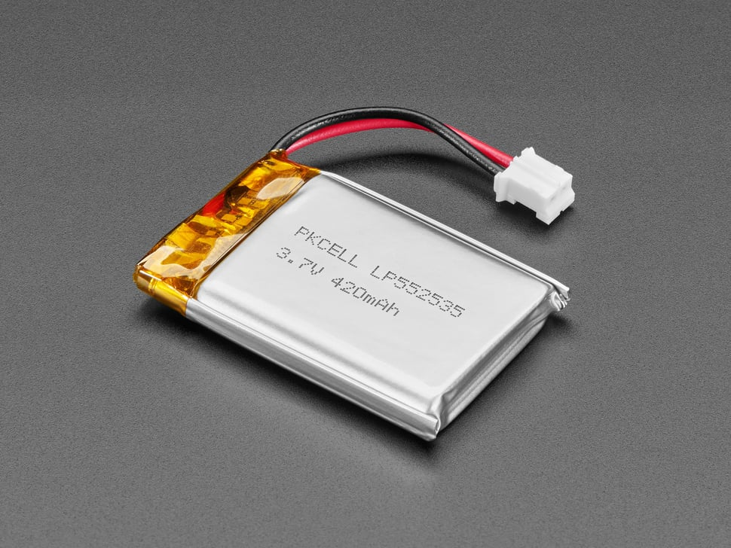
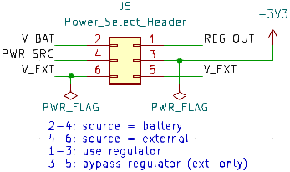
Power Subsystem
Overview
Power all subsystems
Battery life > 10 hr
Time to charge < 6 hr
 | Datasheet Range | Tested Value
Battery | 3.0 – 4.2 V | 4.13 V
MCU | 2.4 – 3.6 V | 3.30 V
Display | 2.4 – 3.6 V | 3.30 V
Distance Sensor | 2.5 – 3.6 V | 3.30 V
Temp. Sensor | 0.4 – 5.0 mA | 1.4 mA
LED | 20 mA ideal | 18.9 mA
Challenges / Verifications
First regulator burned out
Second regulator malfunctional
Third time’s a charm
ECE 445
GRAINGER ENGINEERING

Slide 7
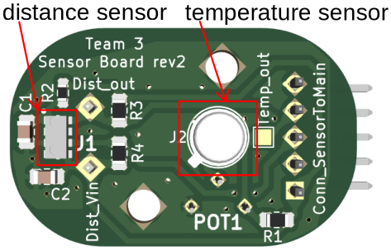
Sensor Subsystem
Overview
Readings ≥ 1 per second
Temperature accuracy ±3°C
Distance accuracy:
±1 cm below 10 cm
±10% from 10-20 cm
Challenges / Verifications
Temperature calibration
Pin assignments in Arduino IDE
Enclosure considerations
ECE 445
GRAINGER ENGINEERING

Slide 8
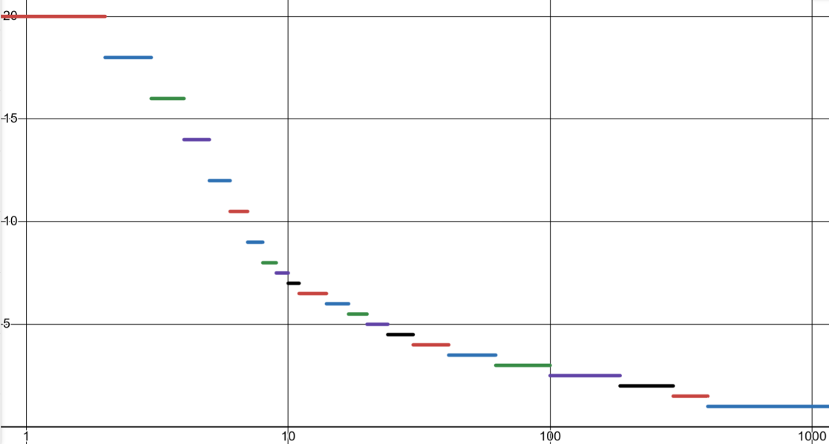
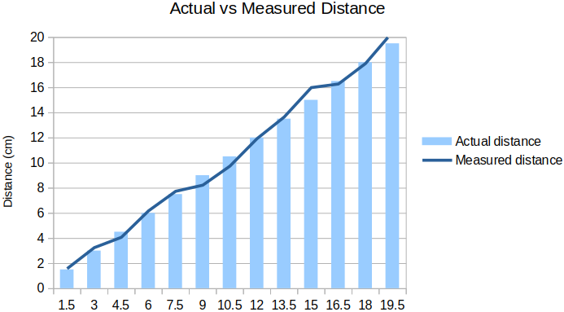
Sensor Subsystem
Software Distance Mappings
Overview
Readings ≥ 1 per second
Temperature accuracy ±3°C
Distance accuracy:
±1 cm below 10 cm
±10% from 10-20 cm
Challenges / Verifications
Temperature calibration
Pin assignments in Arduino IDE
Enclosure considerations
Error < 10cm: .09 - .76 cm
Error > 10cm: .42 - 6.7 %
ECE 445
GRAINGER ENGINEERING

Slide 9
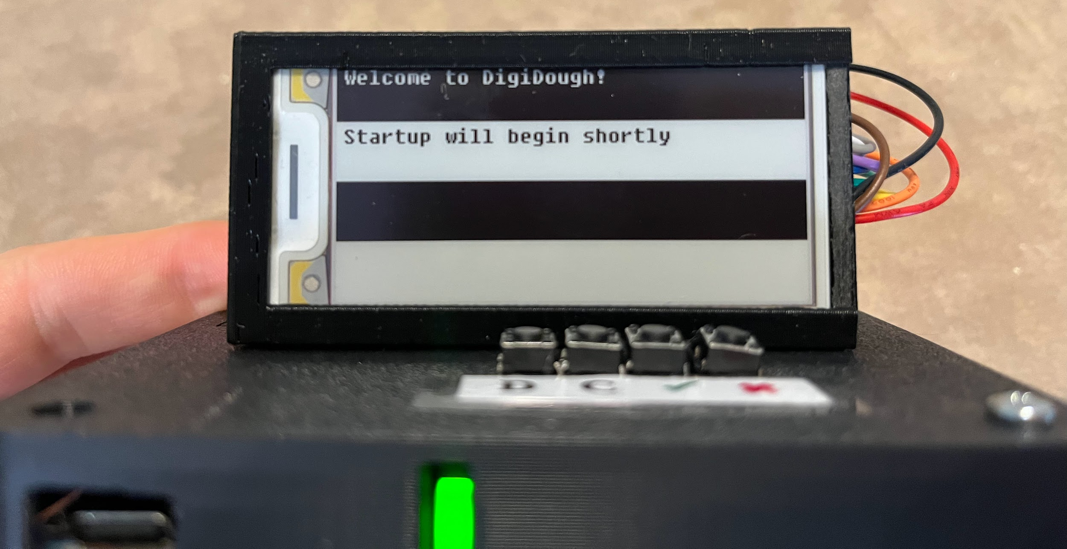
User Interface Subsystem
Overview
Power switch & indicator
Buttons: dough, container, confirm, cancel
Display
Confirmation and prompt screens
Challenges / Verifications
Testing buttons and display lag
Display regularly updates and shows relevant information
Memory hungry libraries
ECE 445
GRAINGER ENGINEERING
Notes:
System is reset whenever power is cycled

Slide 10
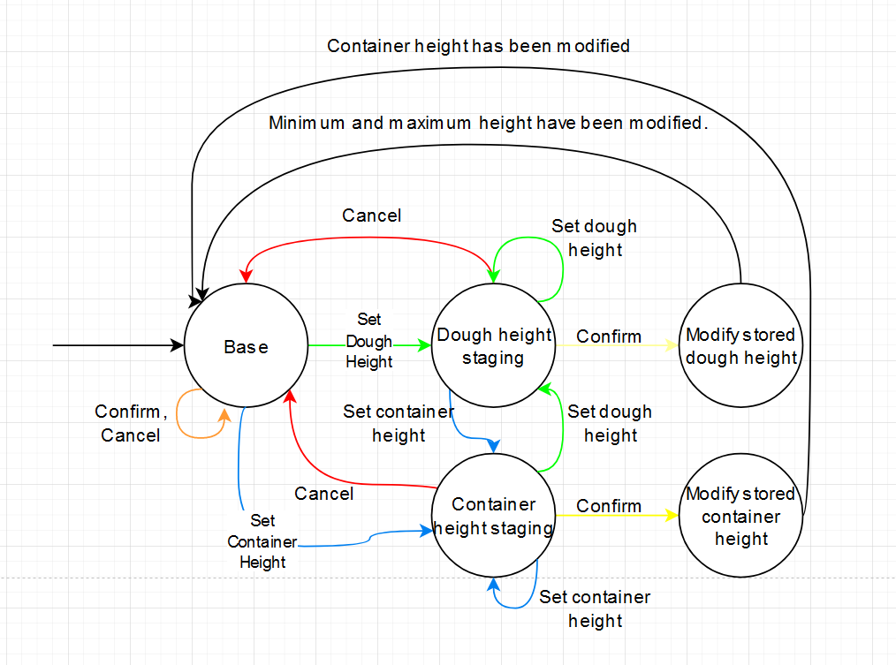
Microcontroller Subsystem
Overview
Compute & store values that are displayed
Print values and states to serial console
Update the display every 5 minutes
Challenges / Verifications
State machine modifications & slow startup
Pin mappings in variant file vs our assignments
IDE Whac-A-Mole
ECE 445
GRAINGER ENGINEERING

Slide 11
Using DigiDough
ECE 445
GRAINGER ENGINEERING

Slide 12
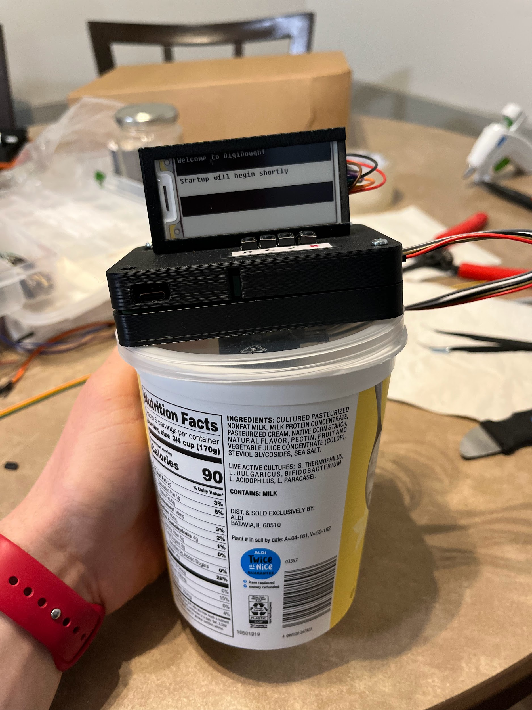
Procedure to Use DigiDough
Attach the device
Set container height
Place dough and set dough height
Put in warm location
Watch current height compared to start height
ECE 445
GRAINGER ENGINEERING

Slide 13
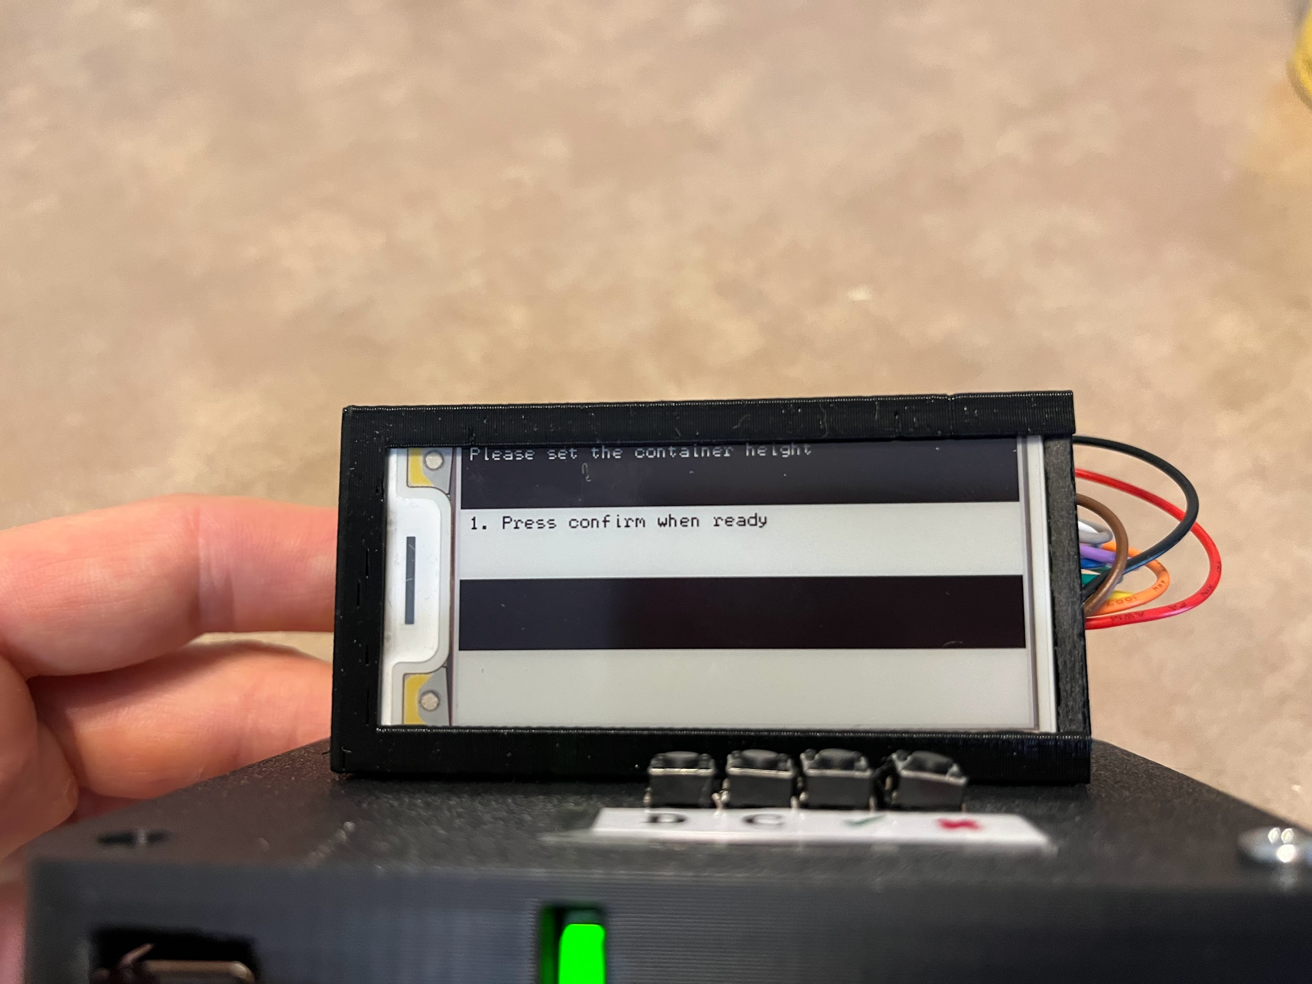
Procedure to Use DigiDough
Attach the device
Set container height
Place dough and set dough height
Put in warm location
Watch current height compared to start height
ECE 445
GRAINGER ENGINEERING

Slide 14
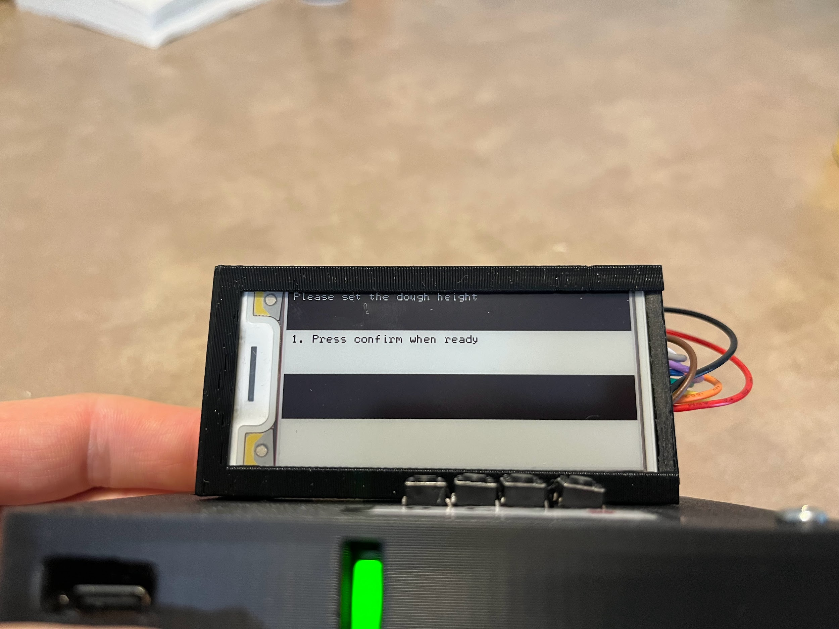
Procedure to Use DigiDough
Attach the device
Set container height
Place dough and set dough height
Put in warm location
Watch current height compared to start height
ECE 445
GRAINGER ENGINEERING

Slide 15
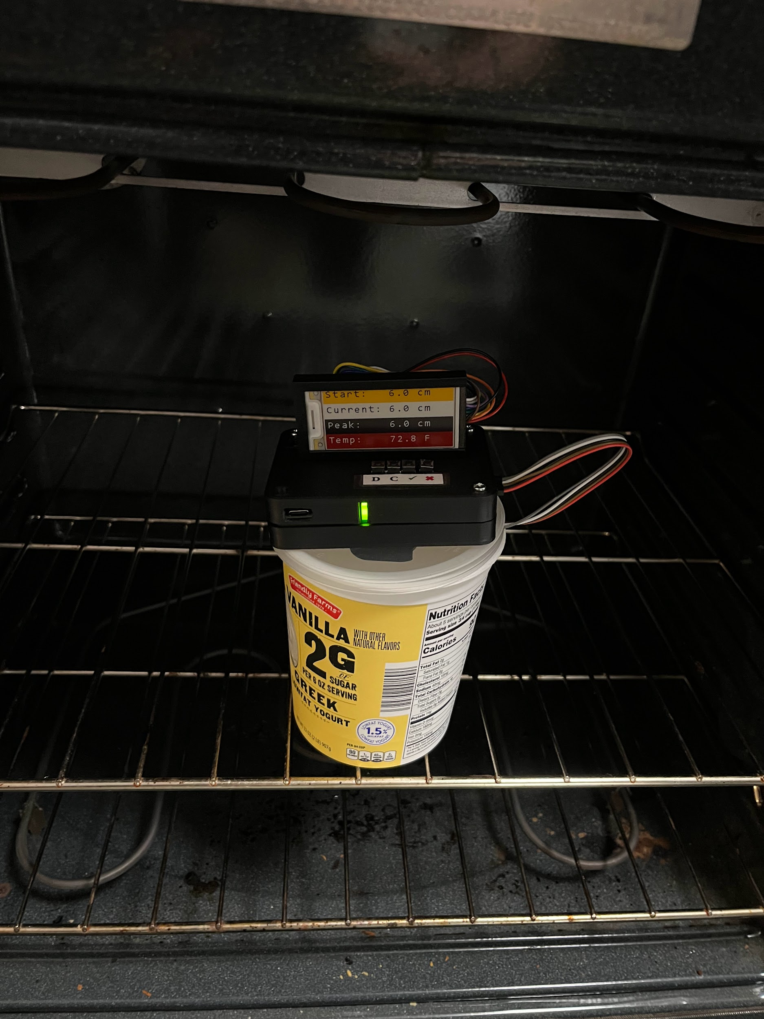
Procedure to Use DigiDough
Attach the device
Set container height
Place dough and set dough height
Put in warm location
Watch current height compared to start height
ECE 445
GRAINGER ENGINEERING

Slide 16
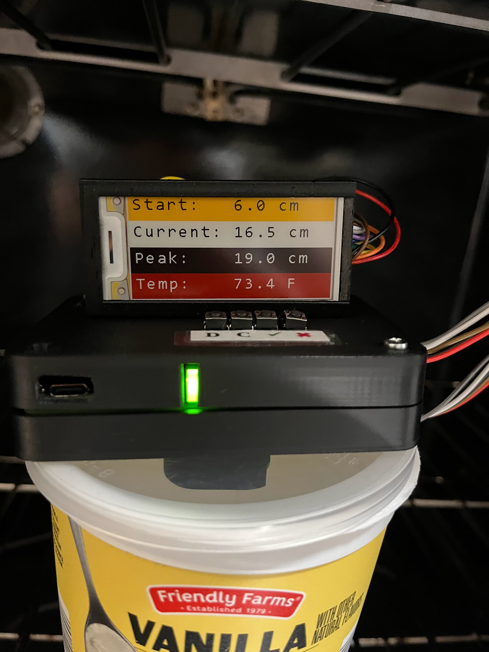
Procedure to Use DigiDough
Attach the device
Set container height
Place dough and set dough height
Put in warm location
Watch current height compared to start height
ECE 445
GRAINGER ENGINEERING

Slide 17
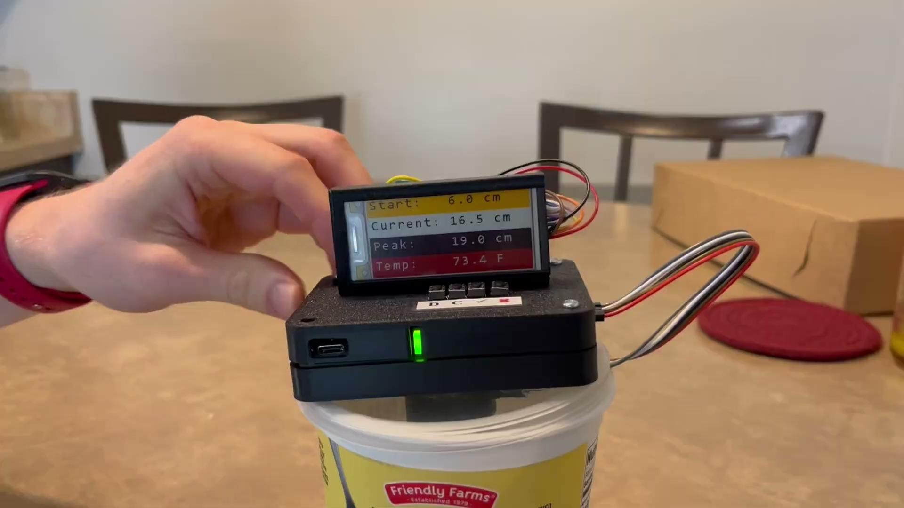
Project Build and Test Results
Project Build Description
Demo with Updating Heights
3D-printed enclosures
Display above main PCB
Magnets attach both parts
Testing Results
Demo Vid
All verifications passed
Works for dough and starter
Good user experience
Physical design improvement
ECE 445
GRAINGER ENGINEERING

Slide 18
Conclusion, Challenges, and Future Work
Conclusion
Future Work
DigiDough works as intended
Learned about the challenges of a development cycle
Timelines: allow for delays and re-designs
STM32: CubeIDE vs other IDEs
Software & library compatibility bottlenecks
Distance sensor proved difficult to work with
Distance sensor swap
Incorporate MCU w/ wifi (ESP32 or a Pico W)
Improve display and UX
ECE 445
GRAINGER ENGINEERING

Slide 19
Thank You!
Special thanks to Tianxiang Zheng, Arne Fliflet, and the rest of the course staff.
ECE 445
GRAINGER ENGINEERING

