Slide 1
Automatic Puzzle Solver
Alex Kim, Conor Devlin, Eric Chen
Team 71
Notes:
all

Slide 2
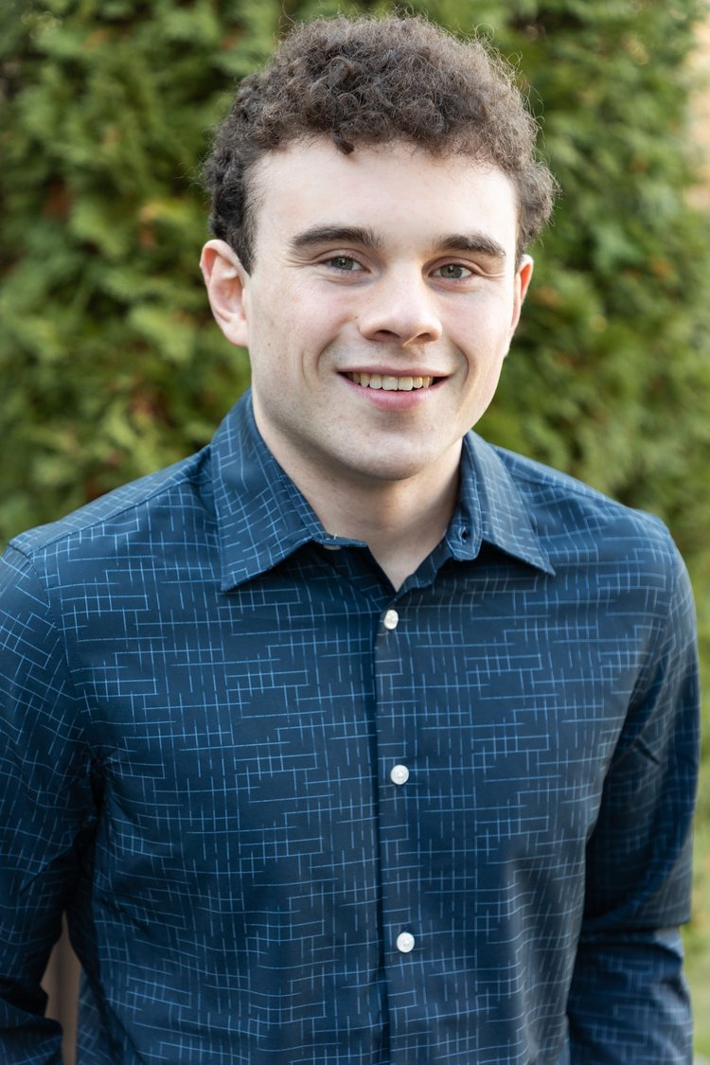
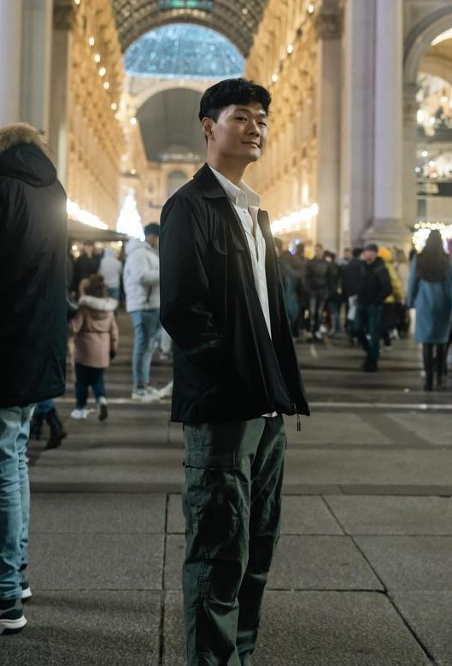
Our Team
Eric Chen
Conor Devlin
Alex Kim
Insert pics here
Insert pics here
Notes:
all

Slide 3
Table of Contents
01
Introduction
02
Objectives
03
Design
04
Build
05
Testing
06
Challenges
07
Conclusions
08
Future Work
Our team and
Motivation for the project
Target high-level requirements
Flow and Hardware/Software Overviews
Diagram and Demo
Requirements and Verification
Challenges we faced and how we overcame them
Wrap-up and reflections
Possible expansions in the future
Notes:
eric

Slide 4
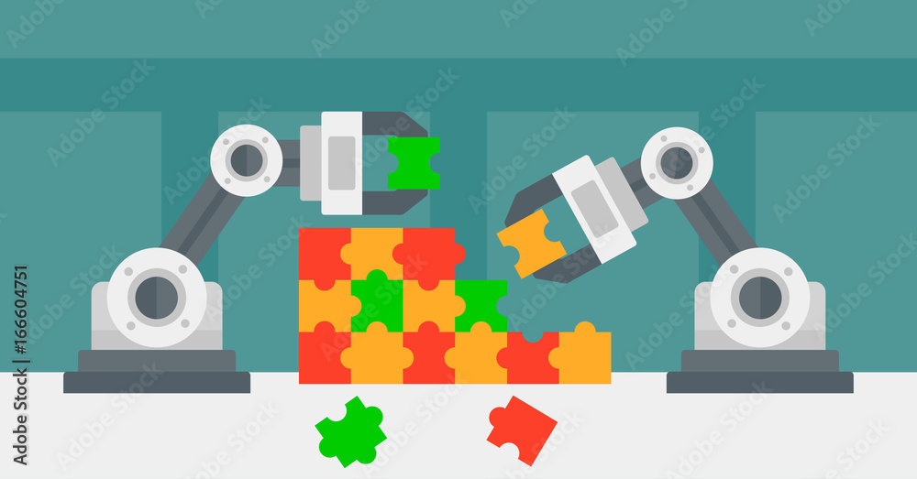
Our Project
Develop an innovative solution to autonomously solve a puzzle.
Incorporate robotics, computer vision, color recognition, etc.
Notes:
eric

Slide 5
High-Level Requirements
Functionality
Precision
Speed
We can correctly identify where individual puzzle pieces are located on the puzzle
The mechanical movement will be precise to 1 mm of movement
We can complete the whole 3x3 piece puzzle in 7 minutes
Notes:
alex

Slide 6
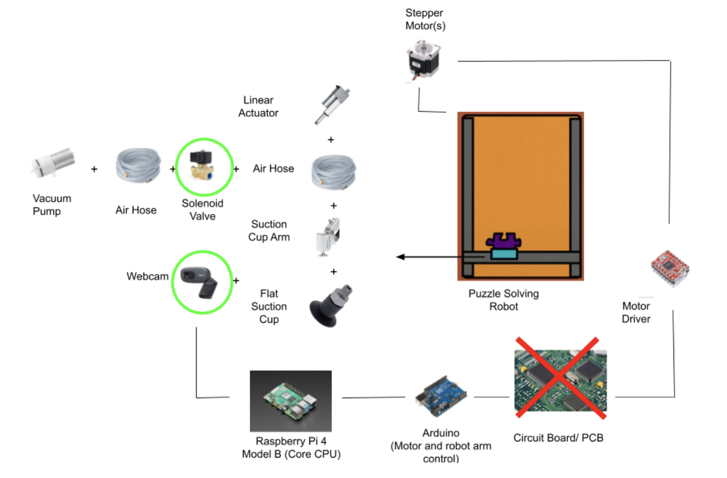
Design Flow
Notes:
alex

Slide 7
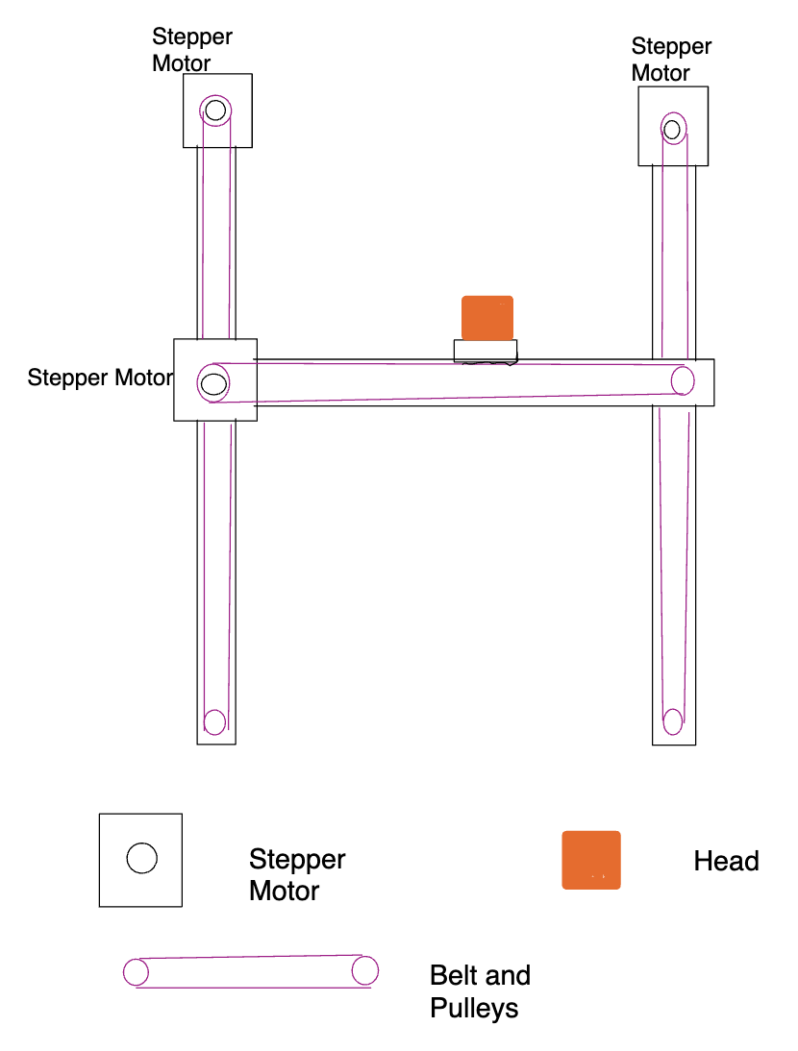
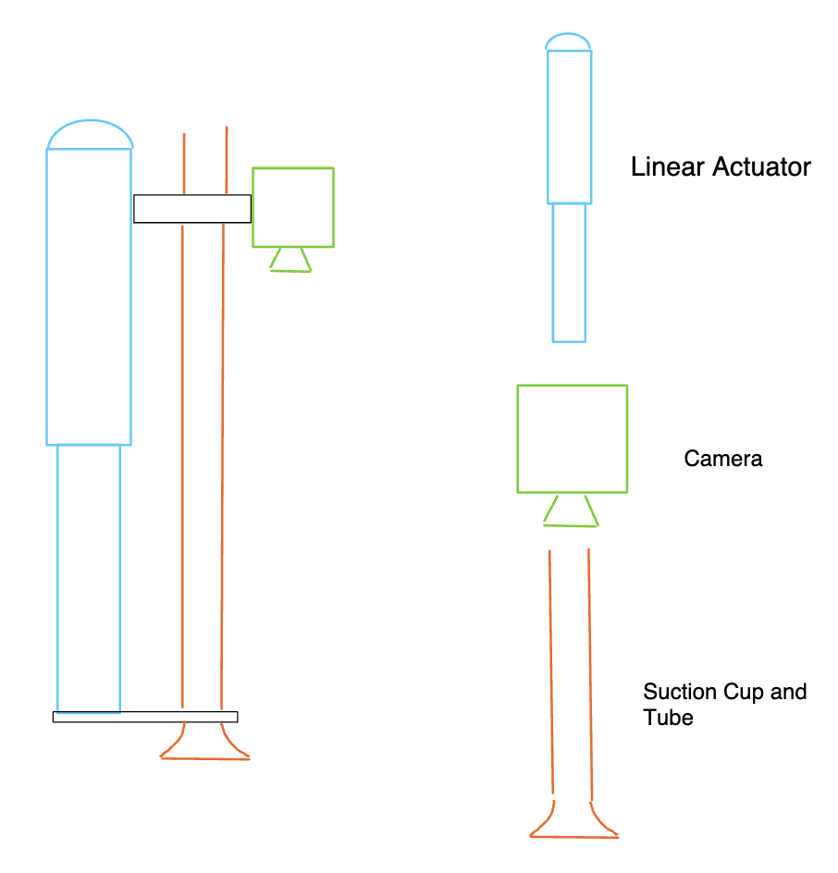
Mechanical Design Overview
Robotic Movement Scheme Overhead View Robotic Arm Side View
Notes:
alex

Slide 8
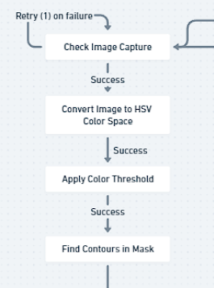
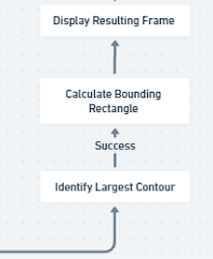
Software Design Overview
HSV Algorithm (OpenCV)
Microcontroller Software (C++)
C++ programmed in the Arduino Uno
OpenCV and Python programmed on the Raspberry Pi 4
Motor driver takes output (color) from HSV Algorithm
Locatize robot arm on startup (limit switches)
Locate pieces and move to correct ending location(s) based on color input
Notes:
Eric conor

Slide 9
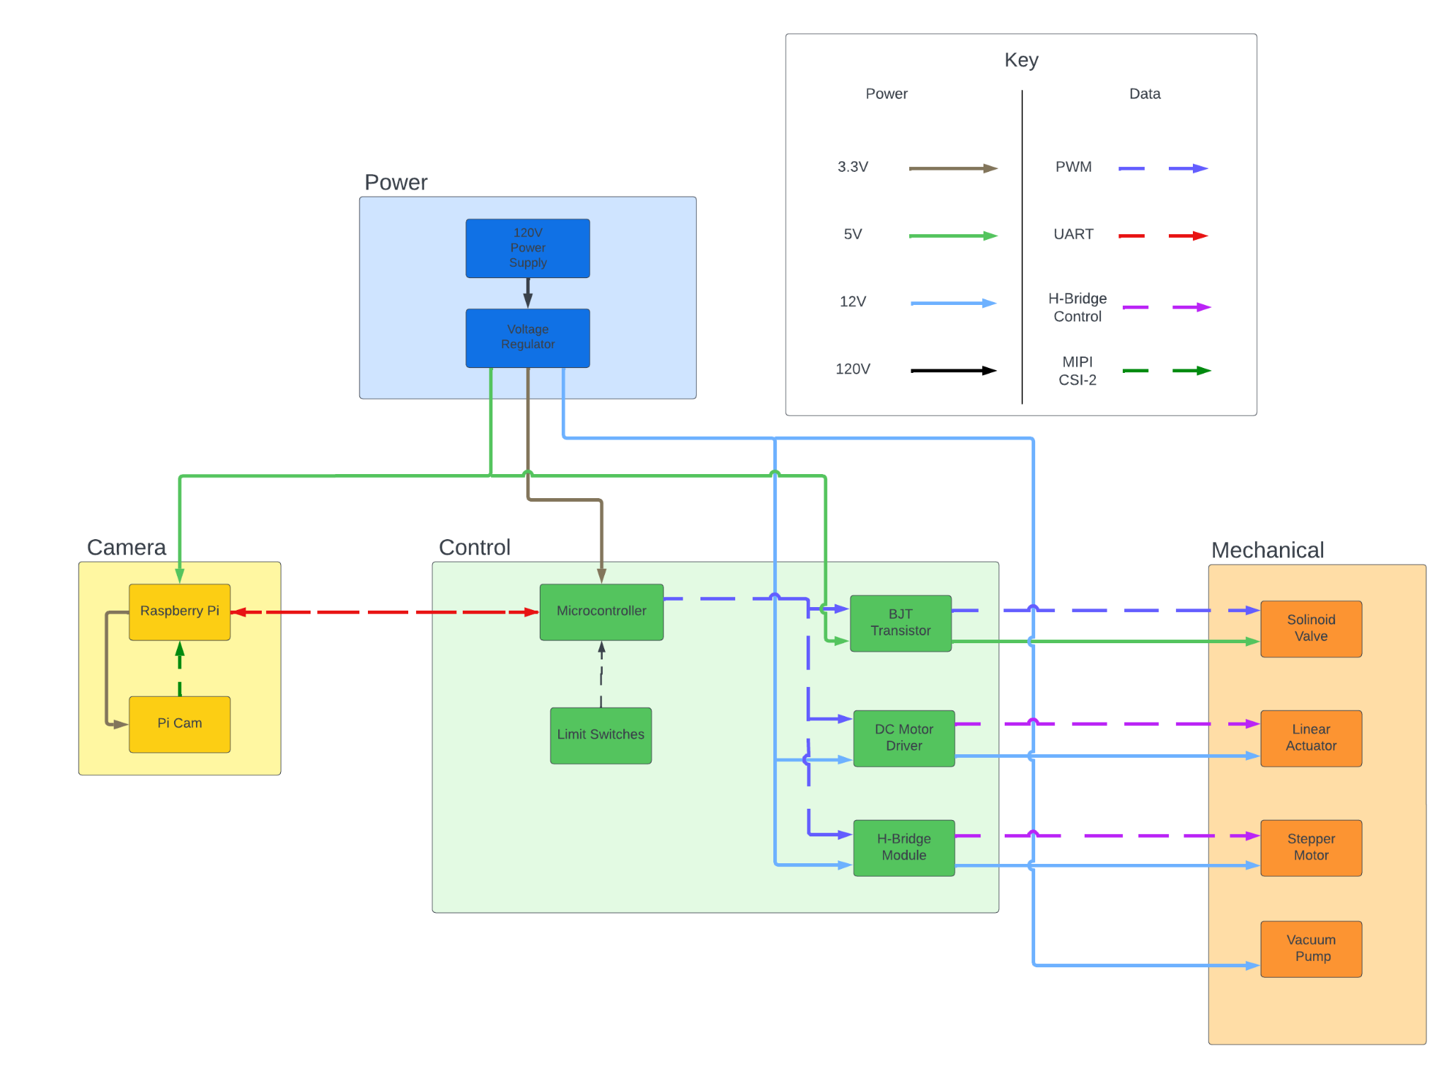
Block Diagram
Notes:
conor

Slide 10
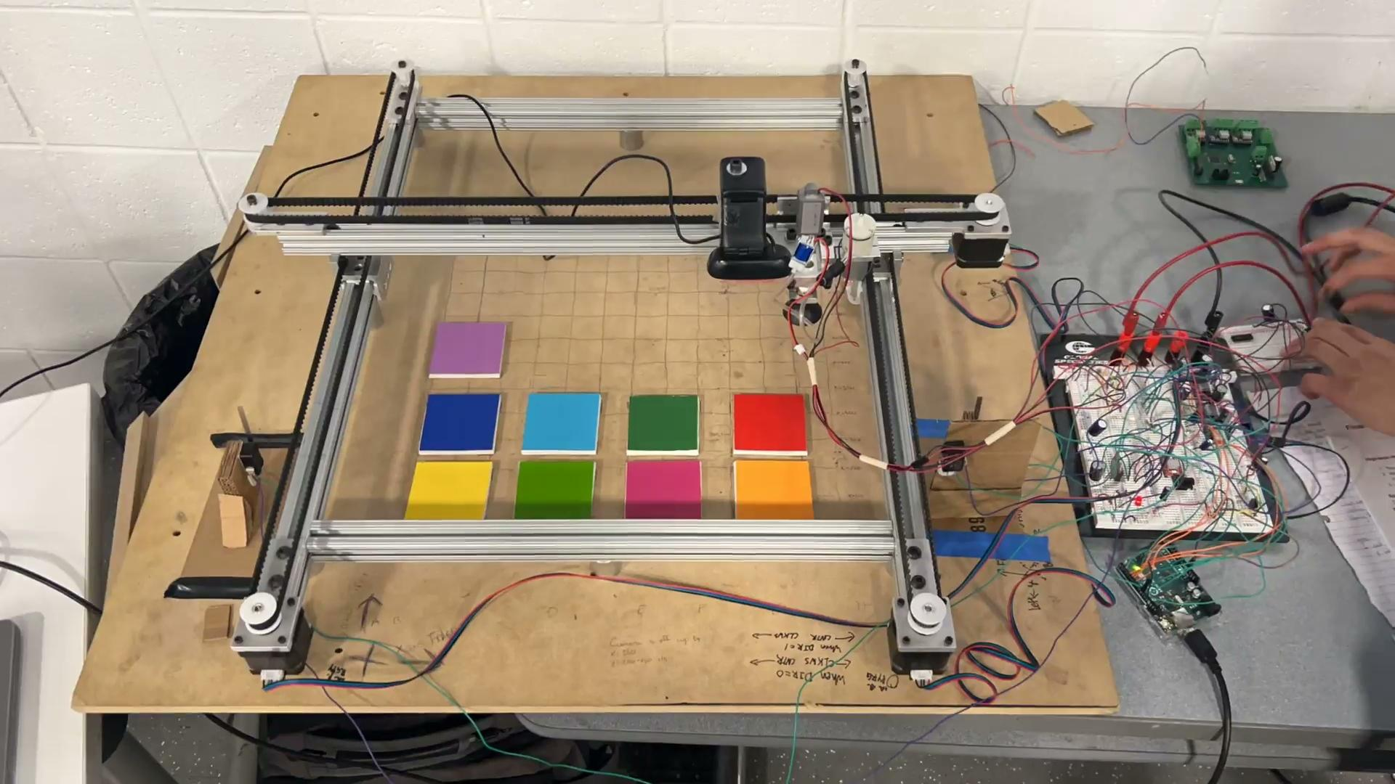
Notes:
conor

Slide 11
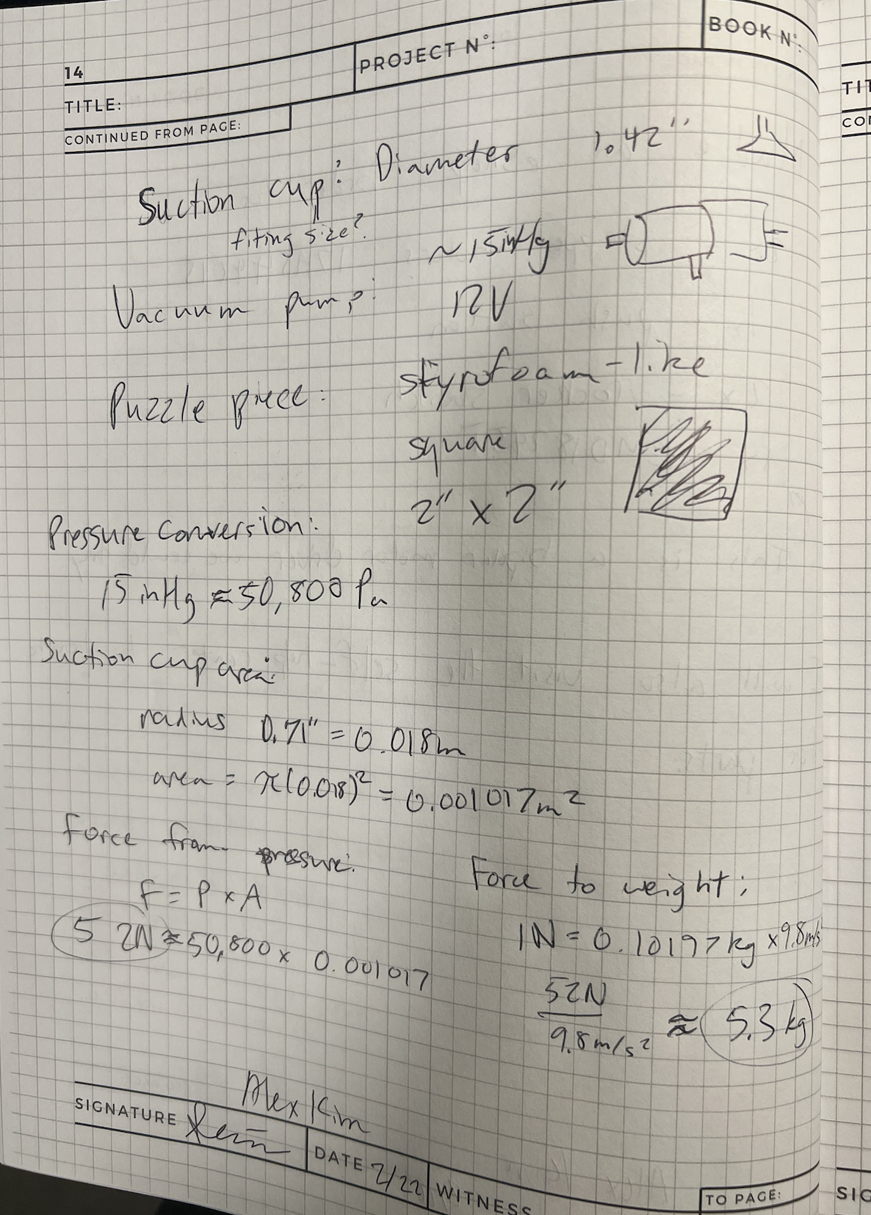
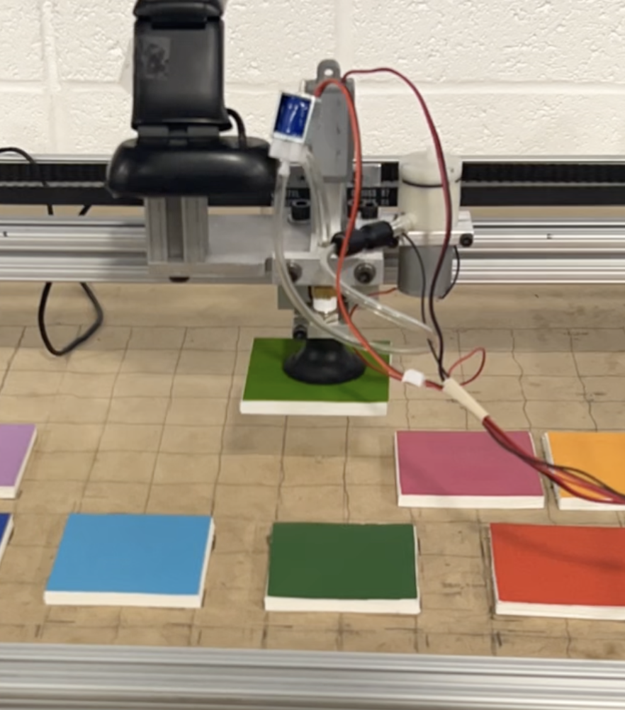
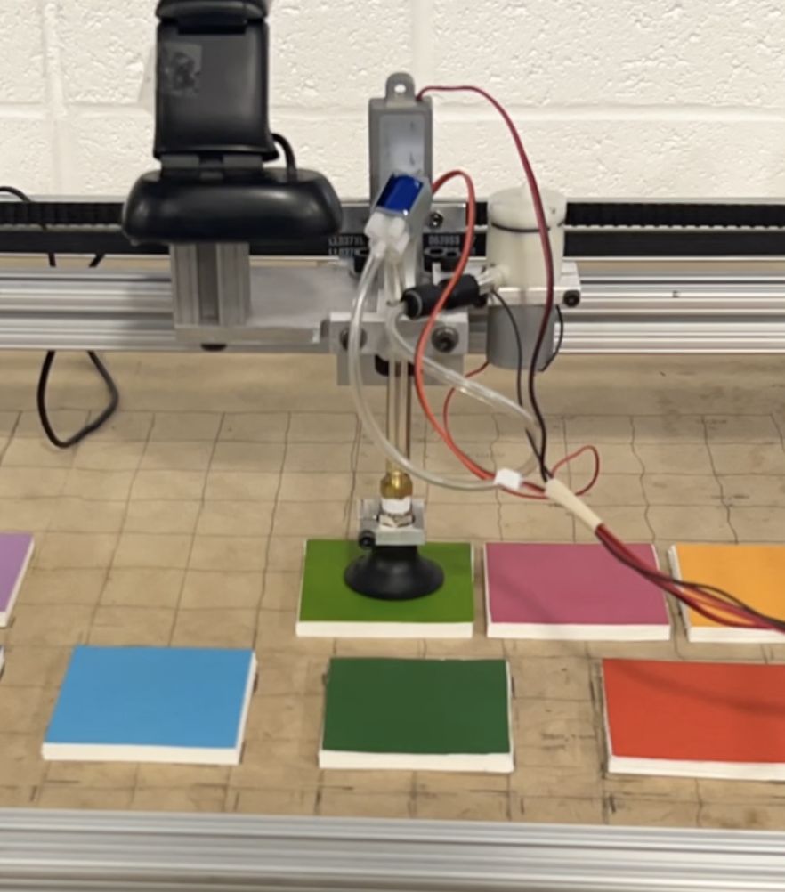
R&V: Mechanical
The vacuum pump and suction cup will be able to pick up puzzle pieces
The linear actuator should be able to reach puzzle pieces on the table, with the suction cup, when fully extended
Notes:
alex

Slide 12
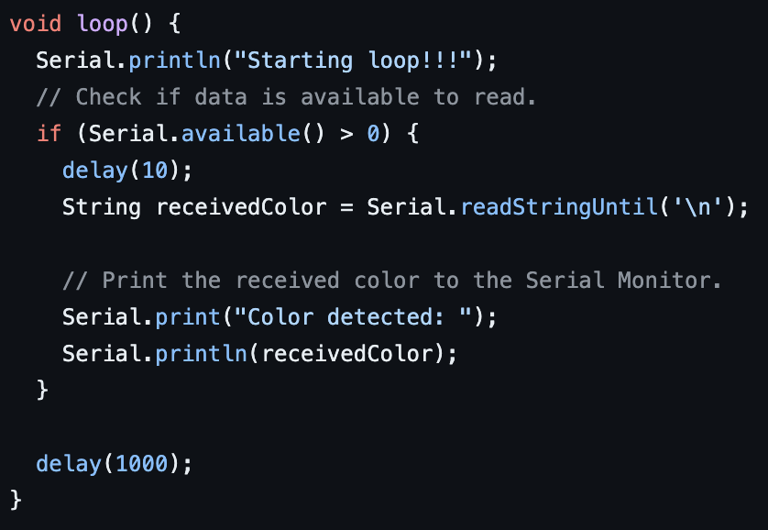
R&V: Control
The microcontroller will be able to record the position of the suction cup, above the table
The microcontroller should be able to receive a signal from the raspberry pi and react accordingly
Notes:
eric

Slide 13
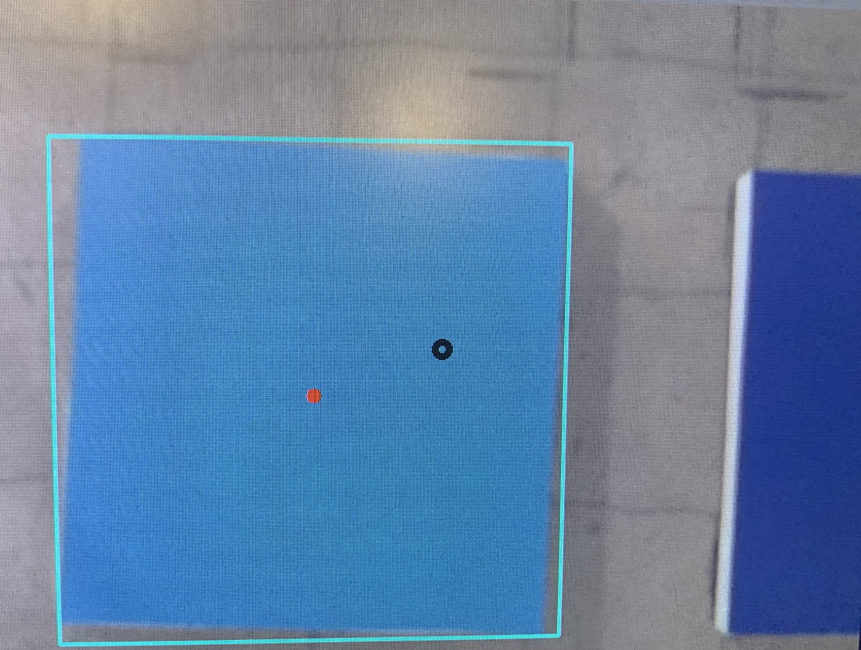
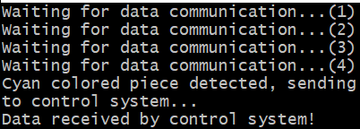
R&V: Camera Feedback
A sudden camera disconnection for more than 10 seconds should display an error and exit
Idle state from camera should receive constant feed with 95% color detection accuracy
The camera subsystem should be able to send basic data to the control subsystem
Notes:
eric

Slide 14
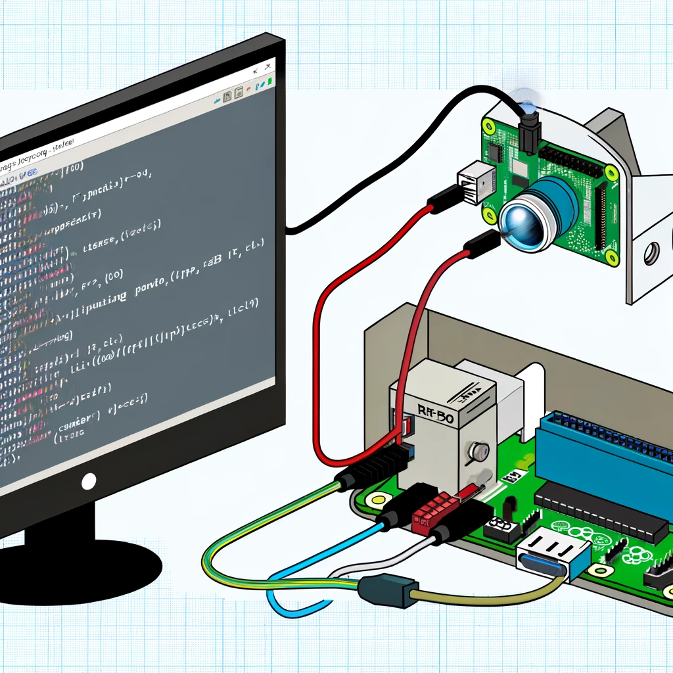
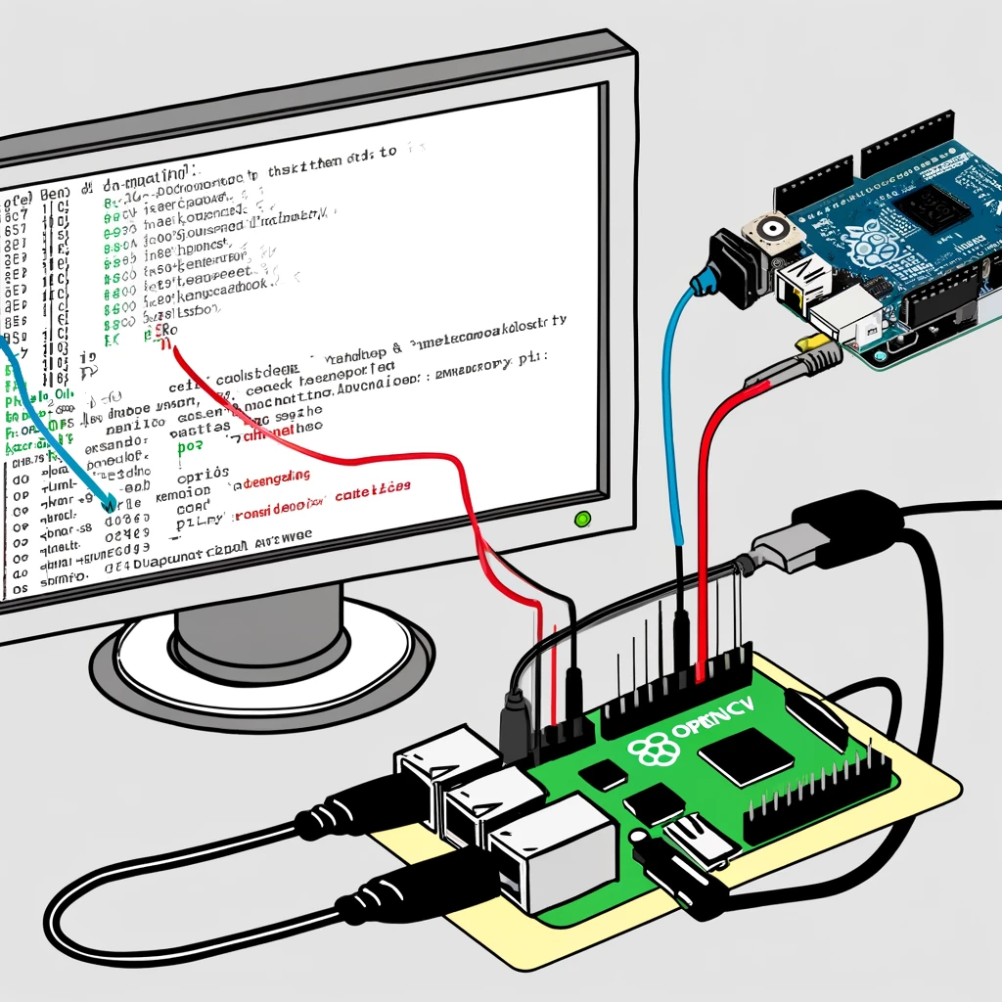
Successes & Challenges
Serial Communication Issues
Mechanical & Circuit
Timing issues and message drops
Buffer overflow
Data parsing errors
Solenoid used too much current for GPIO pins so had to use transistor
Steppers used too much current for kit power supply so had to use second power source
Jittering of steppers prevented 1mm precision high level requirement, fixed with circuit
Notes:
Eric & conor

Slide 15
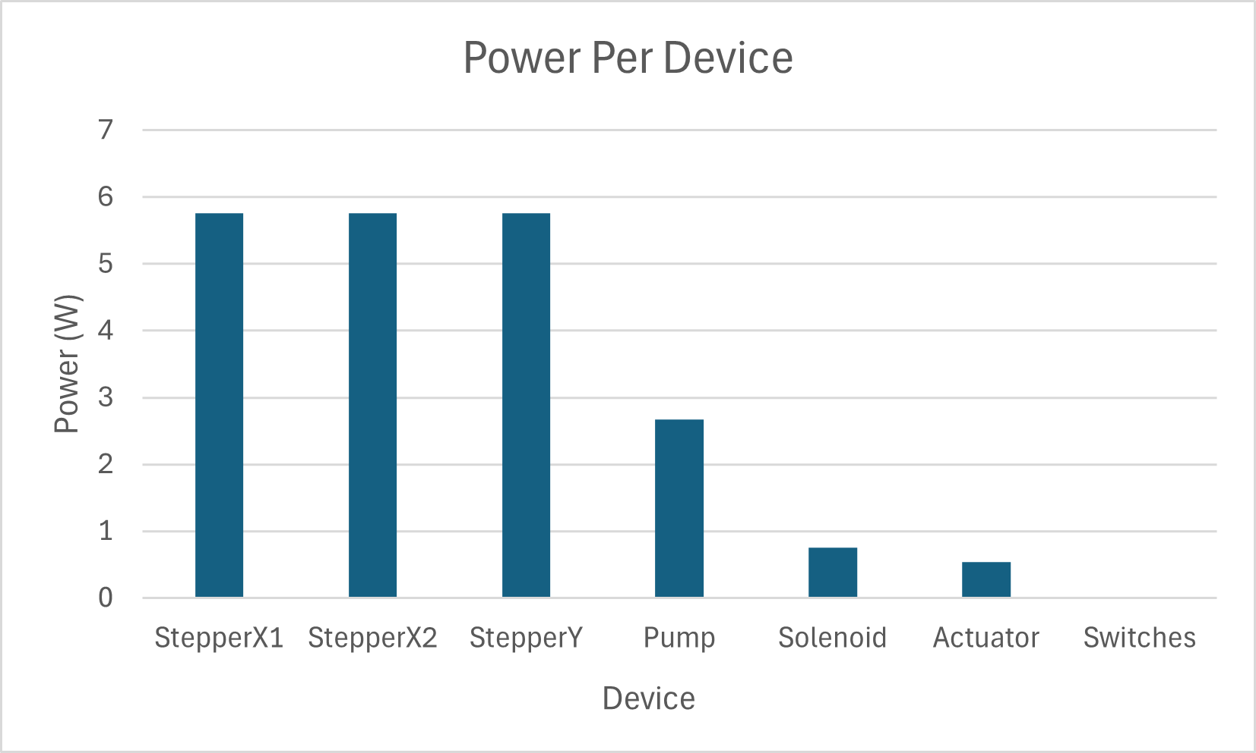
What would we do differently?
StepperX1 | 5.76 W
StepperX2 | 5.76 W
StepperY | 5.76 W
Pump | 2.68 W
Solenoid | 0.755 W
Actuator | 0.54 W
Switches | 0.0027 W
Notes:
conor

Slide 16
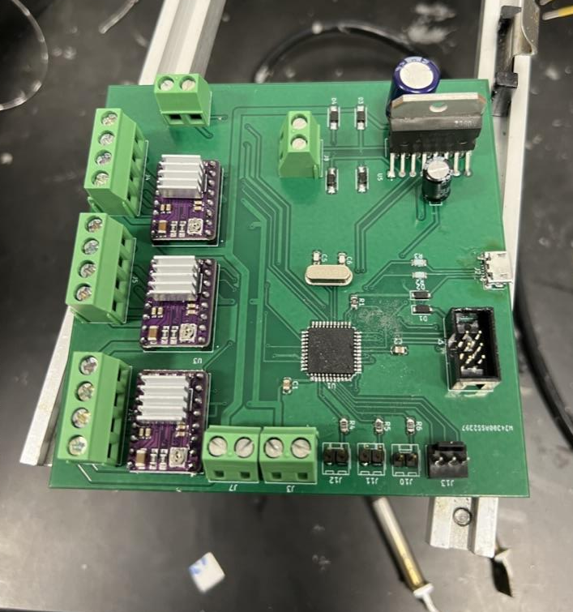
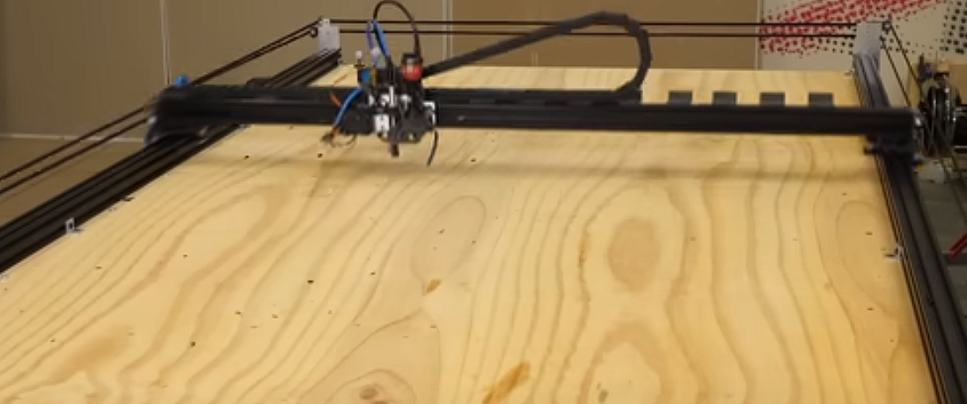
What would we do differently?
Better Localization X and Y
PCB
Robot arm often had slight precision challenges
Only localization happens at the start
Can improve by constant localization
Start earlier because of long shipping times and testing
Start small with the first order to just program a flashing LED on the PCB (testing times/checkpoints)
Notes:
conor

Slide 17
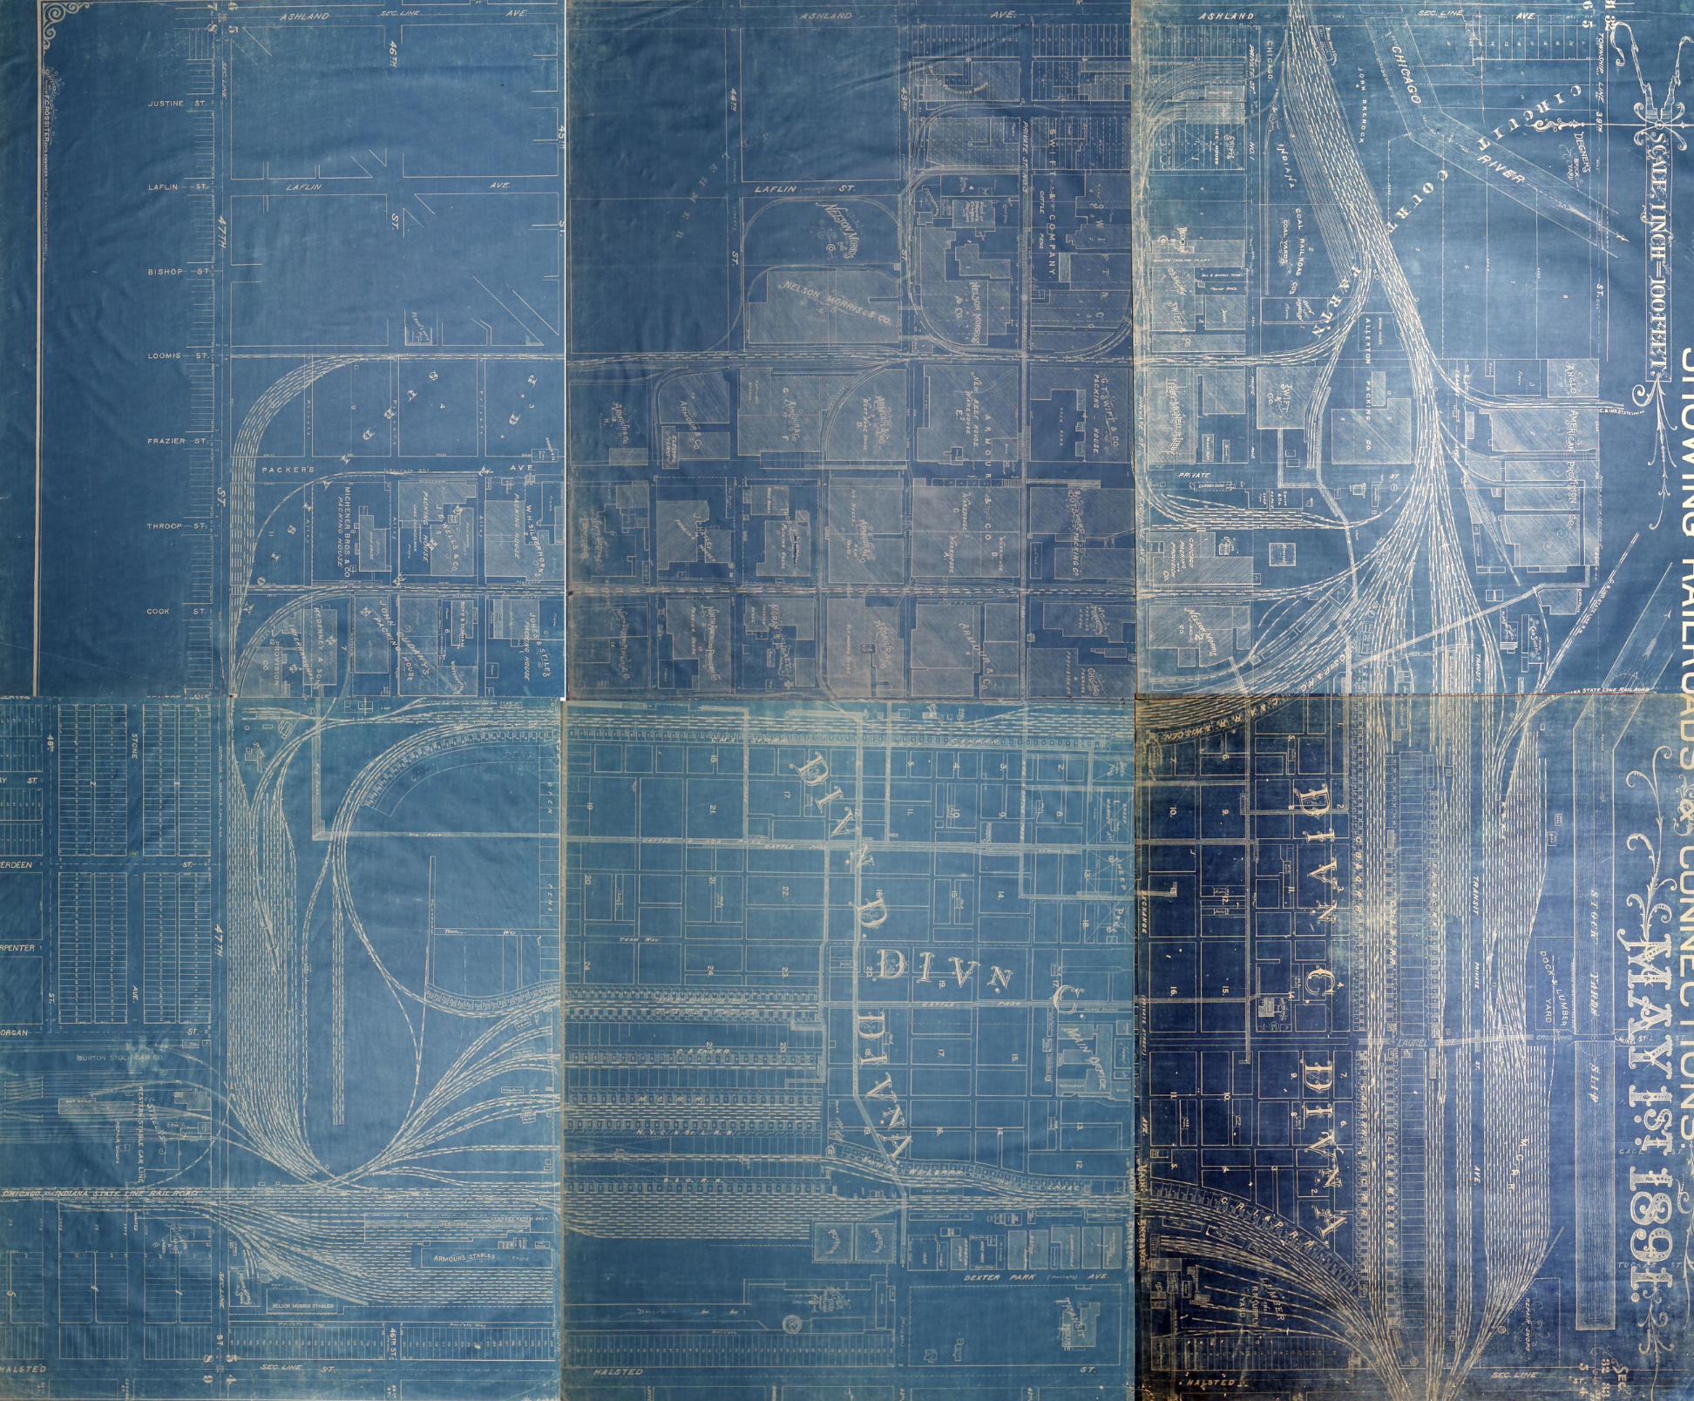
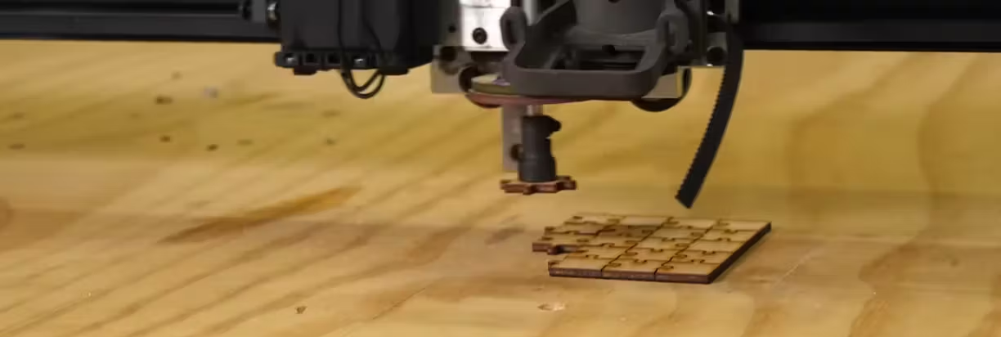
Proof of Concept Finished, What Now?
Expanding Complexity and Increasing Efficiency
Incorporate More Image/Feature Recognition
Use tabs rather than just squares
Increase number of pieces
Improve precision of robot arm and speed of completion
Image and feature detection as part of a bigger picture
Ethical consideration?
Notes:
alex

Slide 18
Thank you!
Any questions?

Slide 19
Image References
https://stock.adobe.com/images/two-robotic-arms-building-a-colorful-puzzle-robot-solving-jigsaw-puzzle-two-robotic-arms-with-puzzle-two-robotic-arms-holding-pieces-of-puzzle-vector-flat-design-illustration-horizontal-layout/166604751
https://stock.adobe.com/images/Electronic-circuit-board-close-up./255223008?as_campaign=TinEye&as_content=tineye_match&clickref=1011lyvd2udd&mv=affiliate&mv2=pz&as_camptype=domain&as_channel=affiliate&as_source=partnerize&as_campaign=tineye
https://hackster.imgix.net/uploads/attachments/1478366/_GcoZhpvBeq.blob?auto=compress%2Cformat
https://community.adobe.com/legacyfs/online/1452623_example-stitch.jpg
https://slidesgo.com

