Slide 1
Hand Gesture Controlled Audio Effects System
Sarthak Singh, Sergio Bernal, Zachary Baum

Slide 2
Introduction

Slide 3
Team #39
Sarthak Singh
Sergio Bernal
Zachary Baum
Notes:
Everyone

Slide 4
Problem & Solution
Problem
Solution
In video production and live music, real-time audio effects are common. However, using controllers or effects processors involves buttons and knobs, which can be inaccessible for those with disabilities or difficult to use
A gesture-controlled audio effects processor. This device will allow users to manipulate audio effects through hand gestures, providing a more dynamic and expressive means of audio control.
Notes:
Zach

Slide 5
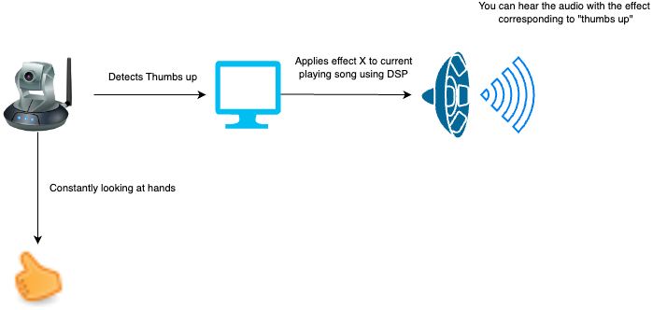
Our Project
Detects hand gesture
Applies sound effect to audio being placed
Digital signal is sent to speaker until another effect is played
Notes:
Zach

Slide 6
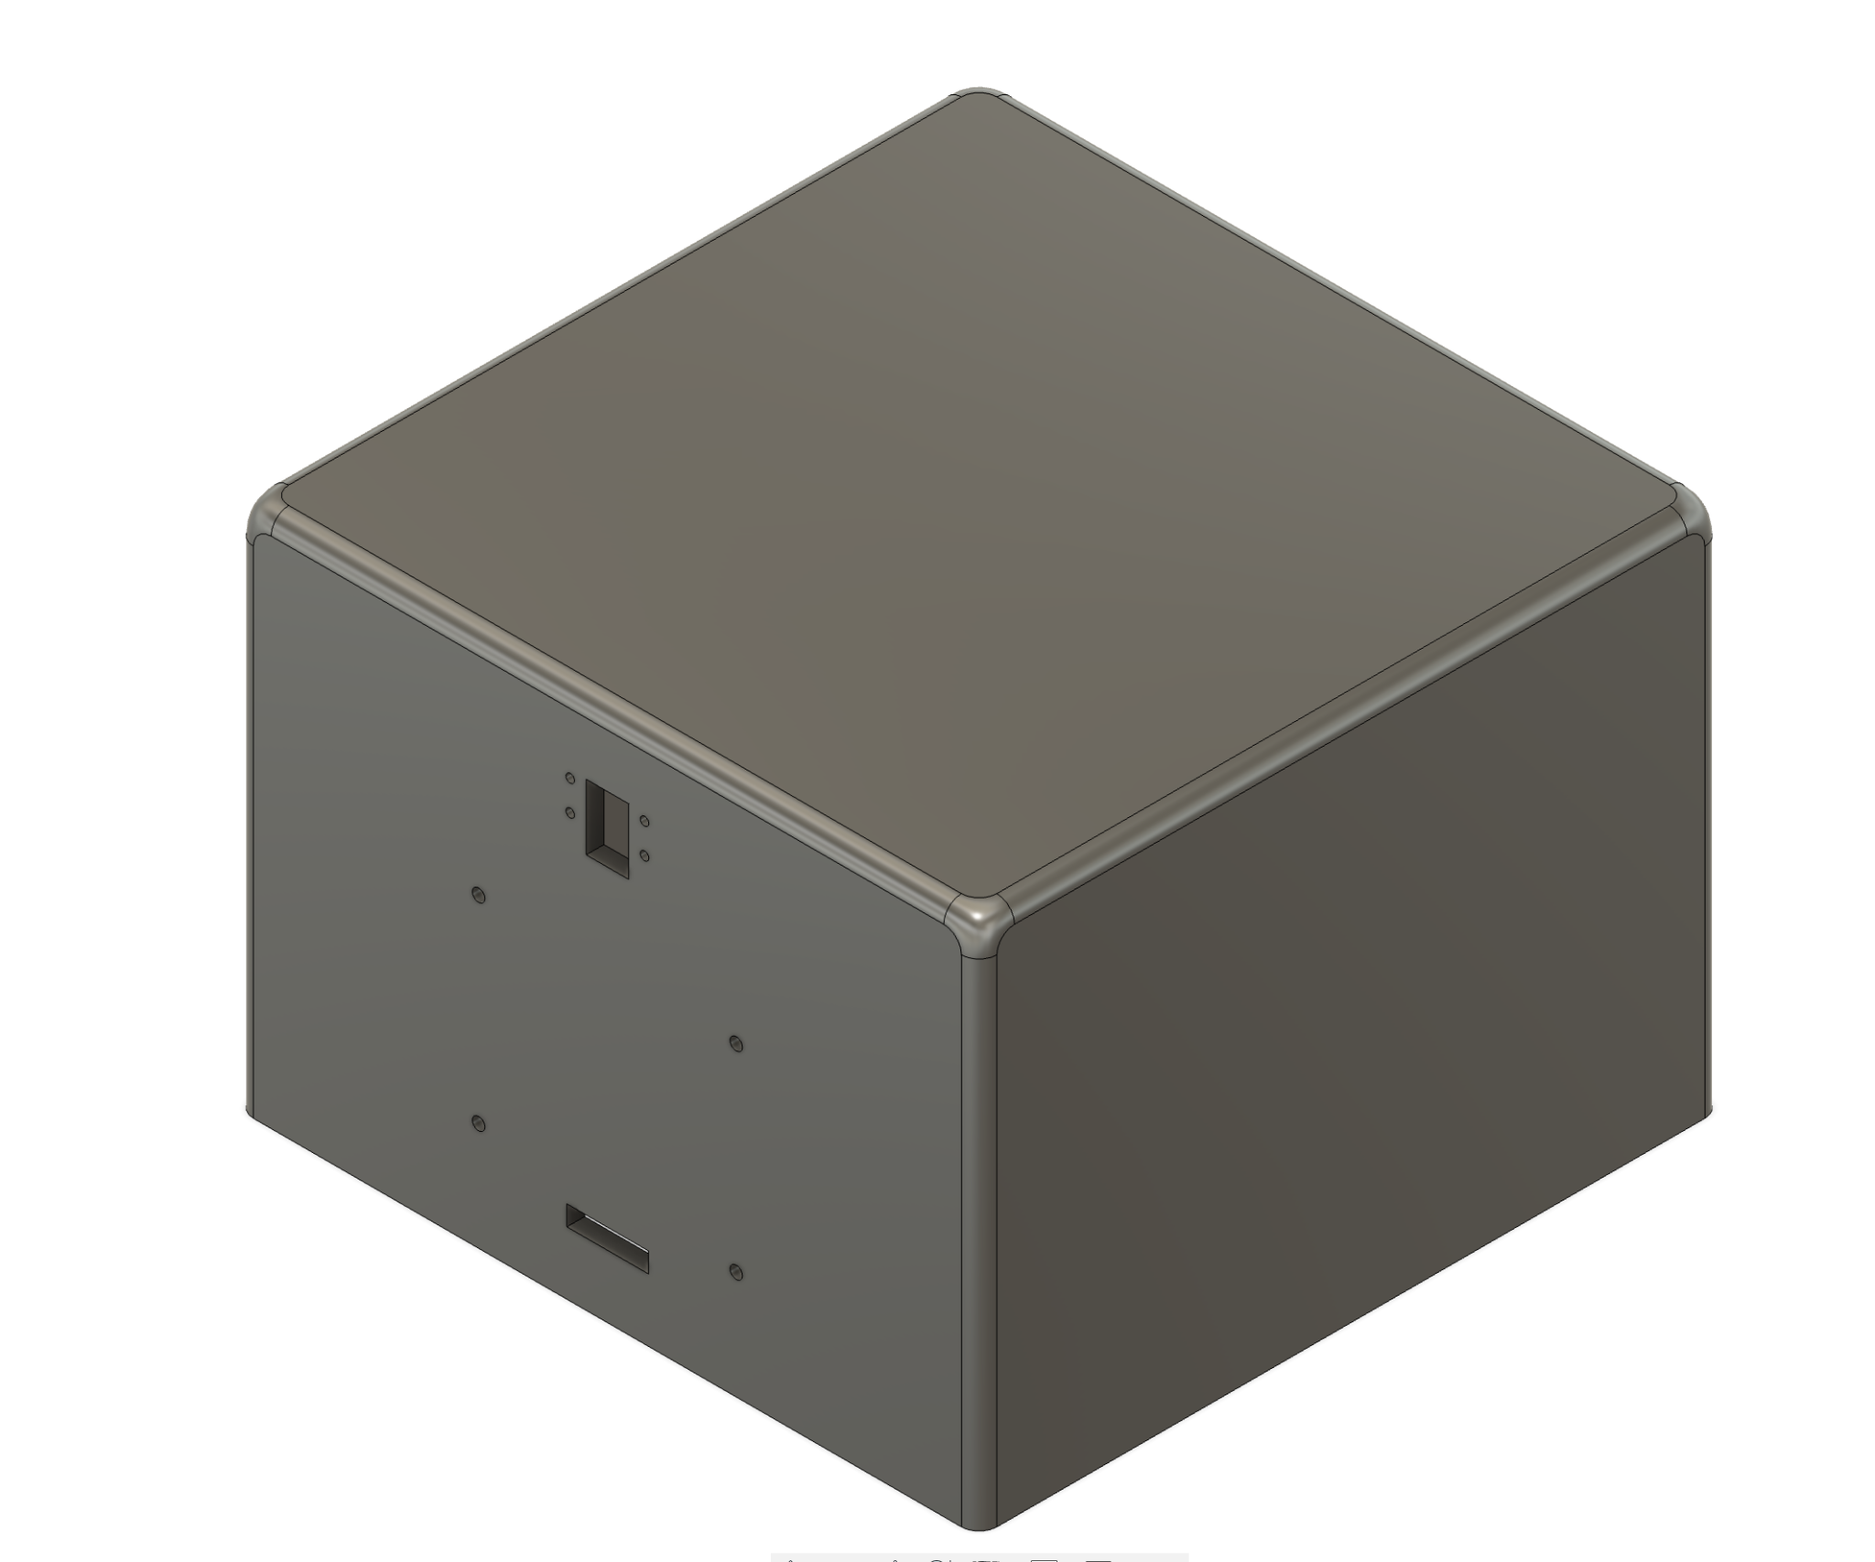
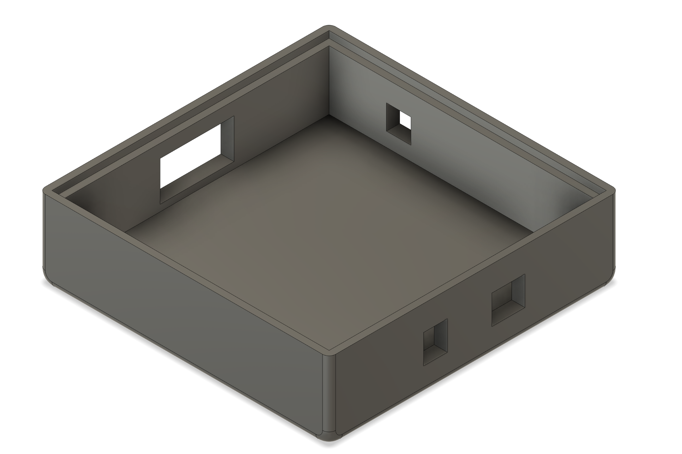
Original Vision
Custom PCB with audio, UI, and power subsystem
Raspberry Pi which powers the gesture subsystem.
3d printed enclosure which holds all of our subsystems
Gesture control subsystem detected 5 gestures using GPIO
DSP applied in real time to an audio file stores in the SD card based on the hand gestures
Notes:
Zach

Slide 7
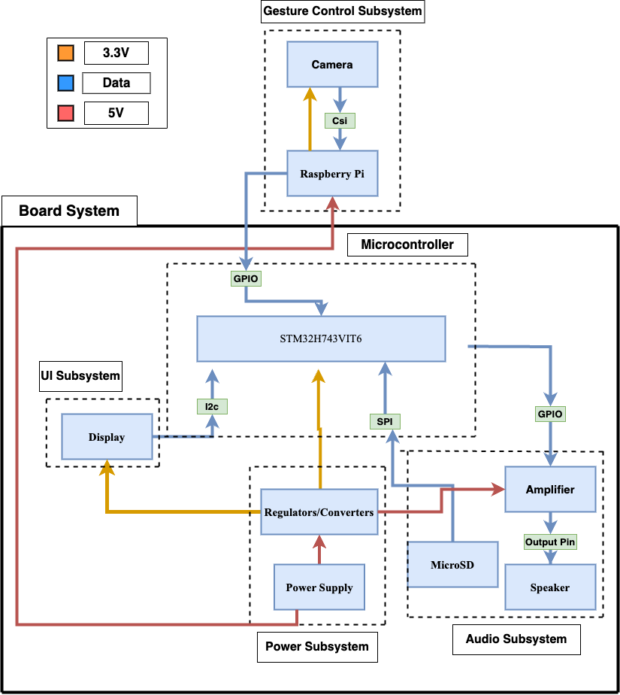
Block Diagram
Notes:
Sarthak

Slide 8
High level requirements
The gesture-controlled audio effects processor is able to detect hand gestures using a camera with 95% accuracy +-5% within 5 seconds of making the gesture.
The gesture-controlled audio effects processor is able to apply 5 digital effects to an audio signal and apply that effect to the external speaker within a 1 second of receiving a signal from the gesture detection subsystem with a tolerance of +-½ of a second.
The external display should accurately show the current playing sound effect with 99% accuracy with a tolerance of +-1%
Notes:
Sarthak

Slide 9
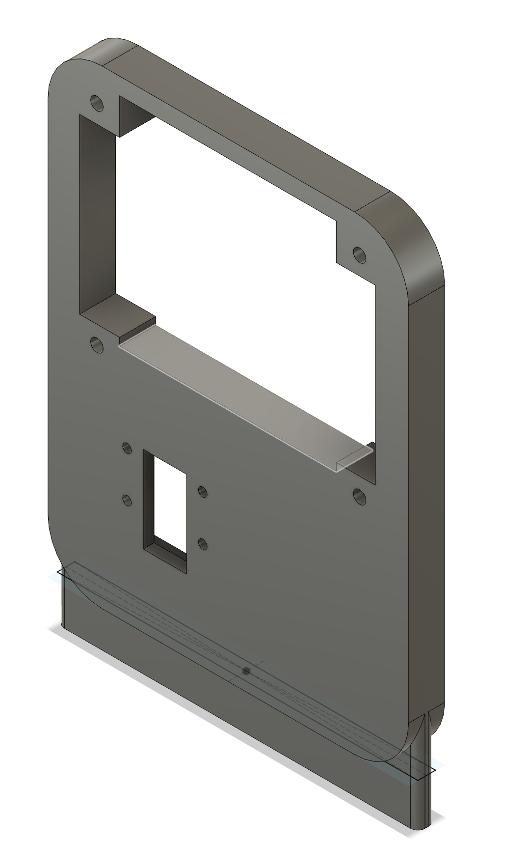
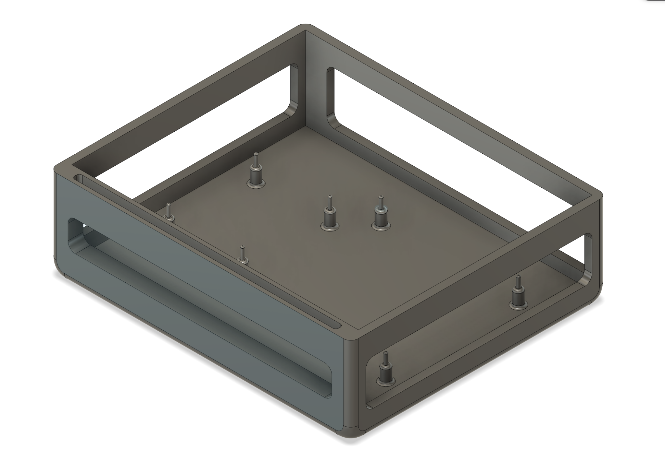
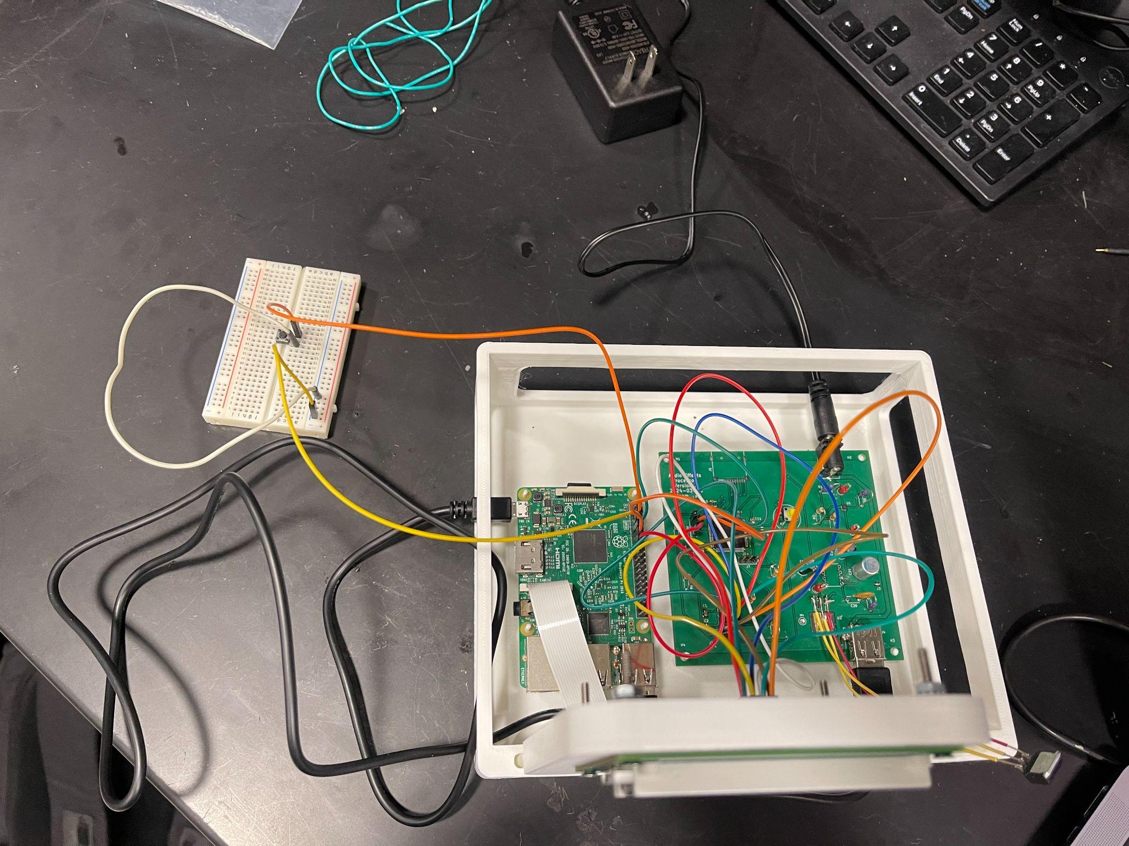
Design Changes
Enclosure will not be fully enclosing the system
New external button to shut off the Pi code
Song restart everytime a new gesture comes up
Notes:
Sarthak

Slide 10
Subsystem overview

Slide 11
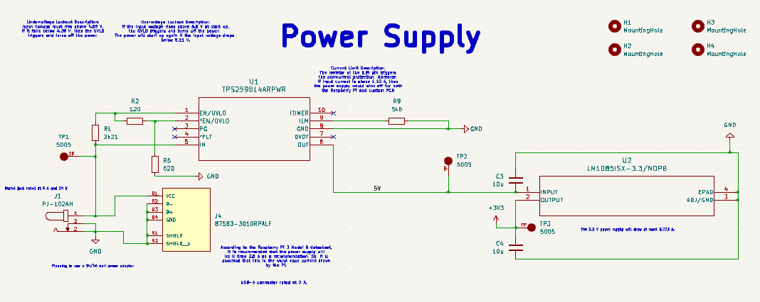
Power Subsystem
Main Components:
Wall power adapter (5V 4.0A)
DC power barrel jack
USB-A connector (USB-A to micro USB B cable to power Raspberry Pi)
Linear Regulator (1.5 V.D. @ 3 A) Fixed at 3.3 V
eFuse (shuts off power if voltage is not between 4.8 V to 5.6 V or current limit is above 2 A due to short)
Notes:
Sergio

Slide 12
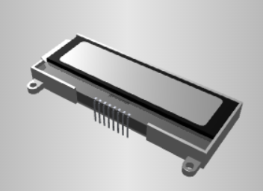
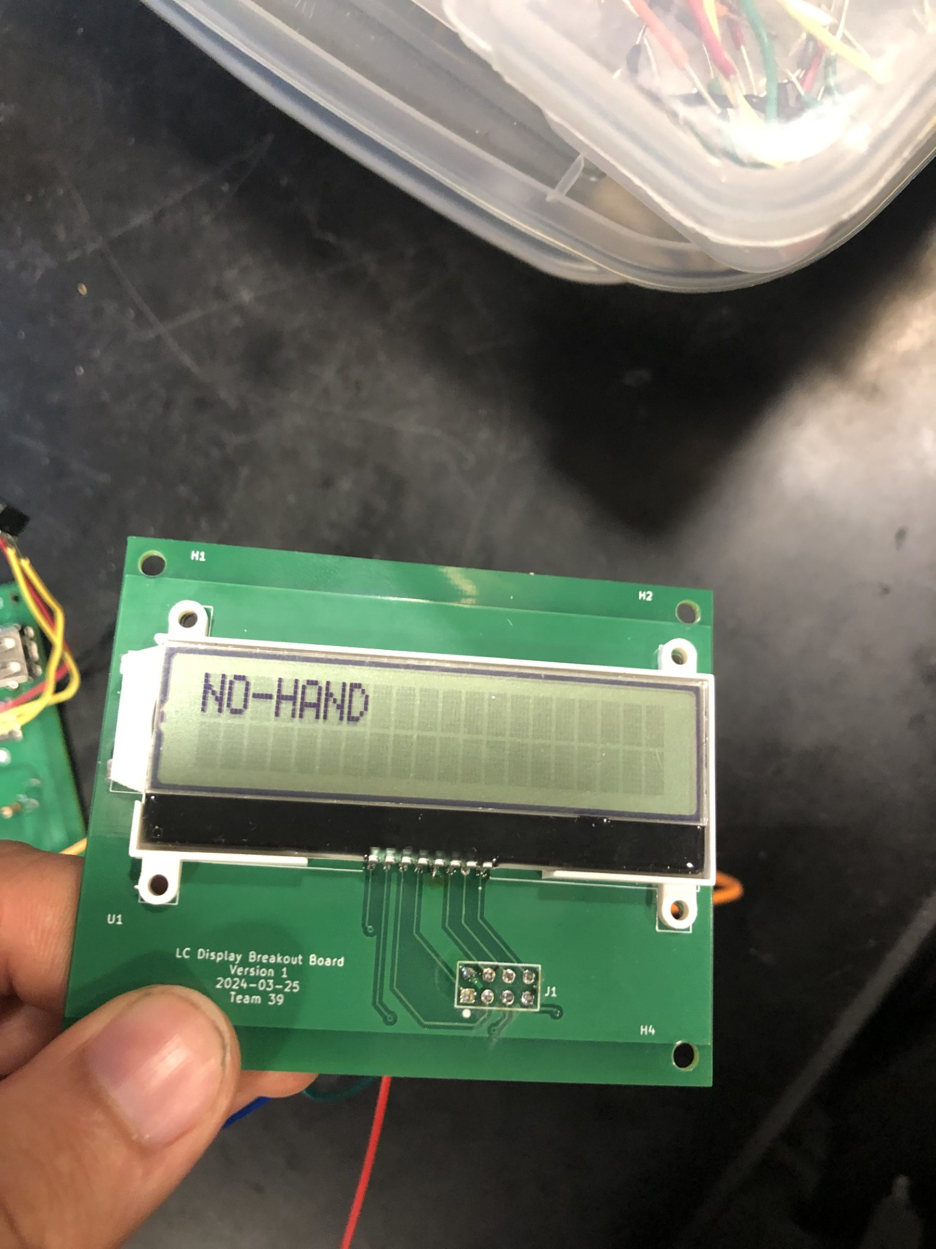
User Interface (UI) Subsystem
Purpose: It displays the state of the system such as what audio effect has been applied to the input audio signal
Capability: It can display up to 20 characters. However, we chose a 7 character word to represent each audio effect case.
NO-HAND
REVERB!
DISTORT
GAIN-UP
GAIN-DN
LO-PASS
Power supply requirement: ~3.3 V
Communication type: I²C
Notes:
Sergio

Slide 13
UI Subsystem Header Connection on Main PCB
Used six header pins and created the necessary connection set-up for LCD to communication through I2C communication (such as pull-up resistors and capacitors given by its datasheet)
Also, added header pins (SWDIO and SWCLK) necessary to program the microcontroller using Serial Wire. It also has pull-up resistors for its connection.
Notes:
Sergio

Slide 14
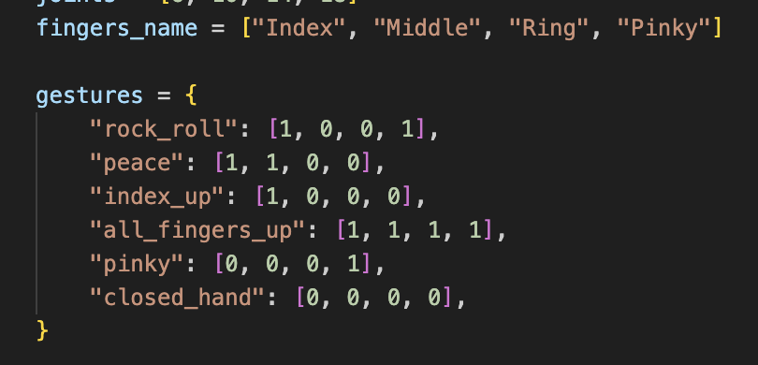
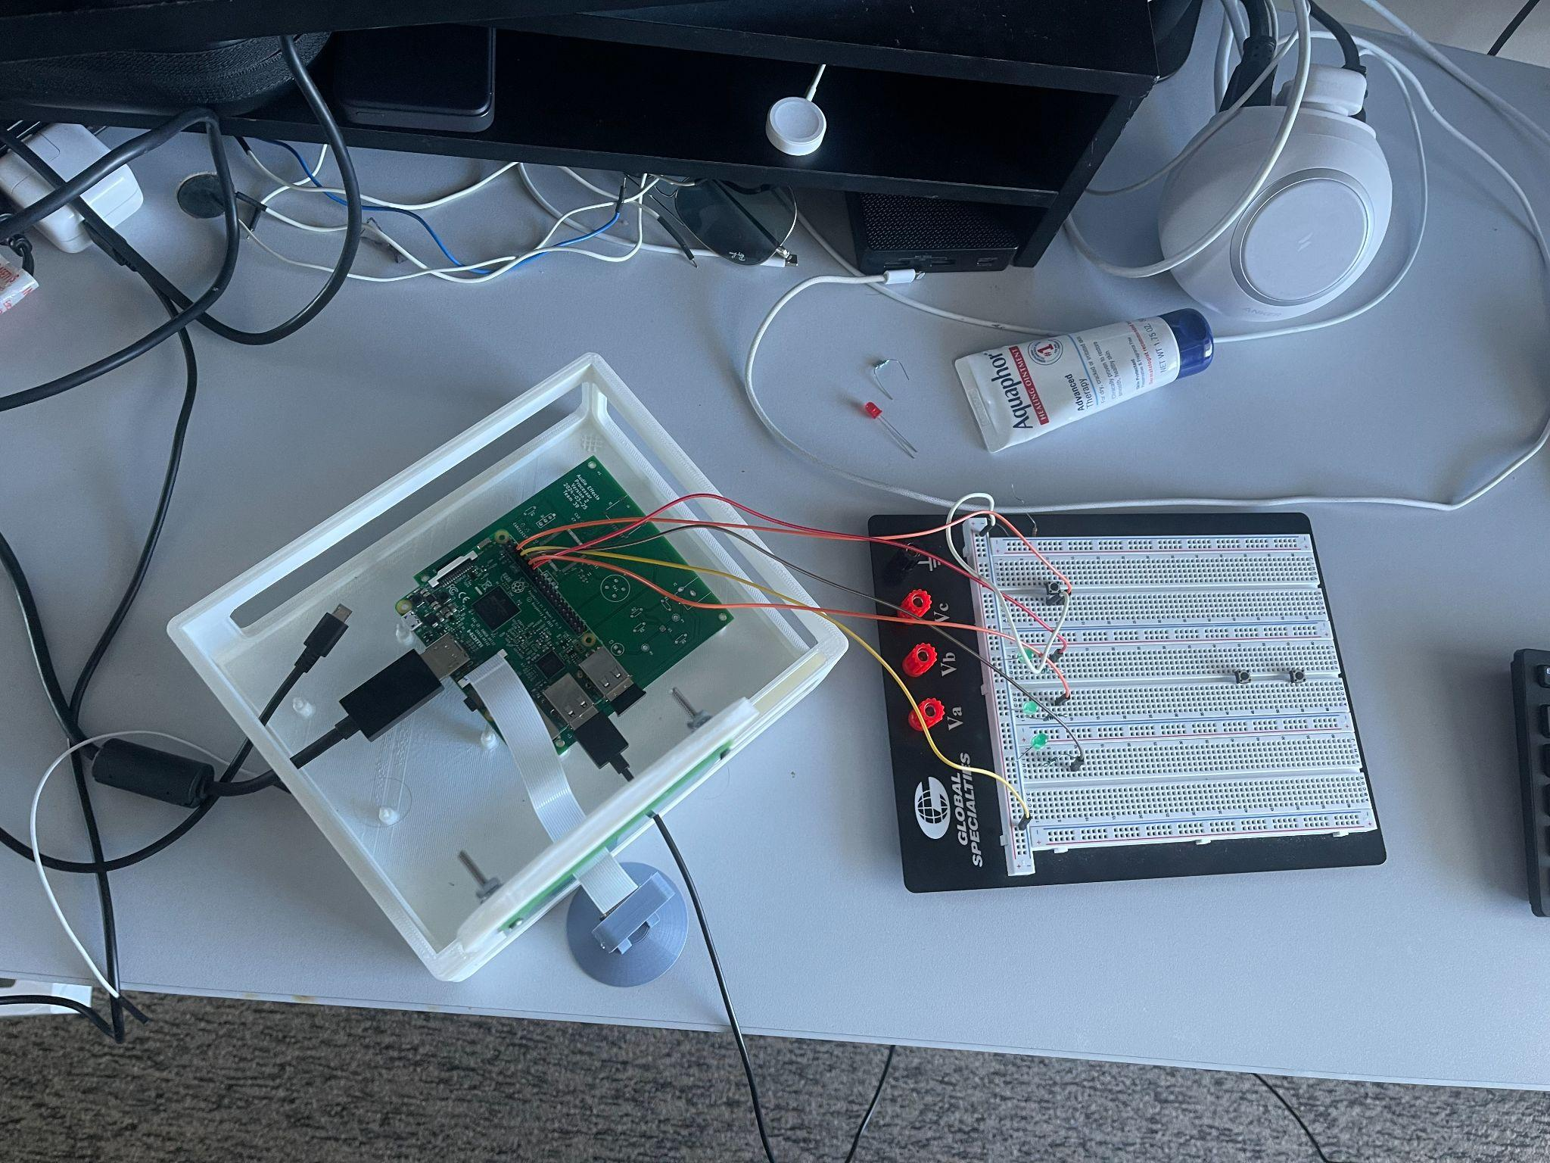
Gesture Control Subsystem
Main Components: Camera, Raspberry Pi, external button
How: Use google’s pre trained mediapipe neural net to detect joint locations
Purpose: Detect hand gestures and convey information to microcontroller using 3 bits
Gestures: We are detecting 5 gestures based on whether each finger is up or down
Notes:
Sarthak

Slide 15
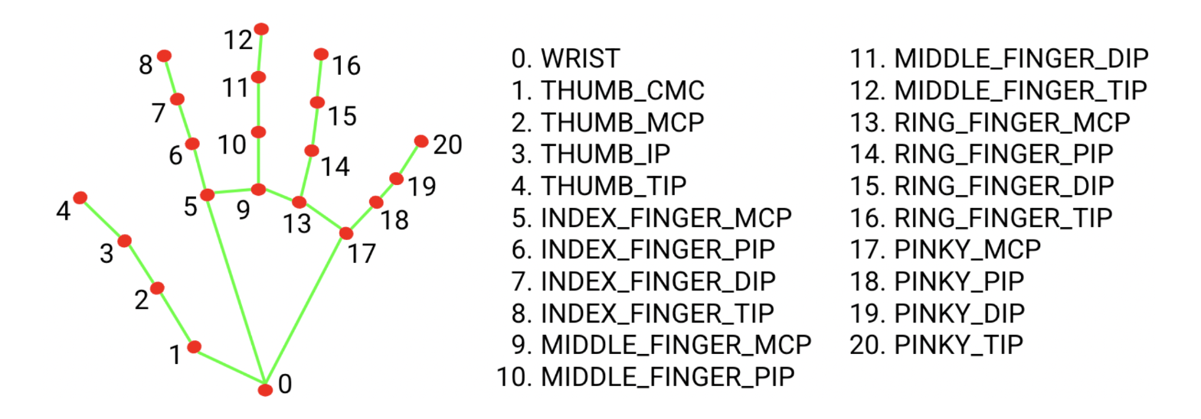
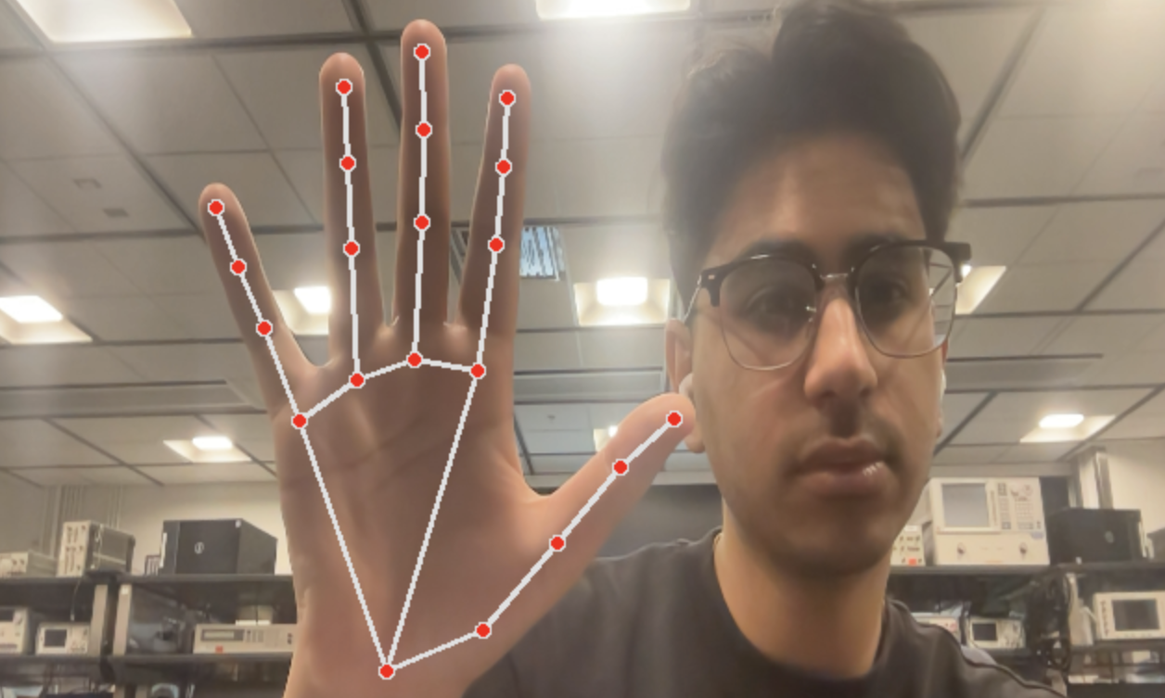
Gesture Control Detection
Use MediaPipe’s pretrained hand detection neural net to take a video stream and translate it to X,Y Coordinates
Calculate the distance between two joints on each hand to detect if a hand was up or down
Use information on which fingers are up vs down to map to a gesture
Output correct GPIO Corresponding to the gesture
Notes:
Sarthak

Slide 16
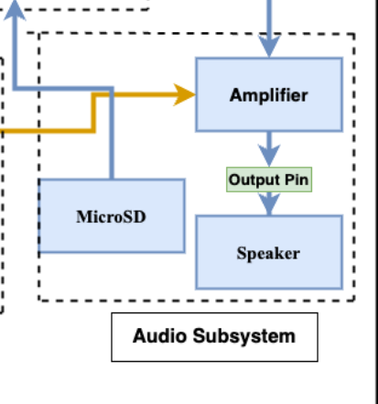
Audio Subsystem
Main Components: STM32 Microcontroller, SD card, Amplifier, and Speaker
How: MicroSD send audio wave file using SPI communication to the STM32, applies audio effects according to gesture, then gpio output from STM32’s internal DAC to Amplifier and speaker
Purpose: Handles audio IO and audio effects processing
Notes:
Zach

Slide 17
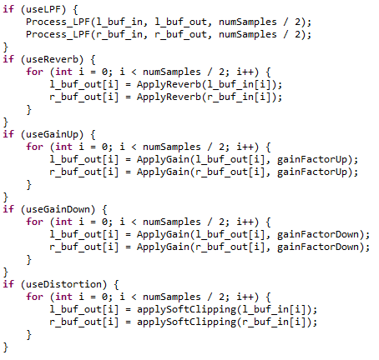
Audio Subsystem Audio Effects
Reverb: Simulates the echo and ambiance of a physical space, adding depth to the audio.
Distortion: Clips and modifies the audio waveform, adding complexity and texture by boosting aggressive tones
Gain up: Increases the amplitude of the audio signal.
Gain Down: Decreases the amplitude of the audio signal.
Low-pass Filter: Attenuates frequencies above a cutoff, reducing high-frequency noise or brightness.
Notes:
Zach

Slide 18
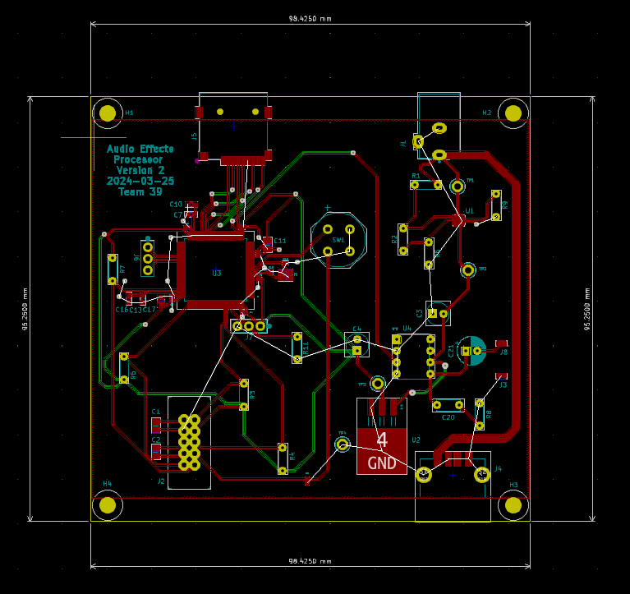
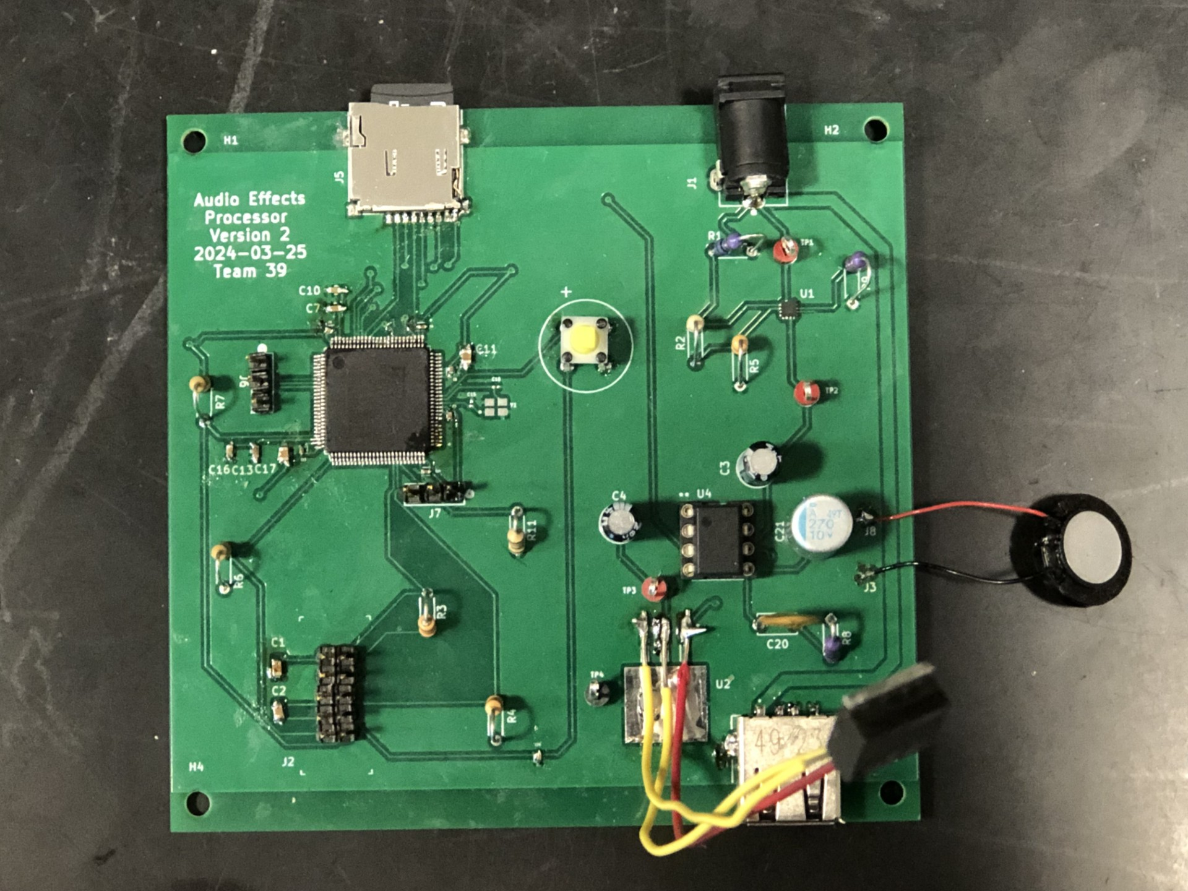
Overall Main PCB Design
Notes:
Sergio

Slide 19
Testing and Results

Slide 20
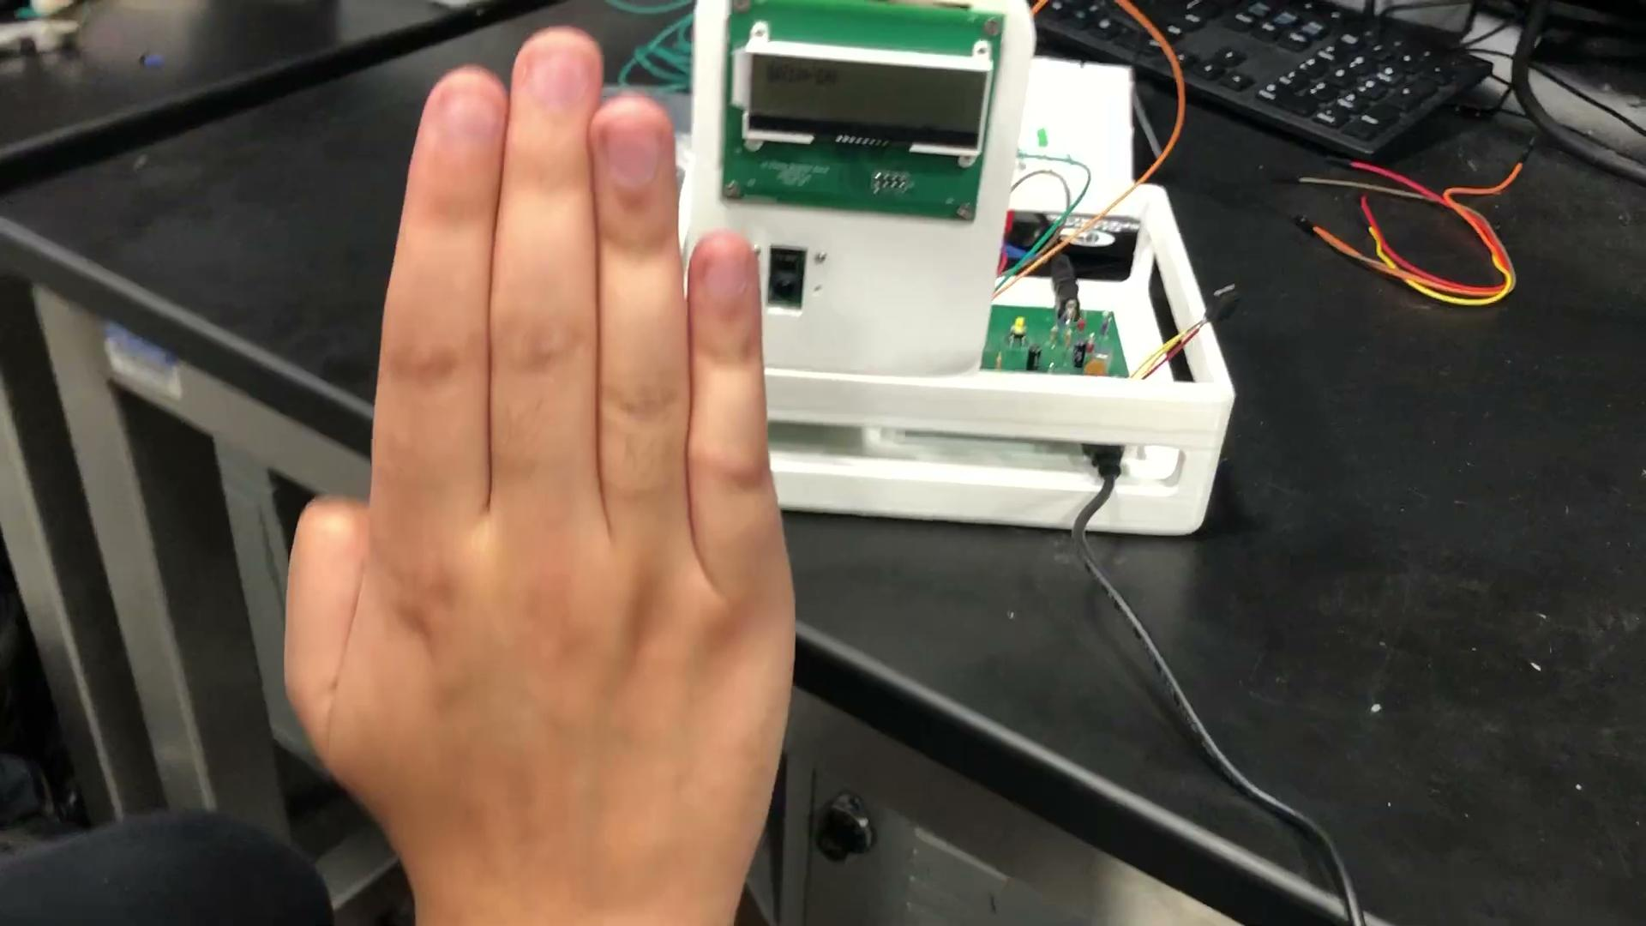
High level overview
Able to get all but one subsystem fully working (Audio)
Power, UI, and Gesture control subsystems were able to all work together
PCB was soldered and programmed successfully
Audio subsystem failed mainly due to parts not arriving on time
Notes:
Sarthak

Slide 21
Gesture Control Subsystem Requirements and Results
Requirements | Successful?
The image processing algorithm that analyzes the captured images from the camera must have a timing of at least 20 frames per second to get an accurate detection of a hand gesture. | Yes
The gesture detection algorithm must detect a hand gesture in less than 5 seconds. | Yes
Full functioning as a subsystem
All 5 gestures were able to be detected
We were able to detect at 30 FPS
It took on average 3 seconds to detect a new gesture
GPIO works perfectly
Notes:
Sarthak

Slide 22
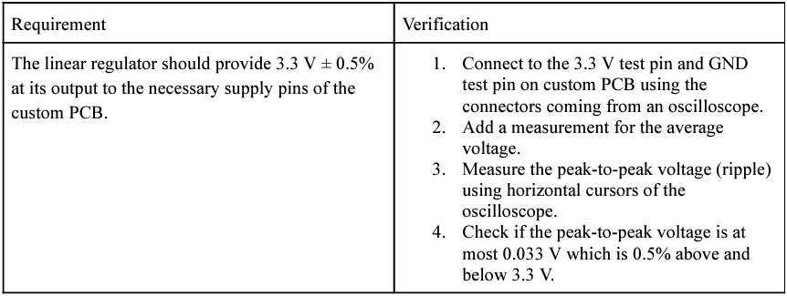
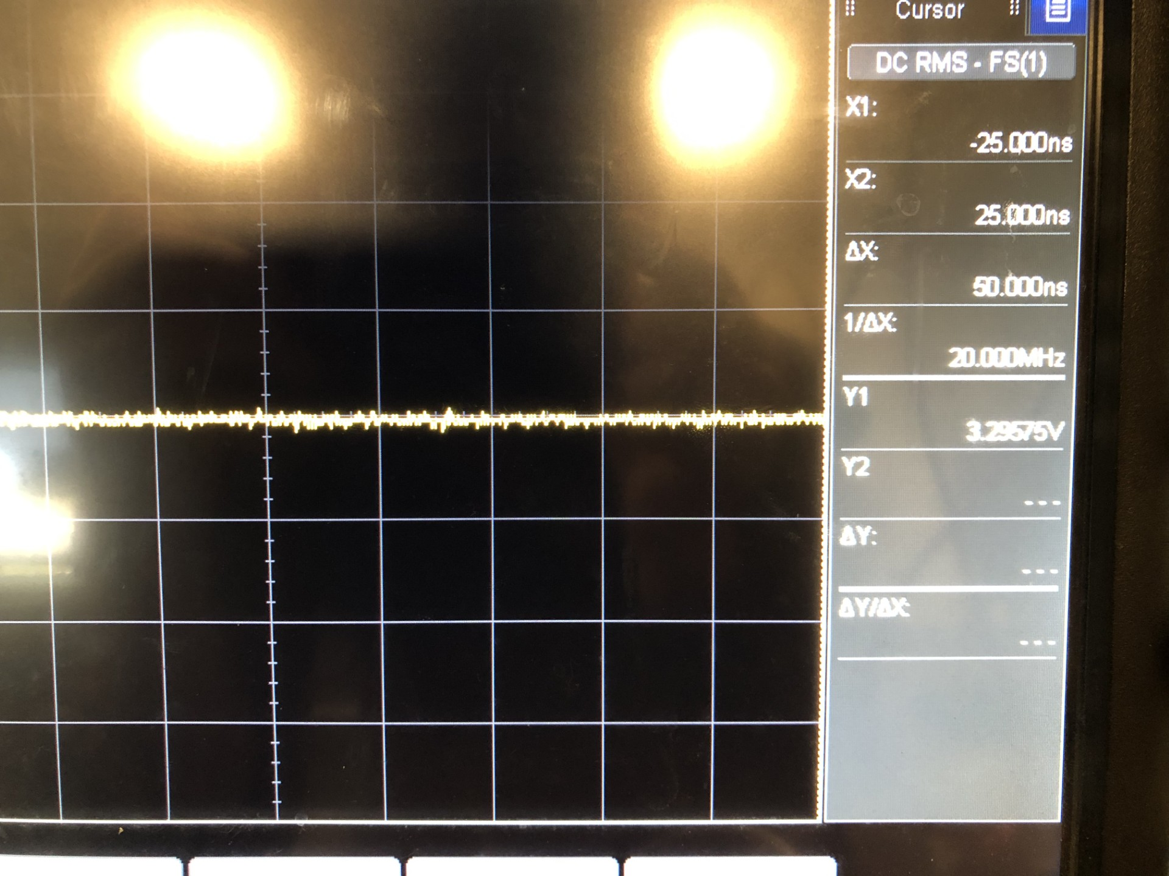
Power Subsystem Requirement and Verification
Linear regulator voltage was stable at 3.295875 V which is within the minus 0.5 % range.
Notes:
Sergio

Slide 23
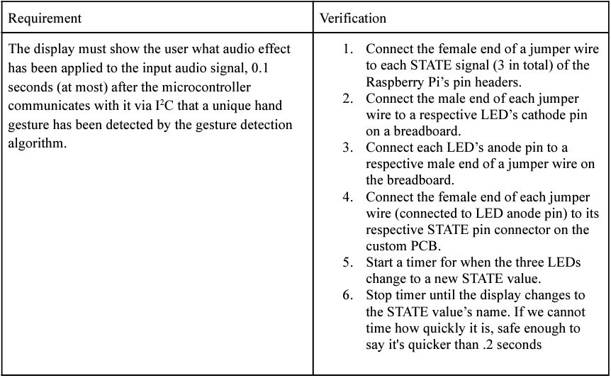
UI Subsystem Requirement & Verification
Requirement was met such that the timing was less than 0.1 seconds
Notes:
Sergio

Slide 24
Audio Subsystem Requirements and Verifications
Requirements | Successful?
The sound being outputted by the speaker must be less than 80dB for safety purposes | No
The effect applied to the input audio signal must be heard clearly such that there should be no static unless distortion is being used | No
Unsuccessful due to components not arriving in time.
C code for all audio effects except for low pass filter were successful however
Notes:
Zach

Slide 25
Reasons for Audio Subsystem not working
Due to timing constraints we were not able to debug audio subsystem code
Low Pass filter audio effect was unsuccessful due to a library(CMSIS-DSP) not being configured correctly
Unable to test on dev board due to the dev board not having audio capabilities
If hardware was made, debugging SD card communication would be the last step
Notes:
Zach

Slide 26
Conclusions

Slide 27
Successes and Challenges
Successes
Challenges
Able to program the STM32H7 microcontroller
Able to deliver power properly to all components on the main PCB, Raspberry PI, and custom LCD breakout PCB.
Able to detect hand gestures properly using software from the Raspberry PI
Able to display each audio effect state and no hand gesture detection on the LCD using the programmed microcontroller.
Difficult to solder microcontroller due to sensitive pins
Difficult to program microcontroller due to an incorrect setting within the STM32CubeIDE software and one of the ST-Link V2 stopped connecting to any PC.
3D Modeling is difficult, and print time is much longer than expected
Notes:
Sergio

Slide 28
What we learned
What we would do differently:
Get extra components in case some broke during soldering process
Start testing earlier and ensure that certain components would be compatible with others
What we learned:
Got experience with debugging both hardware and software
Learned how to use STM32Cube IDE and program on STM32 chips
Gained experience with working as a team and understanding each others strengths and weaknesses
Notes:
Zach

Slide 29
Future work

Slide 30
How to take this further
Future work
Custom Neural Net
Bluetooth Audio
Customize effects
Currently we use a pre trained model
Taking our own images and using that to tune the model would make it more accurate
More powerful hardware would work as well
The audio goes through a speaker but we are limited by the quality of that speaker
With Bluetooth we could have high end audio which people could hear the difference between
There is a pre coded mapping between gesture and effects.
Allowing some touch screen where you could customize it would be more production ready
Notes:
Sarthak

Slide 31
Questions?

Slide 32
Appendix

Slide 33
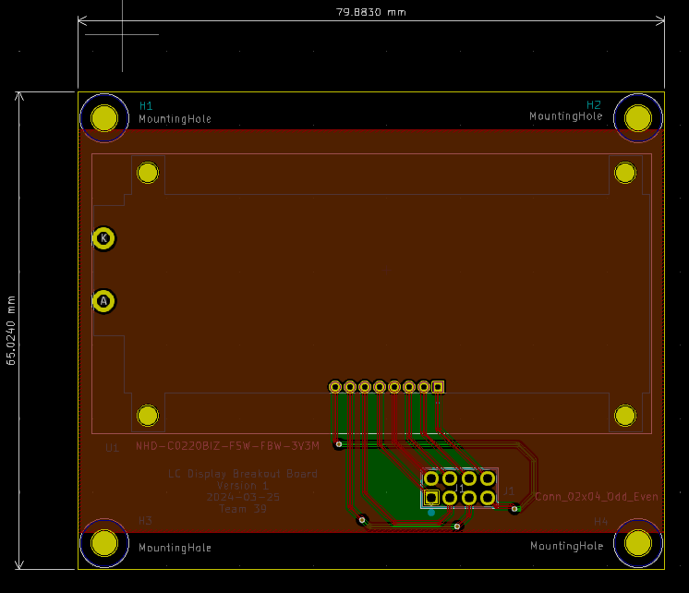
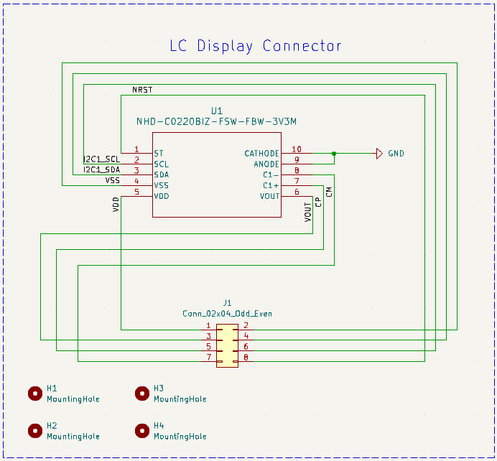
UI Subsystem Custom Breakout PCB

Slide 34
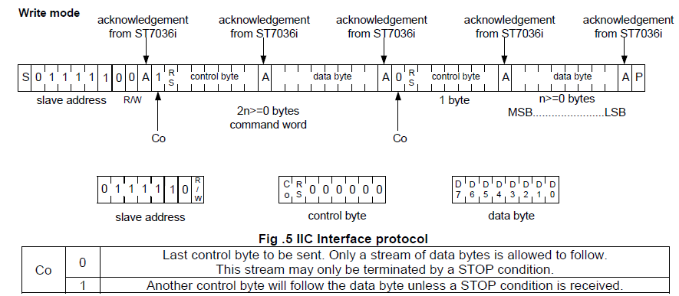
UI Subsystem I2C Communication

Slide 35
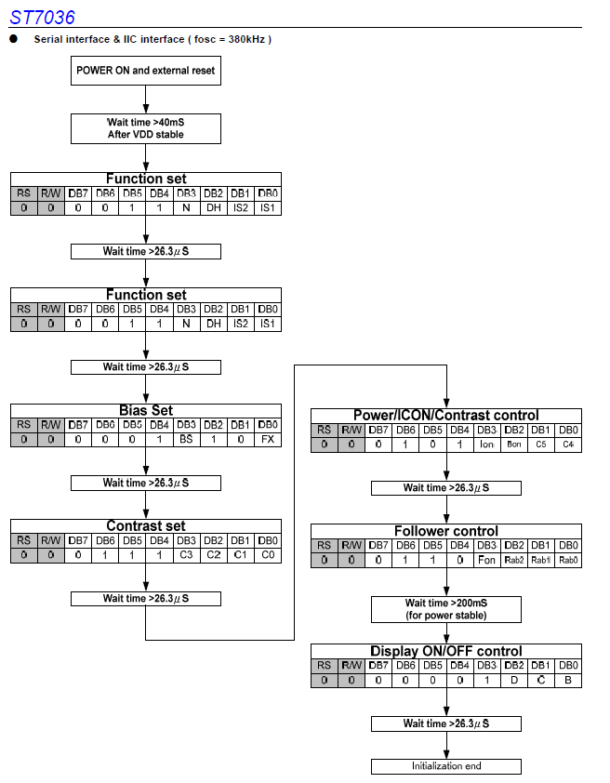
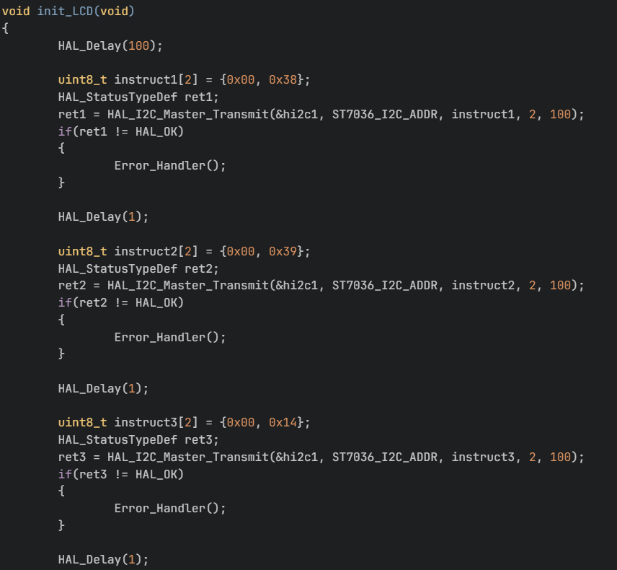
UI Subsystem Software for Initialization

Slide 36
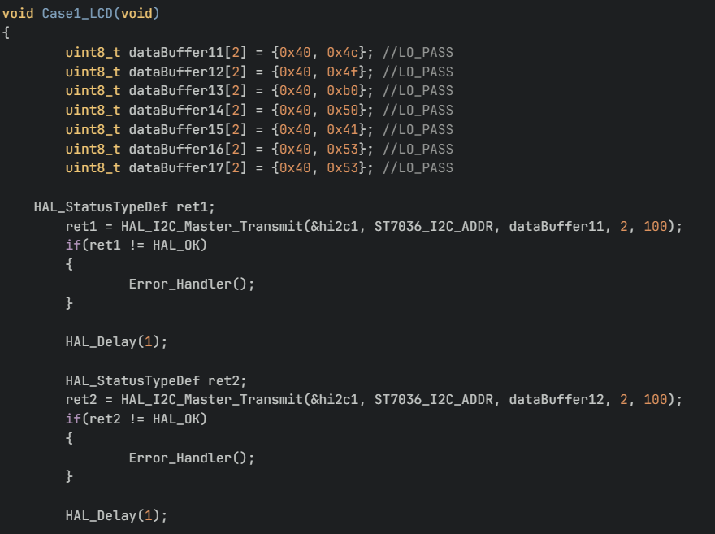
UI Subsystem Software for each Audio Effect Case

Slide 37
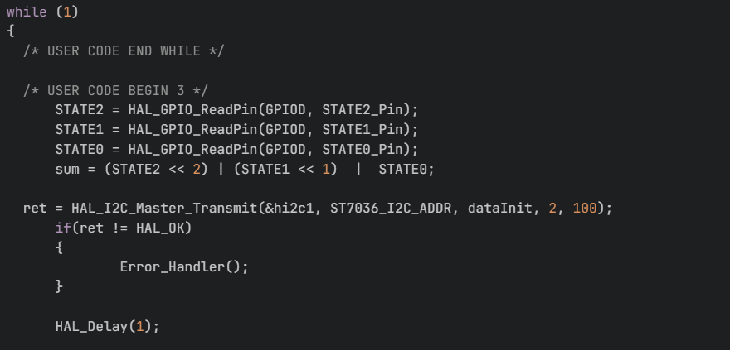
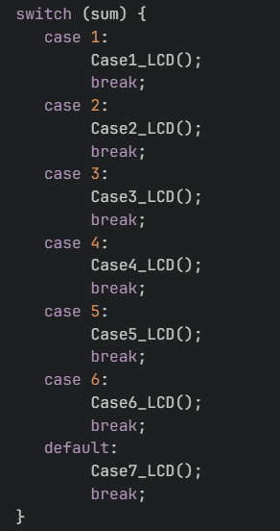
UI Subsystem Main While Loop C Code

