Slide 1
Precision Dumbbell Assistant
Group #40
Ronit Kumar, Cole Trautman, Ellie Beck
April 30, 2024

Slide 2
INTRODUCTION
ELECTRICAL & COMPUTER ENGINEERING
GRAINGER ENGINEERING

Slide 3
PURPOSE
Many people struggle to maintain proper form when doing exercises whether at home or at the gym
We wanted to make a wearable device designed to help when doing bicep curls by
Tracking the reps of the user in a connected app
Giving audio feedback if the user is not using proper form using a buzzer
Giving visual feedback about the user’s form through a connected app
Many people’s first introduction to the gym or first addition to their home gym is dumbbells so there should be a cost effective way to get the most out of their workout
ELECTRICAL & COMPUTER ENGINEERING
GRAINGER ENGINEERING

Slide 4
OBJECTIVE
Allow users to stay safe while doing dumbbell curls
You have a lot of freedom of motion when doing dumbbell curls and it is easy to injure yourself using improper form
Allow users to track their repetitions
Many people lose count of repetitions while exercising and having something count for you helps you hit your goals more easily
Allow users to receive feedback on how to obtain optimal form
Having optimal form leads to faster muscle growth
ELECTRICAL & COMPUTER ENGINEERING
GRAINGER ENGINEERING

Slide 5
HIGH LEVEL REQUIREMENTS
Accurate and consistent in motion and form analysis
Each sensor needs to correctly calculate position and orientation with a tolerance of ±5%
The form analysis should be consistent such that if you perform the same motion multiple times it should consistently categorize it as either correct or not correct
Device must give feedback quickly and loudly in order to immediately prevent poor form
The entire system should read data, analyze it, and provide feedback in no more than 50ms
Device should not restrict the range of motion of the user
Negligible weight of <200g
Flexible connections
ELECTRICAL & COMPUTER ENGINEERING
GRAINGER ENGINEERING

Slide 6
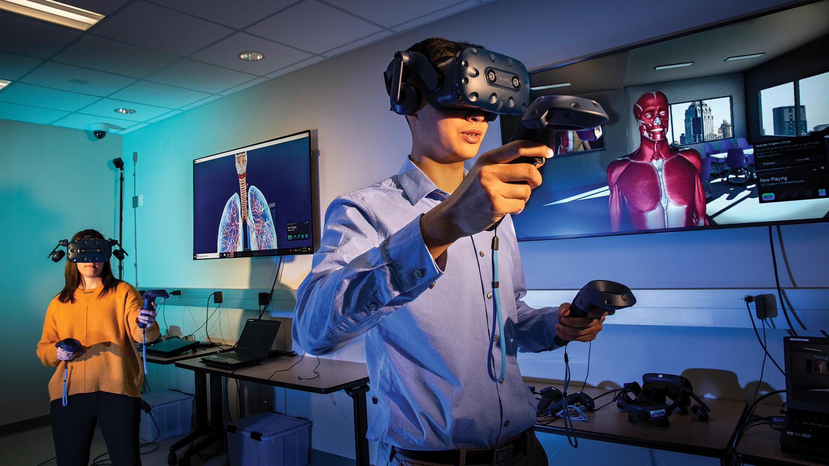
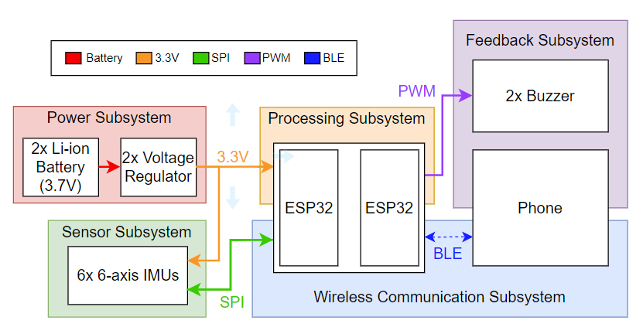
Original Block Diagram
ELECTRICAL & COMPUTER ENGINEERING
GRAINGER ENGINEERING

Slide 7
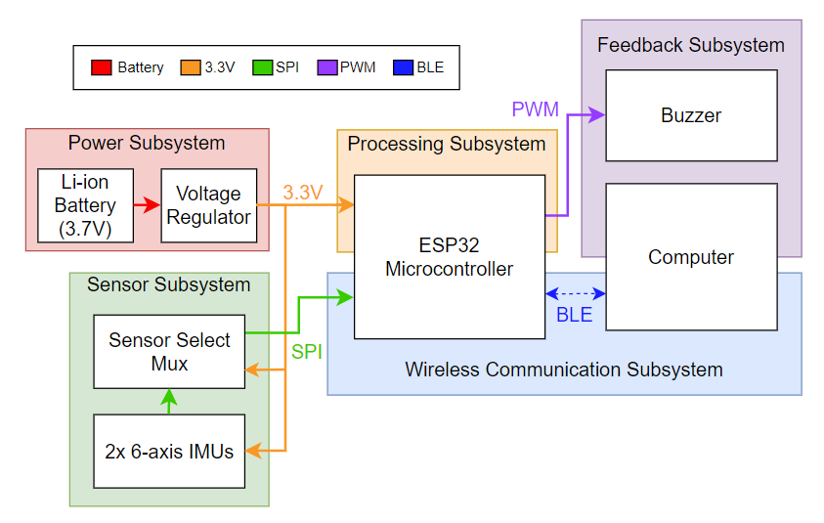
Updated Block Diagram
ELECTRICAL & COMPUTER ENGINEERING
GRAINGER ENGINEERING

Slide 8
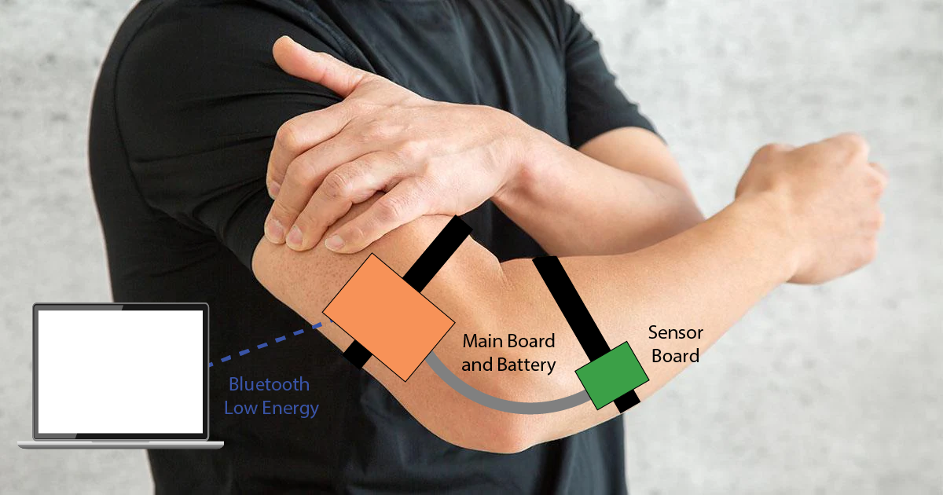
General Design Visual Aid
ELECTRICAL & COMPUTER ENGINEERING
GRAINGER ENGINEERING

Slide 9
SENSING SUBSYSTEM
ELECTRICAL & COMPUTER ENGINEERING
GRAINGER ENGINEERING

Slide 10
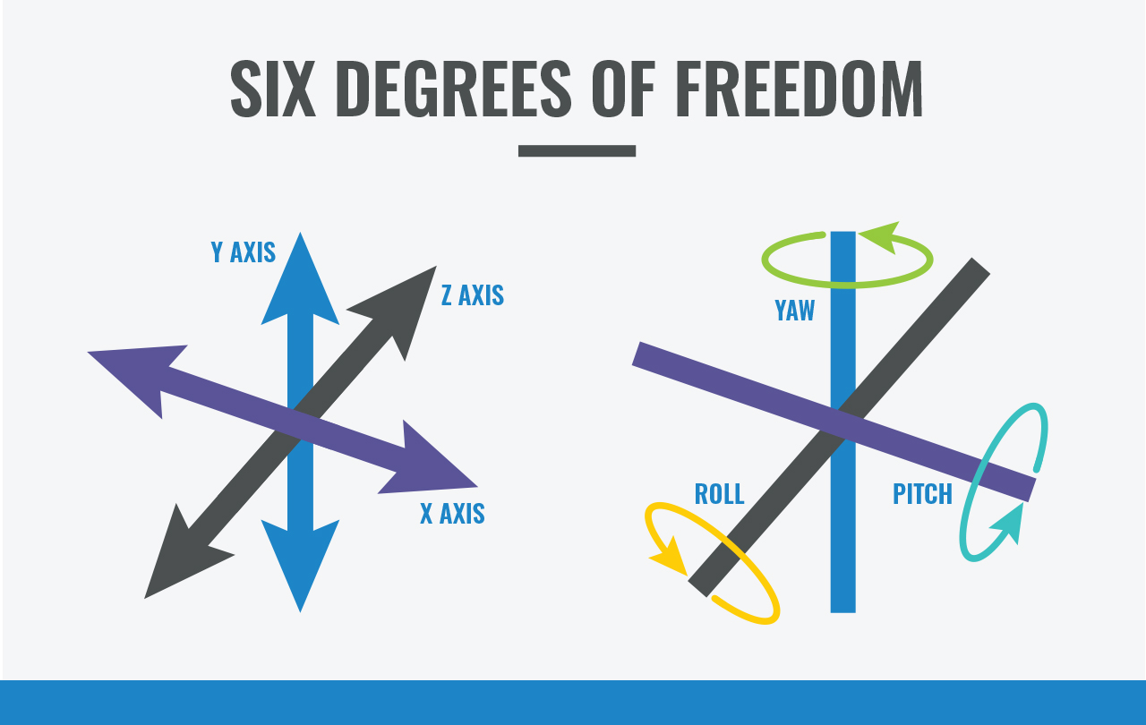
SUBSYSTEM OVERVIEW
Collects raw acceleration and angular velocity data needed to track the user’s arm
Sensors chosen: LSM6DSMTR 6-axis IMUs
The original design utilized bicep, forearm, and shoulder sensors but we found that only bicep and forearm sensors were needed for accurate form analysis.
Sends raw data over SPI to the Processing Subsystem
Due to limitations of the ESP32, each sensor must be read individually using a chip select.
Each sensor’s SPI bus is isolated using 4 bit analog switches.
ELECTRICAL & COMPUTER ENGINEERING
GRAINGER ENGINEERING

Slide 11
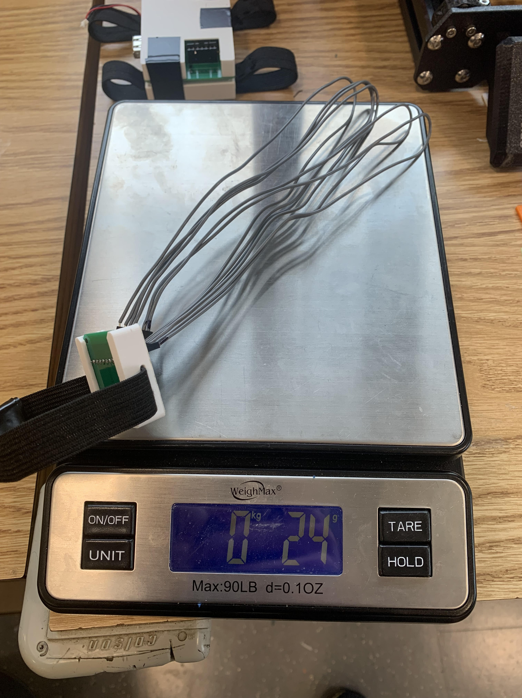
REQUIREMENTS & VERIFICATIONS
Each IMU sensor should provide acceleration and angular velocity with an accuracy of ±5%.
Result: Success! The IMUs gave results within ±1% with minimal delay once the filters were set up properly.
Each IMU sensor should provide data at a rate of at least 20 Hz for a total combined rate of 60 Hz.
Result: Success! The main loop of code runs at 100 Hz, and the sensors are initialized to sample at 104 Hz.
Each sensor board and accompanying wire harness should weigh less than 50g.
Result: Success! The assembled sensor board, enclosure, and wire harness weighs 24g.
ELECTRICAL & COMPUTER ENGINEERING
GRAINGER ENGINEERING

Slide 12
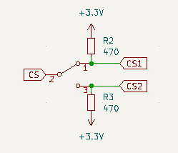
CHALLENGES
The QFN package was incredibly difficult to solder correctly, and if we knew how many hours we would sink into it we would have looked harder for an easier to solder package type.
We realized after our final PCB order that each CS line would need a pull-up resistor because the CS line is floating if the sensor is not selected through the switch.
The forearm sensor failed a few hours before the demo.
It failed after the interrupt wire in the wire harness broke. This wire was not used, but it being disconnected could have possibly caused some signal integrity issues.
Both previously working sensors boards failed, meaning that the failure must have been in the wire harness or the sensor select switch.
ELECTRICAL & COMPUTER ENGINEERING
GRAINGER ENGINEERING
Notes:
Image is placeholder for diagram of pull-up resistor connected to mux

Slide 13
PROCESSING SUBSYSTEM
ELECTRICAL & COMPUTER ENGINEERING
GRAINGER ENGINEERING

Slide 14
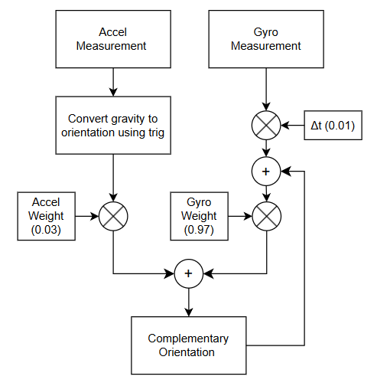
SUBSYSTEM OVERVIEW
Processes the raw acceleration and angular velocity data into usable orientation data
Orientation is calculated using a complementary filter, with an accelerometer weight of 0.03 and a gyroscope weight of 0.97.
Runs our form analysis algorithm to determine whether the user has correct form, as well as how many reps have been done
The user’s forearm and bicep must each stay within certain orientation bounds.
If any measured orientation is outside the bounds, the user is alerted via the buzzer and the web app will display the most likely cause of the issue.
ELECTRICAL & COMPUTER ENGINEERING
GRAINGER ENGINEERING

Slide 15
REQUIREMENTS & VERIFICATIONS
The microcontroller should be able to calculate the position and orientation of each sensor with an accuracy of ±5%.
Result: Partial Success! We were unable to calculate position accurately, but we were able to calculate orientation with ±3% accuracy.
The orientation and position of each sensor should be calculated and analyzed at at least 20 Hz.
Result: Partial Success! The main loop of code runs at around 100 Hz, measured by a multimeter.
The calibration sequence must take less than 20 seconds and provide consistent results.
Result: Success! The sensors are given 1 second to warm up and start outputting valid data. No calibration is needed due to the complementary filter.
SPI communication must operate between each IMU sensor and the ESP32 microprocessor at a speed of at least 10 ± 1.0 MHz.
Result: Success! The SPI bus runs at 10 MHz, measured on an oscilloscope.
ELECTRICAL & COMPUTER ENGINEERING
GRAINGER ENGINEERING

Slide 16
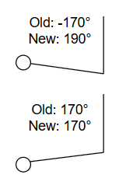
CHALLENGES
We were originally planning on calculating both the position and orientation of each sensor, but we realized that calculating position accurately enough would be impossible.
The position is calculated by integrating the acceleration twice, so any small error in the data would grow at a quadratic rate.
Tuning the complementary filter to converge fast enough while not overshooting the correct angle took some time, but we were able to get it to work fairly well.
Some correct movements overflow the pitch calculated by the forearm sensor (-180 to 180 degrees), so we converted the pitch to a 0 to 360 degrees scale.
ELECTRICAL & COMPUTER ENGINEERING
GRAINGER ENGINEERING
Notes:
Image is placeholder for diagram of pull-up resistor connected to mux

Slide 17
POWER SUBSYSTEM
ELECTRICAL & COMPUTER ENGINEERING
GRAINGER ENGINEERING

Slide 18
SUBSYSTEM OVERVIEW
Provides power for the entire assembly
2 sources of power:
3.7V lithium ion battery (Tiny Circuits ASR00012)
5V from USB - used when programming microcontroller
Both power sources are routed through a 3.3V voltage regulator ( LP2950CZ)
All components use 3.3V
Offers battery protection circuitry including short circuit protection and thermal shutdown
Battery and voltage regulator placed on bicep assembly and power sent through the harness to the forearm
ELECTRICAL & COMPUTER ENGINEERING
GRAINGER ENGINEERING

Slide 19
SUBSYSTEM REQUIREMENT & VERIFICATION
Requirement:
Voltage regulator must provided 3.3V ± 5%
Verification:
Using a multimeter, test the voltage output by the voltage regulator at least 10 times
ELECTRICAL & COMPUTER ENGINEERING
GRAINGER ENGINEERING

Slide 20
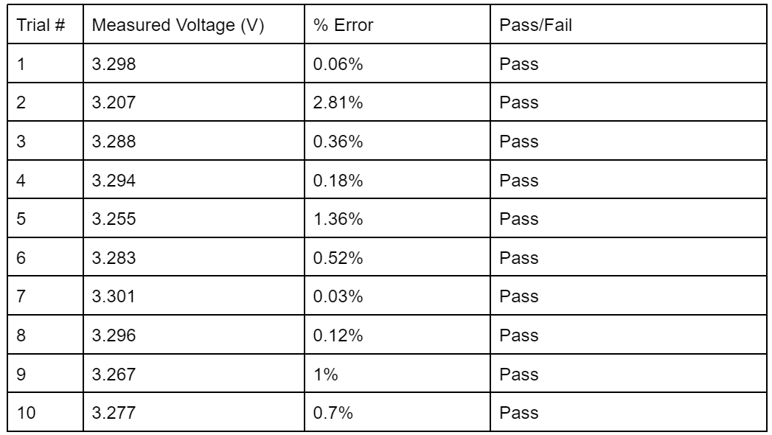
Subsystem Verification Results
ELECTRICAL & COMPUTER ENGINEERING
GRAINGER ENGINEERING

Slide 21
WIRELESS SUBSYSTEM
ELECTRICAL & COMPUTER ENGINEERING
GRAINGER ENGINEERING

Slide 22
SUBSYSTEM OVERVIEW
Uses Bluetooth Low Energy (BLE) for communication between computer and ESP32
power-efficient
longer battery life
Start ESP32 and initialize BLE
Create BLE server and set up BLE service & characteristics
Configure advertising parameters and start advertising
Check for device connections & update connection status
Collect sensor data if device is connected
Update feedback in real time
Detect disconnection request, reset connection status, & restart advertising
ELECTRICAL & COMPUTER ENGINEERING
GRAINGER ENGINEERING

Slide 23
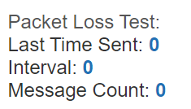
SUBSYSTEM REQUIREMENT & VERIFICATION
Requirement: There must be a Bluetooth Low Energy connection between ESP32 microcontroller and the user’s device at a distance of at least 5 meters.
Result: Success! Used nRF Connect app to test BLE connection from breadboard containing ESP32 to iPhone at different distances
Requirement: BLE Connection must have packet loss of 20% or less
Result: Success! Wrote test in ESP32 code to track time and record message rate
Message count incremented once per second, meaning no packet loss
ELECTRICAL & COMPUTER ENGINEERING
GRAINGER ENGINEERING

Slide 24
CHALLENGES
Error in ESP32-S3 library for compatibility with BLE on Arduino framework
Only got BLE connection working with breadboard and not with PCB
Possible Solutions: use old ESP32 version on PCB or use ESP-IDF framework to program ESP32
BLE permissions in Android Studio
permissions declared in AndroidManifest.xml and requested at runtime
Android emulators don’t have hardware support for BLE demonstration
ELECTRICAL & COMPUTER ENGINEERING
GRAINGER ENGINEERING

Slide 25
FEEDBACK SUBSYSTEM
ELECTRICAL & COMPUTER ENGINEERING
GRAINGER ENGINEERING

Slide 26
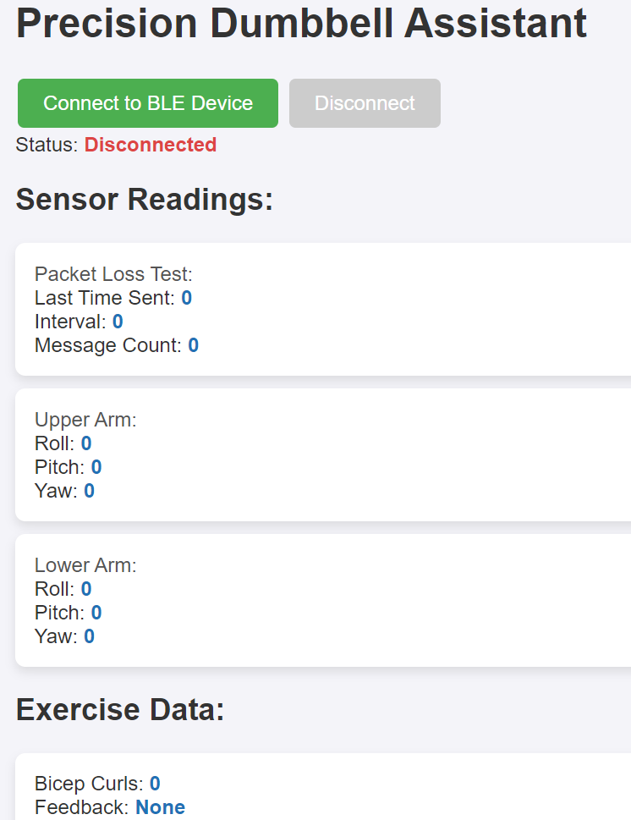
SUBSYSTEM OVERVIEW
User presses “Connect” button on web app
App uses BLE to scan for available devices and connects to ESP32
Rep count and form analysis programmed on ESP32
Sensor readings (roll, pitch, yaw), repetition count, and form feedback sent to app via BLE
App updates display in real time to show information
If form is incorrect, ESP32 triggers buzzer to alert user via PWM-controlled signals for pitch and duration
User can disconnect from BLE using “Disconnect” button
ESP32 stops sending data and notifications
ELECTRICAL & COMPUTER ENGINEERING
GRAINGER ENGINEERING

Slide 27
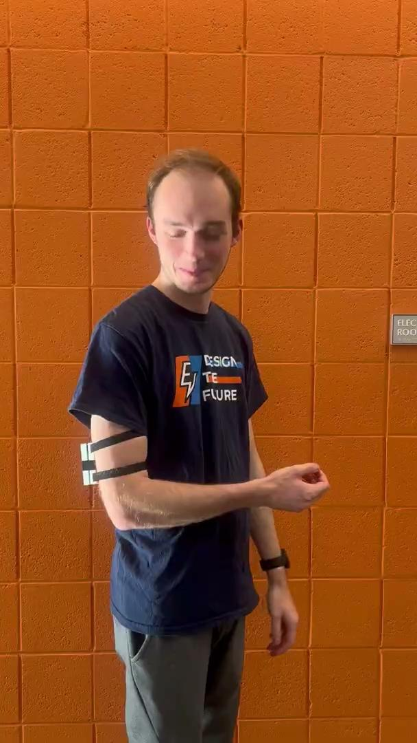
SUBSYSTEM REQUIREMENT & VERIFICATION
Requirement: The buzzer must have a pitch between 200 Hz and 600 Hz with a tolerance of ± 10% and the sound must last at least 1 second
Result: Success! Pitch was set to 200 Hz explicitly in code.
Requirement: The buzzer must have a loudness of at least 60 dB
Result: Success! Buzzer operates at half the possible maximum loudness due to 50% duty cycle. Loudness is 65 dB.
ELECTRICAL & COMPUTER ENGINEERING
GRAINGER ENGINEERING

Slide 28
PCB OVERVIEW
ELECTRICAL & COMPUTER ENGINEERING
GRAINGER ENGINEERING

Slide 29
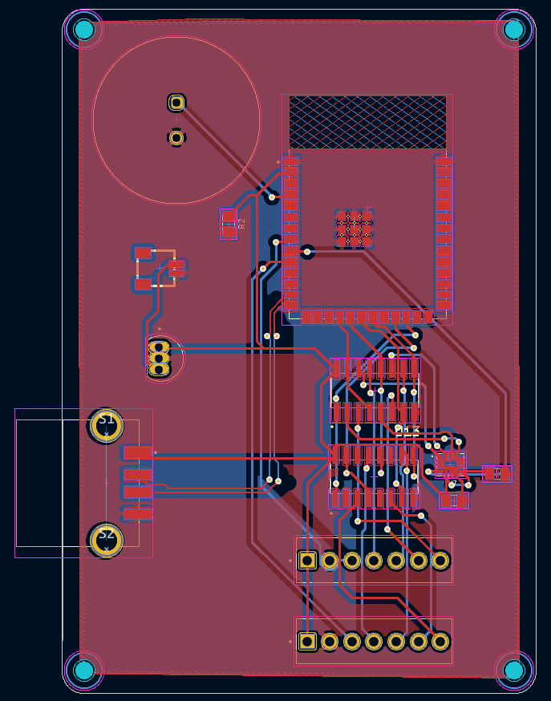
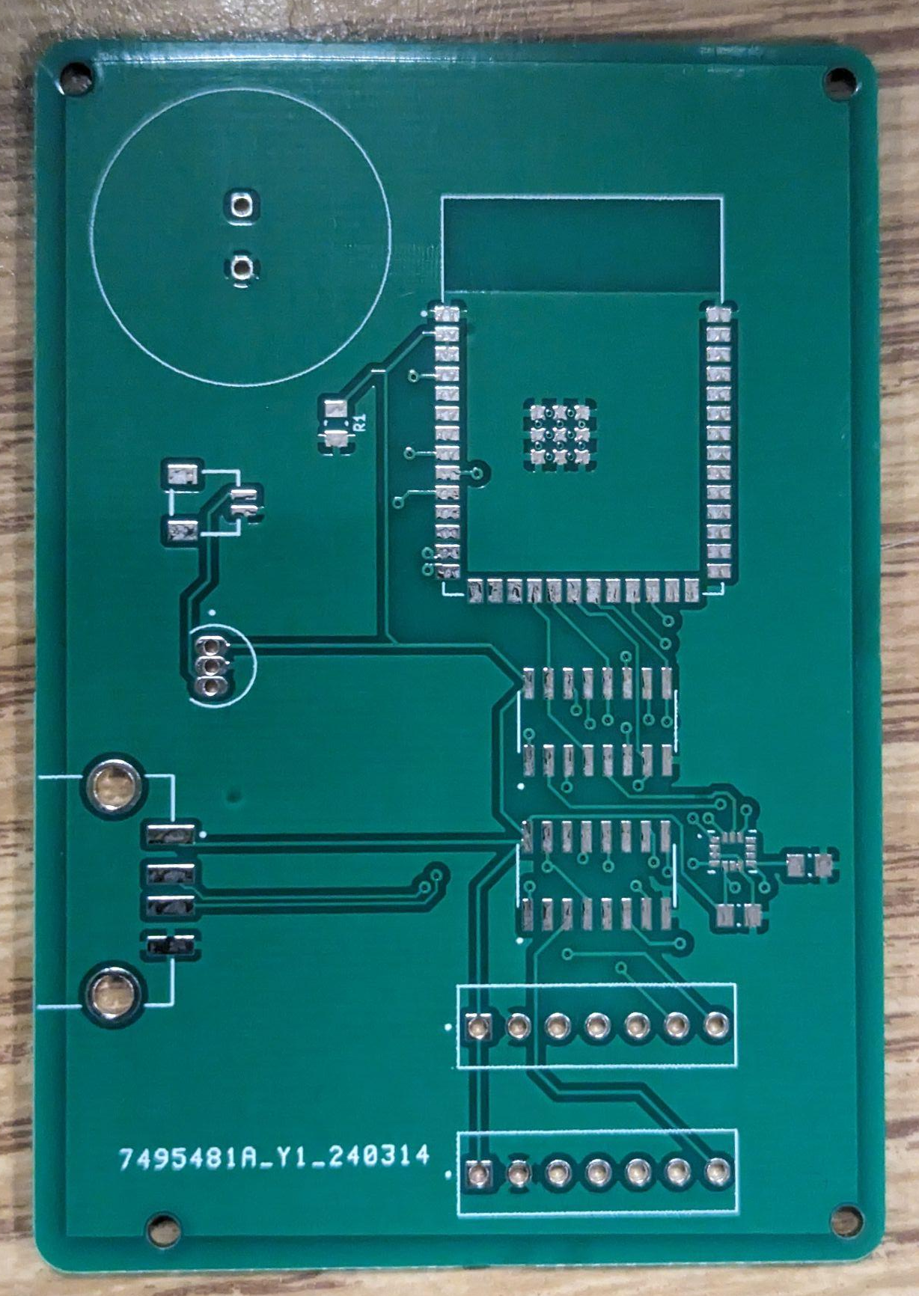
Bicep PCB
VERSION 1
2 Layers
Ground plane on top and bottom layer
54.229mm x 78.359mm
All footprints meet IPC 2222 standards
ELECTRICAL & COMPUTER ENGINEERING
GRAINGER ENGINEERING

Slide 30
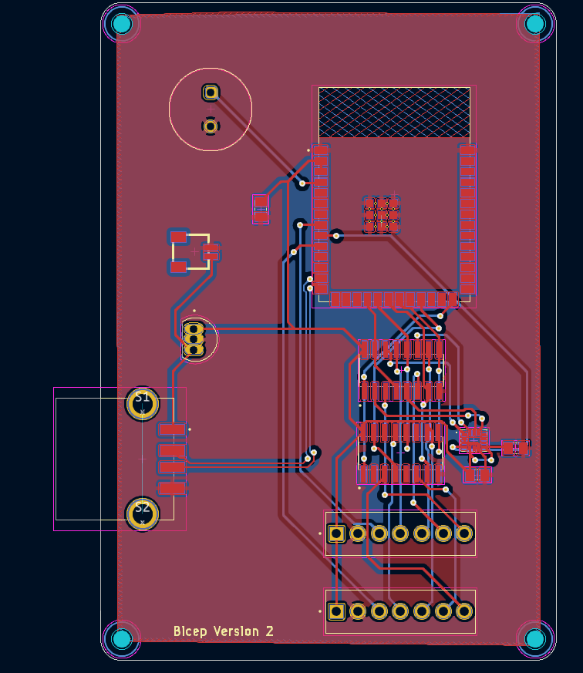
Bicep PCB
VERSION 2
(Current Version)
Changes:
Buzzer courtyard shrunk to meet actual size
5V from USB routed through voltage regulator
IMAGE
ELECTRICAL & COMPUTER ENGINEERING
GRAINGER ENGINEERING

Slide 31
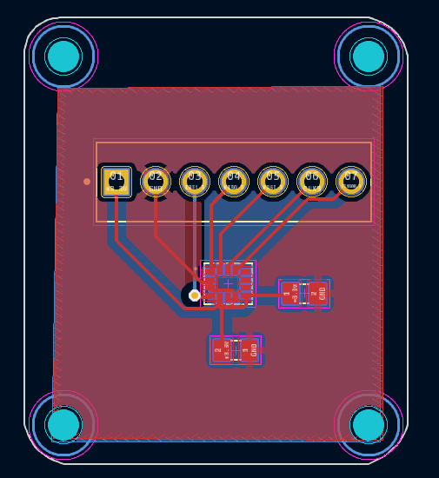
Forearm PCB
(Current Version)
2 layers
Ground plane on top and bottom layer
24.892mm x 28.956mm
All footprints meet IPC 2222 standards
ELECTRICAL & COMPUTER ENGINEERING
GRAINGER ENGINEERING

Slide 32
PCB FUTURE WORK
Add 470Ω pull-up resistor to chip select of the analog switch
Remove second 4-bit analog switch and second connector since we are now only selecting between 2 sensors per arm
Minimize size of bicep pcb
Change buzzer footprint to match new buzzer (CYT1008)
Chosen for being louder than our original buzzer
Add a physical on/off switch to EN pin
ELECTRICAL & COMPUTER ENGINEERING
GRAINGER ENGINEERING

Slide 33
CONCLUSION
ELECTRICAL & COMPUTER ENGINEERING
GRAINGER ENGINEERING

Slide 34
SUCCESSFUL
Accurately determines orientation of each sensor
Form analysis is consistent and accurately determines safe and effective form
Power is able to be delivered by the battery without overheating
Device is wearable and users are able to have the full range of motion needed to complete the exercise
Audio feedback is provided through the buzzer when the form analysis determines that the user has improper form
The app feedback works using the breadboard prototype
ELECTRICAL & COMPUTER ENGINEERING
GRAINGER ENGINEERING

Slide 35
FUTURE WORK
Implement the Bluetooth Low Energy connection on the PCB
Minimize the size of the PCBs for increased comfort for the user
Integrate the added pull-up resistor into the PCB design
Use angled connectors to minimize the bend radius of the wires and minimize the profile of the harness
Use an even louder buzzer so that it can more easily be heard in a loud environment
Use this same technology to extend to other dumbbell exercises
ELECTRICAL & COMPUTER ENGINEERING
GRAINGER ENGINEERING

Slide 36
Thank You
Questions
ELECTRICAL & COMPUTER ENGINEERING
GRAINGER ENGINEERING

