Slide 1
ECE 333 Renewable Energy Systems
Lecture 13: Per Unit, Power Flow
Prof. Tom Overbye
Dept. of Electrical and Computer Engineering
University of Illinois at Urbana-Champaign
overbye@illinois.edu

Slide 2
Announcements
First exam average: 74.1
Per unit and power flow is only covered in lecture; not in the book
No quiz on March 12
HW 6 is posted on the website and is due on Thursday March 19. HW 6 must be turned in and will count the same as a quiz. There will be no quiz on March 19.
Start Reading Chapter 4 (The Solar Resource)

Slide 3
Wind Speed Doubling and Wind Turbine Generator (WTG) Output
Just about everyone missed problem 3.d, asking about what happens to the output of a WTG if the wind speed doubles; the answer was "It Depends"
Power in wind goes up by 8, but not usually the power output
Image shows power output for GE 1.5 and 1.6 MW WTGs; cut-in speed is 3.5 m/s, while cut-out is 25 m/s
Image: http://site.ge-energy.com/prod_serv/products/wind_turbines/en/downloads/GEA14954C15-MW-Broch.pdf

Slide 4
Wind Power and the Power Flow
The most common power system analysis tool is the power flow (also known sometimes as the load flow)
power flow determines how the power flows in a network
also used to determine all bus voltages and all currents
because of constant power models, power flow is a nonlinear analysis technique
power flow is a steady-state analysis tool
it can be used as a tool for planning the location of new generation, including wind
Notes:
3

Slide 5
Simplified Power System Modeling
Balanced three phase systems can be analyzed using per phase analysis
A “per unit” normalization is simplify the analysis of systems with different voltage levels.
To provide an introduction to power flow analysis we need models for the different system devices:
Transformers and Transmission lines, generators and loads
Transformers and transmission lines are modeled as a series impedances

Slide 6
Load Models
Ultimate goal is to supply loads with electricity at constant frequency and voltage
Electrical characteristics of individual loads matter, but usually they can only be estimated
actual loads are constantly changing, consisting of a large number of individual devices
only limited network observability of load characteristics
Aggregate models are typically used for analysis
Two common models
constant power: S_{i} = P_{i} + jQ_{i}
constant impedance: S_{i} = |V|² / Z_{i}

Slide 7
Generator Models
Engineering models depend upon application
Generators are usually synchronous machines
For generators we will use two different models:
a steady-state model, treating the generator as a constant power source operating at a fixed voltage; this model will be used for power flow and economic analysis
This model works fairly well for type 3 and type 4 wind turbines
Other models include treating as constant real power with a fixed power factor.

Slide 8
Per Unit Calculations
A key problem in analyzing power systems is the large number of transformers.
It would be very difficult to continually have to refer impedances to the different sides of the transformers
This problem is avoided by a normalization of all variables.
This normalization is known as per unit analysis.

Slide 9
Per Unit Conversion Procedure, 1φ
Pick a 1φ VA base for the entire system, S_{B}
Pick a voltage base for each different voltage level, V_{B}. Voltage bases are related by transformer turns ratios. Voltages are line to neutral.
Calculate the impedance base, Z_{B}= (V_{B})²/S_{B}
Calculate the current base, I_{B} = V_{B}/Z_{B}
Convert actual values to per unit
Note, per unit conversion on affects magnitudes, not
the angles. Also, per unit quantities no longer have
units (i.e., a voltage is 1.0 p.u., not 1 p.u. volts)

Slide 10
Per Unit Solution Procedure
Convert to per unit (p.u.) (many problems are already in per unit)
Solve
Convert back to actual as necessary

Slide 11
Per Unit Example
Solve for the current, load voltage and load power
in the circuit shown below using per unit analysis
with an S_{B} of 100 MVA, and voltage bases of
8 kV, 80 kV and 16 kV.
Original Circuit

Slide 12
Per Unit Example, cont’d
Same circuit, with
values expressed
in per unit.

Slide 13
Per Unit Example, cont’d

Slide 14
Per Unit Example, cont’d
To convert back to actual values just multiply the
per unit values by their per unit base

Slide 15
Three Phase Per Unit
Procedure is very similar to 1φ except we use a 3φ
VA base, and use line to line voltage bases
Pick a 3φ VA base for the entire system,
Pick a voltage base for each different voltage level, V_{B}. Voltages are line to line.
Calculate the impedance base
Exactly the same impedance bases as with single phase!

Slide 16
Three Phase Per Unit, cont'd
Calculate the current base, I_{B}
Convert actual values to per unit
Exactly the same current bases as with single phase!

Slide 17
Three Phase Per Unit Example
Solve for the current, load voltage and load power
in the previous circuit, assuming a 3φ power base of
300 MVA, and line to line voltage bases of 13.8 kV,
138 kV and 27.6 kV (square root of 3 larger than the 1φ example voltages). Also assume the generator is Y-connected so its line to line voltage is 13.8 kV.
Convert to per unit
as before. Note the
system is exactly the
same!

Slide 18
3φ Per Unit Example, cont'd
Again, analysis is exactly the same!

Slide 19
3φ Per Unit Example, cont'd
Differences appear when we convert back to actual values

Slide 20
3φ Per Unit Example 2
Assume a 3φ load of 100+j50 MVA with V_{LL} of 69 kV is connected to a source through the below network:
What is the supply current and complex power?
Answer: I=467 amps, S = 103.3 + j76.0 MVA

Slide 21
Power Flow Analysis
We now have the necessary models to start to develop the power system analysis tools
The most common power system analysis tool is the power flow (also known sometimes as the load flow)
power flow determines how the power flows in a network
also used to determine all bus voltages and all currents
because of constant power models, power flow is a nonlinear analysis technique
power flow is a steady-state analysis tool

Slide 22
Linear Power System Elements

Slide 23
Nonlinear Power System Elements
Constant power loads and generator injections are nonlinear and hence systems with these elements can not be analyzed by superposition
Nonlinear problems can be very difficult to solve,
and usually require an iterative approach

Slide 24
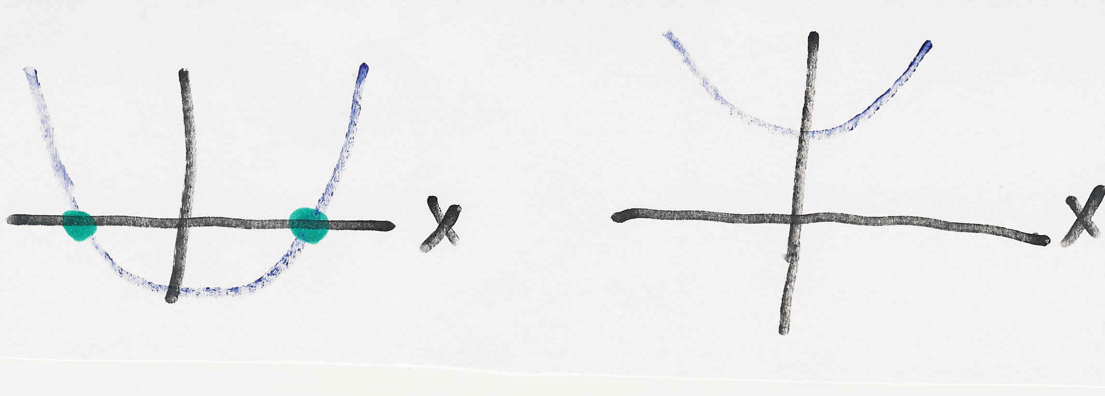
Nonlinear Systems May Have Multiple Solutions or No Solution
Example 1: x² - 2 = 0 has solutions x = ±1.414…
Example 2: x² + 2 = 0 has no real solution
f(x) = x² - 2
f(x) = x² + 2
two solutions where f(x) = 0
no solution f(x) = 0

Slide 25
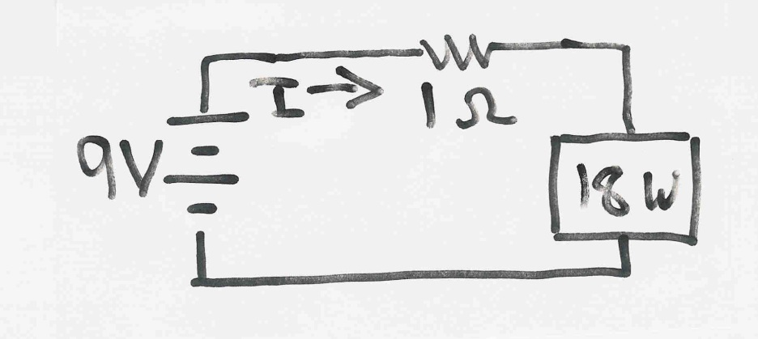
Multiple Solution Example 3
The dc system shown below has two solutions:
where the 18 watt
load is a resistive
load
What is the
maximum
P_{Load}?

Slide 26
Adding New Generation
Adding (siting) large amounts of new generation, such as for a wind farm, often require changes to the transmission system
Developers try to site where existing capacity is available
Getting new right-of-ways for transmission lines can be quite difficult (i.e., not in my backyard [NIMBY]) even when the transmission is associated with "green" energy
High voltage (e.g., 345 kV) overhead transmission lines can cost $2 million per mile, whereas burying the conductors can increase costs by a factor of 10
AC lines cannot be buried for long distances because of the high capacitance associated with underground lines

Slide 27
Adding New Generation and Transmission
Power flow studies are done to determine how much new transmission is required, and which would be the best right-of-ways
Often there is no single best answer
Example: Ameren Illinois Rivers Project
Project Website: http://www.ilriverstransmission.com/maps

Slide 28
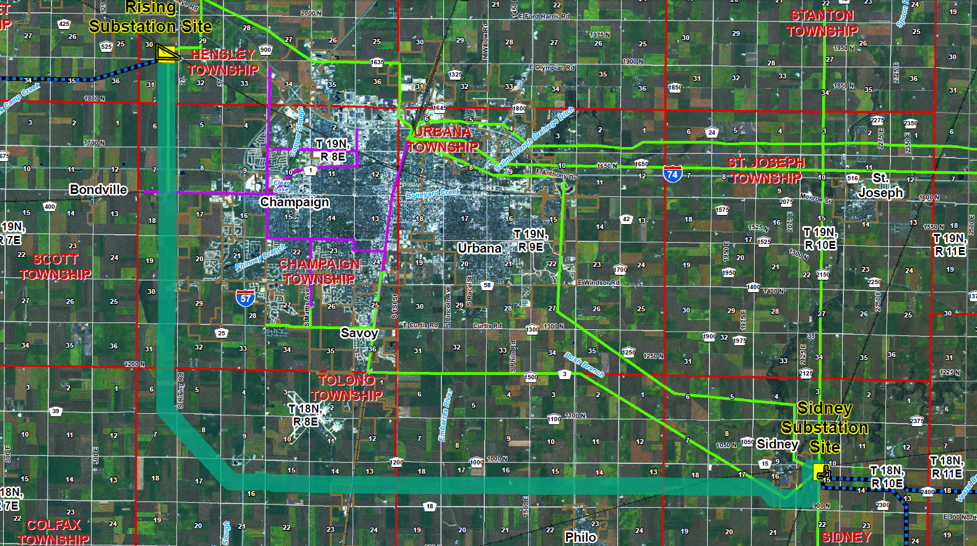
Ameren Illinois Rivers Project: Sidney to Rising 345 kV Line
One portion of project is adding a new 28 mile 345 kV transmission line in Champaign County
Estimated in-service Nov 2016, cost $66 million

Slide 29
Bus Admittance Matrix or Y_{bus}
First step in solving the power flow is to create what is known as the bus admittance matrix, often call the Y_{bus}.
The Y_{bus} gives the relationships between all the bus current injections, I, and all the bus voltages, V, I = Y_{bus} V
The Y_{bus} is developed by applying KCL at each bus in the system to relate the bus current injections, the bus voltages, and the branch impedances and admittances

Slide 30
Y_{bus} Example
Determine the bus admittance matrix for the network
shown below, assuming the current injection at each
bus i is I_{i} = I_{Gi} - I_{Di} where I_{Gi} is the current injection into the bus from the generator and I_{Di} is the current flowing into the load

Slide 31
Y_{bus} Example, cont’d

Slide 32
Y_{bus} Example, cont’d
For a system with n buses, Y_{bus} is an n by n
symmetric matrix (i.e., one where A_{ij} = A_{ji})

