Slide 1
ECE 329 Exam 1 Review
Nancy Zhao and Shuo Liu

Slide 2
Exam 1 Info
Time: Thursday, 9/27, 7:00 – 8:15pm
Location: ECEB 1002
Conflict Exam: 5:30 – 6:45pm
One 3” x 5” card is allowed

Slide 3
Concept List
Vector fields and Lorentz force (Lecture 1)
Gauss’s Law (Lecture 2-3)
Divergence and curl(Lecture 4-5)
Boundary condition (Lecture 6)
Poisson’s and Laplace’s equations (Lecture 7)
Conductors, dielectrics, and polarization (Lecture 8-10)
Magnetic force and fields and Ampere’s Law (Lecture 12)

Slide 4
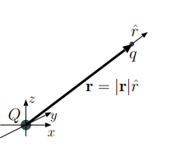
Gauss’s Law
Coulomb’s Law specifies the electric field of a stationary charge Q at the origin as
$$E\left(r\right)=\frac{Q}{4πε_{0}r^{2}}\hat{r}$$
Gauss’s Law:

Slide 5
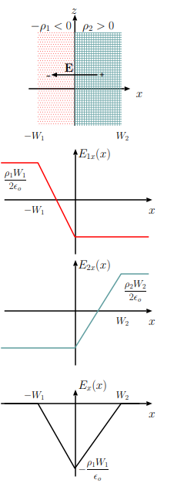
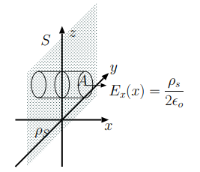
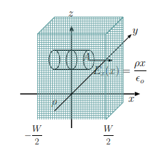
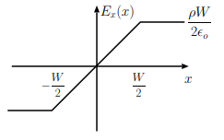
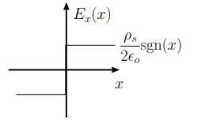
Models of Gauss’s Law

Slide 6
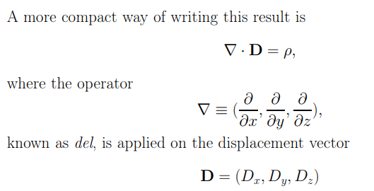
Divergence and Curl
If $∇×E=0$, vector field E is said to be curl-free
Divergence Theorem
Stoke’s Theorem

Slide 7
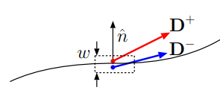
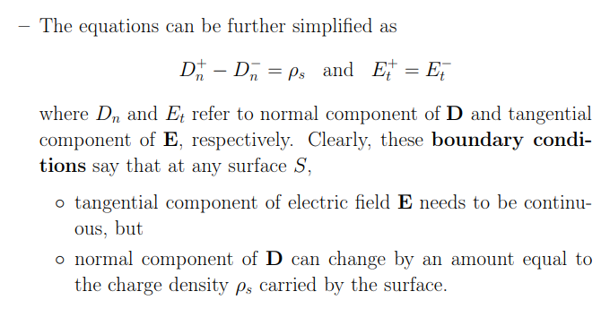
Boundary Condition

Slide 8
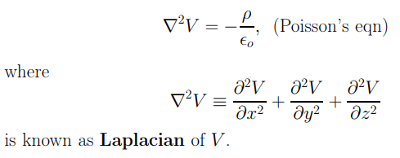
Poisson’s and Laplace’s Equations
When Poisson’s Eqn cannot be used?

Slide 9
Capacitance and Conductance
Parallel plate capacitor

Slide 10
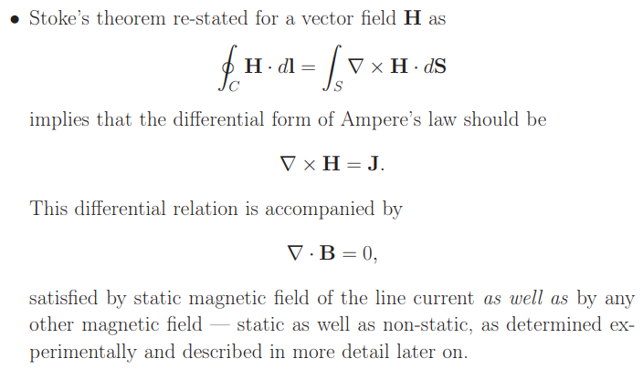
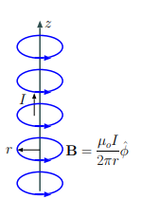
Ampere’s Law
Magnetic force on a moving charge q
Ampere’s Law

Slide 11
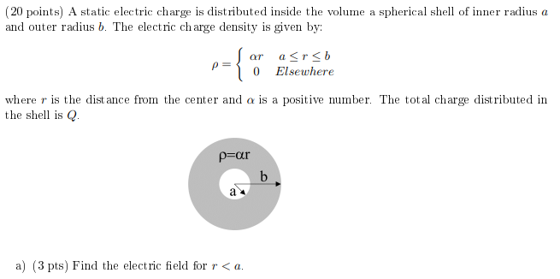
Practice Problems
SP 17

Slide 12
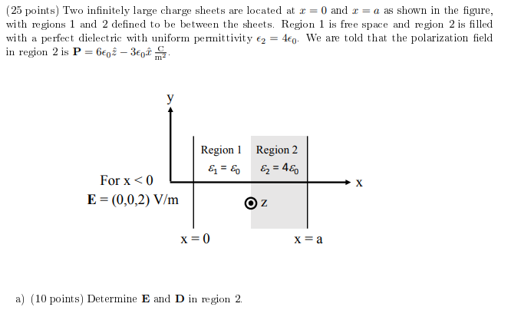
Practice Problems
SP 16

Slide 13
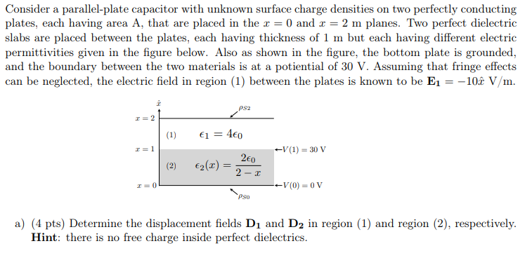
Practice Problems
FA12

