Slide 1
Object Category Detection:
Parts-based Models
04/16/15
Computer Vision
CS 543 / ECE 549
University of Illinois
Derek Hoiem

Slide 2
Previously…
Template Matching
Training Image
Close Match
Not close
Template Matching

Slide 3
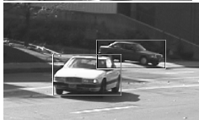
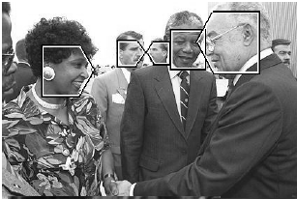
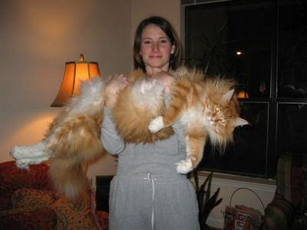
Goal: Detect all instances of objects
Cars
Faces
Cats

Slide 4

Last class: sliding window detection
…
…
Notes:
The dominant paradigm in computer vision today is local and independent…

Slide 5
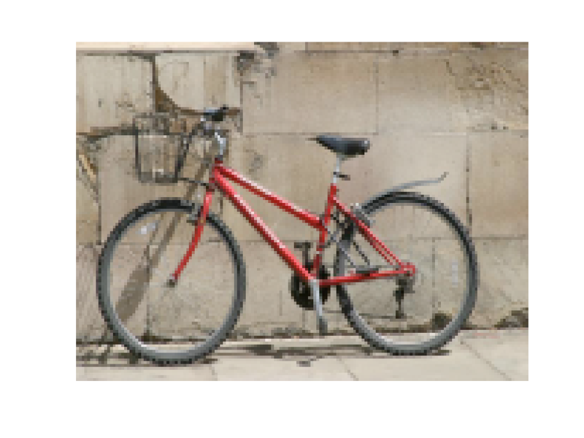
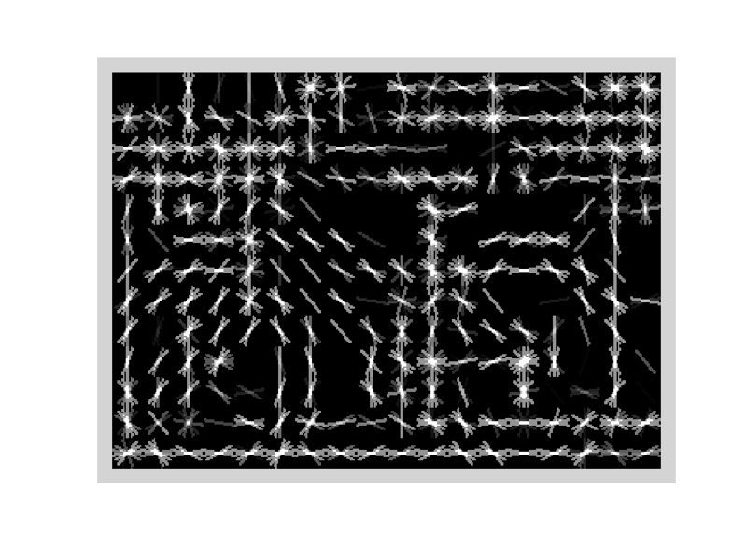
Object model: last class
Statistical Template in Bounding Box
  Object is some (x,y,w,h) in image
  Features defined wrt bounding box coordinates
Image
Template Visualization
Images from Felzenszwalb

Slide 6
Last class: statistical template
Object model = log linear model of parts at fixed positions
?
+3
+2
-2
-1
-2.5
= -0.5
> 7.5
Non-object
?
+4
+1
+0.5
+3
+0.5
= 10.5
> 7.5
Object

Slide 7
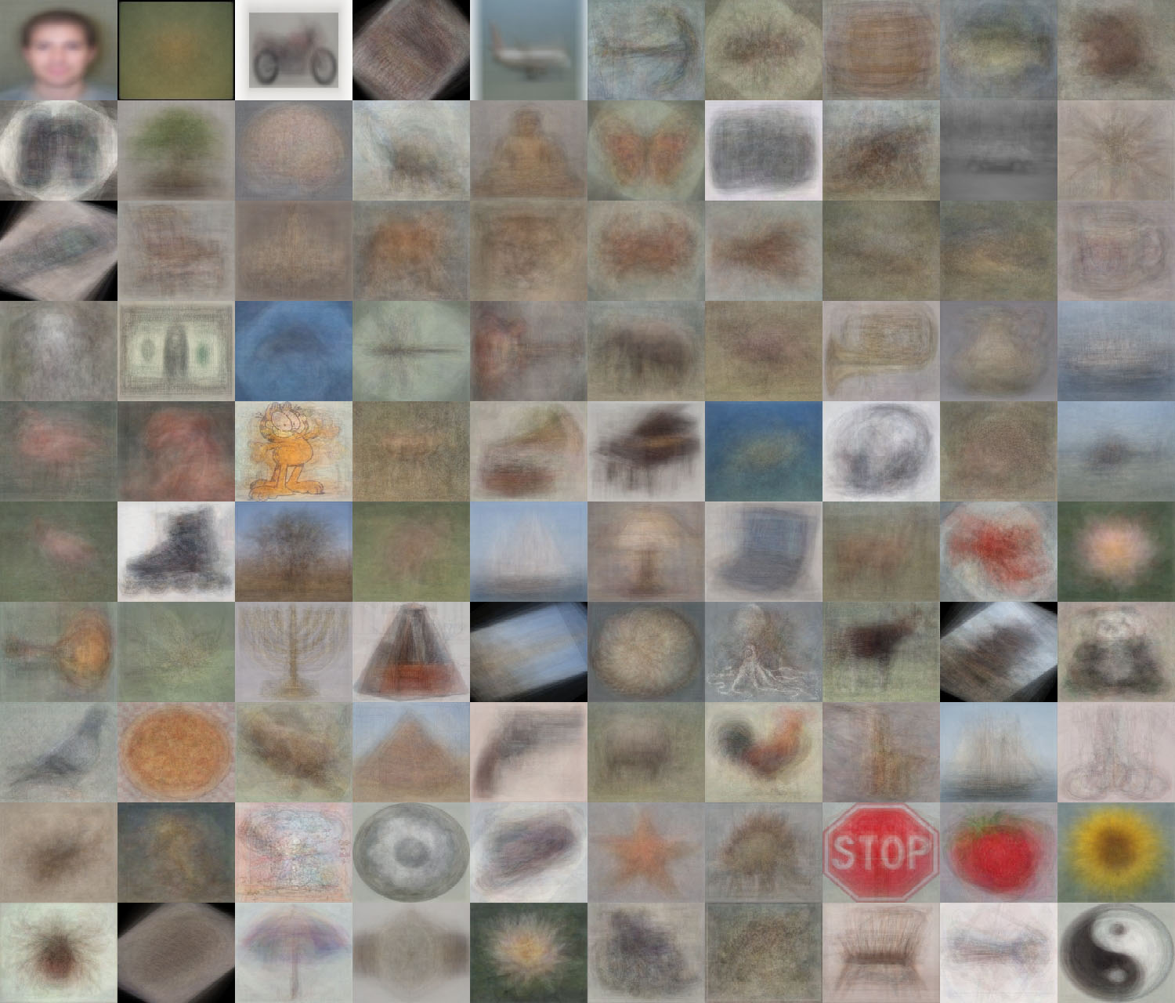
When do statistical templates make sense?
Caltech 101 Average Object Images

Slide 8
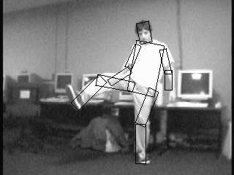

Object models: this class
Articulated parts model
  Object is configuration of parts
  Each part is detectable
Images from Felzenszwalb

Slide 9
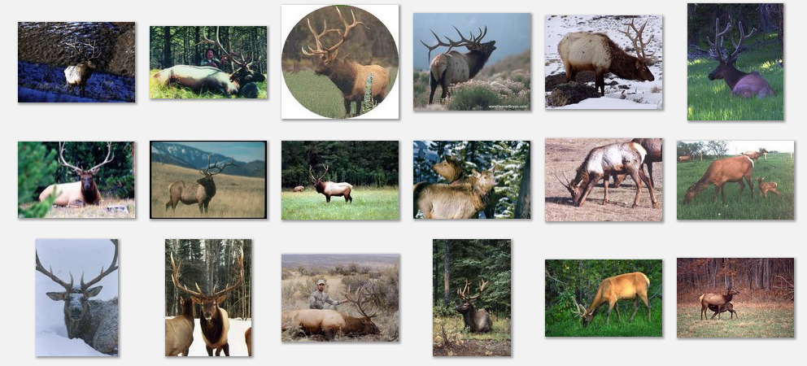
Deformable objects
Images from Caltech-256
Slide Credit: Duan Tran

Slide 10
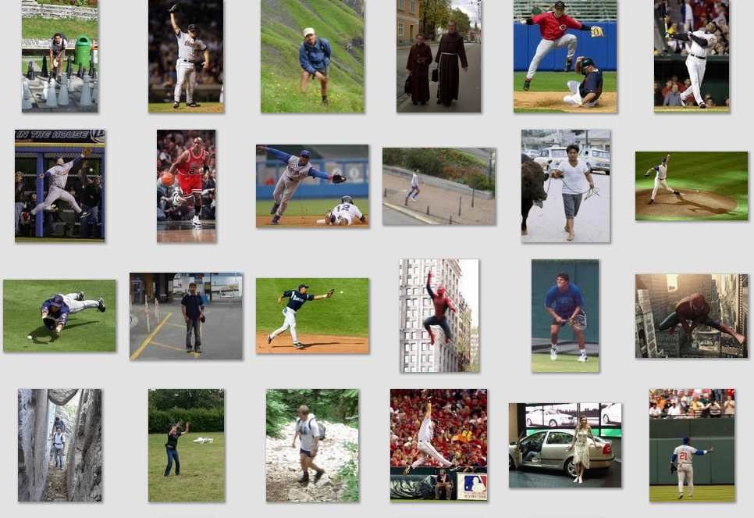
Deformable objects
Images from D. Ramanan’s dataset
Slide Credit: Duan Tran

Slide 11
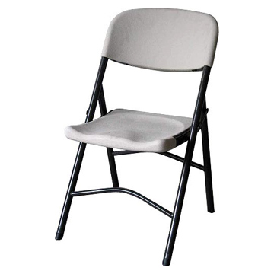
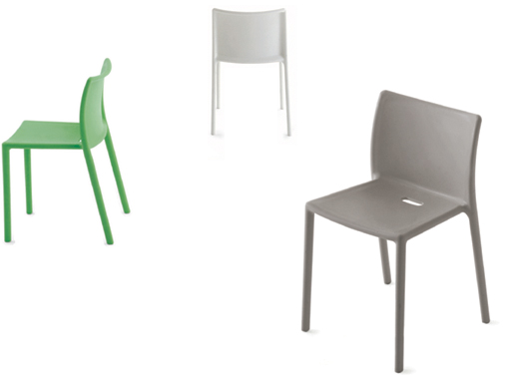
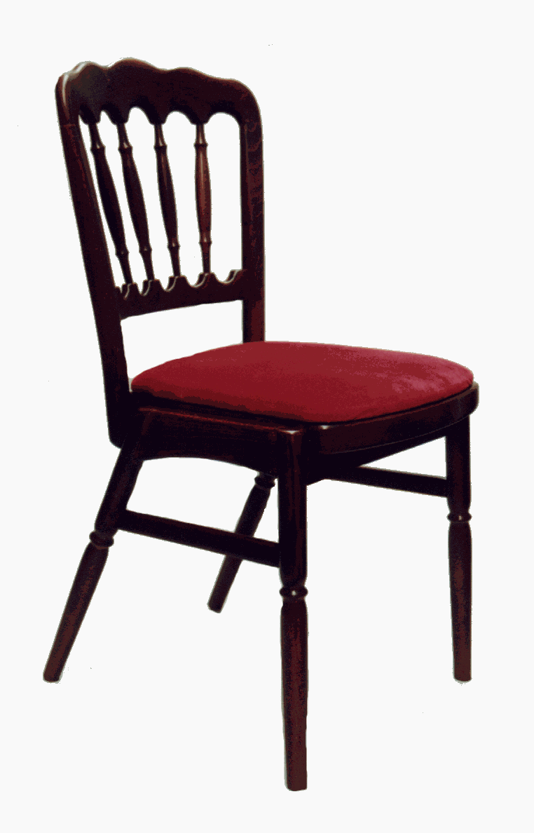
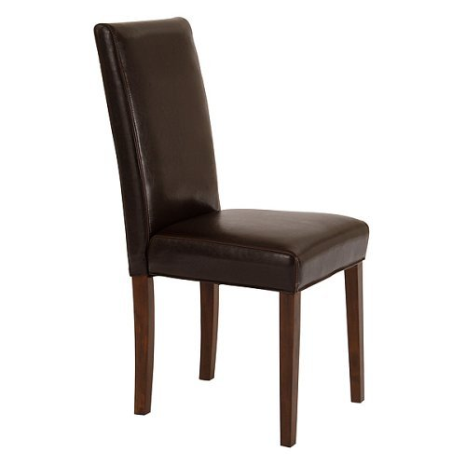
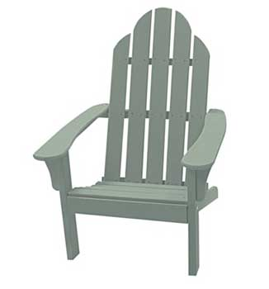
Compositional objects

Slide 12
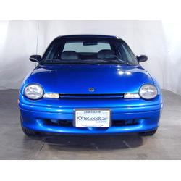
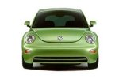
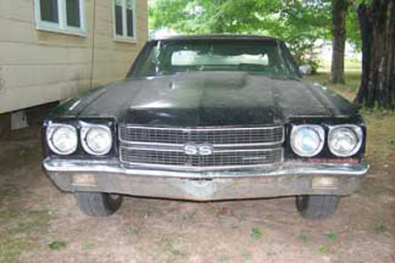
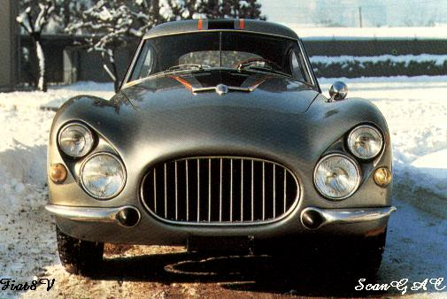
Parts-based Models
Define object by collection of parts modeled by
  Appearance
  Spatial configuration
Slide credit: Rob Fergus

Slide 13
How to model spatial relations?
One extreme: fixed template

Slide 14
How to model spatial relations?
Another extreme: bag of words
=

Slide 15
How to model spatial relations?
Star-shaped model
Part
Part
Part
Root
Part
Part

Slide 16
How to model spatial relations?
Star-shaped model
=
X
X
≈
Part
Part
Part
X
Root
Part
Part

Slide 17
How to model spatial relations?
Tree-shaped model

Slide 18
How to model spatial relations?
Many others...
O(N⁶)
O(N²)
O(N³)
O(N²)
Fergus et al. ’03
Fei-Fei et al. ‘03
Leibe et al. ’04, ‘08
Crandall et al. ‘05
Fergus et al. ’05
Crandall et al. ‘05
Felzenszwalb & Huttenlocher ‘05
Csurka ’04
Vasconcelos ‘00
Bouchard & Triggs ‘05
Carneiro & Lowe ‘06
from [Carneiro & Lowe, ECCV’06]

Slide 19
Today’s class
Star-shaped model
  Example: Deformable Parts Model
    Felzenswalb et al. 2010
Tree-shaped model
  Example: Pictorial structures
    Felzenszwalb Huttenlocher 2005
Sequential prediction models
Part
Part
Part
Root
Part
Part

Slide 20

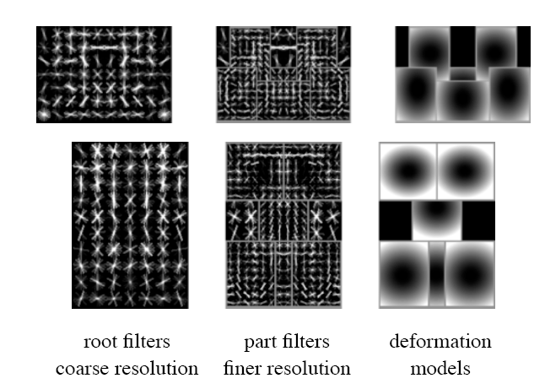
Deformable Latent Parts Model (DPM)
Detections
Template Visualization
Felzenszwalb et al. 2008, 2010

Slide 21


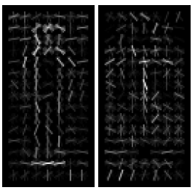
Review: Dalal-Triggs detector
.
-
= 0.16
Image Window
HOG
SVM weights (pos/neg)
score
Extract fixed-sized (64x128 pixel) window at each position and scale
Compute HOG (histogram of gradient) features within each window
Score the window with a linear SVM classifier
Perform non-maxima suppression to remove overlapping detections with lower scores

Slide 22
Deformable parts model
Root filter models coarse whole-object appearance
Part filters model finer-scale appearance of smaller patches
For each root window, part positions that maximize appearance score minus spatial cost are found
Total score is sum of scores of each filter and spatial costs
Root filter
Part filters
Spatial costs

Slide 23
DPM: computing object score
Scores from individual part detectors
Scores from root detector
With generalized distance transform, compute the maximum part score corresponding to each root position

Slide 24
DPM: mixture model
Each positive example is modeled by one of M detectors
In testing, all detectors are applied with non-max suppression

Slide 25
DPM: Training
Solve for latent parameters (root/part positions, mixture component) that maximize score and are consistent with ground truth bounding box
Add negative examples that achieve some minimum score (> 1 – delta)
Solve for SVM weights given current latent parameters and negative examples

Slide 26
Results

Slide 27
Improvement over time for HOG-based detectors
AP on PASCAL VOC 2007
DPM v4 (3 comp., left/right flip)
DPM v5
DPM v2
(2 comp., context)
DPM v3
DPM v1 (1 component, parts)
Dalal-Triggs (1 component, no parts)

Slide 28
Tree-shaped model

Slide 29
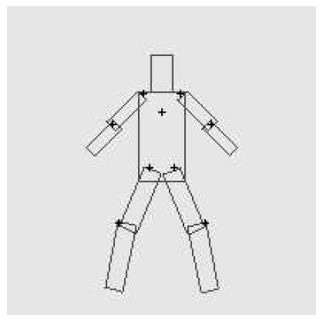
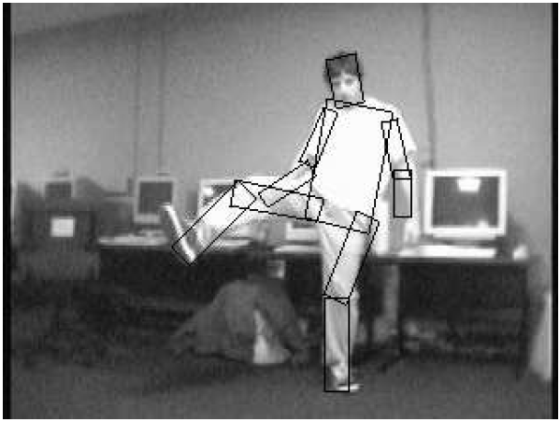
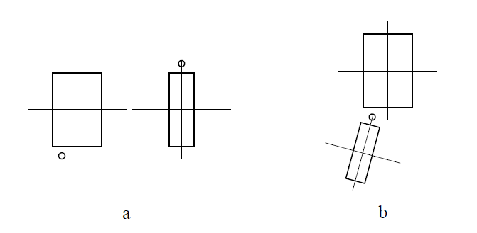
Pictorial Structures Model
Part = oriented rectangle
Spatial model = relative size/orientation
Felzenszwalb and Huttenlocher 2005
Notes:
What is the root of the tree?

Slide 30
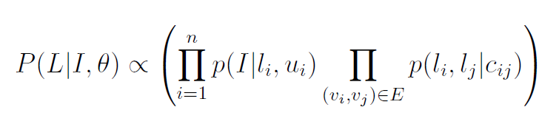
Pictorial Structures Model
Appearance likelihood
Geometry likelihood

Slide 31
Modeling the Appearance
Any appearance model could be used
  HOG Templates, etc.
  Here: rectangles fit to background subtracted binary map
Can train appearance models independently (easy, not as good) or jointly (more complicated but better)
Appearance likelihood
Geometry likelihood

Slide 32
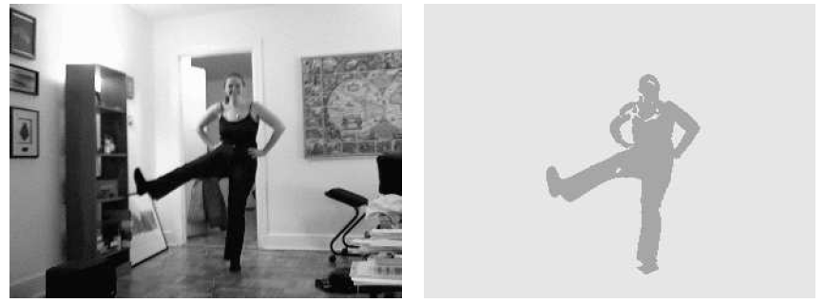

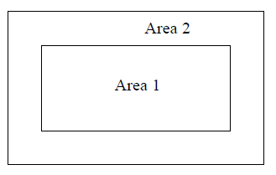
Part representation
Background subtraction

Slide 33
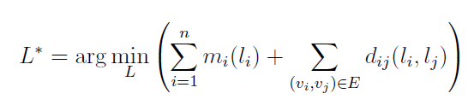
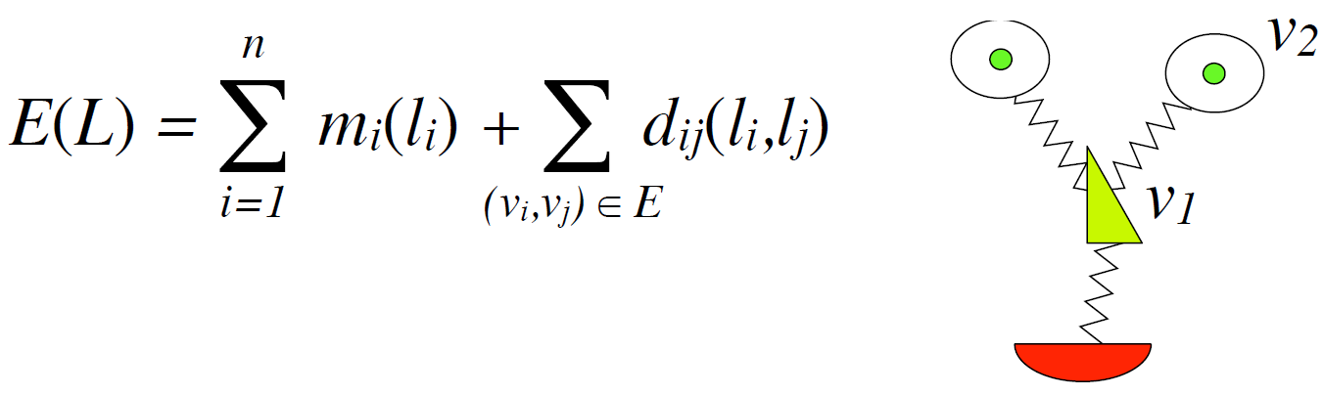
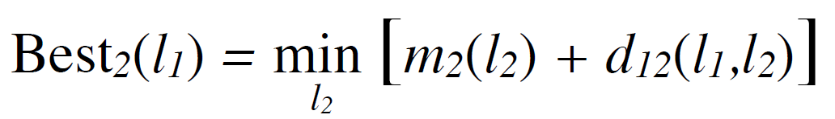
Pictorial structures model
Optimization is tricky but can be efficient
For each l₁, find best l₂:
Remove v₂, and repeat with smaller tree, until only a single part
For k parts, n locations per part, this has complexity of O(kn²), but can be solved in ~O(kn) using generalized distance transform

Slide 34
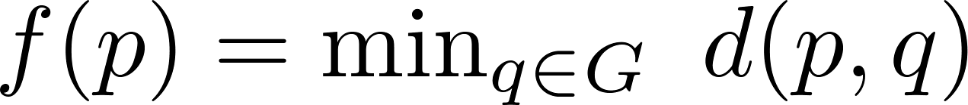
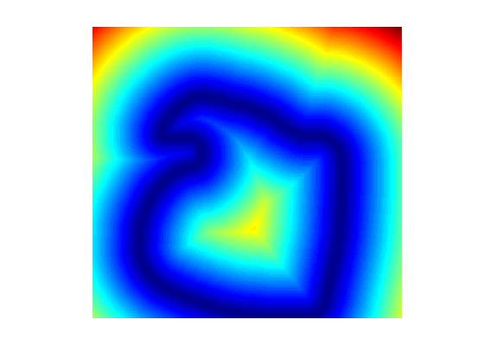
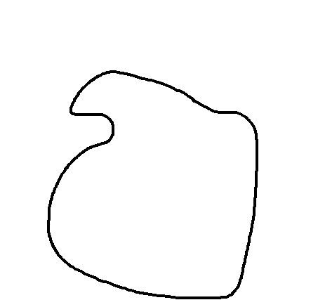
Distance Transform
For each pixel p, how far away is the nearest pixel q of set G
  G is often the set of edge pixels
G: black pixels
p₁
q₁
q₂
p₂

Slide 35
Distance Transform - Applications
Set distances – e.g. Hausdorff Distance
Image processing – e.g. Blurring
Robotics – Motion Planning
Alignment
  Edge images
  Motion tracks
  Audio warping
Deformable Part Models

Slide 36

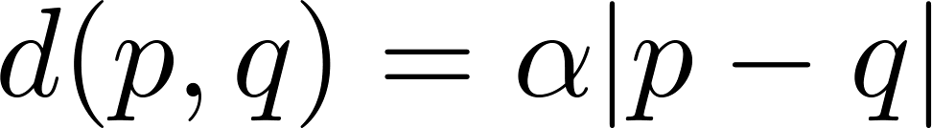
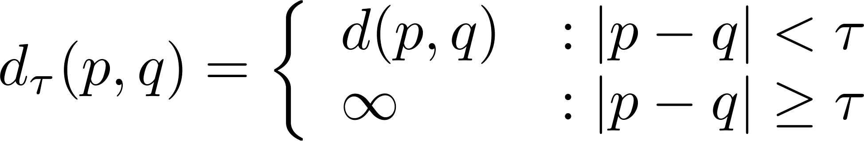
Generalized Distance Transform
Original form:
General form:
For many deformation costs,
Quadratic
Abs Diff
Min Composition
Bounded

Slide 37
Pictorial structures model
To create multiple likely candidates
Sample root node, then each node given parent, until all parts are sampled

Slide 38
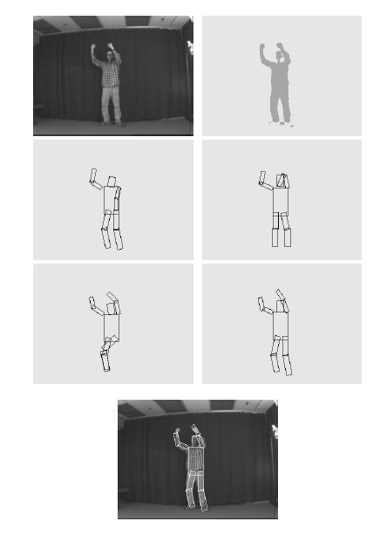
Sample poses from likelihood and choose best match with Chamfer distance

Slide 39
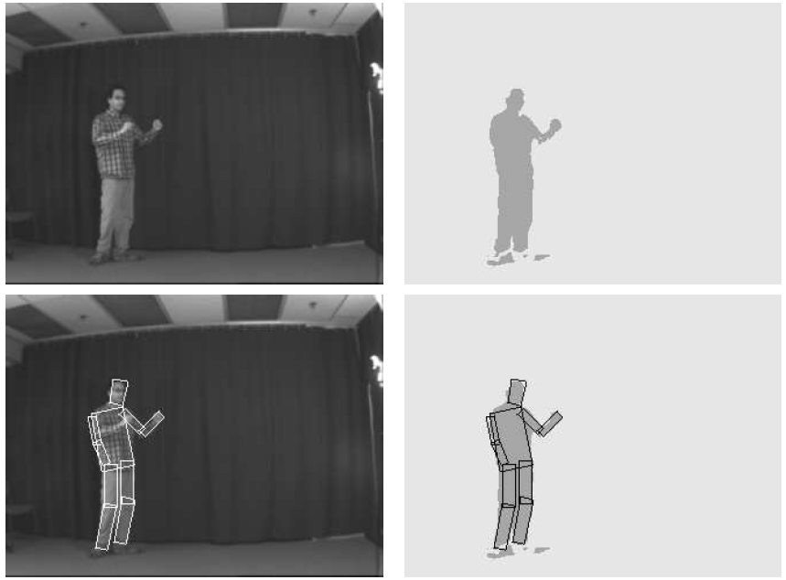
Results for person matching

Slide 40
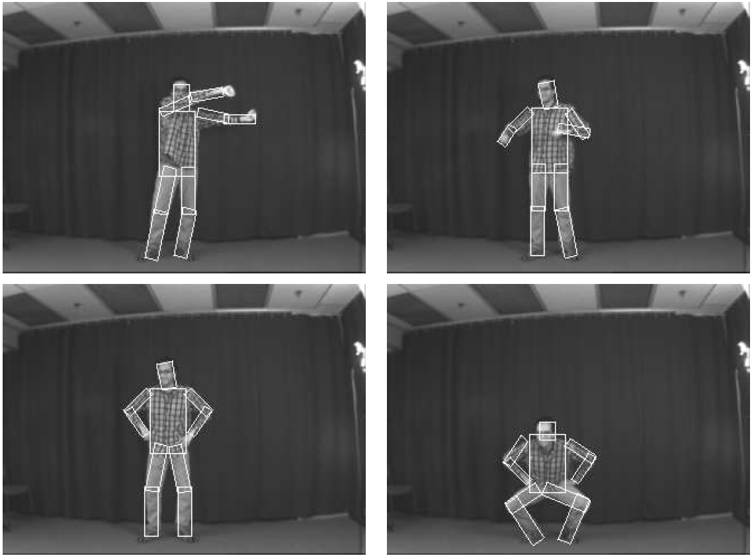
Results for person matching

Slide 41
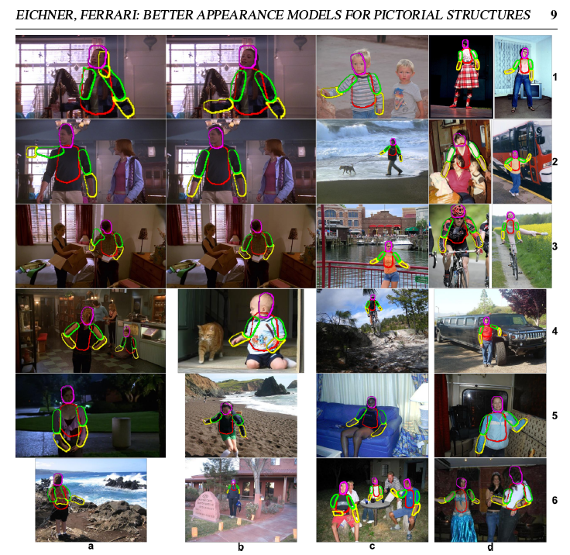
Enhanced pictorial structures
Learn spatial prior
Color models from soft segmentation
(initialized by location priors of each part)
BMVC 2009

Slide 42
2 minute break
Comparing a sliding window/part detector
  What are the advantages of the part detector?
  What are the advantages of the sliding window detector?

Slide 43
2 minute break

Slide 44
Example from Ramakrishna

Slide 45
Sequential structured prediction
Can consider pose estimation as predicting a set of related variables (called structured prediction)
  Some parts easy to find (head), some are hard (wrists)
One solution: jointly solve for most likely variables (DPM, pictorial structures)
Another solution: iteratively predict each variable based in part on previous predictions

Slide 46
Pose machines
Ramakrishna et al. ECCV 2014

Slide 50
Example results

Slide 51
General principle
“Auto-context” (Tu CVPR 2008): instead of fancy graphical models, create feature from past predictions and repredict
Can view this as an “unrolled belief propagation” (Ross et al. 2011)
Tu Bai 2010: Auto-context
Ross Munoz Hebert Bagnell 2011: Message-Passing Inference Machines

Slide 52
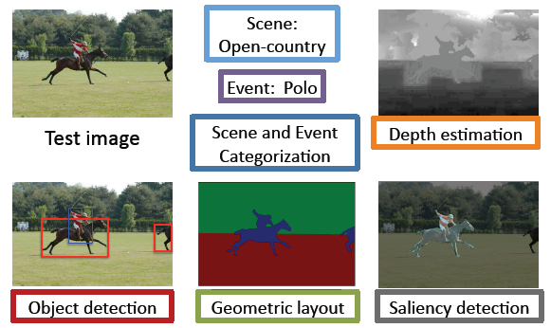
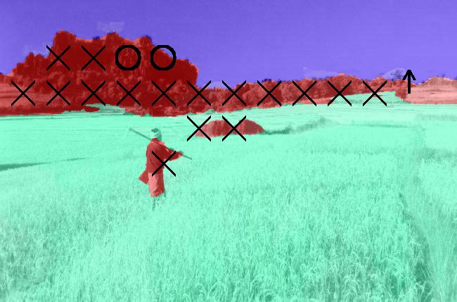
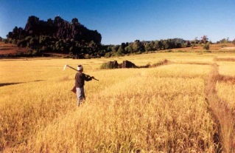
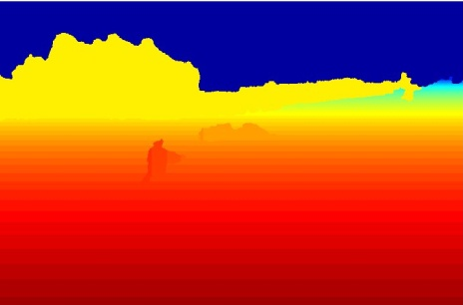
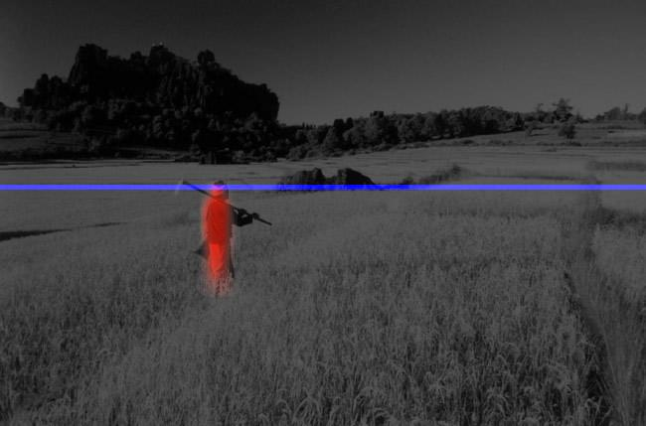
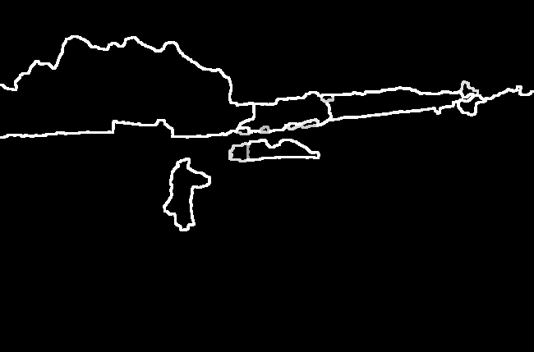
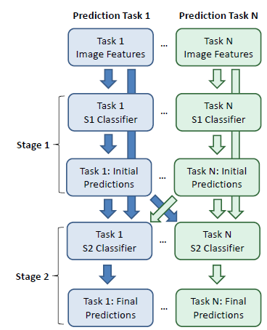
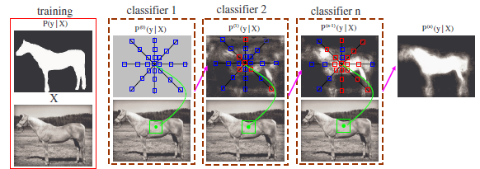
Many uses and variations on sequential structured prediction
Cascaded Classification Model
Closing the Loop
Scene Analysis Processes
Surface Orientation
Object/Viewpoint
Occlusion/Depth
Input Image
Hoiem Efros Hebert 2008
Intrinsic Images
Autocontext
Tu 2008
Tu Bai 2010
Heitz Gould Saxena Koller 2008
Li Kowdle Saxena Chen 2010
Notes:
141 97

Slide 53
Learning to search for landmarks
Learn to find easy landmarks (body joints) first and use them as context for harder ones
Singh et al. CVPR 2015

Slide 54
Results: best (top) to worst (bottom)

Slide 55
Graphical models vs. structured prediction
Advantages of sequential prediction
  Simple procedures for training and inference
  Learns how much to rely on each prediction
  Can model very complex relations
Advantages of BP/graphcut/etc
  Elegant
  Relations are explicitly modeled
  Exact inference in some cases

Slide 56
Things to remember
Models can be broken down into part appearance and spatial configuration
  Wide variety of models
Efficient optimization can be tricky but usually possible
  Generalized distance transform is a useful trick
Rather than explicitly modeling contextual relations, can encode through features/classifiers

Slide 57
Next classes
HW 5 due Monday (last one!!)
Tues: Object tracking with Kalman Filters
Thurs: Action Recognition

