Slide 1
Projective Geometry and
Camera Models
02/24/15
Computer Vision
CS 543 / ECE 549
University of Illinois
Derek Hoiem

Slide 2

HWs
HW 1 back today
  Solutions are posted
  Frequent mistake on question about shadow on specular surface
HW 2 due next Tues
HW 3 should be out by end of week

Slide 3
Top edge methods
Huy Le (0.673):
  Find edge magnitudes using sobel
  Suppress using canny on R, G, B (OR edge maps) max pooling
  Get max filter response of applying RFS filters (from Oxford) to boundary map

Slide 4
Top edge methods
Austin Walters (0.673):
  convert to LAB
  compute gradient magnitudes
  take max over channels
Yang Xu (0.646)
  oriented filter within RGB+HSV
  group edges using connected components
  threshold based on edge length/intensity

Slide 5
Think about your final projects
Strongly encouraged to work in groups of 2-4 (but if you have a good reason to work by self, could be ok)
Projects don’t need to be of publishable originality but should evince independent effort to learn about a new topic, try something new, or apply to an application of interest
Proposals will be due after Spring Break

Slide 6


Last notes on registration
Thin-plate splines: combines global affine warp with smooth local deformation
Diff of predicted vs. actual position
Smoothness cost for local warps
There is a closed form solution for parameter estimation and warping
Affine warp
Local deformation according to distance from control points

Slide 7
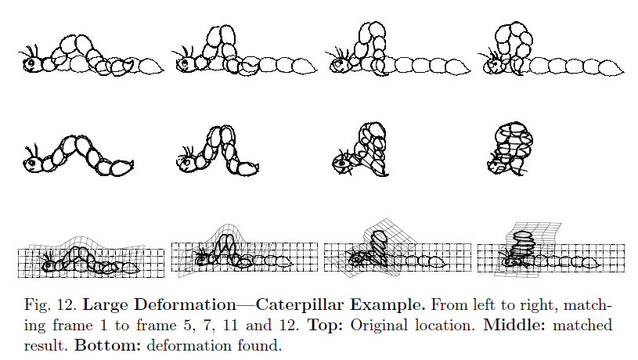
Robust non-rigid point matching: http://noodle.med.yale.edu/~chui/tps-rpm.html (includes code, demo, paper)
  Thin-plate spline registration with robustness to outliers

Slide 8
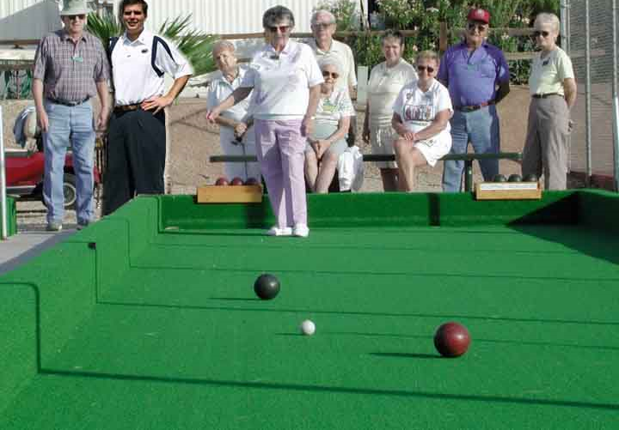
Next two classes: Single-view Geometry
How tall is this woman?
How high is the camera?
What is the camera rotation?
What is the focal length of the camera?
Which ball is closer?

Slide 9
Today’s class
Mapping between image and world coordinates
  Pinhole camera model
  Projective geometry
    Vanishing points and lines
  Projection matrix

Slide 10
Image formation
Let’s design a camera
  Idea 1: put a piece of film in front of an object
  Do we get a reasonable image?
Slide source: Seitz

Slide 11
Pinhole camera
Idea 2: add a barrier to block off most of the rays
  This reduces blurring
  The opening known as the aperture
Slide source: Seitz
Notes:
Q: How does this transform the image? A: It gets inverted

Slide 12

Pinhole camera
f
c
f = focal length
c = center of the camera
Figure from Forsyth

Slide 13
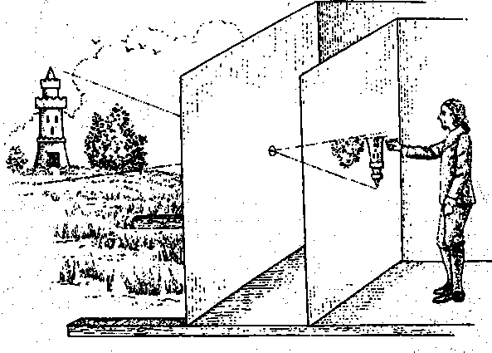
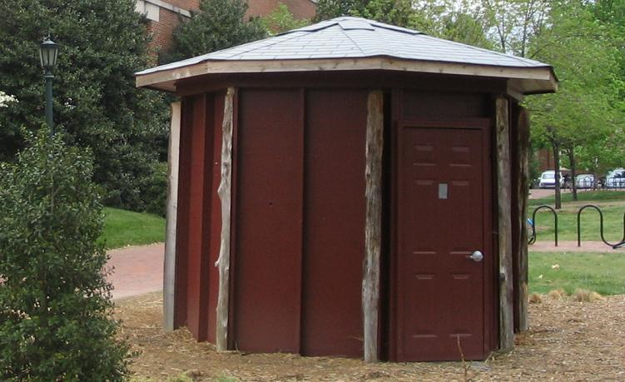
Camera obscura: the pre-camera
First idea: Mo-Ti, China (470BC to 390BC)
First built: Alhazen, Iraq/Egypt (965 to 1039AD)
Illustration of Camera Obscura
Freestanding camera obscura at UNC Chapel Hill
Photo by Seth Ilys
Notes:
Alhazen was born in Basra, moved to Egypt. Proposed to the king to control the Nile with a dam. Realized he couldn’t do it and feigned madness until the king died. During that time, he wrote the book of optics.

Slide 14
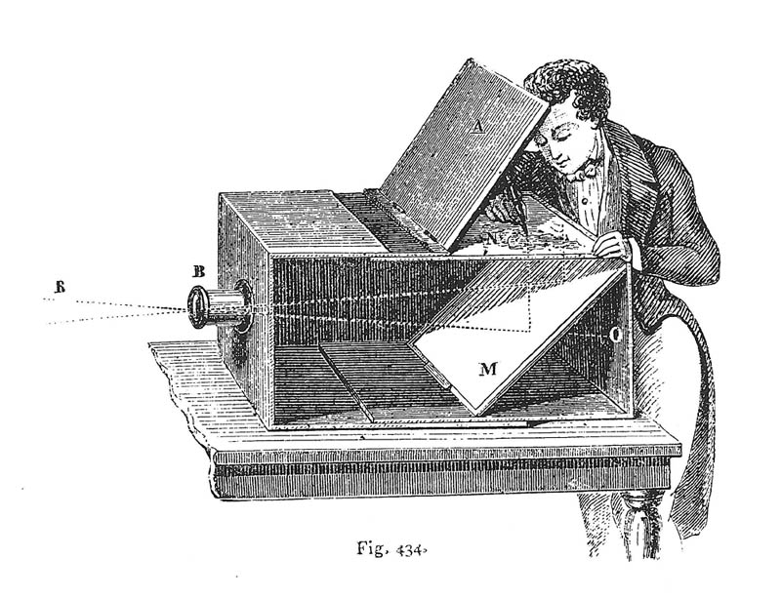
Camera Obscura used for Tracing
Lens Based Camera Obscura, 1568

Slide 15
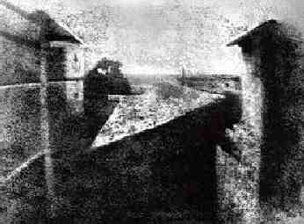
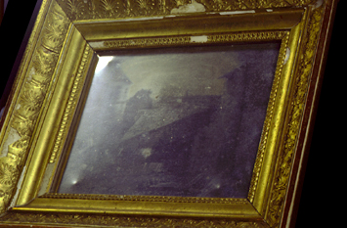
First Photograph
Oldest surviving photograph
  Took 8 hours on pewter plate
Photograph of the first photograph
Joseph Niepce, 1826
Stored at UT Austin
Niepce later teamed up with Daguerre, who eventually created Daguerrotypes

Slide 16
Dimensionality Reduction Machine (3D to 2D)
3D world
2D image
Figures © Stephen E. Palmer, 2002

Slide 17

Projection can be tricky…
Slide source: Seitz

Slide 18
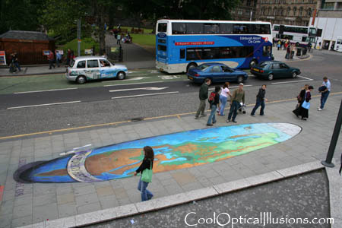
Projection can be tricky…
Slide source: Seitz
Making of 3D sidewalk art: http://www.youtube.com/watch?v=3SNYtd0Ayt0

Slide 19
Projective Geometry
What is lost?
Length
Who is taller?
Which is closer?

Slide 20
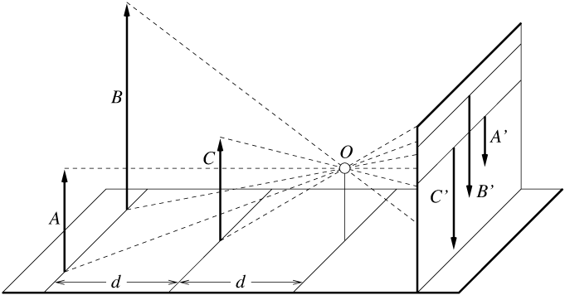
Length is not preserved
A’
C’
B’
Figure by David Forsyth

Slide 21
Projective Geometry
What is lost?
Length
Angles
Parallel?
Perpendicular?

Slide 22
Projective Geometry
What is preserved?
Straight lines are still straight

Slide 23
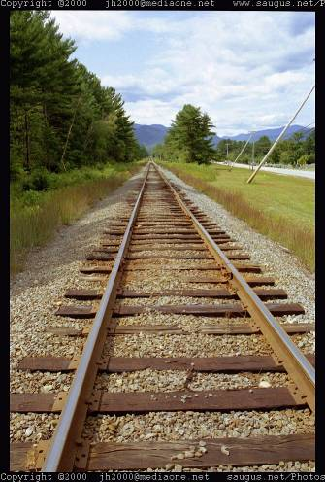
Vanishing points and lines
Parallel lines in the world intersect in the image at a “vanishing point”
Notes:
Go to board, sketch out various properties of vanishing points/lines

Slide 24
Vanishing points and lines
Vanishing Point
Vanishing Point
o
o
Vanishing Line
The projections of parallel 3D lines intersect at a vanishing point
The projection of parallel 3D planes intersect at a vanishing line
If a set of parallel 3D lines are also parallel to a particular plane, their vanishing point will lie on the vanishing line of the plane
Not all lines that intersect are parallel
Vanishing point <-> 3D direction of a line
Vanishing line <-> 3D orientation of a surface
Notes:
Go to board, sketch out various properties of vanishing points/lines
Parallel lines intersect at a point
The intersection of red lines and blue lines form a parallelogram
Sets of parallel lines on the same plane form a vanishing line
Sets of parallel planes form a vanishing line
Not all lines that intersect are parallel

Slide 25

Vanishing points and lines
Vertical vanishing
point
(at infinity)
Vanishing
line
Vanishing
point
Vanishing
point
Slide from Efros, Photo from Criminisi

Slide 26
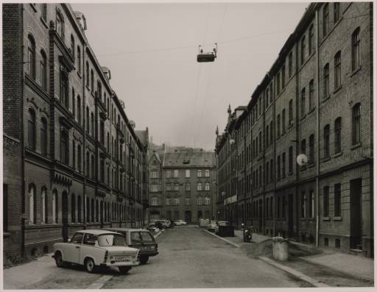
Vanishing points and lines
Photo from online Tate collection
Notes:
Where are the vanishing points? Do buildings on left and buildings on right have the same vanishing line? Which way is the camera tilted?

Slide 27
Note on estimating vanishing points
Use multiple lines for better accuracy
… but lines will not intersect at exactly the same point in practice
One solution: take mean of intersecting pairs
… bad idea!
Instead, minimize angular differences
Notes:
Go to board, sketch out various properties of vanishing points/lines

Slide 28

Vanishing objects

Slide 29
Projection: world coordinates→image coordinates
.
Optical Center (u₀, v₀)
.
.
Y
f
Z
X
.
v
Camera Center (t_{x}, t_{y}, t_{z})
u

Slide 30




Homogeneous coordinates
Conversion
Converting to homogeneous coordinates
homogeneous image
coordinates
homogeneous scene
coordinates
Converting from homogeneous coordinates
Notes:
Append coordinate with value 1; proportional coordinate system

Slide 31
Homogeneous coordinates
Invariant to scaling
Point in Cartesian is ray in Homogeneous
Homogeneous Coordinates
Cartesian Coordinates
Notes:
Q: Suppose we have a point in Cartesian coordinates. What is that in homogeneous coordinates? A: a ray

Slide 32
Basic geometry in homogeneous coordinates
Line equation: ax + by + c = 0
Append 1 to pixel coordinate to get homogeneous coordinate
Line given by cross product of two points
Intersection of two lines given by cross product of the lines

Slide 33
Another problem solved by homogeneous coordinates
Intersection of parallel lines
  Cartesian: (Inf, Inf)
  Homogeneous: (1, 1, 0)
  Cartesian: (Inf, Inf)
Homogeneous: (1, 2, 0)
Notes:
Parallel lines intersect at different infinities

Slide 34

Projection matrix
Slide Credit: Saverese
R,T
j_{w}
k_{w}
O_{w}
i_{w}
x: Image Coordinates: (u,v,1)
K: Intrinsic Matrix (3x3)
R: Rotation (3x3)
t: Translation (3x1)
X: World Coordinates: (X,Y,Z,1)
Notes:
We can use homogeneous coordinates to write camera matrix in linear form.

Slide 35
Interlude: when have I used this stuff?

Slide 36
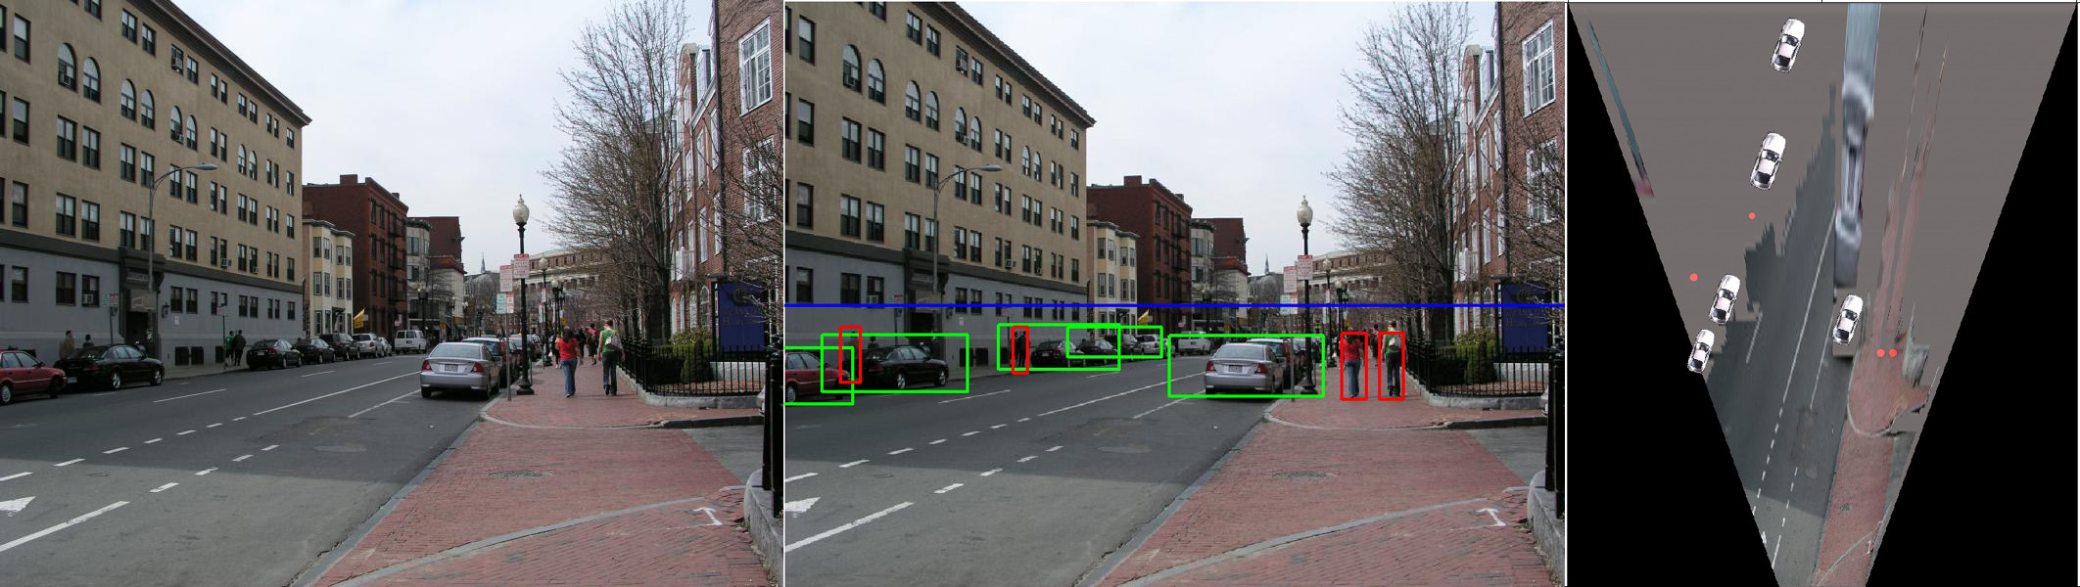
When have I used this stuff?
Object Recognition (CVPR 2006)

Slide 37
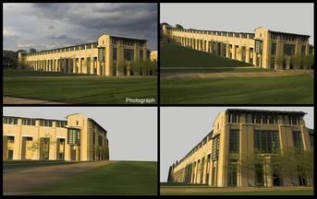
When have I used this stuff?
Single-view reconstruction (SIGGRAPH 2005)

Slide 38
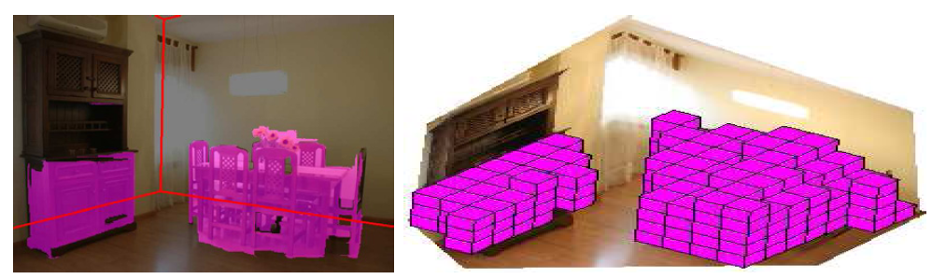
When have I used this stuff?
Getting spatial layout in indoor scenes (ICCV 2009)

Slide 39
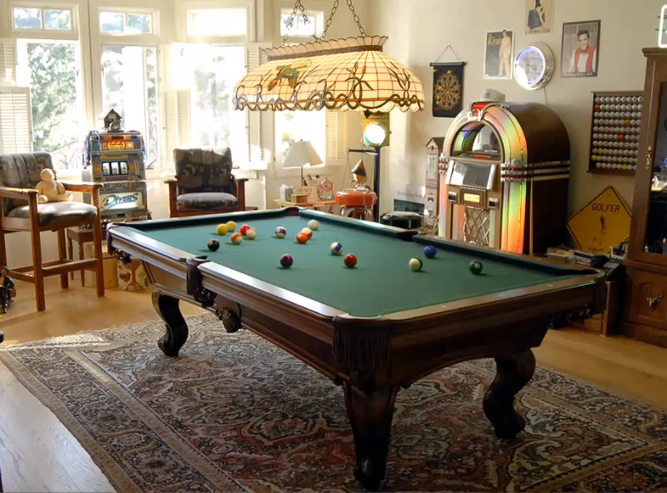
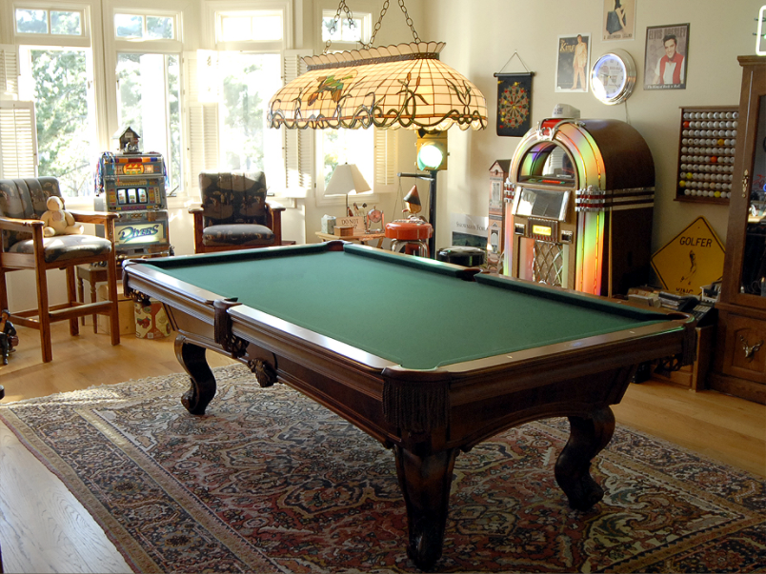
When have I used this stuff?
Inserting synthetic objects into images: http://vimeo.com/28962540

Slide 40
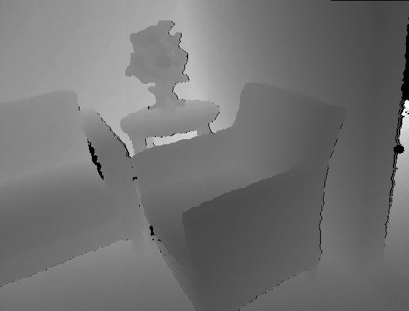

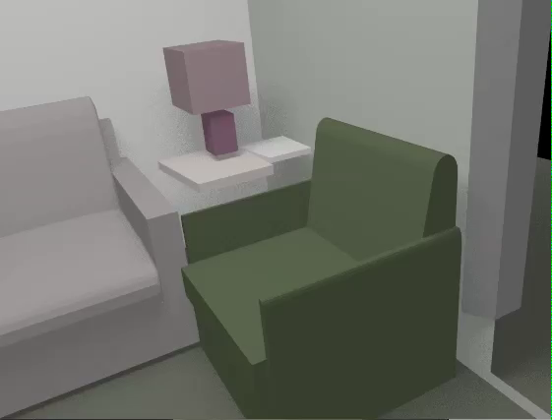
When have I used this stuff?
Creating detailed and complete 3D scene models from a single view (ongoing)

Slide 41
Pinhole Camera Model
x: Image Coordinates: (u,v,1)
K: Intrinsic Matrix (3x3)
R: Rotation (3x3)
t: Translation (3x1)
X: World Coordinates: (X,Y,Z,1)

Slide 42
Projection matrix
Intrinsic Assumptions
Unit aspect ratio
Optical center at (0,0)
No skew
Extrinsic Assumptions
No rotation
Camera at (0,0,0)
K
Slide Credit: Saverese
Notes:
Work through equations for u and v on board

Slide 43
Remove assumption: known optical center
Intrinsic Assumptions
Unit aspect ratio
No skew
Extrinsic Assumptions
No rotation
Camera at (0,0,0)

Slide 44
Remove assumption: square pixels
Intrinsic Assumptions
No skew
Extrinsic Assumptions
No rotation
Camera at (0,0,0)

Slide 45
Remove assumption: non-skewed pixels
Intrinsic Assumptions
Extrinsic Assumptions
No rotation
Camera at (0,0,0)
Note: different books use different notation for parameters

Slide 46
Oriented and Translated Camera
R
j_{w}
t
k_{w}
O_{w}
i_{w}

Slide 47
Allow camera translation
Intrinsic Assumptions
Extrinsic Assumptions
No rotation

Slide 48
3D Rotation of Points
Slide Credit: Saverese
Rotation around the coordinate axes, counter-clockwise:
p’
γ
y
p
z

Slide 49
Allow camera rotation

Slide 50
Degrees of freedom
5
6
Notes:
How many known points are needed to estimate this?

Slide 51
Vanishing Point = Projection from Infinity

Slide 52
Orthographic Projection
Special case of perspective projection
  Distance from the COP to the image plane is infinite
  Also called “parallel projection”
  What’s the projection matrix?
Image
World
Slide by Steve Seitz

Slide 53
Scaled Orthographic Projection
Special case of perspective projection
  Object dimensions are small compared to distance to camera
  Also called “weak perspective”
Image
World
Slide by Steve Seitz

Slide 54

Example
Far field: object appearance doesn’t change as objects translate
Near field: object appearance changes as objects translate

Slide 55
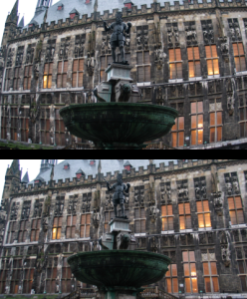
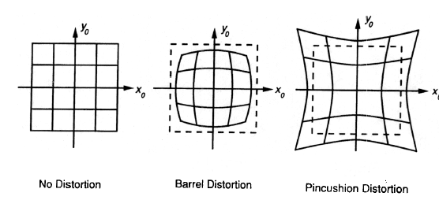
Beyond Pinholes: Radial Distortion
Common in wide-angle lenses or for special applications (e.g., security)
Creates non-linear terms in projection
Usually handled by through solving for non-linear terms and then correcting image
Corrected Barrel Distortion
Image from Martin Habbecke

Slide 56
Things to remember
Vertical vanishing
point
(at infinity)
Vanishing points and vanishing lines
Pinhole camera model and camera projection matrix
Homogeneous coordinates
Vanishing
line
Vanishing
point
Vanishing
point

Slide 57
Next class
Applications of camera model and projective geometry
  Recovering the camera intrinsic and extrinsic parameters from an image
  Recovering size in the world
  Projecting from one plane to another

