Slide 1
Context and Spatial Layout
04/26/12
Computer Vision
CS 543 / ECE 549
University of Illinois
Derek Hoiem

Slide 2
Final projects
See class web page for details
Poster session: May 10, 10:30-1pm
  Will send out general invite
  Each person presents for ~1.25 hour, then look at other half of posters and review two
Paper: 4-8 pages (NIPS format)
  Turn in at poster session or at my office by May 11 noon
  Cannot accept late papers (or posters)

Slide 3
Announcements
Lana is looking for students!
HW5 almost graded, done by Tues

Slide 4
Today’s class: Context and 3D Scenes

Slide 5
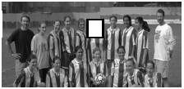
Context in Recognition
Objects usually are surrounded by a scene that can provide context in the form of nearby objects, surfaces, scene category, geometry, etc.

Slide 6

Context provides clues for function
What is this?
These examples from Antonio Torralba

Slide 7

Context provides clues for function
What is this?
Now can you tell?

Slide 8
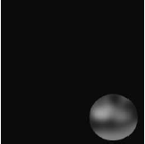
Sometimes context is the major component of recognition
What is this?

Slide 9

Sometimes context is the major component of recognition
What is this?
Now can you tell?

Slide 10

More Low-Res
What are these blobs?

Slide 11
More Low-Res
The same pixels! (a car)

Slide 12
There are many types of context
Local pixels
  window, surround, image neighborhood, object boundary/shape, global image statistics
2D Scene Gist
  global image statistics
3D Geometric
  3D scene layout, support surface, surface orientations, occlusions, contact points, etc.
Semantic
  event/activity depicted, scene category, objects present in the scene and their spatial extents, keywords
Photogrammetric
  camera height orientation, focal length, lens distorition, radiometric, response function
Illumination
  sun direction, sky color, cloud cover, shadow contrast, etc.
Geographic
  GPS location, terrain type, land use category, elevation, population density, etc.
Temporal
  nearby frames of video, photos taken at similar times, videos of similar scenes, time of capture
Cultural
  photographer bias, dataset selection bias, visual cliches, etc.
from Divvala et al. CVPR 2009

Slide 13

Cultural context
Jason Salavon: http://salavon.com/SpecialMoments/Newlyweds.shtml

Slide 14
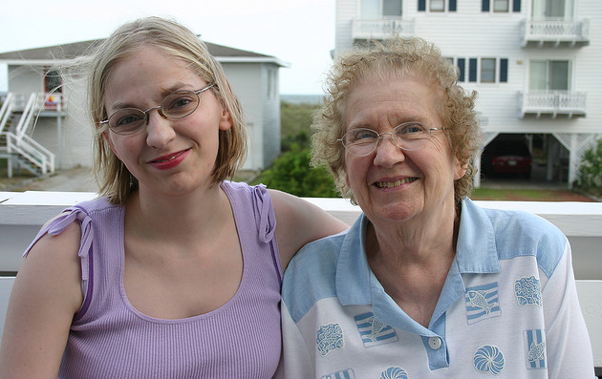
Cultural context
“Mildred and Lisa”: Who is Mildred? Who is Lisa?
Andrew Gallagher: http://chenlab.ece.cornell.edu/people/Andy/projectpage_names.html

Slide 15
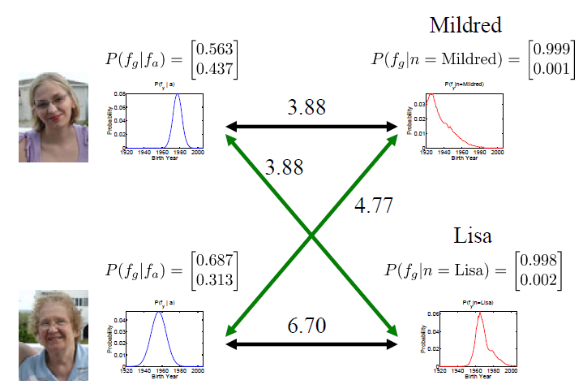
Cultural context
Age given Appearance
Age given Name
Andrew Gallagher: http://chenlab.ece.cornell.edu/people/Andy/projectpage_names.html

Slide 16




Spatial layout is especially important
Context for recognition

Slide 17
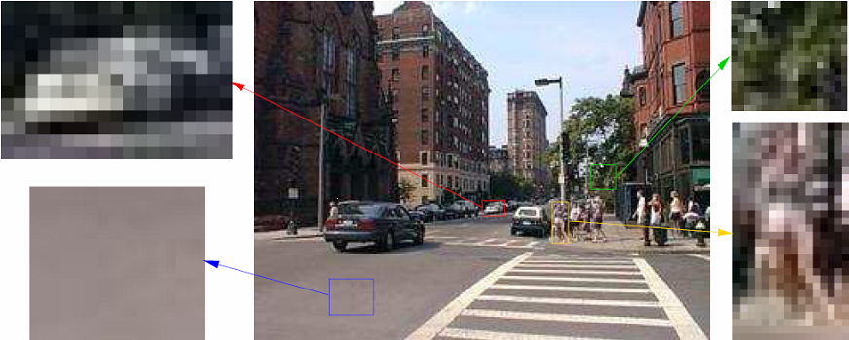
Spatial layout is especially important
Context for recognition

Slide 18

Spatial layout is especially important
Context for recognition
Scene understanding

Slide 19
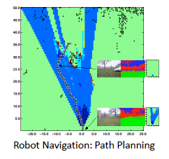

Spatial layout is especially important
Context for recognition
Scene understanding
Many direct applications
  Assisted driving
  Robot navigation/interaction
  2D to 3D conversion for 3D TV
  Object insertion

Slide 20
Spatial Layout: 2D vs. 3D?

Slide 21
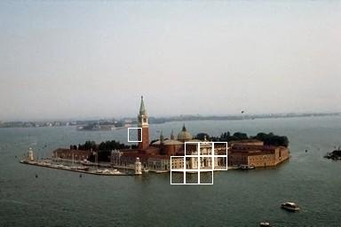
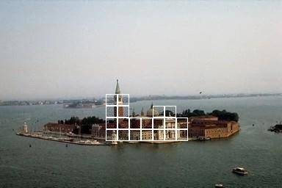




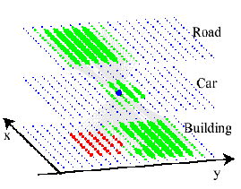

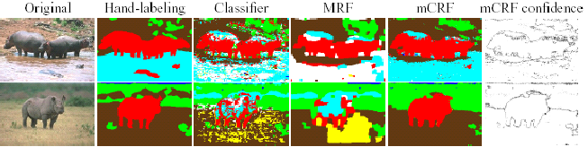


Context in Image Space
[Torralba Murphy Freeman 2004]
[Kumar Hebert 2005]
[He Zemel Cerreira-Perpiñán 2004]

Slide 22
But object relations are in 3D…
Close
Not Close
Notes:
Clearly, image understanding is a 3D problem.

Slide 23
How to represent scene space?

Slide 24
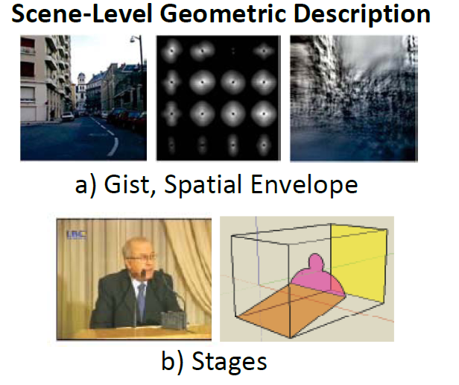
Wide variety of possible representations
Figs from Hoiem/Savarese Draft

Slide 25
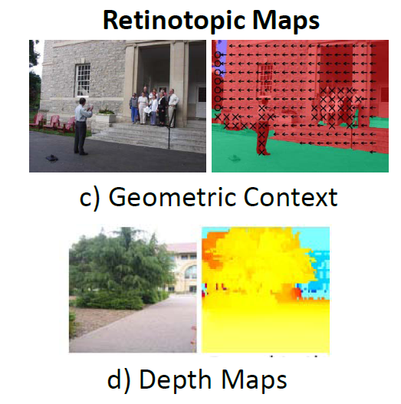
Figs from Hoiem/Savarese Draft

Slide 26
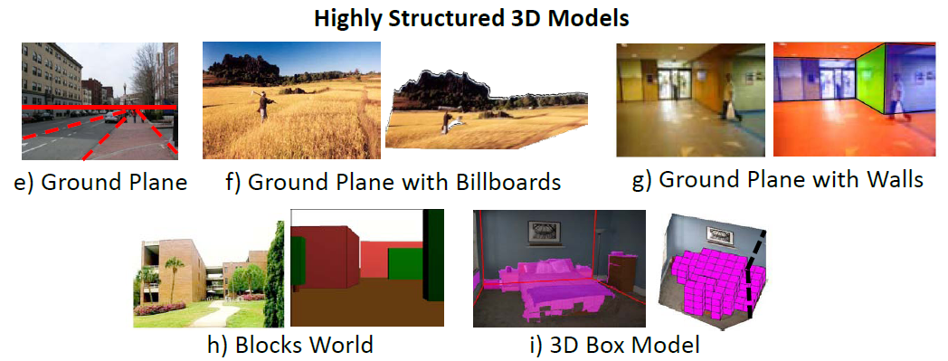
Figs from Hoiem/Savarese Draft

Slide 27
Key Trade-offs
Level of detail: rough “gist”, or detailed point cloud?
  Precision vs. accuracy
  Difficulty of inference
Abstraction: depth at each pixel, or ground planes and walls?
  What is it for: e.g., metric reconstruction vs. navigation

Slide 28
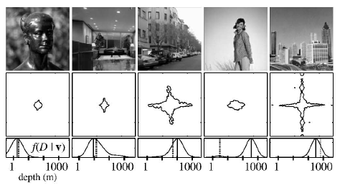
Low detail, Low/Med abstraction
Holistic Scene Space: “Gist”
Torralba & Oliva 2002
Oliva & Torralba 2001

Slide 29
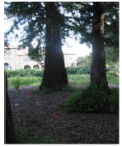
High detail, Low abstraction
Depth Map
Saxena, Chung & Ng 2005, 2007

Slide 30
Medium detail, High abstraction
Room as a Box
Hedau Hoiem Forsyth 2009

Slide 31
Examples of spatial layout estimation
Surface layout
  Application to 3D reconstruction
The room as a box
  Application to object recognition

Slide 32







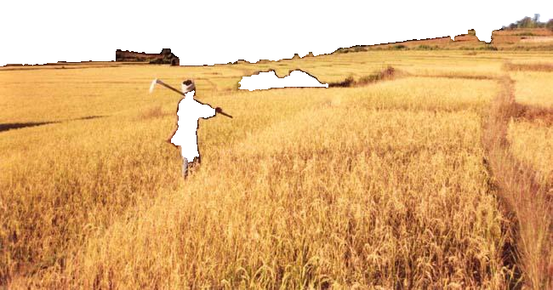
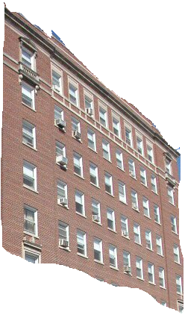

Surface Layout: describe 3D surfaces with geometric classes
Sky
Non-Planar Porous
Vertical
Non-Planar Solid
Planar
(Left/Center/Right)
Support

Slide 33
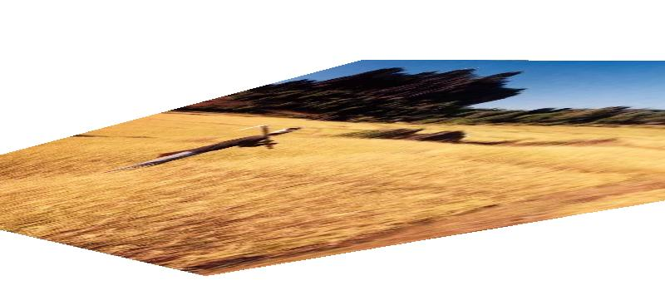

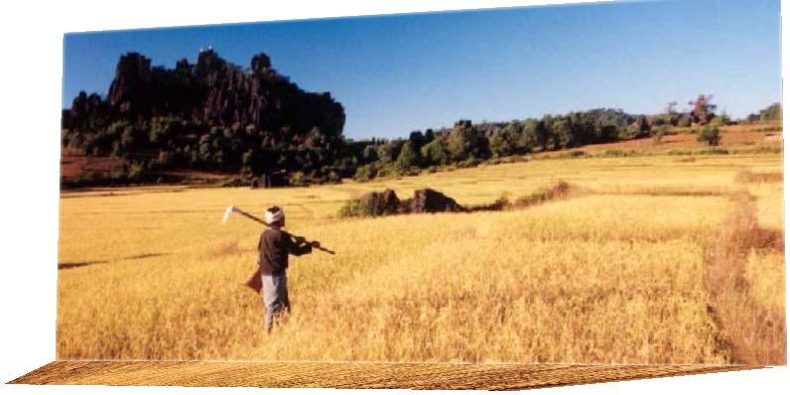
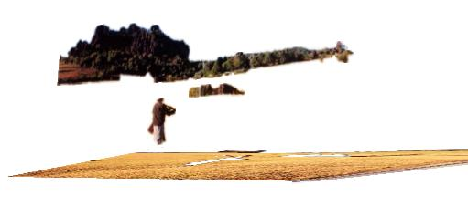
The challenge
?
?
?
Notes:
Recovering 3D geometry from a SINGLE 2D projection is a very hard problem. In fact, it’s mathematically impossible. (next) A single 2D projection could be produced by any of an infinite number of 3D geometrical configurations.

Slide 34


Our World is Structured
Abstract World
Our World
Image Credit (left): F. Cunin and M.J. Sailor, UCSD
Notes:
If our world were an abstract world, with pieces of matter floating in mid-air, we would have no chance of getting the 3D geometry from a single image. Fortunately, our world is a structured place. Most objects do not float but rest on the ground. Due to gravity, scenes tend to consist of a fairly flat ground, objects sticking out of the ground at roughly right angles, and the sky. Ground tends to be below sky, and materials often correspond to 3D orientations.

Slide 35


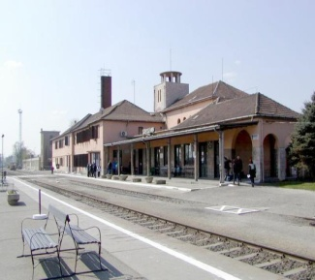



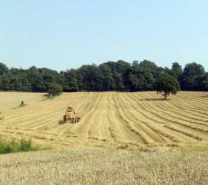



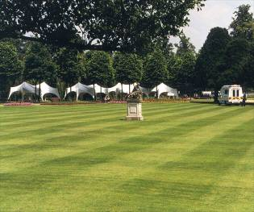
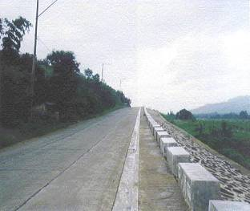
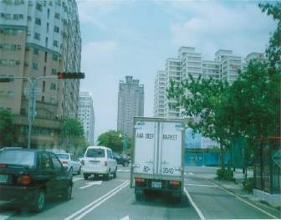


Learn the Structure of the World
Training Images
…

Slide 36
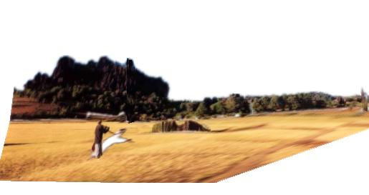
Infer the most likely interpretation
Unlikely
Likely

Slide 37
Geometry estimation as recognition
Features
Color
Texture
Perspective
Position
Surface Geometry Classifier
Vertical, Planar
Region
…
Training Data
Notes:
Regions → Surface Orientation Label
Boundaries → Occlusion Labels
Similar Images → Viewpoint

Slide 38

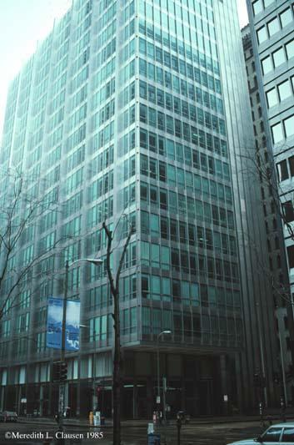

Use a variety of image cues
Color, texture, image location
Vanishing points, lines
Texture gradient

Slide 39


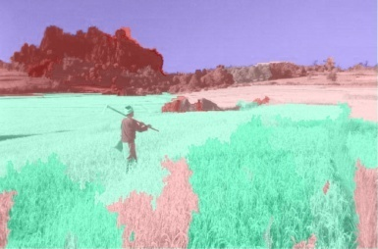
Surface Layout Algorithm
Input Image
Segmentation
Surface Labels
Features
Perspective
Color
Texture
Position
Trained Region Classifier
…
Training Data
Hoiem Efros Hebert (2007)

Slide 40
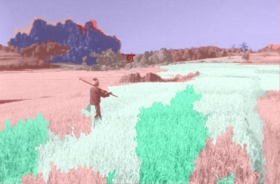
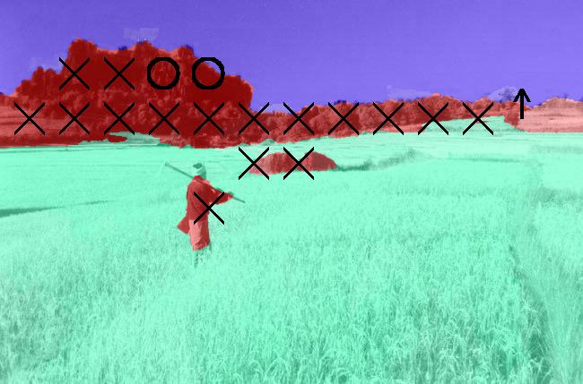

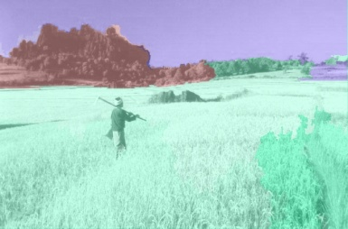
Surface Layout Algorithm
Multiple Segmentations
Confidence-Weighted Predictions
Final
Surface Labels
Input Image
Features
Perspective
Color
Texture
Position
…
…
Trained Region Classifier
Training Data
…
Hoiem Efros Hebert (2007)
Notes:
Specify how estimates are combined. Perhaps show result examples

Slide 41
Surface Description Result

Slide 42
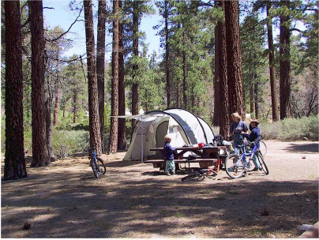
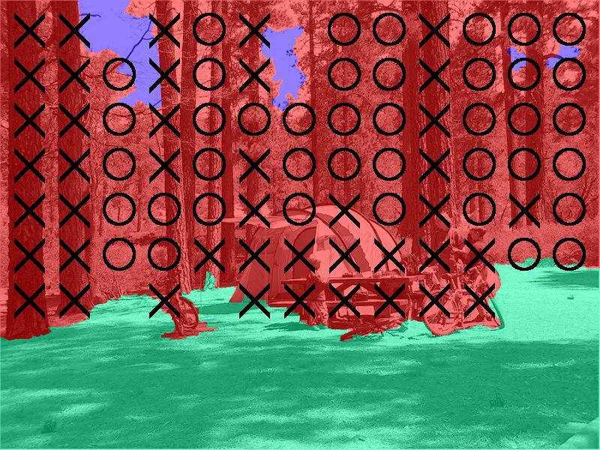
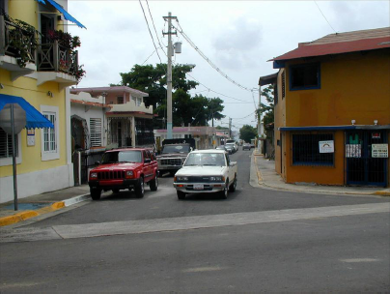
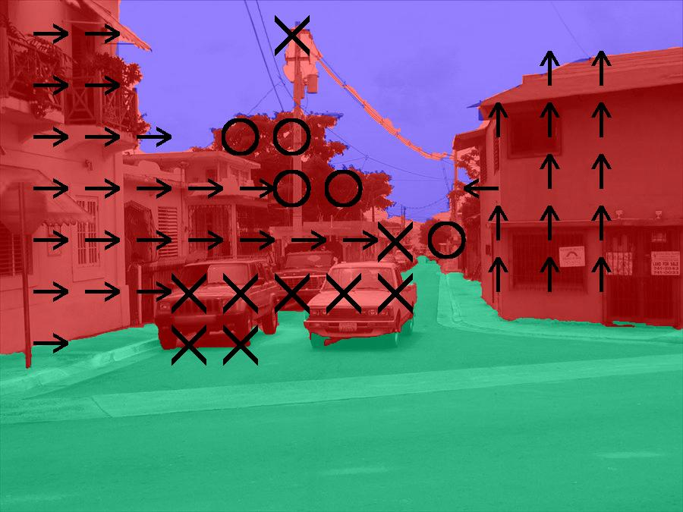
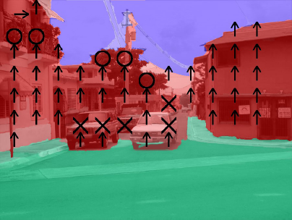
Results
Input Image
Ground Truth
Our Result

Slide 43
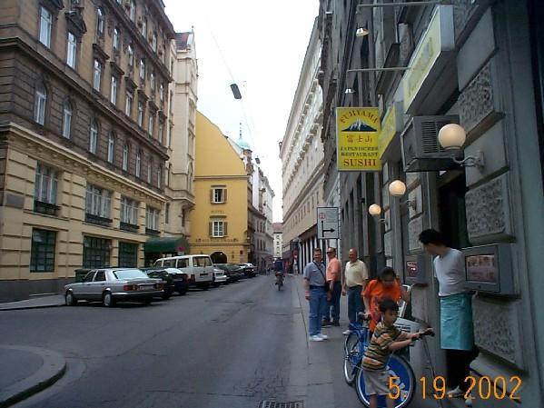
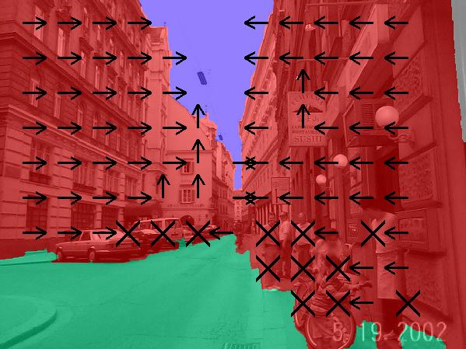
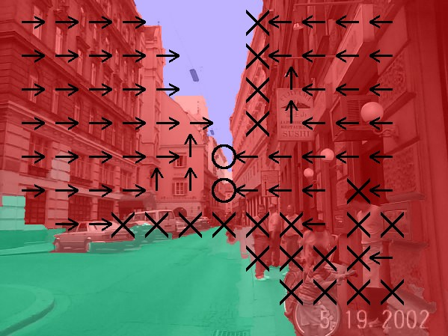
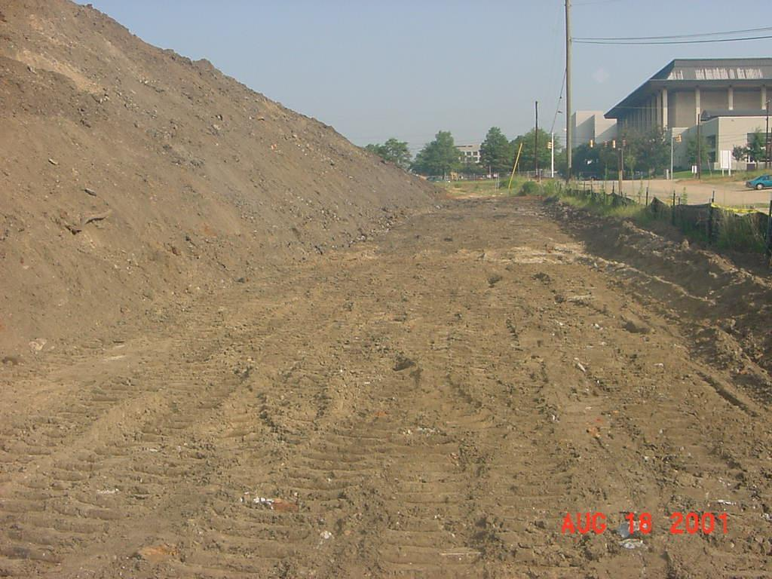
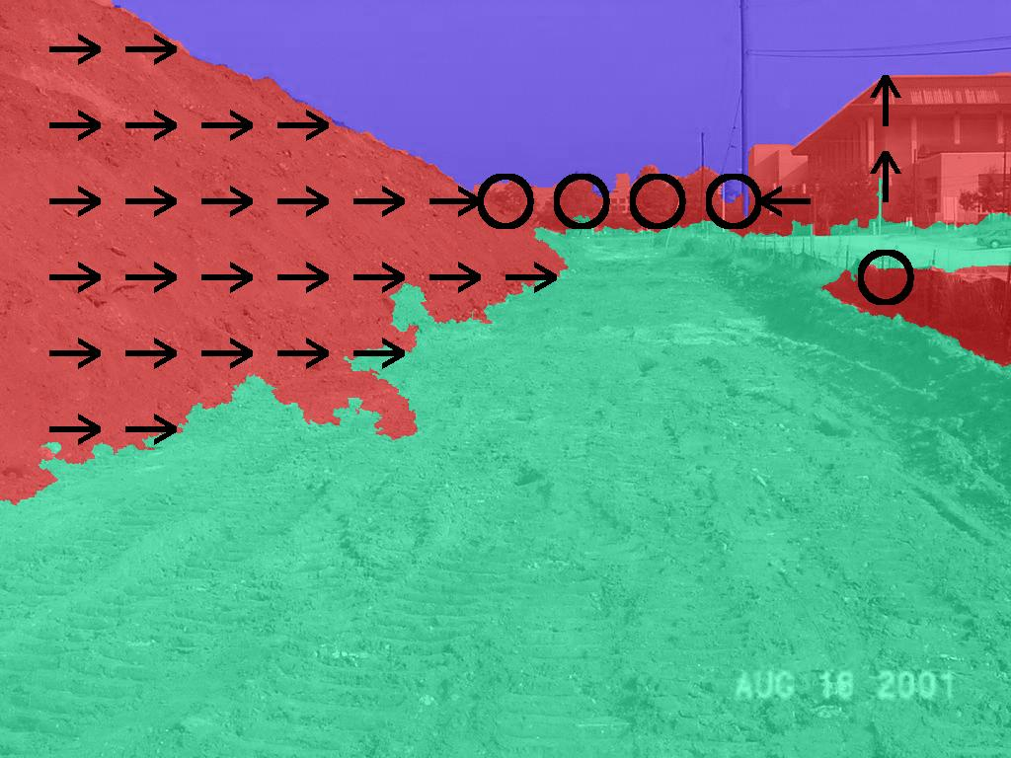
Results
Input Image
Ground Truth
Our Result
Notes:
Create ground truth with markings this size!... Put ground truth in here

Slide 44
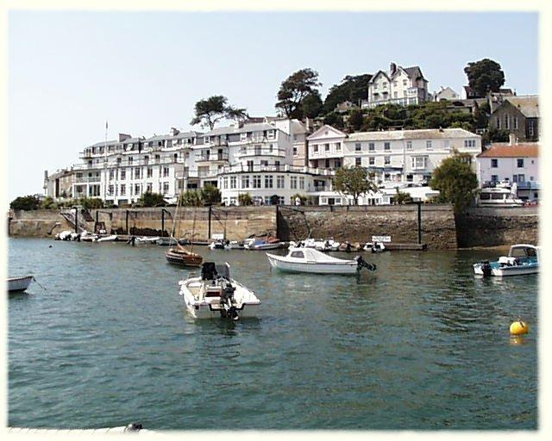
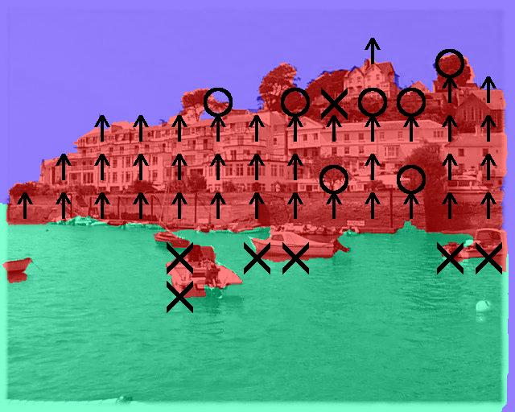


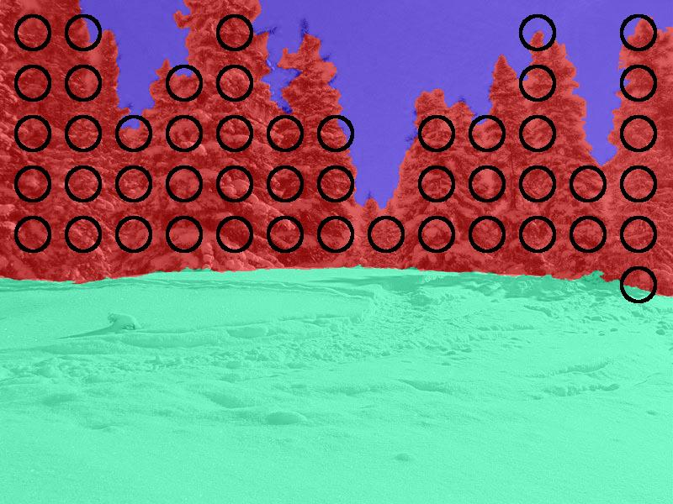
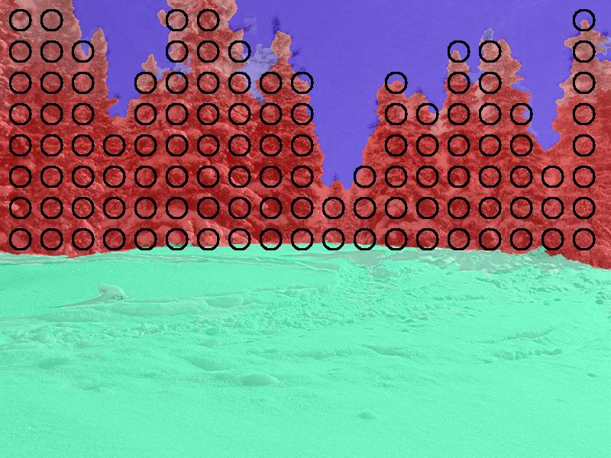
Results
Input Image
Ground Truth
Our Result
Notes:
Create ground truth with markings this size!... Put ground truth in here

Slide 45

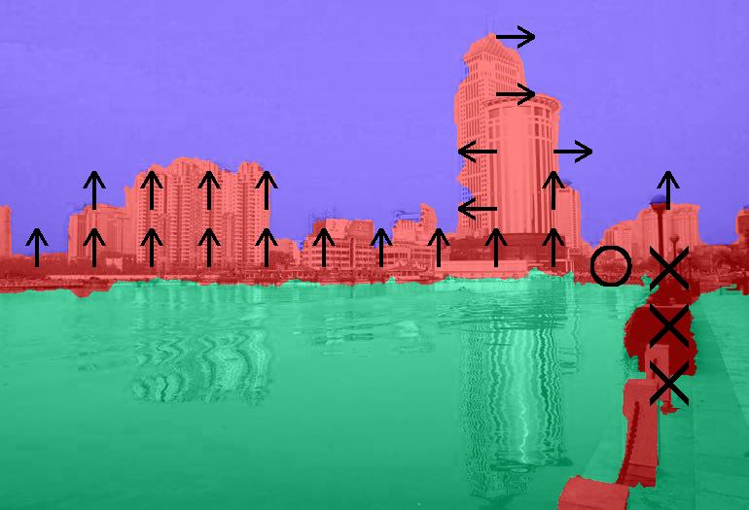
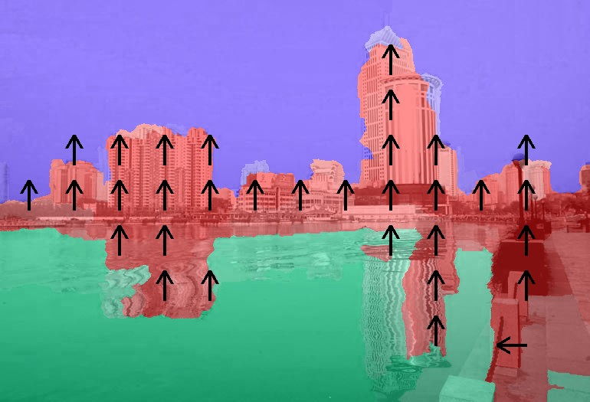

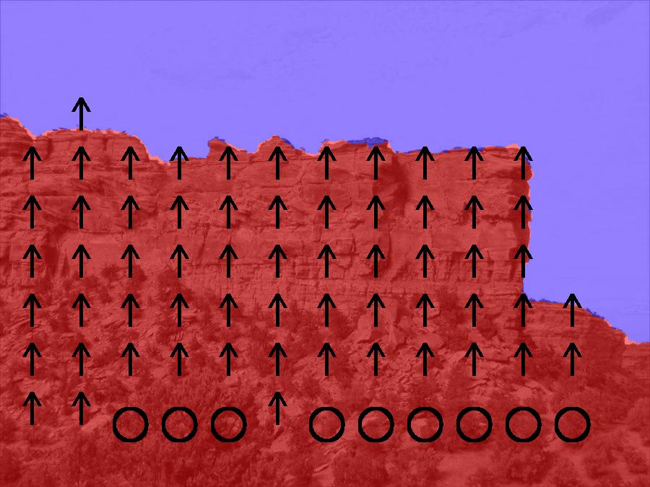
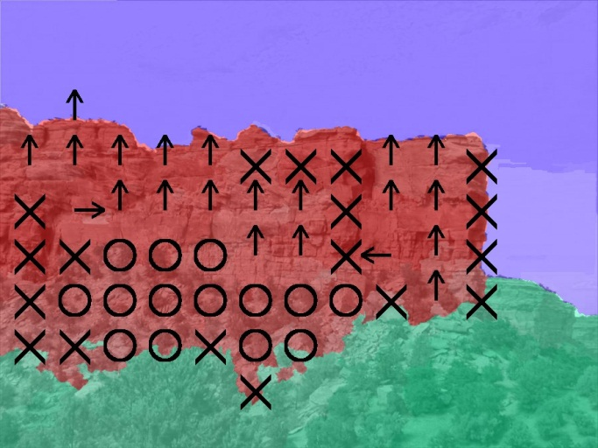
Failures: Reflections, Rare Viewpoint
Input Image
Ground Truth
Our Result
Notes:
Alyosha suggests unusual viewpoint here

Slide 46
Average Accuracy
Main Class: 88%
Subclasses: 61%
Notes:
Turn into intensity confusion matrix

Slide 47

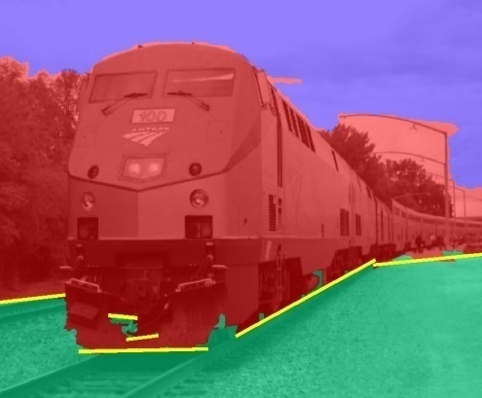


Automatic Photo Popup
Labeled Image
Fit Ground-Vertical Boundary with Line Segments
Form Segments into Polylines
Cut and Fold
Final Pop-up Model
[Hoiem Efros Hebert 2005]
Notes:
Note that horizon estimate is often poor

Slide 48

Automatic Photo Popup

Slide 49

Notes:
Explain holes

Slide 50
Mini-conclusions
Can learn to predict surface geometry from a single image
Very rough models, much room for improvement

Slide 51

Interpretation of indoor scenes

Slide 52
Vision = assigning labels to pixels?
Lamp
Wall
Sofa
Table
Floor
Floor

Slide 53
Vision = interpreting within physical space
Wall
Sofa
Table
Floor

Slide 54
Physical space needed for affordance
Could I stand over here?
Is this a good place to sit?
Can I put my cup here?
Walkable path

Slide 55


Physical space needed for recognition
Apparent shape depends strongly on viewpoint

Slide 56

Physical space needed for recognition

Slide 57


Physical space needed to predict appearance

Slide 58

Physical space needed to predict appearance

Slide 59
Key challenges
How to represent the physical space?
  Requires seeing beyond the visible
How to estimate the physical space?
  Requires simplified models
  Requires learning from examples

Slide 60

Our Box Layout
Hedau Hoiem Forsyth, ICCV 2009
Room is an oriented 3D box
  Three vanishing points specify orientation
  Two pairs of sampled rays specify position/size

Slide 61
Our Box Layout
Room is an oriented 3D box
  Three vanishing points (VPs) specify orientation
  Two pairs of sampled rays specify position/size
Another box consistent with the same vanishing points

Slide 62


Image Cues for Box Layout
Straight edges
  Edges on floor/wall surfaces are usually oriented towards VPs
  Edges on objects might mislead
Appearance of visible surfaces
  Floor, wall, ceiling, object labels should be consistent with box
left wall
right wall
floor
objects

Slide 63



Box Layout Algorithm
Detect edges
Estimate 3 orthogonal vanishing points
Apply region classifier to label pixels with visible surfaces
  Boosted decision trees on region based on color, texture, edges, position
Generate box candidates by sampling pairs of rays from VPs
Score each box based on edges and pixel labels
  Learn score via structured learning
Jointly refine box layout and pixel labels to get final estimate
+

Slide 64






Evaluation
Dataset: 308 indoor images
  Train with 204 images, test with 104 images

Slide 65






Experimental results
Detected Edges
Surface Labels
Box Layout
Detected Edges
Surface Labels
Box Layout

Slide 66






Experimental results
Detected Edges
Surface Labels
Box Layout
Detected Edges
Surface Labels
Box Layout

Slide 67
Experimental results
Joint reasoning of surface label / box layout helps
  Pixel error: 26.5% → 21.2%
  Corner error: 7.4% → 6.3%
Similar performance for cluttered and uncluttered rooms

Slide 68
Mini-Conclusions
Can fit a 3D box to the rooms boundaries from one image
  Robust to occluding objects
  Decent accuracy, but still much room for improvement

Slide 69


Using room layout to improve object detection
Box layout helps
  Predict the appearance of objects, because they are often aligned with the room
  Predict the position and size of objects, due to physical constraints and size consistency
2D Bed Detection
3D Bed Detection with Scene Geometry
Hedau, Hoiem, Forsyth, ECCV 2010, CVPR 2012

Slide 70





Search for objects in room coordinates
Recover Room Coordinates
Rectify Features to Room Coordinates
Rectified Sliding Windows
Hedau Forsyth Hoiem (2010)

Slide 71
Reason about 3D room and bed space
Joint Inference with Priors
Beds close to walls
Beds within room
Consistent bed/wall size
Two objects cannot occupy the same space
Hedau Forsyth Hoiem (2010)

Slide 72

3D Bed Detection from an Image

Slide 73

Generic boxy object detection
Hedau et al. 2012

Slide 74

Generic boxy object detection

Slide 75

Generic boxy object detection

Slide 76


Good localization in image doesn’t mean good localization in 3D
2D Cuboid Detection
Floor Plan
True Location
Detected location

Slide 77






Refining 3D location
Refit bounding box by detecting bottom edges of objects and furniture legs
Original
Refined
Original
Refined
Cuboid Fit
Floor Plan

Slide 78


3D Evaluation
Ground Truth
Estimate
Ground Truth
Estimate

Slide 79


3D Evaluation
Precision-Recall for
3D Voxel Occupancy
Precision-Recall for
Floor Layout

Slide 80
Mini-Conclusions
Our simple room box layout helps detect objects by predicting appearance and constraining position
We can search for objects in 3D space and directly evaluate on 3D localization

Slide 81
Things to remember
Objects should be interpreted in the context of the surrounding scene
  Many types of context to consider
Spatial layout is an important part of scene interpretation, but many open problems
  How to represent space?
  How to learn and infer spatial models?
  Important to see beyond the visible
Consider trade-off of abstraction vs. precision

Slide 82
Next class: last day of class
HW 5 returned
Overview of vision
Important open research problems
Feedback / ICES forms

